Slide 1
About OMICS Group
OMICS Group International is an amalgamation of Open Access publications and worldwide international science conferences and events. Established in the year 2007 with the sole aim of making the information on Sciences and technology ‘Open Access’, OMICS Group publishes 400 online open access scholarly journals in all aspects of Science, Engineering, Management and Technology journals. OMICS Group has been instrumental in taking the knowledge on Science & technology to the doorsteps of ordinary men and women. Research Scholars, Students, Libraries, Educational Institutions, Research centers and the industry are main stakeholders that benefitted greatly from this knowledge dissemination. OMICS Group also organizes 300 International conferences annually across the globe, where knowledge transfer takes place through debates, round table discussions, poster presentations, workshops, symposia and exhibitions.

Slide 2
About OMICS Group Conferences
OMICS Group International is a pioneer and leading science event organizer, which publishes around 400 open access journals and conducts over 300 Medical, Clinical, Engineering, Life Sciences, Phrama scientific conferences all over the globe annually with the support of more than 1000 scientific associations and 30,000 editorial board members and 3.5 millionfollowers to its credit.
OMICS Group has organized 500 conferences, workshops and national symposiums across the major cities including San Francisco, Las Vegas, San Antonio, Omaha, Orlando, Raleigh, Santa Clara, Chicago, Philadelphia, Baltimore, United Kingdom, Valencia, Dubai, Beijing, Hyderabad, Bengaluru and Mumbai.

Slide 3
Why are Life Sciences companies scared of “The Cloud”.
Regulatory Affairs Conference
Raleigh. 8Th September 2014.

Slide 4

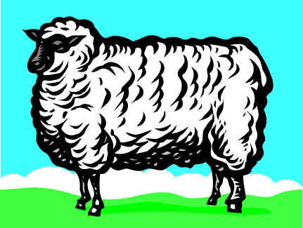
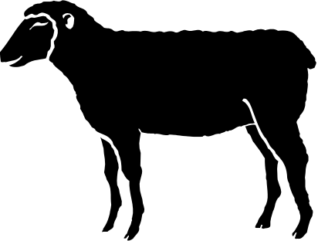
What have sheep and trains got to do with it?
Notes:
By Back ground I’m a chemical engineer. I came into the Pharmaceutical Industry via banknote printing , which might seem a long way away, but it also concerns production of large numbers of very high quality items, so in may ways I wasn't surprised by what I found when I joined what was GD Searle in October 1984.
I would like to emphasize the engineering part. I’ve always been involved in looking for practical solutions to real problems, which I’d like to illustrate by an old joke that most people have probably heard.
An artist , an engineer and a mathematician are travelling on a train from England to Scotland . The astronomer looks out of the window, sees a black sheep standing in a field, and remarks, “Look at that - the sheep in Scotland are black!" “Well, no” says the engineer. “We can really only say some Scottish sheep are black." The mathematician rolls his eyes at his companions' muddled thinking and says, “All we can say with certainty is that in Scotland, there is at least one sheep, at least one side of which appears to be black for the time that it takes this train to pass.“
The bit that usually gets missed out at the end is that the engineer replies, if you want to base your belief system on the concept that Scottish sheep can change color that’s up to you. From the practical point of view I’m making the reasonable assumption that some Scottish sheep are black.
The point of all this is that the engineer takes up the position that will work in practice, rather than one of ideological purity, and that affects what I’m going to speak about.

Slide 5

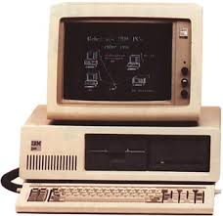
But that doesn’t mean that it has to be impractically purist.
The slow uptake of Cloud system by Life
Sciences companies seems more to be about issues that are theoretical rather than practical.
So what is everyone so afraid of?
Life Sciences is A Scientific industry
Notes:
Life Sciences is by definition a scientific industry segment, but it doesn’t mean that it has to work on a purely theoretical basis. It seems to me that the slow take up of cloud services is more about issues that are theoretical rather then practical.
The question is, what is the industry afraid of?
After I was a chemical engineer I became a pharmaceutical production manager.
Almost the first thing I did was nearly to get my fist production batch rejected because I filled in the batch documentation with a blue pen instead of a black one. Our QMS specified black ink. I thought it was almost the stupidest thing I’d ever heard and I still do. I remember asking the Quality Manager what regulation said that we had to use black ink and I was told that wasn’t the point. It was part of our QMS.
I moved into Information Technology a few years later. One of the first things I noticed was that in the corner of the IT department was an old PC XT., I went and had a look at it and it was running DOS 3. This would be about 1990. I asked the person in charge of that section if we were running a DOS museum and he almost panicked when I said that I had looked at the machine. “You didn’t change it?” That machine is validated, we don’t want to have to go and do all of that that again”. It was an onerous procedure which at that time they had to work out from scratch .
My suspicion is that LS doesn’t want the bother of working out from scratch how to validate a new type of system. That’s what they’re scared of, and I hope to show that their fears are unfounded.

Slide 6
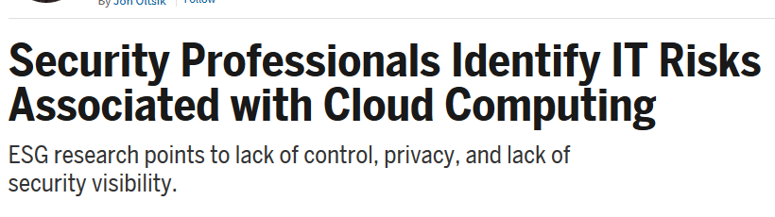
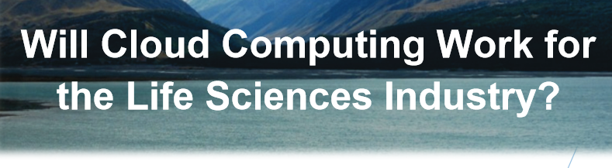
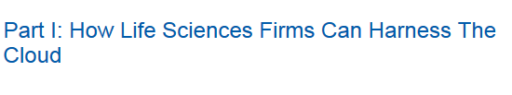
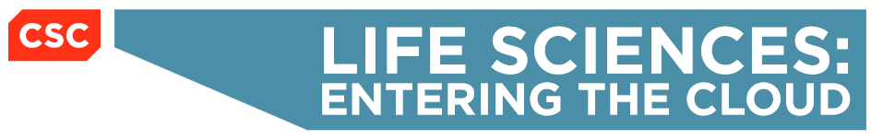
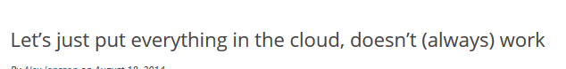
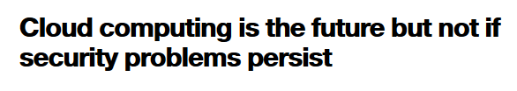
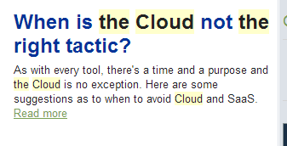
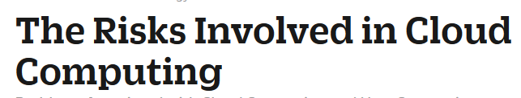
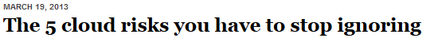
Are they scared?
Notes:
So where does this come from ? You only have to take a quick look online to see that there are lots of articles about the use of cloud systems, The trouble is that the positive ones mainly come from the people who are trying to sell you cloud systems.
When you start looking at independent review sites there are a lot of cautions, which can be confusing.

Slide 7

Guidance
GAMP5 is no help
  Some of the GPGs have a little information particularly the Testing GPG.
ICH – nothing
FDA guidance – nothing and no rules that apply to cloud computing.
ITIL, COBIT, PIC/S etc. not much
There is very little “official” guidance
Notes:
Nothing much exits in the way of guidance , however that doesn’t stop us thinking for ourselves.

Slide 8
“Cloud is by definition, difficult to pin down, so I don’t feel we can use it.”
Quotes from LS companies.
“It’s impossible to Validate a cloud system .”
“How can I have confidence in something that is so hard to control?
“I’m not handing my ability to maintain my systems in a state of compliance over to a third party.”
“How do I qualify Infrastructure that I can’t even touch?
“Where is this damn cloud anyway?.”
Notes:
One further issue is the lack of understanding in LS companies themselves. Here are some quotes that I have heard personally.

Slide 9

I don’t use the cloud at all...
According to a Citrix Survey 95% of people that claim they are not using cloud computing are actually doing so. With such things as
Online Banking
Social Networking
Storing personal photos
Almost all online mail is now cloud-based
  Office 365
  Gmail
  Yahoo Mail
Remember Outlook Express….?
Notes:
But when you ask them if they use the cloud you generally get a no answer but probing a bit more deeply this picture doesn’t seem to be accurate.
My impression is that some Life Sciences companies are in denial. Here’s some examples of cloud systems that I’ve found used quite commonly.

Slide 10

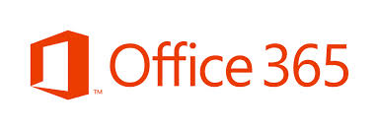


Are we in denial?
“We’re not really using it for anything that would be regulated.”
“Office doesn’t affect product Quality.”
“We’re only using it to move things from one place to another.”
“It’s just the helpdesk. Nothing to do with product. .”
Notes:
These are all cloud applications that I have found in use in companies that said that they were not using cloud systems.

Slide 11

What are the benefits?
Low or Zero capital cost
High availability
Additional capacity can be added rapidly
Automatic Load balancing
You get a lot for your money
So What’s the problem?
Notes:
So why are they using these system – the same reason why everyone is using cloud systems?
What’s the issue? I suggest that it’s a combination of fear of loss of control and simply having to think for once.
There’s a conflict between the purists and the pragmatists here. Some of it based on myth and I’d like to look at one or two of these now.

Slide 12

Some myths and strange worries about the cloud 1
It’s vague and undefined
The NIST provided good definitions several years ago of
  Infrastructure as a service
  Platform as a Service
  Software as a Service
  Private, public, hybrid cloud
We’ll be putting our systems in the hands of people who know nothing of the Life Sciences Industry
  True if you choose a service provider who knows nothing of the Life Sciences Industry
  There are a lot of good ones available.
Notes:
There are very good definitions available which I’ll go over in my main talk.

Slide 13

Some myths and strange worries about the cloud
Only a handful of Major players can build the massive infrastructure needed. We’ll be at the mercy of Google, Microsoft or Amazon.
How much infrastructure do you need?
There are a large number of small suppliers that can help out.
It was never designed for the Life Sciences Industry
  True. Neither was
      SAP, Oracle E-Business Suite, Microsoft AX ….
Notes:
There are very good definitions available which I’ll go over in my main talk.

Slide 14

Some myths and strange worries about the cloud 2
Only a handful of Major players can build the massive infrastructure needed. We’ll be at the Mercy of Google, Microsoft or Amazon.
How much infrastructure do you need?
There are a large number of small suppliers that can help out.
It was never designed for the Life Sciences Industry
  True. Neither was SAP, Oracle E-Business Suite, Microsoft AX ….
Notes:
There are very good definitions available which I’ll go over in my main talk.

Slide 15

The most valid questions
The main issues
How can we validate and qualify a system when we don’t even know where the server is?
How can we deal with frequent changes
to the software we might not even
find out about?
Notes:
To me it seem that the most useful questions to ask are as above
Mostly these have been put to me as rhetorical questions, which were assumed to be the end of the argument.
In many ways there’s nothing I like better than a rhetorical question that’s supposed to have no answer.
In fact answers exist to both of these questions and they are not technically difficult to find, though quite a bit of work might be involved.
One last point which is still put to me from time to time is that no industry is like the Life Sciences industry.
My answer – you should get out more.

Slide 16
The Main Types of Cloud Models
Service Models
  Cloud Infrastructure as a Service (IaaS)
    Software and operating system still controlled by the User
  Cloud Platform as a Service (PaaS)
    Software still controlled by the User
  Cloud Software as a Service (SaaS)
    Software NOT controlled by the User
SaaS
PaaS
IaaS
Notes:
This is from my main presentation. I’d like to say a little now about different types of cloud model .
NIST still defines three different service models, Each with its own definition. I’m going to work from the inside, outwards as it were based on the diagram above an quickly cover the definitions.

Slide 17
How do you Validate them?
Maybe you don’t
IaaS and PaaS are infrastructure models
  SaaS later.
  You Qualify infrastructure in the same was as you’ve always done
  Qualification of virtual servers has been done for decades
  Qualification of IaaS and PaaS is only one further level of abstraction further on.
Challenges
  Lack of guidance and standards
  Your QMS may not cover IaaS and PaaS
    Then re-write your QMS!
  New technology – no change there.
Notes:
What we’ve been asking about so far is Service models. There are also deployment model to consider and again I’m going to use the NIST definitions.
There are also various deployment models which include the Private Cloud, Community Cloud, Public Cloud or Hybrid Cloud.
The Private Cloud and Community Cloud may be either on the owner’s premises or off-premise and managed by a third party, with the Public and Hybrid Cloud generally being off-premise.

Slide 18

Example – Private cloud provided by an outsourced vendor.
Assume PaaS, you still need to have:
Electronic Recordkeeping Compliance
SOPs
Validation of Applications
Infrastructure Qualification
Security
Training and Training records
Backup and restore
Problem reporting
Business continuity
Disaster recovery
Record retention
Archival
Configuration Management
Change Management
  Risk and impact assessment
  Back out plans
  Justification etc.
Risk Assessment and Management
Service Level agreements
Etc.
What is different with a Cloud based system?
  Not a lot!
Notes:
Thinking in terms of PaaS there are a list of things that you need to consider, some of which are around infrastructure Qualification and some around simple control.
It’s not necessarily meant to be comprehensive but it covers most areas.
There isn’t anything in the list which can’t be applied to a Cloud based system or can’t be handled by a cloud service provider that understands the Life Sciences Industry .

Slide 19
What is Computerized System Validation?
Software as a Service
There are different definitions of computerized systems validation and they are interpreted differently by different organizations
  Only your organization can definitively state whether it’s possible to validate SaaS applications in accordance with your own Policies and Procedures
Generally, validation
  Is a process of verifying requirements, specifications, design and functionality
    The latter usually by testing
  Relies on the qualification of the underlying IT infrastructure
Notes:
The situation is different with Software as a Service, and I’m going to go into some detail of how it was tackled in the main presentation tomorrow.
Only your organization can definitively state whether it’s possible to validate SaaS applications in accordance with your own Policies and Procedures if it’s not possible maybe it’s time to change your policies and procedures.

Slide 20
The traditional methodology depends on a “frozen” system, and its functions.
It’s necessary to move away from the idea that this is a fixed entity like a packaging machine that can be validated in the same way. It a service, not an entity.
Similar changes in thinking have occurred before – e.g. GAMP4 to GAMP 5. From IQ/OQ/PQ to a more flexible approach.
Possible time to start thinking things through from the start again . Scary and hard work!
SaaS requires a different approach
Notes:
The situation is different with Software as a Service, and I’m going to go into some detail of how it was tackled in the main presentation tomorrow.
Only your organization can definitively state whether it’s possible to validate SaaS applications in accordance with your own Policies and Procedures if it’s not possible maybe it’s time to change your policies and procedures.

Slide 21
What are we actually trying to achieve?
Regulatory authorities are usually looking for very simple things:
That the product does not harm the patient
That the product actually works
That you make it to the correct standard consistently
That you identify it properly.
That you can demonstrate that your systems are under control
Notes:
The situation is different with Software as a Service, and I’m going to go into some detail of how it was tackled in the main presentation tomorrow.
Only your organization can definitively state whether it’s possible to validate SaaS applications in accordance with your own Policies and Procedures if it’s not possible maybe it’s time to change your policies and procedures.

Slide 22
Can this be achieved with software as a service?
Some Life Sciences companies think not because:
Their QMS can’t handle it
  Then Critically examine the QMS
There is no history of inspections, warning letters, etc. to which to refer
  Nor was there for the first ERP systems but it didn’t stop companies using them.
There is very little guidance around
  No but the regulations are available and that is what you need to satisfy.
  Decide for yourself what is good practice

Slide 23
Can this be achieved with software as a service?
The IT people work for a different company?
  Have a service level agreement that says that they work to your QMS.
  They don’t have the training
  Give them it.
Generalist cloud providers don’t have the training, and knowledge of Life Sciences that we expect in our industry
  Look at a specialist company, then.
All these issues can be tackled.

Slide 24
To conclude:
Life Sciences companies need to stop fooling telling them selves that their industry is unique and nobody works to the same quality standards.
Use of cloud services is an industry norm. LS companies should not be missing out on the benefits because of outdated notions of how validation should be done.
  It needs to be thought through according to the real requirements, and not just be referring to existing SOPs.
  We need to get away from the idea of validating a fixed thing and embrace the idea of having control of a service.
Life Sciences companies should stop being cowardly and use every means of improving their services, including the “The cloud” It will be uncomfortable but it will be worth it.

Slide 25
Let Us Meet Again
We welcome you all to our future conferences of OMICS Group International
Please Visit:
regulatoryaffairs.conference@omicsgroup.us
regulatoryaffairs@conferenceseries.net
http://regulatoryaffairs.pharmaceuticalconferences.com/

