Slide 1
About OMICS Group
OMICS Group International is an amalgamation of Open Access publications and worldwide international science conferences and events. Established in the year 2007 with the sole aim of making the information on Sciences and technology ‘Open Access’, OMICS Group publishes 400 online open access scholarly journals in all aspects of Science, Engineering, Management and Technology journals. OMICS Group has been instrumental in taking the knowledge on Science & technology to the doorsteps of ordinary men and women. Research Scholars, Students, Libraries, Educational Institutions, Research centers and the industry are main stakeholders that benefitted greatly from this knowledge dissemination. OMICS Group also organizes 300 International conferences annually across the globe, where knowledge transfer takes place through debates, round table discussions, poster presentations, workshops, symposia and exhibitions.

Slide 2
About OMICS Group Conferences
OMICS Group International is a pioneer and leading science event organizer, which publishes around 400 open access journals and conducts over 300 Medical, Clinical, Engineering, Life Sciences, Phrama scientific conferences all over the globe annually with the support of more than 1000 scientific associations and 30,000 editorial board members and 3.5 millionfollowers to its credit.
OMICS Group has organized 500 conferences, workshops and national symposiums across the major cities including San Francisco, Las Vegas, San Antonio, Omaha, Orlando, Raleigh, Santa Clara, Chicago, Philadelphia, Baltimore, United Kingdom, Valencia, Dubai, Beijing, Hyderabad, Bengaluru and Mumbai.

Slide 3
Validation of a Cloud-Based ERP system, in practice.
Regulatory Affairs Conference
Raleigh. 8Th September 2014

Slide 4
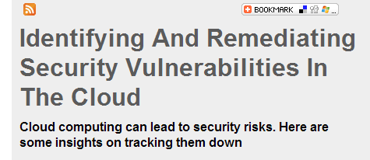
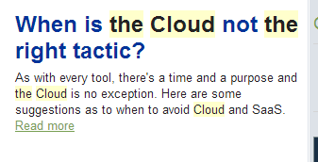
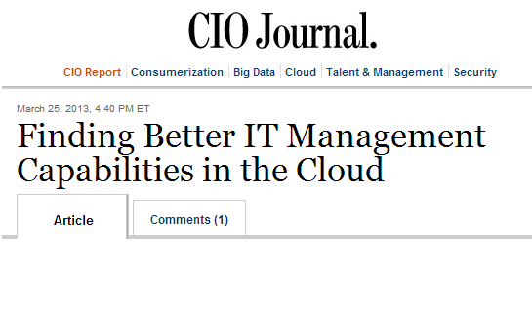
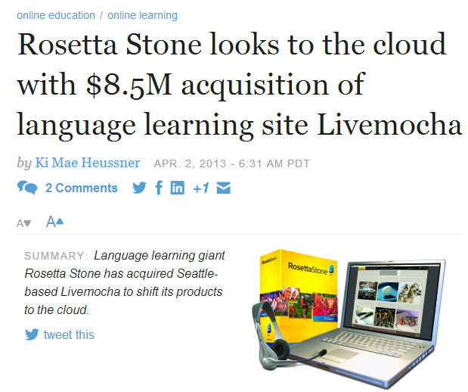
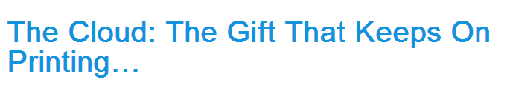
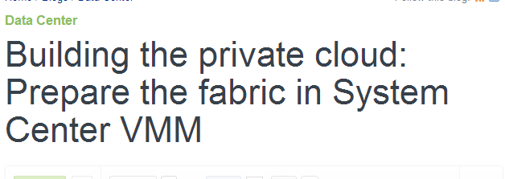
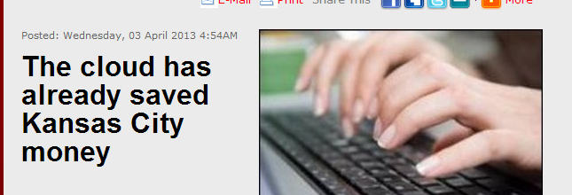
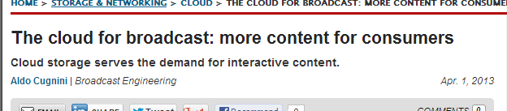
What is the “The Cloud”
Notes:
If you were present for my keynote speech you’ll be aware that the use of cloud services by Life Sciences companies is something that interests me a great deal. It’s a real buzzword at the moment but there is still a lot of confusion as to what it actually is .
It took me only a few minutes to find these headlines
I don’t like the term “The cloud” it implies that there’s only one.
Or at least that we’re dealing with a single technology or a single kind of service which we’re not really.
To avoid confusion I’m going to use some definitions first. They’re not my definitions they com from the American National Institute of Standards and Technology the NIST. I think they’re pretty good and I’m going to stick to them.

Slide 5

The NIST Definition of Cloud computing
“Cloud computing is a model for enabling ubiquitous, convenient, on-demand network access to a shared pool of configurable computing resources (e.g., networks, servers, storage, applications, and services) that can be rapidly provisioned and released with minimal management effort or service provider interaction”.
Some Definitions
Notes:
This in itself is a bit of a mouthful which says more about what it does than what it is but I’d draw your attention to this phrase here.
I’m IT infrastructure person or used to be and we’re getting closer to something that I can understand here, but it’s still not very precise. You really need to look at the different kinds of cloud model to understand them, so lets do a quick review.
I’d have used the word “provided” rather than “Provisioned” but I didn’t write the definition.

Slide 6
The Main Types of Cloud Models
Service Models
  Cloud Infrastructure as a Service (IaaS)
    Software and operating system still controlled by the User
  Cloud Platform as a Service (PaaS)
    Software still controlled by the User
  Cloud Software as a Service (SaaS)
    Software NOT controlled by the User
SaaS
PaaS
IaaS
Notes:
NIST still defines three different service models, Each with its own definition. I’m going to work from the inside, outwards as it were based on the diagram above an quickly cover the definitions.

Slide 7

Infrastructure as a Service
Infrastructure as a Service (IaaS)
  The capability provided to the consumer is to provision processing, storage, networks, and other fundamental computing resources where the consumer is able to deploy and run arbitrary software, which can include operating systems and applications. The consumer does not manage or control the underlying cloud infrastructure but has control over operating systems, storage, deployed applications, and possibly limited control of select networking components (e.g., host firewalls).
IaaS
Notes:
Read Definition
I’ve highlighted the most important parts here again – in the Infrastructure as a service model the customer only cedes control over the basic components of the platform to the cloud provider.

Slide 8
Platform as a Service
Platform as a Services (PaaS)
The capability provided to the consumer is to deploy onto the cloud infrastructure consumer-created or acquired applications created using programming languages and tools supported by the provider. The consumer does not manage or control the underlying cloud infrastructure including network, servers, operating systems, or storage, but has control over the deployed applications and possibly application hosting environment configurations.
PaaS
IaaS
Notes:
Read definition
The essential difference here between IaaS and PaaS is that in PaaS you giving the service provider control over the operating system and often the underlying database in addition to the fundamental physical infrastructure.
I’m going to say a bit more about how GAMP views infrastructure in a moment as it doesn’t really align precisely with these definitions, as those of you who’ve read the GAMP good practice guide to infrastructure Qualification will know.

Slide 9
Platform as a Service
Software as a Service (SaaS)
The capability provided to the consumer is to use the provider’s applications running on a cloud infrastructure. The applications are accessible from various client devices through a thin client interface such as a web browser (e.g., web-based email). The consumer does not manage or control the underlying cloud infrastructure including network, servers, operating systems, storage, or even individual application capabilities, with the possible exception of limited user-specific application configuration settings.
SaaS
PaaS
IaaS
Notes:
Read definition.
This is possibly close to what most people think of as being a cloud model, and its one which we’ve used for years though it hasn’t always been known as a cloud model. A good example is Hotmail which has been around on one form another for decades. It certainly pre-dates Gmail which is another cloud based system. We don’t have much control over these, we just use them and do a certain amount of configuration.

Slide 10
GAMP® and IaaS
The GAMP model of Infrastructure.
Note that GAMP defines IT infrastructure as including the operating system (and associated utilities)
  This is excluded in the NIST model
  Care needs to be taken to distinguish between IaaS and PaaS
The NIST model distinguishes between ‘management’ and ‘control’
PaaS
GAMP® IT Infrastructure
IaaS
Notes:
There are a couple of things to note here. The first is that in the GAMP definition of IT Infrastructure the Operating System and utilities are included, while in the NIST Cloud Infrastructure as a Service model the Operating System is not provisioned as part of the service. When looking at the qualification and control of IT Infrastructure it is therefore very important to understand who provisions, manages and controls each layer and component of the IT infrastructure – we’ll pick that up later.
The second thing to highlight is that while at first glance the NIST definition may seem contradictory, this is because it distinguishes between who provisions, manages and controls the infrastructure. It’s important to note the use of these terms (which is why we underlined them on the previous slide) and we’ll again be looking at that later

Slide 11


Yet more kinds of cloud
On-Premise?
Deployment Models
  Private Cloud
    On-premise OR off-premise
  Community Cloud
    On-premise OR off-premise
  Public Cloud
  Hybrid Cloud
Off-Premise?
Notes:
What we’ve been asking about so far is Service models. There are also deployment model to consider and again I’m going to use the NIST definitions.
There are also various deployment models which include the Private Cloud, Community Cloud, Public Cloud or Hybrid Cloud.
The Private Cloud and Community Cloud may be either on the owner’s premises or off-premise and managed by a third party, with the Public and Hybrid Cloud generally being off-premise.

Slide 12

Private cloud
  The cloud infrastructure is operated solely for an organization. It may be managed by the organization or a third party and may exist on-premise or off-premise
Community Cloud
  The cloud infrastructure is shared by several organizations and supports a specific community that has shared concerns(e.g., mission, security requirements, policy, and compliance considerations). It may be managed by the organizations or a third party and may
  exist on-premise or off-premise
Notes:
What we’ve been asking about so far is Service models. There are also deployment model to consider and again I’m going to use the NIST definitions.
There are also various deployment models which include the Private Cloud, Community Cloud, Public Cloud or Hybrid Cloud.
The Private Cloud and Community Cloud may be either on the owner’s premises or off-premise and managed by a third party, with the Public and Hybrid Cloud generally being off-premise.

Slide 13

Public cloud
  The cloud infrastructure is made
  available to the general public or a large industry group and is owned by an organization selling cloud services.
Hybrid cloud
  The cloud infrastructure is a composition of two or more clouds (private, community, or public) that remain unique entities but are bound together by standardized or proprietary technology that enables data and application portability (e.g., cloud bursting for load-balancing between clouds).

Slide 14
What happened to “The Cloud”?
In short it’s a pretty poor description…
Public
Private
Community
Hybrid
SaaS
PaaS
IaaS
Notes:
What we actually and up with is a pretty complex picture of different models, used by one or more organisations that can be private public, hybrid, on premise or off premise, so you see it’s pretty much impossible to talk about levels of control in “the cloud unless you know which one of these models you’re dealing with.
Starting to look like a weather map of Scotland

Slide 15

Qualification of PaaS and IaaS
  Qualification is the same as any other infrastructure.
  It can be Specified, installed, built and verified
  Controlled using support and maintenance processes and procedures
  Understanding- What is provisioned, where it is provisioned Who provisions what
  Understanding who manages the Platform for PaaS
  Whose DBAs for PaaS
  Whose Quality Management System
  Formal qualification and control of the Infrastructure/Platform by whom
  Training and education of service providers staff
Notes:
Going to go over this quickly as I want to spend more time on SaaS

Slide 16


Validation of an SaaS ERP system
FPE produces components for Class 2 Medical devices
They had been using Plex as their ERP system for some years before moving on the medical device market.
ISO 13485 Audits highlighted the fact that Plex was not validated.
Notes:
Going to go over this quickly as I want to spend more time on SaaS

Slide 17
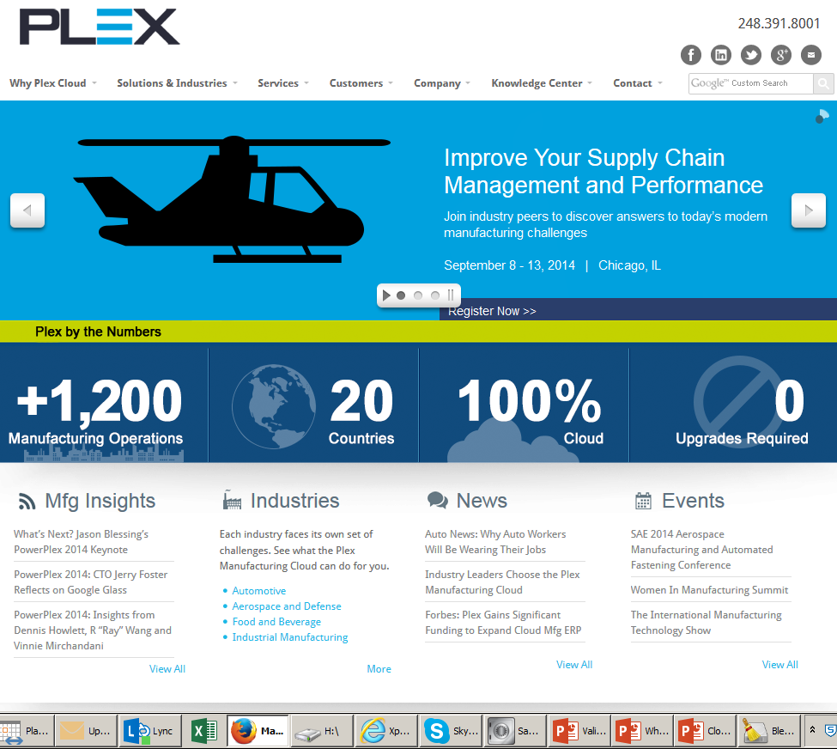
Software as a Service
Notes:
Going to go over this quickly as I want to spend more time on SaaS

Slide 18
Plex
Plex Systems
  Is true Software as a Service
  Fully functional ERP system
  Client companies requires only a machine with a browser
There are no version numbers for the software
  The version is what is in use right now.
  All tenant companies use the same base code
  All client data is in the same database.
Under Part 11 it is an Open System
  No issue - encryption is standard
Notes:
Going to go over this quickly as I want to spend more time on SaaS

Slide 19
Plex
Customization is not offered
  Any development of the software is done by Plex Systems and may then be offered to other clients.
Development of Plex is continuous.
Updates to the system occur several times a day
Tenants may or may not have the option to accept the update
  (depending on whether it is configurable)

Slide 20
The Approach, FPE side - 1
First Validation of the Plex System as used at FPE can be done the same as any other ERP system.
As the system had been in use for some time this was a retrospective validation.
Begin with requirements, which can be based on current practice, verify that these work, test and ensure that governance procedures are in place etc.
Notes:
I’

Slide 21
The Approach, FPE side - 2
It was clear from the start that an IQ/OQ/PQ approach would not work.
  Can IQ minor Infrastructure at FPE
  Clients Browsers switches
Follow the methodology of
  Plan
  Specify
  Configure
  Verify
  Report All as Per GAMP5
Notes:
How may companies here do an IQ on the client workstations?
Browsers can radically alter the way information is displayed and transmitted.

Slide 22
The Approach, FPE side - 3
User Requirements
  Based on current use
  Risk assessment
Functional Requirements
  Not used – make little sense for the tenant company in an SaaS system
Testing
  As normal using the Plex test system
  Same software as live system
  Overwritten with live environment data overnight.
Notes:
How may companies here do an IQ on the client workstations?
Browsers can radically alter the way information is displayed and transmitted.

Slide 23
The Approach, FPE side - 4
Reporting
  Test Report
  Validation Report
Maintenance of Validated state
  Procedures are required of course
  Change and Config management
    Limit to what FPE can actually change.
Notes:
How may companies here do an IQ on the client workstations?
Browsers can radically alter the way information is displayed and transmitted.

Slide 24
The Approach, Plex side – 1
Analysis of Plex internal procedures. What was found:
  SDLC is formal, rigorous and well documented.
  Changes are assessed for risk, impact and allocated to an appropriate level of testing.
  Formal standards are followed for coding, development, based on various ISO standards, ITIL, COBIT and others.
  There is a formal CAPA system
  SLAs are comprehensive

Slide 25
The Approach, Plex side – 2
There are formal documented procedures for:
  Change and config management
  Risk Management
  Development
  Helpdesk
  Infrastructure Qualification (they don’t call it that)
  Testing
  Support Services
  Performance monitoring
  Incident Management
  CAPA
  Periodic Review
  Back and Restore
  Disaster Recovery
  Business Continuity Management
  Security
  User Access
  Data Migration
  Training

Slide 26
The Approach, Plex side – 3
Plex’s IT QMS is as good as most Life Sciences companies, better than some.
Plex were aware that Life Sciences companies required validation, but were not really sure what it was.
Were surprised to learn that they were doing most of it already.
Some gaps were identified:
  Regulatory Compliance Training
  Change control system looks at business risk only, not risk to public health.
  Technical issues with some part 11 requirements.
    (Audit trail and multiple signature functions)

Slide 27
The Approach, Plex side – 4
Plex’s IT QMS is as good as most Life Sciences companies, better than some.
Plex were aware that Life Sciences companies required validation, but were not really sure what it was.
Were surprised to learn that they were doing most of it already.
Some gaps were identified:
  Regulatory Compliance Training
  Change control system looks at business risk only, not risk to public health.
  Technical issues with some part 11 requirements.
    (Audit trail and multiple signature functions)

Slide 28
The model that was developed
Plex are acting as the IT department of the life Sciences company, similar to a conventional outsourcing model.
Therefore they need to work in the same way and under a Quality Management System Suitable for a Life Sciences Company. (They already are – almost)
This needs to be integrated with the QMS of the Client LS Company
Given these concepts:
  Plex can assess the risk and impact of changes in exactly the same way that an IT department in a Life Sciences company does.

Slide 29
Risk assessment of changes
There are multiple changes per day.
If these are all rigorously assessed for risk, tested and verified then the frequency is irrelevant.
Only minor changes in the way Plex functions at different tenants is possible.
  Therefore the tenants may need to do regression testing on such changes that may affect these functions.
  Therefore they need to know about such changes very close to the time at which they are deployed.

Slide 30
The operational model
Plex QMS
Life Sciences Company QMS
Config Management
Change Control
Config Management
Testing – All changes
Change Control
Testing – some changes
Understanding of Regulations

Slide 31
Some surprising advantages .
Advantages over a standards ERP project (some surprising!)
It’s SaaS – low capital cost , flexible, fast, etc. etc.
There is no temporary project team.
  No group of (third party) integration consultants, who disband after the project is finished.
  Software developers are permanent.
  Issues can be referred to the people who wrote the software
  No customizations (can be paid for)
  Service and response levels are set in a SLA.

Slide 32
Tackling the gaps – in progress
Regulatory Compliance training of Plex Software development team.
  Completed earlier this year.
  Developers to CEO level
Change and configuration management procedures
  In change process now, to incorporate patient risk
Part 11 issues
  Audit trail not available on all transactions – being fixed
  Multiple signatures on one session – being fixed.
Completion of FPE pilot project planned for Nov 2014
Will then work with other LS customers.

Slide 33
Let Us Meet Again
We welcome you all to our future conferences of OMICS Group International
Please Visit:
regulatoryaffairs.conference@omicsgroup.us
regulatoryaffairs@conferenceseries.net
http://regulatoryaffairs.pharmaceuticalconferences.com/

