Slide 1




Lipid nuclear receptors in male fertiliry
David VOLLE
CR1 Inserm
UMR Génétique Reproduction & Développement
Inserm U1103, UMR CNRS 6293, Clermont Université
25 Avril 2012

Slide 2
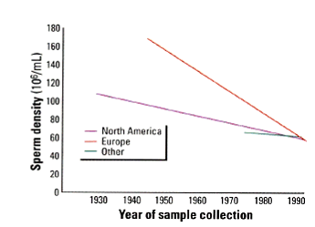
Infertility …
Some points (publication 2012)
25% of couples are steriles (1year)
50% of the case male is involved
Obstructive azoospermia
Secretory azoospermia
In 30% of male infertility, the origin remains unknown
Spermatozoa quality…
ART from testicular spermatozoa
There is a need to better define characteristics of germ cell differentiation
Carlsen et al: 61 articles de 1938 à 1990 Swan et al: 101 articles de 1934 à 1996

Slide 3
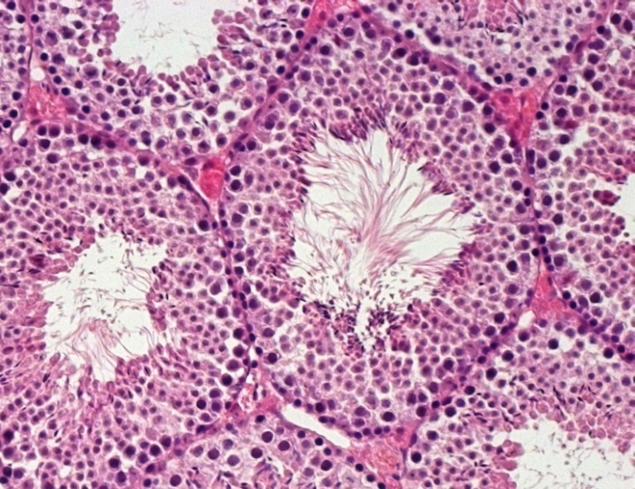
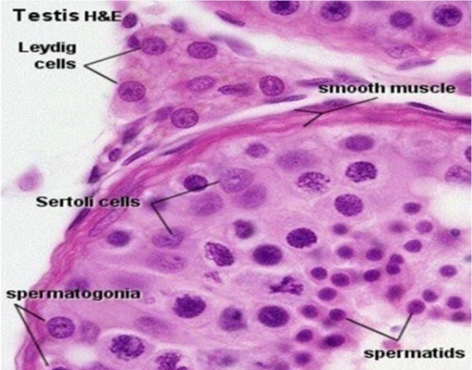
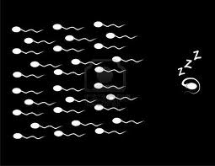
Testicular ohysiology
Endocrine function
(interstitial space)
Exocrine function
Leydig
Testosterone synthesis
Sertoli
Support de of gametogenesis
    Germ cells
Spermatogonia→ spermatocytes → spermatides → spz…
Master II
1 - prolifération
    2 - meisosi
3 - spermiogenesis
n=6
n=6
Témoin
4 mois

Slide 4
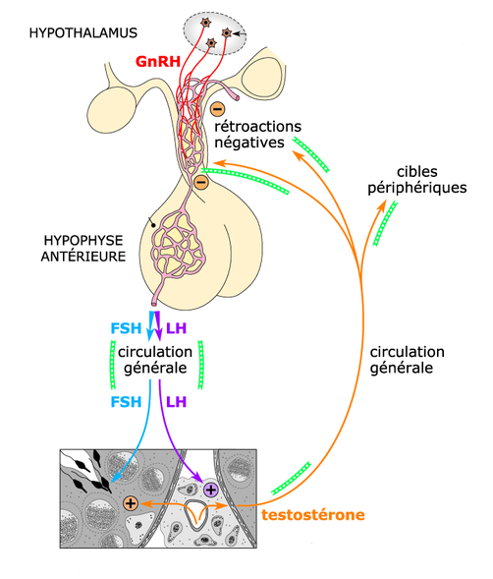
Hypothalamo-Pituitary axis
Cellule de Sertoli
Cellule de Leydig
Testosterone

Slide 5
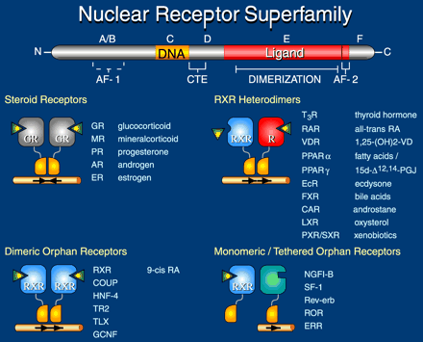
Local regulation of testicular function
Nuclear receptor superfamily

Slide 6
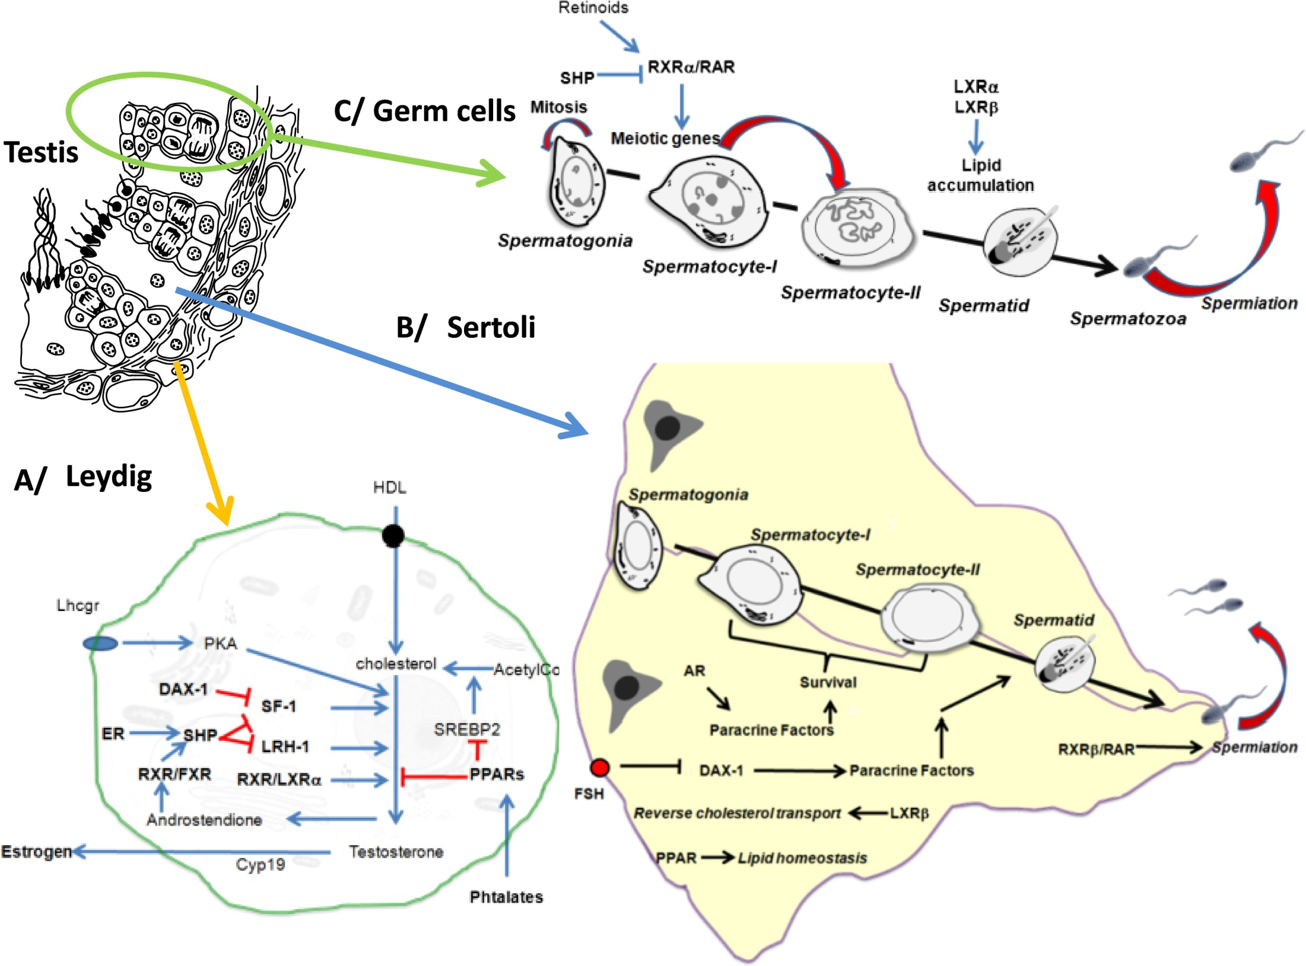

Slide 7
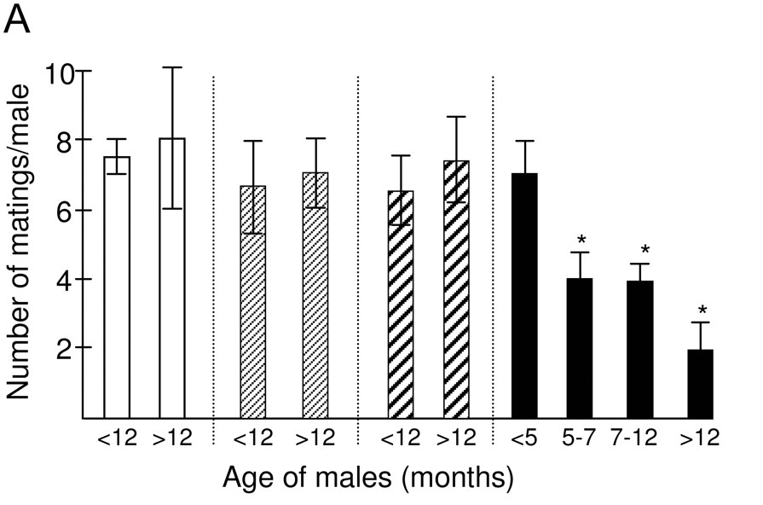
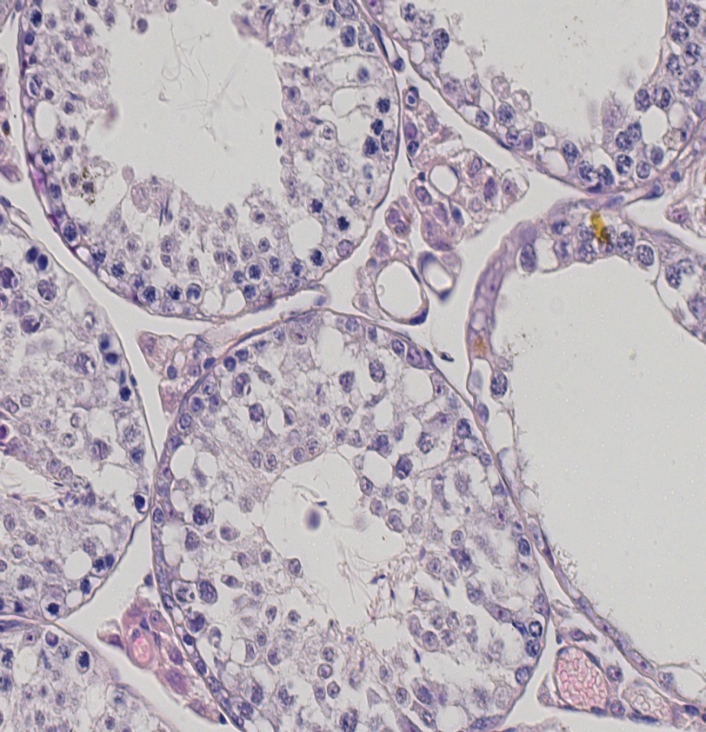
Thje Liver X Receptors α and β
Volle et al. Mol Endocrinol. 2007
Lack of LXRs leads to male infertility

Slide 8
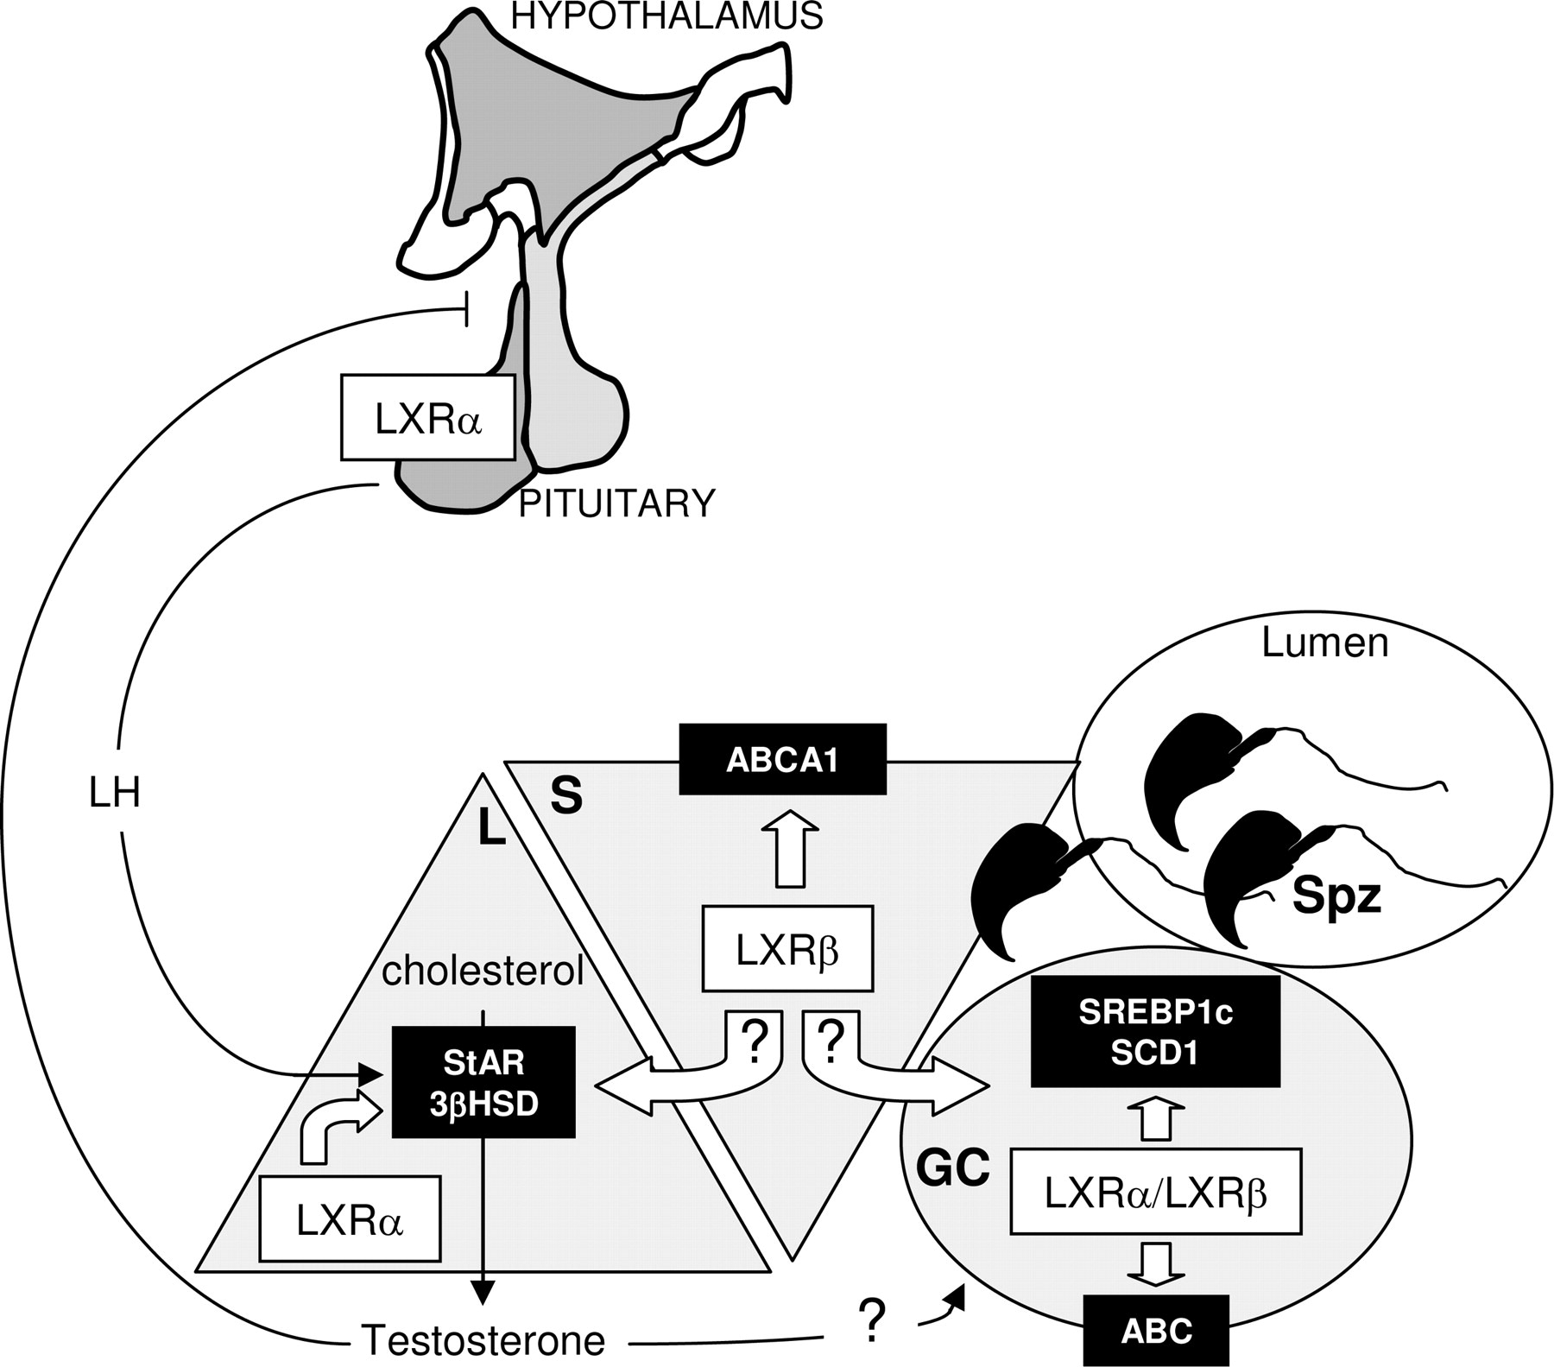
Volle et al. Mol Endocrinol. 2007
Sertoli
Germ cells
Leydig

Slide 9
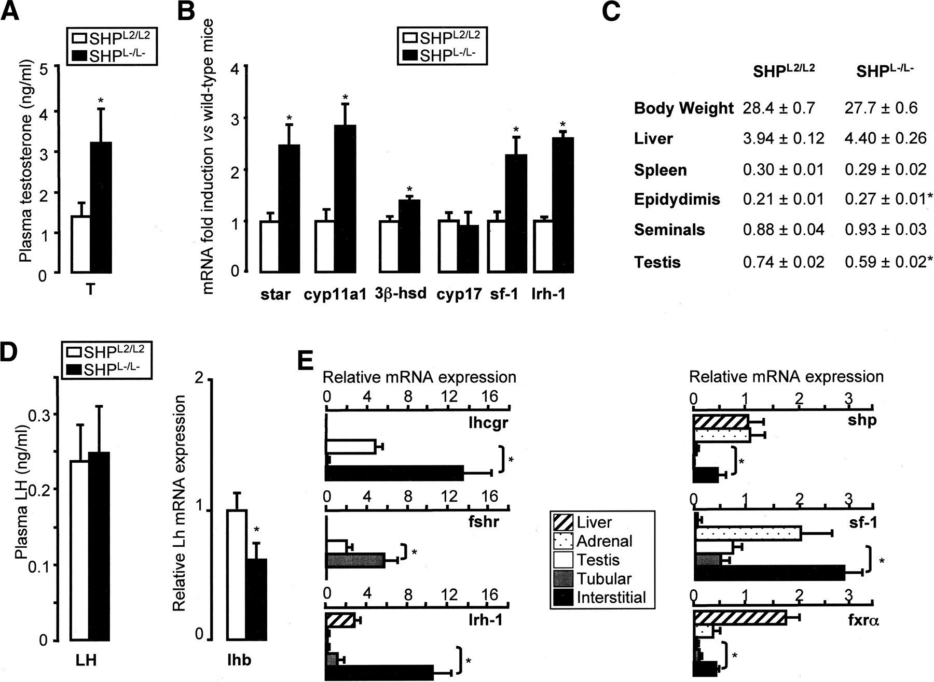
The Small Heterodimer Partner
In adult testis
Lhcgr
Fsh
Shp
Testosterone
Volle et al. Genes & Dev 2007

Slide 10
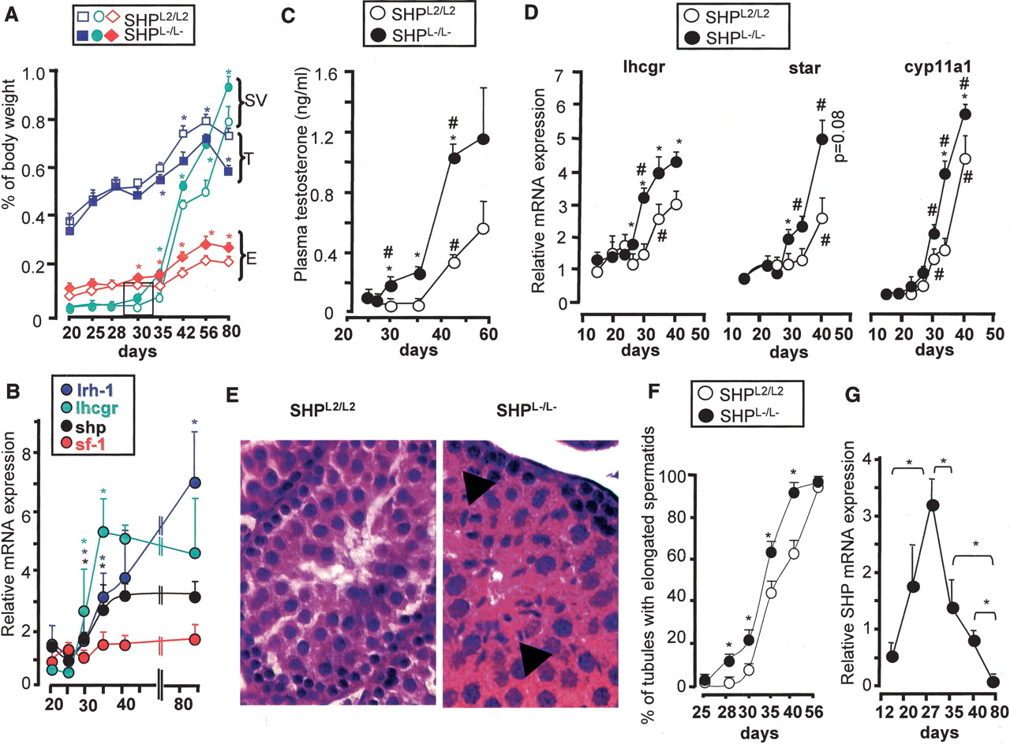
Complexity of the impact on testicular physiology
SHP in neonatal
Volle et al. Genes & Dev 2007

Slide 11
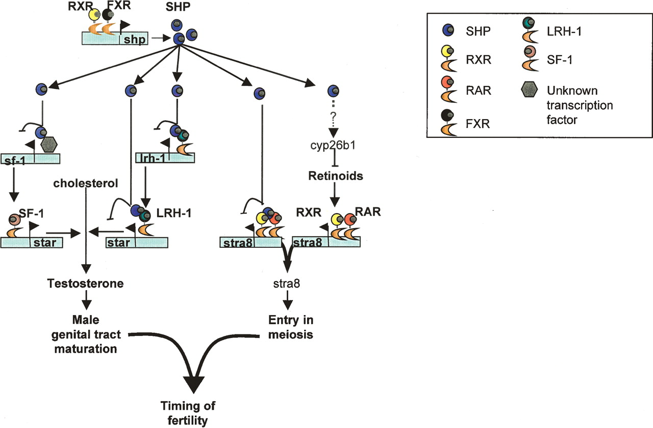
A model for the role of SHP in testis
Volle et al. Genes & Dev 2007

Slide 12
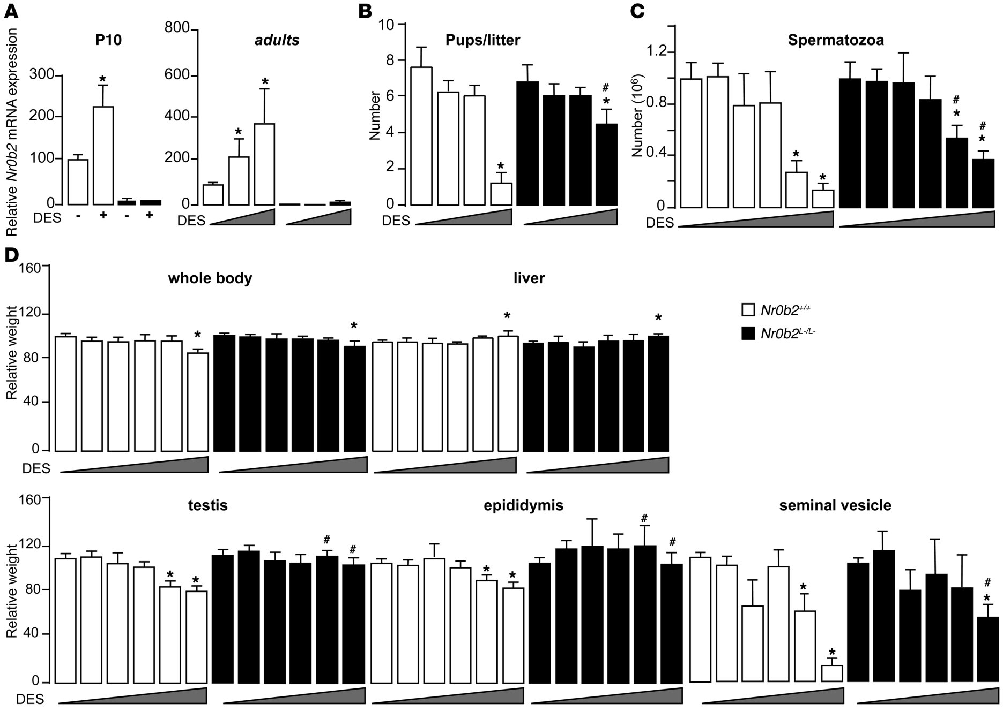
Shp and estrogenic endocrine disrupters
Volle et al. JCI 2009
Shp a molecular link between estrogenic endocrine disrupters and tesis physiology

Slide 13
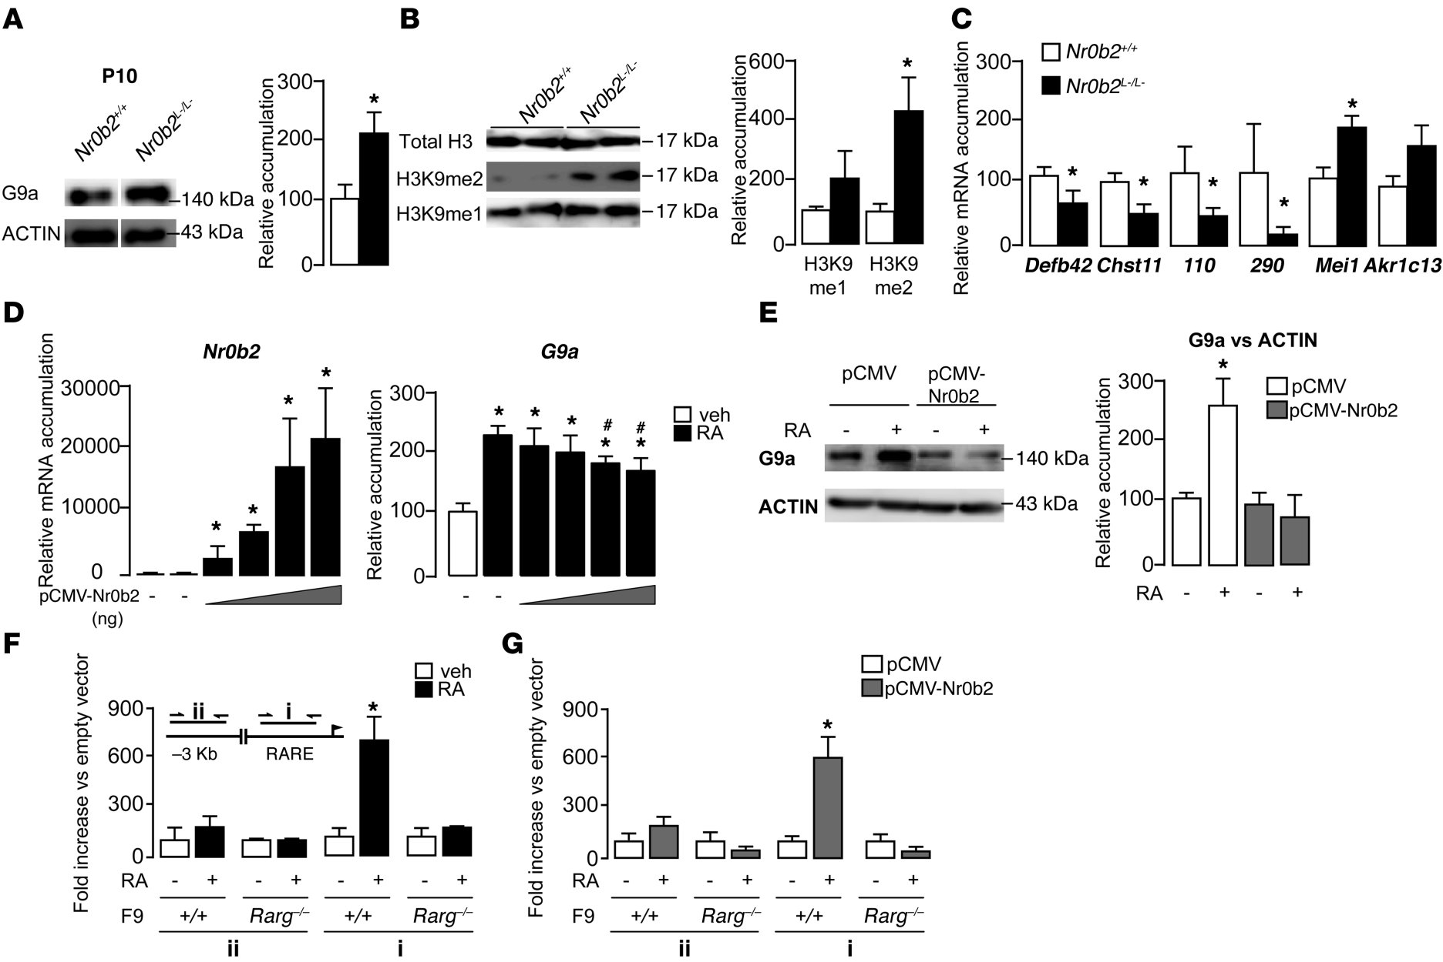
Shp and estrogenic endocrine disrupters
Volle et al. JCI 2009
Shp acts through retinoid/G9a pathway

Slide 14
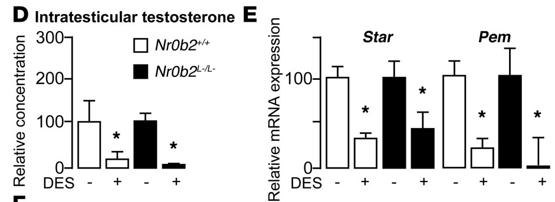
Shp and estrogenic endocrine disrupters
Shp does not control neonatal steroidogenesis

Slide 15
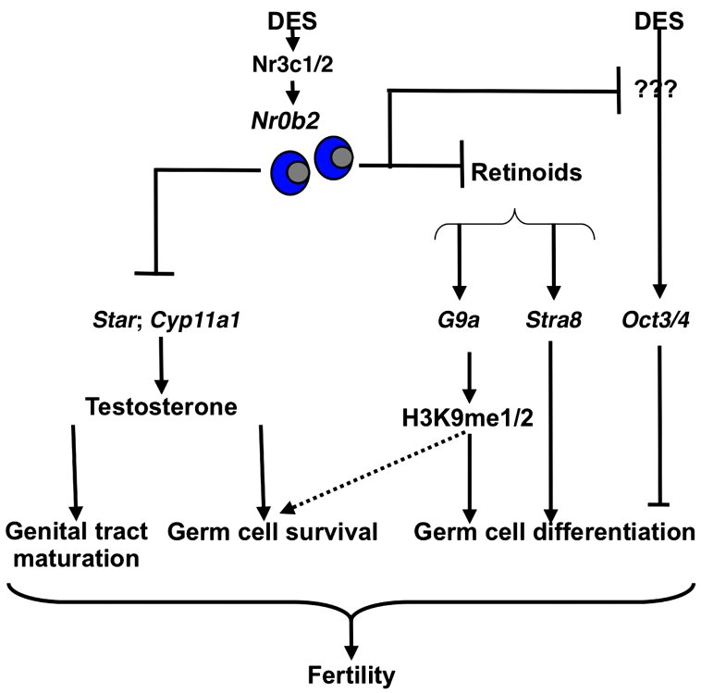
A more complex model than expected

Slide 16
Complexity of the impact on testicular physiology
Cell type where NR is expressed

Slide 17
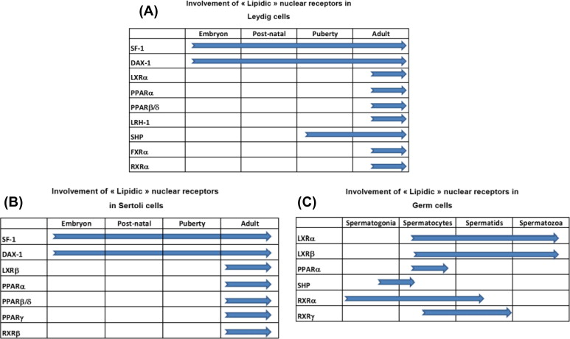
Maqdasy et al. MCE 2013

Slide 18
Complexity of the impact on testicular physiology
Cell type where NR is expressed
When NR is expressed
Potential links between Eds and male disorders

Slide 19
Perspectives
Identification of etiology of infertility
Polymorphisms
Potential therapeutical targets

Slide 20
Thanks for your attention

