Slide 1





Overview of the
The Atmospheric Mercury Network
David A. Gay¹, David Schmeltz², Eric Prestbo³, Mark Olson¹, Timothy Sharac², and Robert Tordon⁴
¹ National Atmospheric Deposition Program, University of Illinois (217) 244 – 0462, dgay@illinois.edu
² U.S. EPA, Office of Atmospheric Programs, Clean Air Markets Division
³ Tekran Research and Development
⁴ Environment Canada

Slide 2
A Cooperative Research Program (Un. Of Illinois)
  Measure wet deposition of pollutants
    Three networks (NTN, AIRMoN, Mercury Deposition Network)
  Monitor the rate of pollution movement to the surface
    dry deposition est., AMoN, Atmospheric Mercury Network)
  North America
    US, Canada, and some in Mexico
    Also Taiwan, South America, Hawaii
  Owned and operated by our members
    Decisions made by our members
    Started in 1978, 37th year
  Over 450,000 precipitation chemistry
  samples

Slide 3





















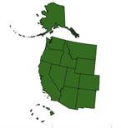














The NADP Cooperators
(100+ total agencies)
Tribal
Organizations
Federal
Agency
Members
NRSP-#3
Universities
US
States
Other
Organizations
EPA Taiwan

Slide 4
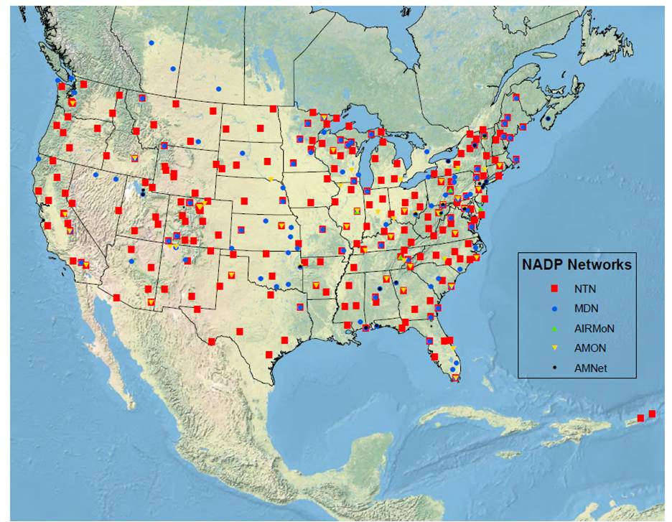
NADP - All Network Sites
Alaska, Hawaii
Alert Nunavut, Canada
Argentina, Taiwan

Slide 5
National Trends Network (NTN)
Atmospheric Integrated Research and Monitoring Network (AIRMoN)
Ammonia Monitoring Network (AMoN)
Mercury Deposition Network (MDN)
(wet deposition)
Atmospheric Mercury Network (AMNet)
(gaseous, dry dep.)
Trial Network
Mercury Litterfall Network

Slide 6
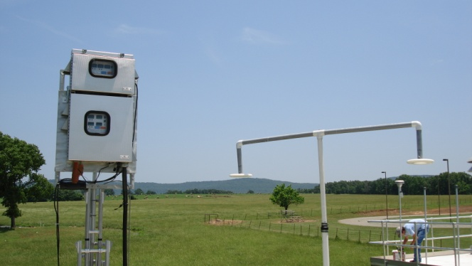
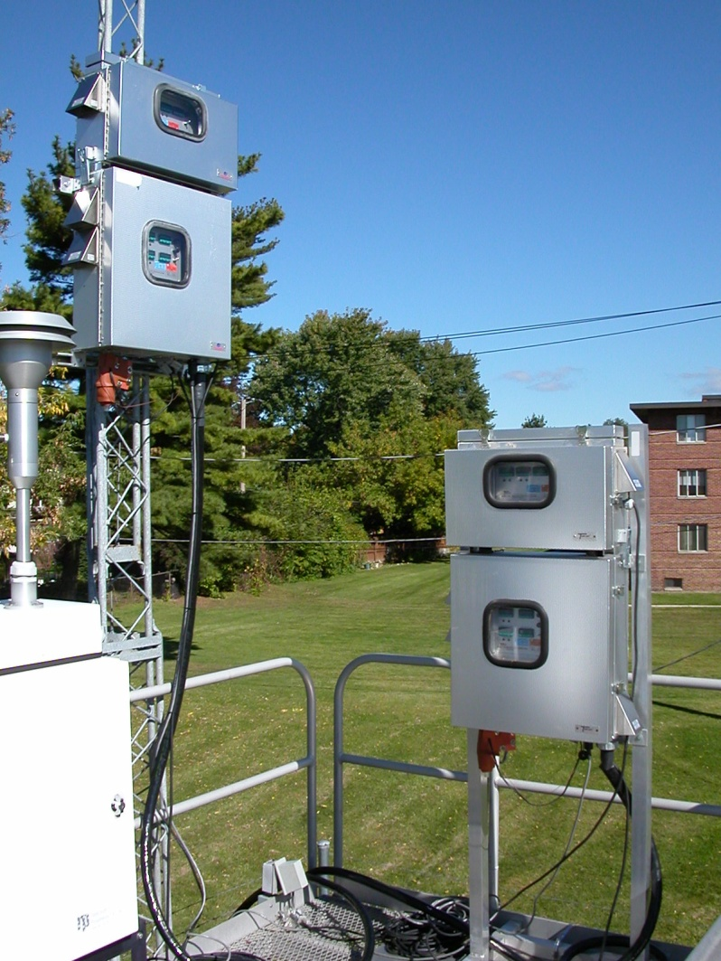
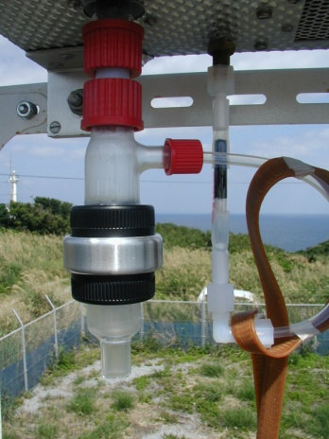
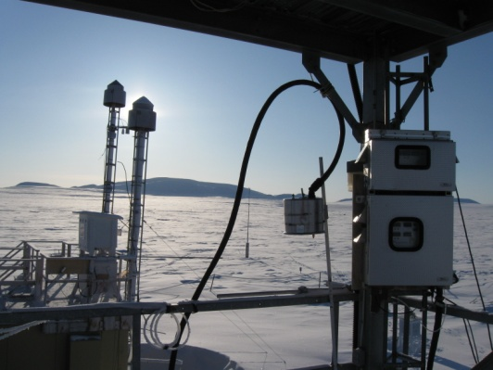
Atmospheric Mercury Network Goals
Goals:
  dry deposition estimates in weekly fashion alongside wet deposition
  For use in model evaluation
  Trends estimates

Slide 7
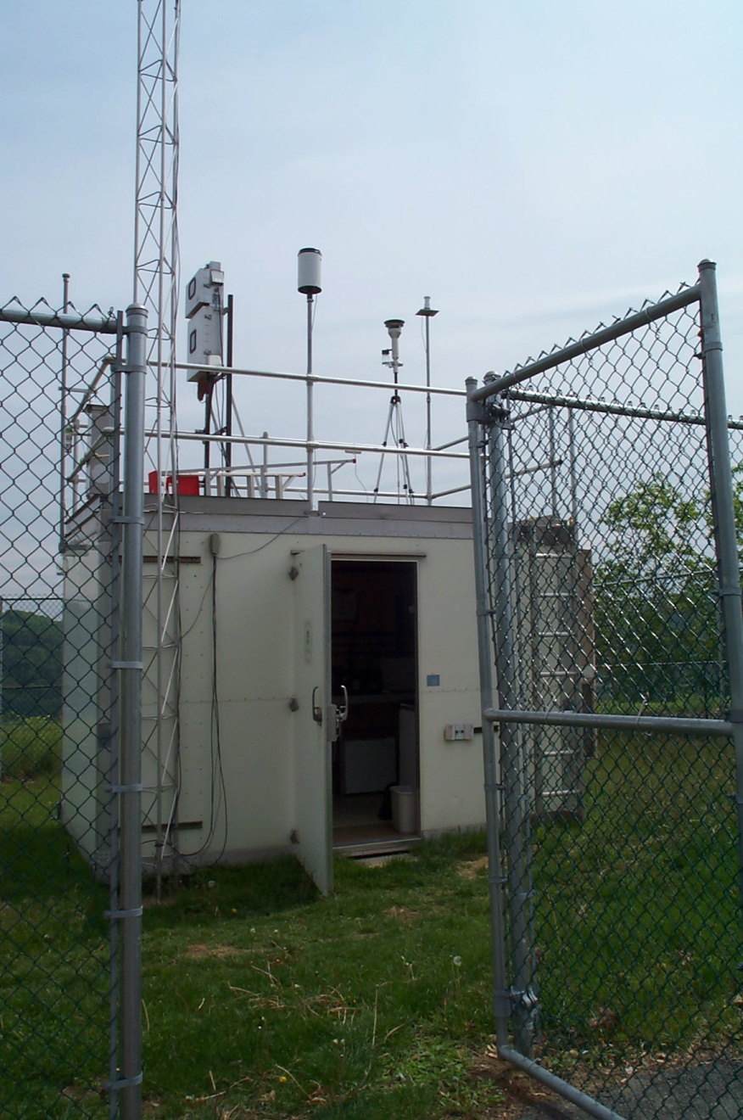
AMNet Measurements
Mercury fractions
  GEM (hourly)
  GOM (2 hourly)
  PBM_{2.5} (2 hourly)
Tekran System
  2537, 1130, 1135
With wet deposition flux
  Mercury Deposition Network
Land cover variables
  for estimates of dry deposition flux

Slide 8
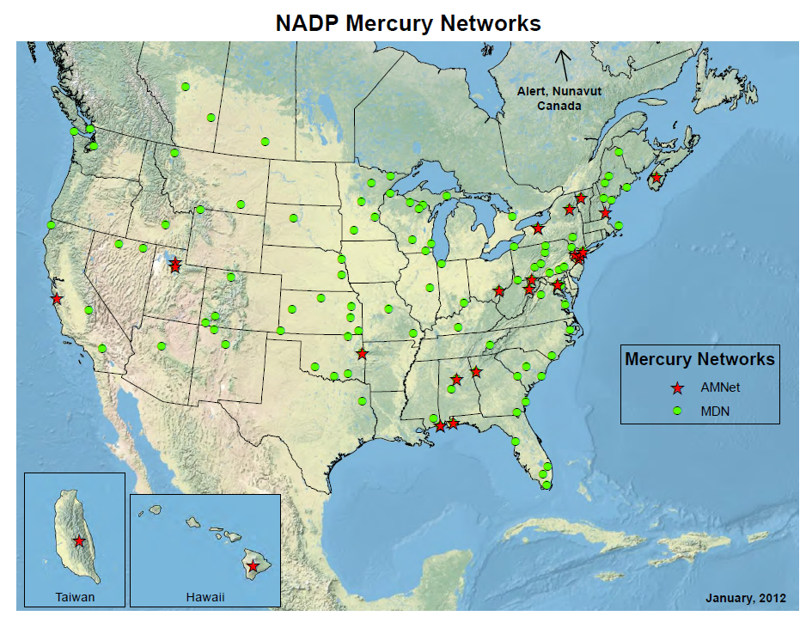
NADP’s Mercury Networks
http://nadp.isws.illinois.edu/MDN/
http://nadp.isws.illinois.edu/amn/

Slide 9
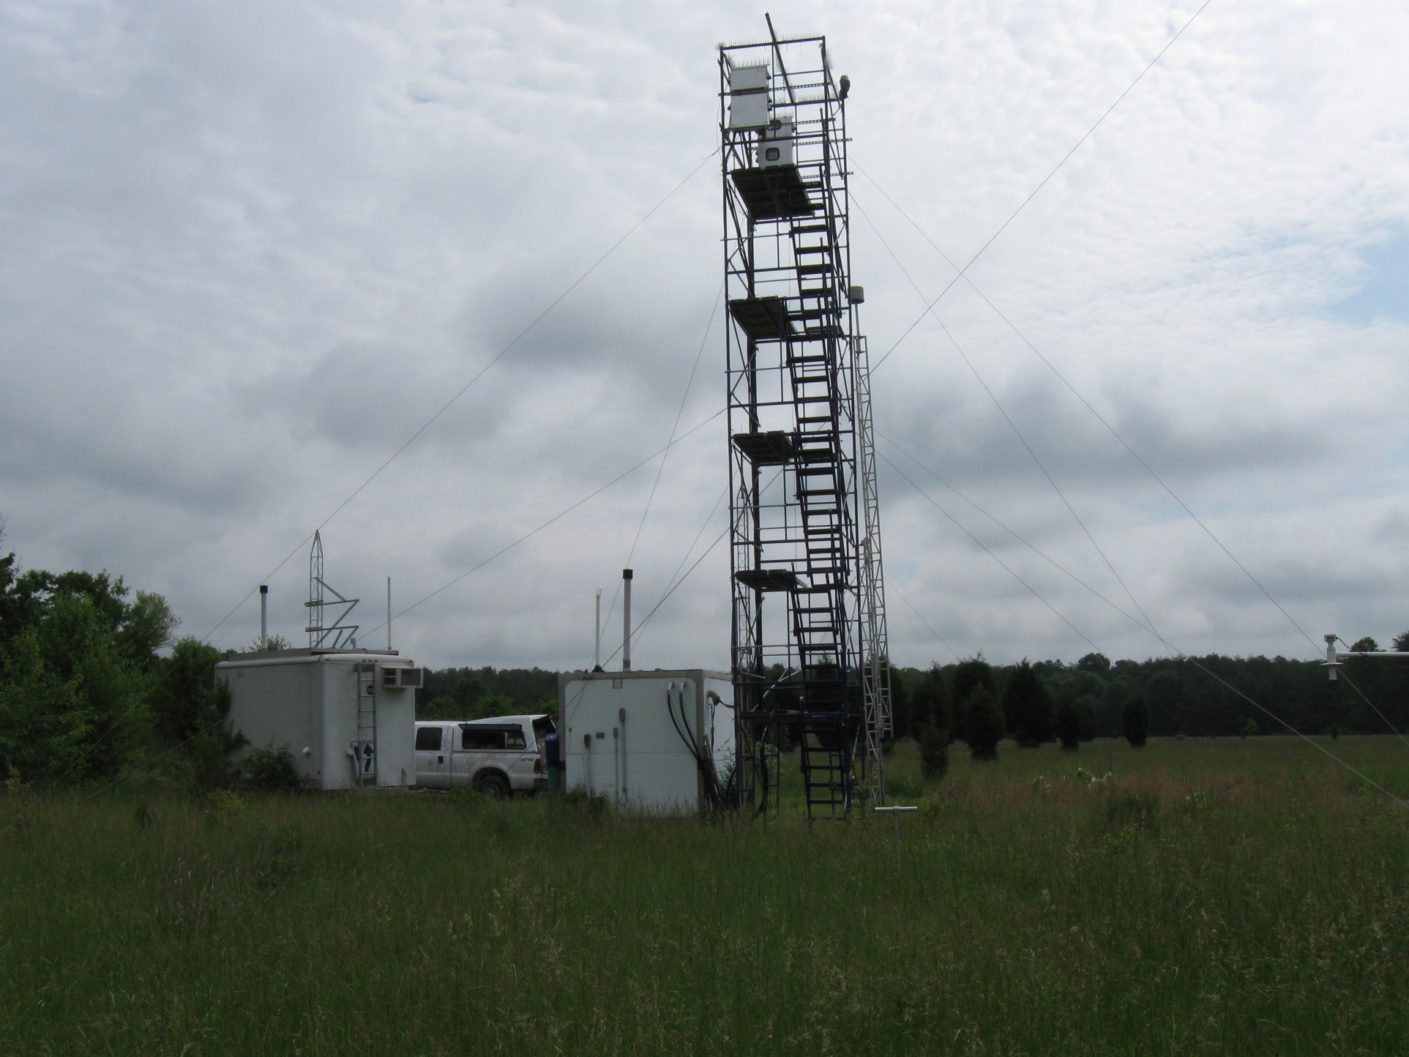
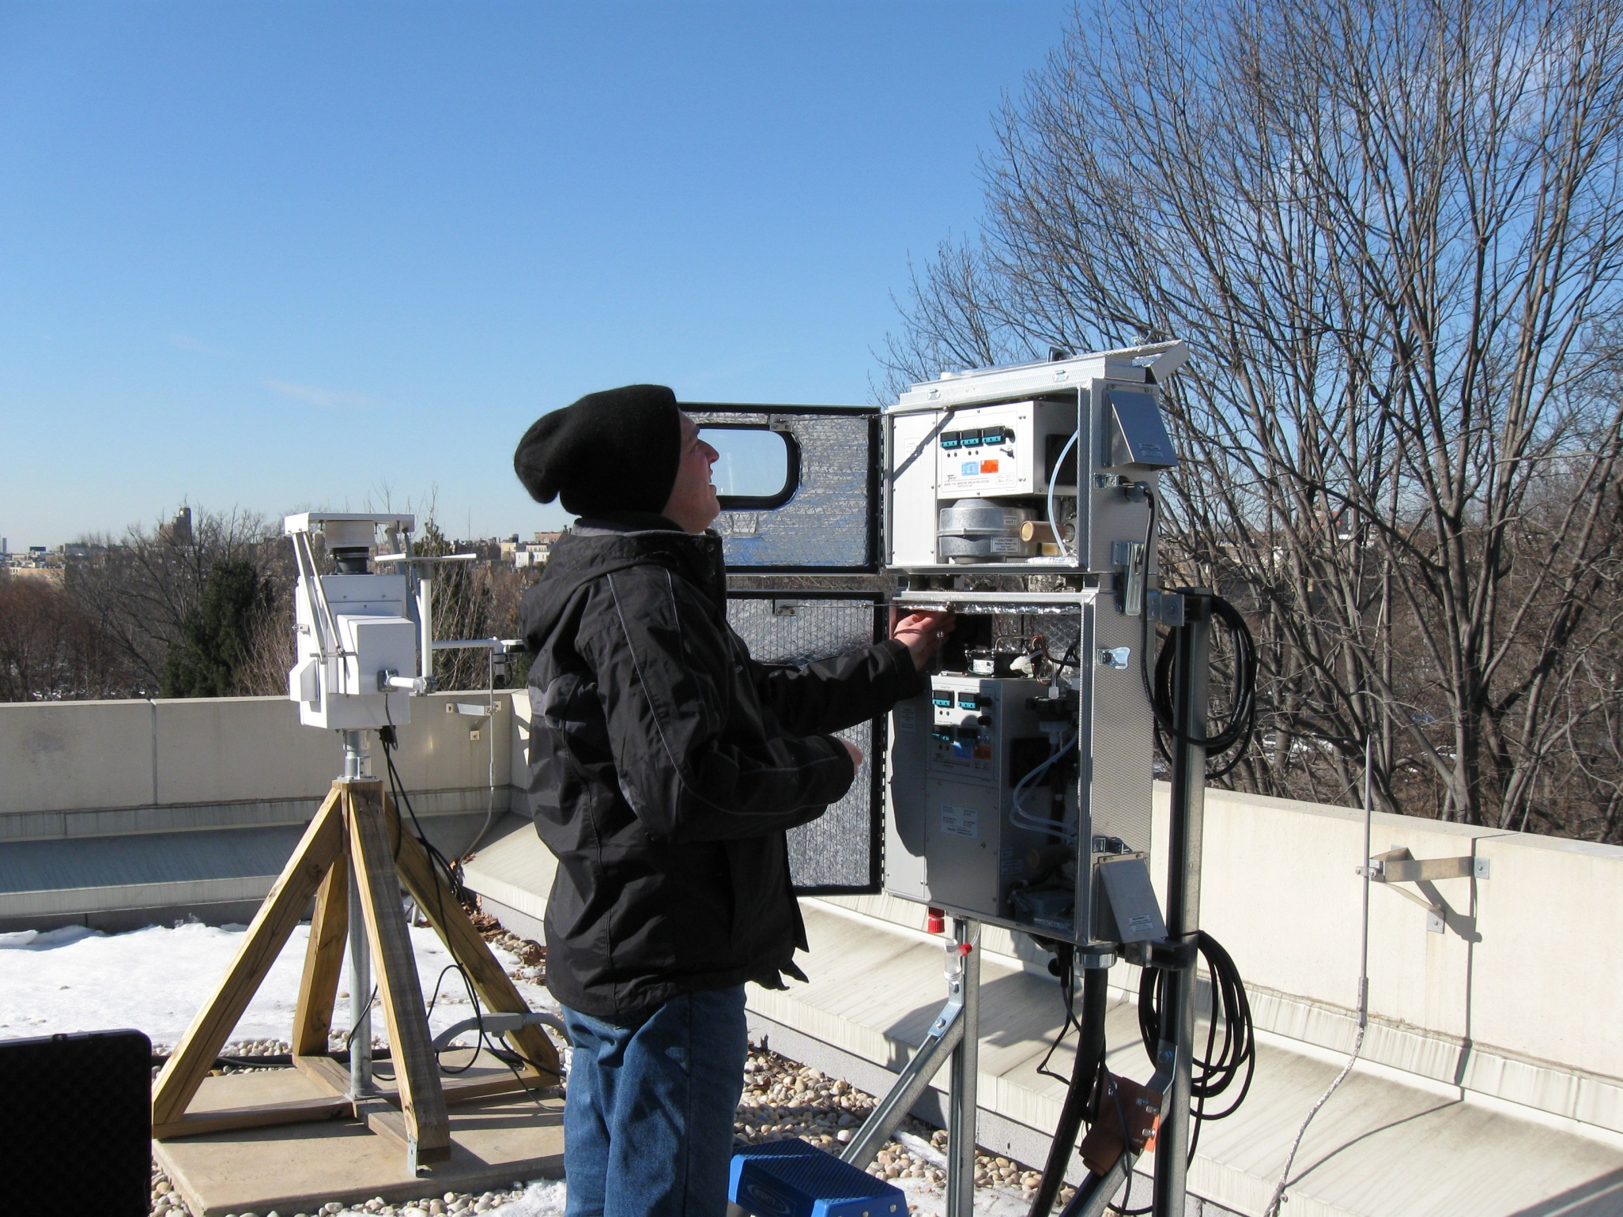
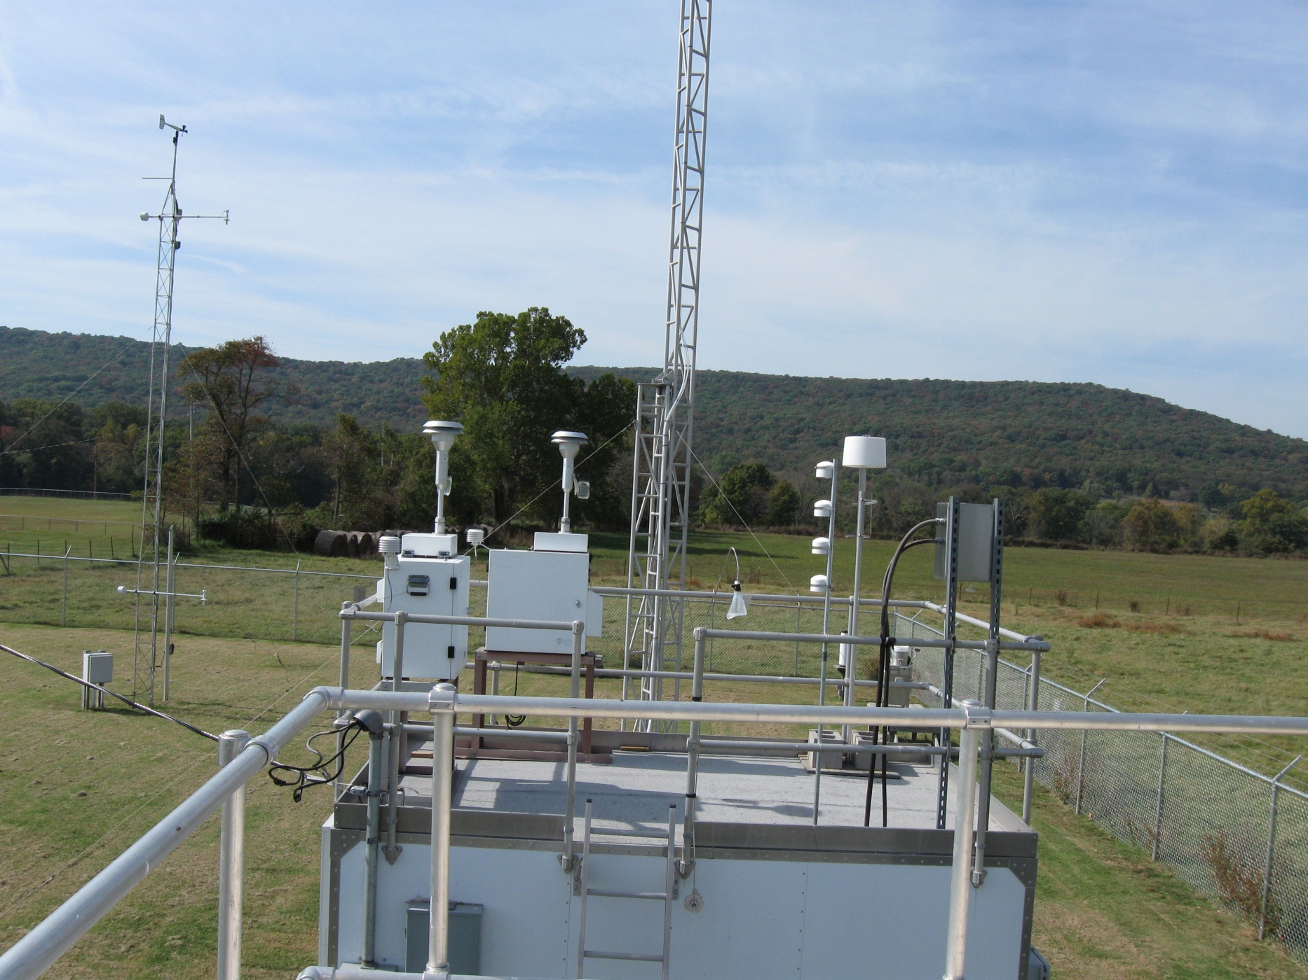
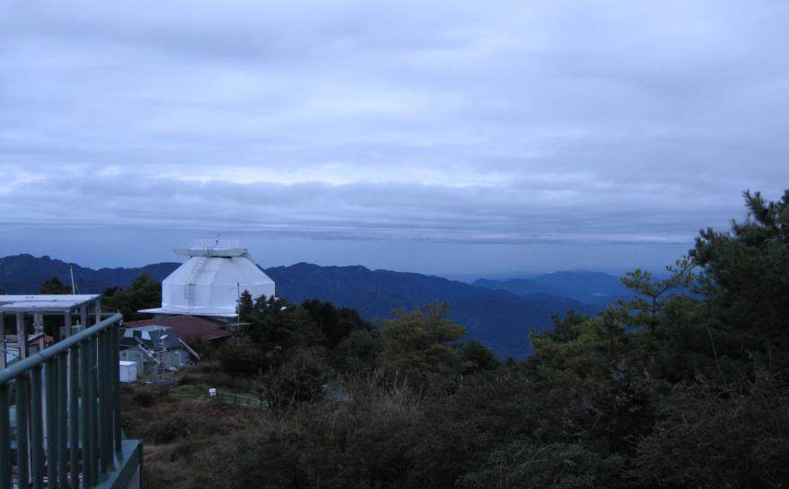
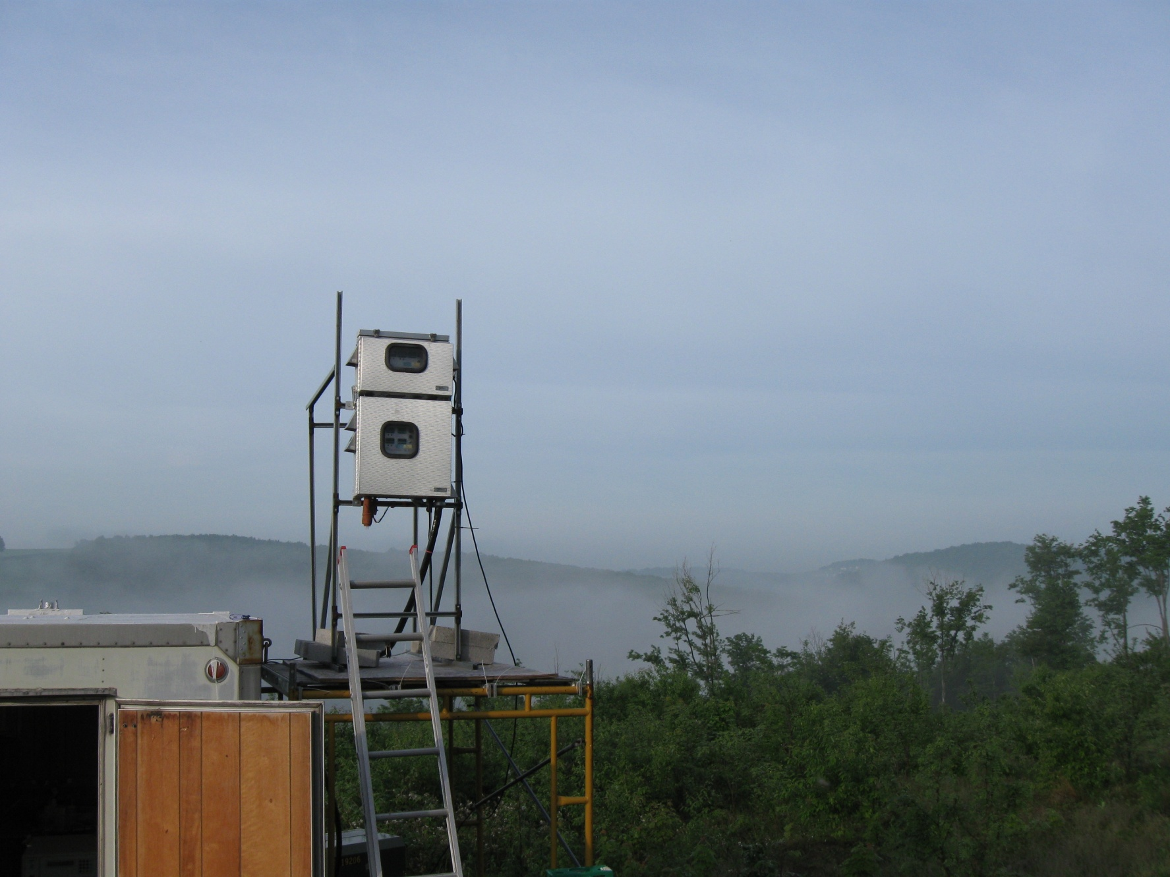
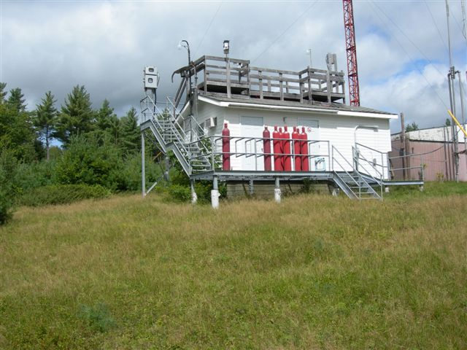
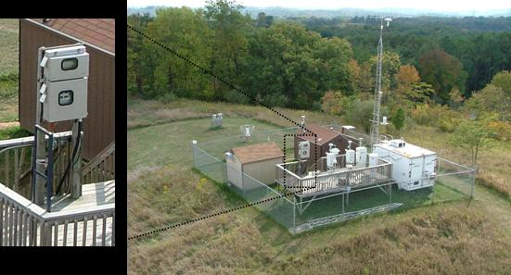
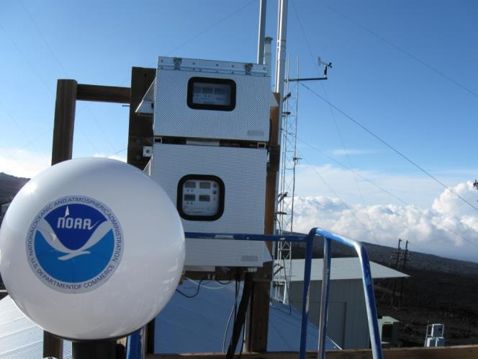
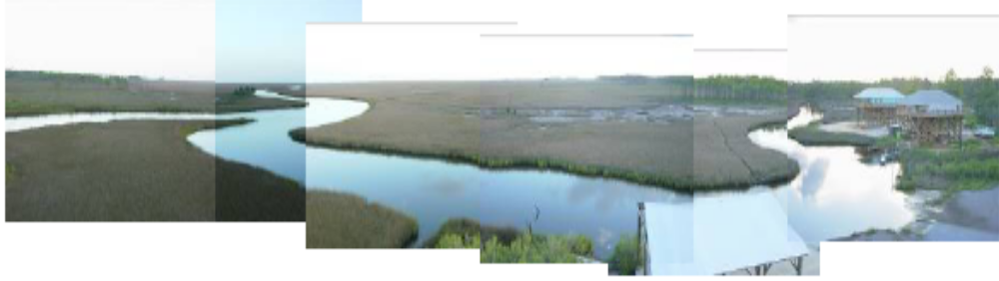
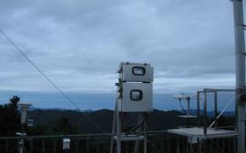
Operating AMNet Sites

Slide 10

Data Availability
98 site years of data available
  Only validated data available
  averaged to hourly GEM, 2-hourly GOM & PBM_{2.5}
Through December 2013,
  291,000 valid observations
  of GEM, of GOM, and of PBM_{2.5}
  2009 – current, ongoing
Available: http://nadp.isws.illinois.edu

Slide 11

AMNet Quality Assurance Overview
Field Operations SOP
  operation, reporting, etc.
  weekly/monthly/quarterly maintenance
Data Management SOP
Site Survey SOP
  siting criteria
Quality Assurance Plan
Site pictures, information
Available on the NADP Webpage

Slide 12
Automated Quality Assurance
Upon import of raw data, flags are assigned to each observation
AMNet currently utilizes 51 Quality Assurance flags, most are automated
  23 are warning flags which leave the data valid
  26 are control flags which invalidate the data
Then manual review, with final flag assignment
QA system available for GMOS
Check
Warning
Control

Slide 13
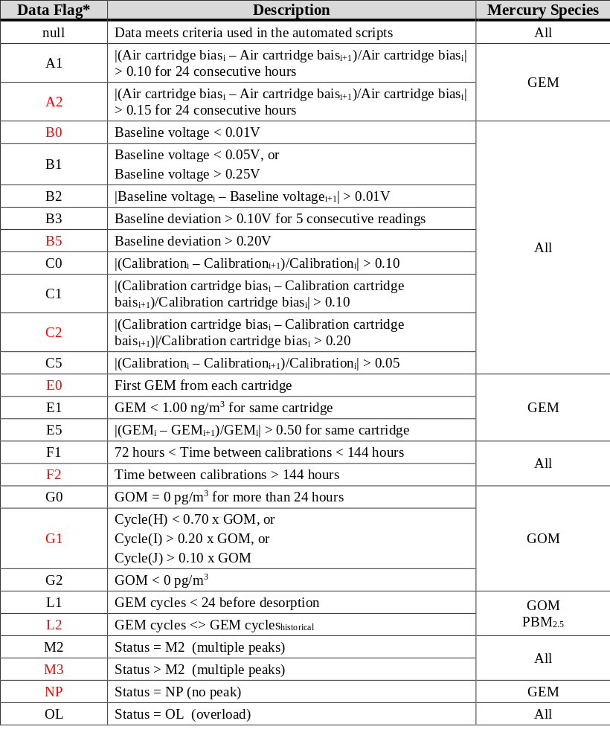
Examples of
QA Flags

Slide 14
Output Data
from the AMNet

Slide 15
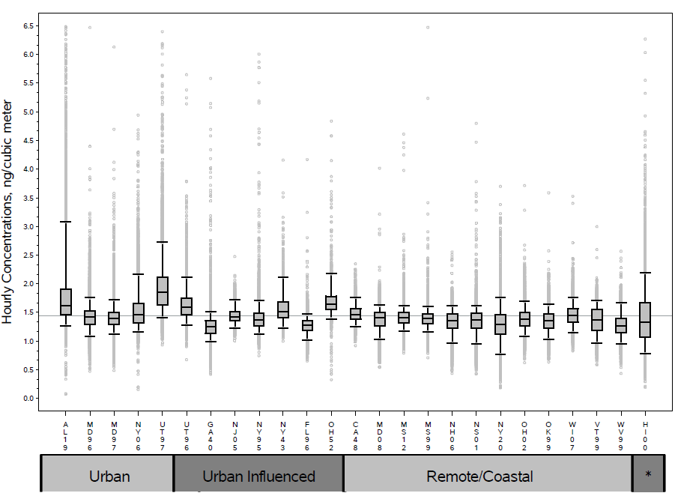
Gaseous Elemental Hg
2009 to 2013

Slide 16
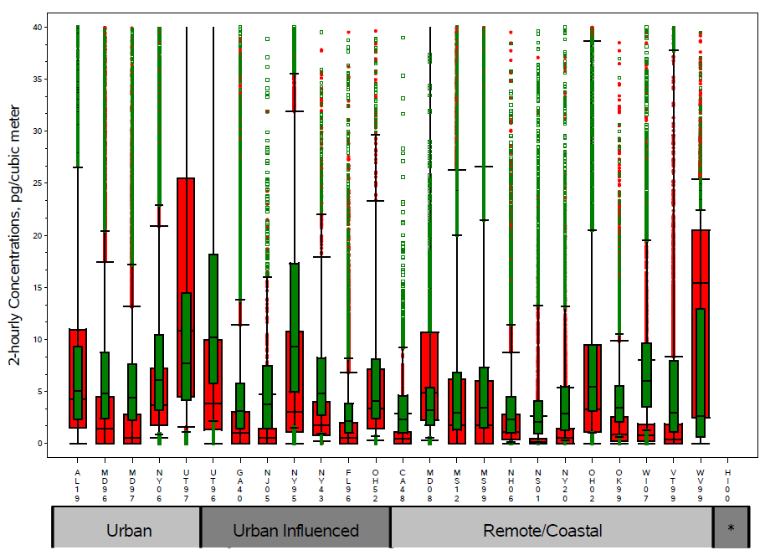

PBM and GOM (2009 – 2013)
scale
GOM
PBM_{2.5}

Slide 17
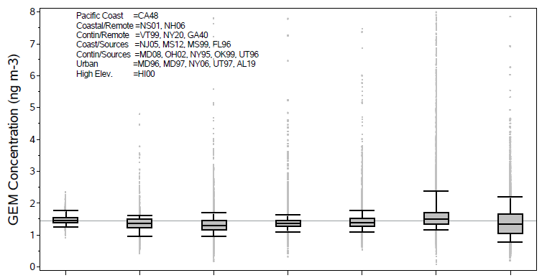
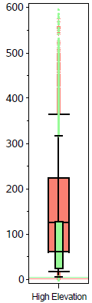
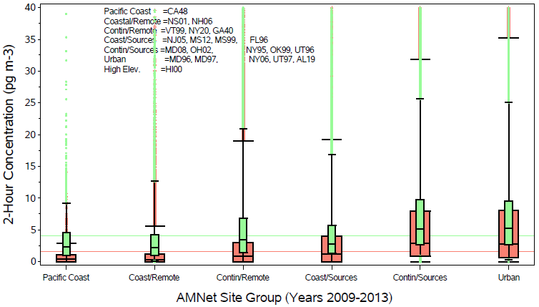

Slide 18
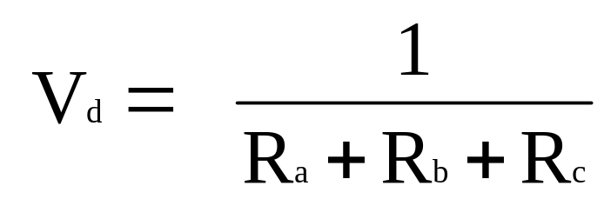
Proposed: Estimate Dry Deposition
Weekly GOM, PBM, and GEM (downward)
flux (F ) = air concentration x dry deposition velocity (Vd)
F= V_{deposition} * Concentration_{air}
  where:
Ra as aerodynamic resistance, Rb as quasi-laminar resistance, and Rc as canopy resistance

Slide 19
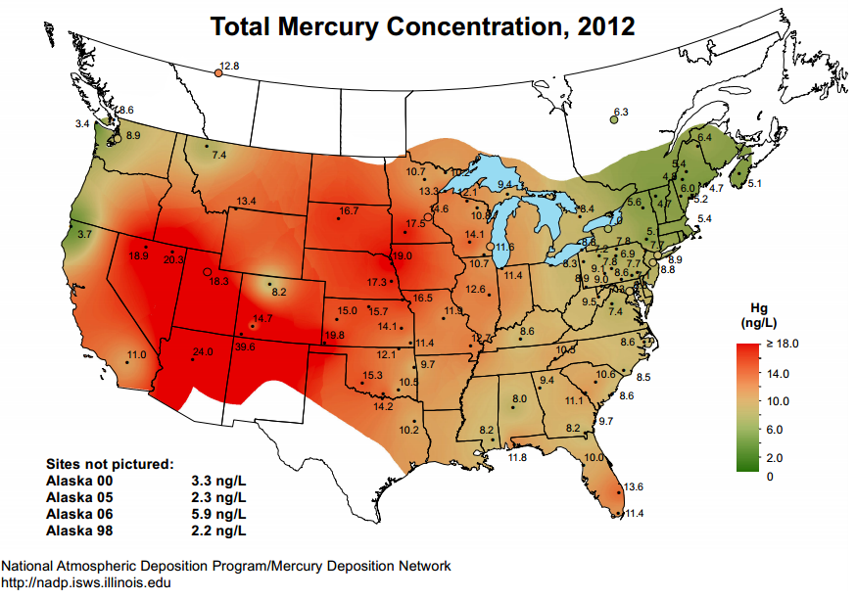
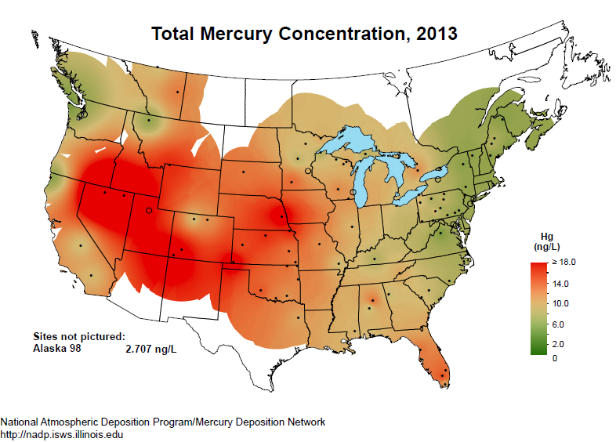
Preliminary
2013 MDN Wet Concentration Map

Slide 20
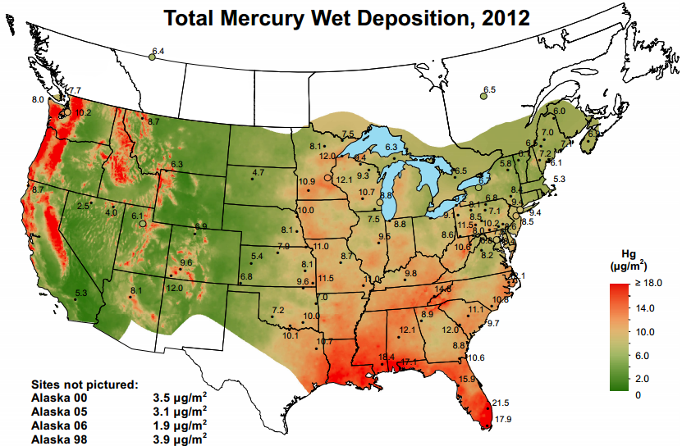
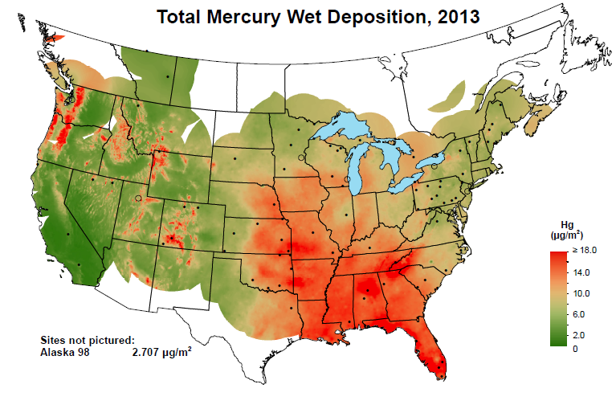
Preliminary
2013 MDN Wet Deposition Map

Slide 21
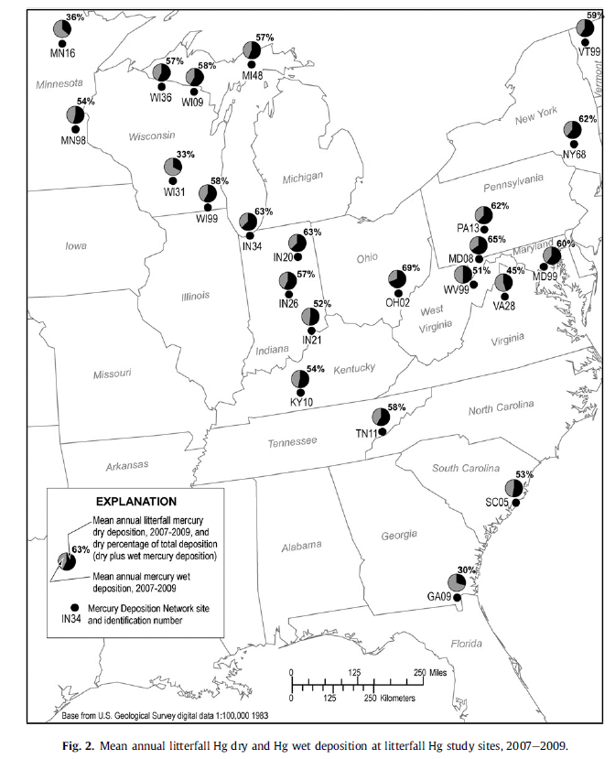
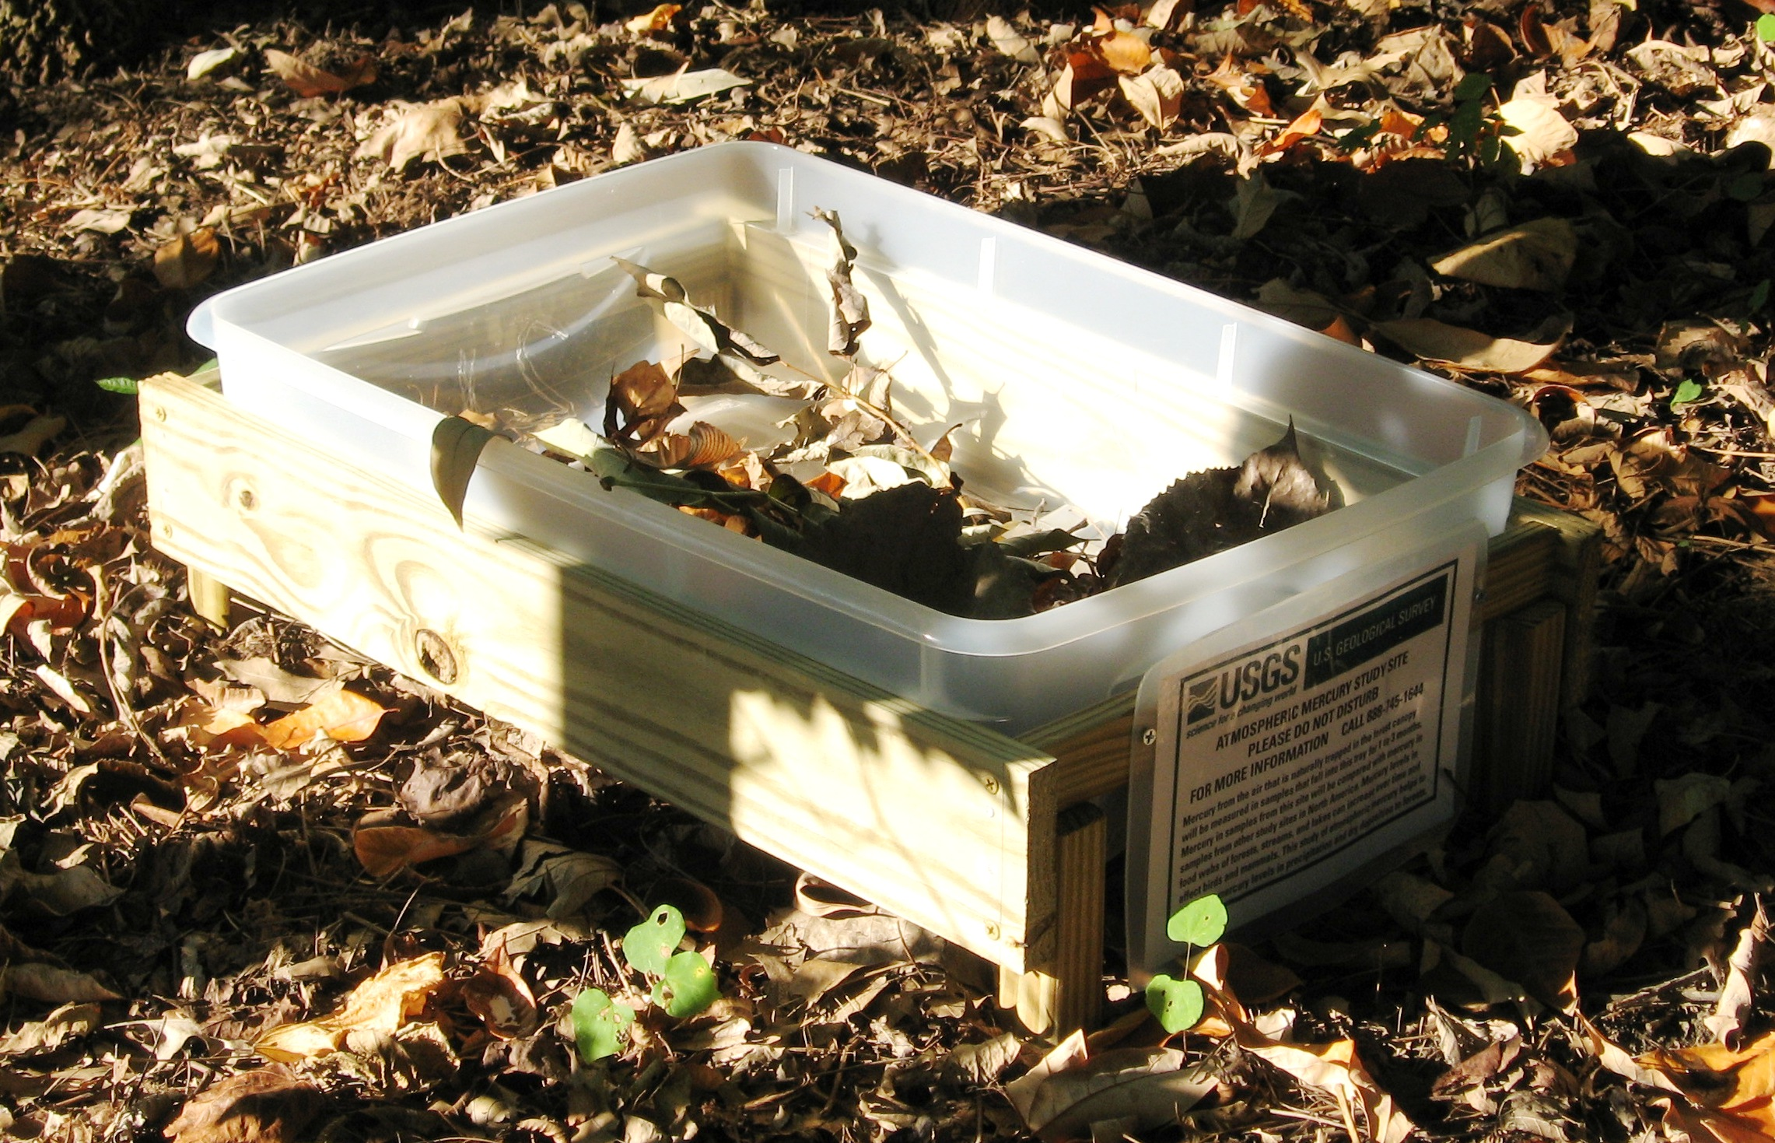


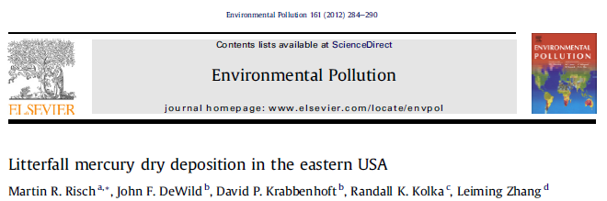
New NADP Trial Network: Mercury Litterfall
Started in 2012
In cooperation with USGS
  and USGS Mercury Research Lab
14 stations (w/MDN)
Monthly observations
  (May to Nov)

Slide 22
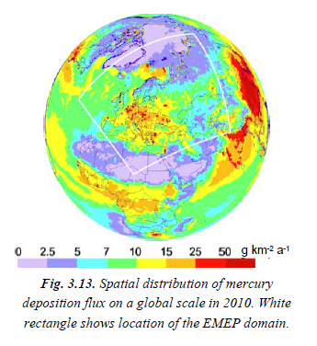
Future Plans: Networking Asia
Asia Pacific Mercury Monitoring Network
Consistent wet deposition observations
Gaseous measurements
  Tekran GEM and current GOM/PBM
  Manual GEM/GOM/PBM
Consistent sampling and data reduction methods
Open access to data

Slide 23
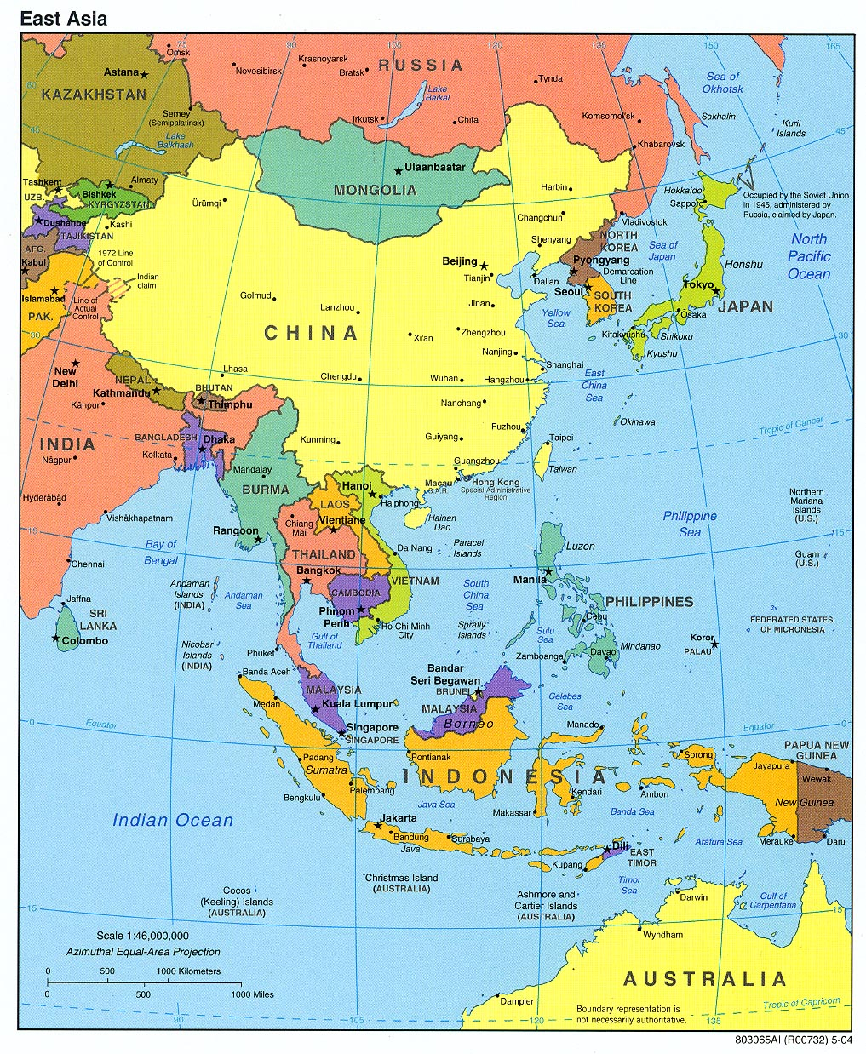
Initial Locations
Asia Pacific Mercury
Monitoring Network
Wet Deposition Sites
*
*
cucurrnetCurrent
*
*
*
Current Members
Attending next meeting
(Sept. 2014 in Da Nang Viet.)
Multiple instruments and or Tekrans
*

Slide 24
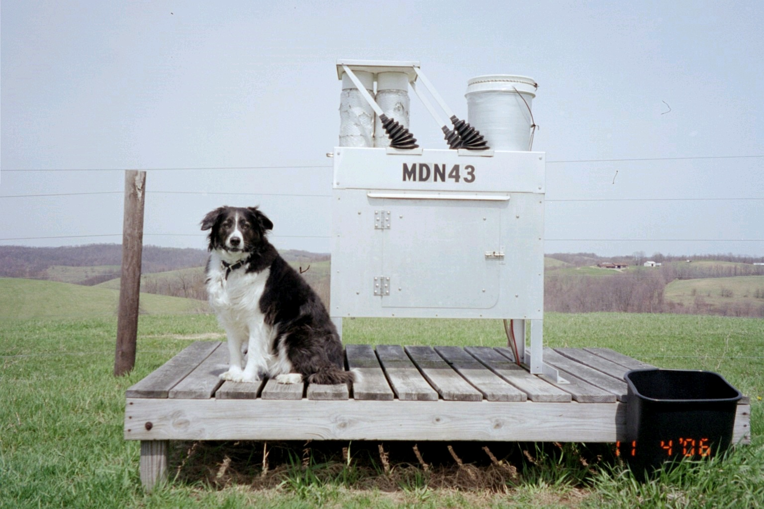
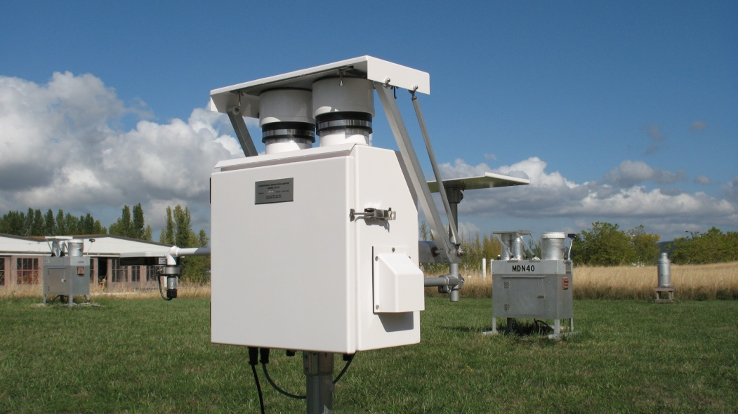
Thank you.

