Slide 1
Inertial Fusion with Incoherent Laser Drivers: StarDriver
Quantum Physics and Nuclear Engineering,
London, UK, March 14 2016
David Eimerl¹,Stan Skupsky², Andrew J.Schmitt³, Michael Campbell²
¹ EIMEX, Fairfield, CA, USA
²Laboratory for Laser Energetics, Rochester, NY, USA
³Naval Research Laboratory, Washington, DC

Slide 2
Talk Outline
Current problems in inertial confinement fusion
Incoherence as their solution : StarDriver
Spatial coherence and hydrodynamics
Bandwidth and laser-plasma instabilities
Laser Technology

Slide 3

Inertial confinement fusion uses a large laser (about 1 MegaJoule) to compress a small pellet of DT to burn.
Laser Ablation
For ignition: R/r~ 25
R
For energy gain of 50: R/r ~ 40
2r
Fusion energy production has significantly tighter tolerances than ignition.
Hot dense fuel
Fuel sphericity at burn is determined by the L-mode content of the drive

Slide 4
There are two legacy approaches to inertial confinement fusion: direct drive and indirect drive.
Direct Drive
Indirect Drive
SRS/SBS
2ω_{pe}/CBET
Wall motion
Time-dependent asymmetry
RT
UV/visible light
2ω_{pe},
CBET
RT
corona
Hohlraum
Thermal X-rays?
Control and perhaps elimination of instabilities may possibly be achieved using UV/visible radiation with (enough of) the highly incoherent features of thermal X-rays.

Slide 5
Incoherent drive is motivated by considerations of both target physics and laser science and engineering
Laser experiments in both indirect drive and direct drive ICF have exposed several types of instabilities that present significant challenges to achieving ignition.
(A) Hydrodynamic
Imprint, target manufacturing and ablation drive symmetry
(B) Laser-Plasma
Spatial interference pattern, spatial coherence (phase matching), laser coherence time
(C) Laser Technology
Cost, reliability

Slide 6
Comparison of Thermal Radiation with Laser Radiation
Thermal/X-ray:
Legacy Laser Systems:
Glass Lasers:
Wavelength ~ 350 nm Laser optical frequency ~ 10³ THz Bandwidth ~ 0.001 - 1THz
KrF Laser :
Wavelength ~ 248nm
Bandwidth ~ 5THz
Spatial coherence
length ~ 1000nm
Coherence time ~ 10⁻⁹ - 10⁻¹³ s
Mean Wavelength ~ 1nm
Bandwidth ~ 10⁶ THz
Spatial coherence
length ~ 2nm
Coherence time ~ 10⁻¹⁸ s

Slide 7
Talk Outline
Current problems in inertial confinement fusion
Incoherence as a key element: StarDriver
Spatial coherence and hydrodynamics
Bandwidth and laser-plasma instabilities
Laser Technology

Slide 8
Broad or ultra-broad bandwidth is key to controlling instabilities
Imprint and ablative drive pressure non-uniformities are significantly reduced by increasing the bandwidth of the laser drive.
Asymptotic smoothing levels <1% can be reached in a few hundred ps rather than nanoseconds, with 2% laser bandwidth at 351 nm.
One method to reduce or suppress the most significant laser-plasma instabilities is high laser bandwidth (2%-10%) and/or a high density of modes in k-space.
StarDriver offers both control of instabilities and extreme system flexibility by configuring the laser drive as many nearly monochromatic beamlets spanning a wide range in frequency.
Notes:
David we can use the intrinsic gain bandwidth of the lasers too (taking into account gain sat of course)
Refer to our Comments in plasma paper of years ago
8

Slide 9
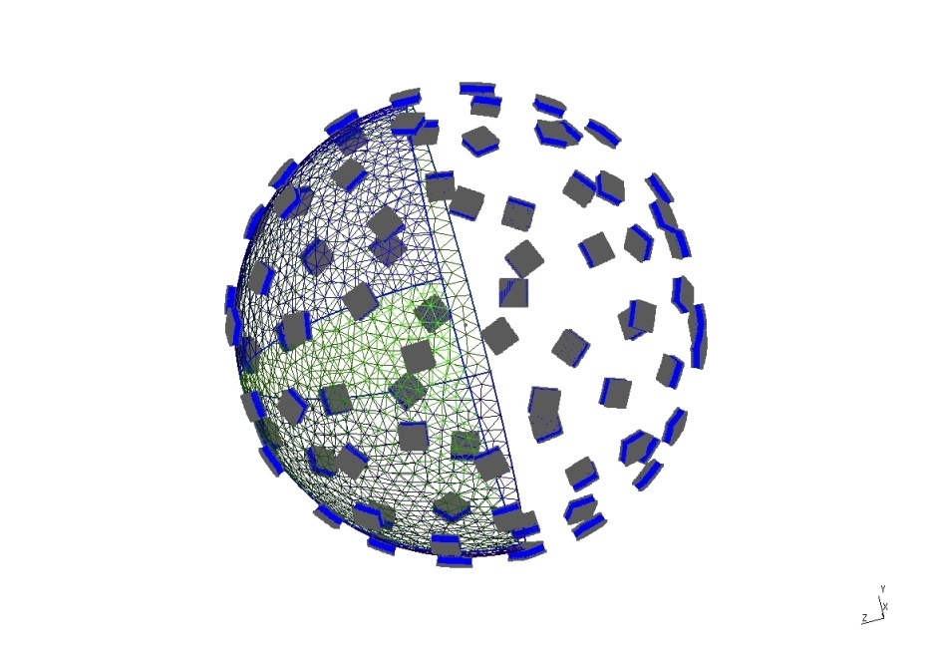
The StarDriver-class laser fusion concept
Target
In total, there are about 10,000 beamlets, sized at the sweet spot of the laser-optical technology, each one ~100Joules, 5-10cm in aperture, delivering ~1MJ on target
Each beamlet is nearly monochromatic
Each beamlet has a different wavelength from the others
The effective bandwidth of the laser drive is the bandwidth spanned by overlapping beamlets at the target.
Different focusing/timing strategies will enable time-dependent features in the drive such as zooming.
Effectively ~4π illumination
Grouped to allow collection of released energy
Notes:
David make not that the beams do not rely on any coherent tricks to reach the required intensity on target several times diffraction limit is good enough! yes
9

Slide 10
Talk Outline
Current problems in inertial confinement fusion
Incoherence as their solution : StarDriver
Spatial coherence and hydrodynamics
Bandwidth and laser-plasma instabilities
Laser Technology

Slide 11
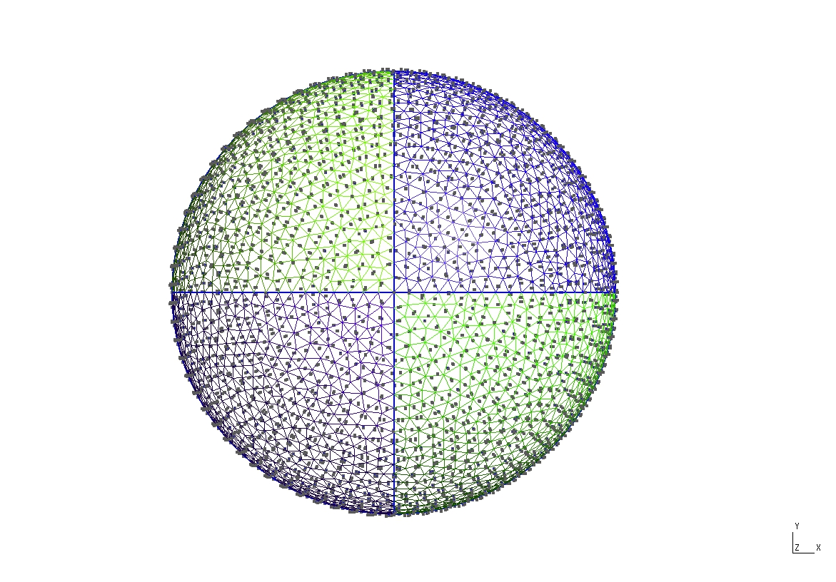
The many beamlets create together a 3D speckle pattern on the small pellet.
The speckle pattern, if static, causes the pellet to distort as it is compressed, because a static speckle pattern creates a persistent non-spherical pressure. With bandwidth, the speckle pattern “shimmers” thereby smoothing out the pressure on the pellet and enabling a truly spherical implosion.
The rms pressure variation is required to be < 1%

Slide 12
A hard sphere target model applies at very early times and avoids the complexities of propagation and absorption in the corona
Laser Spot 1/e point
Lab Z-axis
Z
Target radius
(x,y)
Beamlet Axis
R-z
e
X
s
o (out of plane)
Zoom = ratio of laser spot 1/e point to target (hard sphere) radius
P
Tangent Plane at P

Slide 13
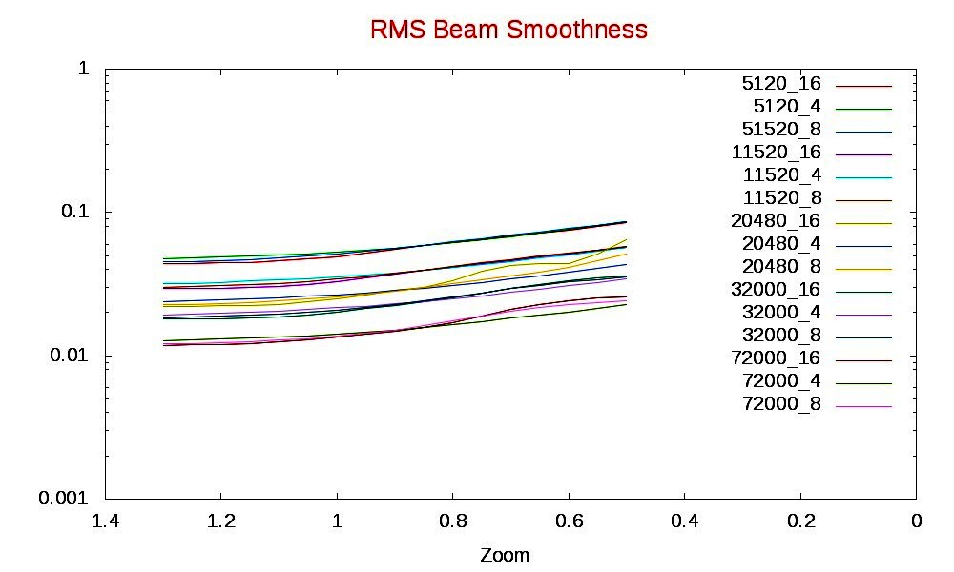
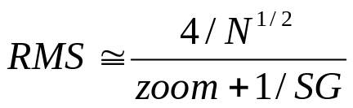
The asymptotic RMS beam smoothness (δI/I) is not low enough with monochromatic beams
>150,00 beamlets (without SSD) are needed to reach 1% asymptotic smoothness

Slide 14
2D SSD disperses each beamlet and adds many speckle patterns to the drive on target
~300GHz dispersed beam with many speckle patterns
Monochromatic beam
Gratings and modulators
Frequencies (GHz, at 3ω) 74.1 173.4
Phase Amplitudes 6.34 4.02
Fraction of target radius/mode) 0.01 0.01
2D SSD allows 5120 physical beamlets in a ported configuration to provide over 400,000 speckle patterns at the target. The initial rate of decrease of the RMS smoothness is given by the total drive bandwidth, but asymptotically the RMS smoothness approaches the limit controlled by the 2D SSD.

Slide 15
2D SSD enables asymptotic smoothness below 1% for 5120 beamlets with 2% and 10% bandwidth at 351nm

Slide 16
2D SSD improves the asymptotic low L-mode symmetry for zoom < 0.75
72000 beamlets
No SSD
5120 beamlets
No SSD
5120 beamlets
with SSD

Slide 17
Talk Outline
Current problems in inertial confinement fusion
Incoherence as their solution : StarDriver
Spatial coherence and hydrodynamics
Bandwidth and laser-plasma instabilities
Laser Technology

Slide 18
Corona Profiles in IFE-scale direct drive targets
Profile # | 1 | 2 | 3 | 4 | 5
Time | 9.5 | 10.12 | 11 | 12 | 13 | ns
Critical radius | 1.044 | 1.02 | 0.975 | 0.806 | 0.586 | mm
Total laser power | 57 | 186 | 248 | 247 | 245.8 | TW
Density/Critical density at maximum growth rate | 0.2456 | 0.2424 | 0.2395 | 0.2382 | 0.2359
Radius | 1.229 | 1.289 | 1.383 | 1.255 | 1.054 | mm
Gradient scale length | 256 | 318 | 481 | 473 | 477 | microns
Temperature | 1.919 | 3.352 | 4.604 | 5.132 | 6.16 | keV
Threshold Parameter | 103 | 259 | 369 | 396 | 469

Slide 19
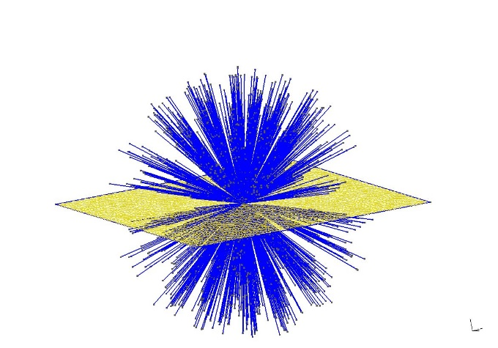
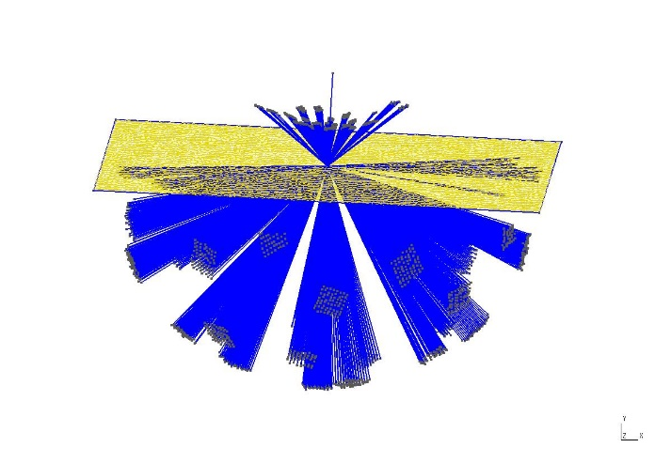
The spectrum of all the rays that penetrate to a depth in the corona forms a “k-space” of laser modes
About 4000 rays from 5120 beamlets penetrate to the ¼ critical surface and overlap there. The k-space is an approximation to a fully incoherent thermal distribution of light energy
Length proportional to ray intensity
Length proportional to ray frequency offset at (2% bandwidth)

Slide 20
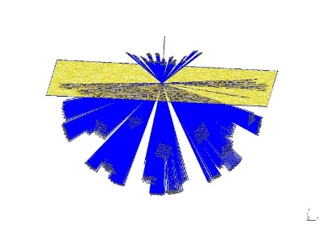

The 2ω_{pe} instability driven by an incoherent driver “k-space”
Conjugate k-space (ω_{L}<0)
Conjugate electron wave spectrum (ω<0)
Electron wave
+
+
Conjugate electron wave spectrum (ω<0)
positive feedback for original electron wave
k-space (ω_{L}>0)

Slide 21
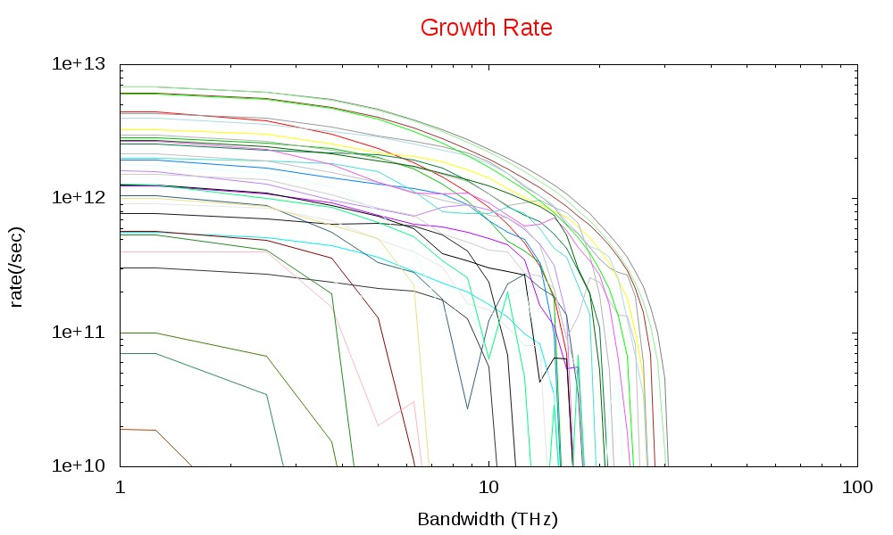
A system bandwidth of ~3% bandwidth suppresses the 2ω_{pe} instability in IFE-scale targets

Slide 22
The ultra-broad bandwidth of StarDriver enables the suppression of laser-plasma instabilities
Laser bandwidth required for LPI control:
2ω_{pe}: ~2–3%
SRS: ~1–3%
SBS: ≤0.1%
StarDriverTM vs Large Aperture Laser Systems:
LIFE bandwidth 0.02%
KrF bandwidth 0.25%
StarDriverTM bandwidth 1%-10%
The bandwidth of StarDriver can be as large as that of the range of available (and suitable) laser gain media. Bandwidth adequate to suppress LPI completely (i.e. ultra-broad bandwidth) appears feasible.
Notes:
Need to add something about CBET

Slide 23
Talk Outline
Current problems in inertial confinement fusion
Incoherence as their solution : StarDriver
Spatial coherence and hydrodynamics
Bandwidth and laser-plasma instabilities
Laser Technology

Slide 24
StarDriver laser innovation: legacy laser drivers are large systems with large optics, with the intent of minimizing cost.
NIF: 192 beams with 10 kJ of 0.35 µm light (>20 kJ of 1 µm light )
LMJ (France) : 220 beams
Omega(LLE): 60 beams
Nike(NRL,KrF): 56 beams
IFE concepts (e.g. LIFE) ~400 beams
The StarDriver concept is to replicate many beamlets: a “building block” approach. Each beamlet is ~100 joules, so that a fusion laser driver would contain thousands of beams, each optimized and independent.

Slide 25
StarDriver beamlets are small aperture: each beamline can be configured for maximum effectiveness using optical elements available today.
Rectangular Beam
Two out-of-plane mirrors
Bi-cylindrical lenses
Square Beam
Laser system
Beam Rotator
Beam reshaper
Beam positioning and
pointing optics
Debris Shield
Phase plate
Final Focusing lens
To Target
Square segments.
The phase plate is rotated to align its segments with the rotated beam profile
Frequency convertor
Rotated Square Beam
Notes:
Make comment that we build upon DOD , small aperture allows more ready cooling and variety of amplifier architectures and higher efficiency

Slide 26
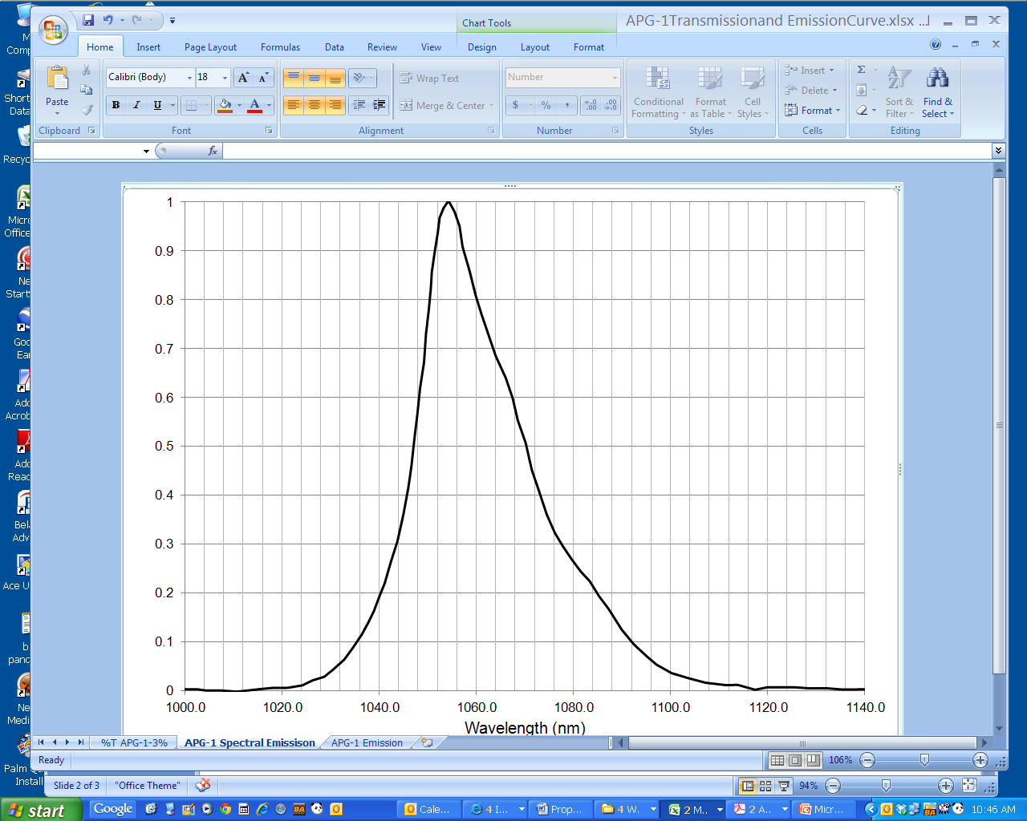
The StarDriver system bandwidth is effectively that of the (complete set of) gain media
For example, APG-1 Nd:glass by itself has a 1.6% effective bandwidth as a StarDriver Gain Material
Δλ ~ 17 nm (1.6% BW)
APG1 is a well-established average power material that enables a StarDriver with coherence time ~ 100fs
Small aperture enables ~full bandwidth to be exploited
Wavelength (nm)
Notes:
26

Slide 27
APG-1 as the laser medium should significantly reduce LPI and reduce RMS smoothness
Process | N_{e}/N_{crit} | T_{e} (keV) | (1 + 4(Δω/γ)²)⁻¹
CBET | 0.1 | 2-4 | .0003
Process | N_{e}/N_{crit} | T_{e} (keV) | γ¹⁵ (sec⁻¹) | γ¹³ (sec⁻¹) | γ¹⁵/Δω
2ω_{pe} | 0.25 | 2-6 | 10¹³ | 10¹² | 0.1
SBS | 0.1 | 2-6 | 3 x10¹² | 3 x10¹¹ | 0.03
Experiments/simulations will be required to demonstrate this potential
Notes:
CBET also reduced by “zooming the beams” different focusing at different times

Slide 28





A StarDriver bandwidth of ~ 3-4% can potentially be realized using several Nd:glass types*
(StarDriverTM Potential Operating Bandwidth)
Δλ_{eff} ~ 45 nm (4.2% bandwidth)
Δλ_{eff} ~ 30 nm (2.8% bandwidth)
Silica
Silicates
Phosphates
Fluorophosphates
Fluoroberyllates
1045
1050
1055
1060
1065
1070
1075
1080
1085
1090
Wavelength (nm)
*Data source: LLNL Report M095 Rev 2, V1 (1981)
Notes:
28

Slide 29

With StarDriver an ultra-broad bandwidth ~ 7% can possibly be realized using Nd* and Yb:glass types
(StarDriverTM Potential Operating Bandwidth)
Δλ_{eff} ~ 75 nm (7% bandwidth)
Nd:glasses
Yb:glasses?
1040
1050
1060
1070
1080
1090
1100
1110
1120
Wavelength (nm)
The Drive bandwidth can be further expanded by developing new laser host materials, and perhaps using other ions, as well as nonlinear optical methods (e.g. SRRS in D₂). Bandwidth greater than 10% appears to be potentially achievable by a combination of these approaches.
*Data source: LLNL Report M095 Rev 2, V1 (1981)
Notes:
Make comment that small aperture enables broader range of materials because no need to grow large boules or melts
29

Slide 30
With beamlets of 100J and 10Hz rep rate, and 1-10 ns pulsewidth, StarDriver enables participation from small companies in the IFE mission
The legacy glass laser drivers have a large aperture because that was believed to minimize the cost.
With new laser technology and advanced control systems, the cost of a 100J beamlet at 5cm aperture is no longer prohibitive.
Development of the beamlets is within the scope of smaller companies and universities
Beamlets are scaled to lie at the sweet spot of laser-optical technology, for minimum cost and maximum reliability.

Slide 31
Executive Summary
StarDriver is a new concept for a laser driver for ICF and IFE, comprising many (~10000) small aperture beamlets
It is capable of high bandwidth (2% today, possibly >10% in the future) and has extreme flexibility to tailor the laser drive to the target requirements.
An attractive configuration has 80 ports on the target chamber with 64 beamlets at each port. Each set of 64 beamlets is packaged as a bundle of lasers with common mechanical, thermal and electrical support. Each beam is individually monochromatic but with 2D SSD phase modulation.
Calculations of the laser drive in this configuration, (5120 physical beamlets with 2D SSD) show very rapid smoothing. The asymptotic smoothness (δI/I) of 0.00938 is reached in a few hundred ps, for improved control of RT and imprint.
For LPI, the bandwidth(2%) is adequate to suppress CBET. A bandwidth in the range of 2-3% is believed to suppress the 2ω_{pe} instability.

Slide 32
Summary : Benefits of incoherent drive
  Incoherent addition (beam smoothing): laser coupling improves
  Control of the most significant LPI
  Increased overall laser efficiency (optimized beam manipulations)
  Greater flexibility in tuning the drive features
  Industry / small company participation in ICF mission
  Advanced manufacturing and material options
  Less expensive development costs and time
  Technology spin-off applications for “unit cell” beamlet

Slide 33

Acknowledgements
In this work one of us (DE) received support from the University of Rochester, Laboratory for Laser Energetics, Rochester NY.
The contributions of the following colleagues are also gratefully acknowledged:
W.F.Krupke^{(a)}, Jason Zweiback^{(b)}, W.L.Kruer^{(c)}, John Marozas^{(d)} , J. Zuegel^{(d)}, J. Myatt^{(d),} J. Kelly^{(d)}, D. Froula^{(d)}, R.L.McCrory^{(d)}
WFK Lasers, Pleasanton CA
Logos Technologies, Washington DC
LLNL Retired
LLE
Notes:
Add Sandia for me (both logos and SNL)
33

