Slide 1




Fatty acid methyl esters (FAME) from oil seeds grown in arid lands
Taoufik Houachri, David Bolonio, Alberto Llamas, Ana-María Al-Lal, José Rodríguez-Fernández, Mohamed El Gazzah, Martin Mittelbach, Magín Lapuerta and Laureano Canoira

Slide 2
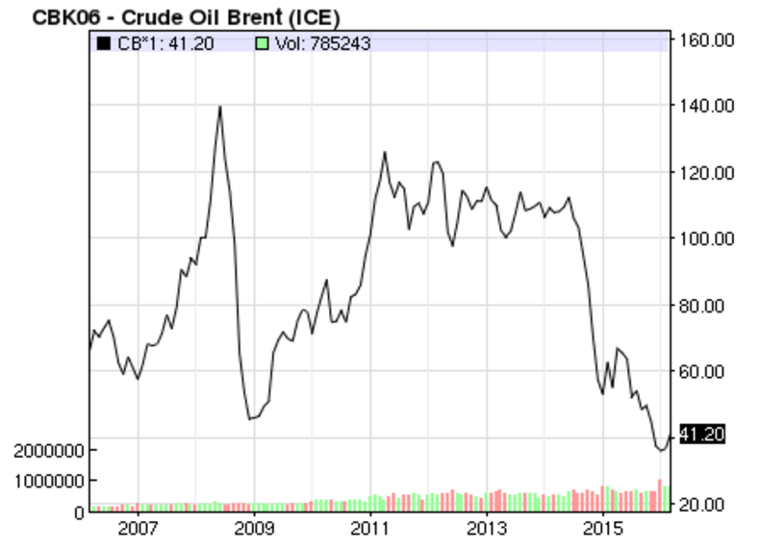
Sustainable Biofuels: a real alternative
The transport sector consumes about 30 % of the total energy use and 93 % of that consumption uses oil products, the least diversified sector
Price volatility
Energy independence

Slide 3
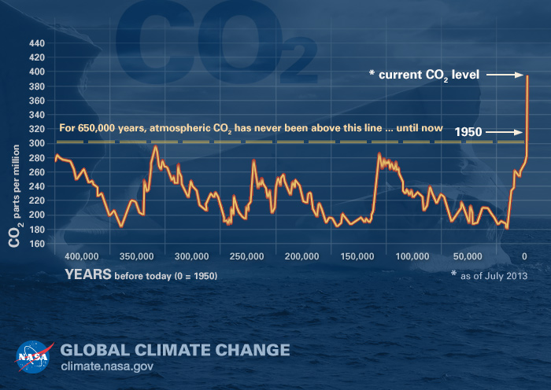
Sustainable Biofuels: a real alternative
CO₂ levels and climate change

Slide 4
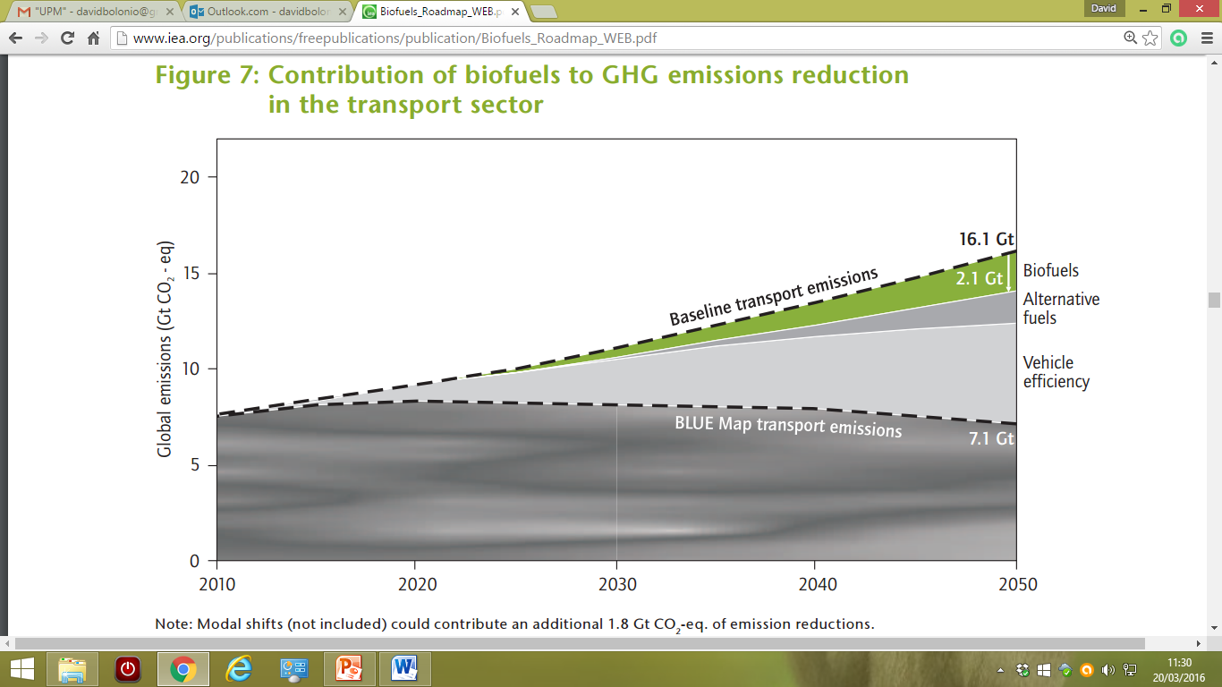
Sustainable Biofuels: a real alternative
The IEA “Biofuels for Transport” roadmap describes the steps necessary to reach approximately 760 Mtoe (32 EJ) in 2050, a share of 27 % of total transport fuel

Slide 5

Framework of the project
Previous studies
Partners
-Universidad Politécnica de Madrid
-Universidad de Castilla-La Mancha
-University of Graz
-Faculté des Sciences de Tunis
Rare species of potential oleaginous plants
Extraction of oil and analysis
Development of equations
Prediction of properties
Selection of the most promising species
Collection of bigger amounts
Direct measurement of properties

Slide 6
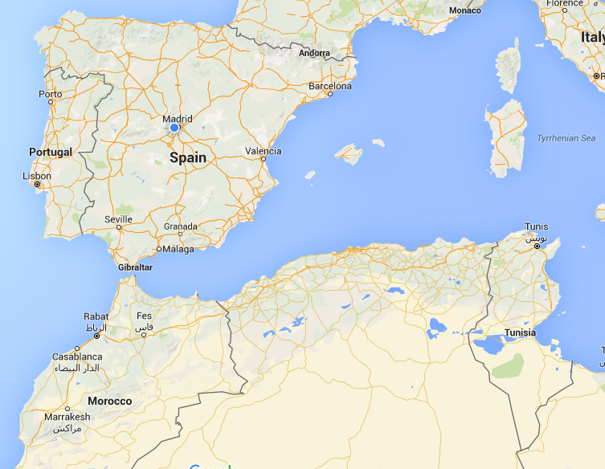
Tunisia
Tunisia’s climate similar to Spain
Hot-summer Mediterranean climate:
-Winters: mild temperatures with moderate rainfall
-Summers: hot and dry
-Temperatures in July and August can exceed 40 °C
Plants
Ibicella lutea
Onopordum nervosum
Peganum harmala
Silybum marianum
Smyrnium olusatrum
Solanum elaeagnifolium

Slide 7
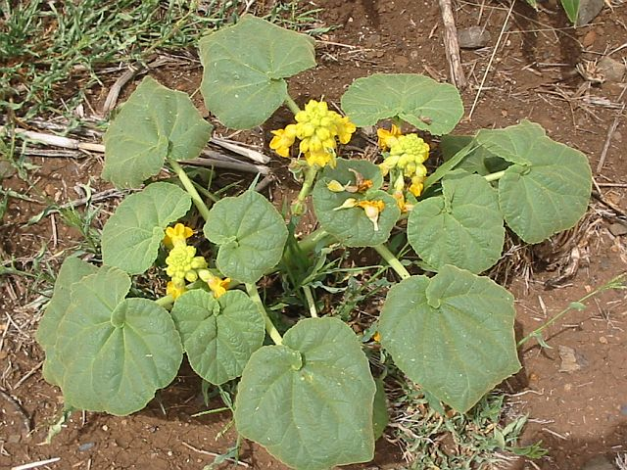
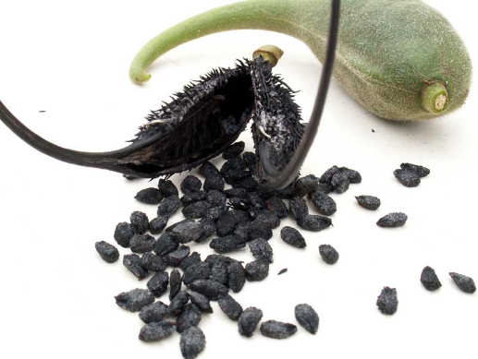
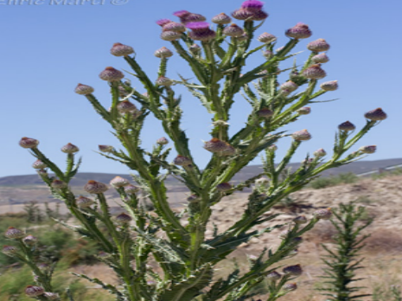
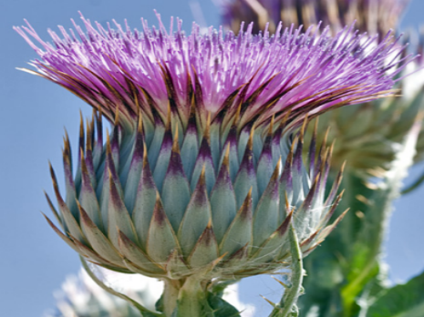
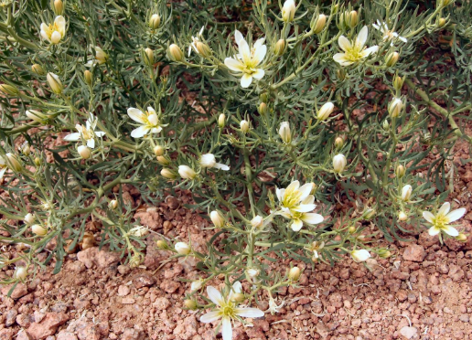
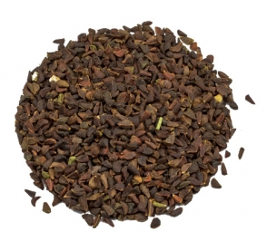
Plants
Ibicella lutea
Family: Martinyaceae
Devil’s claw
Native to South America
Onopordum nervosum
Family: Asteraceae
Cotton thistle
Native to the Iberian Peninsula
Peganum harmala
Family: Nitraceae
Sirian rue
Native to the Mediterranean area and South East Asia

Slide 8
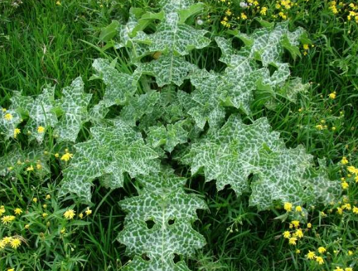
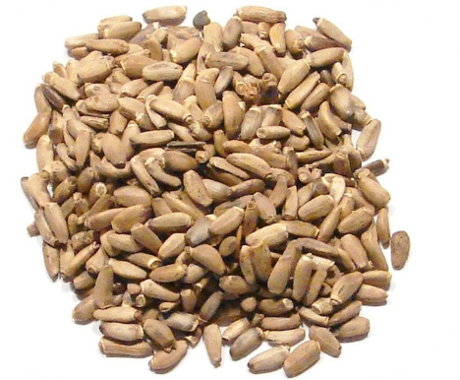
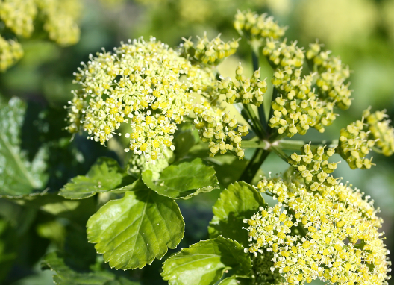
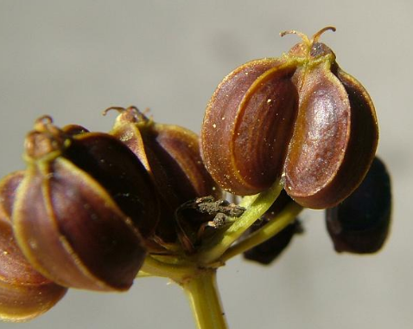
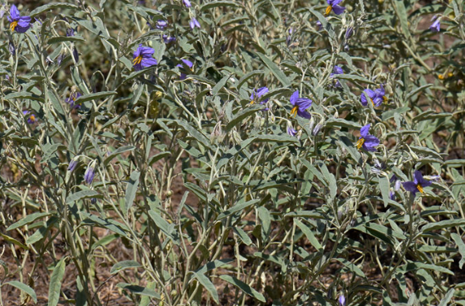
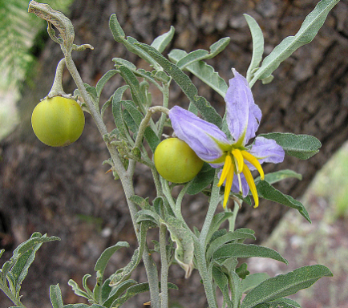
Plants
Silybum marianum
Family: Asteraceae
Cardus marianus
Native of Southern Europe through to Asia
Smyrnium olusatrum
Family: Apiaceae
Alexanders
Native from the Mediterranean area
Solanum elaeagnifolium
Family: Solanaceae
Silverleaf nightshade
Native from South and Central America

Slide 9
Experimental procedure
Seeds
Oil
Degumming
Soxhlet extraction
Hexane, 24 h
95 °C, 30 min
85 wt % orthophosphoric acid, 0.2 vol %
Purification
Transesterification
Esterification
60 °C, 3 h
Sodium methoxide 1 wt %
Methanol (molar ratio 6:1)
60 °C, 4 h
p-Toluensulfonic acid 0.5 wt % Methanol (molar ratio 6:1)
Analysis
Gas Chromatography (GC-FID)
Differential Scanning Calorimetry (DSC)

Slide 10
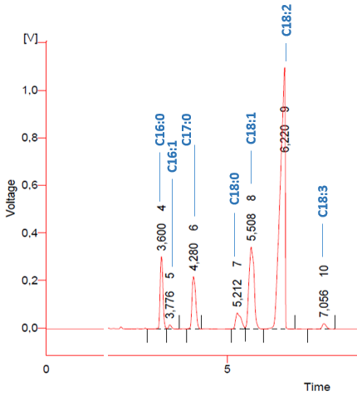
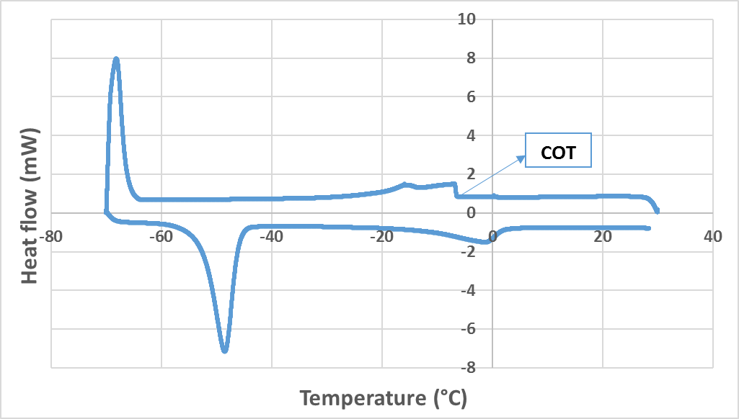
Analytical methods
GC-FID
DSC
FAME Solanum elaeagnifolium
COT: Crystallization Onset Temperature

Slide 11
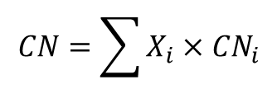
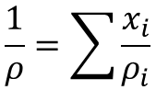
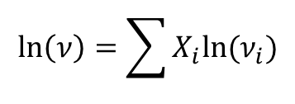
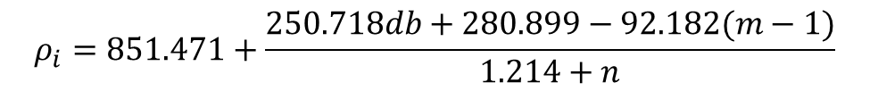
Prediction of properties
Cetane Number
$${CN}_{i}=−23.523+\left(2.366+6.299e^{−0.411db}\right)ne^{−0.018n}$$
$$CN=\sum{X_{i}×{CN}_{i}}$$
Density
$$ρ_{i}=851.471+\frac{250.718db+280.899−92.182(m−1)}{1.214+n}$$
$$\frac{1}{ρ}=\sum{\frac{x_{i}}{ρ_{i}}}$$
Kinematic viscosity
$$\ln\left(ν_{i}\right)=−12.503+2.496×\ln\left(W_{i}\right)−0.178×db$$
$$\ln\left(ν\right)=\sum{X_{i}ln⁡(ν_{i})}$$
Lapuerta, M., Rodríguez-Fernández, J., & Armas, O. (2010). Correlation for the estimation of the density of fatty acid esters fuels and its implications. A proposed biodiesel cetane index. Chemistry and physics of lipids, 163(7), 720-727.
Ramírez-Verduzco, L. F., Rodríguez-Rodríguez, J. E., & del Rayo Jaramillo-Jacob, A. (2012). Predicting cetane number, kinematic viscosity, density and higher heating value of biodiesel from its fatty acid methyl ester composition. Fuel, 91(1), 102-111.

Slide 12
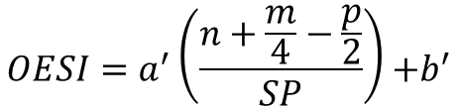
Prediction of properties
Lower heating value
$$LHV=\frac{HHV−213.65×H(wt.\%)−0.77×O(wt.\%)}{1000}$$
Higher heating value
$$HHV=\frac{{ΔHf}_{(g)}−m×{ΔHf}_{CO_{2}\left(g\right)}−p/2×{∆Hf}_{H_{2}O (g)}}{W}−{∆H}_{vap}$$
Smoke Point (OESI)
$$OESI=a^{′}\left(\frac{n+\frac{m}{4}−\frac{p}{2}}{SP}\right){+b}^{′}$$
Lapuerta, M., Rodríguez-Fernández, J., & Armas, O. (2010). Correlation for the estimation of the density of fatty acid esters fuels and its implications. A proposed biodiesel cetane index. Chemistry and physics of lipids, 163(7), 720-727.
Llamas, A., Lapuerta, M., Al-Lal, A. M., & Canoira, L. (2013). Oxygen Extended Sooting Index of FAME blends with aviation kerosene. Energy & Fuels, 27(11), 6815-6822.
Barrientos, E. J., Lapuerta, M., & Boehman, A. L. (2013). Group additivity in soot formation for the example of C-5 oxygenated hydrocarbon fuels. Combustion and Flame, 160(8), 1484-1498.

Slide 13




Prediction of properties
Oxidation stability (Induction Time)
$IT=0.214×P_{FAME}+0.671$
$$if 0<P_{FAME}<45$$
$IT=−0.234×U_{FAME}+22.318$
$$if 0<U_{FAME}≤84$$
Cold flow performance
-Cloud Point
$$CP=−0.576×U_{FAME}+48.255 if 0<U_{FAME}≤84$$
$$CP=5.5997+1.1014×COT$$
-Pour Point
$$PP=−0.626×U_{FAEE}+45.594 if 0<U_{FAME}≤84$$
$$PP=3.8151+1.2489×COT$$
-Cold Filter Plugging Point
$$CFPP=−0.561×U_{FAME}+43.967 if 0<U_{FAME}≤84$$
$$CFPP=1.7914+0.8629×COT$$
Sarin, A., Arora, R., Singh, N. P., Sarin, R., & Malhotra, R. K. (2010). Blends of biodiesels synthesized from non-edible and edible oils: influence on the OS (oxidation stability). Energy, 35(8), 3449-3453.
Dunn, R. O. (1999). Thermal analysis of alternative diesel fuels from vegetable oils. Journal of the American Oil Chemists' Society, 76(1), 109-115.

Slide 14
Results
Composition and crystallization onset temperature
 | C10:0 | C14:0 | C15:0 | C16:0 | C16:1 | C18:0 | C18:1 | C18:2 | C18:3 | C20:0 | Fatty acid ester content (%wt.) |  | COT (°C)
Ibicella lutea |  |  |  | 9.10 | 0.33 | 2.33 | 52.36 | 35.88 |  |  | 97.90 |  | -0.52
Onopordum nervosum |  |  |  | 9.08 |  | 3.56 | 27.02 | 60.34 |  |  | 99.6 |  | 8.39
Peganum harmala |  |  |  | 4.02 |  | 2.57 | 26.93 | 53.62 | 2.44 | 1.27 | 63.13 |  | 3.15
Silybum marianum |  | 0.08 | 0.02 | 9.44 | 0.07 | 7.11 | 25.48 | 49.26 | 0.19 | 3.95 | 97.63 |  | 10.80
Smyrnium olusatrum | 2.36 | 0.16 | 0.07 | 5.26 | 0.26 | 1.07 | 74.14 | 14.1 | 0.48 | 0.25 | 60.63 |  | -26.85
Solanum elaeagnifolium |  |  |  | 9.86 | 0.59 | 4.24 | 20.92 | 63.32 | 1.07 |  | 97.9 |  | -5.50

Slide 15
Results
Estimated properties
FAME | Cetane number | Density at 15 °C (kg/m³) | Kinematic viscosity at 40 °C (mm²/s) | LHV (MJ/kg) | OESI | Induction time (h) | CFPP (°C)
Ibicella lutea | 57.4 | 882.4 | 4.19 | 37.35 | 8.01 | 2.6 | -3.2
Onopordum nervosum | 53.3 | 885.4 | 4.00 | 37.31 | 8.26 | 2.6 | -3.2
Peganum harmala | 49.1 | 890.1 | 3.85 | 37.38 | 8.98 | 1.5 | -5.8
Silybum marianum | 58.8 | 882.6 | 4.27 | 37.39 | 8.14 | 2.7 | -3.0
Smyrnium olusatrum | 60.0 | 880.3 | 4.29 | 37.33 | 7.72 | 1.8 | -5.1
Solanum elaeagnifolium | 52.7 | 885.9 | 3.95 | 37.3 | 8.29 | 2.8 | -2.8
Standard EN14214
Lower limit | 51 | 860 | 3.50 |  |  | 8 | country specific
Upper limit | - | 900 | 5.00 |  |  | -

Slide 16
Conclusions
1
Seeds from six oleaginous plants native (Tunisia)
FAME production
GC-FID: Ester profiles
DSC: COT values
Oil extraction
2
Cetane number, density and viscosity values
EN14214
3
Poor but aceptable in warm climate countries
Cold flow performance
4
Oxidation stability
Need of additives
Tons of oil per hectare?
Intensive farming
5
Future studies
Sustainable biofuel source?
Life cycle analysis

Slide 17

Thank you for your attention
Questions?
David Bolonio
david.bolonio@upm.es
Universidad Politénica de Madrid (Spain)

