Slide 1
In Pursuit of the Unknown: Standardizing Endpoint Assays for Evaluating Complex Immunological Signatures
David A. Hokey, Ph.D.
Sr. Director of Immunology & Animal Studies

Slide 2
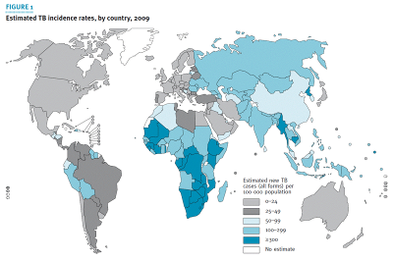
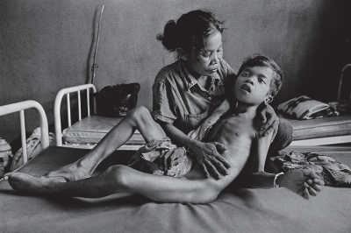
Tuberculosis: a devastating epidemic
8.7 million new cases and 1.4 million deaths in 2011
WHO declared global public health emergency
Over 2 billion people or 1/3 of the world’s population is infected with M. tuberculosis
TB/HIV co-epidemic – TB is the leading cause of death for people living with HIV
MDR/XDR/TDR on the rise
Photo by James Nachtwey xdrtb.org

Slide 3

Key challenges in vaccine development
Unknown correlation between animal models and human protection
Animal challenge studies are long and expensive
Lack of immune correlate of protection
Optimal antigen identification unclear
Protective human immunity not well understood: ~10% develop active disease
Very large sample sizes required for Phase III efficacy studies

Slide 4

Progress
We have identified immune responses that help to control TB
  CD4+ T cells (from HIV+ patients)
  CD8+ T cells (NHP models)
  IFN-γ pathways (human deficiencies)
  TNF (TNF blocking antibodies)
Refining animal models
Expanding immunological assays to look at more facets of the immune response (looking beyond Th1)
Expansion of the clinical pipeline to test novel platforms and gain more knowledge on human immune responses and their impact on human disease

Slide 5
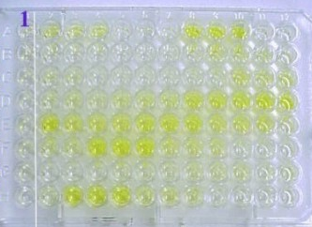
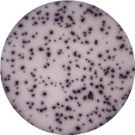


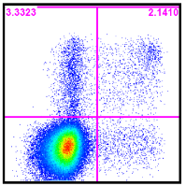
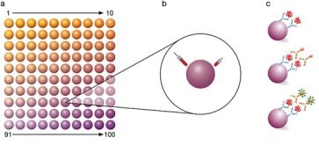
Immune assays for measuring responses to TB vaccines
Simple assays (measuring single variables)
    ELISA (cytokines, antibodies, etc)
    ELISpot (cytokines, B cell responses)
    Western blot (antibodies)
    Proliferation assays
    MGIA
Complex assays
    Tetramers
    ICS (whole blood or PBMC ICS by flow cytometry)
    Multiplex (measure multiple cytokines or antibodies)

Slide 6
IFN-γ ELISpot
Our ELISpot assay is based on the assay currently in use by the HVTN
ELISpot is a simple assay that is relatively easy to qualify and validate
Ideal as an immunogenicity assay in efficacy trials
Highly sensitive
Extremely limited assessment of immune responses compared to other assays such as ICS

Slide 7
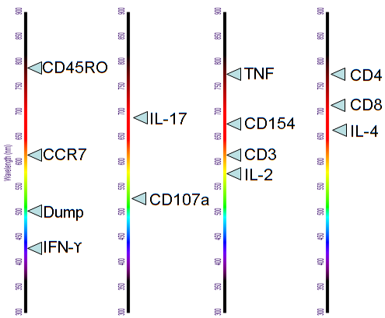
13-color ICS assay
Purpose | Marker
Dump | Viability
 | CD14
 | CD19
Lineage | CD3
 | CD4
 | CD8
Degranulation | CD107a
B cell help | CD154
Th1 cytokines | IFN-γ
 | IL-2
 | TNF
Th17 cytokine | IL-17
Th22 cytokine | IL-22
Memory | CCR7
 | CD45RO
The Panel
Violet
407nm
Blue
488nm
Green
532nm
Red
640nm

Slide 8
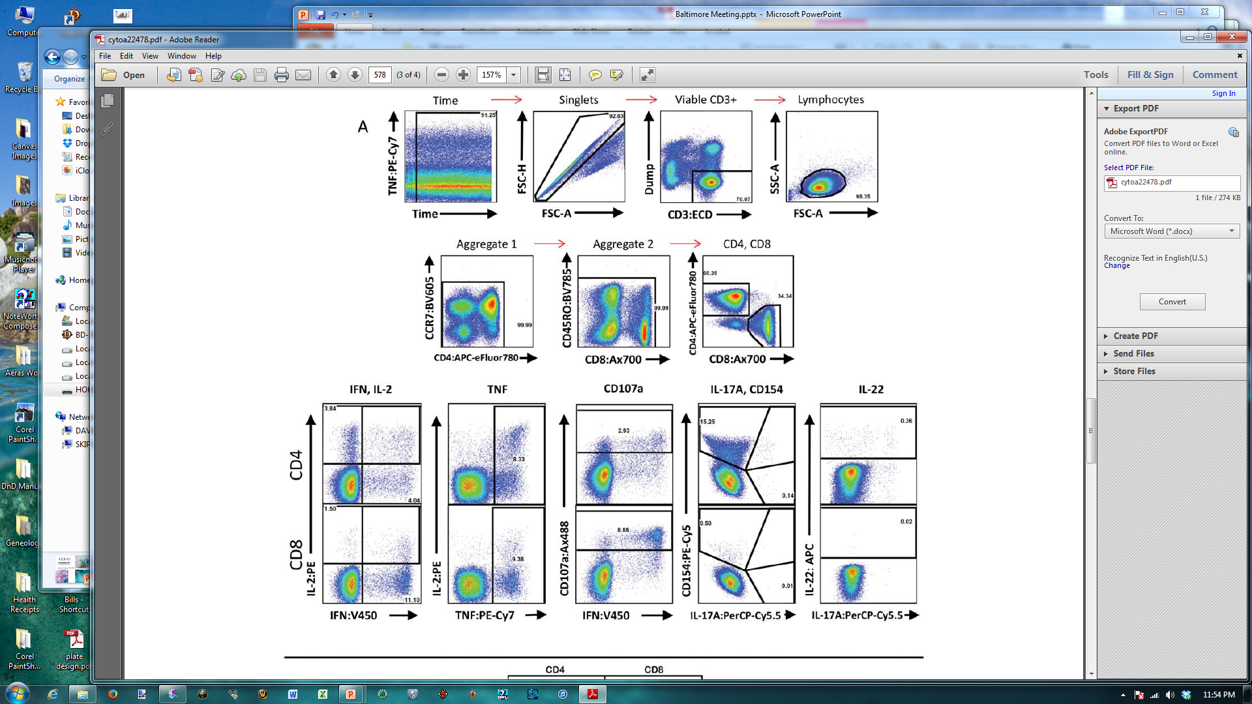
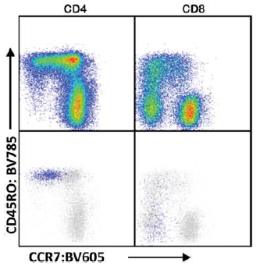
ICS assay
OMIP-22
A. Graves et al. Cytometry Part A. 2014
How do you adequately control such a complex assay?

Slide 9
Strategy for assay controls
We obtained leukapheresis samples from CMV-reactive donors for use as assay controls in the IFN-γ ELISpot
Each leukapheresis sample generated 400-700 vials of PBMC (25 x 10e6 cells per vial)
Obtained every 25th vial from the series for evaluation of stability of the first leukapheresis sample following the freezing process

Slide 10
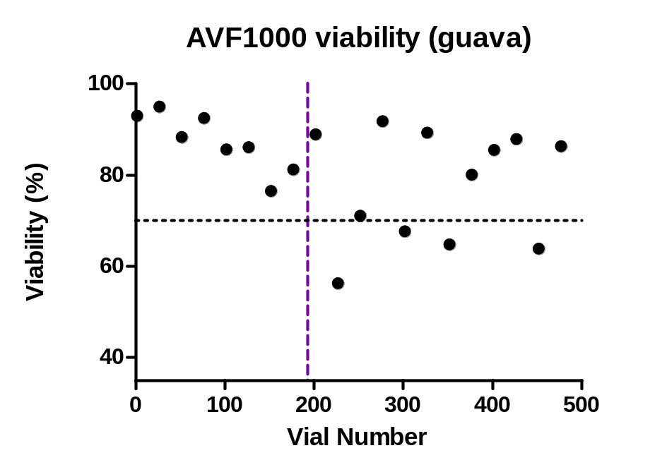
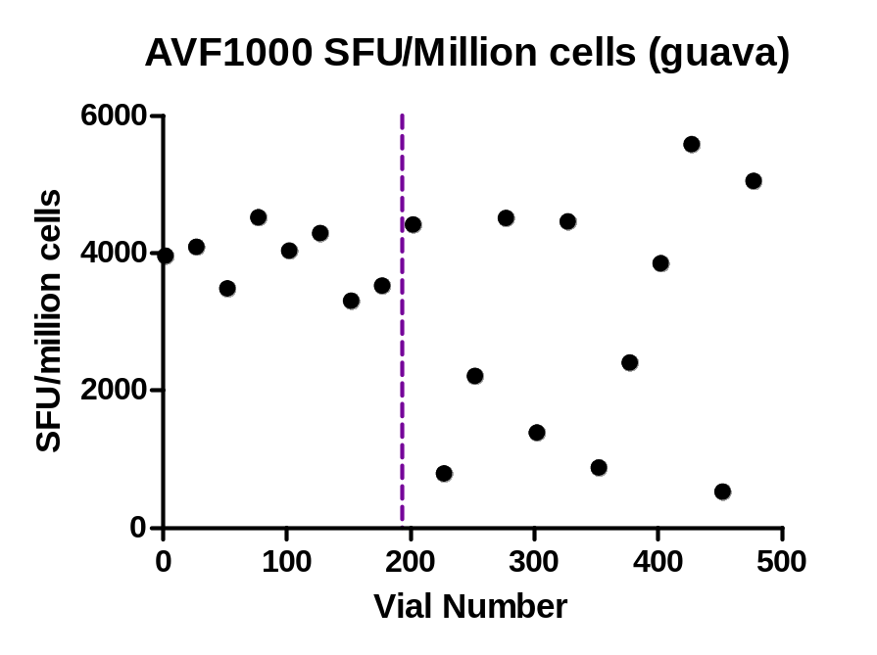
Trending of the first leukapheresis sample
We started freezing using Cool Cells, but then had to switch to Mr. Frosty containers (indicated below by the dotted line)
There was a clear issue with the Mr. Frosty containers – subsequently we obtained sufficient Cool Cells to freeze an entire series of vials

Slide 11
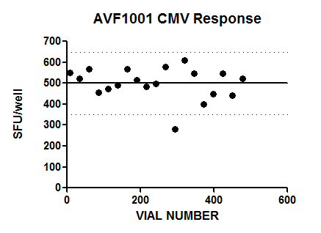
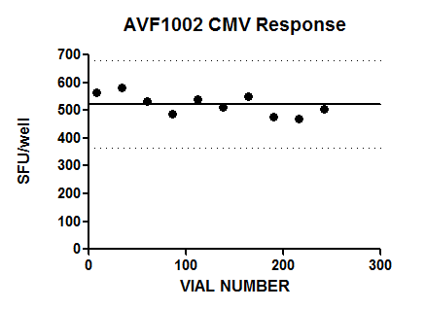
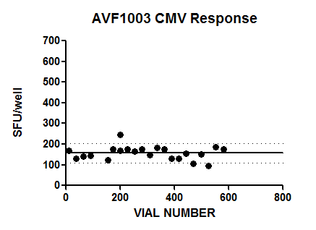
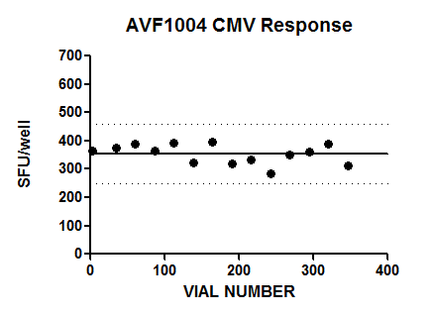
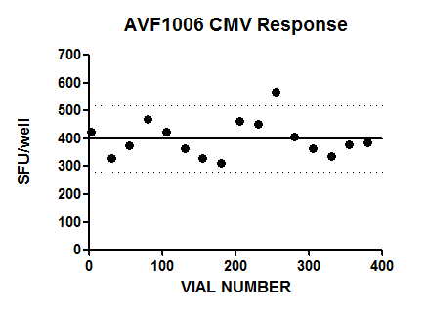
Subsequent samples with Cool Cells
Following the first donor, more Cool Cells were obtained and we collected more leukapheresis samples which were then trended

Slide 12
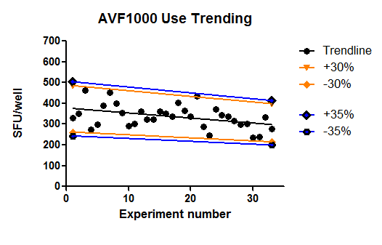
Long-term trending
The first donor has been used in multiple assays for more than a year
We have examined the trending of this donor as a factor of time

Slide 13
Addressing the downward trend
The primary concern with the trend was that the assay may be losing sensitivity over time
In order to assess whether the observed loss of response is due to the donor sample or possibly due to an issue with the sample storage or freezing, we examined the responses that have been observed in the ICS assay over the same time period and observed a very similar trend

Slide 14
Conclusions regarding assay stability
Based on the consistency of the data between two different assays, we believe that the observed decline is due to a loss in functionality of the control donor rather than a decrease in assay sensitivity
In addition to the experiments shown, we have also generated data with other laboratories comparing assay results and obtained strikingly consistent data
The loss in functionality of the control donor is likely due to either the length of time the cells were in freezing solution during the freezing process or due to long-term storage in LN2 (or both!)
Despite the loss of function, real-time trending allows for detection of assay fluctuations that call into question the validity of the generated data (we currently use +/- 30% for cellular assays)

Slide 15
Assay performance
Both the ELISpot and ICS assays have been used in multiple clinical trials
  Protein/adjuvant combinations
  Viral vectors
    Adenovirus
    MVA
  Recombinant mycobacteria
  Mycobacterial lysates (soon!)
Generally, responses are low in the TB field
The largest responses seen to date was generated using a heterologous prime/boost regimen

Slide 16

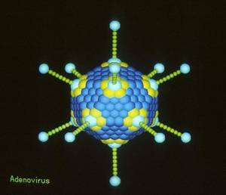

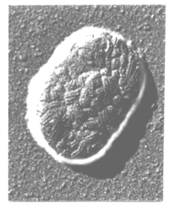
AERAS-402/MVA85A
AERAS-402
  Adenovirus serotype 35 (Ad35) vaccine
  Encodes a fusion protein of Ag85A, Ag85B, and TB10.4
  Dominant response is CD8+ T cells largely against Ag85B
MVA85A
  Modified Vaccinia Ankara (MVA) vector
  Encodes Ag85A
  Dominant response is CD4+ T cells against Ag85A
Both have been shown to be safe and immunogenic in adults with lower immunogenicity in infants

Slide 17
AERAS-402/MVA85A study design
Group | Injection #1 | Injection #2 | Injection #3 | Total
1 | AERAS-402 1 x 10¹¹ vp | AERAS-402 1 x 10¹¹ vp | MVA85A 1 x 10⁸ pfu | 15
2 | AERAS-402 1 x 10¹¹ vp | MVA85A 1 x 10⁸ pfu | N/A | 15
Total Number of Subjects |  |  |  | 30
Group 1: AAM (Vaccinated on days 0, 28, and 119)
Group 2: AM (Vaccinated on days 0 and 56)

Slide 18
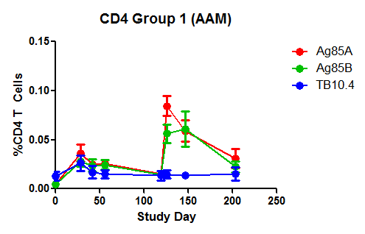
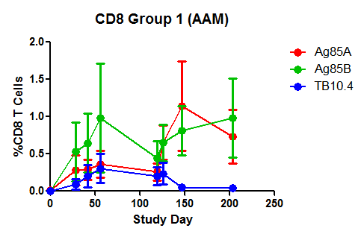
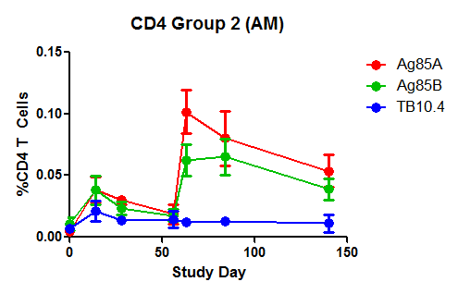
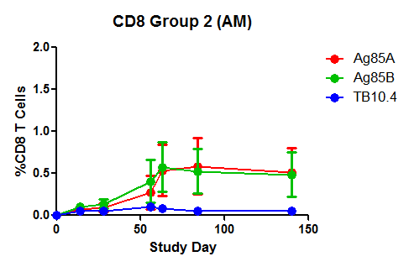
AERAS-402/MVA85A
(Vaccinated 0, 28, and 119)
(Vaccinated 0, 28, and 119)
A
A
M
A
A
M
(Vaccinated 0, 56)
(Vaccinated 0, 56)
A
M
A
M

Slide 19
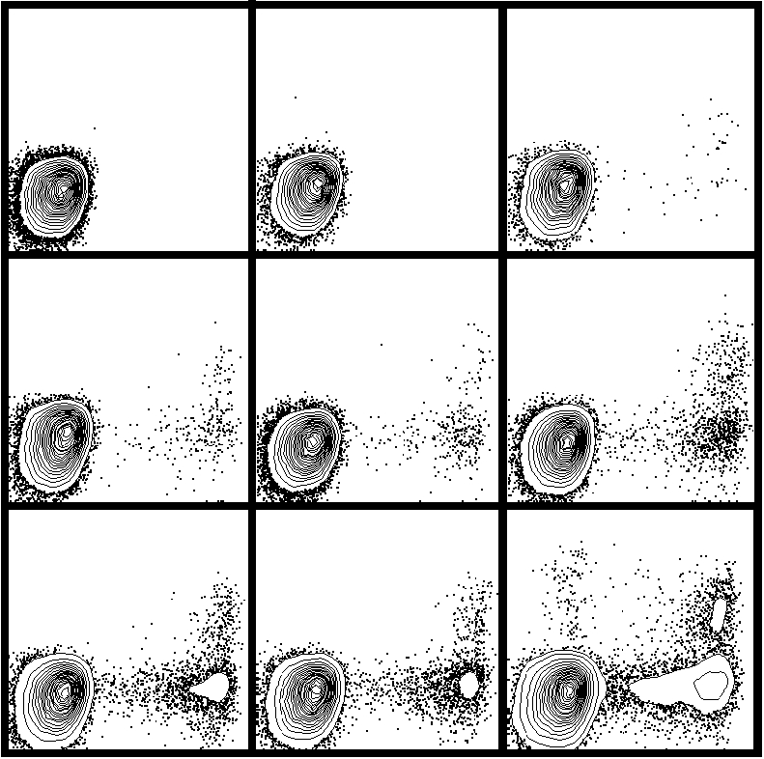
CD8+ Ag85A responses (AAM group)
DMSO
D 0
D 28
AERAS-402 on days 0 and 28
D 56
D 119
D 126
MVA85A on day 119
D 147 (4.5%)
D 203
SEB
Largest vaccine-induced responses in TB uninfected adults observed to date
IL-2
IFN-γ

Slide 20
Aeras global partners
Academia
Oxford University, United Kingdom
South African TB Vaccine Initiative (SATVI), South Africa
St. Johns Research Institute, India
Makerere University, Uganda
Kenya Medical Research Institute, Kenya
Karolinska Institute, Sweden
Wuhan University, China
Albert Einstein College of Medicine, U.S.
Arizona State University, U.S.
Biomedical Primate Research Center, the Netherlands
Boston University
Case Western Reserve University, U.S.
Central Institute for Tuberculosis, Russia
Centre for International Health, University of Bergen, Norway
Colorado State University, U.S.
Dartmouth University
Emory University, U.S.
Food and Drug Administration, U.S.
Foundation for Innovative New Diagnostics (FIND), Switzerland
Harvard University, U.S.
International AIDS Vaccine Initiative (IAVI), U.S.
Johns Hopkins University, U.S.
KNCV Tuberculosis Foundation, the Netherlands
Leiden University Medical Center, the Netherlands
Life Science Research Israel (LSRI), Israel
Max Planck Institute for Infection Biology, Germany
McGill University, Canada
National Cancer Institute (NKI), the Netherlands
New York University, U.S.
Oregon Health Sciences University, U.S.
Public Health Research Institute, & UMDNJ U.S.
Stanford University, U.S.
Saint Louis University., U.S.
University of Bergen, Norway
University of California-Davis, U.S.
University of California-San Francisco, U.S.
University of Maryland, College Park, U.S.
University of Pennsylvania, U.S.
University of Tampere, Finland
University of Wales, United Kingdom
Vanderbilt University., U.S.
Walter Reed Army Institute of Research, U.S.
Foundations/
Governments/
NGOs
Bill & Melinda Gates Foundation, U.S.
Ministry of Foreign Affairs of Denmark
The Netherlands Ministry of Foreign Affairs, the Netherlands
Centers for Disease Control and Prevention (CDC), U.S.
Fogarty International Center and NIAID, National Institutes of Health, U.S.
Research Council of Norway, Norway
AIDS Fondet, Denmark
Cambodian Health Committee, Cambodia
European and Developing Countries Clinical Trials Partnership (EDCTP), European Commission
LHL/ The Norwegian Association of Heart and Lung Patients, Norway
Planeta Salud, Spain
Manhiça Health Research Centre, Mozambique
Medicine in Need (MEND), U.S.
Stop TB Partnership, Switzerland
TB-Alert, United Kingdom
Tuberculosis Vaccine Initiative (TBVI), Netherlands
Wellcome Trust, United Kingdom
Aeras
Foundations/Government/NGOs
Academia
Industry
Industry
GlaxoSmithKline Biologicals, Belgium
Crucell, the Netherlands
Statens Serum Institute, Denmark
ImmunoBiology, United Kingdom
Wuhan Institute of Biological Products, China
Serum Institute, India
Thymed, Germany
Alphalyse, Denmark
Japan BCG Laboratory, Japan
Korean Institute of TB, Korea
Cyncron, Denmark
Cellestis, Australia
Immune Solutions, New Zealand
Larimer, U.S.
Sanofi Pasteur, France
Smittskyddsinstitutet, Sweden
BIOCON, U.S.
Emergent BioSolutions, U.S.
Intercell, Austria
Spring Valley Laboratories, U.S.
Statens Serum Institute, Denmark
Bioland, Korea

Slide 21








Aeras Gratefully Acknowledges the Volunteers in Our Clinical Trials, Hard Work of Many Partners, and Support of the Following Major Donors:
Netherlands Ministry of Foreign Affairs
US Food and Drug Administration

