Slide 1
About OMICS Group
OMICS Group International is an amalgamation of Open Access publications and worldwide international science conferences and events. Established in the year 2007 with the sole aim of making the information on Sciences and technology ‘Open Access’, OMICS Group publishes 400 online open access scholarly journals in all aspects of Science, Engineering, Management and Technology journals. OMICS Group has been instrumental in taking the knowledge on Science & technology to the doorsteps of ordinary men and women. Research Scholars, Students, Libraries, Educational Institutions, Research centers and the industry are main stakeholders that benefitted greatly from this knowledge dissemination. OMICS Group also organizes 300 International conferences annually across the globe, where knowledge transfer takes place through debates, round table discussions, poster presentations, workshops, symposia and exhibitions.

Slide 2
About OMICS Group Conferences
OMICS Group International is a pioneer and leading science event organizer, which publishes around 400 open access journals and conducts over 300 Medical, Clinical, Engineering, Life Sciences, Phrama scientific conferences all over the globe annually with the support of more than 1000 scientific associations and 30,000 editorial board members and 3.5 million followers to its credit.
OMICS Group has organized 500 conferences, workshops and national symposiums across the major cities including San Francisco, Las Vegas, San Antonio, Omaha, Orlando, Raleigh, Santa Clara, Chicago, Philadelphia, Baltimore, United Kingdom, Valencia, Dubai, Beijing, Hyderabad, Bengaluru and Mumbai.

Slide 3
Nutrition
&
HAIR & SCALP DIALOGUE
What are we eating?
Why are we losing HAIR?

Slide 4
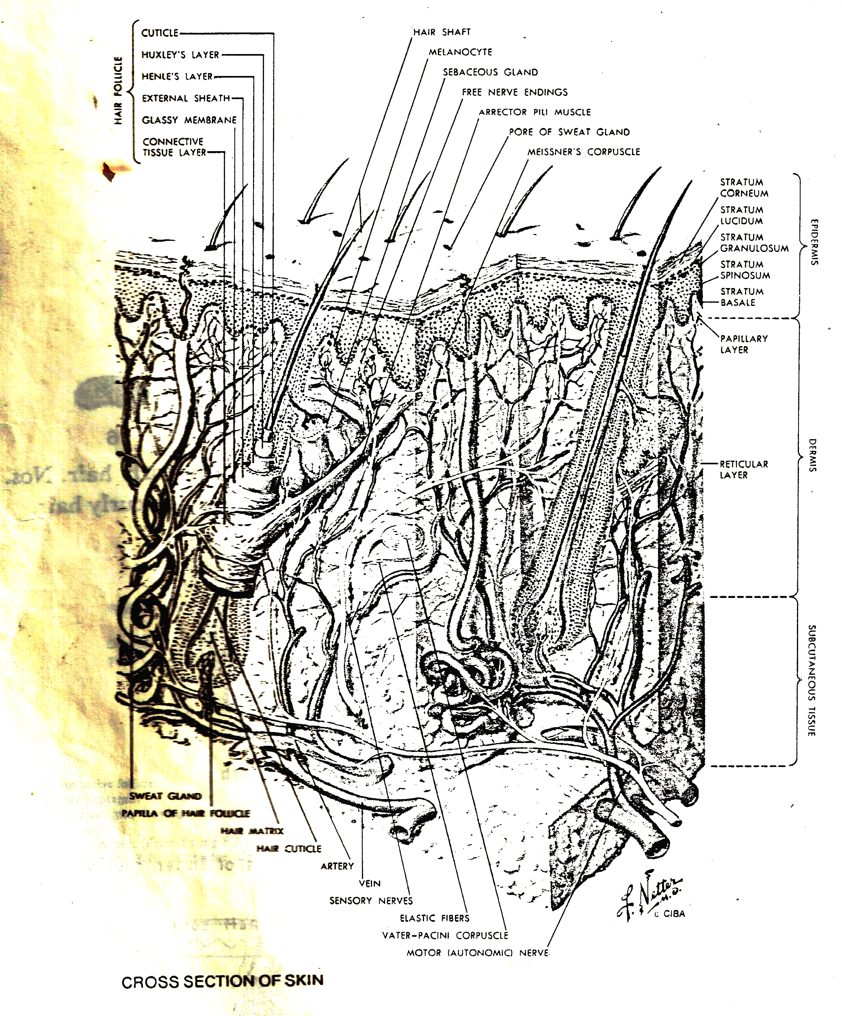

Slide 5
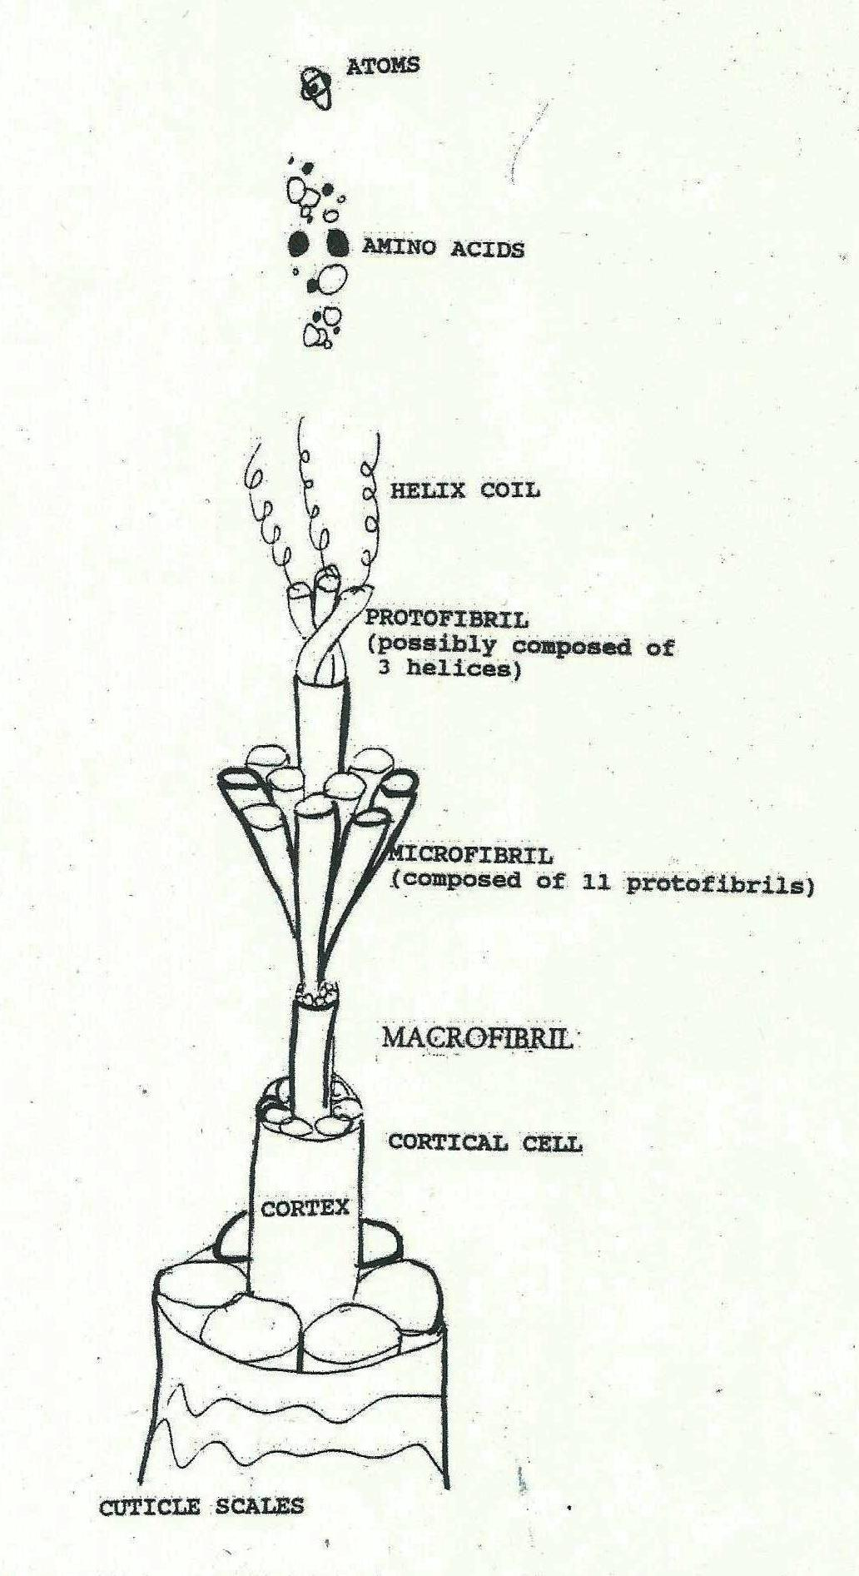

Slide 6
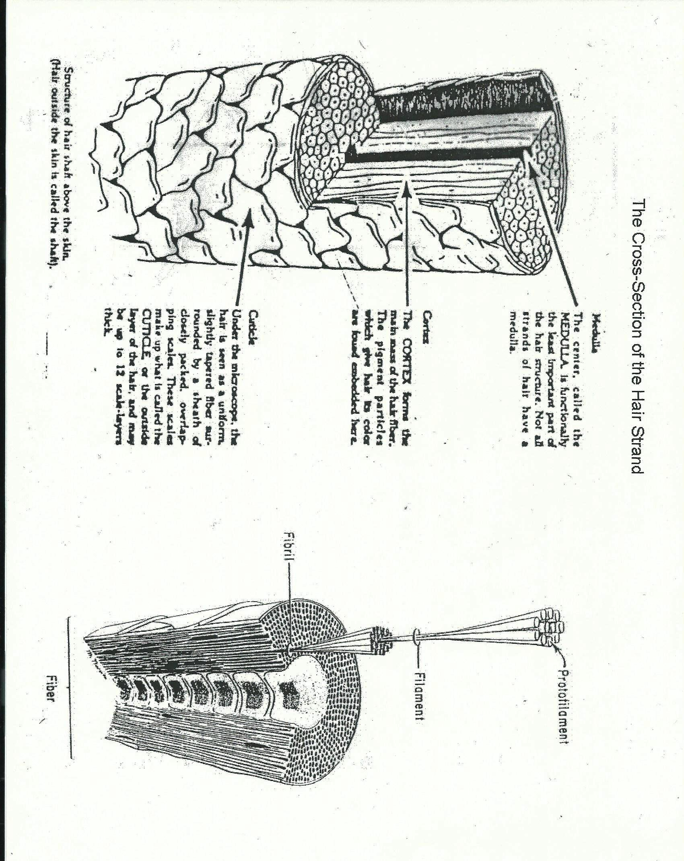

Slide 7
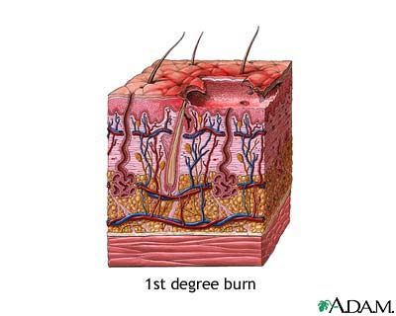

Slide 8
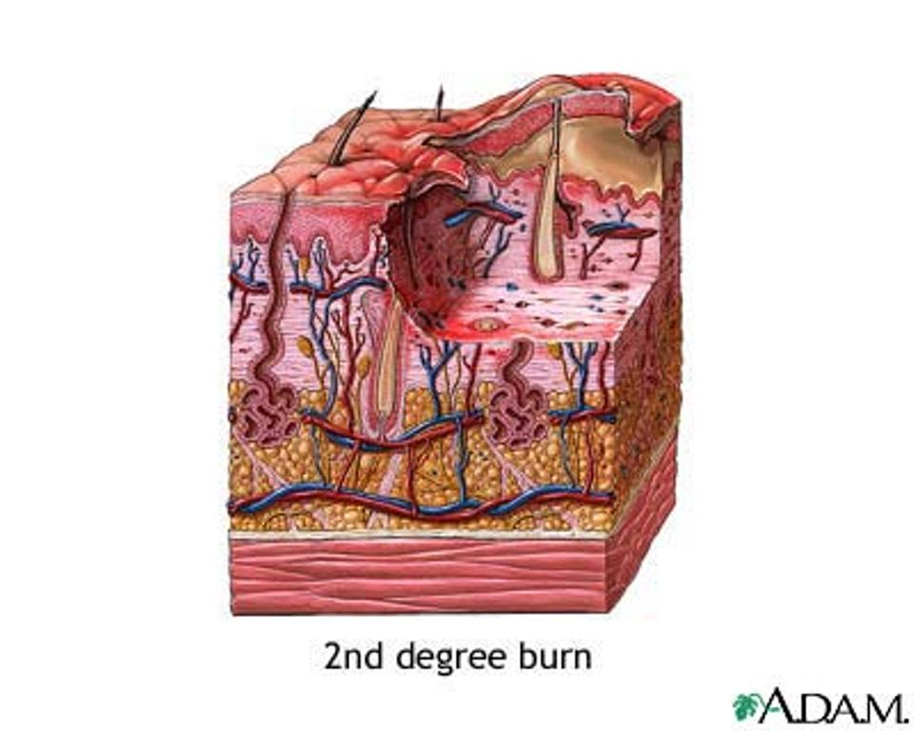

Slide 9
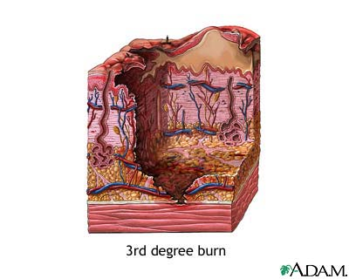

Slide 10
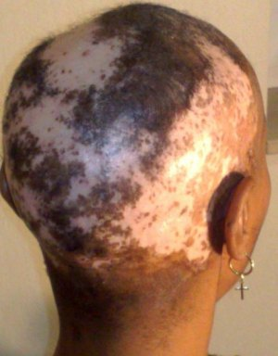

Slide 11
Did You Know?
There are 300,000 hairs on the human scalp.
Hair on the scalp grows approximately a half inch each month.
The shape of the hair follicle determines whether a person has straight or curly hair.
On average, healthy hair loss per day is between 100 and 150 hairs.
Hair, which is made up of dead cells filled with keratin (a protein found in nails and outer skin), grows from small pits in the dermis (the middle layer of skin just below the surface or epidermis). The pits, which are called hair follicles, cover most of the body, with certain areas having a heavier concentration than others. For example, the scalp has many hair follicles, while the soles of the feet have none.
Hair problems may be due to cosmetic causes, such as excessive shampooing and blow-drying, or due to underlying diseases, such as thyroid problems.

Slide 12
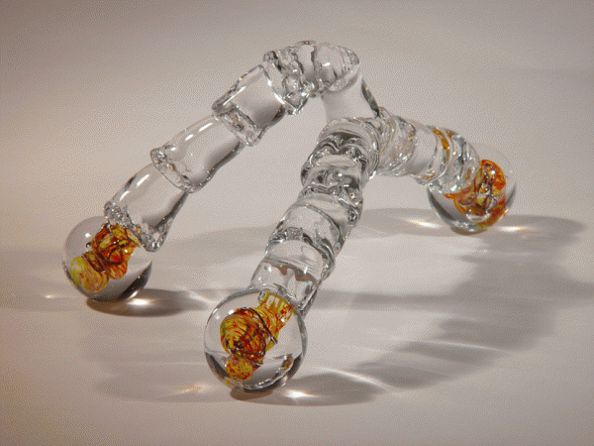
An example of an un-pigmented hair strand

Slide 13
The five staples are:
Starch
Carbohydrates
Protein
Fats
Dairy

Slide 14
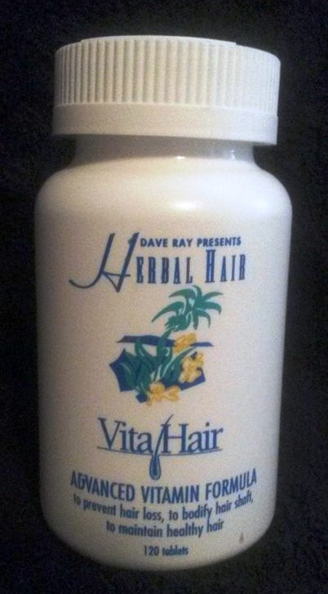
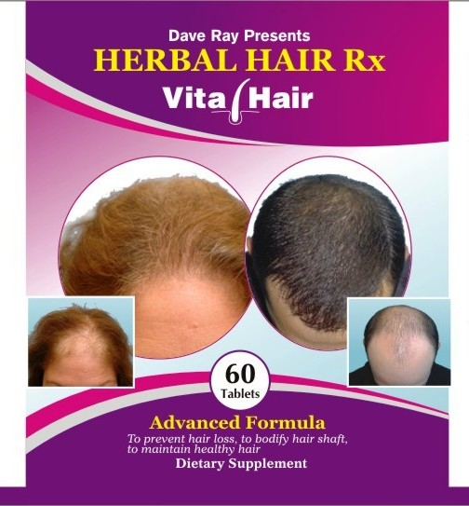

Slide 15
Top 10 Foods for Healthy Hair
When it comes to healthy hair, it’s not just what you put on your tresses that counts -- it’s what you put in your body, too.
Better-looking hair can start at your next meal.
"Just like every other part of your body, the cells and processes that support strong, vibrant hair depend on a balanced diet."
It can take longer to notice changes (both good or bad!) in your hair than in your skin. For example, "just one week with a poor diet can yield acne flare-ups or dry, sallow skin within days.", "but with hair, it can take a few months for a nutritional deficiency or the effects of a crash diet to show up."
The nutrients you eat today help fortify the hair follicle -- from which each strand is born -- and the scalp that surrounds it. "Healthier follicles? Healthier hair. Healthier scalp? Healthier hair!"
Of course, there's more to your hair than what you eat. Smoking, hormonal imbalances, and not enough sleep can also affect how your hair looks and feels. No magic nutrient can make up for those concerns.
Still, you have a lot more leverage than you might think. If you eat a balanced, varied, protein-rich diet that focuses on the following 10 foods, you'll be giving your hair the TLC it needs and deserves.

Slide 16
1. Salmon
Besides being rich in protein and vitamin D (both are key to strong hair) the omega-3 fatty acids found in this tasty cold-water fish are the true superstar. Your body can't make those fatty acids, which your body needs to grow hair. About 3% of the hair shaft is make up of these fatty acids. Omega-3s are also found in cell membranes in the skin of your scalp, and in the natural oils that keep your scalp and hair hydrated.
Other options: If salmon doesn't thrill you, you can also get essential fatty acids from fish like herring, sardines, trout, and mackerel, as well as avocado, pumpkin seeds and walnuts
2. Walnuts
These are the only type of nuts that have a significant amount of omega-3 fatty acids. They're also rich in biotin and vitamin E, which helps protect your cells from DNA damage. Since your hair rarely gets much shielding from the sun, this is especially great. Too little biotin can lead to hair loss. Walnuts also have copper, a mineral that helps keep your natural hair color rich and lustrous.
Other options: Try using walnut oil in your salad dressing or stir-fry instead of canola or safflower oil.

Slide 17
3. Oysters
Oysters are rich in zinc, a lack of which can lead to hair loss (even in your eyelashes), as well as a dry, flaky scalp. Three ounces has a whopping 493% of your daily value. You can get some zinc through fortified cereals and whole grain breads, but oysters can boast a good level of protein too. "Remember, hair is about 97% protein." Without enough protein, your body can't replace the hairs that you naturally shed every day and what you do make can be dry, brittle, or weak.
Other options: Get your fill of zinc with nuts, beef, and eggs.

Slide 18
4. Sweet Potatoes
Sweet potatoes are a great source of the antioxidant beta carotene, which your body turns into vitamin A. "Basically, every cell of the body cannot function without enough A." It also helps protect and produce the oils that sustain your scalp, and being low on vitamin A can even leave you with itchy, irksome dandruff.
Other options: Carrots, cantaloupe, mangoes, pumpkin and apricots are all good sources of beta carotene.
5. Eggs
A great source of protein, eggs are loaded with four key minerals: zinc, selenium, sulfur, and iron. Iron is especially important, because it helps cells carry oxygen to the hair follicles, and too little iron (anemia) is a major cause of hair loss, particularly in women.
Other options: You can also boost your iron stores with animal sources, including chicken, fish, pork, and beef.

Slide 19
6. Spinach
The iron, beta carotene, folate, and vitamin C in spinach help keep hair follicles healthy and scalp oils circulating.
Other options: Try similarly nutrient-rich dark, leafy vegetables such as broccoli, kale and Swiss chard.
7. Lentils
Tiny but mighty, these legumes are teeming with protein, iron, zinc and biotin, making it a great staple for vegetarian, vegans, and meat eaters.
Other options: Toss other beans such as soybeans (the young ones are called edamame) and kidney beans into your soup or salad.

Slide 20
8. Greek yogurt
Cruise the dairy aisle for low-fat options such as Greek yogurt, which is high in hair-friendly protein, vitamin B5 (pantothenic acid -- an ingredient you'll often see on hair care product labels) and vitamin D. Emerging research links vitamin D and hair follicle health, but exactly how that works isn't clear.
Other options: Cottage cheese, low-fat cheese, and skim milk also fit the bill.
9. Blueberries
Exotic super fruits may come and go but when it comes to vitamin C, "It's hard to top this nutrient superhero.“ C is critical for circulation to the scalp and supports the tiny blood vessels that feed the follicles. Too little C in your diet can lead to hair breakage.
Other options: Kiwis, sweet potatoes, tomatoes and strawberries.

Slide 21
10. Poultry
This everyday entree is extraordinary when it comes to protein, as well as hair-healthy zinc, iron, and B vitamins to keep strands strong and plentiful. Because hair is nearly all protein, "foods rich in protein are literally giving you the building blocks for hair."
Other options: Lean cuts of beef are another good source of lean protein.

Slide 22
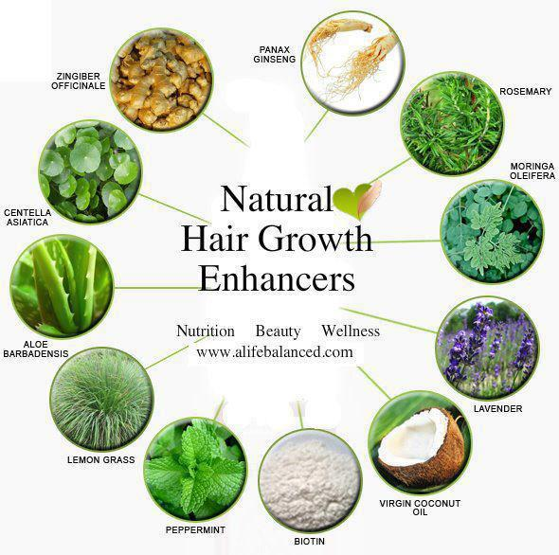

Slide 23
Vita-Hair Product Description
Vita-Hair Repair Advanced Formula contains 60 capsules, which is a one month supply. They should be taken with meals, twice daily, with a full glass of warm water.
Product benefits
Promotes thicker, sexier hair
Helps maintain healthier, stronger hair
Promotes shiny and manageable hair
Effective for most hair types
Manufactured by a certified "A" rated lab that follows strict GMP guidelines for quality control
Third party tested to confirm what's in our product is on our label
Uses zero synthetic or harmful ingredients, binders or fillers

Slide 24
Main Ingredients
Biotin
This B7 vitamin is necessary for cell growth! It is also essential in the production of fatty acids, the metabolism of fats and amino acids. Biotin is often recommended as a nutritional supplement to strengthen hair and nails.
Folic Acid
This B9 vitamin, or folate, is necessary for numerous bodily functions. Because we can’t synthesize it, we have to get our daily requirement of folate through our diet or nutritional supplements. Folate is especially important in aiding rapid cell division and growth, and producing healthy red blood cells.
Organic Kelp Powder
This amazing ingredient provides the body with a regular source of iodine. Iodine is a key trace element that helps to maintain healthy thyroid function. Why is this important? One of the most common reasons for hair loss or thinning hair is thyroid disease. By combating the negative effects of thyroid dysfunction (such as hair loss and weakness), the body can begin to repair itself.

Slide 25
Saw Palmeto Powder
This ingredient is shown to help block DHT, a hormone that shrinks hair follicles and starves the hair of nutrients.
MSM
MSM is used by the body for healthy keratin and collagen production.
Collagen
Collagen is an abundant protein found naturally in the body that strengthens connective tissues as it improves elasticity in the skin and flexibility in the hair. Collagen supplements are an effective anti-aging tool for whole body vitality.
Silicon
an essential trace mineral that helps your body function properly. The primary symptom of a Silicon deficiency is dull, lifeless hair that falls out at an alarming rate.
Other ingredients include Vitamin A, additional B vitamins, and organic rice concentrate.

Slide 26
Ingredients and their benefits:
Vitamin B1 – Thiamine – A protein builder that helps give the hair shine, volume and good texture. Enhances circulation to build nutrients to the scalp.
Vitamins B2 – Riboflavin – Stimulates health and growth of hair, skin and eyes by bringing oxygen to body tissues. Can help to eliminate dandruff. May aid in preventing hair loss.
Vitamin B3 – Niacinamide – Supports healthy hair by helping digestion and improving circulation.
Vitamin B5 – Pantothenic Acid – Helps produce full, healthy hair by stimulating vitamin utilization and releasing energy from food. With folic acid and PABA can help restore natural hair color. May aid in preventing hair loss.
Vitamin B6 – Pyridoxine – supports the growth of red blood cells that are important for healthy hair and scalp maintenance. Helps prevent dandruff. May help in preventing hair loss.
Vitamin B12 - Cyanocobalamin – Required for red blood cell formation to help maintain healthy hair and scalp.
Biotin – Helps improve hair quality. May aid in preventing hair loss particularly in men. Can prevent hair from graying.
Folic Acid – Helps maintain healthy hair and skin. May aid in preventing hair loss . With PABA and pantothenic acid, may delay graying of hair.
Inosital – Helps improves skin health, hair shine and body. May aid in preventing hair thinning and loss.
Vitamin E – Tecopherol – Key to hair health and growth by supplying oxygen to the body and improving the scalp circulation. Helps control dandruff. May aid in preventing hair loss.
Copper – An important anti-graying agent. Necessary for healthy hair.
Iron – Helps maintain healthy hair, nails and skin tone. May aid in preventing hair loss.

Slide 27
Selenium
Help in the treatment and prevention of dandruff. Necessary for healthy hair.
Zinc
Stimulates hair growth. Aids in preventing hair loss. May help treat and prevent dandruff.
L-Methionine.
May help in preventing hair loss
N-Acetylcysteine
Supply sulfur needed for healthy.
Aloe Vera
Brings vitality to hair.
Essential Fatty Acids- Polyseosaturates
Improves texture by preventing dryness and brittleness.

Slide 28
EXACTLY WHAT DOES YOUR HAIR GET?
VitaminB3, B5 and B6 provide health and growth.
B12 increases energy at the root.
C improves scalp circulation and encourages growth.
E increases oxygen intake and expands fullness.
Zinc fights bacteria and stimulates growth.
Iron maintains the basic health and strength.
Folic Acid helps to prevent hair loss.

Slide 29
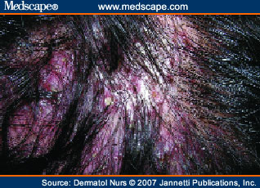
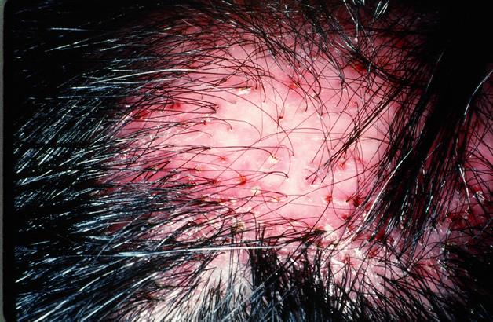
Scarring Alopecia:
This condition has four types
Folliculitis Decalvans:

Slide 30
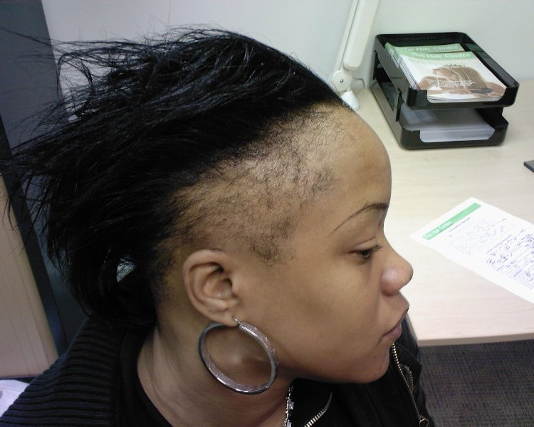
Hot Comb Alopecia
Central Centrifugal Cicatricial Alopecia

Slide 31
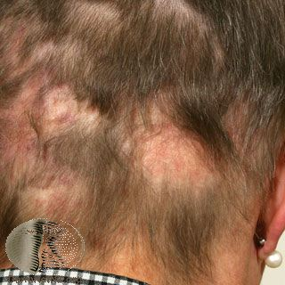
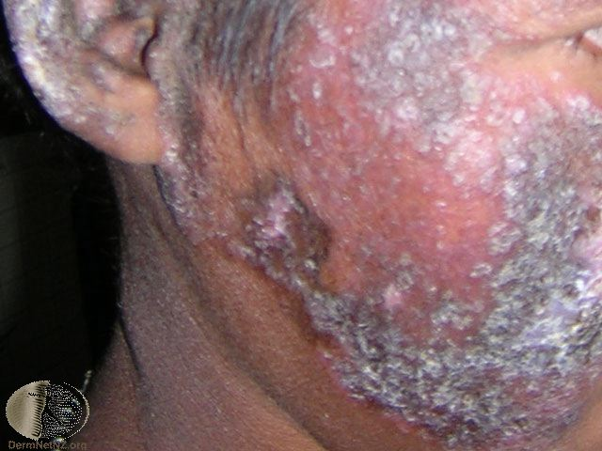
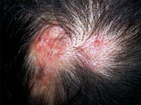
Discoid Lupus Erythematosus

Slide 32
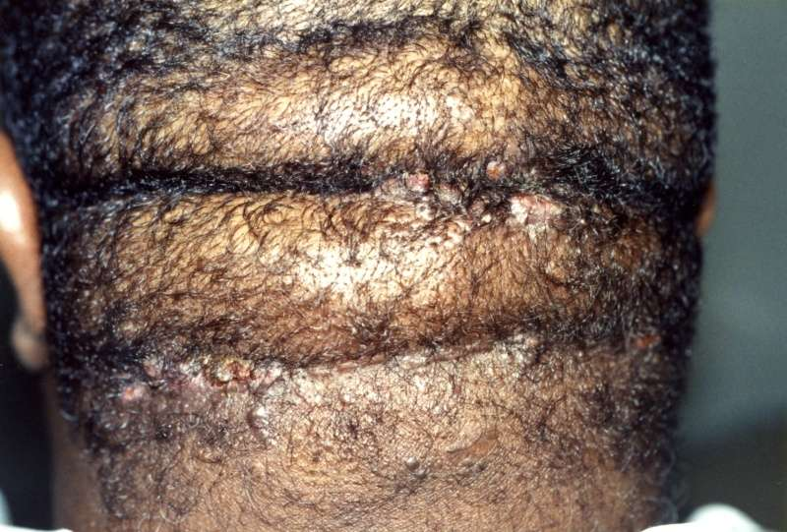
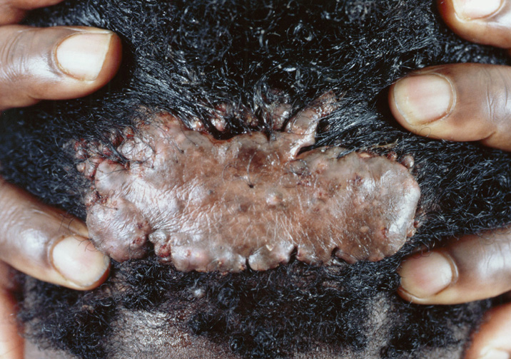
Peri-Folliculitis Keloidalis Occipitalis (PFKO) abbreviated
Also referred to Keloidalis Nuchae

Slide 33
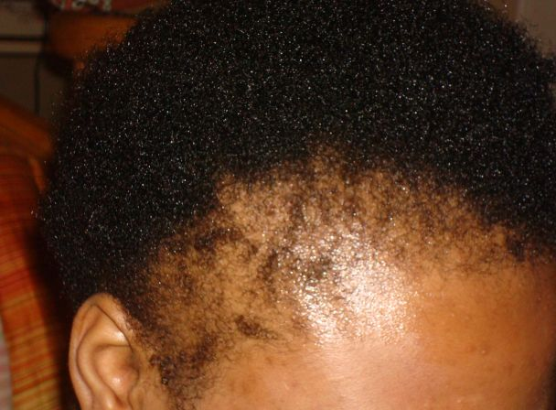
Nonscarring Alopecia:
Traction Alopecia

Slide 34
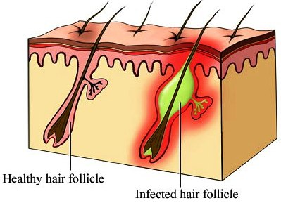

Slide 35
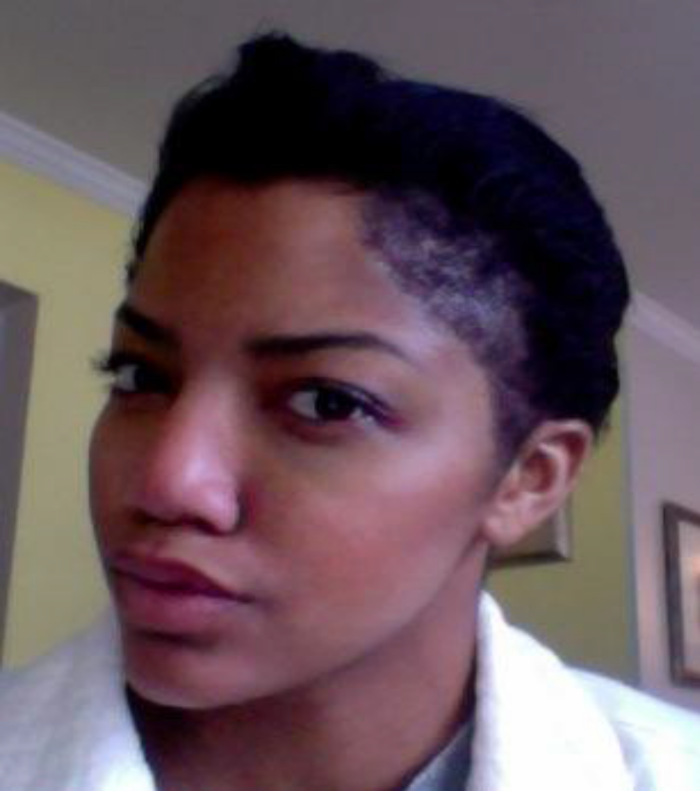


Slide 36
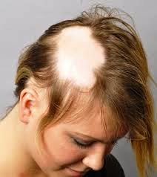
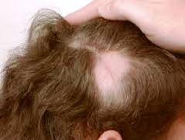
Alopecia Areata Progression

Slide 37
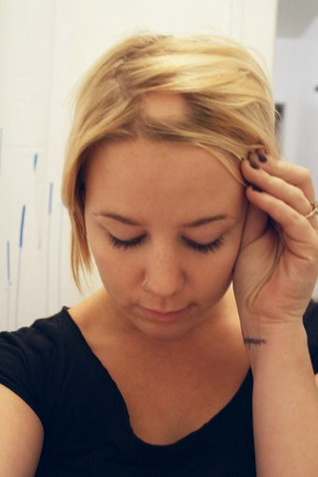
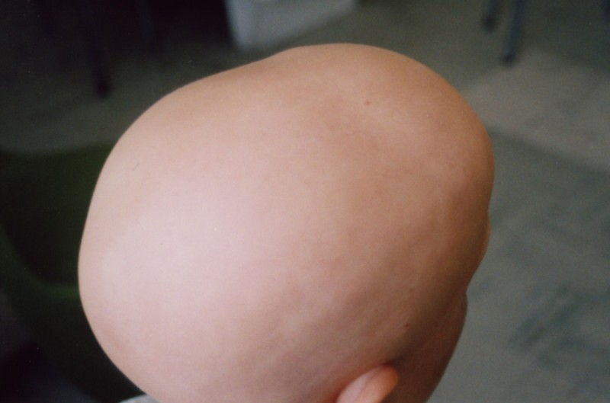
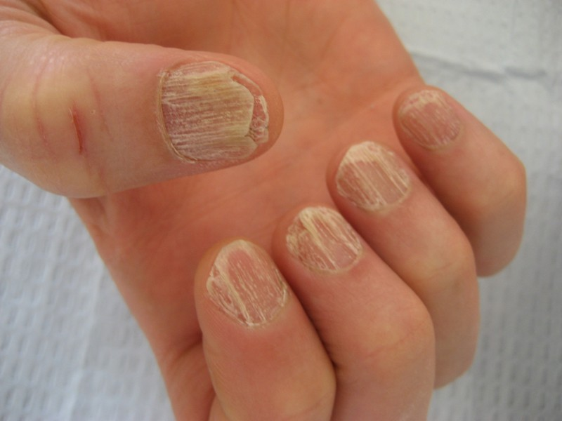
Alopecia
Areata Totalis Universalis

Slide 38
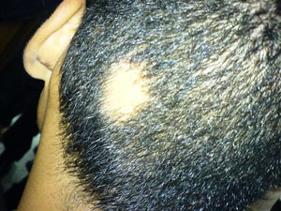
Juvenile Alopecia

Slide 39
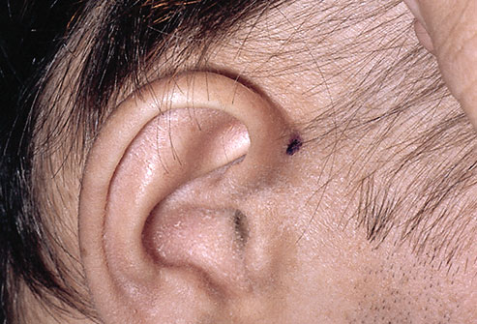
Telogen Effluvium:

Slide 40
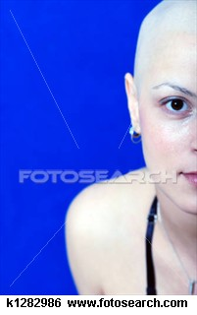
Post Chemotherapy:

Slide 41
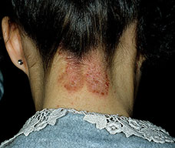
An example of Lichen Simplex Chronicus

Slide 42
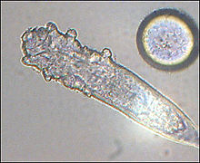
DEMODEX

Slide 43
Species
Demodex aries Demodex aurati Demodex brevis Demodex bovis Demodex canis Demodex caprae Demodex caballi Demodex cati Demodex cornei Demodex criceti Demodex equi Demodex folliculorum Demodex gapperi Demodex gatoi Demodex injai Demodex ovis Demodex phyloides Demodex zalophi

Slide 44
Demodex is a genus of tiny parasitic mites
that live in or near hair follicles of mammals.
Around 65 species of Demodex are known
Two species living on humans have been identified:
Demodex folliculorum and Demodex brevis,
both frequently referred to as eyelash mites.
Demodex canis lives on the domestic dog.
Infestation with Demodex is common and
usually does not cause any symptoms,
although occasionally some skin diseases
can be caused by the mites.
'Demodex' is derived from
Greek 'dēmos' fat + 'dēx', a wood worm.

Slide 45
Demodex folliculorum
D. brevis
Simon 1842
Akbulatova 1963

Slide 46
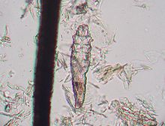
Demodex Canis

Slide 47
The ITCHY SCALP formula which works for us is 8 fresh Rosemary leaves, 1 Table spoon fo Kerosene Oil to liter of hot water drawn, then cooled. Placed in the refrigerator. Take half cup and add 3 drops of “Restoration Oil”. Apply to the scalp for thirty minutes, plasticated or 10 minutes of steamer.

Slide 48
Email: hair.scalpUSA@gmail.com
Or
BeautySurgeon@aol.com
347 934 8494
www.HerbalHairRx.com

Slide 49
Lets Meet again at Cosmetology-2015
4th International Conference and Expo
On
Cosmetology & Trichology
June 22-24, 2015 Philadelphia, USA
Theme: Cosmetology and Trichology: Tracking and Tackling its Consequences
Website: http://cosmetology-trichology.conferenceseries.com/

