Slide 1
A “Lean” Application in Documenting Patient Education
Darrin Doman, MS, CCC-SLP
Patient Education

Slide 2

About UUHC

Slide 3

About UUHC

Slide 4
Team Members
Darrin Doman
Clinical Staff Education
UUHC
Jean Shipman
Director
Eccles Health Sciences Library
Erica Lake
Associate Director
Hope Fox Eccles Health Library
Madeline Araya
Systems Analyst III
UUHC
Alisha Richins
Outpatient Clinics Nurse Educator
UUHC
Jessi Van Der Volgen
NLM Associate Fellow
Eccles Health Sciences Library

Slide 5
Problem Statement
Patient education impacts:
Outcomes/Quality of care
Patient satisfaction
Accreditation
Meaningful Use (MU) reimbursement
Varied processes for providing patient education exist, but not all can be audited to demonstrate compliance with the MU measure which becomes more stringent with future Phases.

Slide 6
Gemba
Two Outpatient Clinics
Representing a continuum of current Meaningful Use compliance
6 Team Members
FOLLOWED
11 Providers
ACROSS
38 Patient Interactions
USING
Standardized Shadow Protocol

Slide 7
Root Cause Analysis
Synthesis of Shadow Protocol Data Revealed-
Inconsistent process for documentation
Variable provider awareness/education of Meaningful Use patient instruction requirements
Gaps in clinical references, differing personal preference of reference material
Poor usability of patient education resource as embedded in EHR

Slide 8
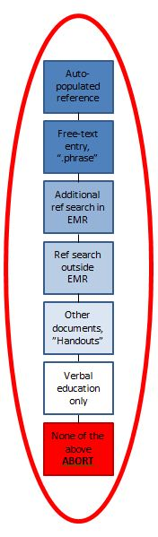
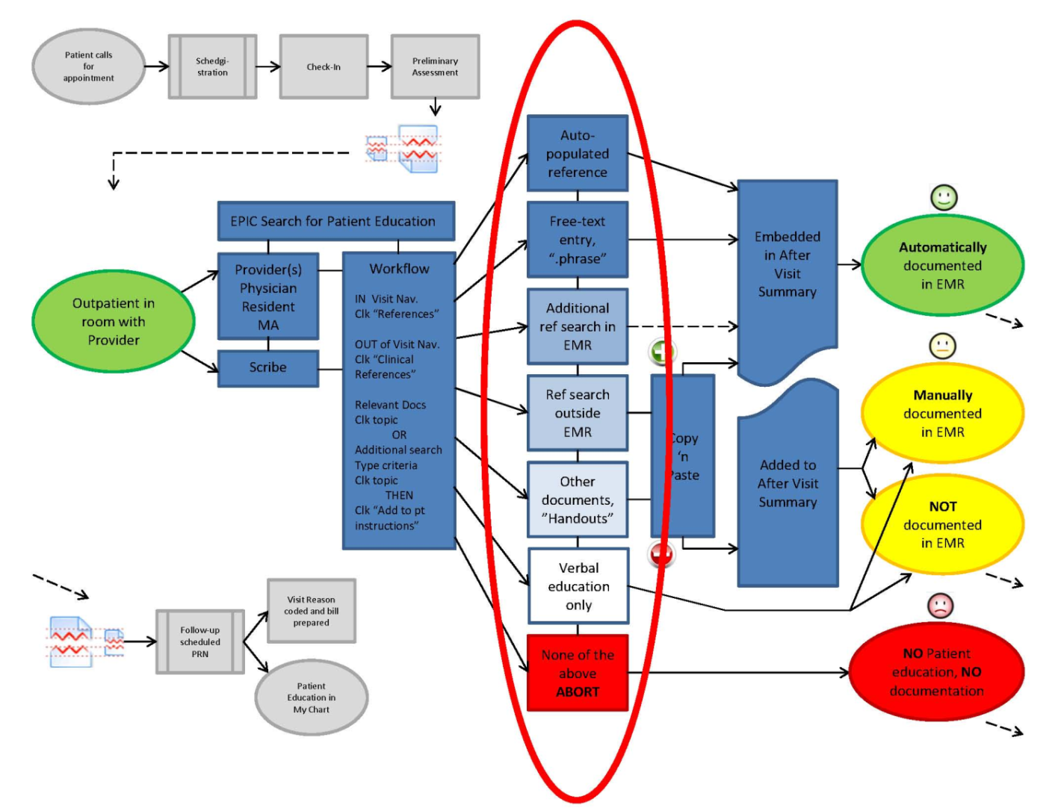
Initial Process Map

Slide 9
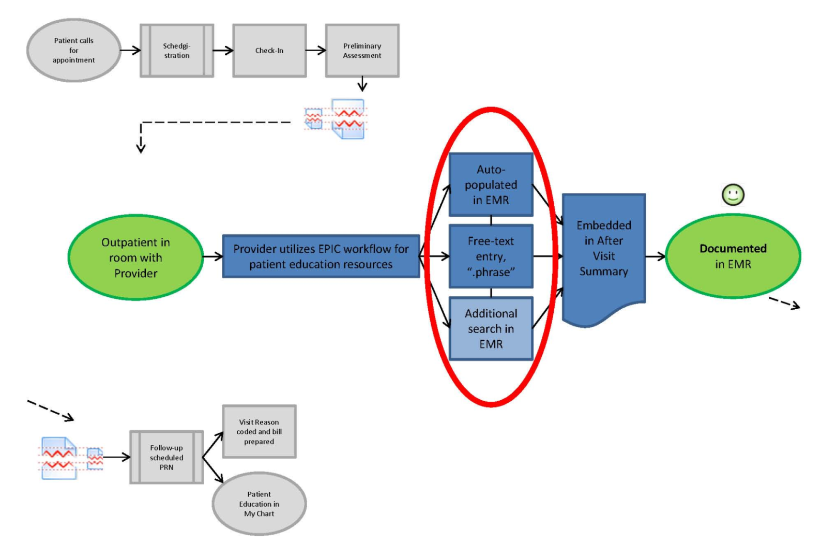
Desired Results

Slide 10

Improvements
Clinic dashboard to track compliance over time
MU patient instruction focused script added to EHR training
Emphasize standard EHR workflow for documentation
License expanded library of reference material
Standardize workflow for custom content

Slide 11
Sustaining Measures
Patient Education Steering Committee
Focused IT support for patient education initiatives in EHR, liaison with content vendor
Leverage IT training to accommodate changes in practice

Slide 12
Financial Impact
Phase II Meaningful Use Compliance 2014
Cost Avoidance
  For every minute of physician time saved per patient encounter
  $2,231,053 in annual savings
Revenue Generation
  1 Additional patient encounter per day
  $ 200 average revenue from a single outpatient encounter
  343 MU eligible providers
  X 225 working days per year
  $15,435,000 in additional revenue annually

Slide 13


Slide 14
Bibliography
Bartlett EE. Cost-benefit analysis of patient education. Patient Education and Counseling. 1995 Sep; 26(1-3): 87-91. Erratum in Patient Educ Couns 1996 Apr; 27(3):279.
On the average, for every dollar invested in patient education, $3-4 was saved. [ $4.50-6.00 in 2013]
Eckman MH, Wise R, Leonard AC, Dixon E, Burrows C, Khan F, Warm E. Impact of health literacy on outcomes and effectiveness of an educational intervention in patients with chronic diseases. Patient Education and Counseling. 2012 May; 87(2):143-51.
Incorporation of an educational program into clinical visits for patients with chronic disease improved disease-specific knowledge and prompted patients to become activated and involved in their care, improving health behaviors and outcomes. Lower health literacy was not a barrier to this beneficial effect. Patients with lower health literacy may also benefit from educational, shared decision-making interventions.
Felley C, Perneger TV, Goulet I, Rouillard C, Azar-Pey N, Dorta G, Hadengue A, Frossard JL. Combined written and oral information prior to gastrointestinal endoscopy compared with oral information alone: a randomized trial. BMC Gastroenterology. 2008 Jun 3; 8:22.
Written information led to more favourable assessments of the quality of information and had no impact on patient anxiety nor on the overall assessment of the endoscopy. Because structured and comprehensive written information is perceived as beneficial by patients, gastroenterologists should clearly explain to their patients the risks, benefits and alternatives of endoscopic procedures.
Fleming MF, Mundt MP, French MT, Manwell LB, Stauffacher EA, Barry KL. Benefit-cost analysis of brief physician advice with problem drinkers in primary care settings. Medical Care. 2000 Jan; 38(1):7-18. Comment in Med Care. 2000 Jan; 38(1):4-6; ACP J Club. 2000 Sep-Oct; 133(2):75.
Study estimates the economic costs and benefits of brief physician advice in managed care settings. The total economic benefit of the brief intervention was $423,519 (95% CI: $35,947, $884,848), composed of $195,448 (95% CI: $36,734, $389,160) in savings in emergency department and hospital use and $228,071 (95% CI: -$191,419, $757,303) in avoided costs of crime and motor vehicle accidents. The average (per subject) benefit was $1,151 (95% CI: $92, $2,257). The estimated total economic cost of the intervention was $80,210, or $205 per subject. The benefit-cost ratio was 5.6:1 (95% CI: 0.4, 11.0), or $56,263 in total benefit for every $10,000 invested.

Slide 15
Bibliography
Gallefoss F. The effects of patient education in COPD in a 1-year follow-up randomised, controlled trial. Patient Education and Counseling. 2004 Mar; 52(3): 259-66.
Study to explore the effects and health economic consequences of patient education in patients with COPD in a 12-month follow-up. Patient education reduced the need for GP visits with 85% (from 3.4 to 0.5, P<0.001) and kept a greater proportion independent of their GP during the 12-month follow-up, compared with no education (73% versus 15%, respectively). Patient education reduced the need for reliever medication from 290 to 125 The control and intervention groups induced mean total costs of NOK 19,900 and 10,600 per patient, respectively. [NOK 19,900 = 3,630.54 US dollars; NOK 10,600 = 1,933.85 US dollars] For every NOK put into patient education, there was a saving of 4.8. Patient education of patients with COPD improved patient outcomes and reduced costs in a 12-month follow-up.
Grote KD. A better hospital experience. The McKinsey Quarterly, 2007. http://www.mckinseyquarterly.com/A_better_hospital_experience_2081
77% of patients would switch hospitals for better communication.
Hill J, Bird H. The development and evaluation of a drug information leaflet for patients with rheumatoid arthritis. Rheumatology (Oxford). 2003 Jan; 42(1):66-70.
A large minority of patients have poor reading skills, but when a drug information leaflet is designed to be easy to read patients gain significant amounts of knowledge from it. Providing additional verbal explanations did bring about increases in knowledge but these were not significant.
The Joint Commission of Acceditation of Healthcare Organizations. Comprehensive Accreditation Manual for Hospitals: The Official Handbook. January 2007. PC 21.
Patients must be given sufficient information to make decisions and to take responsibility for self-management activities related to their needs. Patients, and, as appropriate, their families are educated to improve individual outcomes by promoting health behaviors and appropriately involving patients in their care, treatment, and service decisions.

Slide 16
Bibliography
Kern LM, Malhotra S, Barrón Y, Quaresimo J, Dhopeshwarkar R, Pichardo M, Edwards AM, Kaushal R. Accuracy of electronically reported "meaningful use" clinical quality measures: a cross-sectional study. Annals of Internal Medicine. 2013 Jan 15; 158(2):77-83.
Wide measure-by-measure variation in accuracy threatens the validity of electronic reporting. If variation is not addressed, financial incentives intended to reward high quality may not be given to the highest-quality providers.
Koelling TM, Johnson ML, Cody RJ, Aaronson KD. Discharge education improves clinical outcomes in patients with chronic heart failure. Circulation. 2005 Jan 18; 111(2):179-85. Epub 2005 Jan 10.
Costs of care, including the cost of the intervention, were lower in patients receiving the education intervention than in control subjects by 2823 dollars per patient (P=0.035).
Kreofsky L. Engaging staff to engage patients: Patient engagement is essential for meaningful use, and studies show it is becoming more definitively linked to consumer satisfaction. Health Management Technology. 2013 Feb; 34(2):12-3.
Larson CO, Nelson EC, Gustafson D, Batalden PB. The relationship between meeting patients' information needs and their satisfaction with hospital care and general health status outcomes. International Journal for Quality in Health Care. 1996 Oct; 8(5):447-56.
The multivariate regression results show that meeting information needs are positively and significantly associated with both patient satisfaction measures (i.e., Ratings of Care Processes, p < 0.01; Global Satisfaction, p < 0.05, Perceived Health Benefit, p < 0.01) and one general health status measure (i.e. Quality of Life, p < 0.01). CONCLUSION: The results suggest that providers of care should ensure that they meet the information needs of patients with specific conditions because patients' perceptions of both quality of care and quality of life are associated with the clinicians' ability to transfer key information to their patients.
Leisner BA, Wonch DE. How documentation outcomes guide the way: a patient health education electronic medical record experience in a large health care network. Quality Management in Health Care. 2006 Jul-Sep;15(3):171-83.
Staff involvement in format design and development combined with consistent feedback and evaluation resulted in improved documentation compliance. Future work is focused on the quality of evaluations of patient learning needs and electronic recording of patient teaching and education.

Slide 17
Bibliography
Pew Internet & American Life Project. The online health care revolution: How the Web helps Americans take better care of themselves. http://www.pewinternet.org/Reports/2000/The-Online-Health-Care-Revolution.aspx November 2000.
Of those online, 86% are concerned about the reliability of the information they find at 25,000+ health-related websites, and 75% cite their doctor’s direction as the most important source for guidance to quality health content.
Safeer RS, Keenan J Health literacy: the gap between physicians and patients. American Family Physician. 2005 Aug 1; 72(3): 463-8.
For optimal comprehension and compliance, patient education material should be written at a sixth-grade or lower reading level, preferably including pictures and illustrations. All patients prefer reading medical information written in dear and concise language. [From article: Poor health literacy results in $69 billion in health care costs annually.]
Sheard C, Garrud P. Evaluation of generic patient information: effects on health outcomes, knowledge and satisfaction. Patient Education and Counseling. 2006 Apr; 61(1): 43-7.
Patients increasingly expect written information; however amount, quality and timeliness vary considerably. PRACTICE IMPLICATIONS: Providing patients with commercially produced standardized information in addition to internally produced hospital information could have an additional, though limited, benefit to patients' health outcomes. This could be a way of incorporating the expertise of both providers to the patient's benefit.
Staywell Custom Communications. Research brief: New media & Online Health Tools. 2009. www.staywellcustom.com
Nearly half of consumers (48%) would fill out an online medical assessment to get personalized health information.
Throop C, Seidman J. The Ix After-Visit Summary (AVS). October, 2009. http://www.healthwise.org/docs/document/ixdocs/8154.pdf
Research suggests patients forget somewhere between 40 and 80 percent of medical information given immediately after the visit. Of the information that is remembered, almost half is remembered incorrectly. The After Visit Summary is an Information Therapy tool that can be used to help patients remember pertinent medical information.

