Slide 1
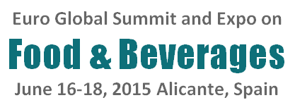

America’s regulation of food policy from victim and consumer advocate perspectives
Darin Detwiler, USA
Senior Food Policy Coordinator
Adjunct Faculty
NORTHEASTERN
UNIVERSITY
Your Voice for Safe Food

Slide 2
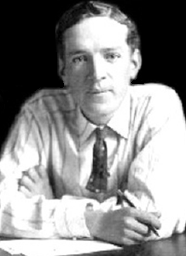

1906:
Upton Sinclair
exposed to the world how unsanitary working conditions in the meat industry
put consumers
at risk.

Slide 3
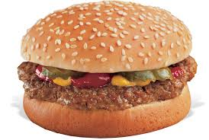
1993
E.coli outbreak in ground beef
  Fast Food Hamburgers
  Sickened >650 people in
  several states
  Alarming number of hospitalizations
  Many children developed HUS
  Killed 4 children
Your Voice for Safe Food

Slide 4
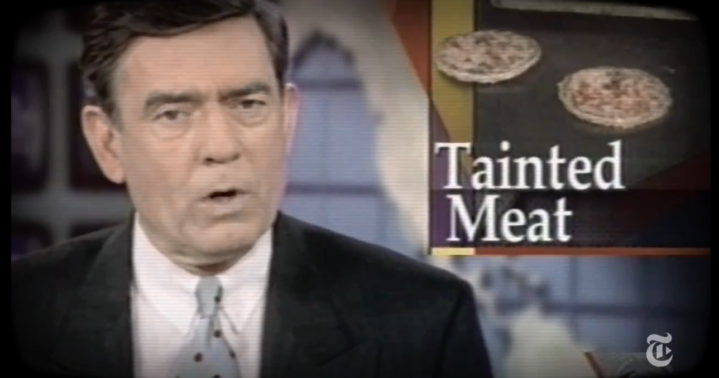
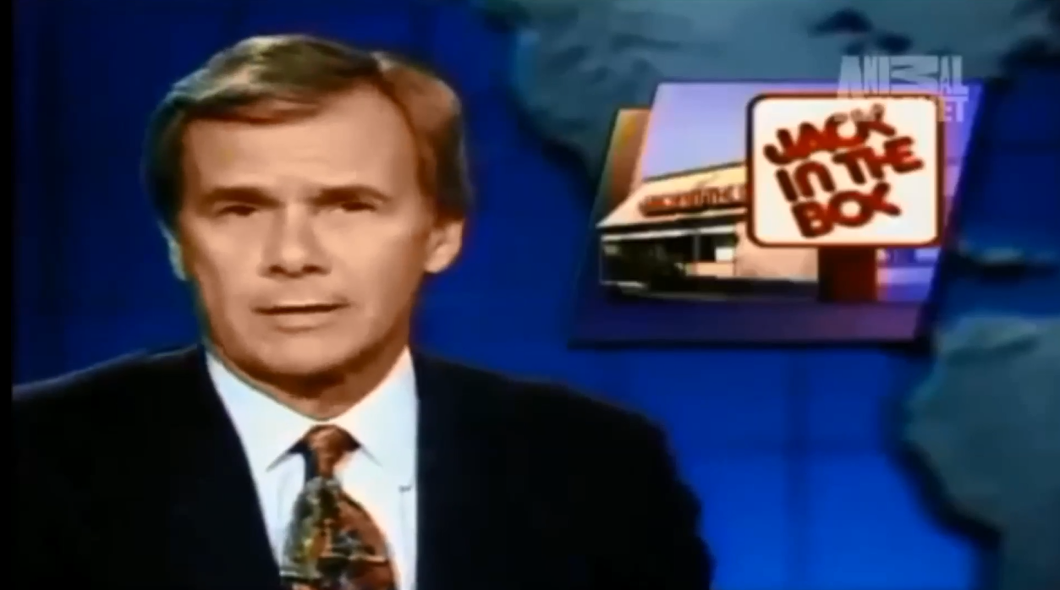
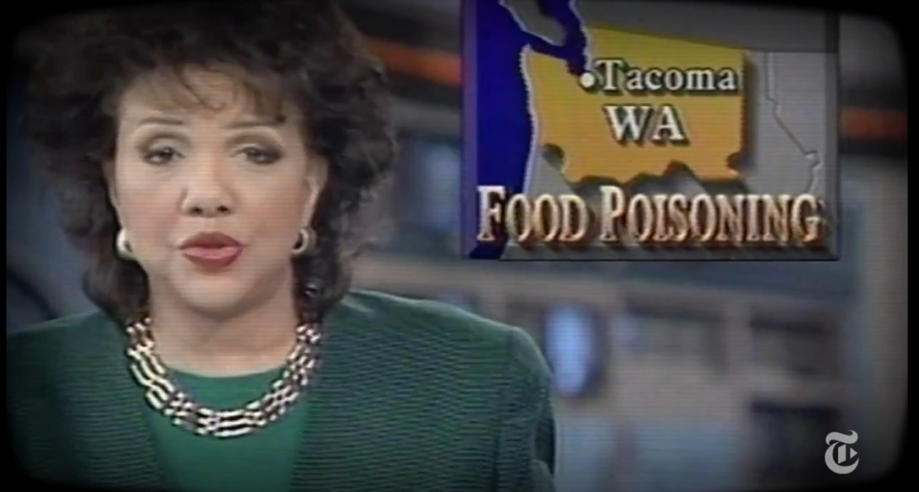
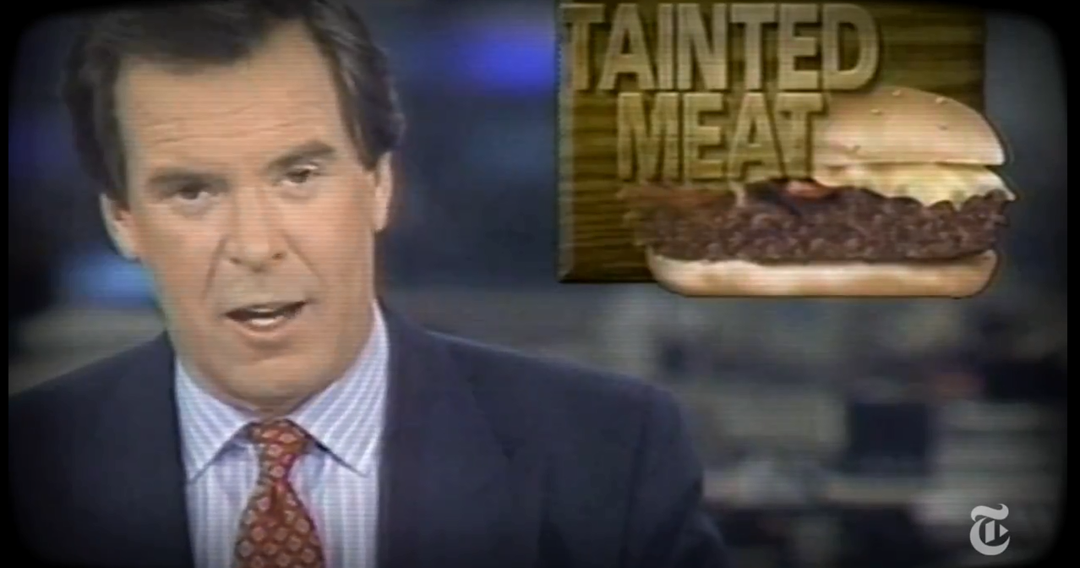
1993

Slide 5
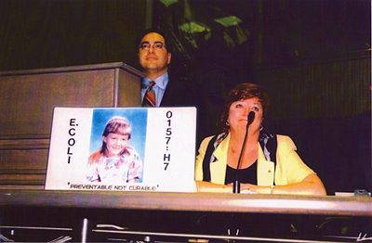
STOP Foodborne Illness is a leading national nonprofit public health organization dedicated to the prevention of illness and death from foodborne pathogens by:
Your Voice for Safe Food

Slide 6
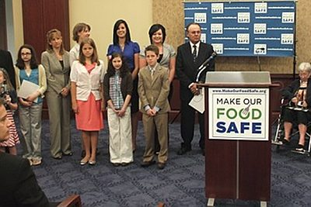
STOP Foodborne Illness
Your Voice for Safe Food

Slide 7
STOP Foodborne Illness
Advocating for sound public policy,
Building public awareness,
Assisting those impacted by foodborne illness.
Your Voice for Safe Food

Slide 8
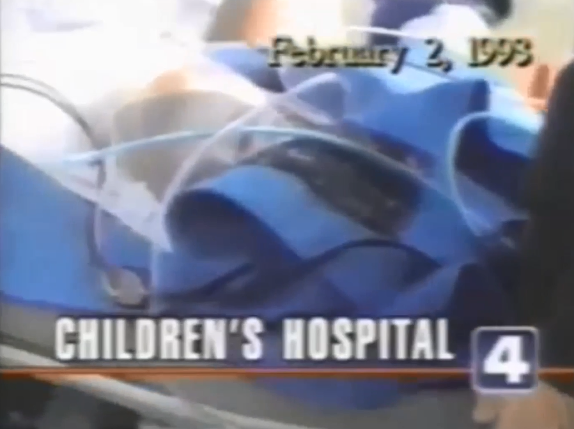
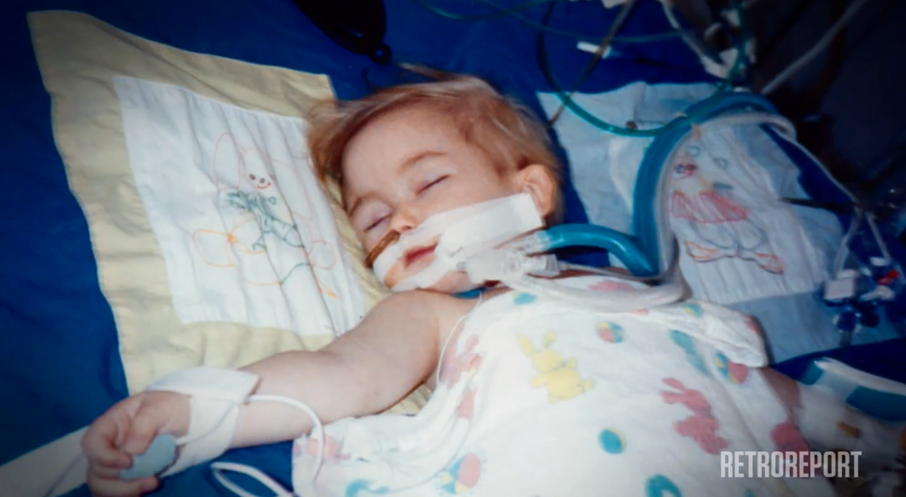
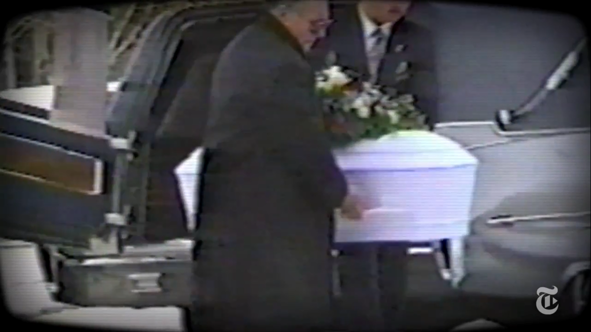

Slide 9
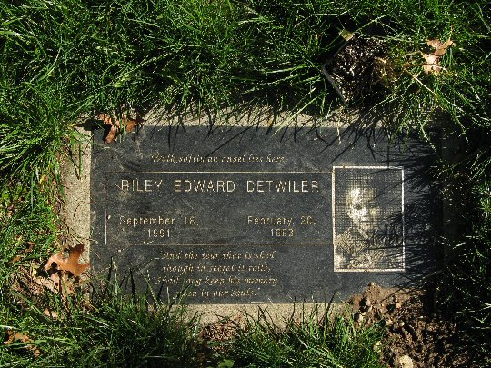
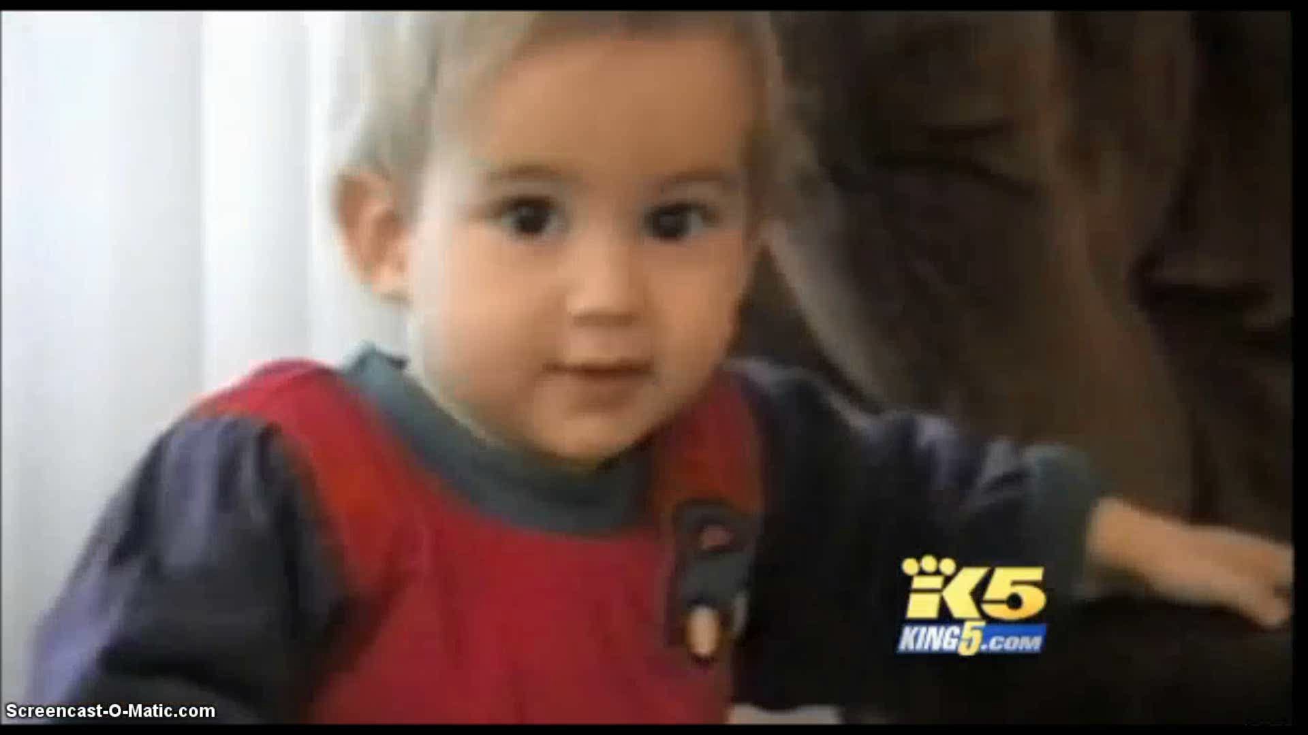
Your Voice for Safe Food

Slide 10
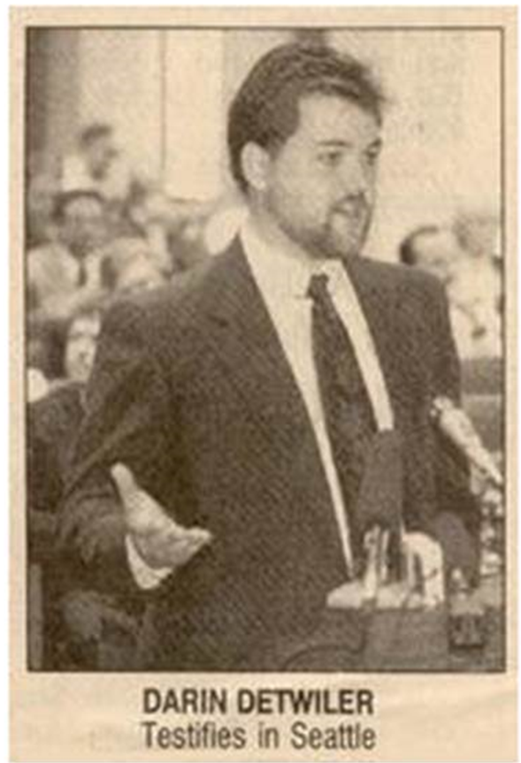

Your Voice for Safe Food

Slide 11
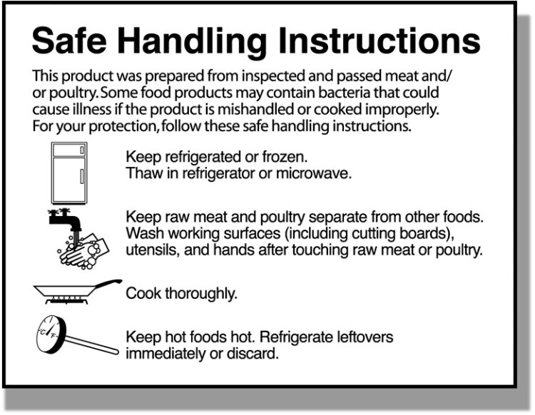
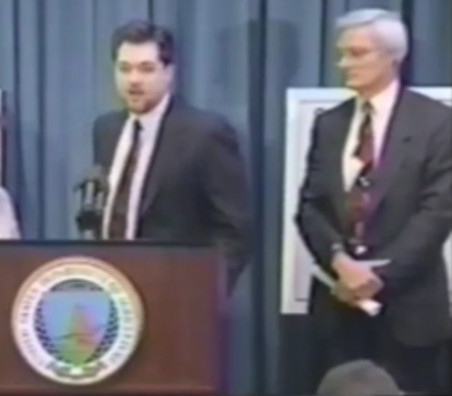


Your Voice for Safe Food

Slide 12
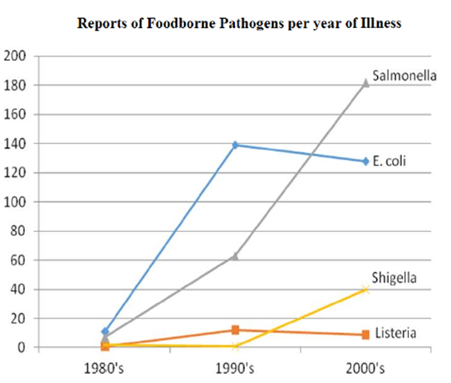
Your Voice for Safe Food

Slide 13

1998
E.coli outbreak in Apple Juice:
  sickened >70 people in several states
  14 children developed HUS
  killed a 16-month-old girl
First U.S. federal criminal conviction in a large-scale
food-poisoning outbreak
Your Voice for Safe Food

Slide 14
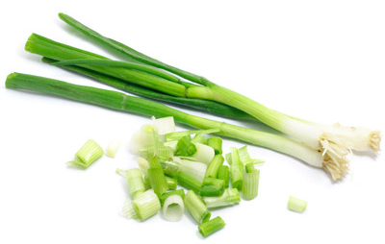
2003
Hepatitis from Mexican Onions
3 died,
600 ill in 3 states
Your Voice for Safe Food

Slide 15
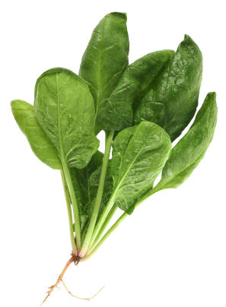
2006
E.coli in Spinach
5 died,
200 ill in 26 States
Your Voice for Safe Food

Slide 16
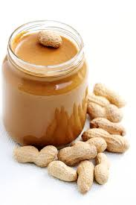
2006-2007
Salmonella in Peanuts
Company shipped peanut butter contaminated with Salmonella
Nation-wide outbreak
Sickened over 700
In 2015 company agreed to plead guilty and pay $11.2 million
Your Voice for Safe Food

Slide 17
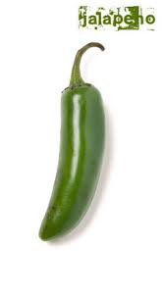
2008
Salmonella –
Mexican Jalapenos
1,440 ill in 43 states
Your Voice for Safe Food

Slide 18
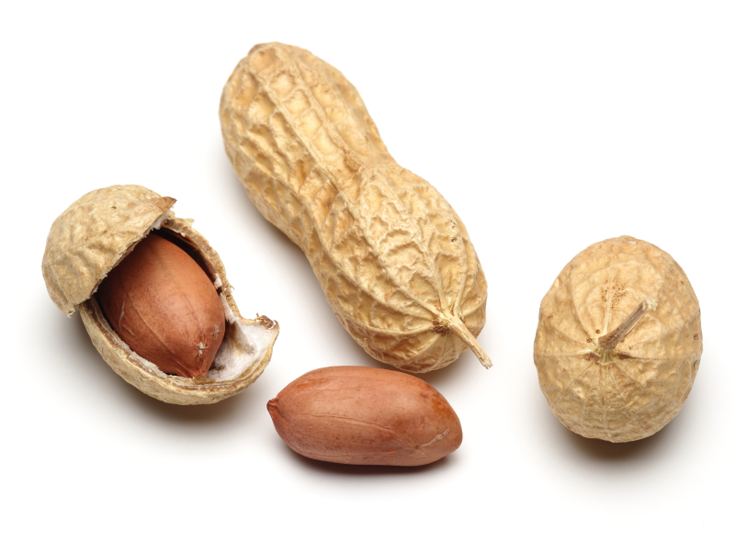
2008- 2009
Salmonella
in peanuts
9 died,
714 ill in 47 States
98 federal felony charges - introducing adulterated food into interstate commerce, “with the intent to defraud or mislead”
Your Voice for Safe Food

Slide 19

2010
Eggs Salmonella in eggs
1,939 confirmed ill (estimates > 62,000)
RECALL:
Your Voice for Safe Food

Slide 20
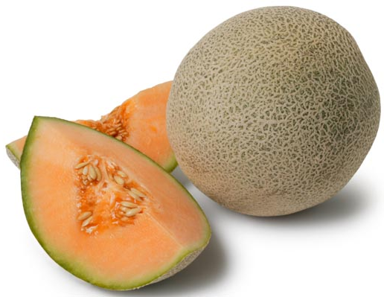
2011
Listeria outbreak tied to Cantaloupes
147 ill in 28 states
34 died
Your Voice for Safe Food

Slide 21
Your Voice for Safe Food

Slide 22
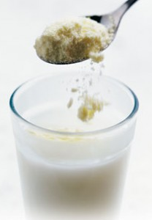
1955
Arsenic-tainted Milk Powder in Japan
Arsenic accidentally mixed into preservative which was then added to milk powder
> 13,400 illnesses
> 100 deaths
Company’s head of factory production - three years in jail
Your Voice for Safe Food

Slide 23

1981
Toxic oil syndrome in Spain
Colza oil intended for industrial rather than food use
About 25,000 affected
Over 600 people died
Your Voice for Safe Food

Slide 24
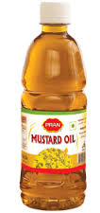
1998
Mustard Oil Contamination
New Delhi, India
Mustard oil (for cooking) mixed with a poisonous Mexican poppy seed oil
~ 3,000 people hospitalized
60 deaths
Your Voice for Safe Food

Slide 25
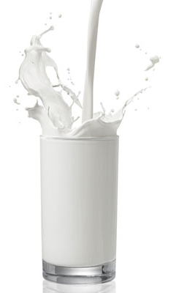
2008
Melamine in Milk - China
Melamine added to powdered milk and baby formula produced by state-owned dairy company
300,000 illnesses
54,000 babies hospitalized
Six babies died due to kidney damage
Your Voice for Safe Food

Slide 26
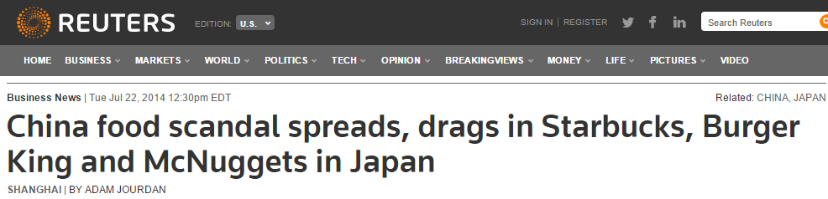
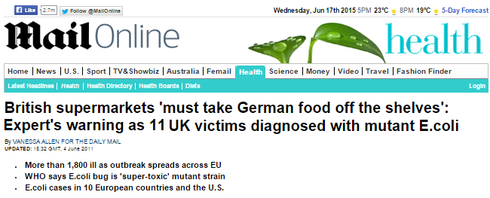
Your Voice for Safe Food

Slide 27
When does a multi-state outbreak become a pandemic?
Your Voice for Safe Food

Slide 28
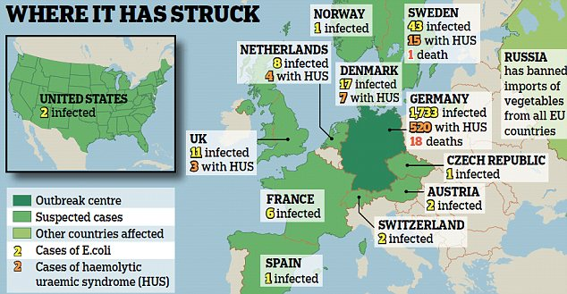
Your Voice for Safe Food

Slide 29
“The things described
by Mr. Sinclair
happened yesterday,
are happening today,
and will happen tomorrow,
and the next day,
until some
Hercules comes
to cleanse the
filthy stable.”
Your Voice for Safe Food

