Slide 1
Scenario modeling to support the protection of a threatened species (Rangifer tarandus caribou) in a highly industrialized landscape in Alberta, Canada
Dr. Danielle J. Marceau
Department of Geomatics Engineering, University of Calgary, Alberta, Canada
dmarceau@ucalgary.ca
Dr. C.A.D. Semeniuk, D. Birkigt, M. Musiani, M. Hebblewhite and S. Grindal
Third International Conference on Biodiversity and Sustainable Energy Development
Valencia, Spain, June 24-26, 2014

Slide 2

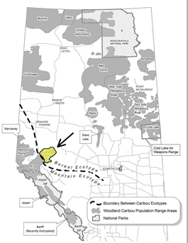
Context and study area (1)
Woodland caribou in Alberta are designated as threatened
  Continued declines associated with human activities
Little Smoky Caribou herd in west-central Alberta
  Range covers about 3,100 km²
  Threatened herd includes 78 individuals
The Alberta government recommends:
  the assessment and management of cumulative effects on caribou
  the provision of adequate habitat for their persistence

Slide 3
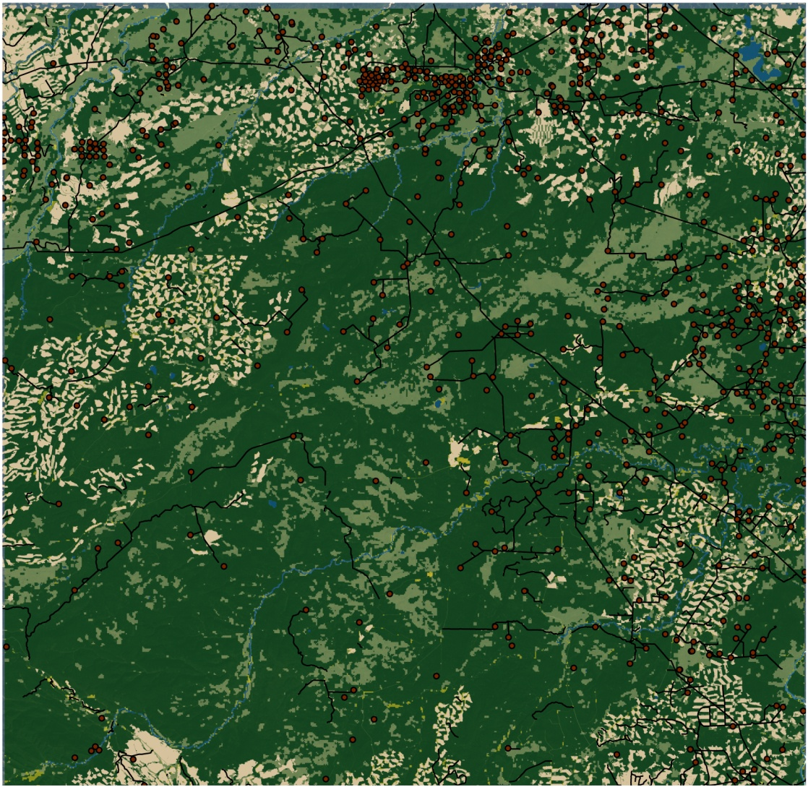
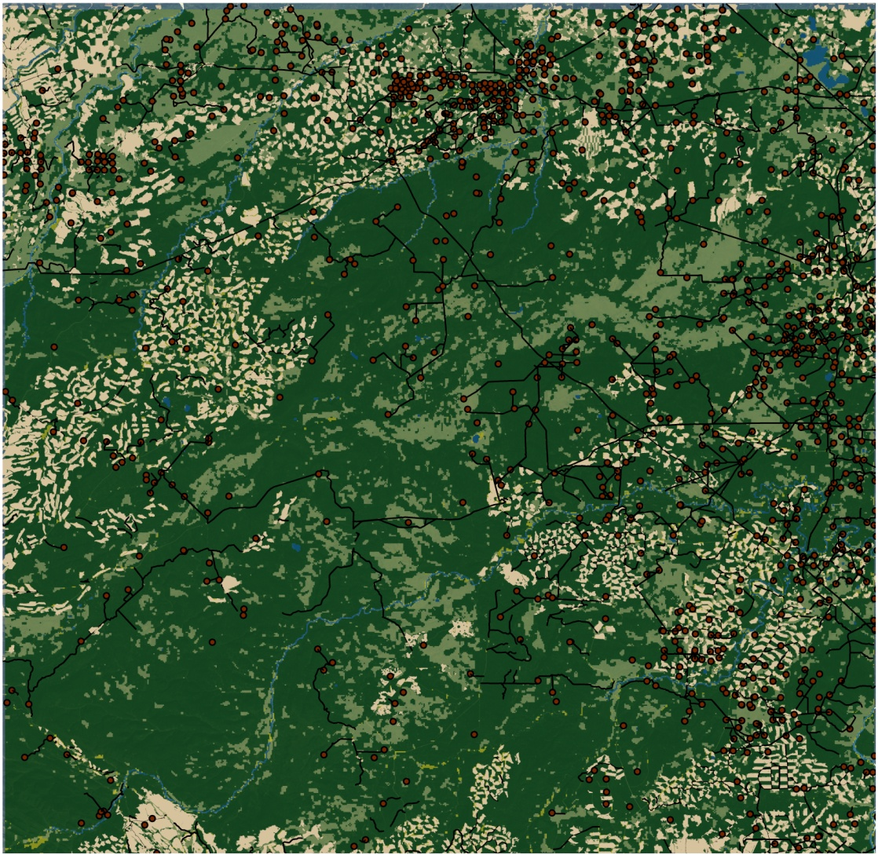
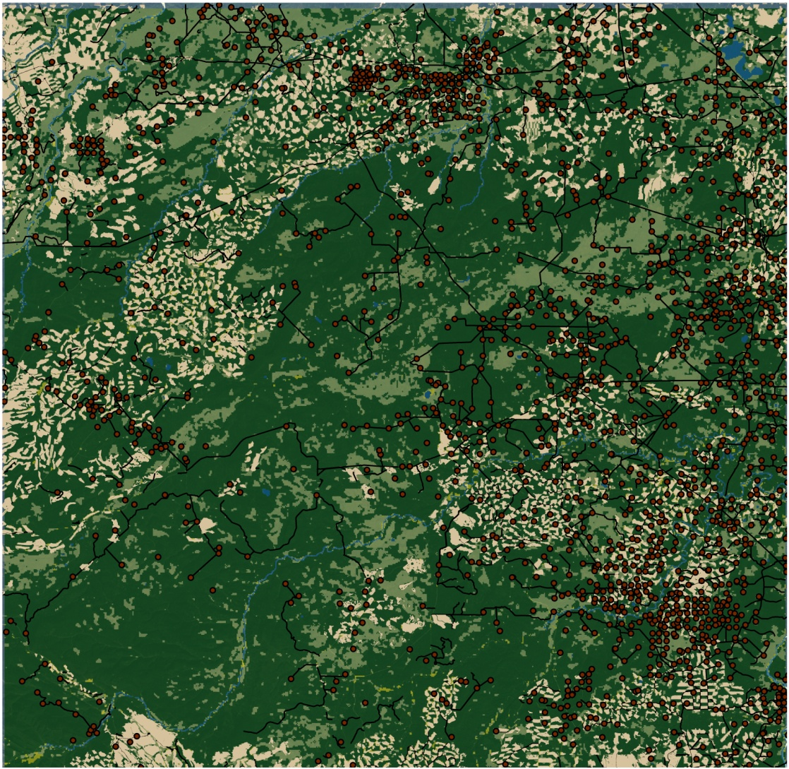
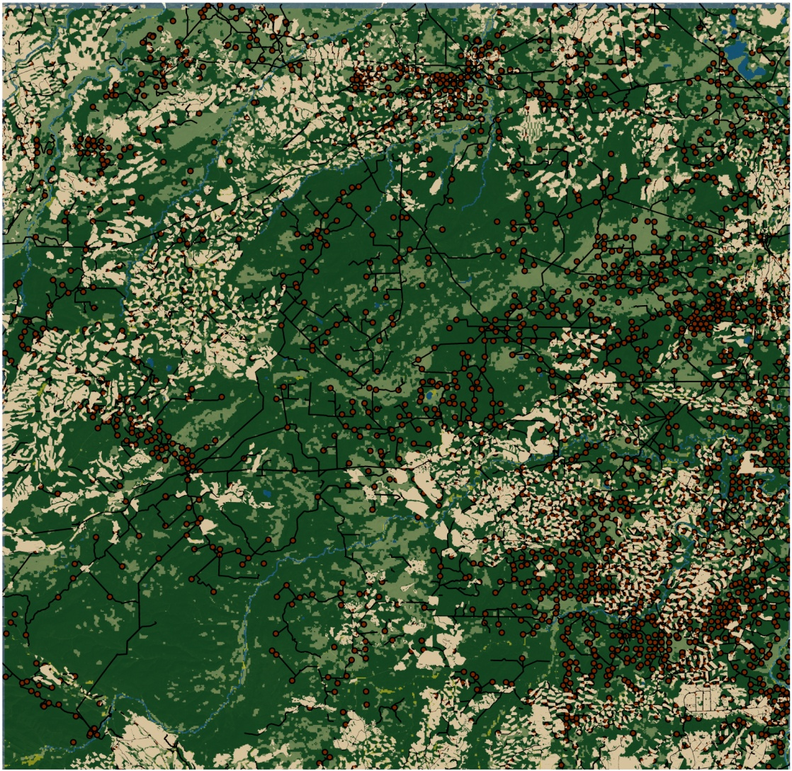
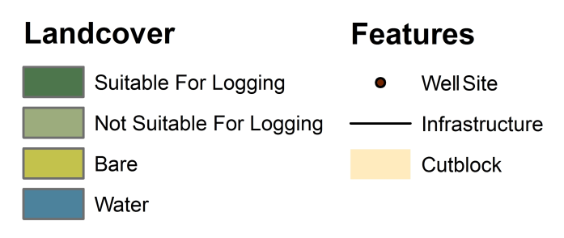
Context and study area (2)
The range has the highest level of industrial development of any caribou herd in Canada
  Oil and gas industry (pipelines, seismic lines, wells)
  Forestry (cut blocks, roads)
1998
2001
2004
2011
(Birkigt, 2011)

Slide 4
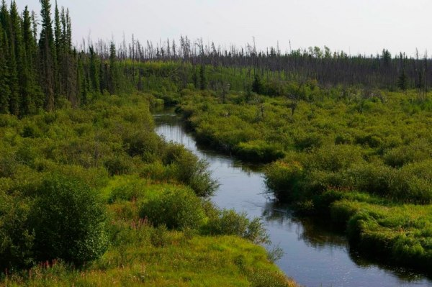
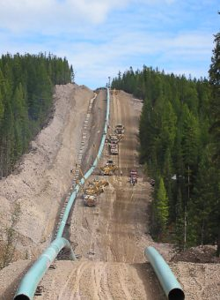
Context and study area (3)
These industrial activities affect caribou in several ways:
  They destroy and fragment the caribou range composed of old growth conifer forests and muskegs
  They remove large areas that contain lichens, their primary winter food source
  They increase the risk of predation by facilitating the access to predators
  They increase the stress on caribou that perceive anthropogenic activities and features as disturbance

Slide 5
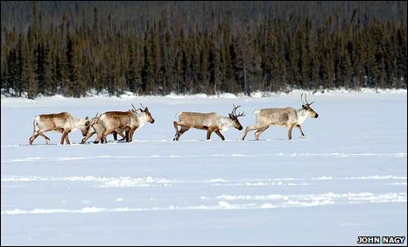
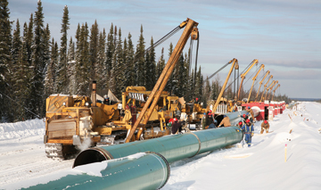
Objectives
To determine how the industrial activities influence woodland caribou habitat selection and use in the study area
An agent-based model was developed to:
  Simulate and recreate the movement behaviors of caribou to explore how they select and use their winter habitat
  Assess how caribou adapt to their changing environment
  Determine the relative impact of different industrial features on caribou habitat selection strategies in winter

Slide 6
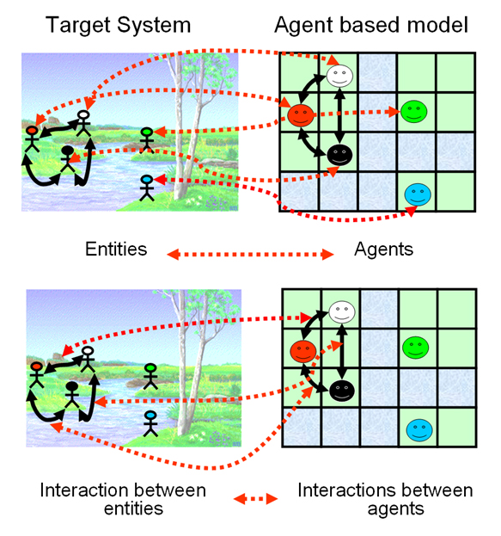
Agent-based models (ABMs)
Agent-based models simulate a community of agents that interact within an environment that supports their activities
Agents can be any entity of the real world
  They are goal-driven and try to fulfill specific objectives
  They are aware of and can respond to changes in their environment
  They can communicate with other agents
  They can cooperate, coordinate, and negotiate with each other
  They have a memory
  They can learn and adapt
(Galan et al., 2009)

Slide 7
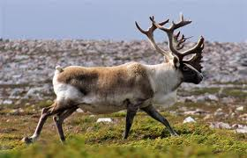
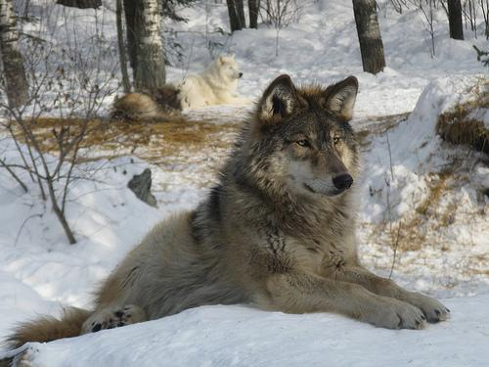
Modeling approach
Our modeling approach combines movement ecology with behavioural ecology within an ABM framework
The ABM simulates caribou as individual agents that:
  Are capable of making trade-off decisions to maximize their survival and reproductive success
  Are spatially aware of their surrounding environment
  Have a memory
  Can learn where to forage, while concurrently avoiding predators and habitat disturbance

Slide 8
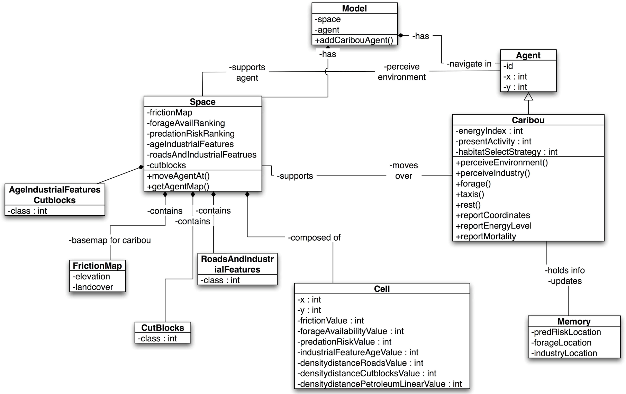
Model architecture
(Semeniuk et al., 2012)

Slide 9
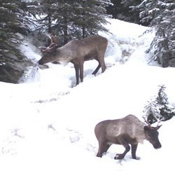
Caribou data collection
Caribou data were needed to parameterize and validate the ABM
These datasets include:
  Radio-collared GPS location data from 13 female caribou in the winter 2004-2005
  Preferred land-cover types and elevation
  Bio-energetic functions
  Movement (range, daily distance, speed)
  Spatial memory

Slide 10
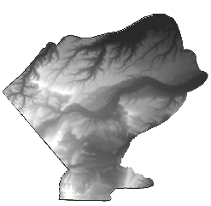
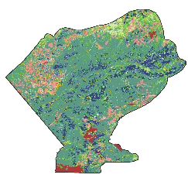
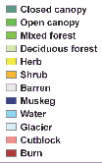
Environmental data collection (1)
Several geographic datasets were incorporated into a GIS database as attribute layers of the study area
  Digital Elevation Model at 30 m resolution
  Land-cover map produced from Landsat TM imagery with 12 classes
Digital Elevation Model
Land-cover map for 2005
(Semeniuk et al., 2011)

Slide 11
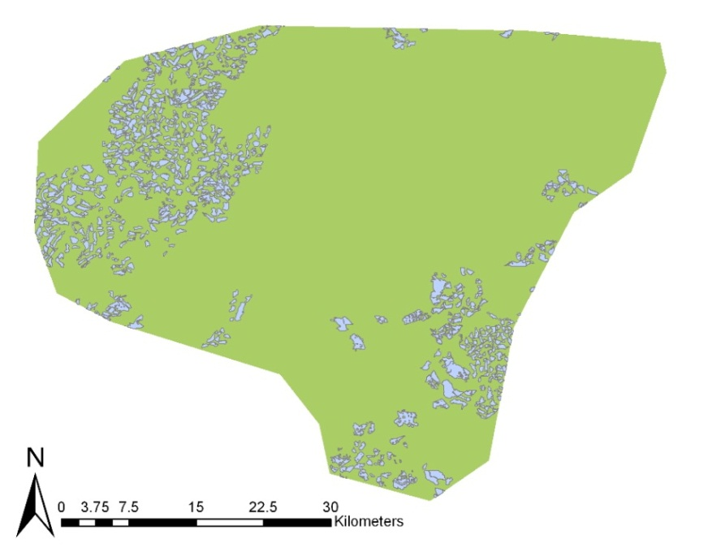
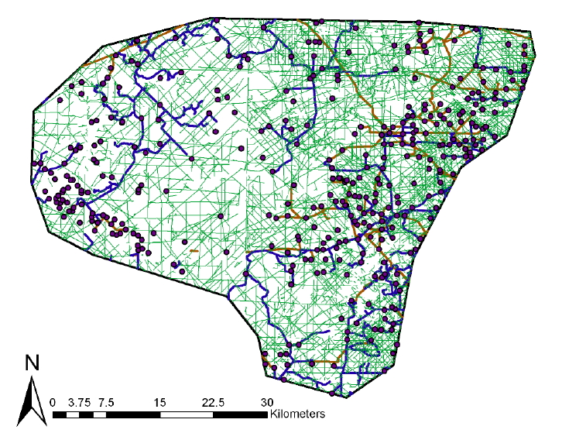
Environmental data collection (2)
Other geographic datasets were incorporated into a GIS database as attribute layers of the study area
  Map of cut blocks for the year 2005
  Map of the industry features for the year 2005
Forestry cut blocks in 2005
Industry features in 2005
(Semeniuk et al., 2011)

Slide 12
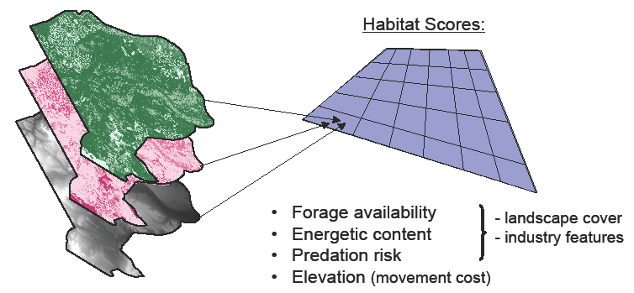
Representation of the environment
The environment was represented as a virtual grid (45 m resolution) where the caribou agents are located and perform their activities
Each cell of the environment was assigned four values:
  A forage availability score
  An energetic content
  A predation risk score
  An elevation value
(Semeniuk et al., 2011)

Slide 13
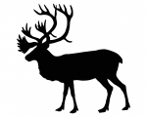
Agent’s behavior (1)
The ABM is based on the premise that the individual animal’s internal state influences how it perceives its environment, which drives its decision-making process
Based on caribou bio-energetics, the model considers:
  The internal state of the animal (why to move)
  The motion (how to move)
  The navigation (when and where to move)
?
?
?
(Semeniuk et al., 2011)

Slide 14
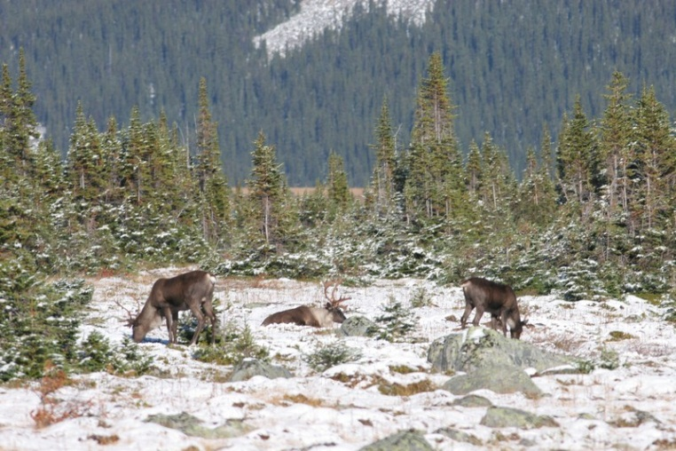

Agent’s behavior (2)
Caribou engage in different types of movement, reflecting different scales of habitat selection
The model simulates four types of movement:
  Local, intra-patch foraging where caribou move one cell at a time
  Inter-patch foraging, up to two cells at a time
  Random taxiing to an unknown location
  Revisiting a previously-visited patch drawn from memory

Slide 15
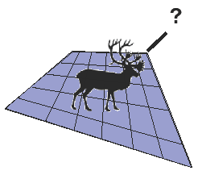
Agent’s memory
The model considers two types of memory: reference and working
Reference memory:
  Stores locations for profitable feeding and low risk areas
Working memory:
  Used to avoid backtracking on recently depleted food patches
(Semeniuk et al., 2011)

Slide 16
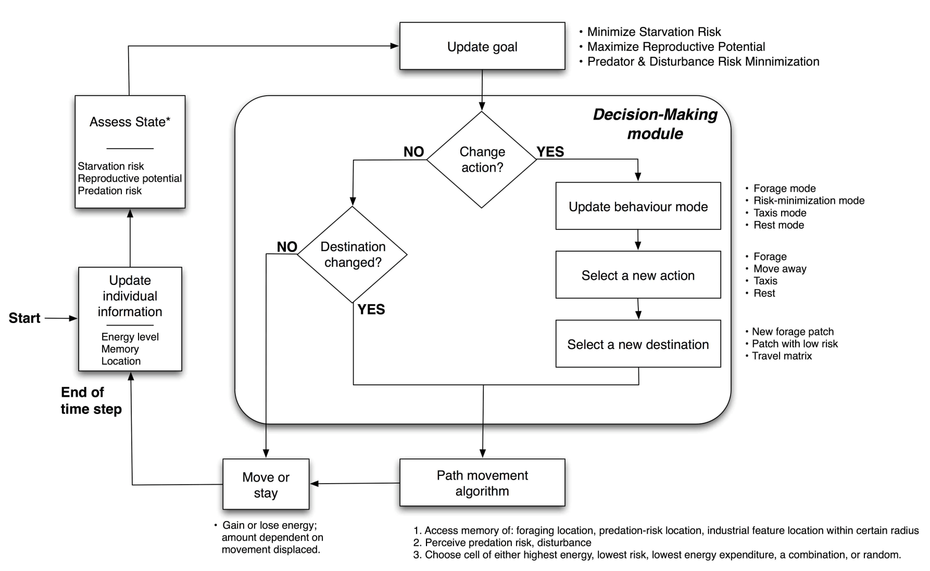
Caribou agent’s decision making
(Semeniuk et al., 2012)

Slide 17
Simulation framework (1)
The simulation framework is as follow:
The model is run with one agent per simulation
The spatial resolution is 45 m
The time step is 30 min
The model is run for 180 days (winter season)
An agent represents a pregnant female at 132 kg
Initial starting coordinates match the location of actual caribou
Each simulation is replicated 65 times; results are averaged
The model was developed in NetLogo

Slide 18
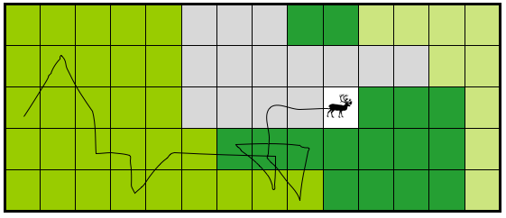
Simulation framework (2)
The model keeps a record of the caribou agent’s internal state and movement during the simulation
The following information is recorded:
  Location, the cell occupied by the caribou agent
  Current energetic uptake
  Cumulative amount of energy accumulated and lost
  Net cumulative energy
  Previous locations of high energy return and low predation risk
(Semeniuk et al., 2011)

Slide 19
Simulation framework (3)
Five behavioral strategy scenarios were simulated:
DRP: balance between energy requirements, long-term reproduction and avoidance of predation
DP: reproductive requirements are neglected
RP: reproductive requirements take precedence
DR: predation insensitive
P: predation hyper-sensitive

Slide 20
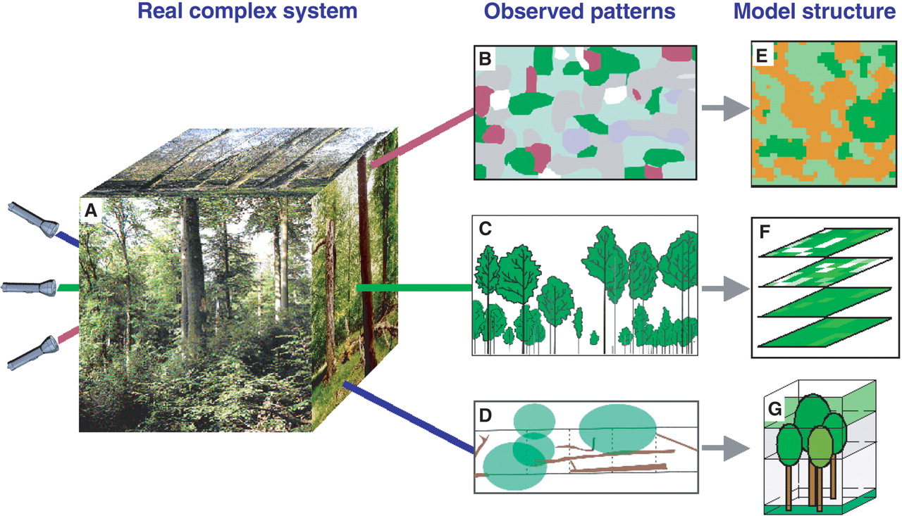
Model validation (1)
The quality of the simulation results was measured using the pattern-oriented modeling approach (Grimm et al., 2005)
Consists in comparing simulated patterns with observed ones

Slide 21
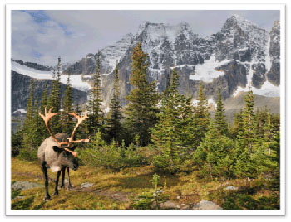
Model validation (2)
Different metrics were used to compare the patterns generated through the simulation with observed patterns from the scientific literature and field observations
Bio-energetic patterns:
  Daily energy gain/expenditure
  Cumulative energy loss over winter
  Energy budget
Spatio-temporal patterns:
  Daily distance traveled
  Daily step length pattern
  Use of low/high elevations
  Land-cover usage
  Range: minimum convex polygon

Slide 22
Results: bio-energetic patterns (1)
The values obtained with the model fall within the range of values reported in the literature
 | Actual Values | Energetics & Predation (DRP) | Energy Acquisition (DP) | Energy Conservation (RP) | Predation-Insensitive (DR) | Predation – hypersensitive (P)
Median daily energy gain (MJ) | 22 - 33 | 25.4 | 24.6 | 24.6 | 28.2 | 21.7
Mean daily energy loss (MJ) | -28.7 | -28.1 | -28.1 | -26.4 | -25.9 | -27.8
Percent time spent foraging (%) | 50 – 88 | 76.9 | 69.6 | 71.2 | 74.6 | 64.9
(Semeniuk et al., 2012)

Slide 23
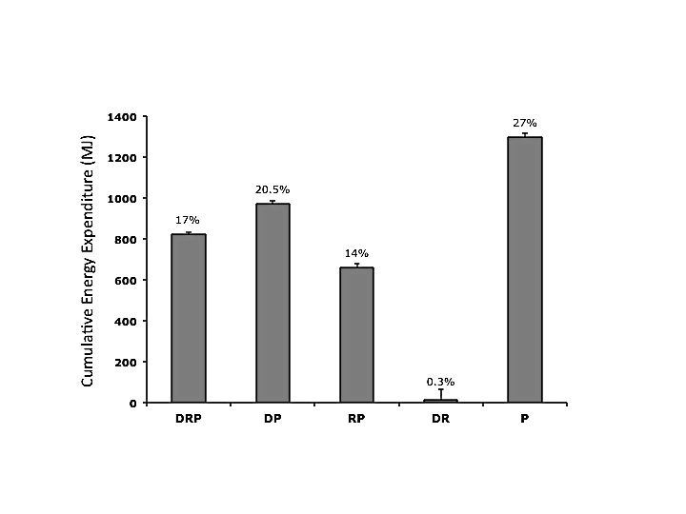
Results: bio-energetic patterns (2)
As expected, in each simulated scenario, the caribou agents experienced a cumulative energetic deficit by the end of the season
The deficit is the largest for the scenario P in which the agents are hypersensitive to predation
It is the smallest for the scenario DR in which the agents are not sensitive to predation
(Semeniuk et al., 2012)

Slide 24
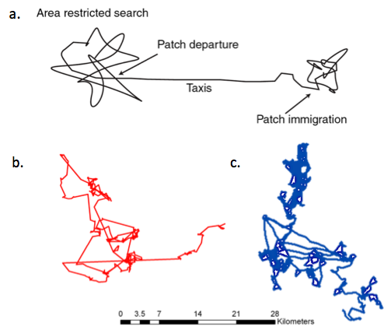
Results: movement patterns (1)
The trajectories of the agents exhibit the typical movement path displayed by real caribou: high tortuosity in the small-scale movements separated by straighter tracks in the large-scale ones
a: typical movement behavior
b: movement displayed by a real female caribou
c: movement of a simulated caribou agent
(Semeniuk et al., 2012)

Slide 25
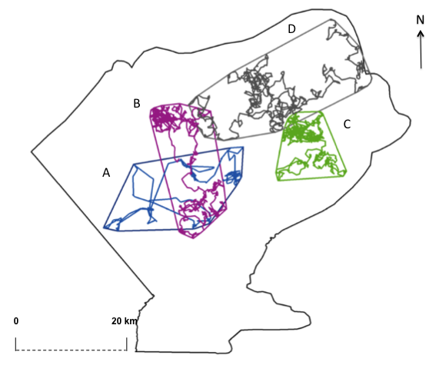
Results: movement patterns (2)
The trajectories of three simulated agents (B, C, and D) closely match the individual minimum convex polygon of a real caribou
Scenarios:
  A: real caribou
  B: energetics and predation
  C: predation-insensitive
  D: predation hypersensitive
The caribou agents use the landscape differently depending on the scenario being simulated
(Semeniuk et al., 2012)

Slide 26
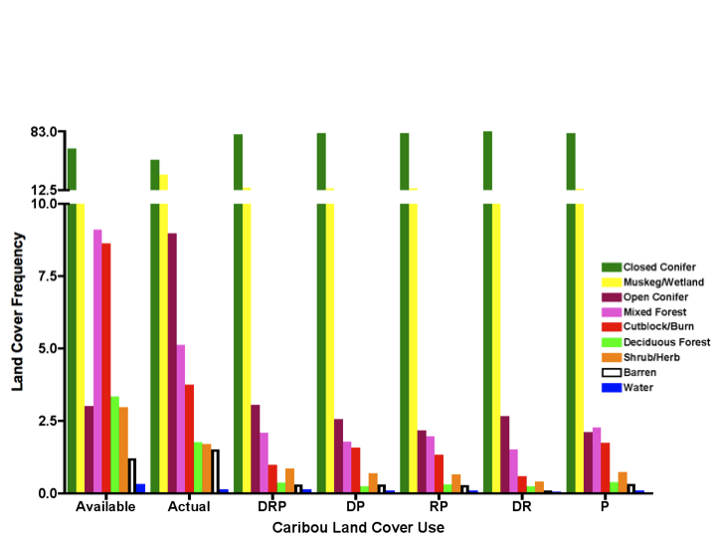
Results: land-cover use
Simulated caribou used land-cover classes similarly to actual caribou with respect to the overall order
Closed conifers and muskeg/wetlands are used the most in all scenarios
Open conifers is not used as much by the agents as the actual caribou do; this is due to the allocation of forage value and energetic content during the calibration of the model
(Semeniuk et al., 2012)

Slide 27
Results: summary
The ranking of scenarios based on how closely they match the patterns of real caribou reveals the following:
The Energetics and Predation scenario (DRP) in which the caribou agent must trade-off its daily energy requirement, minimize its reproductive energy loss and minimize the predation risk is the best-fit scenario
Not recognizing industrial features as predation risk (Predation insensitive scenario, DR) causes simulated caribou to unrealistically reduce their daily and landscape movements
The Hyper-sensitive scenario (P) results in unrealistic energetic deficits and large-scale movement patterns, unlike those observed in real caribou
The simulated patterns are the result of trade-off decisions made by the caribou agents; they emerge from these decisions

Slide 28
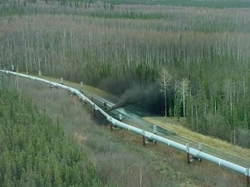
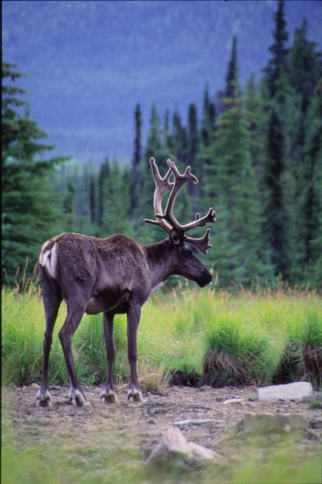
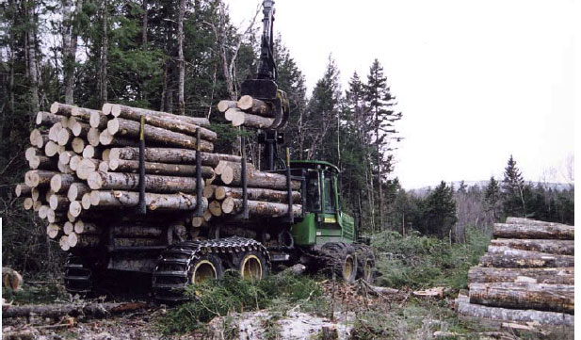
Conclusion
Our model demonstrates that caribou (LSM) are sensitive to industrial features on the landscape that evoque anti-predator responses and bioenergetic costs in the absence of any explicit predators modelled
  Management efforts should ensure that caribou:
    are not increasingly energetically stressed
    have enough high-quality forage and available habitat to meet their needs required for reproduction
  Management efforts should limit new industrial development and restore some areas

Slide 29
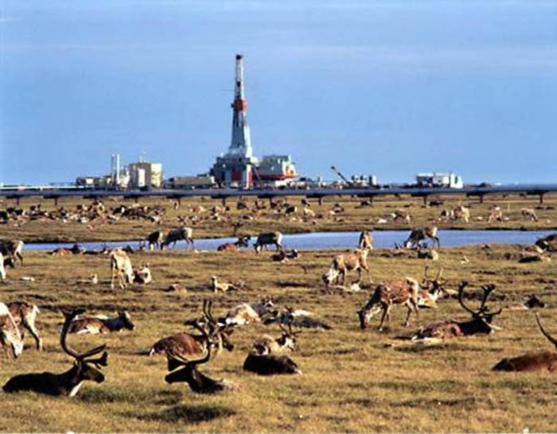
Acknowledgements
Semeniuk, C., M. Musiani, M. Hebblewhite, S. Grindal, and D. J. Marceau, 2012. Incorporating behavioral-ecological strategies in pattern-oriented modelling of caribou habitat use in a highly industrialized landscape. Ecological Modelling 243: 18-32.
  Funding was provided by:
    GEOIDE
    MITACS/NSERC
    ConocoPhillips Canada
    Tecterra

Slide 30
Work in progress: dynamic landscape (1)
In its actual version, the ABM simulates the behavior of caribou agents on a static environment corresponding to know conditions for a specific season (winter 2004-2005)
Work is in progress to simulate a changing landscape using a CA model
  Scenarios of future land development plans (oil and gas and forestry) are being simulated
Transition rules implemented for well development:
  Wells are located preferably on low slope
  They are located in areas having a high resource potential
  They are preferably found within 2 km of existing infrastructure
  They are preferably located within 1.8 km of another well

Slide 31
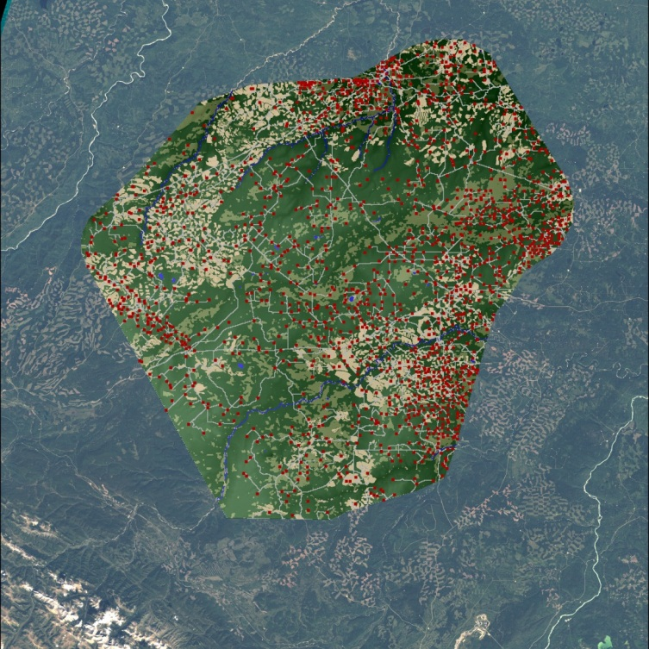
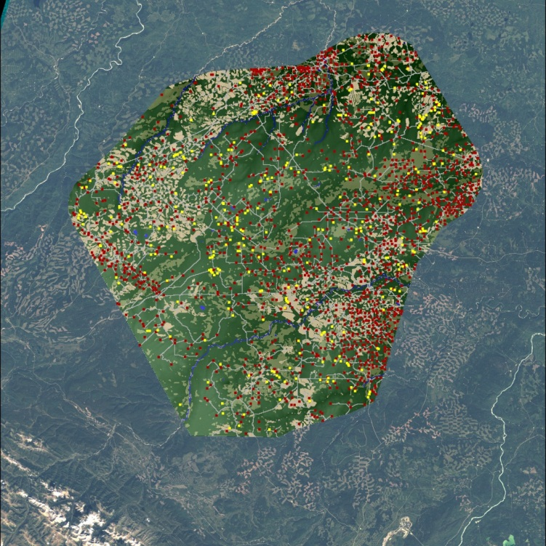
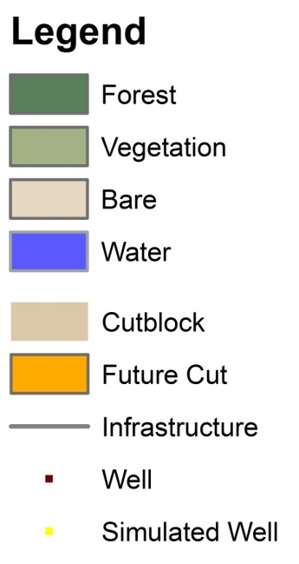
Work in progress: dynamic landscape (2)
Land use map 2011
Simulated well development in 2015
(Birkigt, 2012)

Slide 32
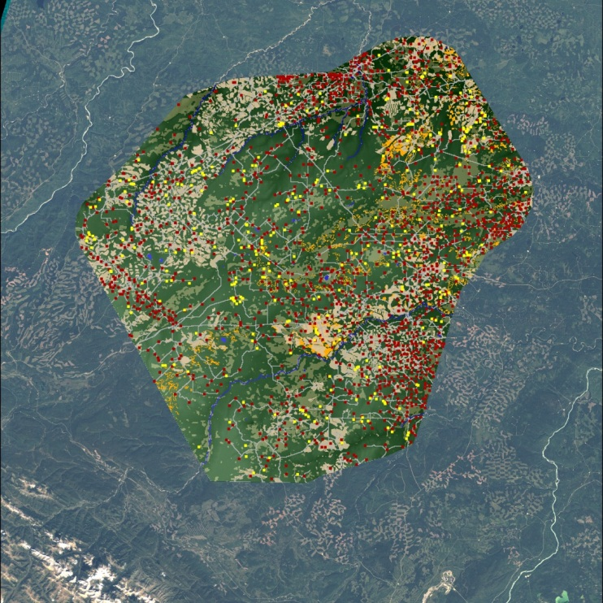
Work in progress: dynamic landscape (3)
Simulated well development and one harvesting plan in 2015
Land use map 2011
(Birkigt, 2012)

Slide 33
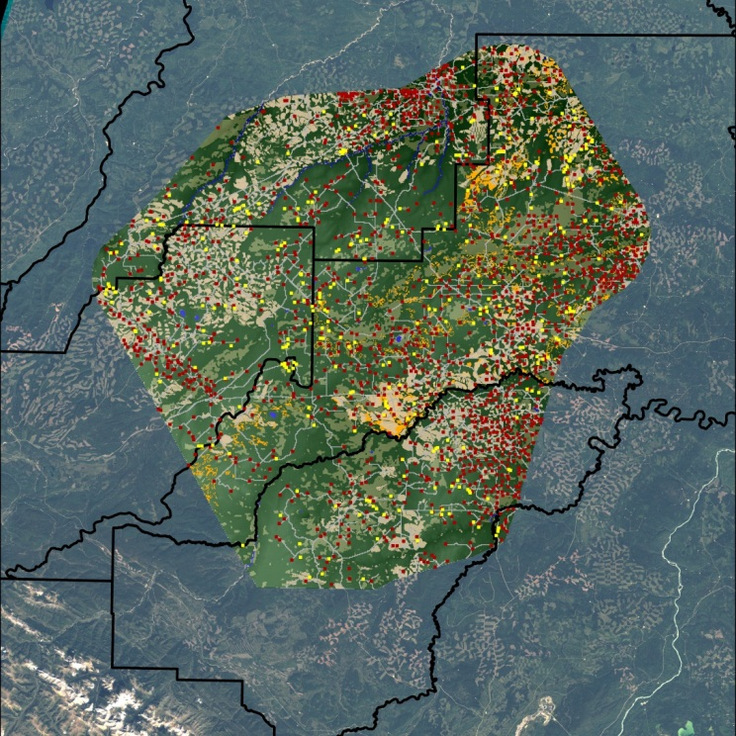
Work in progress: dynamic landscape (4)
Land use map 2011
Management forestry units
(Birkigt, 2012)

Slide 34


