Slide 1

First and second generation biofuels: How to assess their potential for sustainable transportation
Daniela Thrän, Stefan Majer, Markus Millinger
In cooperation with the UFZ
Valencia , 25th of September 2015

Slide 2
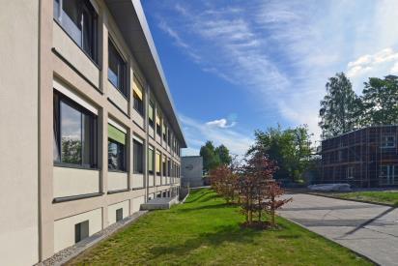
Introduction to the DBFZ
History:
          Founded in 2008 as a non-profit research institute
          Owned by the Federal Ministry for Food and Agriculture
  Our Mission
  Support the efficient and sustainable integration of biomass into a changing future energy system. Development of technologies, methods, tools and strategies for stakeholders from industry, society and policy.
Structure:
    ~ 220 staff members in 4 research departments and administration

Slide 3
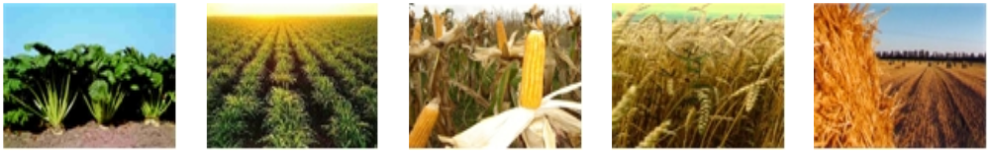
Agenda
Introduction
Methods, indicators and tools for sustainability assessment
Preconditions for the development of sustainable biofuel value chains
      Sustainable resource base
      (GHG-) efficient conversion processes
Summary

Slide 4
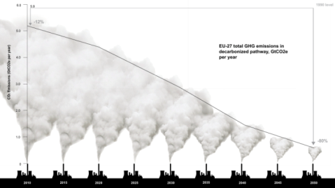
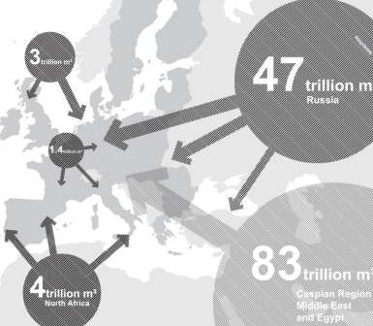
Introduction Why are we promoting bioenergy?
Climate protection
  EU-15: 8% reduction of GHG emissions (2008-2012),
  EU-27: 20% reduction until 2020
  Germany: 40% reduction until 2020 (compared to 1990)
Energy security
  reduction of energy imports
  reduction of dependencies from fossil energy carriers
Creation of income/jobs
  direct: creation of income in rural areas
  indirect: development of a biomass-/bioenergy based economy
Roadmap 2050, Vol. 3
Roadmap 2050, Vol. 3
4

Slide 5
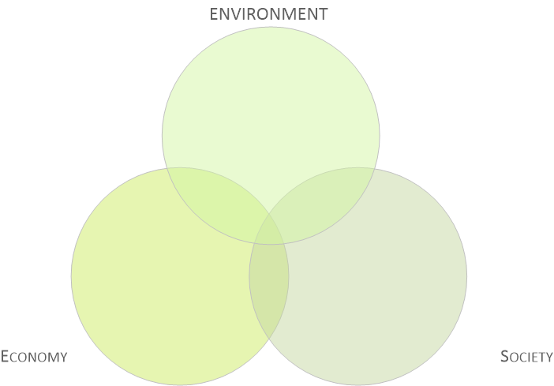
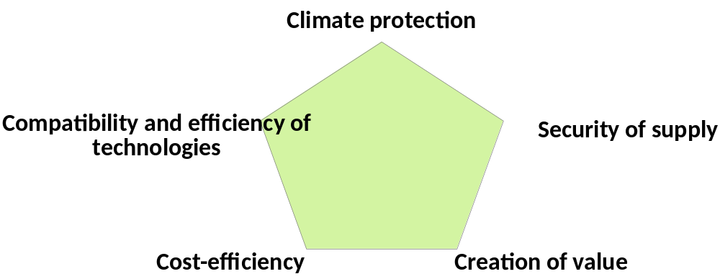
Introduction conflicting targets?
Source: DBFZ, 2014

Slide 6
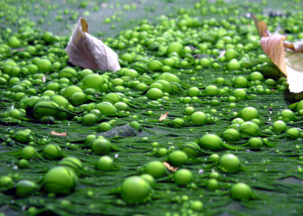
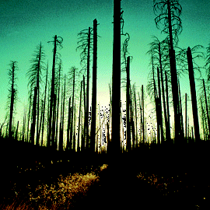
          Introduction - Environmental risks of an increasing bioenergy production
Increasing use of fertilisers and pesticides causes emissions to soil, water and air
Change in existing (traditional) cropping cycles → increasing cultivation of monocultures
Loss of biodiversity
Increasing pressure on natural ecosystems and habitats
Risk of high emissions from direct and indirect land use change scenarios

Slide 7
Introduction - Why do we assess sustainability aspects of bioenergy?
Bioenergy is promoted mainly to reduce environmental impacts compared to fossil systems → to ensure this, a constant monitoring is necessary
Sustainability assessment can help to i) define and monitor environmental and social safeguards and ii) measure the contribution towards GHG-mitigation and supply security targets.
Sustainability assessment can guide technological development and foster optimisation with regards to environmental indicators.
7

Slide 8
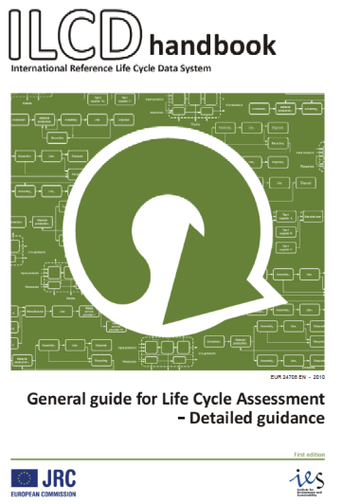
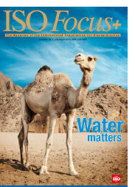
Methods, indicators and tools -
Life cycle assessment
Basic idea of the LCA methodology: The quantification of environmental impacts of a product system throughout its life cycle
Standardized in ISO 14040 & 14044, Guidance in ILCD handbooks
What can be done with LCA?
            Product or project development and improvement
            Strategic planning
            Public policy making
            Marketing and eco-declarations
available at http://lct.jrc.ec.europa.eu
Majer, S. 25.08.2015, Valencia

Slide 9

Methods, indicators and tools - diversification of assessment tools
Based on these classical LCA standards ’new’ approaches were recently developed which have led to some spin-off-standards. They cover issues like the:
‘single-issue-LCAs‘ like carbon footprinting (ISO 14067) or water footprinting (ISO 14046),
‘beyond environment-LCAs‘ like life cycle costing, social LCA and eco-efficiency assessments (ISO 14045) or even life cycle sustainability assessments,
‘beyond product-LCAs‘ like scope LCAs of organisations (ISO 14072) or sector-based IO-LCAs and
‘beyond quantification-LCAs‘ like environmental product declarations (ISO 14025) or other types of environmental labels and claims.
Springer.com

Slide 10
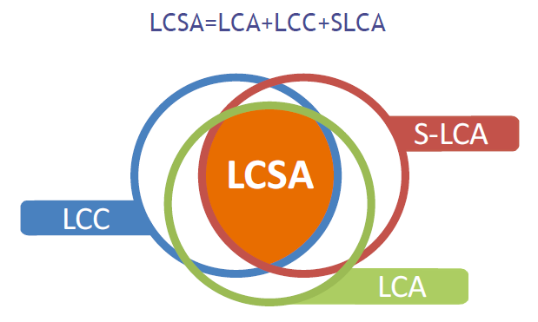
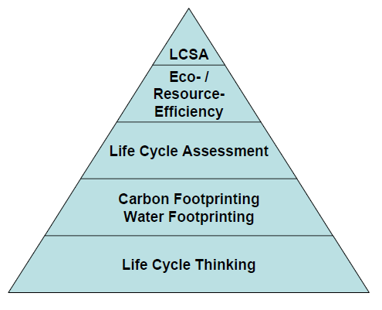
Methods, indicators and tools - the Maslow pyramid of sustainability
Source: based on Finkbeiner et al. 2015
Life Cycle Sustainability Assessment (LCSA) can integrate Life Cycle Assessment (LCA), Environmental Life Cycle Costing (LCC) and Social Life Cycle Assessment (SLCA) to evaluate sustainability of services and products
Source: Finkbeiner et al. 2010

Slide 11
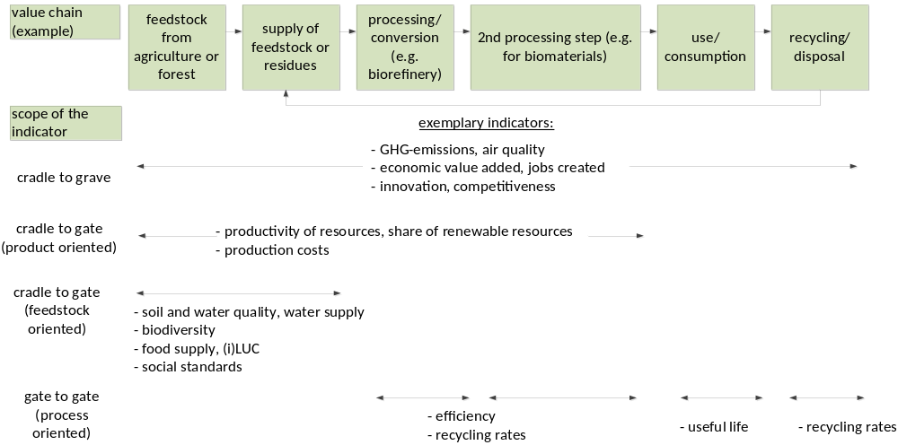
Methods, indicators and tools - examples for different indicators
Source: DBFZ 2015

Slide 12
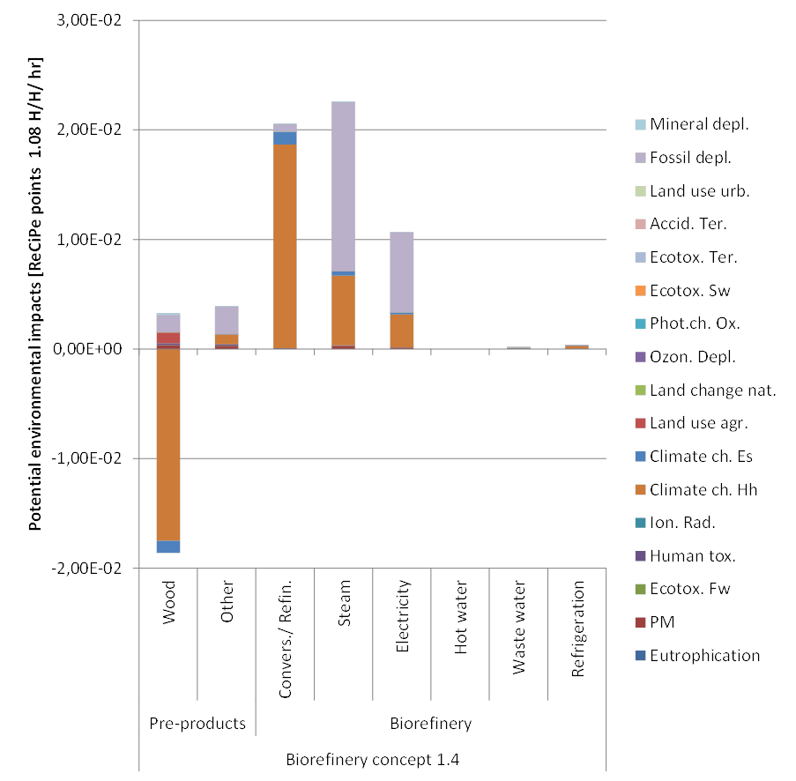
Preconditions for the development of sustainable biofuel value chains – a simple biorefinery example
Source: Budzinski, Nitzsche et al. 2015

Slide 13
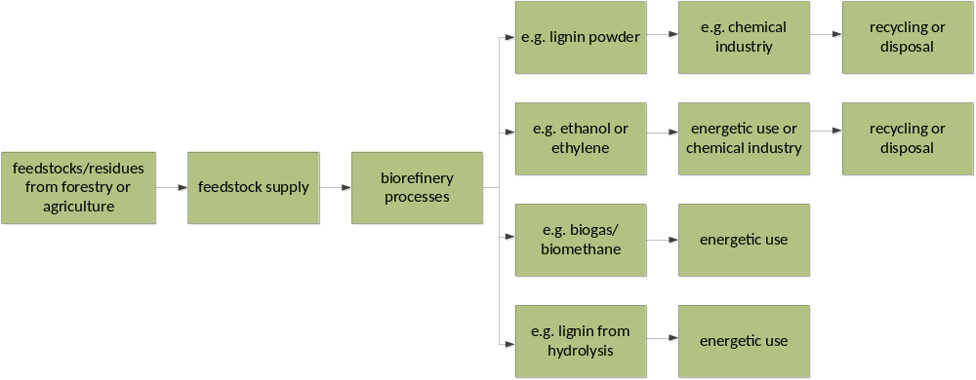
Preconditions for the development of sustainable biofuel value chains
Source: DBFZ 2015
sustainable resource base
efficient conversion processes
substitution of high value products from fossil resources

Slide 14
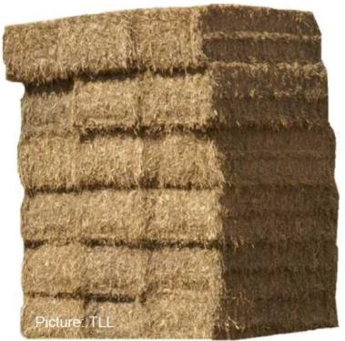
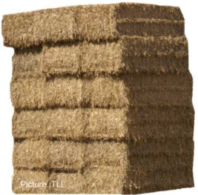

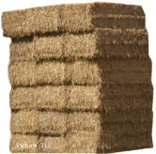
Sustainable resource base – example straw potential Germany
No steady prices for straw in Germany!
30 mill. tfm/a
8-13 mill. tfm/a
??
??
Theoretical
potential
Technical
potential
Economic
potential
Realizable
potential
Straw production
∅1999 - 2007
Technical restrictions,
material use,
humus reproduction
Competitive to other energy carriers?
Willingness to sell straw?
Source: Zeller et al. 2011 (project consortium: DBFZ, TLL, INL, Öko-Institut)

Slide 15
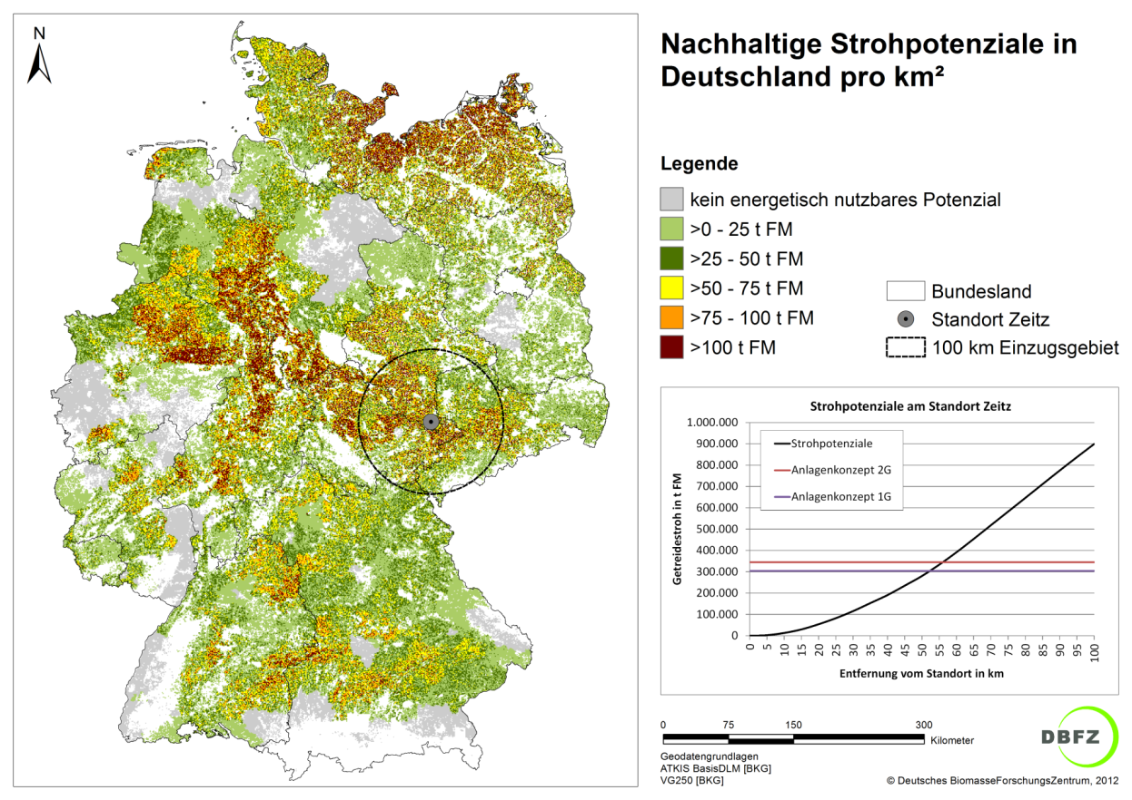
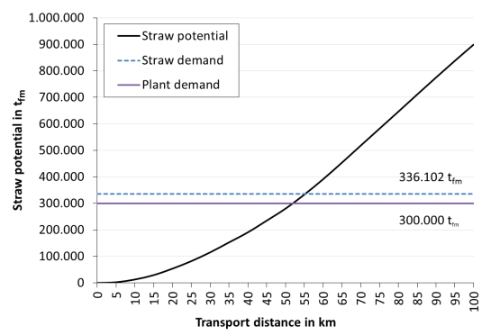
Sustainable resource base - regional distribution of straw potentials 1(2)
Example: bioethanol plant
Strohpotenziale pro km²
Standortauswertung
Straw potentials per km²
Location analysis
Legend
No potential for energy related use
>0 – 25 t_{fm}
>25 – 50 t_{fm}
>50 – 75 t_{fm}
>75 – 100 t_{fm}
>100 t_{fm}
Federal state
Plant position
100 km catchment area

Slide 16
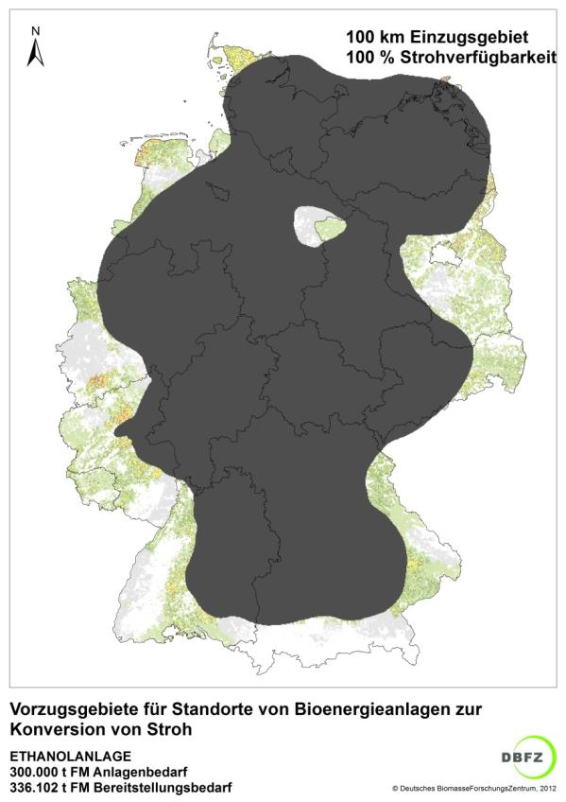
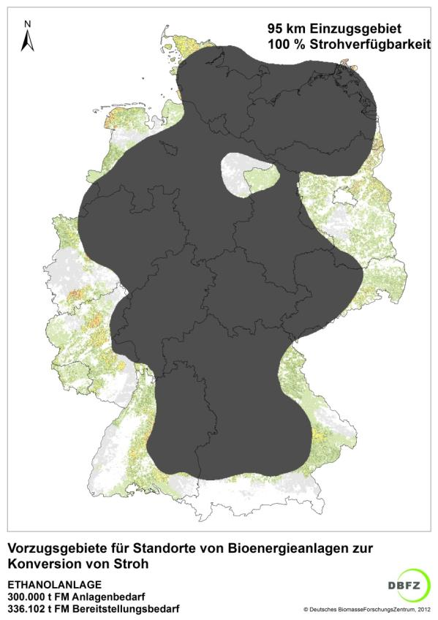
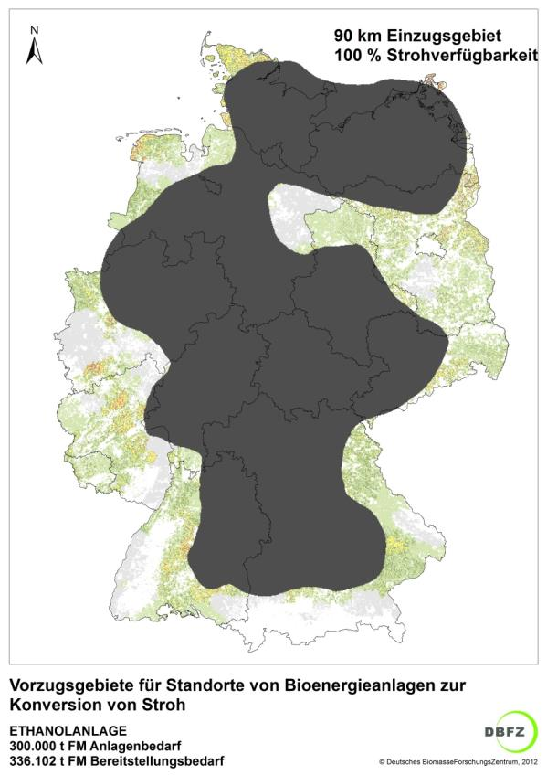
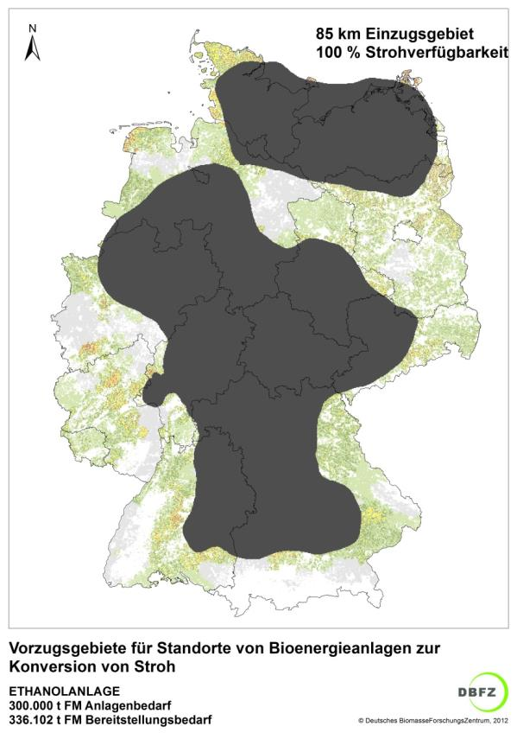
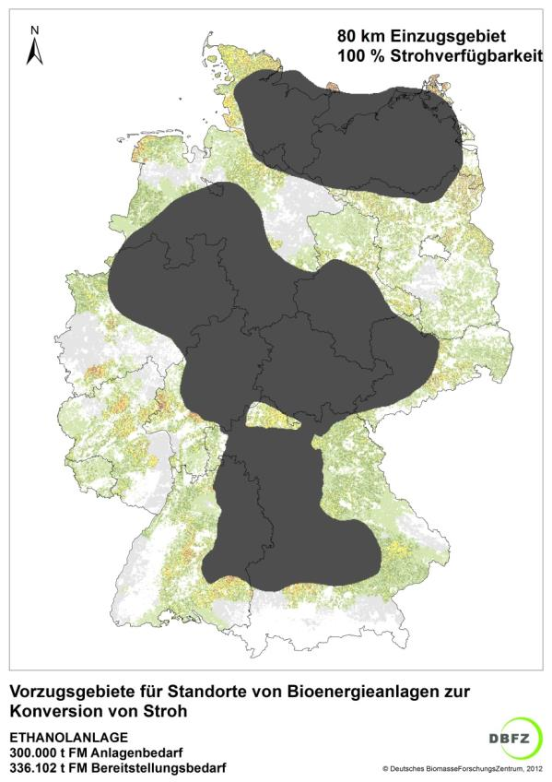
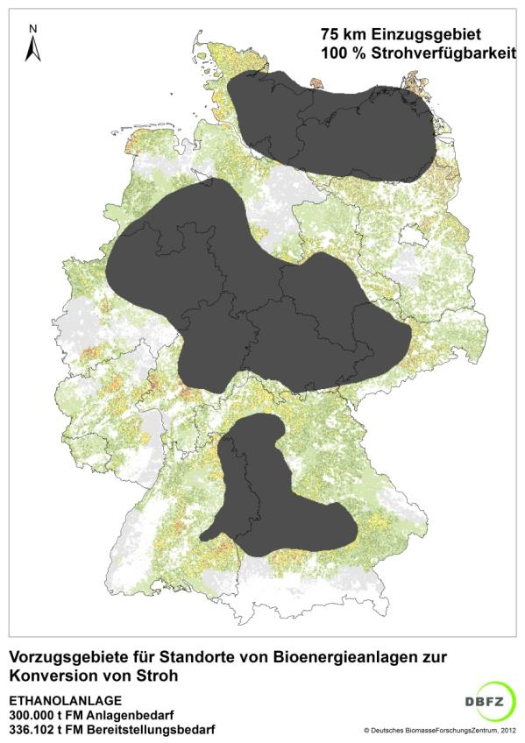
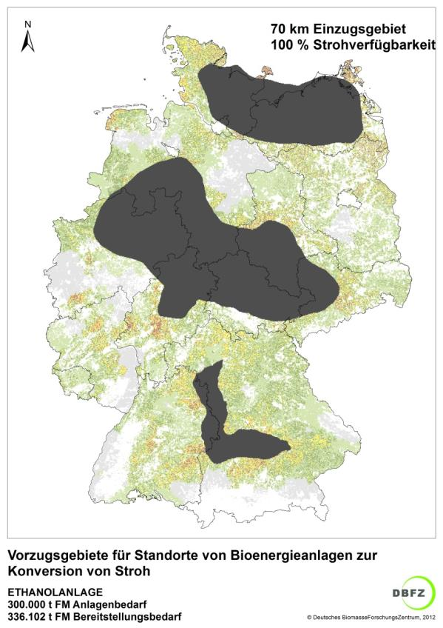
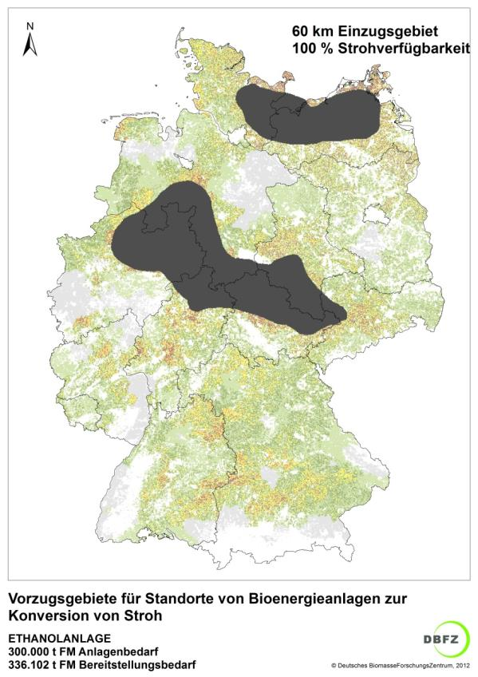
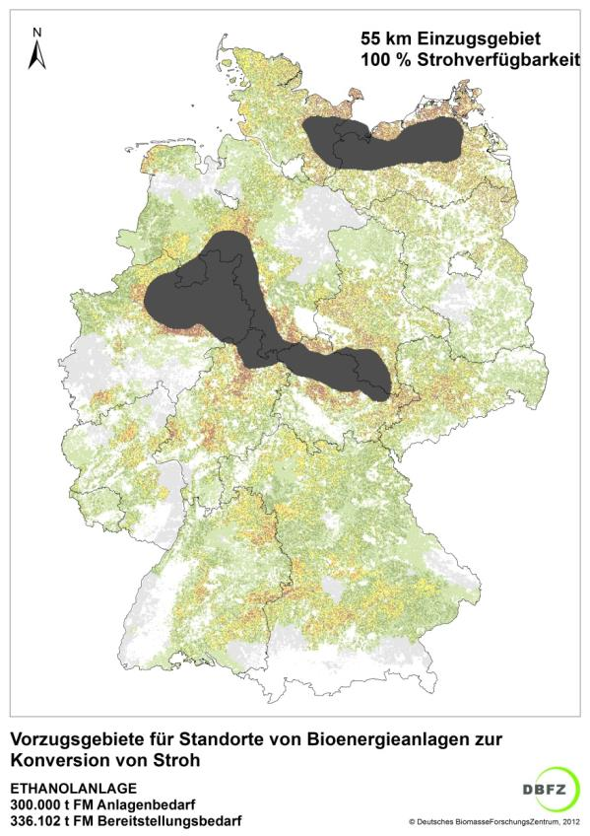
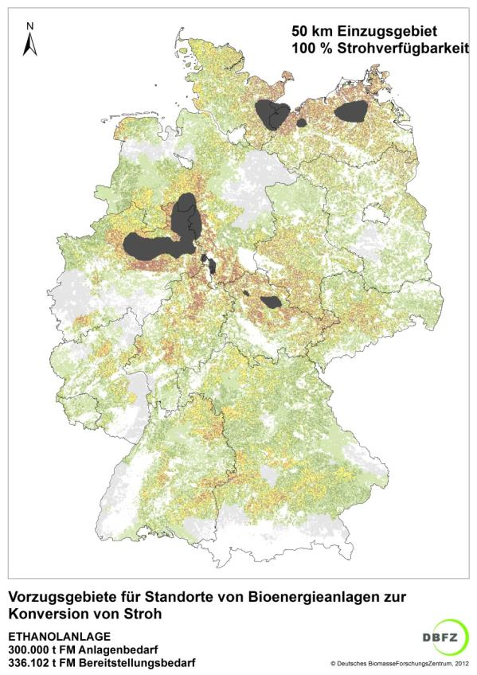
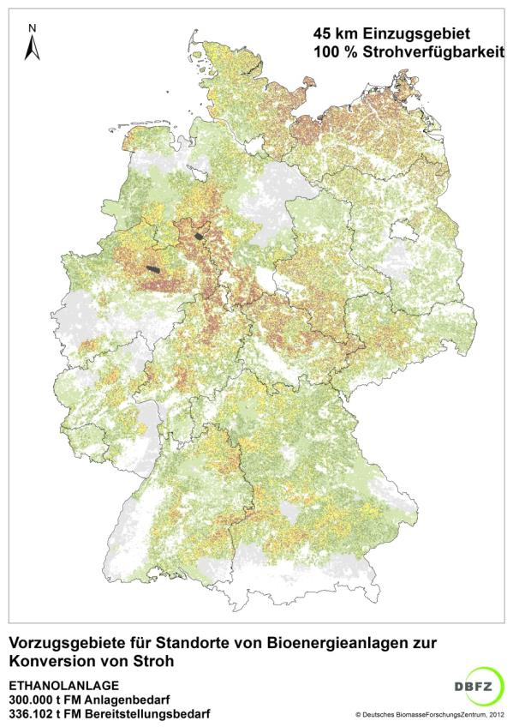
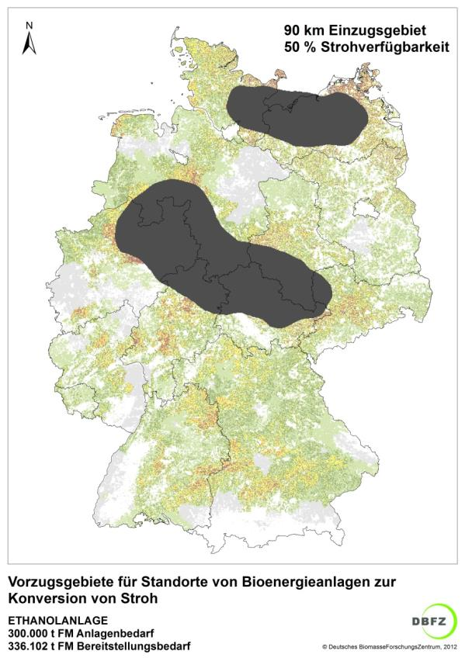
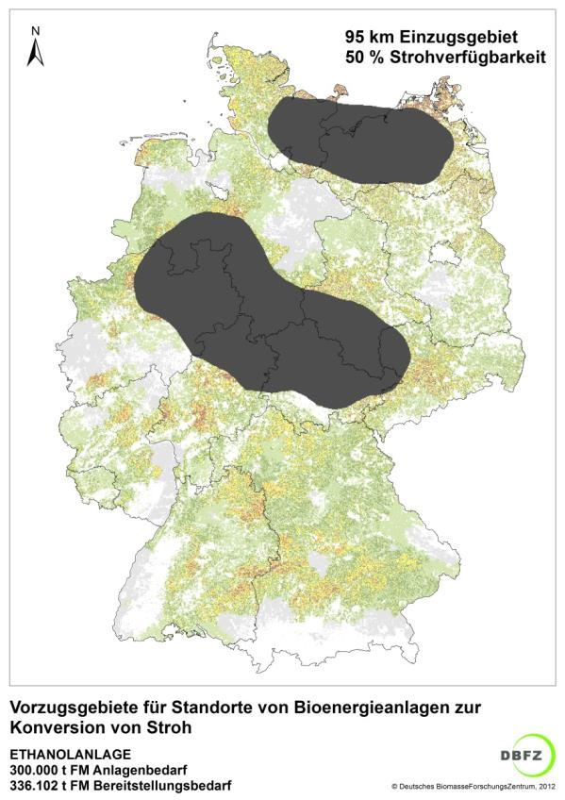
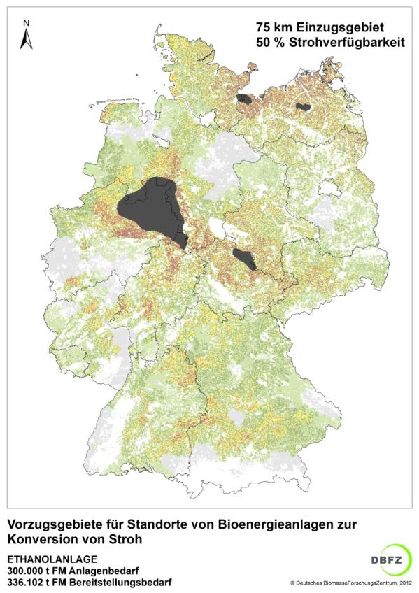
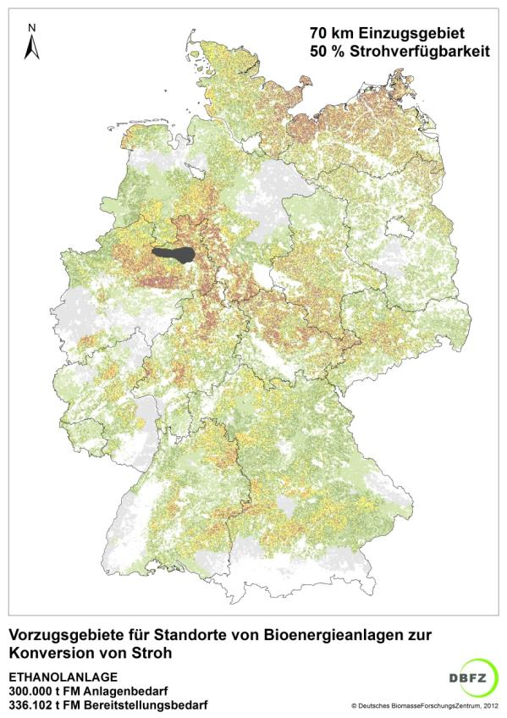
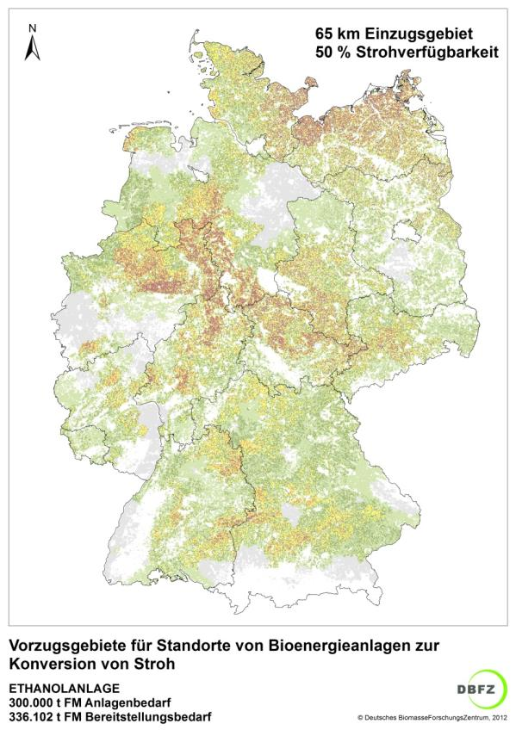

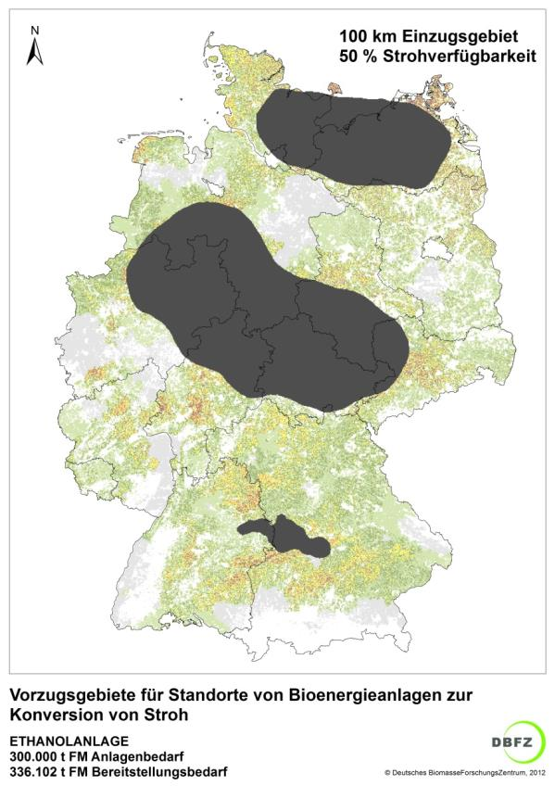

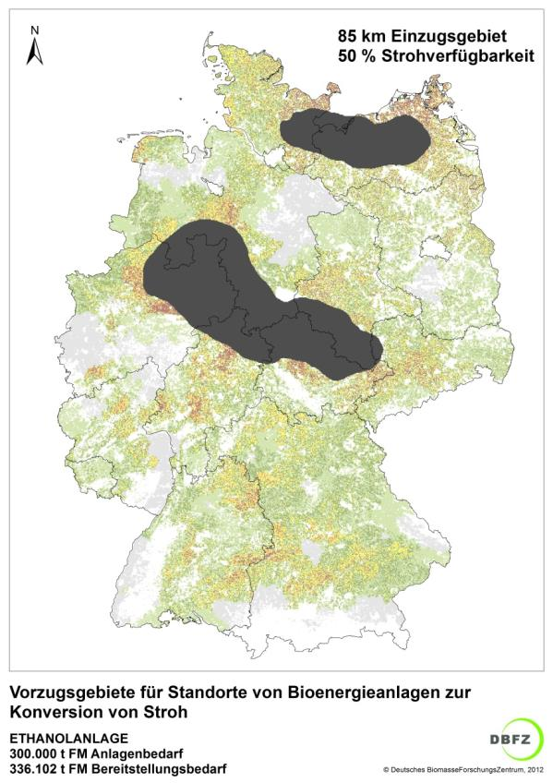

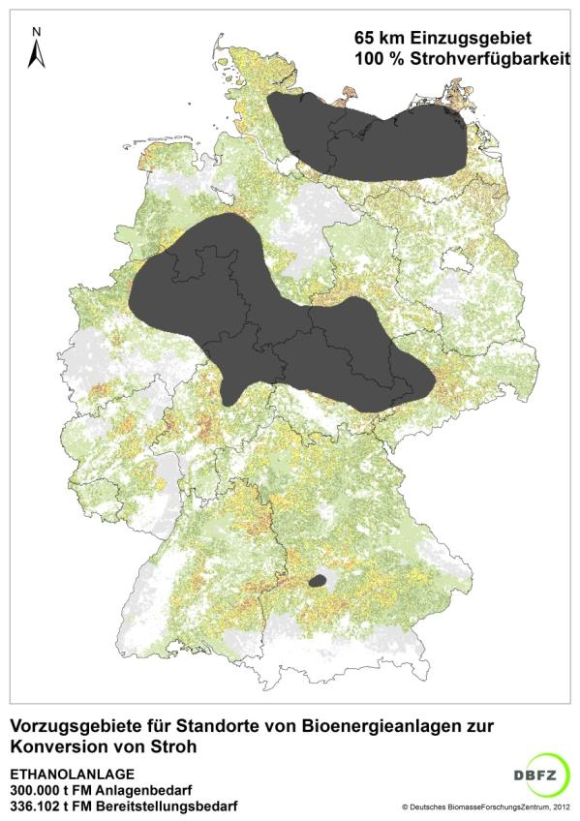
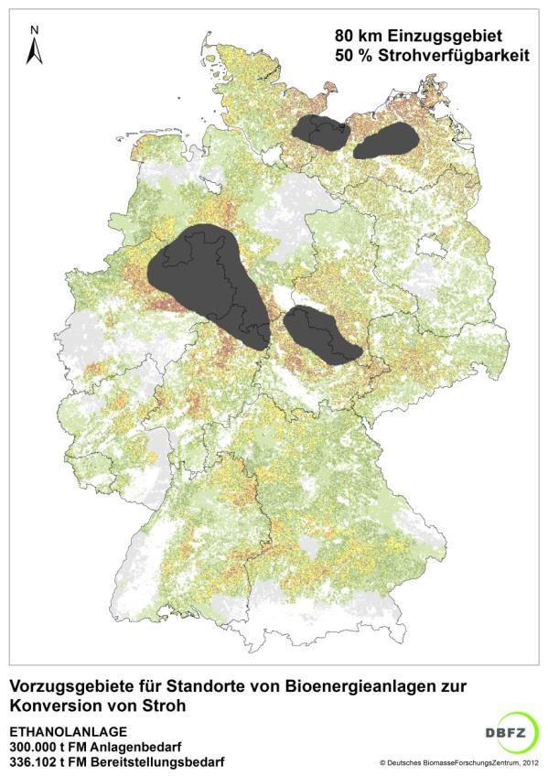

Sustainable resource base - regional distribution of straw potentials 2 (2)
Preference regions
Transport distance
Straw availability
Transport distance
Straw availability
Preference regions for straw- based
bioethanol plants
300 000 t_{fm} plant demand
336 102 t_{fm} total straw demand
Preference regions for straw -based
bioethanol plants
300 000 t_{fm} plant demand
336 102 t_{fm} total straw demand

Slide 17
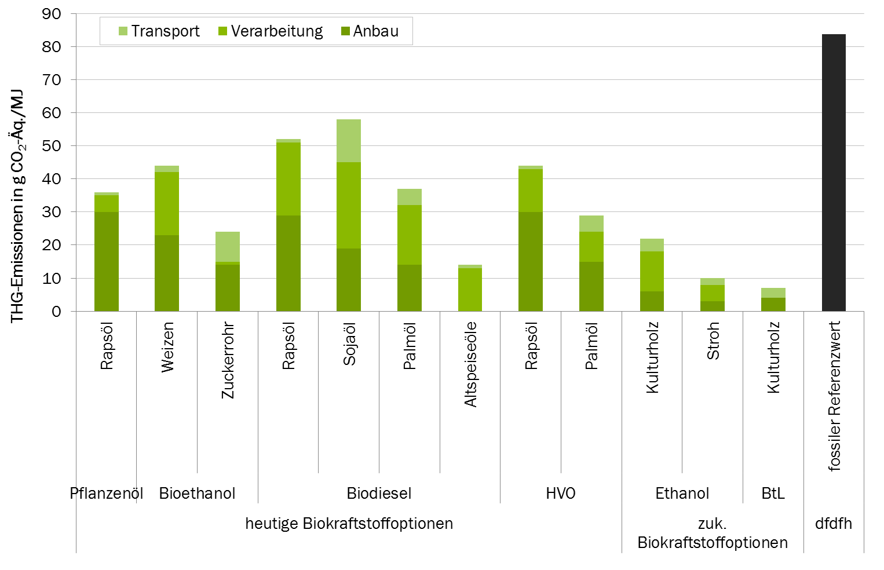
(GHG-) efficient conversion processes default values as a starting point for comparison?
Transport
Processing
Cultivation
GHG-Emissions in gCO₂-Eq./MJ
wheat
palm oil
palm oil
rapeseed oil
sugarcane
soybean oil
Source: DBFZ 2013
rapeseed oil
rapeseed oil
straw
SRC
used cooking oil
SRC
fossil reference value
veg. oil
Bioethanol
current biofuel options
future biofuel
options

Slide 18
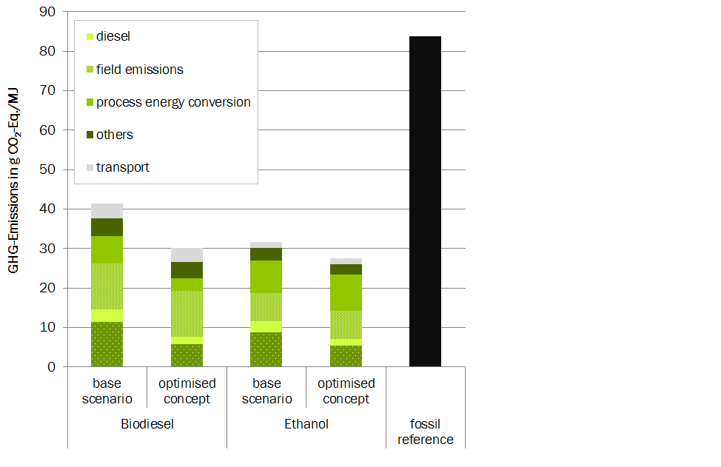
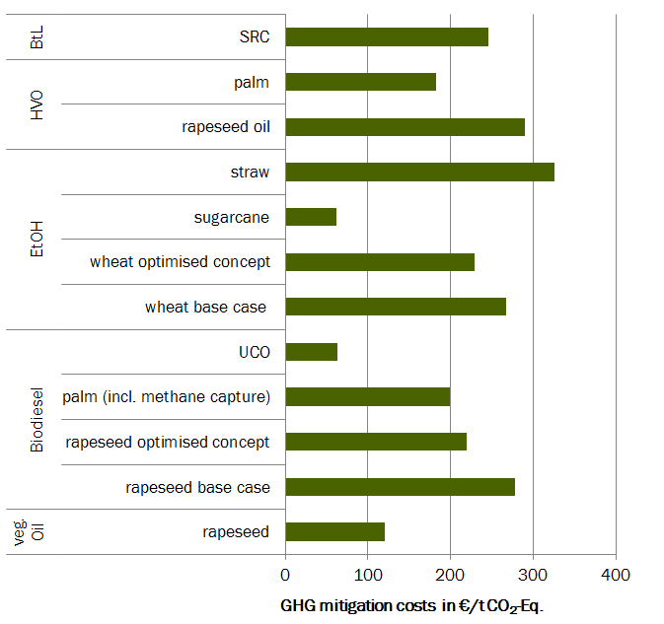
(GHG-) efficient conversion processes optimisation and comparison
51%
64%
62%
67%

Slide 19
Summary & Conclusions
Part 1: Methods, indicators, tools
Wide range of available methodologies and tools to assess environmental, social and economic indicators of first and second generation biofuels
Current reseach activities aim at
        the inclusion of additional indicators and impact categories (biodiversity, water footprinting, additional social indicators, etc.)
        the simplification of methodologies and tools (e.g. screening lca`s)
        the regionalisation of lca approaches (e.g. coupling with regional specific crop modelling, GIS-coupling, etc.)
        the inclusion of temporal aspects (e.g. in carbon balancing for woody biomass)

Slide 20
Summary & Conclusions
Part 2: Preconditions for sustainable biofuel value chains
Sustainable resource base:
      bioenergy projects should be based on a regional assessment of feedstock potentials (including regional sustainability aspects) and sustainability of feedstock production
      land resources for the production of energy crops are limited and in some cases subjects to competing uses –> further effort is needed to foster the production of 2nd generation biofuels from wastes and residues
    Efficient conversion processes
      process energy supply is often the biggest driver for environmental impacts during biomass conversion. LCA approaches can help to identify and assess options for optimisation

Slide 21
Researching the energy of the future – come and join us!
Contact
  Stefan Majer
  Phone: +49 (0)341 2434 - 411
  Email: stefan.majer@dbfz.de

Slide 22
BIOFUELS – “NACH”

