Slide 1

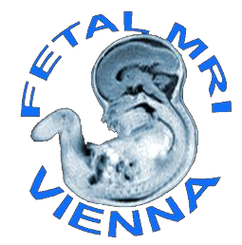
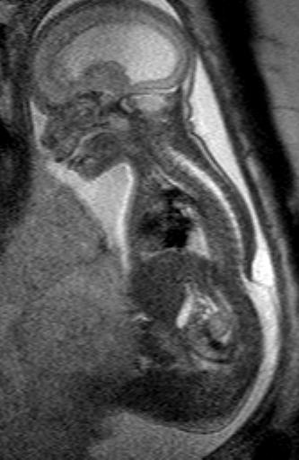
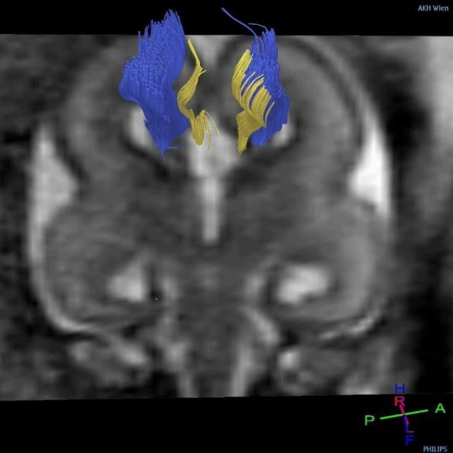
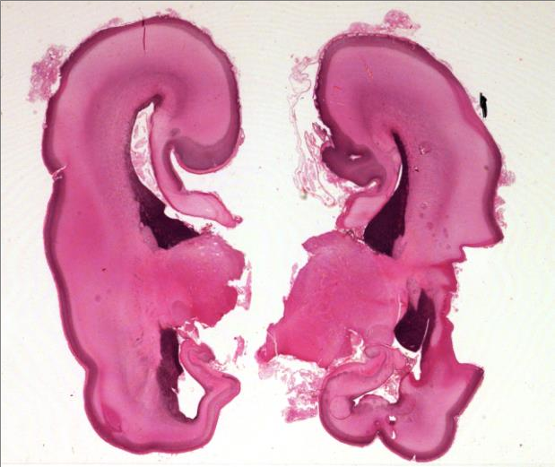
Prenatal Diagnosis of Central Nervous System
(CNS) Pathologies:
does
Fetal
MRI
help
in
their
management?
Daniela Prayer, Division
of Neuroradiology
and Musculoskeletal Radiology
Medical University Vienna/Austria

Slide 2
Fetal MRI: Why?
Indications: ACOG Recommendations
Common Indications:
elevated BMI
Oligo/ Anhydramnios
Scarring of the abdomen
Position of the fetus that allows only restricted
US assesment
Special Indications:
Situations, where MRI allows a better estimation
of the intrauterine situation than US alone

Slide 3
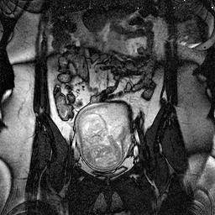
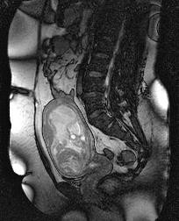
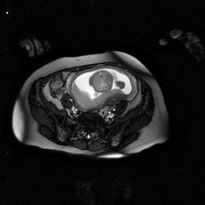
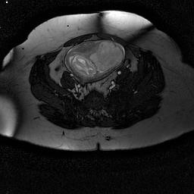
Increased
BMI
+
Anhydramnios
GW
19+1

Slide 4
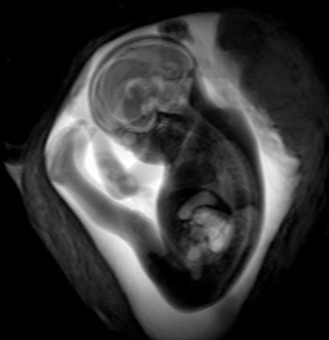
Fetal MRI: Why?
Definitely indicated (>48%):
Callosal agenesis
Posterior fossa anomalies
Microcephaly
Indicated (30-48%):
Ventriculomegaly
Neural tube defects
Diaphragmatic Hernia
Low priority (10-30%):
Very Low priority (0-10%):
Pulmonary anomalies,
Multiple malformations
Abdominal wall defects
Congenital heart defects,
Urinary tract, Twins, Cleft lip
UOG 2017, in press

Slide 5
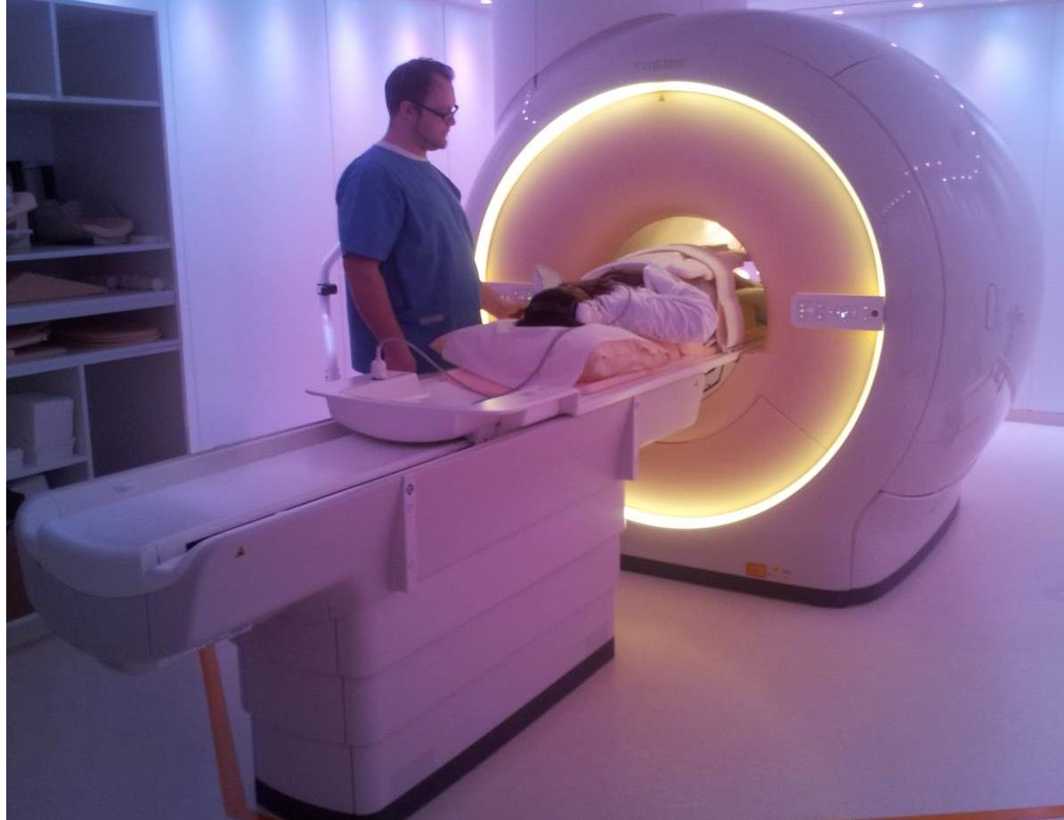
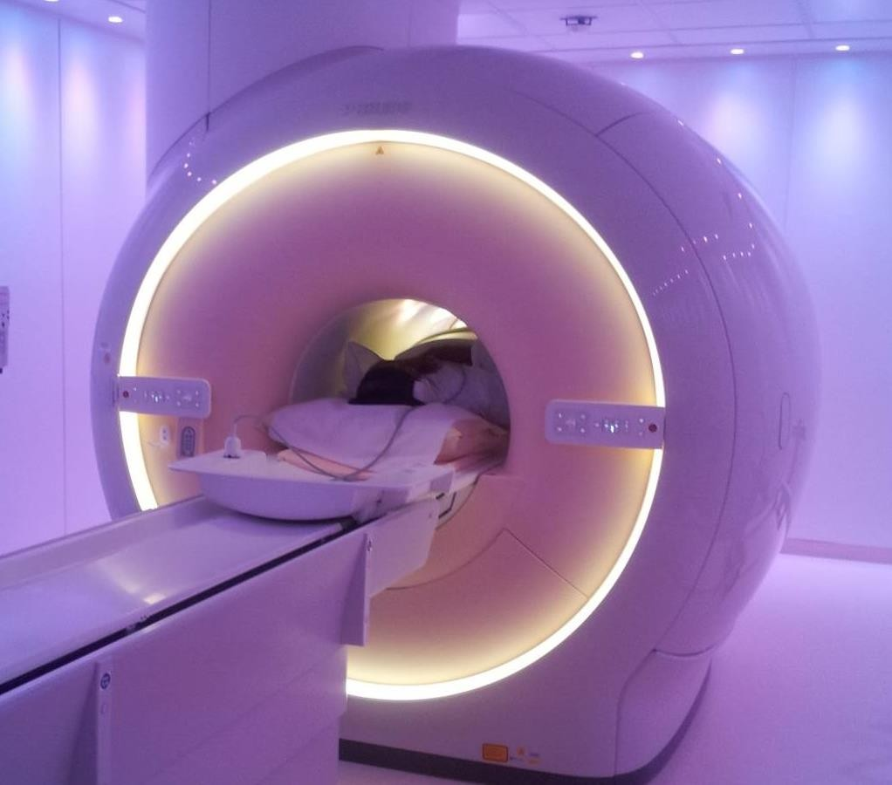
Fetal MRI: How?
Modern 1.5 or 3T, big bores – less claustrophobia

Slide 6
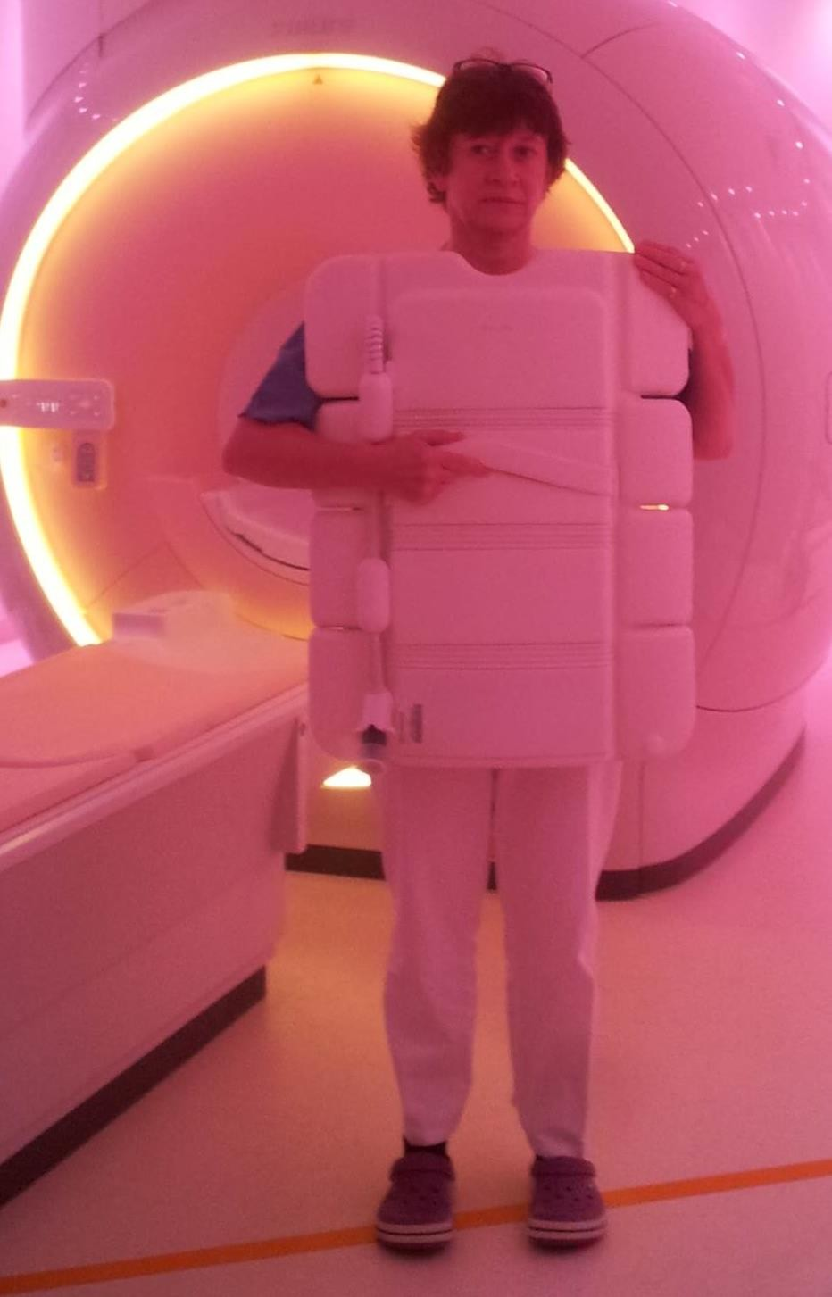
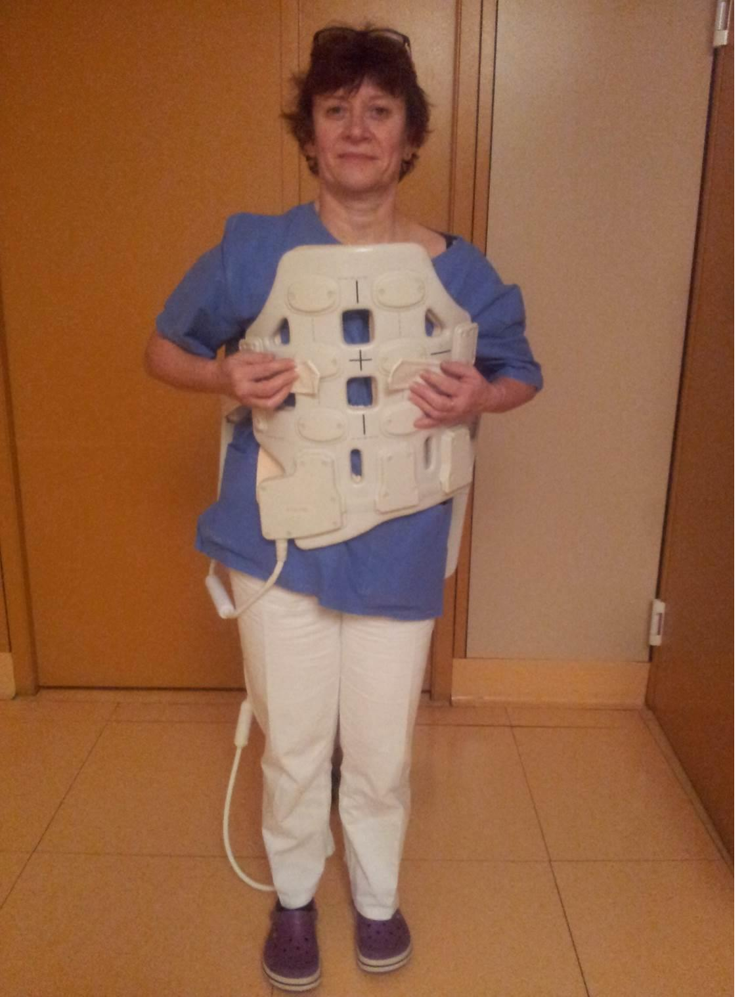
Fetal
MRI:
How?
Large coils:
more receptor
elements, but heavier

Slide 7
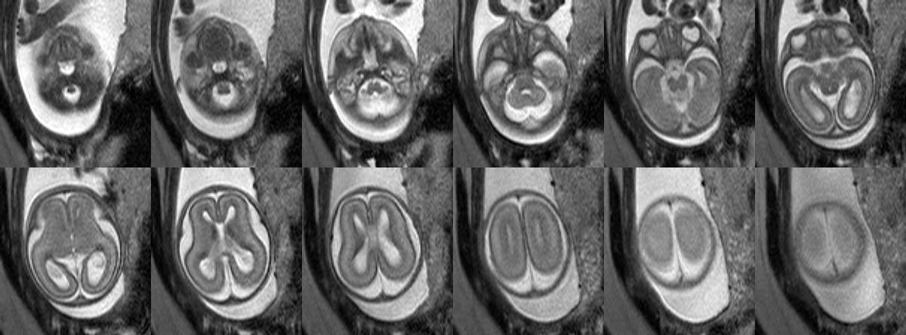
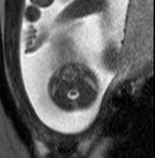
Fetal MRI: How?
GW
20+4
Sequence
= Choice of parameters
signals, resolution…
influencing
Continuous series of images
In 20 sec

Slide 8
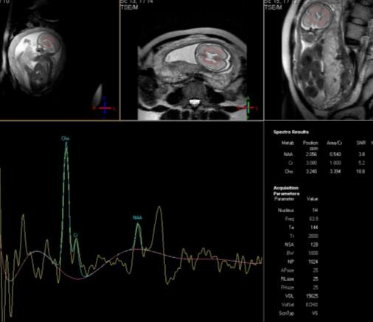
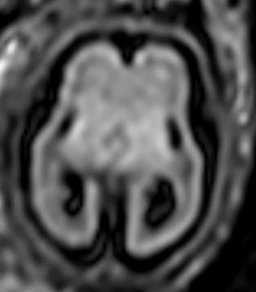
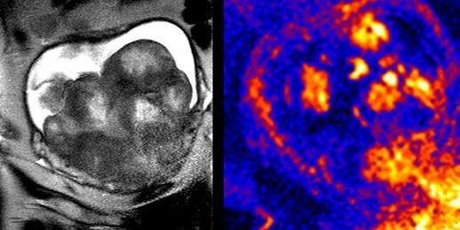
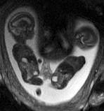
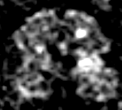
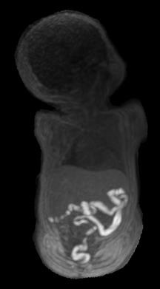
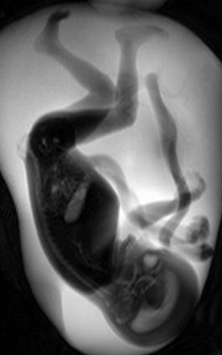

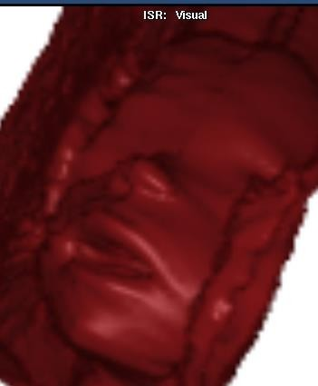
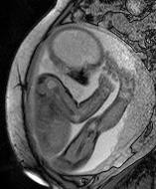
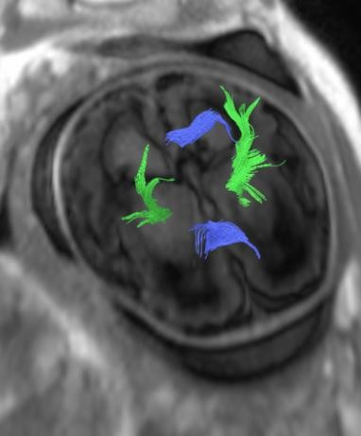
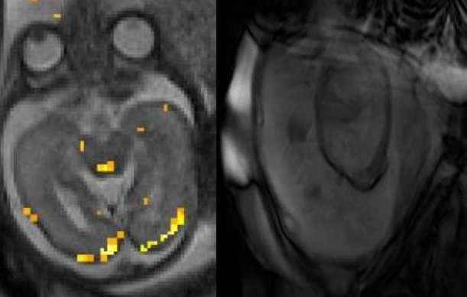
T2
T1
EPI Angiography FLAIR Diffusion- Thick slab Dynamic Metabolic Perfusion-
f-MRI, 3D
information

Slide 9
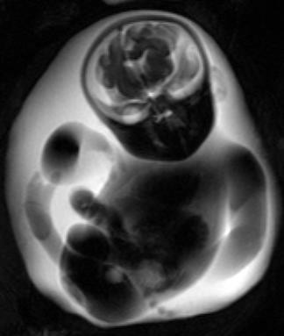
Questions
for
fetal
MRI
pathology present?
no
yes
survival?
no
yes
yes
but (surgical)
required
therapy
prenatal
postnatal
recurrence
risk
prognosis

Slide 10
Questions
for
fetal
MRI
pathology present?
Frequent question:
isolated ventriculomegaly
on
Ultrasound
Ventricle in mm
Classification
Normal
<10mm
Borderline
8.5mm – 10mm
Mild VM
10mm – 15mm
Severe VM
>15mm
Pagani G, Thilaganathan B, Prefumo F. Neurodevelopmental
outcome
in
isolated mild fetal ventriculomegaly: systematic review and meta-analysis.
UOG. 2014;44(3):254-60.

Slide 11
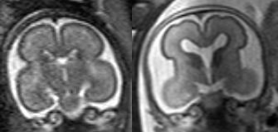
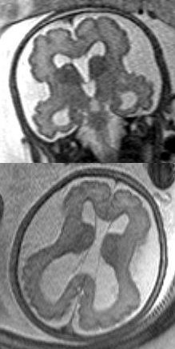
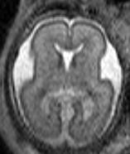
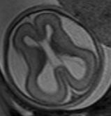
Questions
for
fetal
MRI
Premature
pathology present?
gyri
yes
Cobble
stone Liss encephaly
GW 24 healthy
GW 23+5
GW
29+3

Slide 12
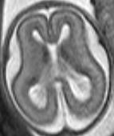
Questions for fetal MRI
pathology present?
no
MRI does not
only show the surface of the
brain
but
also
the
developing parenchyma
Most important structure:
subplate (*) : integrity crucial for normal cortical devlopment
*
*
*
*
GW 20+4
Kostovic I: The Anatomical Record
267 ;1-6 (2002)

Slide 13
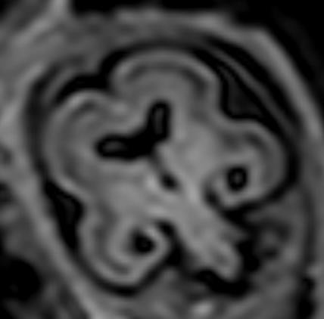
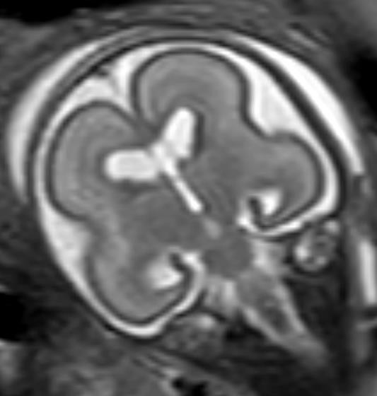
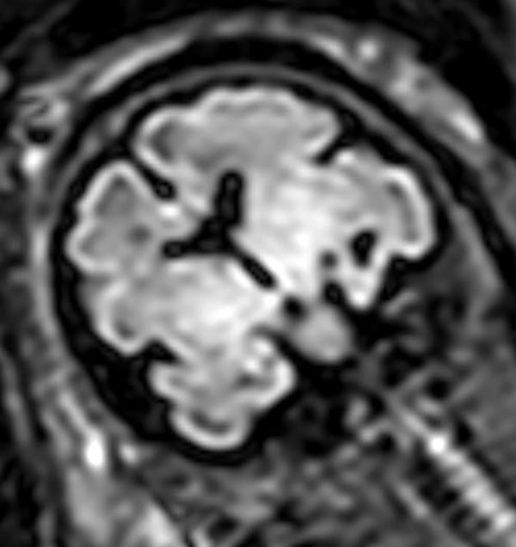
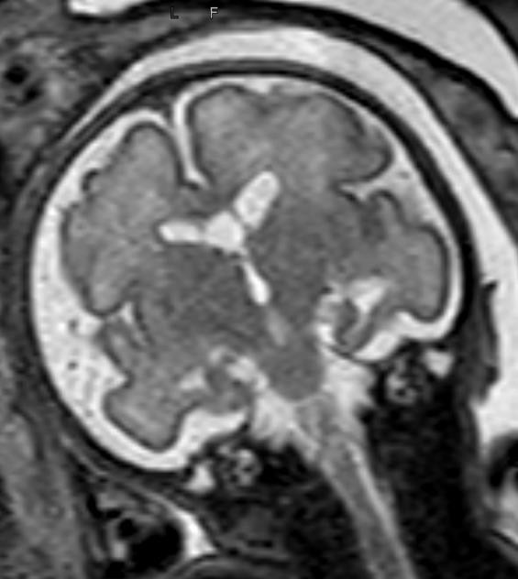
Questions
for
fetal
MRI
pathology present?
no
GW
23
*
*
GW 29
*
From GW
24 onwards
Subplate (*) better
visible on FLAIR than on T2
*
FLAIR
T2

Slide 14
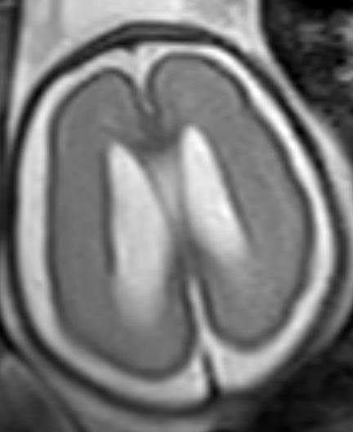
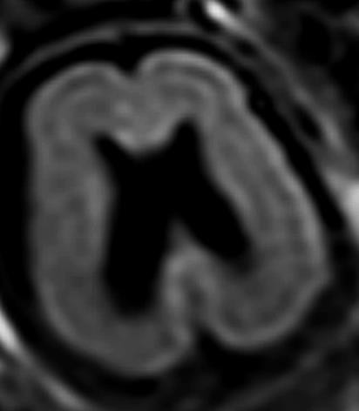
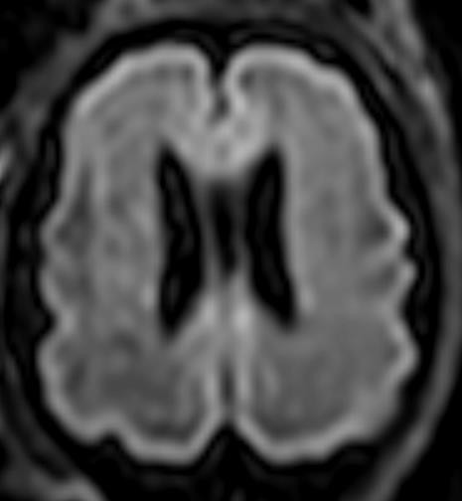
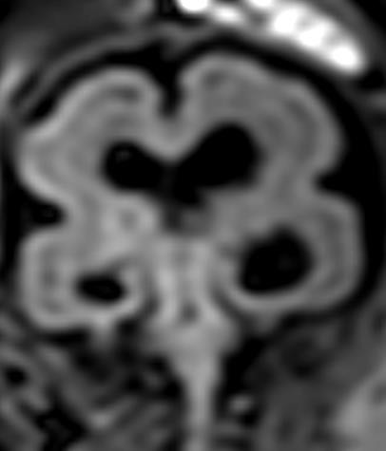
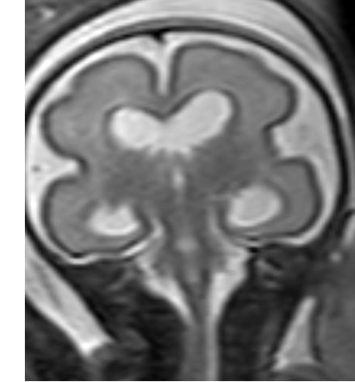
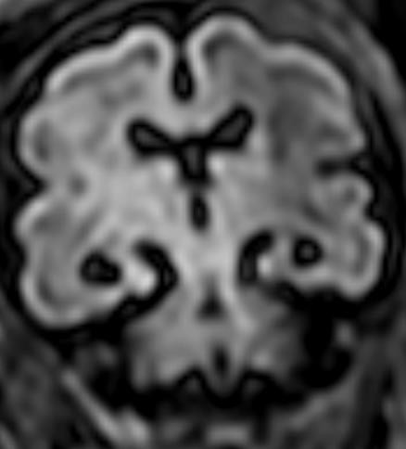
Questions for
fetal
MRI
pathology present?
no
GW
26
GW
31
Borderline
Ventriculomegaly
delineation
subplate normal!
of
T2

Slide 15
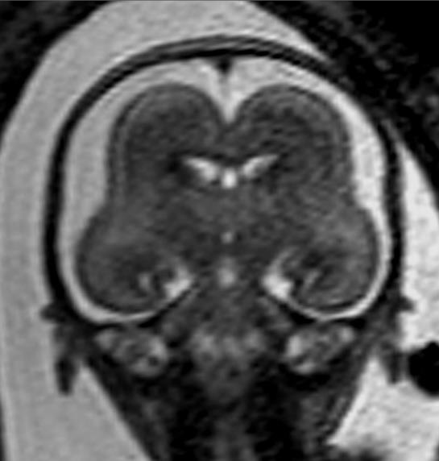
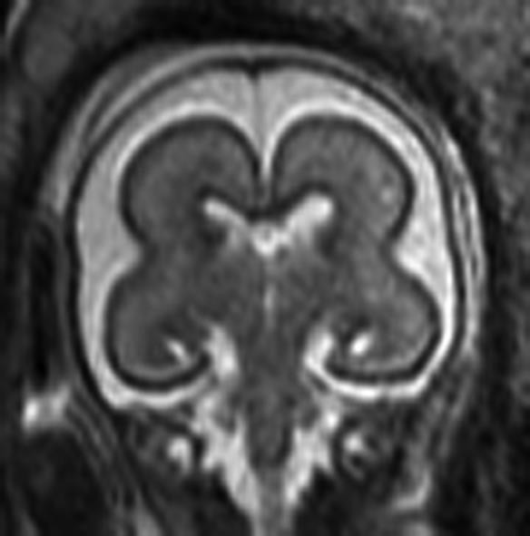
Questions
for
fetal MRI
pathology present?
Thin
subplate
yes
Type I
Liss
encephaly
Shallow
insular
cistern
GW 22
GW 20
normal

Slide 16
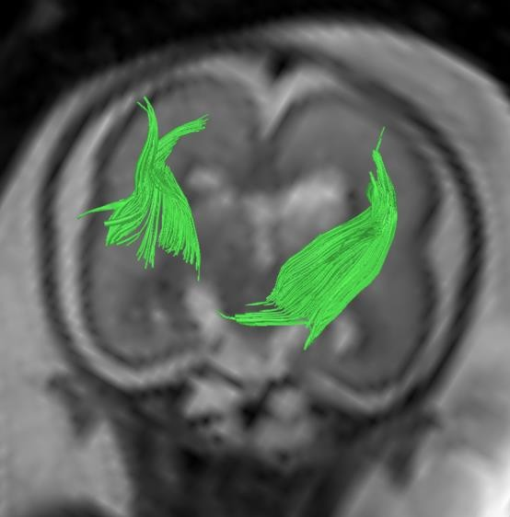
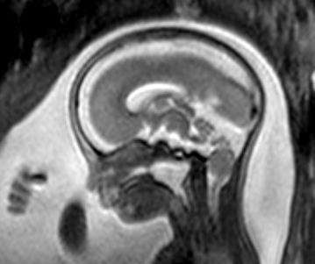
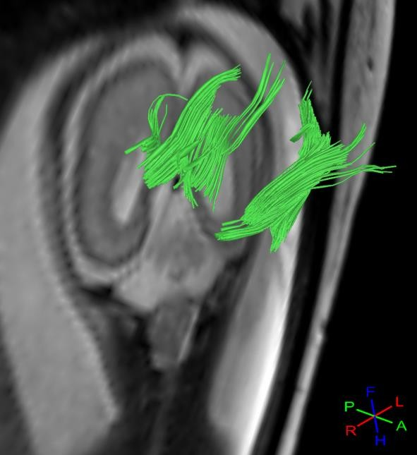
Questions for fetal MRI
survival?
no
Brainstem
segmentation
disorder
Corticospinal
tract
absent
Infratentorially*
Cleft palate
GW 22
Brainstem interrupted
* Visualised
by MRI
-tractography

Slide 17
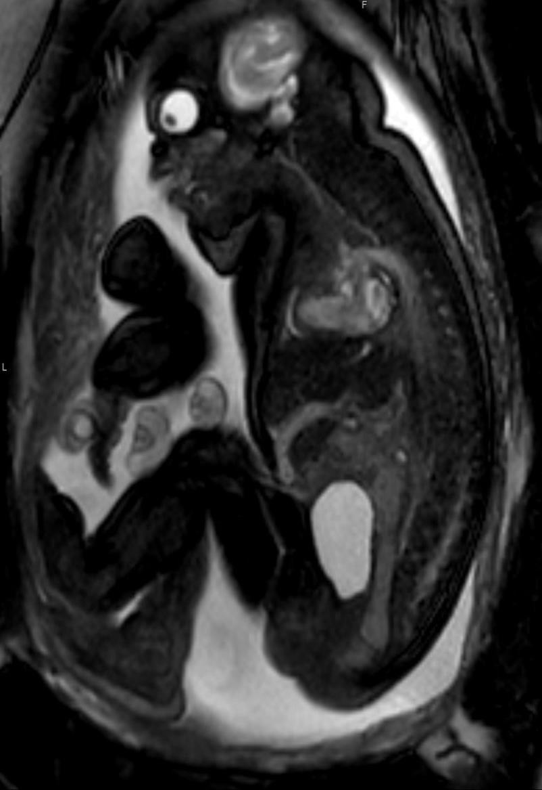
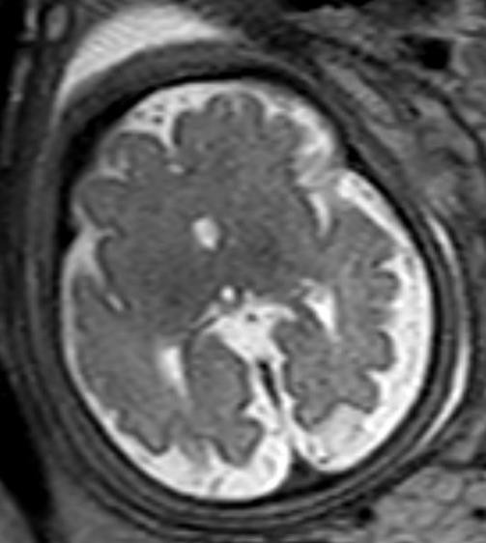
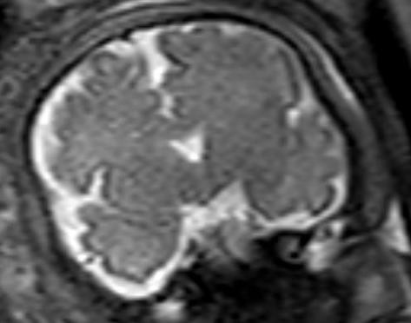

Questions
for
fetal MRI
Trisomy
survival?
no
13
GW
33+5
Lobar holoprosencephaly
Missing venous duct
Referal because of
cardiac malformation facial cleft and rocker bottom feet on US

Slide 18


Questions
for
fetal
MRI
survival?
Yes. Females only…but….
Dysplastic
cortex
Corpus callosum
agenesis
with Probst Bundles*
GW 25 female
* Visualised by MRI-tractography

Slide 19
Questions
for
fetal
MRI
survival?
Yes. Females only…but….
Aicardi syndrome
presumably X-linked
dominant,
•
agenesis of the corpus
callosum, chorioretinal lacunae infantile spasms, with lethality in males.
•
•
Seizures
severe neurological
impairment….
Fernández-Ramos
JA et al. Rev Neurol.2013
Dec 1; (11):481-8.

Slide 20



Questions for
fetal
MRI
survival?
yes
but (surgical) therapy required
prenatal
Fetuses with open dystaphism improve after prenatal closure of the cele
GW
32, Chiari II malformation

Slide 21

Questions for
fetal
MRI
survival?
GW
23
before
yes
but (surgical) therapy required
prenatal
Fetuses with open dysraphism improve after prenatal closure of the cele
GW 28
after
Houston
Courtesy
Gregor Kasprian Vienna/

Slide 22








Questions
“Spina
for fetal
bifida“
MRI
open
neural tube defects
?
closed
tube defects
1
neural
1
Prenatal
surgery unnecessary
potentially
treatable!
Myelo-
meningocele
1: Tortori-Donati
Myelocele
Meningocele
Myelo-
cystocele
P,
Rossi AMD, Biancheri
R. Pediatric neuroradiology.
Berlin ; [Great Britain]: Springer 2005.

Slide 23








Questions
for
fetal
MRI
GW 29+4
GW 31+5

Slide 24




Questions for
fetal
MRI
survival?
GW
28+5
yes
but (surgical) therapy required
postnatal
Postnatal shunt
with less impact
on
vermian herniation
Danzer
2Mo
E et al. Dev Med Child Neurol. 2012;54(1):8-14.

Slide 25


Questions for
fetal MRI
survival?
GW
28+5
yes
but (surgical) therapy required
postnatal
Late spinal
complications
3a
12a

Slide 26


Questions
for
fetal
MRI
recurrence risk
2 month old
seizures
with
Partial Callosal Agenesis?
Callosal Dysgenesis? Schizencephalic clefts?

Slide 27





Questions for fetal MRI
recurrence risk
GW
26
Fetal
Thrombotic
Vasculopathy
Demised Co-Twin
Sato Y, Benirschke K. Pediatrics. 2006;117(1):113-7.

Slide 28



Questions
for fetal MRI
recurrence risk
Subependymal
heterotopia
1st
Fetus GW23+0
2nd
Fetus GW21+3
mother
Filamin A gene mutation!
Parrini et al. Brain. 2006 Jul;129(Pt 7):1892-906.,
Brain 2006

Slide 29



Questions for fetal MRI
prognosis
Spinal
level
in
open
defects?
GW, 22
GW 20
GW, 22
Hipflection:
Kneeextgension:
L1/2
L3
Kneeflection:
Foot dorsiflection:
L4
L5
Foot plantarflection:
sacral
Lindseth RE. (1976) Treatment of the lower extremity in children
paralyzed by myelomeningocele (birth to 18 months).AAOSIC Lectures 25:
76–82.

Slide 30



Questions for fetal MRI
prognosis
Spinal
level
in
open
defects?
Meningocele!
L1
GW,22
assessments
GW 20
GW 22
correlated ± 1 Level of anatomical defect
Pedreira DA et al. Am J Obstet Gynecol. 2016

Slide 31


Questions
for fetal MRI
prognosis
Use
of diffusion- tensor imaging
Diffusion weighted imaging degree and directionality of in tissue
measures water motion
Stochastic
motion
Isotropy
Anisotropy
Brownian motion

Slide 32







Questions for fetal MRI
prognosis
Anisotropic
Diffusion-weighted
Imaging
GW
21+3
GW 25+6
Corpus callosum

Slide 33


Questions
for
fetal
MRI
prognosis
Connectivity
at GW 23

Slide 34








Questions
for
fetal MRI
prognosis
Callosal
Hypogenesis
GW 22

Slide 35





Questions
for
fetal
MRI
prognosis
GW36

Slide 36



Questions for fetal MRI
prognosis
GW 22

Slide 37





Questions
for
fetal
MRI
prognosis
GW 22
5a

Slide 38

Questions
for
fetal
MRI
prognosis
At 5 Years
Normal intelligence
Symmetrical use of
arms
Epilepsy with rare seizures,
EEG focus left
hemisphere

Slide 39



Take home:
Fetal MRI can help with more accurate
prenatal diagnosis and prognosis and thus
support
the
managment
of
a
complicated
pregnancy
Normal
CC
agnesis
CC agenesis with
malformations

Slide 40


Fetal MRI
Precongress course
September 15th

