Slide 1
Rapid Methods and Automation in Microbiology: 25 Years of Development and Predictions
Daniel Y.C. Fung, MSPH, Ph.D.
Professor of Food Science
Kansas State University, Manhattan, Kansas
University Distinguished Professor
Universitát Autónoma de Barcelona, Spain

Slide 3
Food Microbiology
Sample preparation
Total viable cell count
Differential cell count
Pathogenic organisms
Enzymes and toxins
Metabolites and biomass

Slide 4
Foodborne pathogens recognized as predominant in the United States in the last 20 years
Campylobacter jejuni
Campylobacter fetis ssp. fetus
Cryptosporidium cayetanensis
Escherichia coli O157:H7 and related E. coli (e.g. O11:NM, O104:H21)
Listeria monocytogenes
Norwalk viruses
Nitzchia pungens (cause of amnesic shellfish poisoning)
Salmonella Entertidis
Salmonella Typhimurium DT 104
Vibrio cholerae 01
Vibrio vulnificus
Vibrio parahaemolyticus
Yersinia enerolitica

Slide 5
Examples of pathogens associated with fruits and vegetables involved in outbreaks of foodborne disease
Agent | Implicated Food | Reference
B. cereus | Sprouts | Portnoy (1976)
Campylobacter | Cucumber | Kirk (1997)
C. jejuni | Lettuce | CDC (1998)
C. botulinum | Vegetable Salad | PHLS (1978)
Cyclospora | Raspberries | Herwaldt (1997)
E. coli O157:H7 | Radish Sprouts | WHO (1996)
E. coli O157:H7 | Apple Juice | CDC (1996)
E. coli O157:H7 | Iceberg Lettuce | CDR (1997)
Fasciolia hepatica | Watercress | Hardman (1970)
Hepatitis A | Iceberg Lettuce | Rosenblum (1990)
Hepatitis A | Raspberries | Ramsay (1989)
Salmonella Agona | Coleslaw, Onion | Clark (1973)
S. Oranienburg | Watermelon | CDC (1979)
S. Poona | Cantaloupes | CDC (1991)
S. Stanley | Alfalfa Sprouts | Mahon (1997)
Shigella flexneri | Mixed Salad | Dunn (1995)
S. sonnei | Tossed Salad | Martin (1986)
Vibrio cholerae | Salad, Vegetables | Shuval (1989)

Slide 6
Methods for the Detection of Escherichia coli O157:H7 in Foods
Conventional methods – Time honored, “Gold Standard”, up to5 days
ELISA-Enzyme Linked Immunoabsorbant Assay – Manual and automated
Dipsticks – Rapid detection after enrichment
DNA/RNA probes
PCR – Polymerase chain reaction and many modifications
Ribotyping – Pin-point source of contamination
Epifluorescence microscopy
Electrochemical reactions
Fiber-optic biosensor
Fluorescent bacteriophage
Light Addressable Potentiometric Sensor
Electrochemiluminescent Detection of Immunomagnetic captured antigens

Slide 7


Slide 8


Slide 9
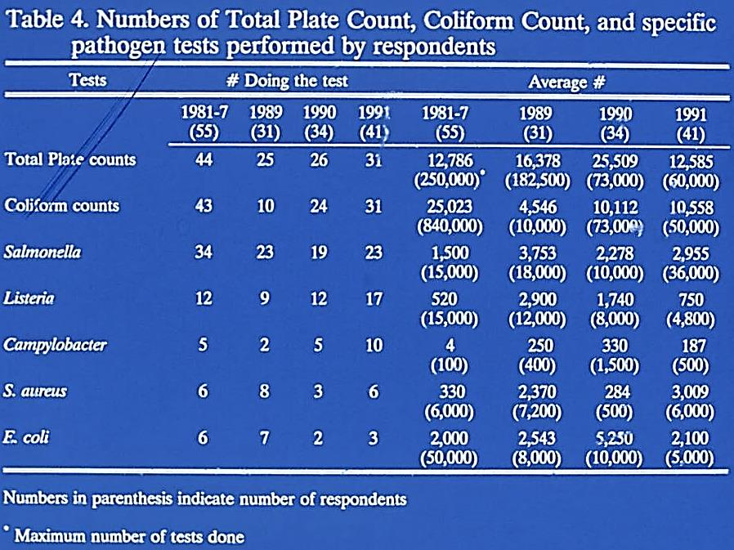

Slide 10
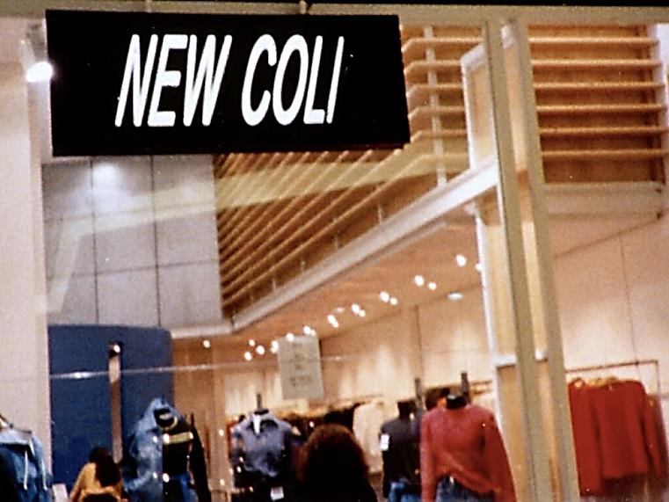

Slide 11
One-Shift Pathogen Tests – 6 to 8 hr.
Validated:
Neogen E. Coli O157:H7 – 8 hr. test
Under development:
Umedic E. Coli O157:H7 – 8 hr. test
Detex E. Coli O157:H7 – 8 hr. test
MicroStar E. Coli – 8 hr. test

Slide 12
Real Time Results – Minutes
RBD2100: viable cell counts – 30 minutes
DEFT: viable cell counts – 60 minutes
Aflatoxin tests: 10 – 20 minutes
ATP tests: 10 – 20 minutes

Slide 13
Advances in Total Viable Cell Count Methodologies
Stomacher vs. Pulsifier
Petrifilm, Redigel, Isogrid, and Spiral Plater data
Fung’s Double Tube for 6 hr. Clostridium perfringens enumeration

Slide 14
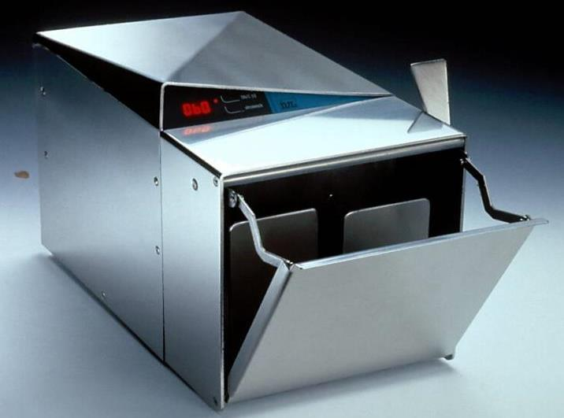
Stomacher

Slide 15
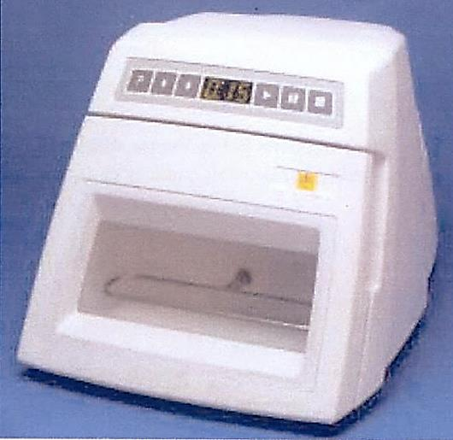
Pulsifier

Slide 16
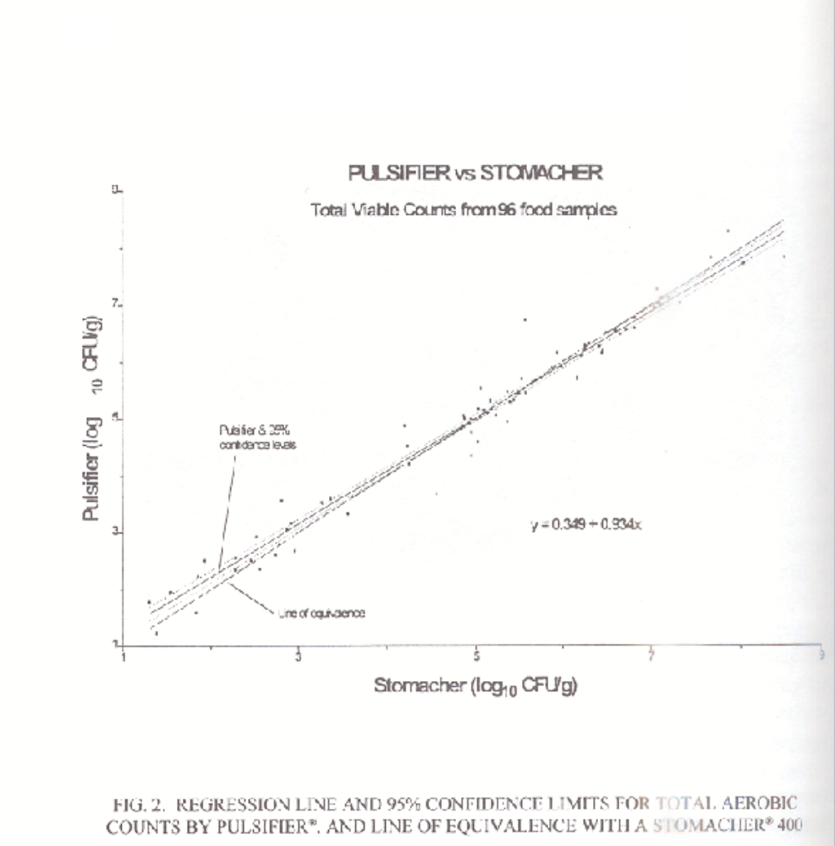
Pulsifier vs. Stomacher
Total Viable Cultures from 96 food samples

Slide 17
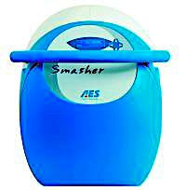
Smasher© by AES Chemunex

Slide 18
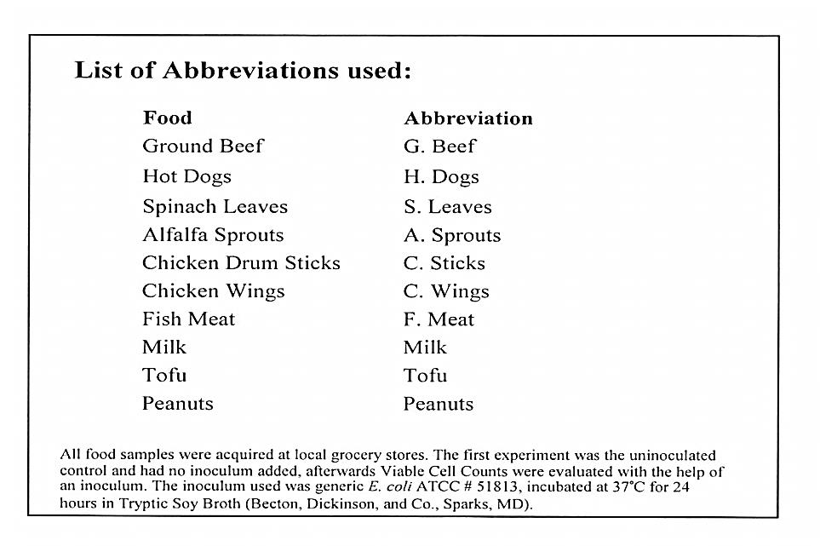

Slide 19
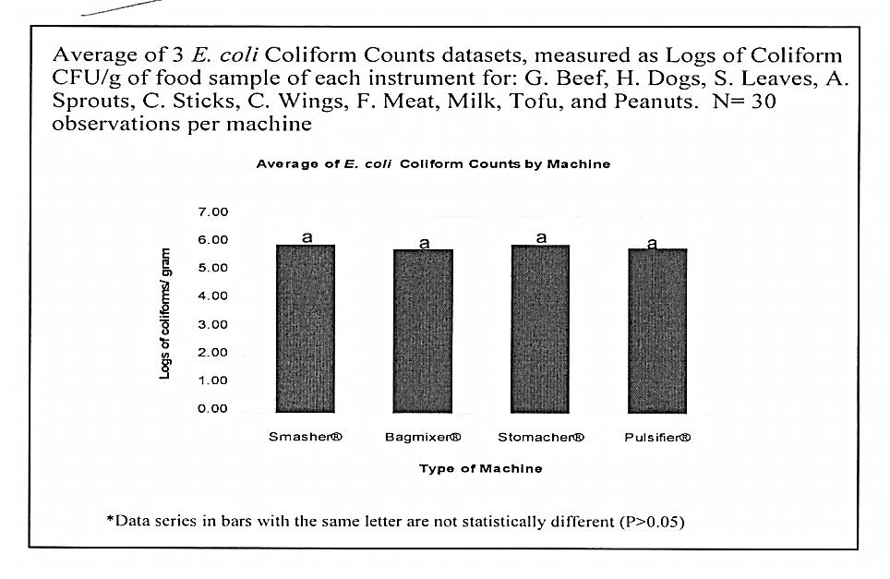

Slide 20
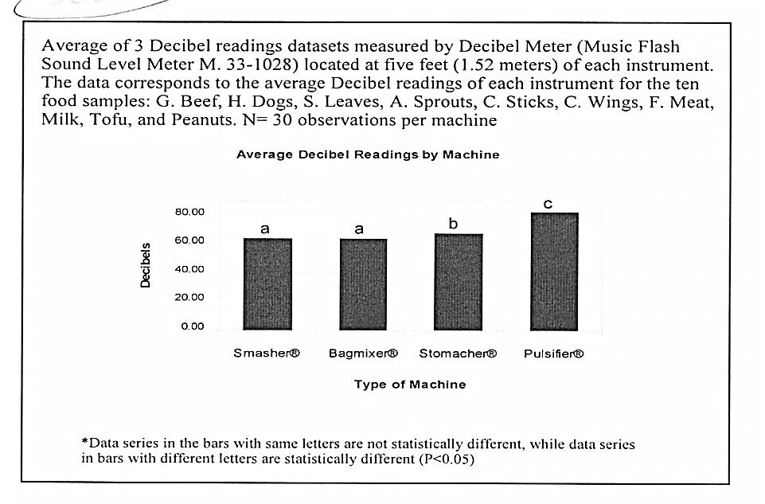

Slide 21
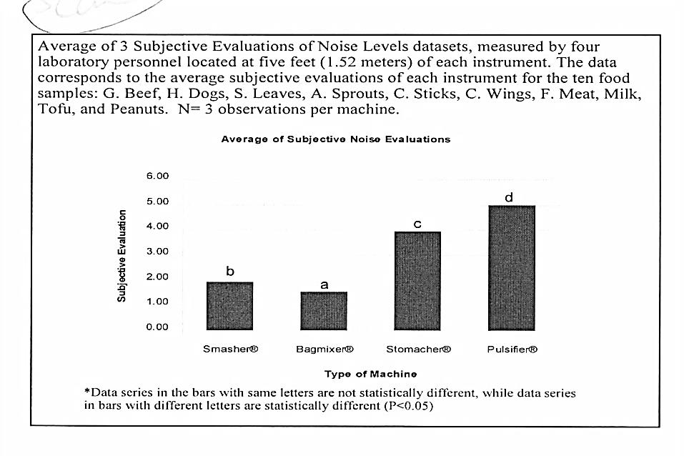

Slide 22
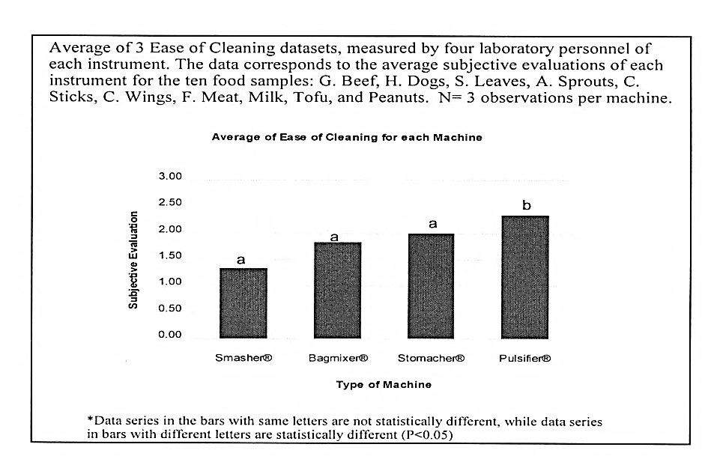

Slide 23
Comparative Analysis of Sampling Methods in Chicken Breast
by Pearson Correlation Coefficient
 | SPC | Redigel | Petrifilm | Spiral P. | Isogrid
SPC | 1.00000 | 0.99855 | 0.99963 | 0.97017 | 0.96992
Redigel | 0.99855 | 1.00000 | 0.99916 | 0.96917 | 0.96875
Petrifilm | 0.99963 | 0.99916 | 1.00000 | 0.97089 | 0.97056
Spiral P. | 0.97017 | 0.96917 | 0.97089 | 1.00000 | 0.99988
Isogrid | 0.96992 | 0.96875 | 0.97056 | 0.99988 | 1.00000

Slide 24
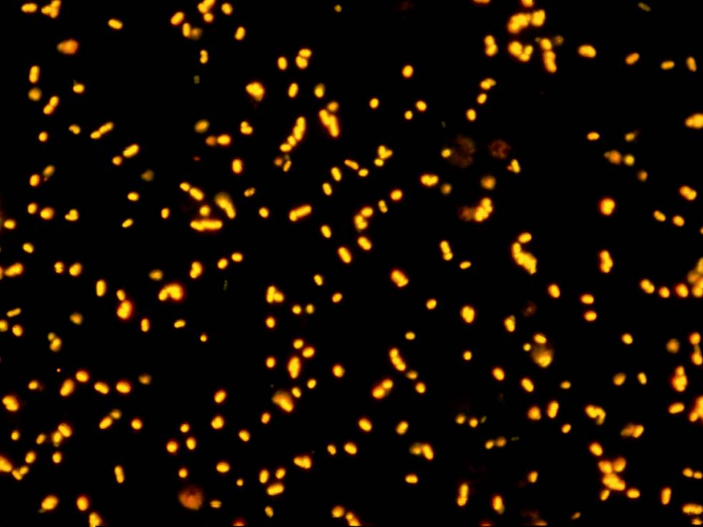

Slide 25
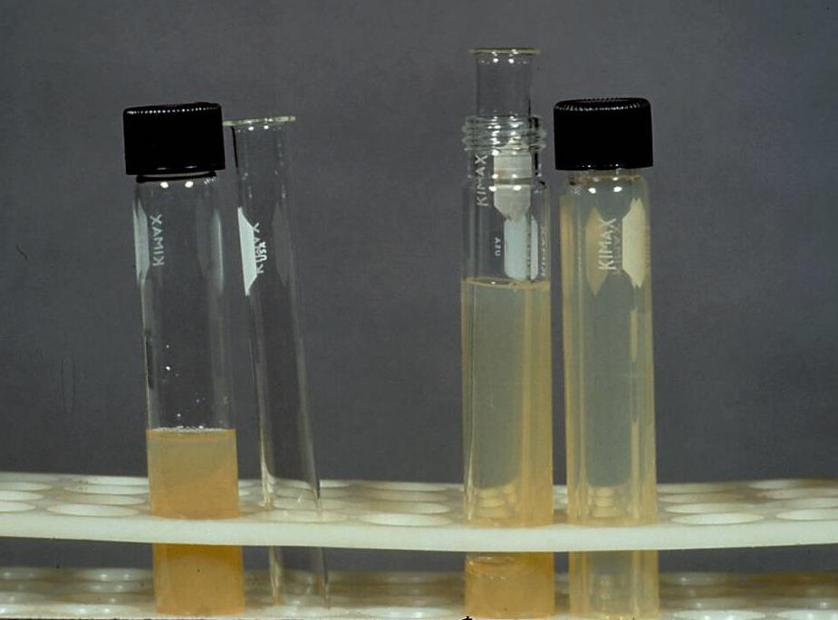

Slide 26
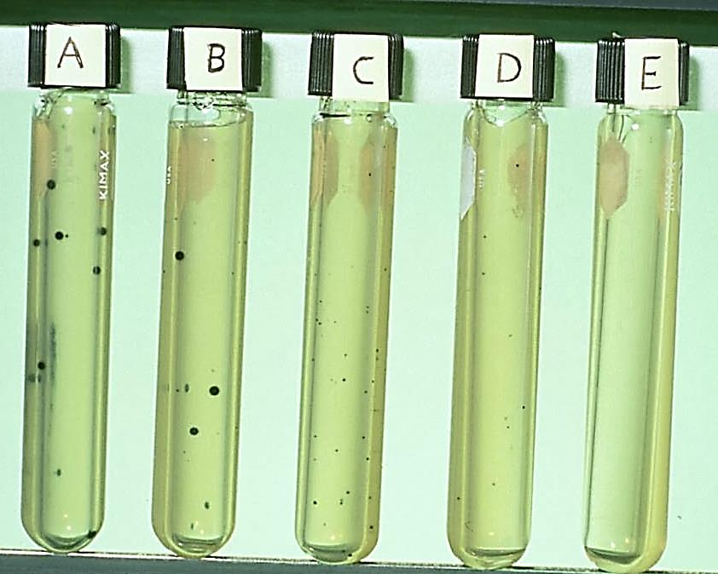

Slide 27
Fung/Fujioka Scale for Beach Water Pollution Based on Single Sample Concentrations (cfu/100 mL) of Clostridium perfringens Using the Fung Double Tube (FDT) Method
Pollution category | FDT (cfu/10 mL)* | Extrapolated FDT (cfu/100 mL) | Scale of beach pollution
I | 0 | <10 cfu | Uncontaminated
II | 1-10 cfu | 10-100 cfu | Nonpoint contamination
III | 11-50 cfu | 110-500 cfu | Sewage contamination
IV | >50 cfu | >500 cfu | Elevated sewage contamination
* After confirmation with conventional method.
cfu, colony forming units in Shahidi Ferguson Perfringens agar medium at 42C in 6 h.

Slide 28
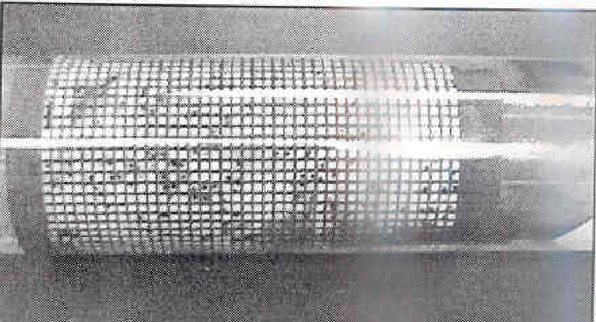
Isogrid

Slide 29
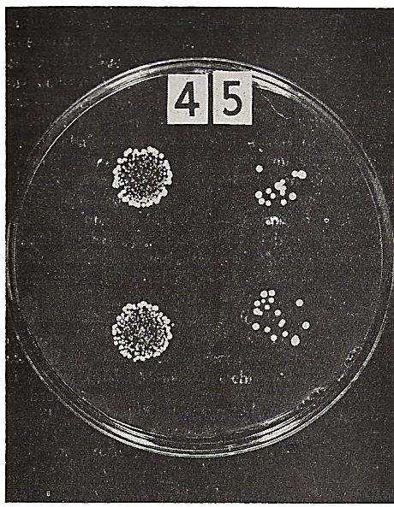
Duplicate spots of different dilutions from a milk sample. The numbers 4 and 5 represent 10⁻⁴ and 10⁻⁵ dilutions, respectively. Data obtained from the 10⁻⁴ dilution were used to calculate cell density.

Slide 30
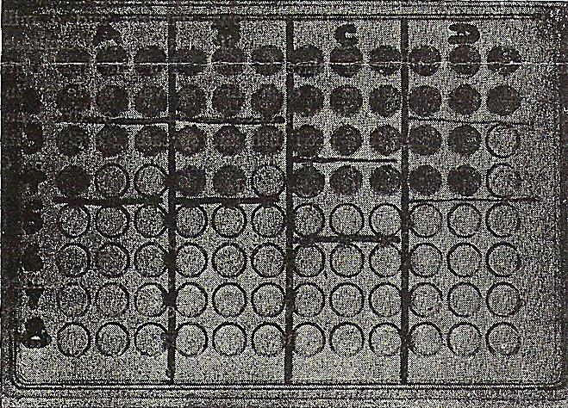
Microtiter plate – MPN evaluation. Turbidity of the wells indicates growth. MPN of sample A is obtained by multiplying 45 (from table 1; 3+/3, 1+/3) x 4 x 10⁴⁻² or 1.8x10⁴ organisms/mL.

Slide 31
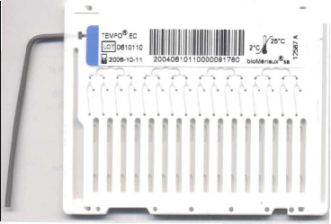

Slide 32
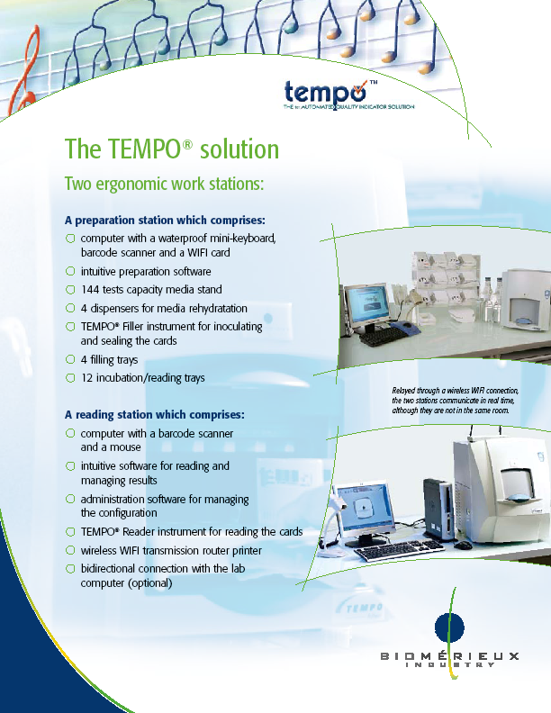

Slide 33
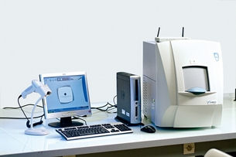
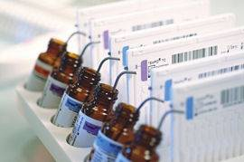
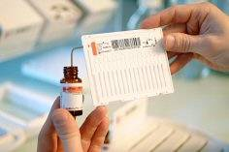

Slide 34
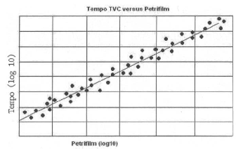

Slide 35
Kang and Fung
Thin agar layer method for the recovery of injured cells in foods and environments

Slide 36
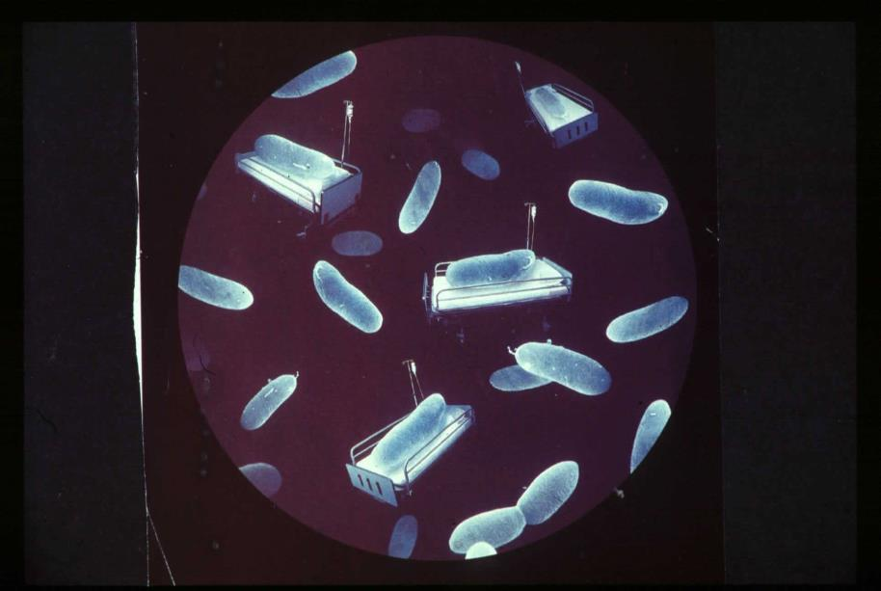

Slide 37
One-Step Thin Agar Layer Method
Inoculation of heat injured microorganisms directly on non-selective thin agar layer
3-5 mL of non-selective agar medium
Selective agar medium
Petri dish
Injured cells recovered and migrated to selective agar and grew in selective agar

Slide 38
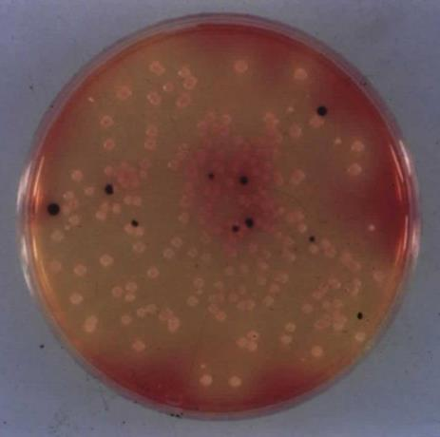
Salmonella typhimurium in Mixed Culture Using TAL

Slide 39
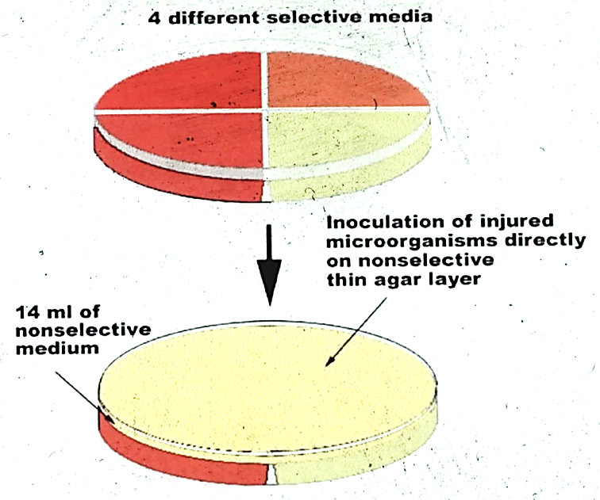

Slide 40
Oxyrase Research at
Kansas State University

Slide 41
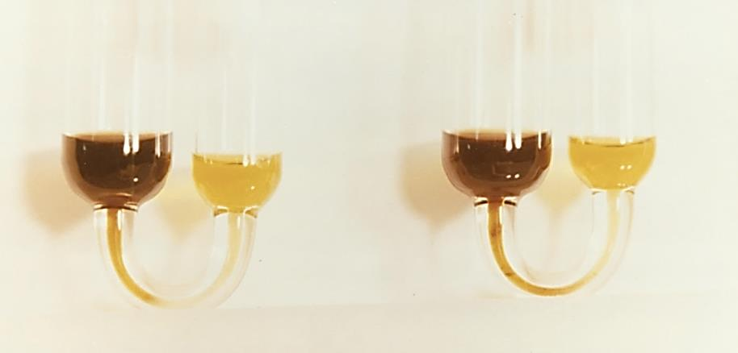
The semisolid agar started to change the color in the left and changed color at mid-point of the column in the right.

Slide 42
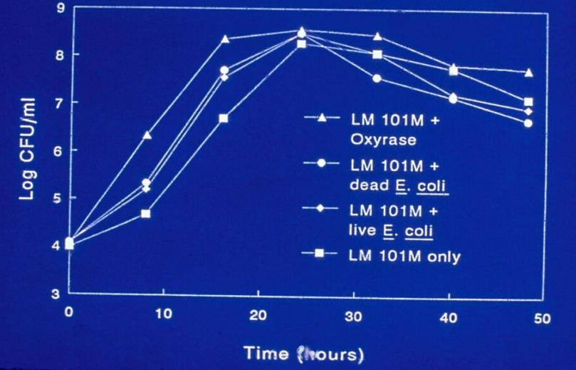
Growth of L. monocytogenes LM 101M in the Presence of E. Coli or OxyraseTM in Fraser broth at 35º C

Slide 43
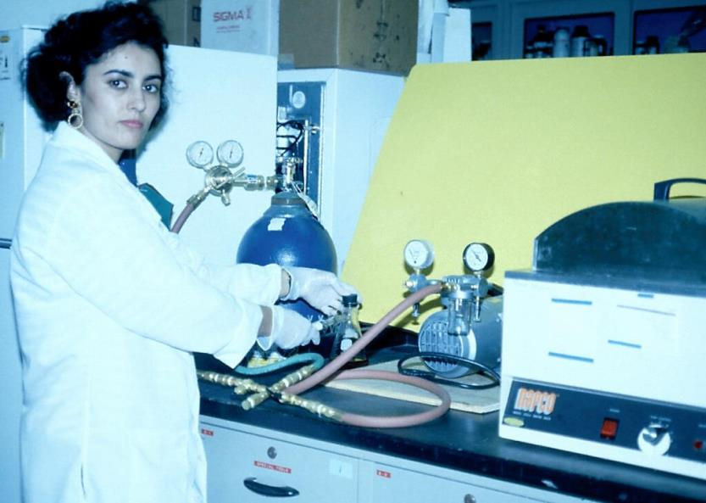

Slide 44
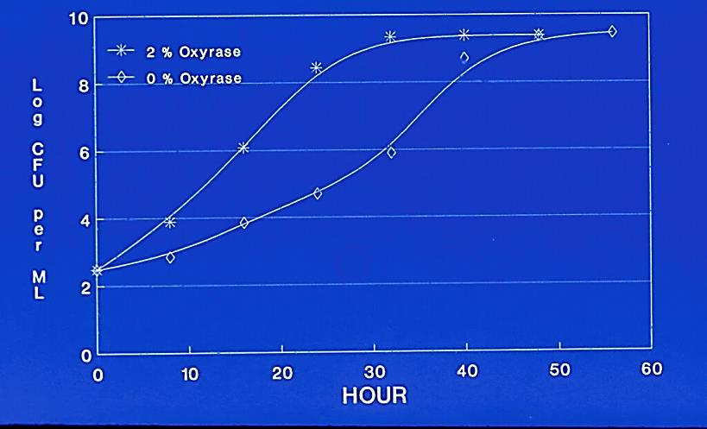
Campylobacter coli 43474 – 42ºC with 2 and 0% Oxyrase

Slide 45
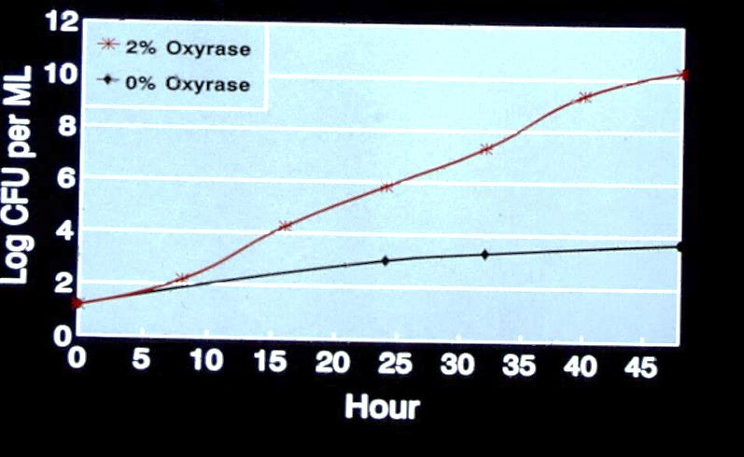
Campylobacter jejuni 43429 – 42ºC with 2 and 0% Oxyrase

Slide 46
Application of Membrane Fractions in Food Safety
Test organisms:
Listeria monocytogenes,
Salmonella typhimurium,
Yersinia enterocolitica,
Escherichia coli O157:H7,
Clostridium perfringens.
Tested by the OmniSpecTM Bioactivity method:
Campylobacter jejuni,
Campylobacter coli.
Tested using the methods described by Niroomand and Fung (1992 a,b, 1993)

Slide 47
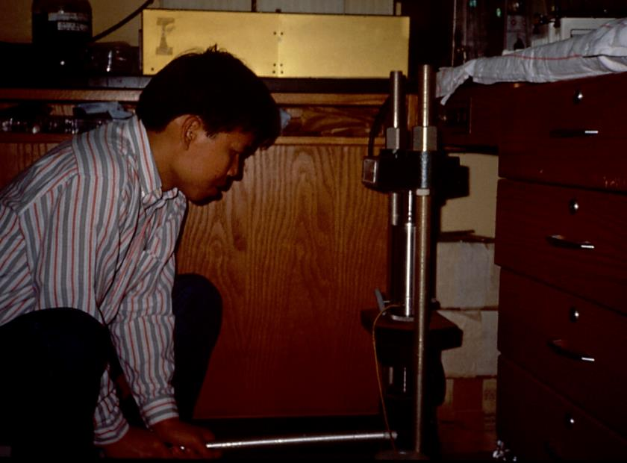

Slide 48
Membrane Bound Enzymes
Non-food grade
  Oxyrase – Commercial (Escherichia coli)
  E-8 – E. Coli E-8
Food grade
  ACE – Acetobacter xylinum
  GLU – Gluconobacter oxydans

Slide 49
Food Fermentation Considerations
All membrane fractions stimulated starter culture activities
  Streptococcus thermophilus
  Lactobacillus bulgaricus
  Lactobacillus lactis
  Lactobacillus cremoris
  Lactobacillus plantarum
  Lactobacillus acidophilus
  Pediococcus acidilactici
  Propionibacterium acidipropionici
  Saccharomyces cerevisiae

Slide 50
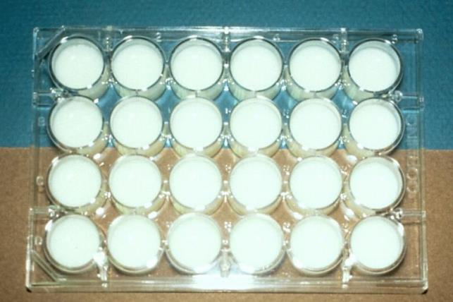
Yogurt and Buttermilk fermentation

Slide 51
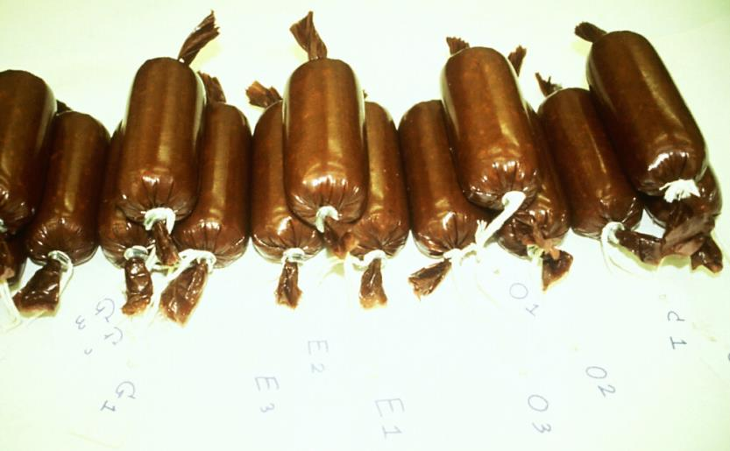
Summer sausage

Slide 52
Results
(Oxyrase & Membrane Fractions)
All membrane fractions accelerated the following fermentation processes:
  Yogurt
  Buttermilk
  Wine
  Beer
  Bread
  Summer sausage

Slide 53
Instantaneous Results – Seconds
  Catalase and enzyme tests
  Food residual tests
  Biosensor

Slide 54
a
Gas Column
b
Test Liquid
% of Gas Column = a/b x 100
Pasteur Pipette
Diagram of Gas Column Method

Slide 55
The Percentage of Catalase Activities and Viable Cell Count in Rainbow Trout “Meat” During 7 Days at 7°C

Slide 56
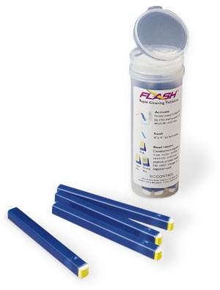
Semi-Quantitative Evaluation of Protein Residues

Slide 57
Automated Instruments Can Monitor Microbial Activities with Ease
Conductance-Malthus
Impedance-Bactometer, RABIT
Bac T/Alert
Omnispec
BioSys

Slide 58
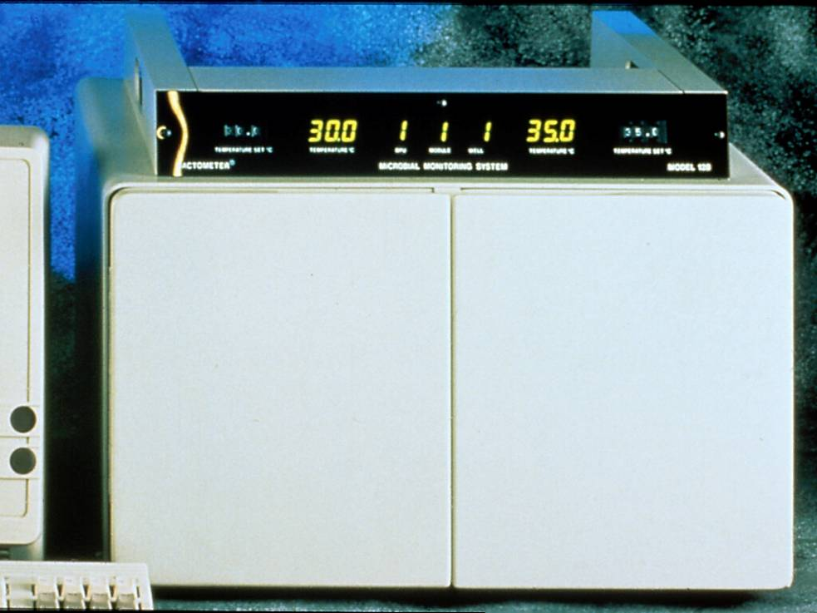

Slide 59
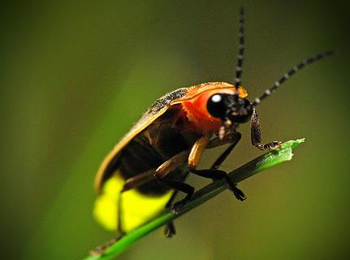
Bioluminescence
A unique type of chemiluminescent reaction catalyzed by an enzyme.

Slide 60
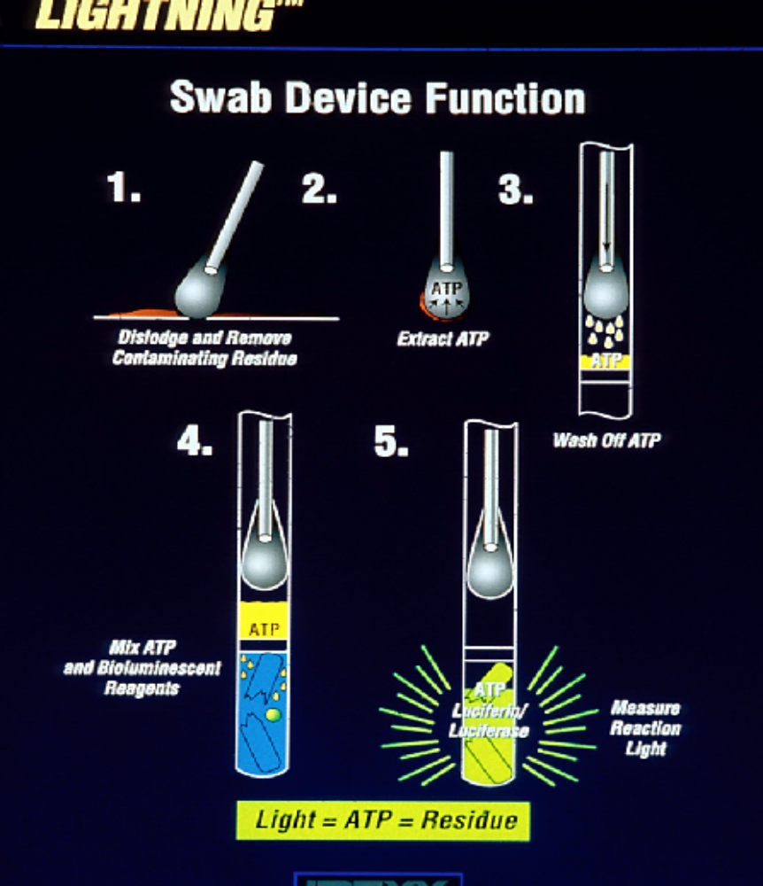

Slide 61
Advances in Immunological Testing
ELISA tests, VIDAS
Diffchamb, Detex system
Lateral Migration immunoassays
Immunomagnetic separation technologies

Slide 62
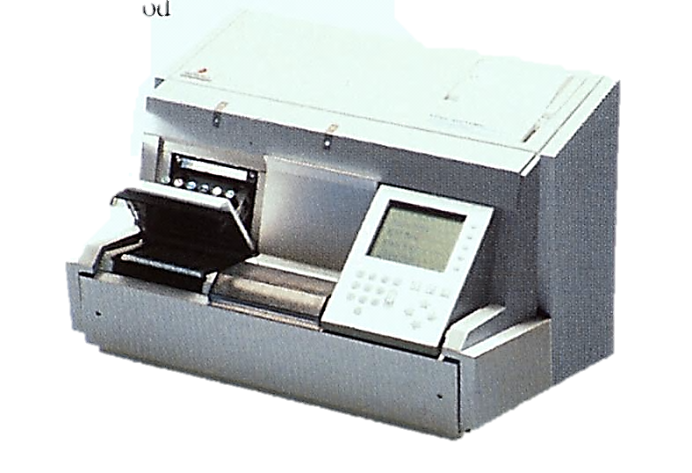
bioMérieux VIDAS®

Slide 63
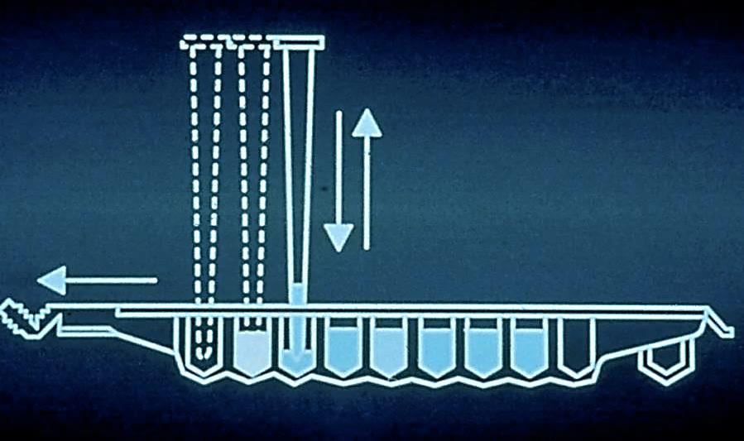

Slide 64
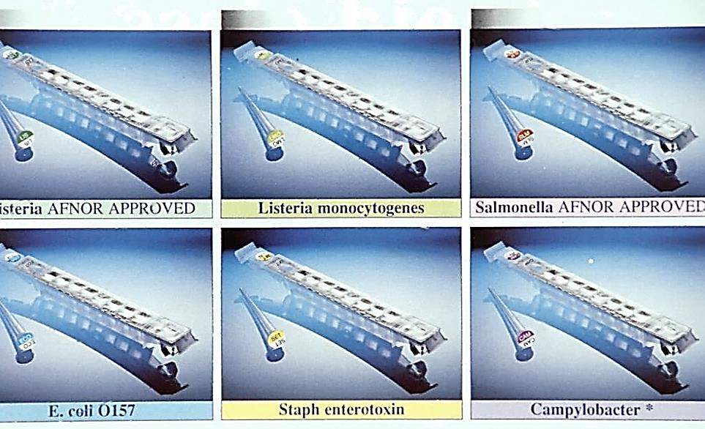

Slide 65
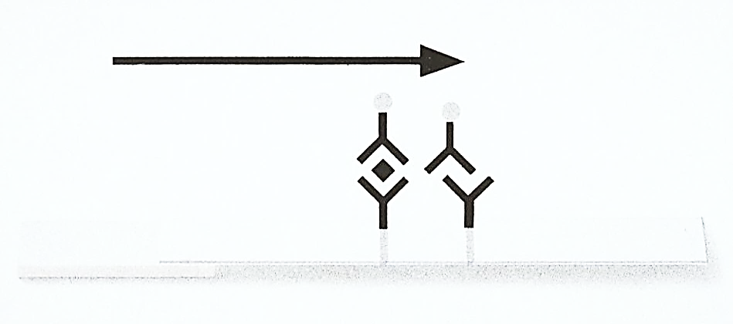

Slide 66
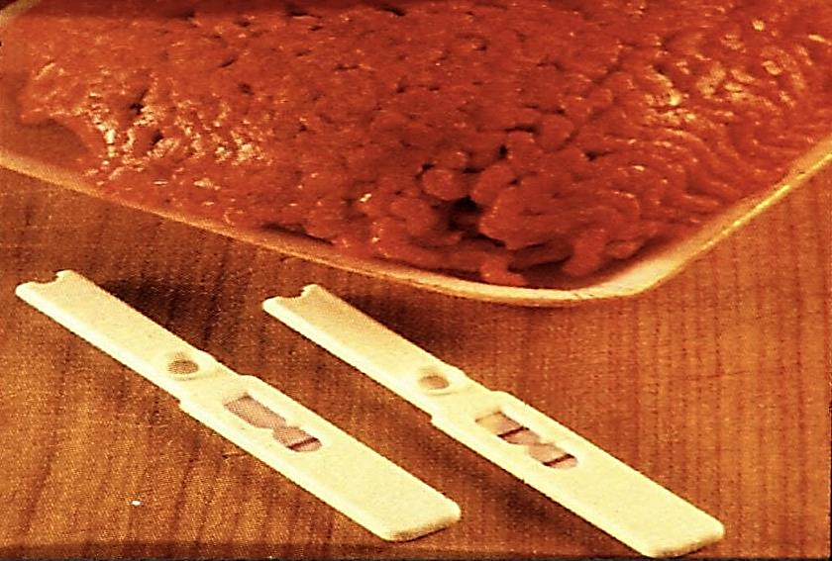

Slide 67
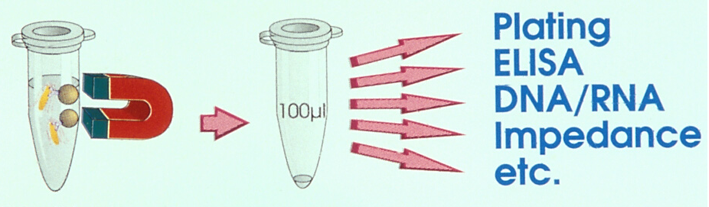
Washing,
Separation,
& Concentration
Reconstitution
Detection

Slide 68
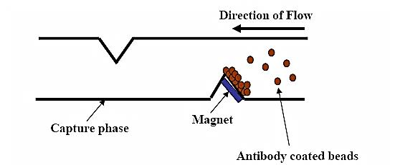
Pathatrix
Antibody coated beads capturing on surface of capture phase
The beads are added to the consumable immediately prior to circulating the sample.

Slide 69
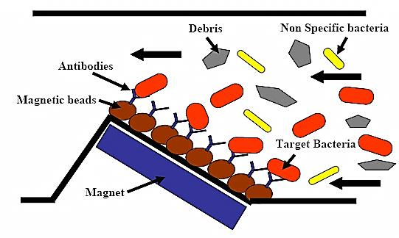
Capture of Target in Food
The sample is re-circulated repeatedly across the capture phase with the whole 250 mL sample passing over the phase approximately twice every minute.

Slide 70
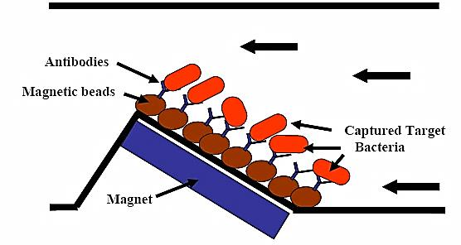
Captured Target Bacteria After Wash
When the re-circulation is complete, the captured bacteria (bound to the magnetic particles) can be washed extensively.

Slide 71
Current State of Microbiological –Genetic Tests
DNA/RNA hybridization
  Needs 6 log CFU/ml, g, cm² for reaction
Polymerase chain reaction and related technologies
  Needs enrichment to ensure monitoring of viable cells and dilute inhibitors
Microarray, biochips, proteomics, geonomics
  Needs sample preparation before application
Biosensors
  Needs concentration of target cells before detection

Slide 72
Genetic Methods
DNA/RNA Hybridization
PCR –BAX
Molecular Beacon Technology
Probelia
Riboprinting and Pulse Net Systems

Slide 73
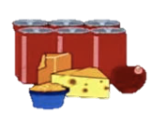

Products for Microbial Analysis
Pre-Enrichment
Microbe Isolation
Screen for it
Positive
Negative
Characterize & Identify it
RiboPrintTM pattern (fingerprint)

Slide 74
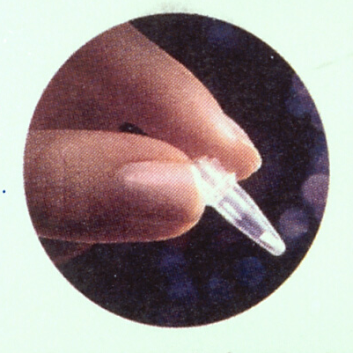

Slide 75
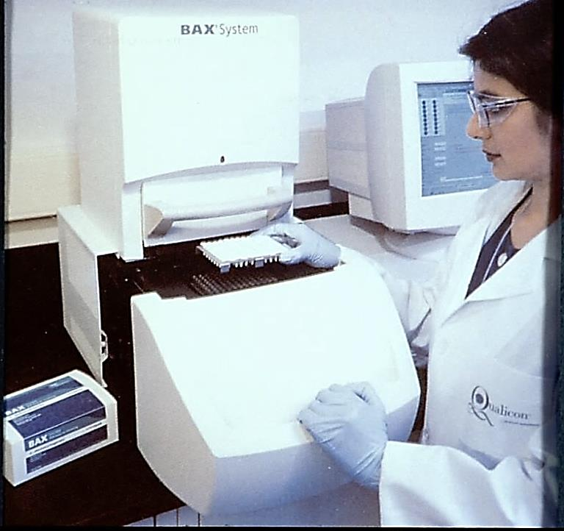

Slide 76


Slide 77

R.A.P.I.D.

Slide 78


Slide 79


Slide 80
Advances in Biosensors
Microarrays, biochips
Nanotechnology
Sampling clean up and extractions
Viability and sensitivities of cells

Slide 81

The biosensor: surface-modified transducer which is reactive towards a specific chosen analyte.

Slide 82





















Slide 83


Slide 84


Nanotechnology: Why Size Matters
Gold nanoparticles can emit intense heat
A cluster of gold nanoparticles 50 nanometers in diameter created a much larger crater in the ice sample.
www.physorg.com/printnews.php?newsid=63003999
Notes:
we need to understand the critical roles that surfaces and interfaces play in nanostructured materials. Nanoparticles have very high specific surface areas, and thus in their assembled forms there are large areas of interfaces. We need to know in detail not only the structures of these
interfaces, but also their local chemistries and the effects of segregation and interaction between the nanoscale building blocks and their surroundings. We need to learn more about the control of nanostructure size and size distribution, composition, and assembly. For some applications, there are very stringent conditions on these parameters; in other applications less so. We must therefore understand the relationships between this stringency and the desired material or device properties.
The second and most fundamentally important theme of this field is that the nanoscale building blocks, because of their sizes below about 100 nm, impart to the nanostructures created from them new and improved properties and functionalities heretofore unavailable in conventional materials and devices. The reason for this is that materials in this size range can exhibit fundamentally new behavior when their sizes fall below the critical length scale associated with any given property. Thus, essentially any material property can be dramatically changed and engineered through the controlled size-selective synthesis and assembly of nanoscale building blocks. Four broadly defined and overlapping application areas that cover the tremendous range of challenges and opportunities for nanostructure science and technology are dispersions and coatings, high surface area materials, functional nanodevices, and consolidated materials.

Slide 85

Microbial Nanosensors on a Chip
Antibody
Biochip

Slide 86

Food Micro – 2008 - 2013

Slide 87
Food Microbiology Market Summary
This report focuses on the microbiology testing practices/diagnostics used by the Food Processing sector to meet its fundamental objective: produce safe, wholesome food products that meet label claims.
The Food Microbiology market (The Market) in 2008 is sizable and represents almost 740 million tests performed globally in the Food Processing Industry by the estimated 40,000 plants having over 25 employees. Historically, this market has been growing reasonably quickly, stimulated to a certain extent by the frequent food safety headlines attributed to this market.

Slide 88
Food Microbiology Market Summary, Cont’d
These estimates are based on all of the samples collected at the 40,000 food processing plants regardless of where they are analyzed (at the plant, at corporate labs sited at a different location, or at outside private labs).
The total worldwide market value for all microbiology tests performed in 2008 is estimated to be over $2.0 billion.

Slide 89
Food Plants with >25 Employees 40,000
Tests/Plant/Year
Routine 15,005
Pathogen 3,453
Total 18,458
Total Tests (Millions)
Routine 600.2 M
Pathogen 138.1 M
Total 738.3 M
Market Value ($$ Million)
Routine $1,050.0 M
Pathogen $1,007.4 M
Total $2,057.4 M

Slide 90
Microbiology Testing – Market Value (1998-2008)
8.7% Growth
IMMR-1
Food Diagnostics
IMMR-2
Food Micro 2005
Food Micro 2008

Slide 91
Routine Micro Tests – Market Value(1998-2008)
6.7% Growth
IMMR-1
Food Diagnostics
IMMR-2
Food Micro 2005
Food Micro 2008

Slide 92
Pathogen Tests – Market Value(1998-2008)
11.2% Growth
IMMR-1
Food Diagnostics
IMMR-2
Food Micro 2005
Food Micro 2008

Slide 93
Pathogen Tests by Organism (2008)

Slide 94
Pathogen Testing Breakdown
(000,000)

Slide 95
2008 Micro Tests by Geographic Region

Slide 96
2008 Geographic Review – Organisms Tested

Slide 97
Sector Comparison Summary – 2008

Slide 98
Microbiology Testing by Food Sector

Slide 99
Routine Microbiology Testing – Method Used

Slide 100
Pathogen Testing – Method Used

Slide 101
Food Micro Test Volume, 2010

Slide 102
Food Micro Market Value, 2010

Slide 103
US Food Micro Market – Test Volume
Growth – 2010/2008
Routine – 10.3%
Pathogen – 32.3%
Total – 14.4%

Slide 104
US Food Micro Market – Market Value
Growth – 2010/2008
Routine – 16.6%
Pathogen – 39.5%
Total – 27.8%

Slide 105
Food Microbiology Growth Model – 2010
Testing Volume
= (Volume of Commodity Produced) x (Rate of Testing per Unit of Commodity)
…results in an Average Testing Volume Increase of 7.0%
Market Value of Testing
= (Testing Volume) x (Average Cost per Test)
…results in an Average Market Growth per Year of 13.0%
Base Commodity
Growth per Year – 1.5%
Annual Change in Testing per Unit of Commodity – 5.5%
Yearly testing Volume– 7.0%
Yearly Change in ACT (constant dollars) – 6.0%

Slide 106
AARG Comparison - # of Tests vs. Market Value

Slide 107
AARG in US Food Micro Market, 2008-2010

Slide 108
Microbiology Tests by Food Segment

Slide 109
2010 Methods Used

Slide 110
Comparative Analysis of Sampling Methods in Ground Beef, Ground Pork, and Raw Milk by Pearson Correlation Coefficient
Method | APC | Redigel | Petrifilm | Spiral P. | Isogrid
APC | 1.000 | 0.999 | 0.999 | 0.999 | 0.999
Redigel | 0.999 | 1.000 | 0.999 | 0.999 | 0.999
Petrifilm | 0.999 | 0.999 | 1.000 | 0.999 | 0.999
Spiral P. | 0.999 | 0.999 | 0.999 | 1.000 | 0.999
Isogrid | 0.999 | 0.999 | 0.999 | 0.999 | 1.000

Slide 111
Total Cost Analysis per Plate (Per viable cell count³)
Method | Material and Media Cost | Labor Costs | Total Cost
APC | $2.06 (12.36) | .21 (1.26) | 2.27 (13.62)
Redigel¹ | 1.16 (6.96) | .21 (1.26) | 1.37 (8.22)
Petrifilm¹ | 1.16 (6.96) | .21 (1.26) | 1.37 (8.22)
Isogrid² | 3.01 (3.01) | .32 (.32) | 3.33 (3.33)
Spiral Plate System* | 2.06 (2.06) | .21 (.21) | 2.27 (2.27)
Notes:
* Does not include initial cost of equipment (Spiral Plate System ranges from $11,700 to $12,500 including the plater, vacuum system, and colony counter; Isogrid ranges from $2,500 to $4,000 including the line counter, vacuum system, 12 filter heads, 3 clamps, and 100 filters. Approximate costs as of 3-1-88).
Cost per plate is reduced by quantity purchased.
Does not reflect possible enzyme pretreatment before filtration- cost averages 30 cents per sample for enzyme treatment.
Assumes an average of six plates for one viable cell count and necessary dilutions.

Slide 112
Rapid Microbiological Methods and
Demonstrating a Return on Investment:
It’s Easier Than You Think!
By Michael J. Miller
President, Microbiology Consultants, LLC.
American Pharmaceutical Review. Vol 12. Issue 5. July/August 2009. PP 42-47.
Russell Publishing Company, Indianapolis, MN.

Slide 113
Example of Operating Costs for the Conventional Method (CM) and the Rapid Microbiological Method (RMM) for Airborne Particles
_________________________________________________________________
CM RMM Year 1 RMM Year 2
_________________________________________________________________________________________________
Number of tests per year 70,000 14,000 14,000
_________________________________________________________________________________________________
Total sampling, testing, data 1.00 0.10 0.10
handling and documentation
resource time per test (hours)
_________________________________________________________________________________________________
Calculated annual labor (hr) 3,500,000 70,000 70,000
_________________________________________________________________________________________________
Total Annual Costs $ 3,675,000 $250,000 $ 466,000
CM used agar base technology. RMM used Mie-scattering technology which can detect, size and quantitate both viable and nonviable particles
Miller, Michael J. 2009. Rapid Microbiological Methods and Demonstrating a Return on lnvestment :It’s Easier Than you Think. American Pharmaceutical Review. Vol 12 Issue 5 July/August 2009. Pp. 42-47. Russell Publishing Company. Indianapolis, MN.

Slide 114
Predictions (1995)
Viable cell counts will still be used
  a. Early sensing of viable colonies on agar 3-4 hrs.
  b. Electronic sensing of viable colonies under microscope 2-3 hrs.
  c. Improvement of vital staining to count living cells
  d. Early sensing of MPN
  2008 (+) on target

Slide 115
Predictions (1995)
2. Real time monitoring of hygiene will be in place
  a. ATP
  b. Catalase
  c. Sensors for biological materials
  d. Sensors for chemical materials
  2008 (+) on target

Slide 116
Predictions (1995)
PCR, ribotyping, genetic tests will become reality in food laboratories. (+)
ELISA and immunological tests will be completely automated and widely used. (+)
Dip Stick technology will provide rapid answers. (+)

Slide 117
Predictions (1995)
Biosensors will be in place in HACCP programs. (?)
Microarrays, biochips, nanotechnologies will be widely used. (+)
Effective separation and concentration of target cells will greatly assist rapid identification. (+)

Slide 118
Predictions (1995)
Microbial alert systems will be in food packages. (+/?)
Consumers will have rapid alert kits for pathogens at home. (?)

Slide 119
Future Developments of Rapid Methods and Automation in Food : A Microbiology Prediction
There will be a lot more microbiological systems at molecular levels for identification of normal and defective food samples.
More instruments to analyze microbial samples in the food industries.
Greater sensitive of information to the molecular level.
Less human manipulations and more automation in sample handling.

Slide 120
Future Developments of Rapid Methods and Automation in Food : A Microbiology Prediction
Need to train more scientists and technicians on sampling foods and analyzing food for pathogenic and spoilage microorganisms.
Automation in analysis of food samples and reporting data.
Instruments to decide pass-fail of food samples for human consumption.

Slide 121
Future Developments of Rapid Methods and Automation in Food : A Microbiology Prediction
More harmonization of microbial protocols among nations.
More international cooperation in methodology developments and usage.
More sophisticated consumers who demand safer food and drink supplies internationally.

Slide 122





Slide 123

Fun Fung Fact:
As of March 2005 the website of Fung’s paper received 2,967 individual ‘hits’!

Slide 124

Konza Night at the Rapid Methods Workshop

Slide 125

Fun Fung Fact:

