Slide 1

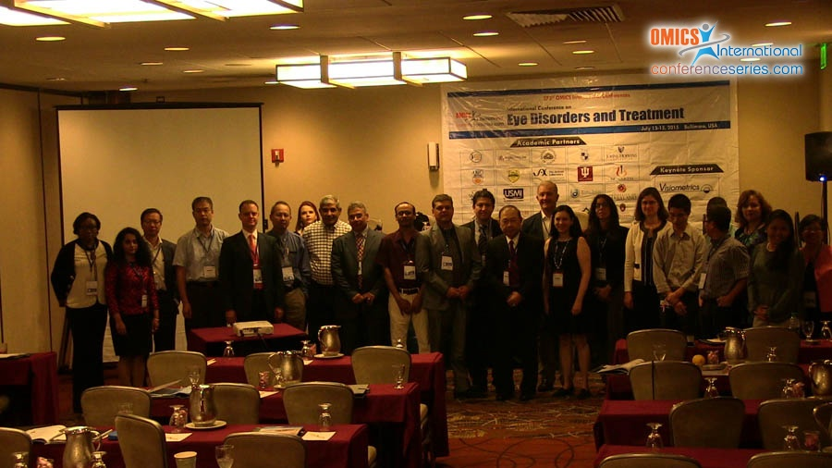

Eye-2015
Baltimore, USA
July13 - 15 2015
Daniel Valverde

Slide 2
Transfer factor strengthened and its contribution to the visual and integral health
Dr. Daniel Valverde.FPH.DES.EES.MSc
PHD Candidate AIU - Honolulu
Facultad de Ciencias Médicas
Universidad de Guayaquil.

Slide 3
Currently Medicine Treatments
TREATMENT OF CONSEQUENCES
Targeted treatments
Many doctors do not notice the general condition of the patient
Is the patient diabetic?
Is the patient hypertensive?
Is the patient dealing another disease?

Slide 4
Preventive treatment
Do we consider the immune system?
The lifestyle?
The feeding?

Slide 5
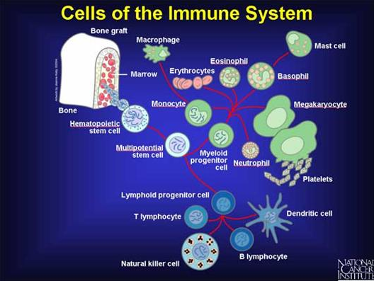
DISEASES
95 percent of the diseases are related directly to the imbalance of the immune system of our body.

Slide 6
Immune Response.
Increased viral and bacterial infections.
increased resistance
microorganisms
Disorders mechanisms
guest protectors

Slide 7
Pathologies currently increasing.
1. Cancer
2. Cardiovascular Diseases
3. Respiratory Diseases
4. Endocrine Diseases
5. Neuropsychiatric Disorders
6. New Group of infections
  a.- HIV
  b.- parenteral types of hepatitis.

Slide 8
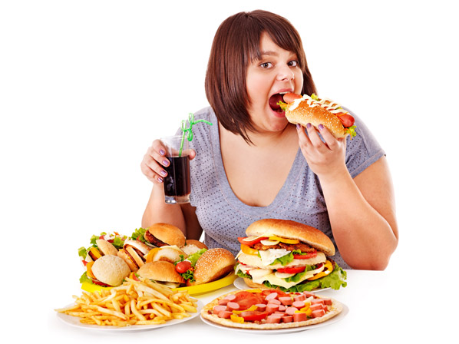
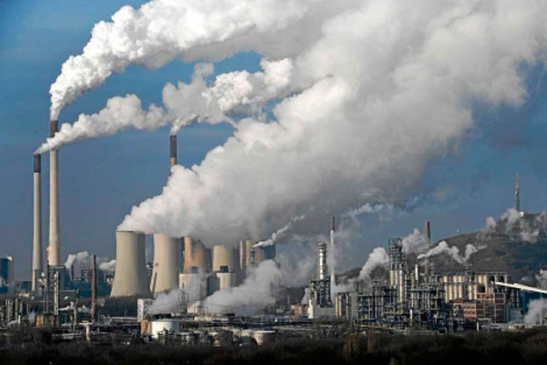
Aggravating factors the imbalance of the immune system
Social factors: Malnutrition. (Everyone eats but not everyone is well fed)
Ecological factors: environmental air pollution derived from new technologies.
Medical factors: unjustified use of some medicines, narcotics, stress and so on.

Slide 9
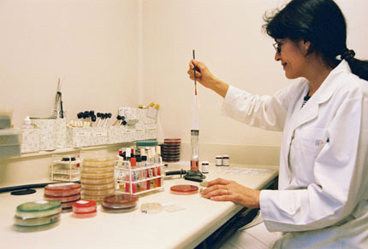
IMPORTANT
A simple tool we could use is to analyze tumor markers in blood.
They give us real data on how the immune system is affected.
We must consider the age and gender of the patient.

Slide 10
Main Tumoral Markers in blood
1) CEA: carcino embryonic Antigen. VN (0-6) and (4.6-10.6)
2) CA 125: Uterus and Ovary. VN (0-35)
3) CA 15-3: Mamas. VN (0-35)
4) CA 19-9. Pancreas stomach. VN (0-37)
5) CA 72-4. Alimentary canal. VN (0-6.7)
6) CA 21-1. Lung. VN (0-3.3)
7) ENE. Lung. VN (0-17)
8) Alphabetoproteins.-Liver. VN (1-7)
9) Prostate Specific Antigen. VN (0-4)

Slide 11
Current trends in medicine.
In medical practice a multitude of immune modulators are used, but its efficacy and other properties defining their safety, simplicity of use and economy differ widely.
AA Vorobiev.
Newsletter No.4 "002 RAMS.
Russia.

Slide 12
Natural modulators
Natural peptides obtained from cow colostrum and avian.
Main function:
Provide immune protection against microbes (bacteria, viruses, fungi and / or protozoa) Cancer cells and other antigens capable of disrupting vital processes for the body.

Slide 13
TREATMENTS
ALTERNATIVES
Immunizations
Antibacterial therapy
Immunomodulators

Slide 14
Transfer factors.
Stimulate cellular components of the immune system (lymphocytes -Nk)
Activates the synthesis immunocyte-kinetic
Regulates immune functions.
It is safe
Orally
Does not cause adverse reactions
Efficacy in adults and children.

Slide 15
Transfer factors
Effective to overcome the disease as auxiliary therapy.
Effective for the prevention of diseases as the immune system balances
Its cost is lower than other therapies such as interferon and its effectiveness is greater in treatments.

Slide 16
Transfer factors
It can be found in a pure state or in combination formulas giving a greater power of action.
We have used transfer factors for over 11 years in our patients and it has developed a series of reports of the benefits of using this. The results have led us to write the book “NO MAS DEFENSAS BAJAS” (NOT MORE LOW DEFENSES) which summarizes the most important cases.

Slide 17
Private practice
We are a team of 5 doctors that in 11 years have treated more than 9,500 patients with Transfer Factor Strengthened with very satisfactory results in interdisciplinary action.
We can share our series with those who are interested.
Just contact us!
davaso80@gmail.com

Slide 18
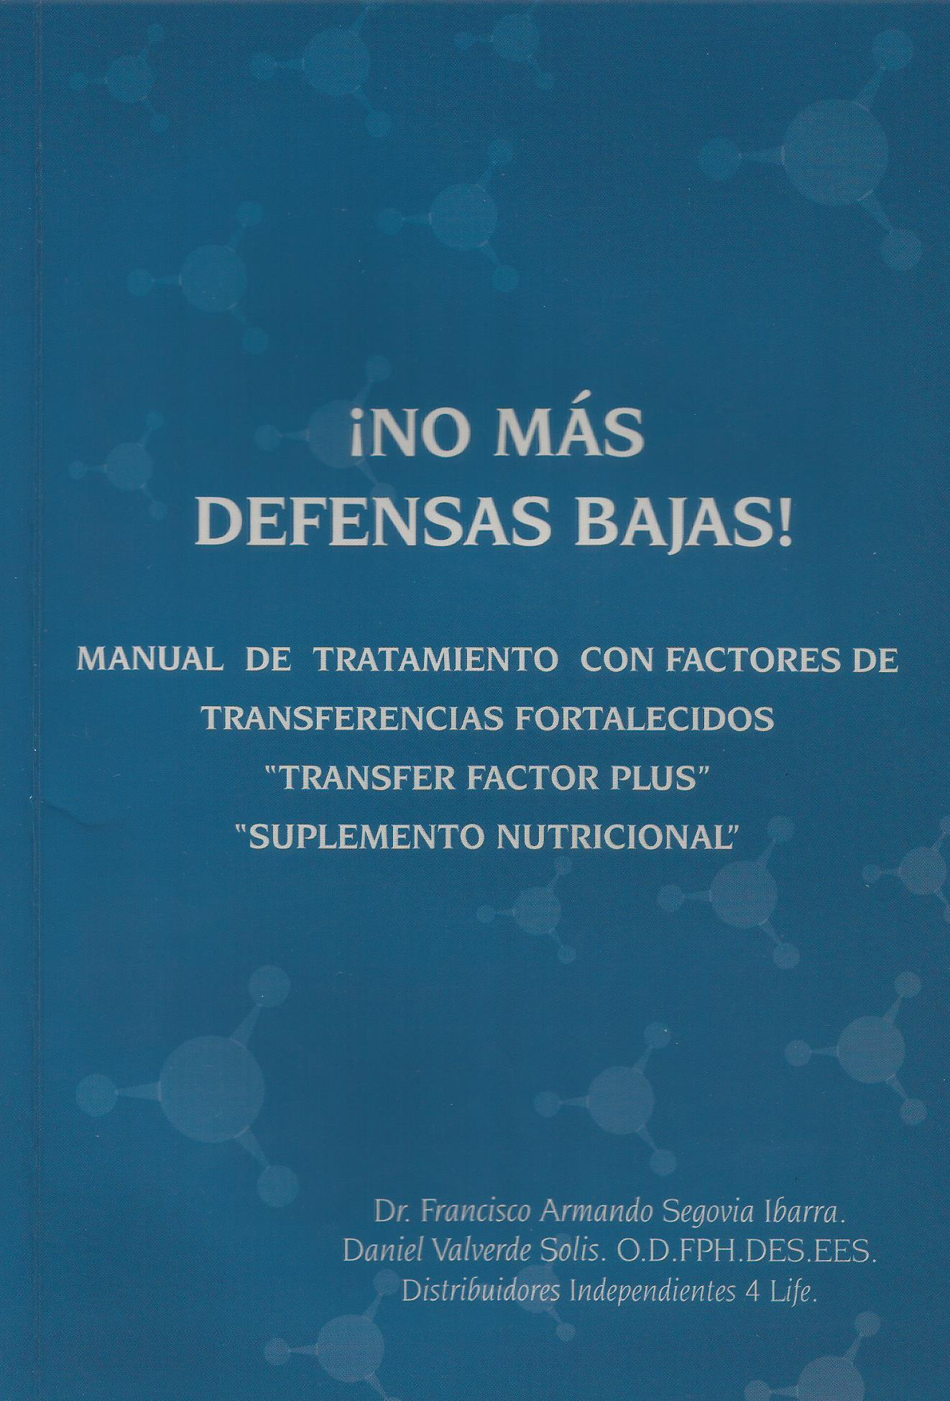
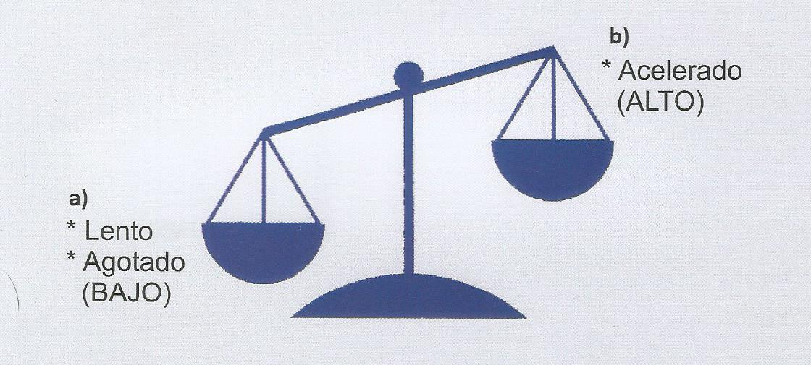
UNBALANCED IMMUNE SYSTEM
ACCELERATED
SLOW

Slide 19
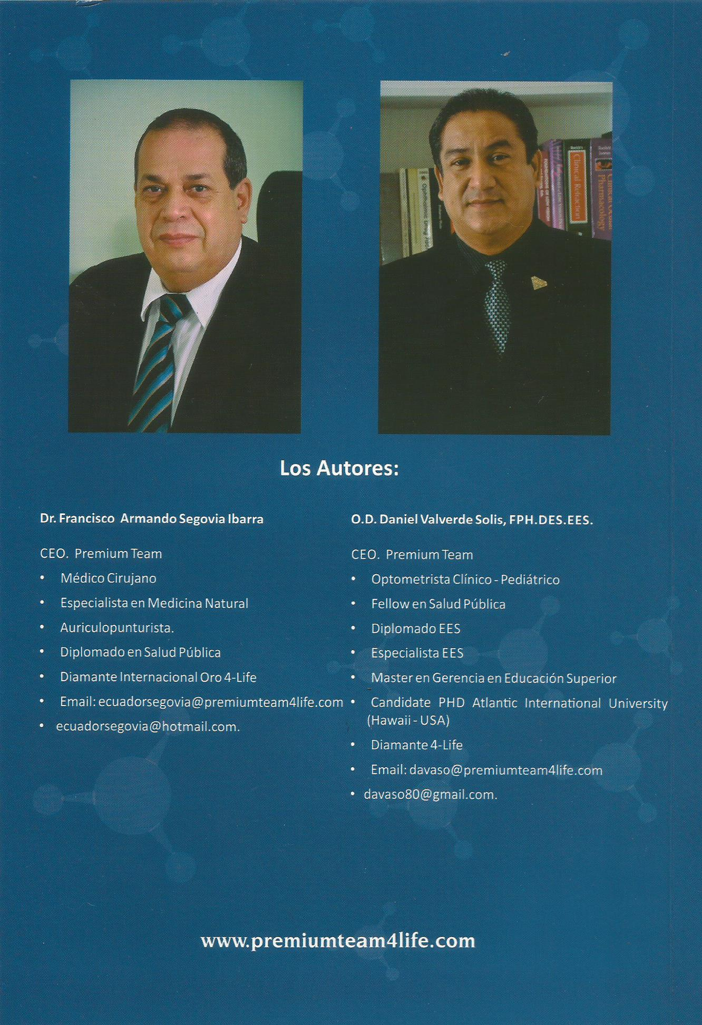
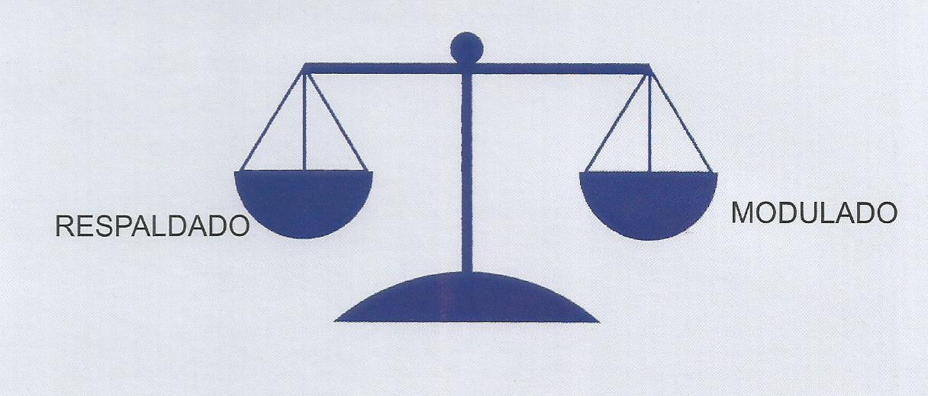
IMMUNE SYSTEM BALANCING

Slide 20
MAIN GOAL
To create awareness of the importance of accompanying our treatments with the auxiliary transfer factors therapy.
To ensure that the immune system of the patient is balanced helping to allow more effectiveness in our treatment recovering health faster and preventing diseases with a strong immune system.

Slide 21
Thank you very much for your attention
Any additional question?
E-mail me: davaso80@gmail.com
Thank you for this opportunity Baltimore.
Dr. Daniel Valverde
Guayaquil, Ecuador.

Slide 22

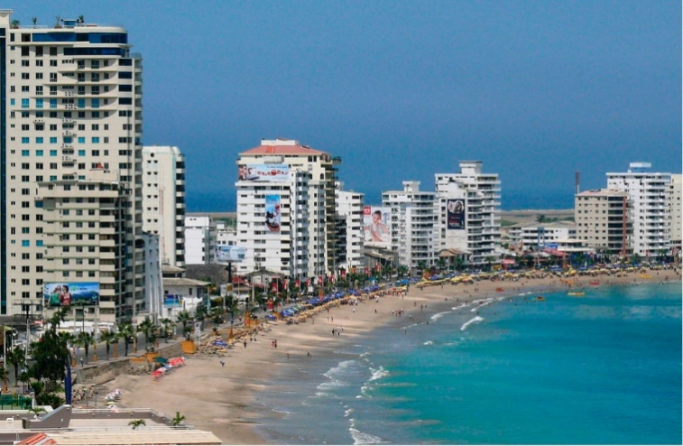
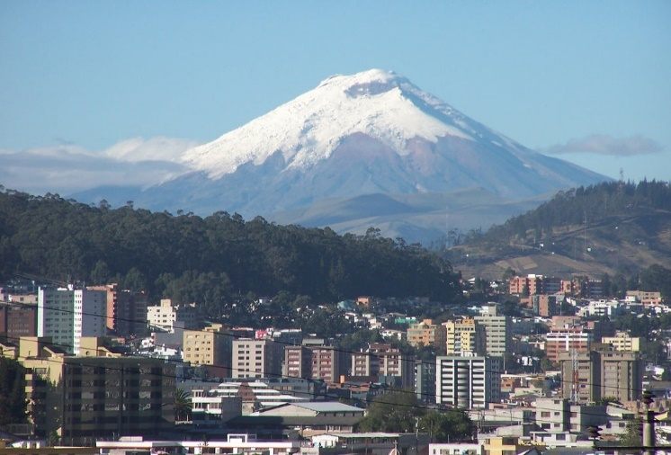

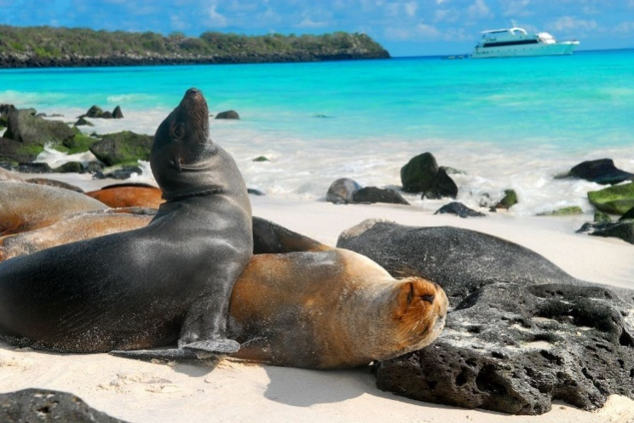
All you need is Ecuador
Four regions and a heart awaits.

Slide 23

Coastal Region - COSTA
Salinas.

Slide 24
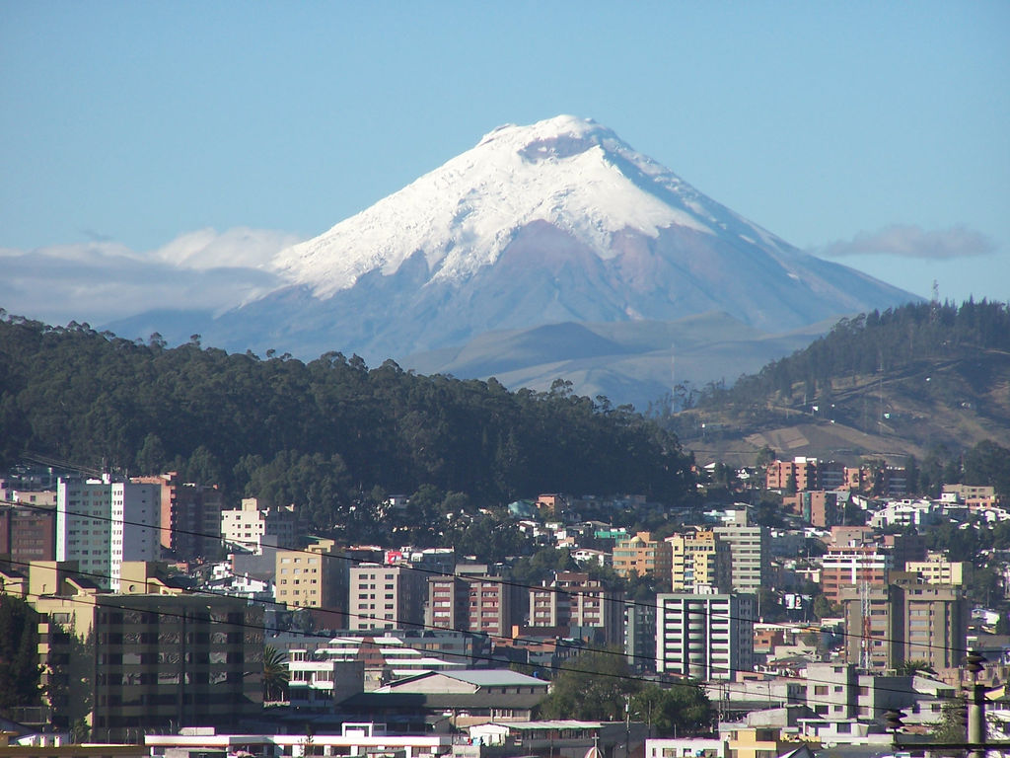
Highland Region - Sierra.
Cotopaxi.

Slide 25
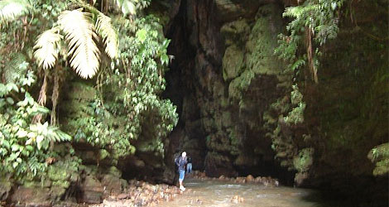
Amazon Region - Oriente
Cuevas de los Tayos.

Slide 26
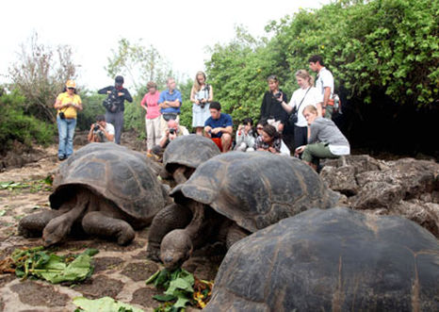
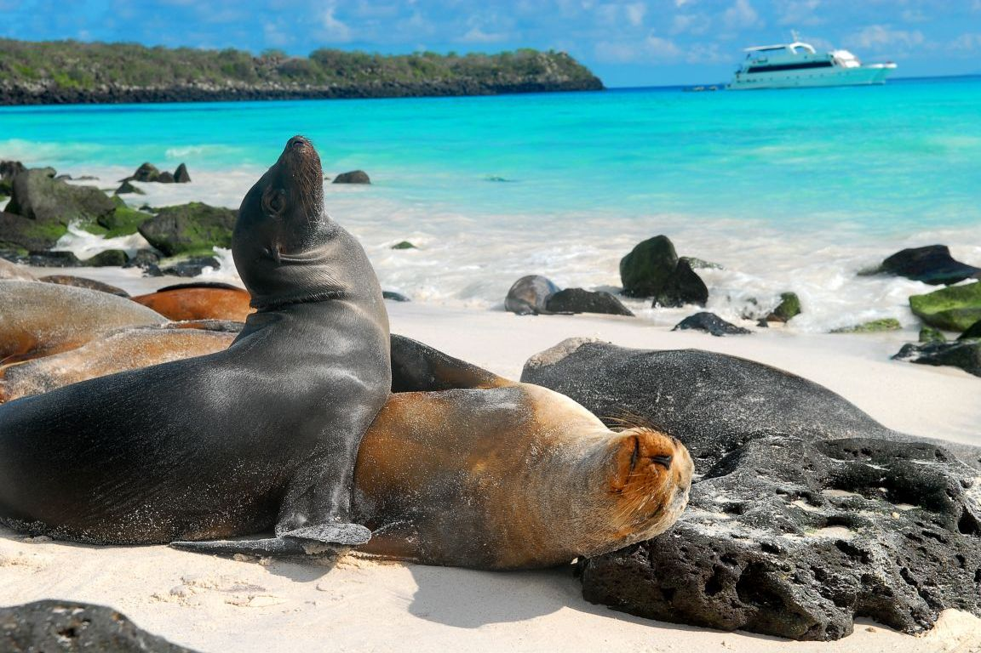
Galápagos Islands

Slide 27

Meet the eminent gathering once again at
Eye-2016
Miami, USA
September 26-28, 2016
Eye– 2016
Website: eye.conferenceseries.com

