Slide 1

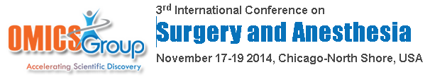
“Looking across the pond”:
Do surgical educators need to consider more emphasis on technical surgical skills in the UK’s current surgical training programme
DSZM Boctor; SBL Low; JM George

Slide 2


Slide 3
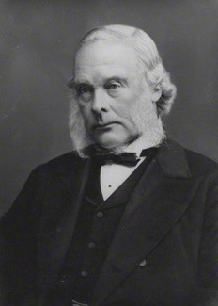
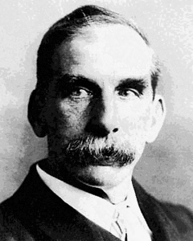
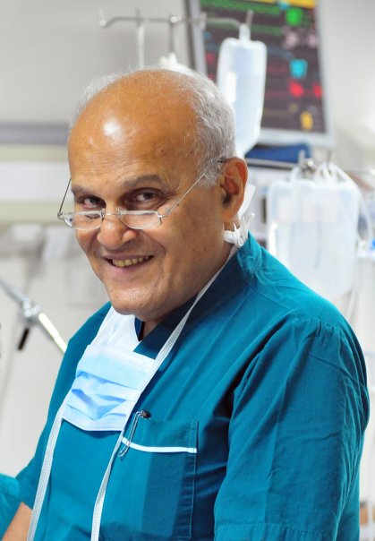

Slide 4
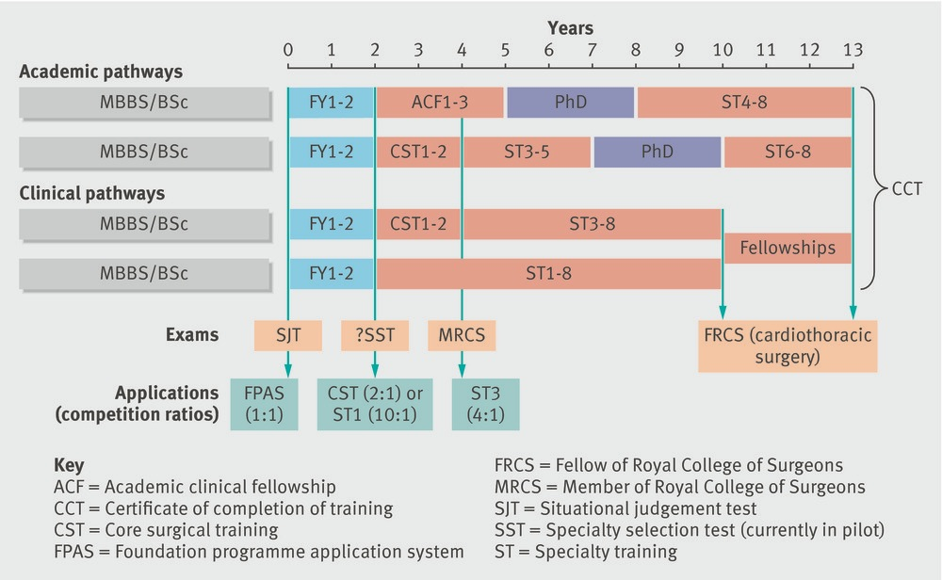
Surgical Training Pathway

Slide 5
Core Surgical Training
Annual Review of Competence Progression (ARCP)
  Workplace-based assessments (WBAs)
    Case-based discussions (CBDs), Clinical examination exercises (CEXs), Directly observed procedures (DOPs)/Procedure-based assessments (PBAs)
  Mini peer assessment tool (mini-PAT)
  Audit reports
  Examinations
  Courses
  Research activity - meetings, presentations, publications
  Teaching
  Logbook (Index cases)
  Management and leadership roles
Notes:
The Annual Review of Competence Progression (ARCP) is a summative event which will determine your level of achievement and define what progress you are making. It therefore records evidence of your training during the year.
WBAs – at least 50% by consultants, minimum 40/ year. Higher in different trusts.

Slide 6
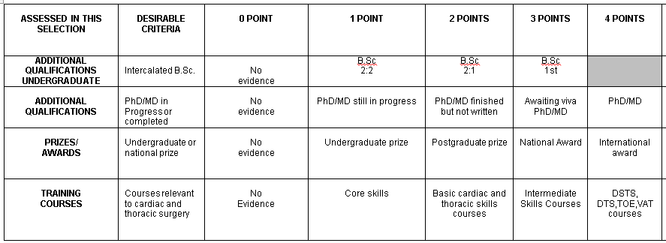
Higher Training Shortlisting Criteria 1

Slide 7
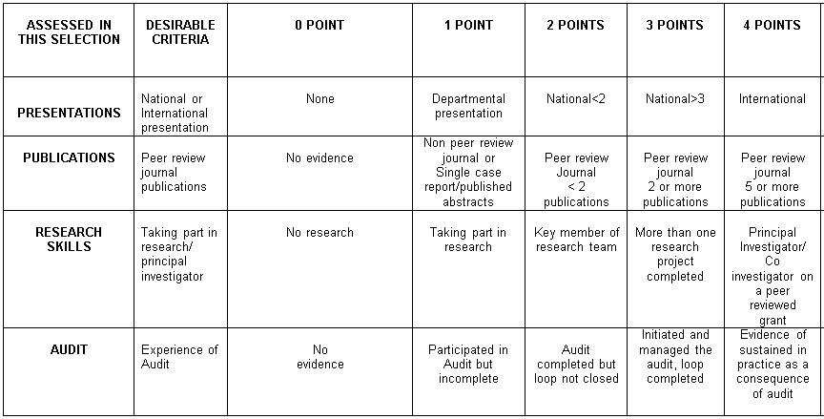
Higher Training Shortlisting Criteria 2

Slide 8

European Working Time Directive (EWTD)
Law passed by European Parliament
Accepted into UK law
Based on Health and Safety principles
All EU workers
Dictates:
  56 hrs/week from August’07 and 48 hrs by August’09
  Rest requirements
Notes:
European Working Time Directive is a law passed by the European Parliament and accepted into UK law. It is based on Health and Safety principles and would be enforced by The Health and Safety Executive. It came into force for the majority of the workforce in 1998 with a phased cut in hours for doctors in training to prevent damage to patient care and safety in the short term.
Essentially it limits all workers in the EU to 56 hours per week from August 07 and 48 hours by August 2009.
It imposes rest requirements of:
11 hours continuous rest in 24 hours.
24 hours continuous rest in 7 days or 48 hours in 14 days
20 minutes break in every shift over 6 hours.
4 weeks annual leave.
It also dictates that compensatory rest must be given for any interruptions of or delay in receiving rest periods.

Slide 9
Disadvantages
Decreased time spent in active training programs
Lack of continuity in patient care
Dependence on rota management and staffing adequacy
Notes:
“The current paradigm of postgraduate medical training, which is organized around blocks of a specific amount of time in each rotation during residency, is naturally hampered with the EWTD, because it implies spending fewer hours a week in a rotation,” he adds. “Thus, the aims and objectives of the rotation cannot be achieved. One possible solution is to change the paradigm of medical training to one based on competency-based learning.”
Dependence on rota management – patient care compromised if rota not well managed or poorly staffed hospital, adding pressure to a organisation that is understaffed and in debt.
- The ratio rose from two doctors per 1000 people in 2000-1 to 2.4 in 2005-6, but it was still only two thirds the ratio in France, Germany, or Italy. BMJ 2008

Slide 10
WHAT IS THE IMPACT???

Slide 11
Literature
Less time spent in theatres (DOH and Social security 1971)
Exposure to operative cases have reduced by 20% (Stevens et al 2007; Garg et al 2003)
Perceptive: Operative ability has reduced (Parsons et al 2007)
  90% of SpRs, 84% of SHOs – ↓ operative ability
  88% SpRs, 76% SHOs – ↓ surgical training
Notes:
Parsons et al: Surgical emergencies, critical care, communication, teaching skills unchanged or better
No study has looked at how much junior surgical residents practise their surgical skills
There are however studies that looked at teaching surgical skills at an earlier level of medical training (ie medical student) and increase intensity and frequency of teaching to junior doctors
UK DOH and Social security survey 1968
Junior doctors spend 20% of time in theatres (Organisation of the work of junior hospital doctors, DOH and social security 1971) vs study in 1991 – surgical PRHOs mainly based on wards or outpatients with considerably less time in theatres (Dowling and Barrett 1991)

Slide 12
Literature
Objective: Operative ability has reduced (Parsons et al 2007)
  Old vs current training - 90% vs 28% could perform open appendicectomy (unsupervised) at the end of SHO training
No study has looked at how much junior surgical residents practise their surgical skills

Slide 13
Our study is the FIRST STUDY to quantify the time spent by junior surgical residents practising their surgical skills

Slide 14
OUR STUDY

Slide 15
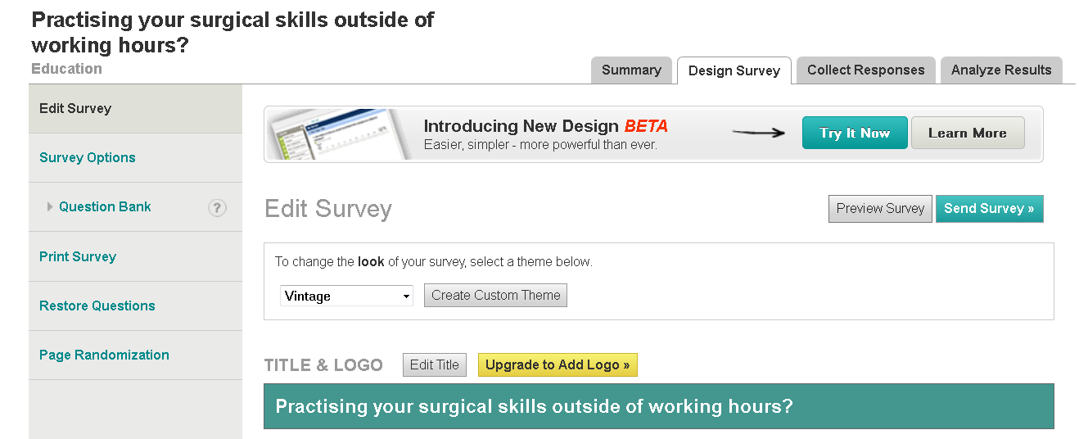
Methods
Questionnaire study
83 UK junior surgical doctors

Slide 16
Questionnaire: 5 questions
1. Which of the following best describes your current job level?
2. Outside of working hours, IN AN AVERAGE WEEK, HOW MUCH TIME (MINUTES/ HOURS) would you say you spend doing training/career-related things
Notes:
(e.g. WBAs, logbook, exam revision, general reading/study, courses, practising surgical/technical skills, teaching, research, audits, etc.)

Slide 17
Questionnaire: 5 questions
3. Outside of working hours, IN AN AVERAGE WEEK, HOW MUCH TIME would you say you spend on practising your SURGICAL/TECHNICAL SKILLS?
4. Outside of working hours, IN AN AVERAGE WEEK, HOW MUCH TIME (MINUTES/ HOURS) do you feel it would be important to spend practising your surgical/technical skills?
Notes:
(e.g. basic surgical skills, laparoscopic training, simulation training, etc.)

Slide 18
Questionnaire: 5 questions
5. If your answer to Question 4 is GREATER than your answer to Question 3:
  Outside of working hours, what areas of training/career-related activities do you think surgical trainees should spend less time on?
  Feel free to make any other comments you feel strongly about.
Notes:
(e.g. WBAs, logbook, exam revision, general reading/study, courses, practising surgical/technical skills, teaching, research, audits, etc.)

Slide 19

Results
31 responders
Ideally: 168 mins/week to practise surgical skills
Reality: 38 mins/ week
Paperwork commitments → Discrepancy
Notes:
Reality – 38 mins = 7.9% of total time spent on professional development outside of working hours

Slide 20
Discussion
Simulation
Mental imagery
Distributed learning
Notes:
Moulton et al 2006: 38 surgical trainees. 2 groups: 1) 1 day intensive or 2) distributed weekly practice regime (same time spent accumulative). Tested skills pre-training, post-training and 1 month post-training. Ultimate test in live anaesthetised rat. Distributed group: better surgical outcome measures and clinical outcome.
Role of mental practice:
Aurora et al 2011 – 1st randomised controlled trial showed mental practice enhanced quality of performance on a virtual reality lap chole (Methods: Tested 20 novice surgeons, 5 virtual reality lap choles each – Grp 1: 30 mins of mental practice vs Grp 2: watching a lecture. Learning curves showed mental practice group superior for every lap chole. Supplemented by mental imagery questionnaire. Shown to work in sports and music.
Sanders et al 2004 – Initial physical practice vs mental imagery rehearsals – 65 students – 3 groups – 1) 3 sessions to suture pig’s foot; 2) 2 sessions of physical practice, 1 session mental imagery; 3) 1 session physical practice, 2 sessions mental imagery. All performed surgery on live rabbit. Found that PP followed by MI = additional PP (Groups 2 + 3 performed as well as Group 1).

Slide 21
Conclusion
First study to quantify time spent on practising surgical skills by junior trainees
Surgery = Craft skill
  10,000 hours in delibrate practice for expertise; Ericsson 2004
Consider diversion of time spent on paperwork to surgical skills

