Slide 1

Using DNA copy number aberrations to identify candidate drivers of carcinogenesis in naturally occurring canine cancers
Daniel Rotroff PhD, MSPH
Postdoctoral Research Fellow, Bioinformatics Research Center, North Carolina State University
2nd International Conference on Genomics and Pharmacogenomics
September 10, 2014

Slide 2
Introduction
There are approximately 78 million domestic dogs residing in the USA.
Cancer is one of the leading causes of death for domestic dogs, with popular breeds such as golden retrievers, Labrador retrievers and boxers, succumbing to cancer with frequencies of 50, 34 and 44%, respectively.
Dogs exhibit a wide variety of spontaneous cancers that share clinicopathologic features with humans
Rotroff et al. (2013) Naturally occurring canine cancers: powerful models for stimulating pharmacogenomic advancement in human medicine. Pharmacogenomics.
Thomas et al. (2014) Genomic profiling reveals extensive heterogeneity in somatic DNA copy number aberrations of canine hemangiosarcoma. Chromosome Res.
Roode et al. Genome-wide assessment of recurrent genomic imbalances in canine leukemia identifies evolutionarily conserved copy number changes and regions for subtype differentiation. In Prep

Slide 3
Introduction
The recent development of a high-quality canine genome sequence assembly has opened the door for researchers to identify key drivers of disease that may impact both canine and human patients.
We have developed tumor-associated genomic DNA copy number aberration profiles for 75 canine hemangiosarcomas and more than 200 canine leukemias and lymphosarcomas using an oligonucleotide array comparative genomic hybridization (oaCGH) platform.
We have mapped canine genes to available human homologues for pathway-based analyses, identified putative drivers of carcinogenesis, and have identified genes that may be useful as diagnostic tools for characterizing leukemia subtypes.
Rotroff et al. (2013) Naturally occurring canine cancers: powerful models for stimulating pharmacogenomic advancement in human medicine. Pharmacogenomics.
Thomas et al. (2014) Genomic profiling reveals extensive heterogeneity in somatic DNA copy number aberrations of canine hemangiosarcoma. Chromosome Res.
Roode et al. Genome-wide assessment of recurrent genomic imbalances in canine leukemia identifies evolutionarily conserved copy number changes and regions for subtype differentiation. In Prep

Slide 4
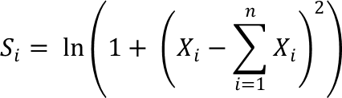
Methods
Study Features
123 leukemias comprised of ALL (28), AML (24), CLL-B (25), and CLL-T (46)
106 lymphosarcomas comprised of B-cell (74) and T-cell (32)
75 hemangiosarcomas from 5 popular dog breeds
~180,000-feature Agilent technologies microarray design oaCGH platform. Array uses ~60-mer oligonucleotides distributed at approximately 13kb intervals
Data Processing
Data was normalized and segmented using CBS.
Gain/Loss/No change calls were made based on a 5 MAD cutoff per subject
Modeling Approaches
Hierarchical clustering
Feature formation
Regions were selected based on S_{i} < 2.5 and were used as features for model development.
A recursive random forest ensemble classification model
Regions with the 100 highest Gini coefficients were used as features in a decision tree classification model

Slide 5
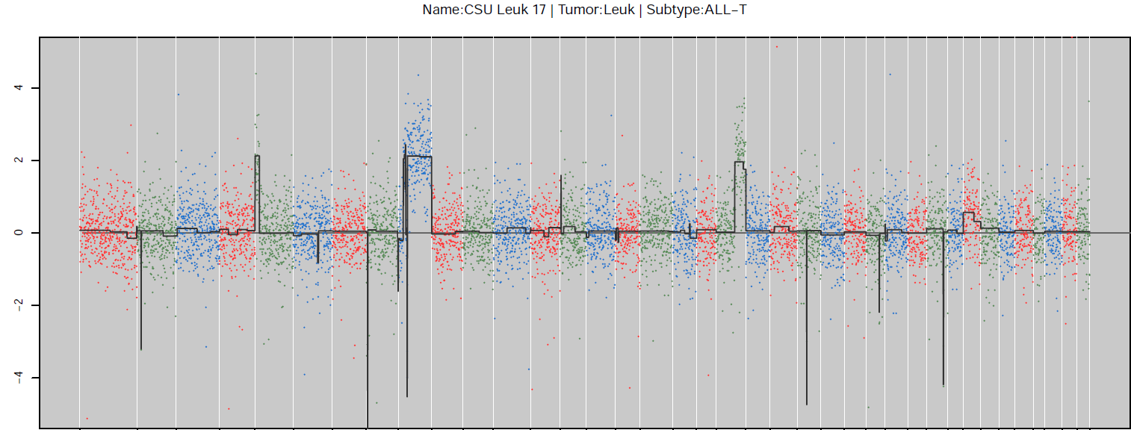
CBS segmentation
Tumor type: Leukemia | Subtype: ALL-T
2
1
Normalized Log₂ Ratio
0
-1
-2
1
2
3
4
5
6
7
8
9
10
17
19
21
23
25
27
29
31
33
35
37
11
12
13
14
15
16
18
20
22
24
26
28
30
32
34
36
38
Example of an individual leukemia patient’s oaCGH profile. The x-axis contains genomic regions and the y-axis is the log₂ ratio of the normalized fluorescent signal. The solid line represents the results of the CBS segmentation algorithm.

Slide 6
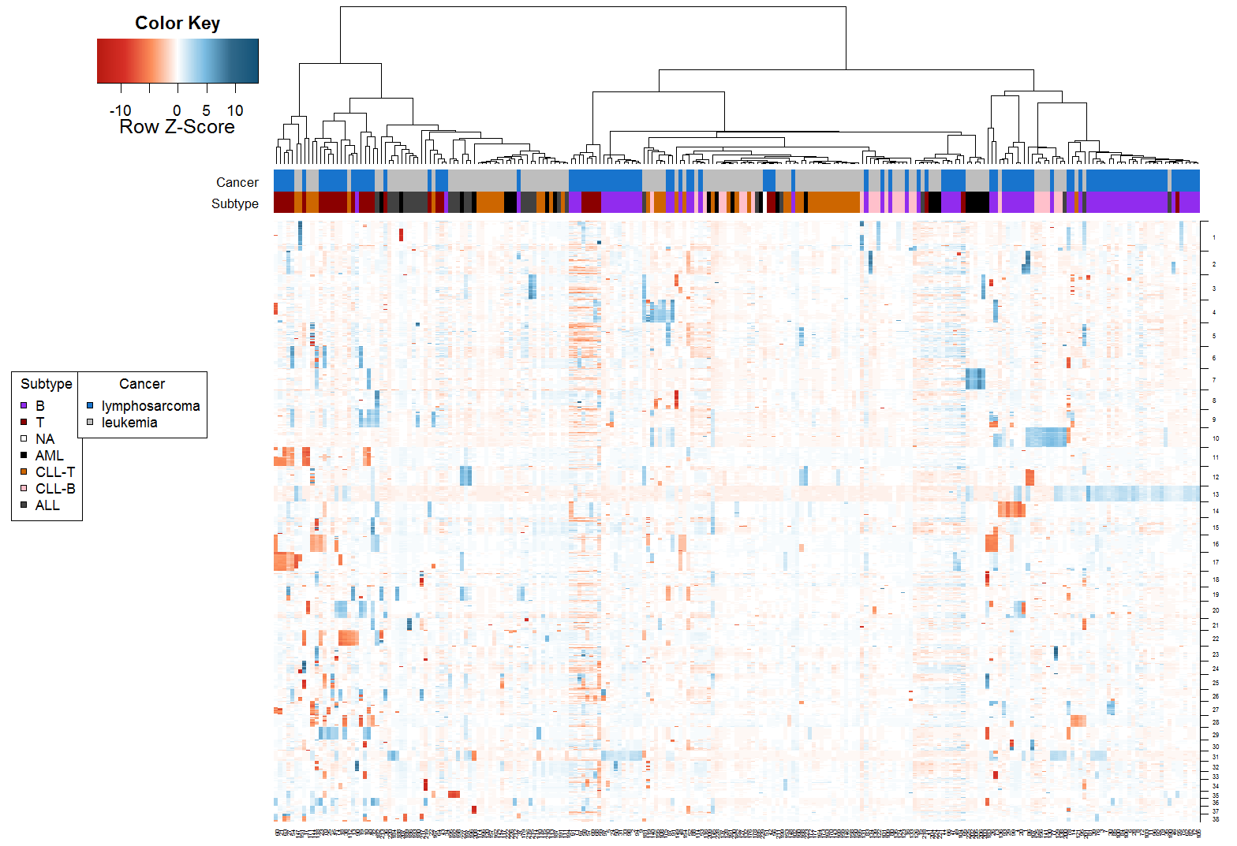
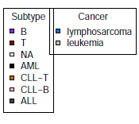
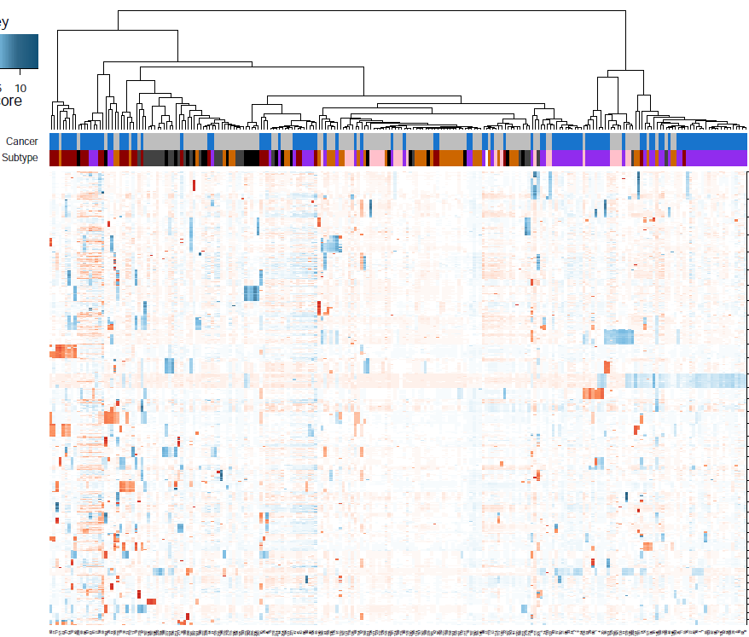
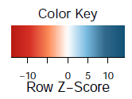
Lymphosarcoma and Leukemia
Figure 3. Hierarchical clustering of leukemia and lymphosarcoma cases. Data consisted of segmented values that were scaled and clustered using Euclidian distance and Ward’s method. Columns represent individual patients and rows represent individual markers along the genome. Blue indicates a region of gain and red indicates a region of loss. The meta data columns indicate the cancer type and subtype.

Slide 7
Canine Hemangiosarcoma

Slide 8
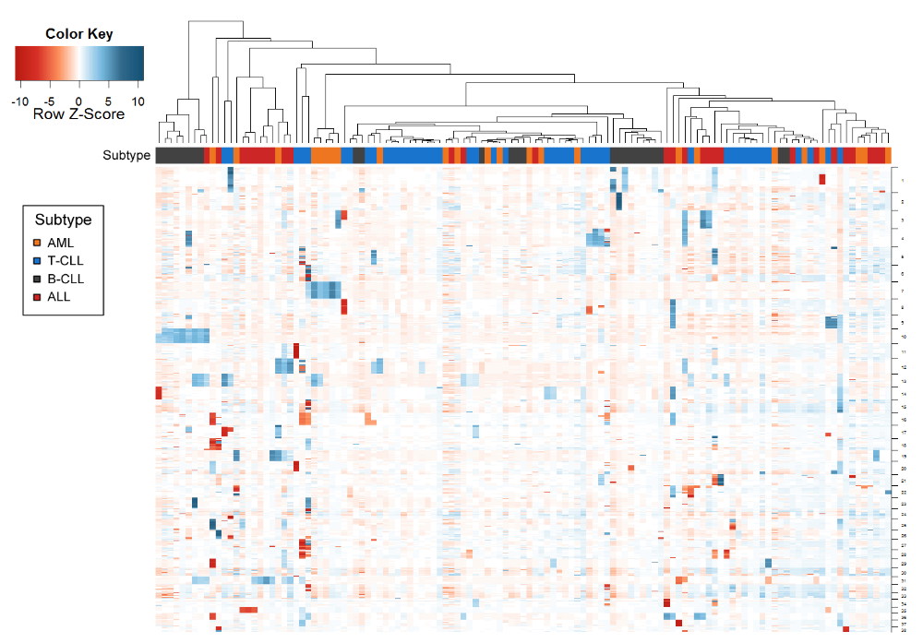
Canine Leukemia
Roode et al. Genome-wide assessment of recurrent genomic imbalances in canine leukemia identifies evolutionarily conserved copy number changes and regions for subtype differentiation. In Prep
Notes:
Hierarchical clustering of canine leukemia cases based on genome wide copy number status. Data consisted of segmented values that were scaled and clustered using Euclidian distance and Ward’s method. Columns represent individual patients and rows represent individual markers along the genome. Blue indicates a region of gain and red indicates a region of loss. Subtype metadata is annotated for each column.

Slide 9
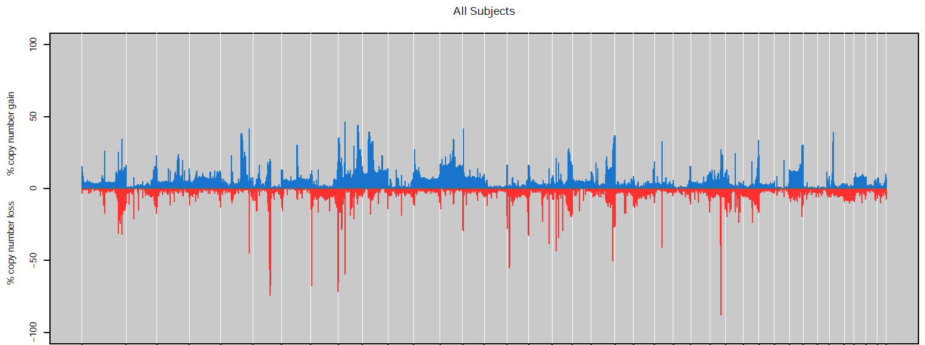
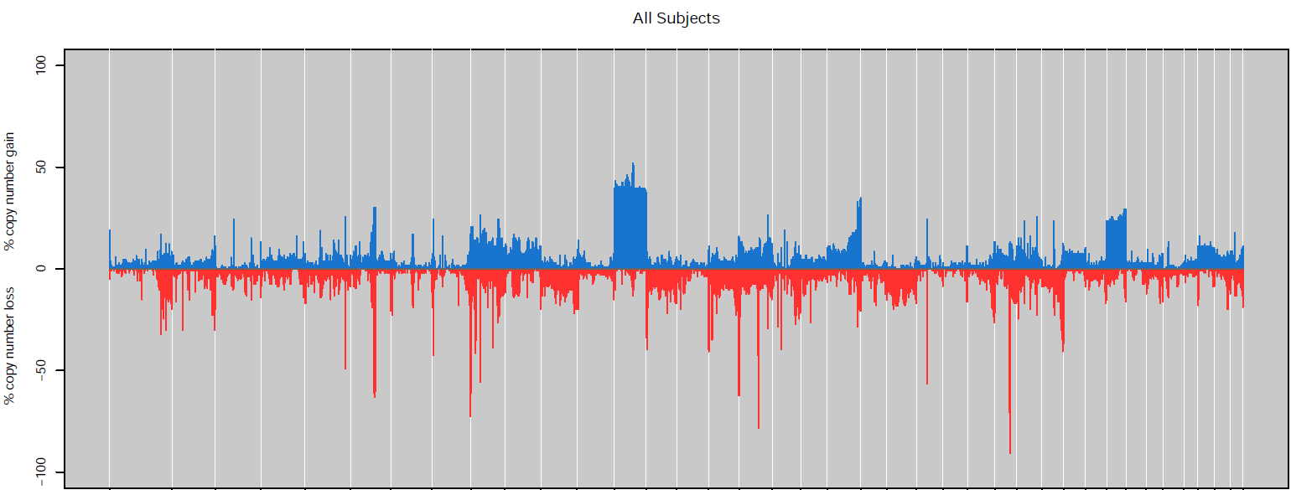
Leukemia vs Lymphosarcoma Penetrance
Leukemia Penetrance Plot
Lymphosarcoma Penetrance Plot
23
25
27
35
1
2
3
4
5
6
7
8
9
10
11
12
13
14
15
16
37
17
18
19
20
21
29
31
33
34
22
24
26
28
30
32
36
38
Notes:
Figure 2. (A) Penetrance plot of leukemia gains and losses across genome. (B) Manhattan plot of statistically significant regions in leukemia cohort, separated by gains and losses. (C) Penetrance plot of lymphosarcoma gains and losses across genome. (D) Manhattan plot of statistically significant regions in the lymphosarcoma cohort, separated by gains and losses. Statistical significance was determined using the DiNAMIC algorithm.

Slide 10
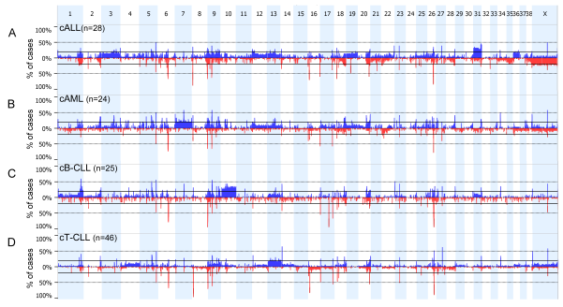
Leukemia Subtype Penetrance
Penetrance plots of genome-wide CNAs in four subtypes of canine (c) leukemia including ALL (A), AML (B), B-CLL (C), and T-CLL (D). CFA1-38 and X are plotted across the x-axis, and the percentage of cases that demonstrated either copy number gain (blue, above midline) or loss (red, below midline) within a defined chromosomal region are represented on the y-axis. The horizontal lines above and below the midline indicate the 20% threshold for definition of a recurrent CNA.
Roode et al. Genome-wide assessment of recurrent genomic imbalances in canine leukemia identifies evolutionarily conserved copy number changes and regions for subtype differentiation. In Prep

Slide 11
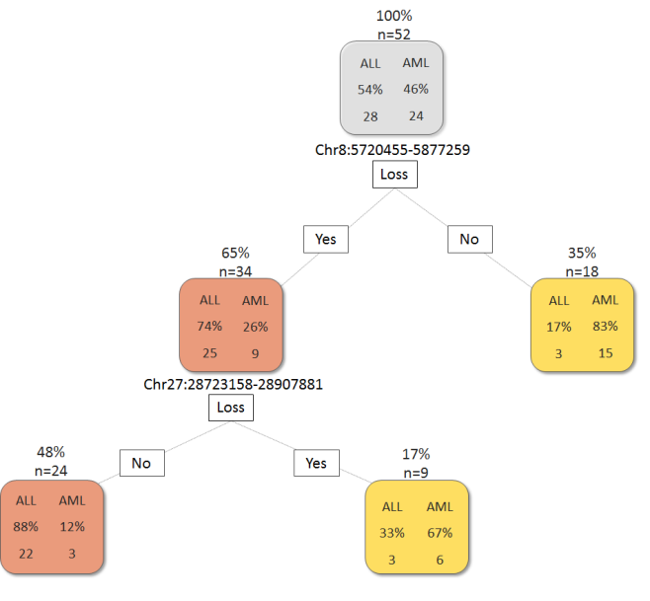
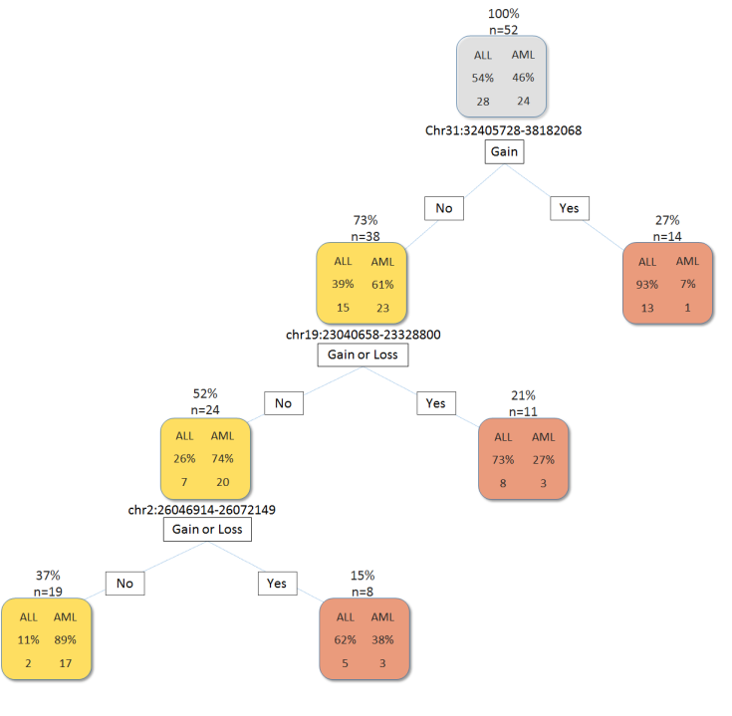
ALL vs AML
Model #1: Decision Tree Classifier Results
 | ALL | AML | Precision
ALL | 22 | 3 | 0.88
AML | 6 | 21 | 0.78
Model #2: Decision Tree Classifier Results
 | ALL | AML | Precision
ALL | 26 | 7 | 0.79
AML | 2 | 17 | 0.89
Model #1: All available features
Model #2: excluding TCR and IG loci
Roode et al. Genome-wide assessment of recurrent genomic imbalances in canine leukemia identifies evolutionarily conserved copy number changes and regions for subtype differentiation. In Prep
Notes:
Figure 6. Diagnostic predictor models for differentiation of AML and ALL based on copy number status of regions defined using a random forest ensemble classification model followed by a decision tree classification model. Model #1 includes a TCR locus as part of the model, whereas model #2 was generated after excluding TCR and IG loci from modeling. Above each box the number of cases following that branch and the percentage based on the total number of cases (n=52) is indicated. Inside each box includes the number of AMLs and ALLs following that branch and the percentage of each subtype based on the total number of cases following that branch. A classification of primarily AML is designated by yellow boxes, and a classification of primarily ALL is designated by red boxes.

Slide 12
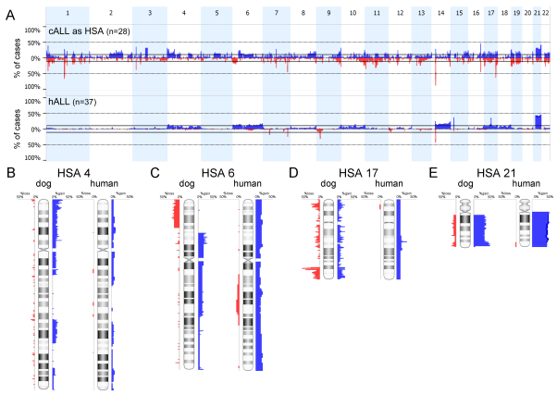
Canine ALL comparison to Human ALL
Roode et al. Genome-wide assessment of recurrent genomic imbalances in canine leukemia identifies evolutionarily conserved copy number changes and regions for subtype differentiation. In Prep
Notes:
To allow direct comparison of oaCGH data from canine case with published human cases, the genome coordinates of all oligonucleotides on the canine array were imported into the Liftover Batch Coordinate Conversion Tool (http://genome.ucsc.edu/cgi-bin/hgLiftOver), using default settings to establish the orthologous nucleotide sequence coordinates within the human genome sequence assembly (February 2009, GRCh37/hg19). With recoded coordinates, the signal intensity data for each array were reprocessed to output each canine oaCGH profile with ‘virtual’ human chromosome locations. To compare the ‘humanized’ canine data with data from human patient samples, readily accessible human data sets were downloaded from the Gene Expression Omnibus (GEO; http://www.ncbi.nlm.nih.gov/geo/) and imported into Nexus Copy Number for analysis using similar methods to those described above. Canine ALL was compared to 37 pediatric ALLs including seven T-cell and 30 B-cell which were assessed using Affymetrix 250k Nsp SNP arrays
Comparison of recurrent genomic CNAs in canine (cALL) and human ALL (hALL). The canine data has been recoded according to the equivalent location of each loci on the corresponding human chromosome. (A) Genome-wide penetrance plots of cALL and hALL. HSA 1-22 are plotted across the x-axis, and the frequency of copy number gain (blue, above midline) or loss (red, below midline) within a defined chromosomal region are represented on the y-axis. The horizontal lines above and below the midline indicate 10%, which was the threshold applied to select regions of imbalance in the dog to compare with humans. (B-E) Selected chromosomes with regions of CNA shared across species. Frequency of gains (blue) along the chromosome is indicated on the right of each chromosome, while frequency of losses (red) are indicated on the left. The scale ranges from 0-50% to better visualize low frequency changes. The most notable shared region is the gain of 21q (E)

Slide 13
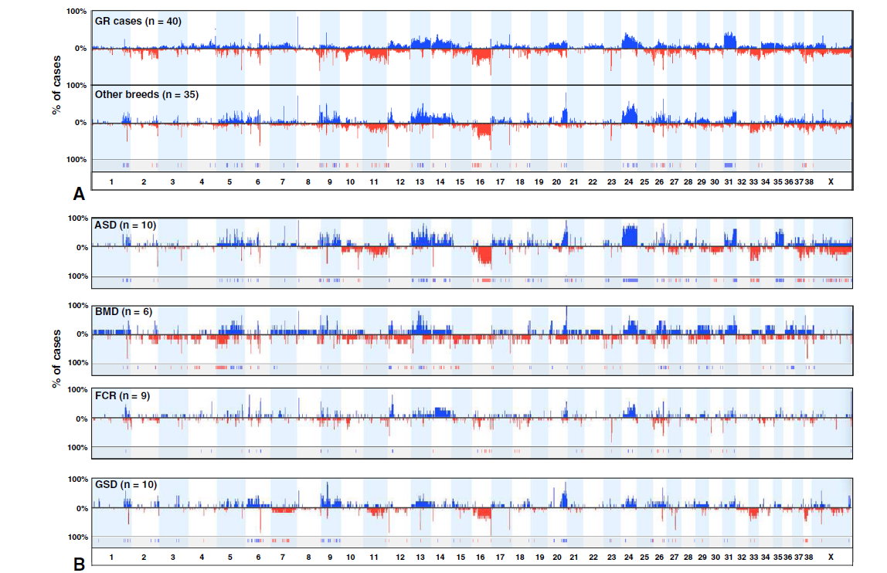
Hemangiosarcoma
Thomas et al. (2014) Genomic profiling reveals extensive heterogeneity in somatic DNA copy number aberrations of canine hemangiosarcoma. Chromosome Res.

Slide 14
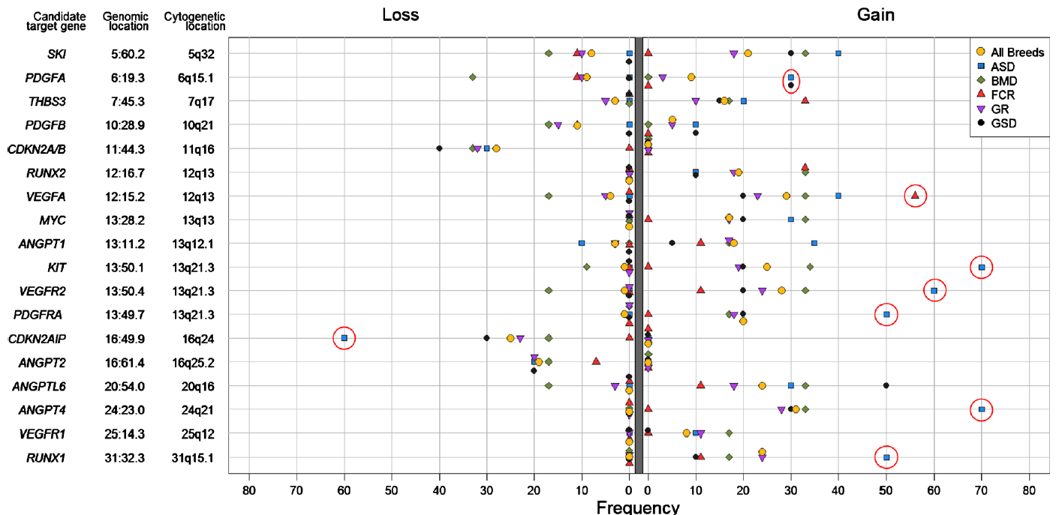
Hemangiosarcoma
Red circles indicate CNA penetrance values that deviate significantly in one breed compared to all other breeds (p<0.05)
Thomas et al. (2014) Genomic profiling reveals extensive heterogeneity in somatic DNA copy number aberrations of canine hemangiosarcoma. Chromosome Res.
Notes:
Forest plot summarizing penetrance data for genes involved in recurrent CNAs identified within the cohort of 75 hemangiosarcoma cases, and within each breed. Genes described in the text are ordered on the vertical axis according to their physical location in the dog genome. The frequency of gain and loss of each locus in each breed is shown on the horizontal axis as a percentage of that population, in addition to the frequency in the entire cohort. Red circles indicate CNA penetrance values that deviate significantly in one breed compared to all other breeds (Fishers Exact test, p<0.05)

Slide 15
Summary
The oaCGH platform detects CNAs that display distinct differences among cancer classifications and subclassifications
These data can be used to develop predictive models, for example CNAs present in CFA31, CFA19, CFA2 accurately distinguished leukemia ALL and AML subtypes in the present study. Validation of this model is currently underway.
Some cancers (e.g. hemangiosarcoma) show heterogeneity of CNAs across different breeds.
Conserved regions between humans and canines can be mapped and compared to human cancers. These analyses show that for some cancers, common aberrations are observed between species, further highlighting the utility of this model for studying human cancers.
Comparing genes in shared aberrations across breeds and species may help to identify candidate genes that are drivers of carcinogenesis.

Slide 16
Acknowledgments
North Carolina State University
University of Utah
Joshua Schiffman
Sarah Roode
Rachael Thomas
Matthew Breen
Alison Motsinger-Reif
Steven Suter
Luke Borst
University of Guelph
Dorothee Bienzle
Colorado State University
Anne Avery
University of Minnesota
Broad Institute
Jaime Modiano
Kerstin Lindblad-Toh

Slide 17
Questions
?

Slide 19
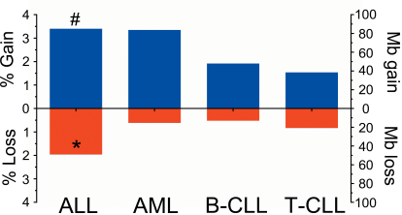
Genomic imbalances in each subtype expressed as percent genome changed and the total number of megabases (Mb) within regions of copy number change. The symbol (#) denotes p<0.05 for total percent genome changed compared to all other subtypes; and the symbol (*) denotes p<0.05 for percent genome loss or gain compared to other subtypes.
Roode et al. In Prep

Slide 20
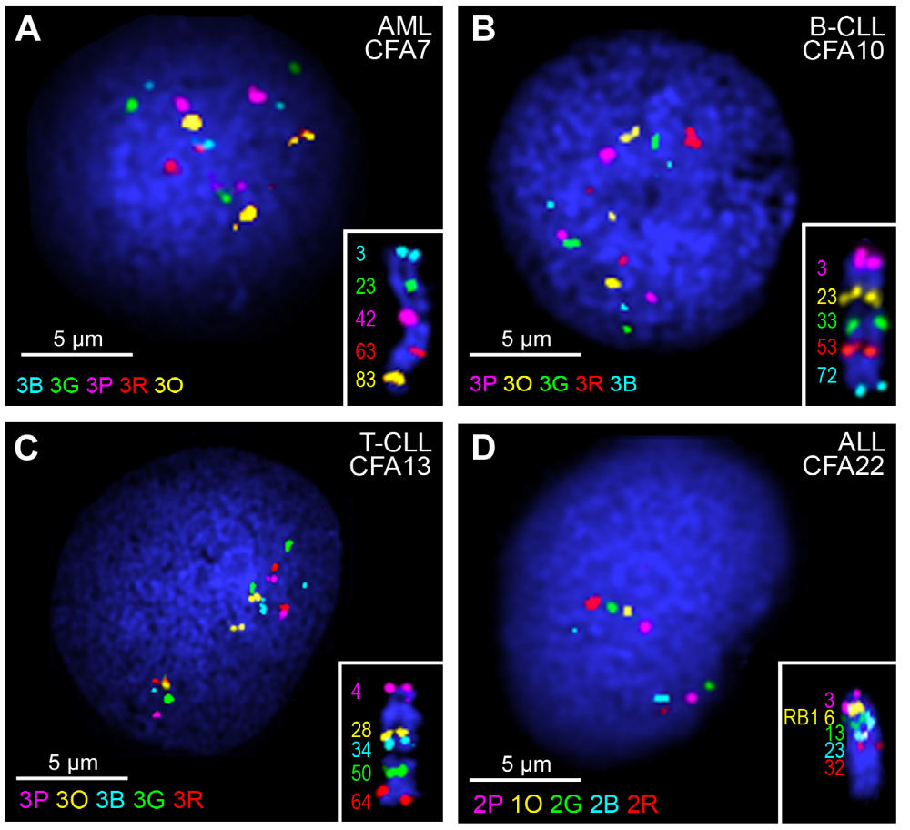
Introduction
FISH verifies recurrent CNAs identified via oaCGH. Each panel (A-D) includes a representative interphase nuclei harvested from whole blood from a dog with leukemia. The inset shows a control dog chromosome with correct localization of each of the differently labeled BAC clones and the approximate Mb position of each clone. Copy number of each colored probe is also indicated in each panel. (A) Trisomy of CFA 7 in AML. (B) Trisomy of CFA 10 in B-CLL. (C) Trisomy of CFA 13 in T-CLL. (D) Loss of region containing RB1 in ALL.
Roode et al. In Prep

Slide 21
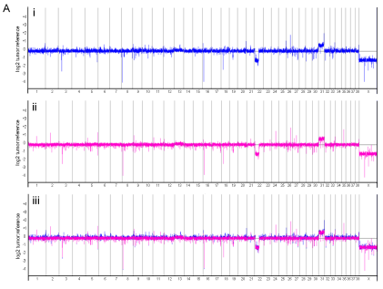
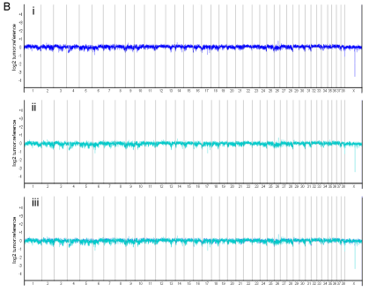
Genome-wide oaCGH profiles comparing DNA isolated from peripheral blood to DNA isolated from flow-sorted neoplastic cells in cases of canine leukemia. Blood samples for representative cases of canine ALL (A) and canine T-CLL (B) were collected and DNA was isolated from both whole blood and a >98% pure population of neoplastic cells derived from fluorescence activated cell sorting. (i) oaCGH profiles of whole blood, (ii) flow-sorted neoplastic cells, and (iii) the stacked overlay of the two profiles, were assessed for differences in aberration detection between sample type due to presumed cell heterogeneity in whole blood. Each oaCGH profile includes the chromosomes (1-38, X) on the x-axis and log2 tumor:reference ratio on the y-axis with gains visible above the midline, and losses below the midline. The case of ALL (A) has a gain of CFA 31 and loss of the proximal half of CFA 22 and CFA X which is equally evident in profiles of both sample types (A,i-iii). The case of T-CLL has few CNAs evident in either sample type (B, i-ii) and the profiles are indistinguishable when overlaid (B, iii).
Roode et al. In Prep

Slide 22
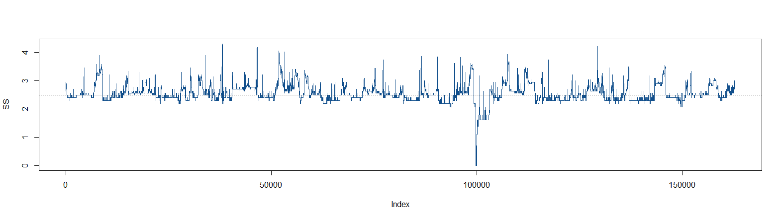
Example of the region calling algorithm for marker at index 100,000. Variance was determined relative to this marker. The more similar a neighboring marker is, the lower the variance value. A value of 0 would indicate an exact match. A threshold hold of 2.5 was used to define regions. Therefore, any contiguous marker with a value of < 2.5 was considered to consist of a single region.

Slide 23
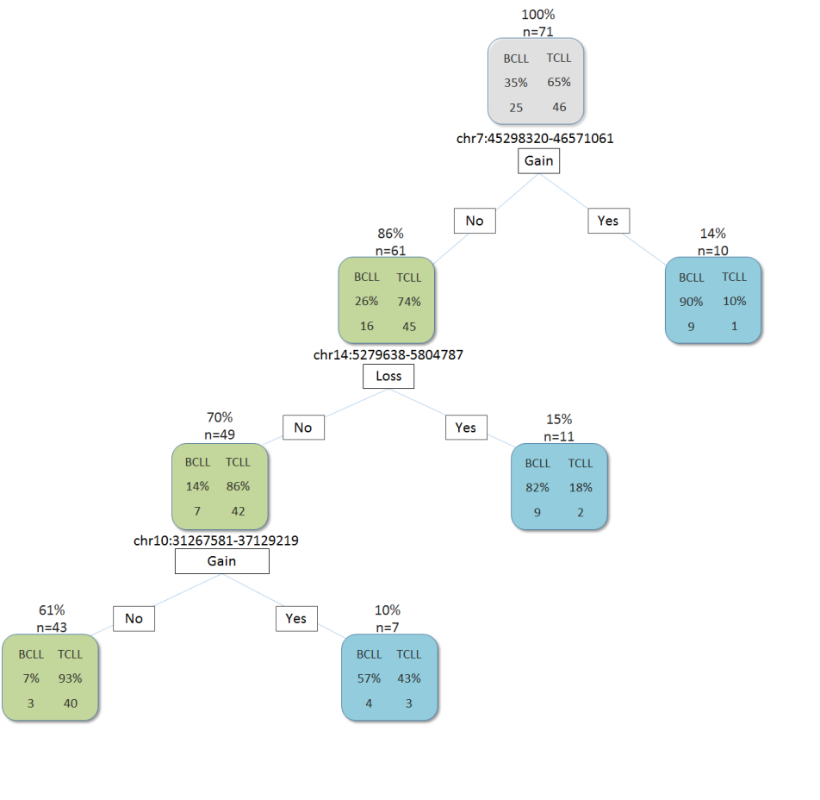
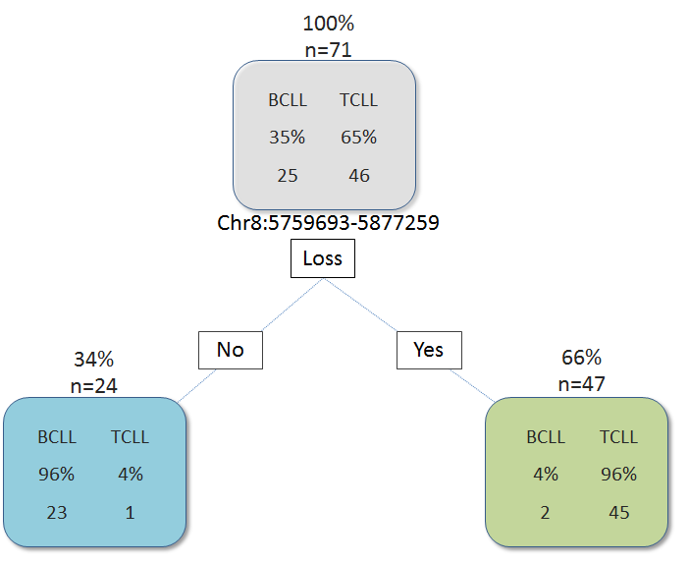
B-CLL vs T-CLL
Decision Tree Classifier Results
 | B-CLL | T-CLL | Precision
B-CLL | 23 | 1 | 0.96
T-CLL | 2 | 45 | 0.96
Model #2: Decision Tree Classifier Results
 | B-CLL | T-CLL | Precision
B-CLL | 22 | 6 | 0.79
T-CLL | 3 | 40 | 0.93
Model #1: All available features
Model #2: excluding TCR and IG loci
Roode et al. In Prep
Notes:
Figure 7. Diagnostic predictor models for differentiation of B-CLL and T-CLL based on copy number status of regions defined using a random forest ensemble classification model followed by a decision tree classification model. Model #1 includes a TCR locus as part of the model, whereas model #2 was generated after excluding TCR and IG loci from modeling. Above each box the number of cases following that branch and the percentage based on the total number of cases (n=71) is indicated. Inside each box includes the number of B-CLLs and T-CLLs following that branch and the percentage of each subtype based on the total number of cases following that branch. A classification of primarily B-CLL is designated by blue boxes, and a classification of primarily T-CLL is designated by green boxes.

