Slide 1

Nutritional solutions for a healthy life
Nutritional Solutions to Counteract the Impact of Air Pollution:
A BCDEF solution
Daniel Raederstorff, PhD
Manfred Eggersdorfer, PhD
DSM Nutritional Products, Kaiseraugst, Switzerland
3rd International Conference on Nutrition & Food Sciences
Valencia, September 23-25, 2014

Slide 2

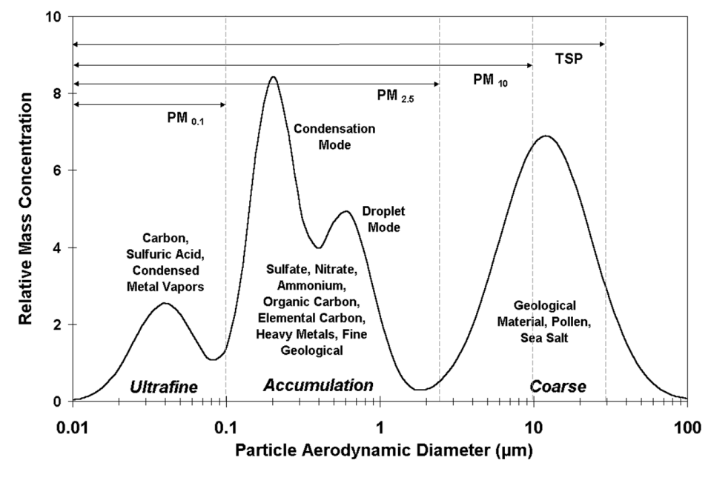
The 2005 WHO Air quality guidelines (AQGs)
Clean air is considered to be a basic requirement of human health and well-being
However, air pollution continues to pose a significant threat to health worldwide
Particulate matter (PM)
Ozone (O₃)
Nitrogen dioxide (NO₂)
Sulfur dioxide (SO₂)
PM2.5 Diameter < 2.5 μm
PM10 Diameter ≥ 2.5 μm
Composition
AQGs for PM
PM2.5 10 μg/m³ annual mean
25 μg/m³ 24-hour mean
PM10 20 μg/m³ annual mean
50 μg/m³ 24-hour mean

Slide 3
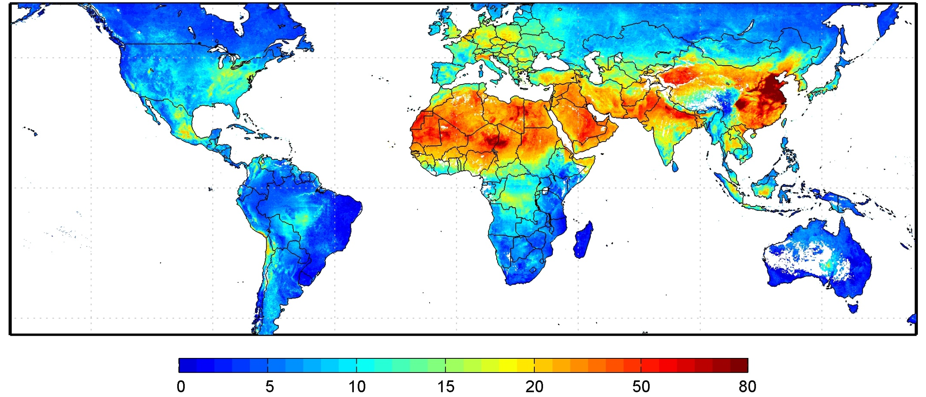
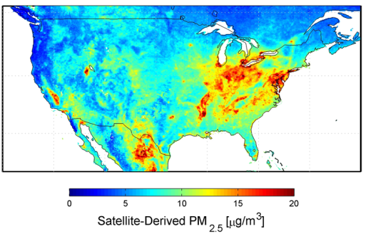
Air pollution a global problem
Global satellite -derived PM2.5 levels averaged over 2001–06
μg/m³
An overlap with maps of population density suggest that more than 80% of the world's population breathe polluted air that exceeds the WHO recommendation (<10 μg/m3 annual mean).
White space indicates water or locations containing < 50 measurements.
http://www.nasa.gov/topics/earth/features/health-sapping.html
Environ Health Perspect 2010;118:847
http://www.nasa.gov/topics/earth/features/health-sapping.html

Slide 4
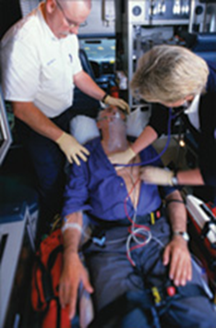
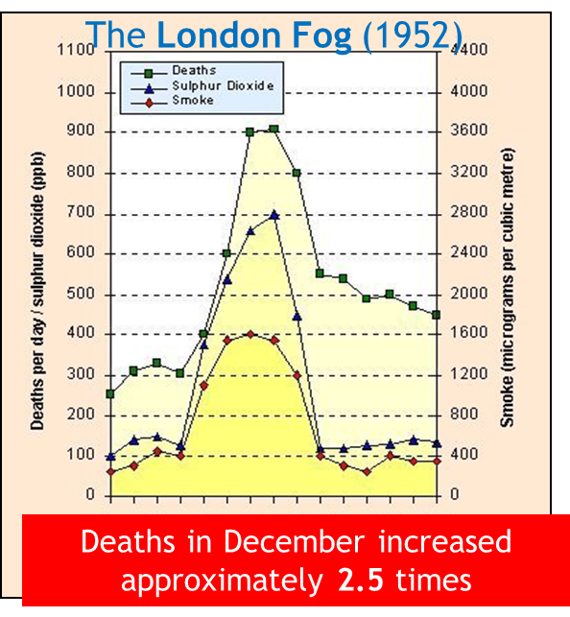
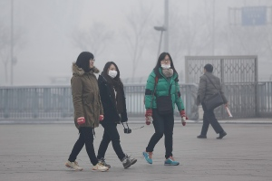
Which adverse Health Effects have been linked to PM 2.5?
Premature death
Lung cancer
Exacerbation of COPD
Development of chronic lung disease
Decreased lung function
Heart attacks
Hospital admissions and ER visits for heart and lung disease
Pre-term birth, Low birth weight
Respiratory symptoms and medication use in people with chronic lung disease and asthma
Increased risk of CVD and diabetes
Increased risk of cognitive deficits
Air pollution delivers smaller babies
Study of 3 million infants suggests connection between inhaled particles and birth weight (Nature, Feb 6, 2013)

Slide 5
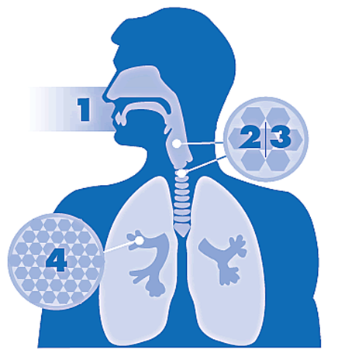
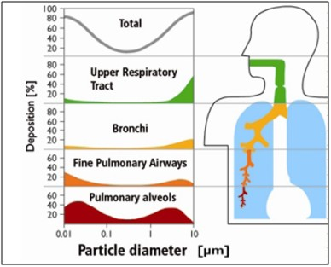
Major responses of the body to air pollution by particulate matter (PM)
PM enters respiratory system when we inhale
PM10 is mostly eliminated by cough, sneeze and swallow
PM2.5 travels all the way to alveoli in lung and causes local and systematic harm including:
↑ Oxidative stress
↑ Inflammation insult
Disturb the autonomic nervous system (ANS)
Adapted from www.bcairquality.ca/health/air-quality-and-health.html ; http://www.icao.int/environmental-protection/Pages/Contaminants.aspx

Slide 6
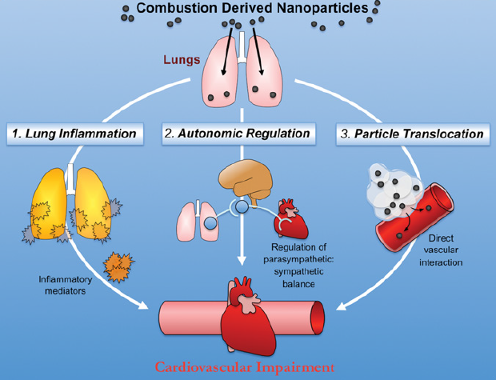
Mechanistic link between PM and CVD
Inhalation of Particulate Matter
ANS imbalance
Adapted from Miller M.R. et al., 2014
Short- and long- term exposure to PM air pollution is associated with an increased risk of CV morbidity and mortality

Slide 7

Some population groups are more at risk
People with heart / lung disease:
  Conditions make them vulnerable
Older adults:
  Greater prevalence of heart / lung disease
Children:
  More likely to be active
  Breathe more air
  Bodies still developing

Slide 8
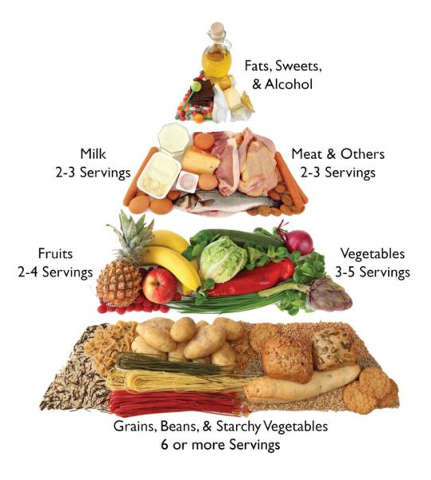
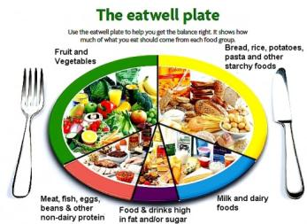

Nutrition & Chronic diseases the link with PM
Nutrition is a key factor for the prevention of chronic diseases (CVD, diabetes)
Small dietary changes can lead to a large reduction in the burden of CVD.
  Eating less fat and fewer calories
  Decrease sugar, salt and saturated fat intake
  Increase fiber, fruit and vegetable intake
  Adequate intake of micronutrients and PUFA
http://www.diabeticdietplan.net/diabetic-diet-plan-1/
33%
33%
Nutritional epidemiology showed that specific nutrients play a key role in maintaining a healthy body and reducing the risk of chronic disease such as CVD.
12%
7%
15%
WHO, IDF

Slide 9
Nutrition solution (A BCDEF solution):
B: Vitamin B’s
C: Vitamin C
D: Vitamin D
E: Vitamin E
F: Fish oil

Slide 10
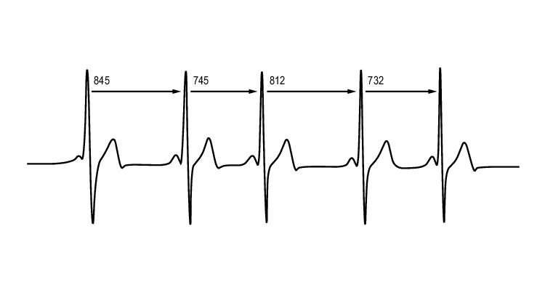
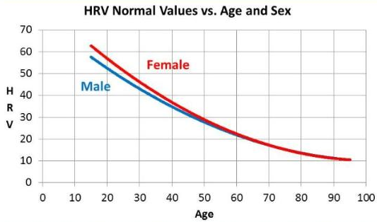
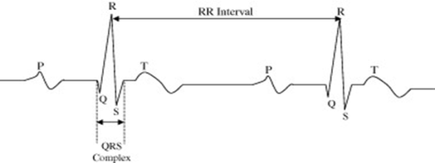
Heart rate variability (HRV)
HRV is regulated by the autonomic nervous system (ANS) and is used to assess the integrity of the ANS
HRV measures the fluctuation between heart beats
  Time-domain indices of HRV:
  SDNN is the standard deviation of all normal beat-to-beat interval (RR intervals) over a period of time. In young adults it is about 40-60 ms.
  Frequency-domain indices of HRV: Analysis of the fluctuations in the frequency domains
    Analysis in the High frequency (HF) range reflect exclusively parasympathetic activity
    Analysis in the Low frequency (LF) range reflect mainly sympathetic activity
A reduction in HRV is positively correlated with increased cardiac morbidity and mortality.
HRV declines with age
ms
http://www.sunscientific.com/What-is-ANS.html
HRV parameters are early indicators of body stress and disease.

Slide 11
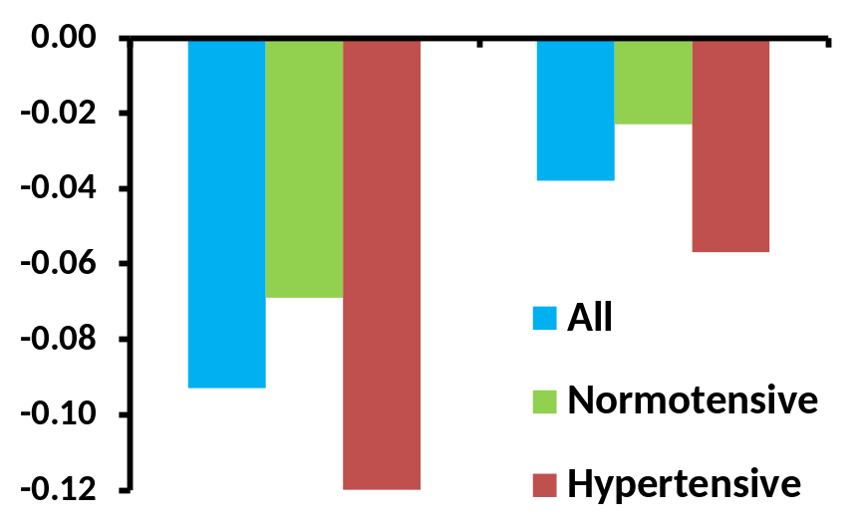
Air pollution and HRV among elderly in Mexico city
Change in HRV for a 10 µg/m³ increase in PM2.5
In Mexico City, 34 nursing home residents underwent heart rate variability analysis every other
day for 3 months.
24-hour average levels of PM2.5
    Indoor PM2.5: 15-67 g/m³
    Outdoor PM2.5: 9-87 g/m³
Daily 1-hour max. ozone levels:
47-228 ppb
HRV-HF
HRV-LF
PM2.5 exposure significantly reduced high frequency component of HRV in elderly.
Hypertensive subjects are more susceptible
Holguin et al. 2003

Slide 12
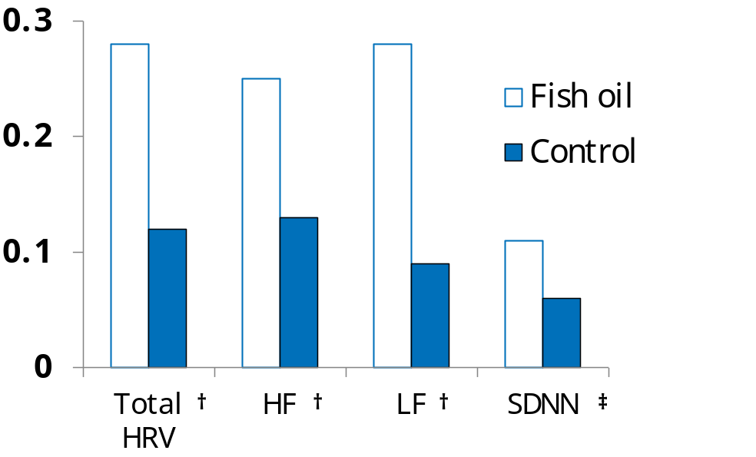
Cardiac autonomic changes in elderly supplemented with fish oil
Net change from baseline
Elderly subjects (n=58) consumed 2 g/d of either fish oil or soy oil for 4 months after a 2 months pre-supplementation period to establish an HRV baseline for each participant .
Time-domain and frequency-domain analysis of HRV was measured
† log10 (ms²)/100,000
‡ log10 (ms²)
Fish oil was associated with a significant increase in HRV
Holguin et al. 2005

Slide 13
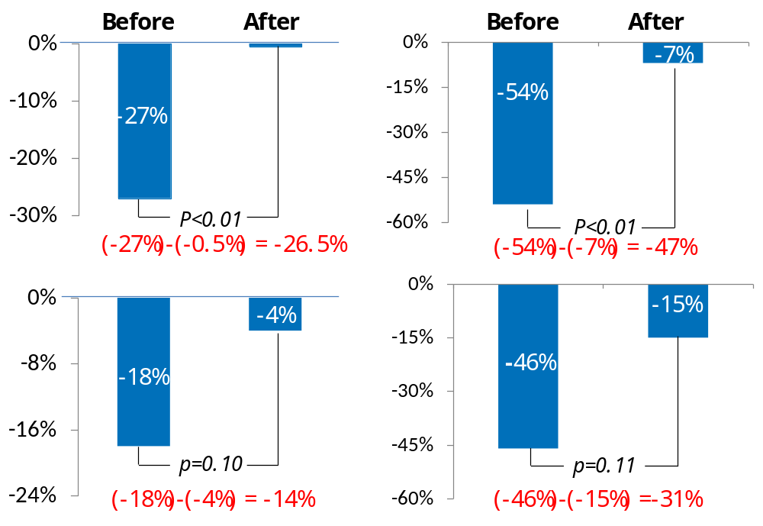
Omgea-3 PUFA presented HRV reductions associated with PM2.5
Change in HRV for an increase in 1 SD (8 µg/m³) of PM2.5
Elderly from a nursing home (n=50, >60 y) received 2g/d of either or fish oil or soy oil for 5 months after a 1 months pre-supplementation.
Indoor mean PM2.5 levels: 18.6 µg/m³ (8 SD).
Parameters: Time- and frequency domain analysis of HRV
Fish oil
HRV-HF
SDNN
Control
Fish oil significantly decreased the negative impact of PM2.5 on HRV in elderly
Romieu et al. 2005

Slide 14
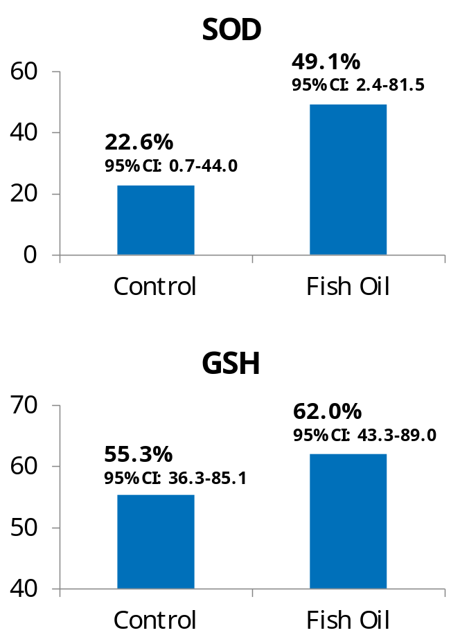
Omgea-3 PUFA enhanced antioxidant defense in elderly exposed to PM2.5
% change from baseline
Elderly from a nursing home (n=52, >60 y) received 2g/d of either or fish oil or soy oil for 4 months after a 3 months pre-supplementation.
Indoor mean daily levels of PM2.5 38.7 µg/m³ (14.7 SD).
Parameters: superoxide dismutase (SOD), glutathione (GSH) and lipoperoxidation (LPO).
PM2.5 decreased SOD activity and GSH levels
Fish oil modulated the oxidative stimuli by increasing SOD activity and GSH levels
Romieu et al. 2008

Slide 15
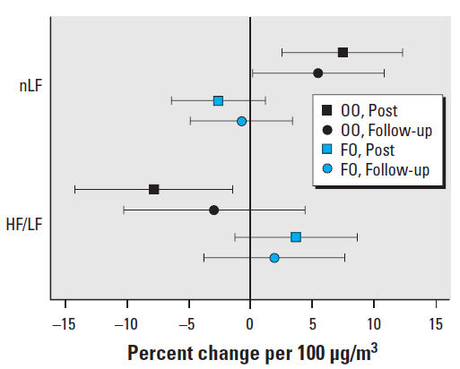
Omega-3 PUFA attenuate particulate matter induced cardiac effects
Healthy subjects (n=29, 50-72 y) received 3g/d of either or fish oil or olive oil for 4 weeks before sequential chamber exposure to filtered air or ambient particulate matter (mean mass concentration 278 µg/m³).
Parameters: Time and frequency domain changes in HRV and electrocardiographic repolarization changes measured before, immediately after, and 20 h after exposure.
Effect of PM on frequency domain indices of HRV
Omega-3 PUFA protect against the deleterious effects of acute exposure to PM
Tong et al. 2012

Slide 16
Dietary methyl nutrients prevent cardiac autonomic dysfunction induced by PM2.5
Baccarelli et al. 2008
Study design:
Elderly men (n=549) from the Boston area (Normative Aging Study) had HRV measured in either 1 (n=363) or 2 (n=186) visits.
The 48-hours moving average of PM2.5 was used as exposure index.
Genotyping of the C677T MTHFR and C1420 cSHMT were performed.
Dietary intake of folate, vitamin B6, B12, and methionine were derived from the food-frequency questionnaire.
Results:
MTHFR 677 CT/TT genotypes had lower HRV than subjects with CC genotypes
PM2.5 effects on HRV were stronger in subjects with MTHFR 677 CT/TT and cSHMT 1420 CC genotypes
The reduction in HRV associated with PM2.5 level was abrogated in subjects with higher intakes of B6, B12 and methionine.
Each 10 µg/m³ increase
in PM2.5 concentration
7% reduction
in SDNN
SDNN (Time-domain indices of HRV) : standard deviation of normal to normal intervals

Slide 17
PM 2.5 reduces HRV/SDNN, which is prevented by vitamin B’s
1.9%
Low
High
-13.1%
≥3.65mg/d
n=356
-8.8%
-5.7%
Vitamin B6
intake
Folate
intake
<495.8µg/d
n=353
≥495.8µg/d
n=354
<3.65mg/d
n=357
1.2%
3.0%
-13.2
≥11.1µg/d
n=356
-11.9%
Vitamin B12
intake
≥1.88mg/d
n=351
Methonine
intake
<1.88mg/d
n=352
<11.1µg/d
n=356
DRI
B6: 1.2 mg/d
B12: 2.4 µg/d
Folate: 400 µg/d
Baccarelli et al. 2008

Slide 18


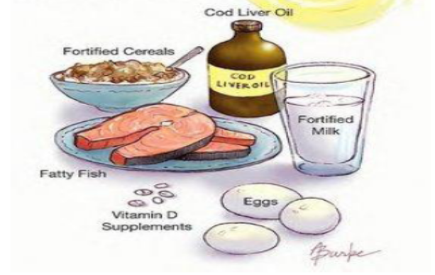

Sources of vitamin D
The role of sunshine....
Main source:
Sunlight (UVB 290–315 nm) induces vitamin D production in skin (80 – 90%)
...influenced by various
determinants
  Sunshine exposure
  Latitude > 37° / Season
  Ethnicity (skin pigmentation)
  Aging
  Weather & air pollution
  Sunlight exposure
  Sunscreen use (>SPF 8)
  Obesity
...further factors
  Degree of clothing (veiling)
  Increase in urbanization
  Lifestyle (limited outdoor activity)
Minor source:
Food intake of vitamin D is scarce (10 -20%) (mainly fatty fish)
Alternative source:
Fortification and supplements

Slide 19
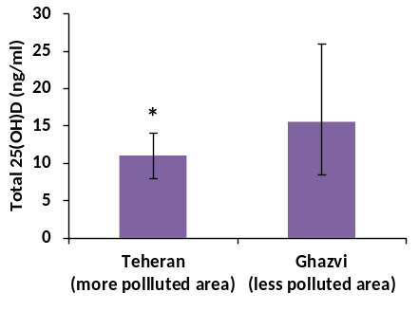
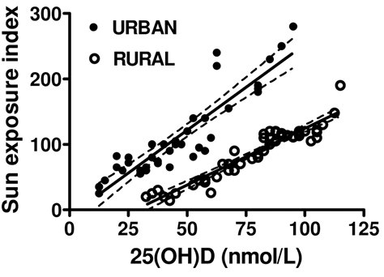
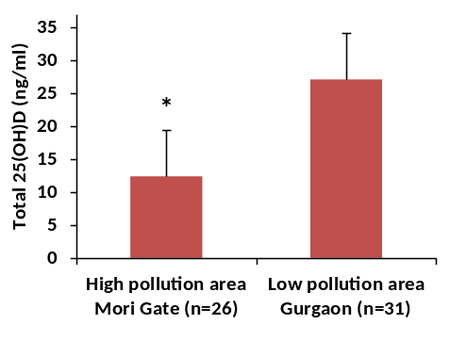
Air pollution compromise the vitamin D status
Vitamin D status is usually dependent on skin exposure to sun’s UVB radiation
Air pollution decrease UVB light and thereby reduce skin vitamin D synthesis
Relationships among vitamin D status and sun exposure index in Belgian urban and rural postmenopausal women
Vitamin D status of healthy women in Iran
Study conducted in September; age 20 to 55 years ; values are median (IQ: 25-75)
Hosseinpanah et al. 2010
Vitamin D status of infants and toddlers in Dehli, India
Study conducted in March, April; age 9 to 24 months ; values are mean (1SD)
Study conducted in June, July; age 51 to 81 years
Manicourt et al. 2008
Agarwal et al. 2002
Air pollution increase the risk of vitamin D deficiency

Slide 20
Antioxidant intervention reduced oxidative stress in subject exposed to PM emissions from coal combustion
Study design: Subject exposed to airborne contamination were supplemented with Vitamins C 500 mg and E 800 mg for 6 months. A panel of biomarkers of oxidative stress was measured before and after supplementation and compared to a control group
Non-enzymatic oxidative stress markers
Enzymatic oxidative stress markers
 | Coal em. | AOX supple.
TBARS | ↑ | ↓
PC: protein carbonyls | ↑ | ↓ Norm
GSH: glutathione | ↓ | ↑ Norm.
PT: protein thiols | ↓ | ↑
α-tocopherol | ↓ | ↑
 | Coal em. | AOX supple.
SOD: superoxide dismutase | ↑ | ↑
CAT: catalase | ↑ | Norm.
GPx: glutathione peroxidase | ↓ | Norm.
GR: glutathione reductase | ↓ | Norm
GST: glutathione S-transferase | ↑ | Norm.
Antioxidant supplementation improved both enzymatic and non-enzymatic antioxidant defense systems in subjects exposed to PM

Slide 21
Summary
PM2.5 a major component of air pollution is a health threat
PM 2.5 is a global and long-term problem
It’s solvable, but neither easy nor quick
Nutrition solution:
PM2.5 induced damage are reduced by fish oil and some vitamins
    Omega-3 PUFA improve heart function and attenuated HRV decline induced by PM2.5 exposure.
    B vitamins prevented the decline of heart rate variability (HRV) induced by PM2.5 exposure.
    vitamin E and C reduce PM2.5 induced oxidative stress
    Air pollution has a negative impact on vitamin D status
Various combinations of nutrients may prevent the impact of PM on different aspects of health.

Slide 22



