Slide 1
Atmospheric Mercury in the Oil Sands Region
Workshop at Earth Science - 2014
Analysis and Application of Speciated Mercury Data
July 30, 2014
Dan McLennan, Matthew Parsons, Monique Lapalme, Corinna Watt, Amanda Cole, Sandy Steffen
Environment Canada

Slide 2
Outline
Preliminary analysis of speciated mercury levels of the ambient air in the Alberta oil sands region
Analysis of total gaseous mercury measurements of the ambient air in the Alberta oil sands region

Slide 3
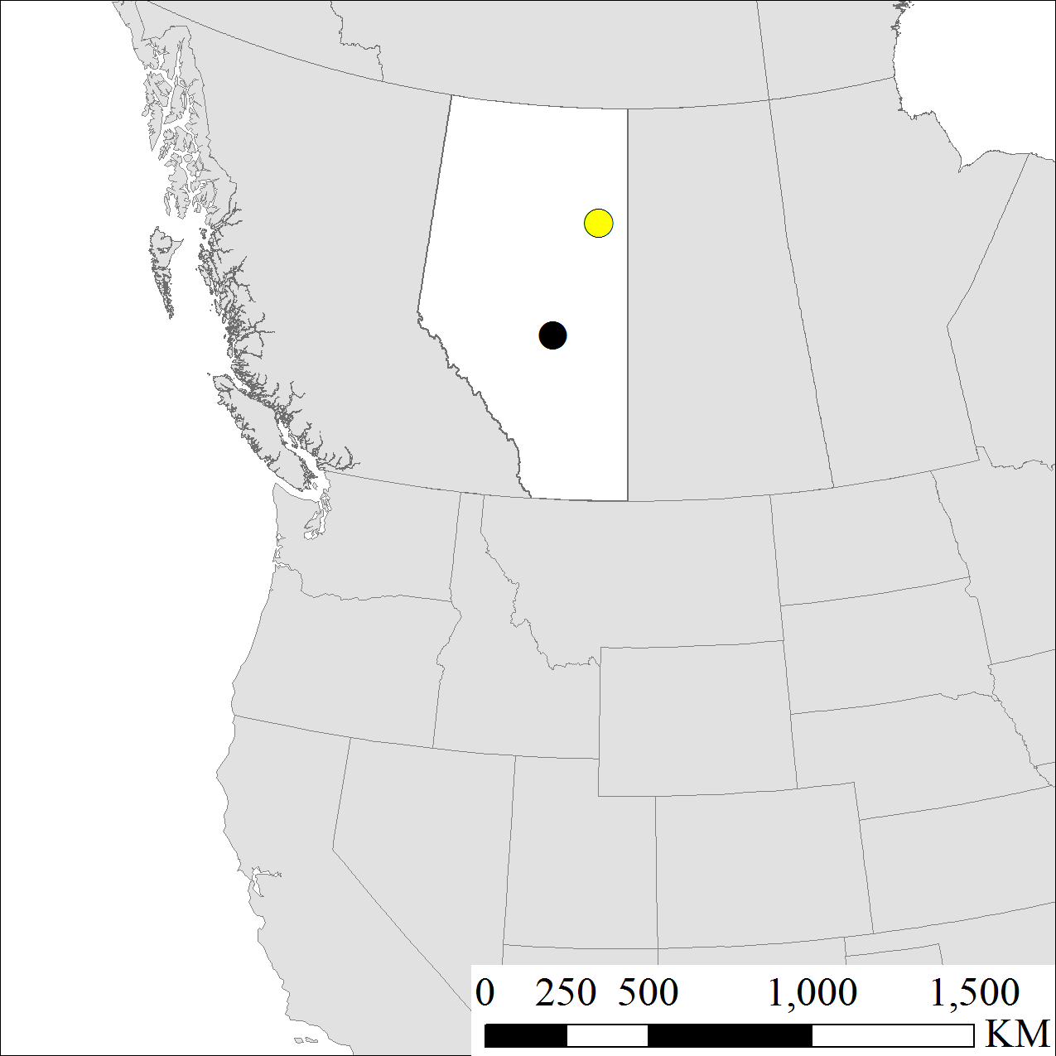
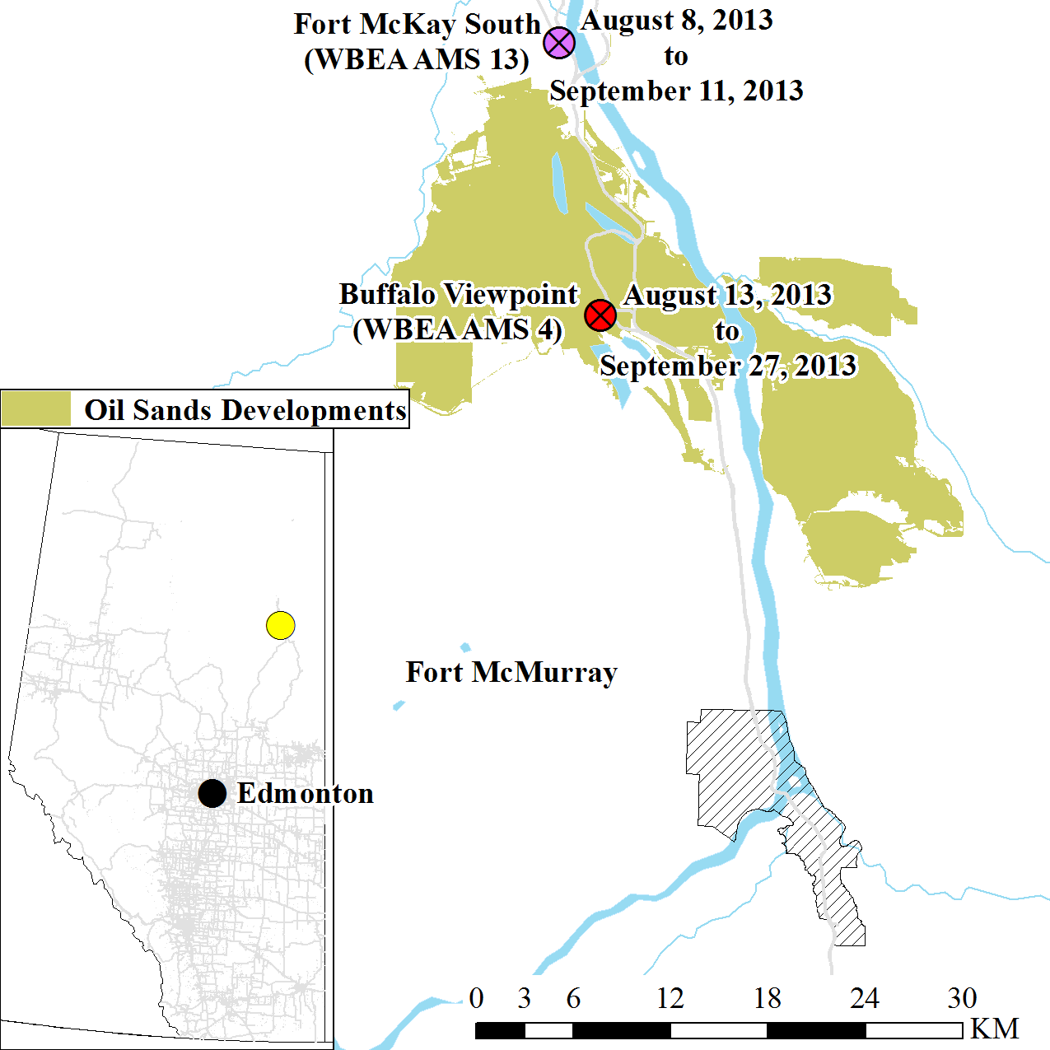
3
Speciated Sites

Slide 4
Comparison of Speciated Mercury Measurements in the Alberta Oil Sands Region
Species | Gaseous Elemental Mercury (GEM) ng/m³ |  | Gaseous Oxidized Mercury (GOM) pg/m³ |  | Particulate Bound Mercury (PBM) pg/m³
Station | AMS 4 | AMS 13 | AMS 4 | AMS 13 | AMS 4 | AMS 13
Average | 1.18 ± 0.16 | 1.17 ± 0.18 | 0.43 ± 0.80 | 0.78 ± 0.95 | 2.42 ± 1.91 | 2.69 ± 1.79
Max | 1.68 | 1.51 | 8.57 | 5.08 | 15.31 | 8.67
Min | 0.71 | 0.51 | 0.00 | 0.00 | 0.00 | 0.00
N | 344 | 249 | 338 | 247 | 338 | 248
*AMS 4 from 13/08/2013 to 27/09/2013
*AMS 13 from 10/08/2013 to 11/09/2013

Slide 5
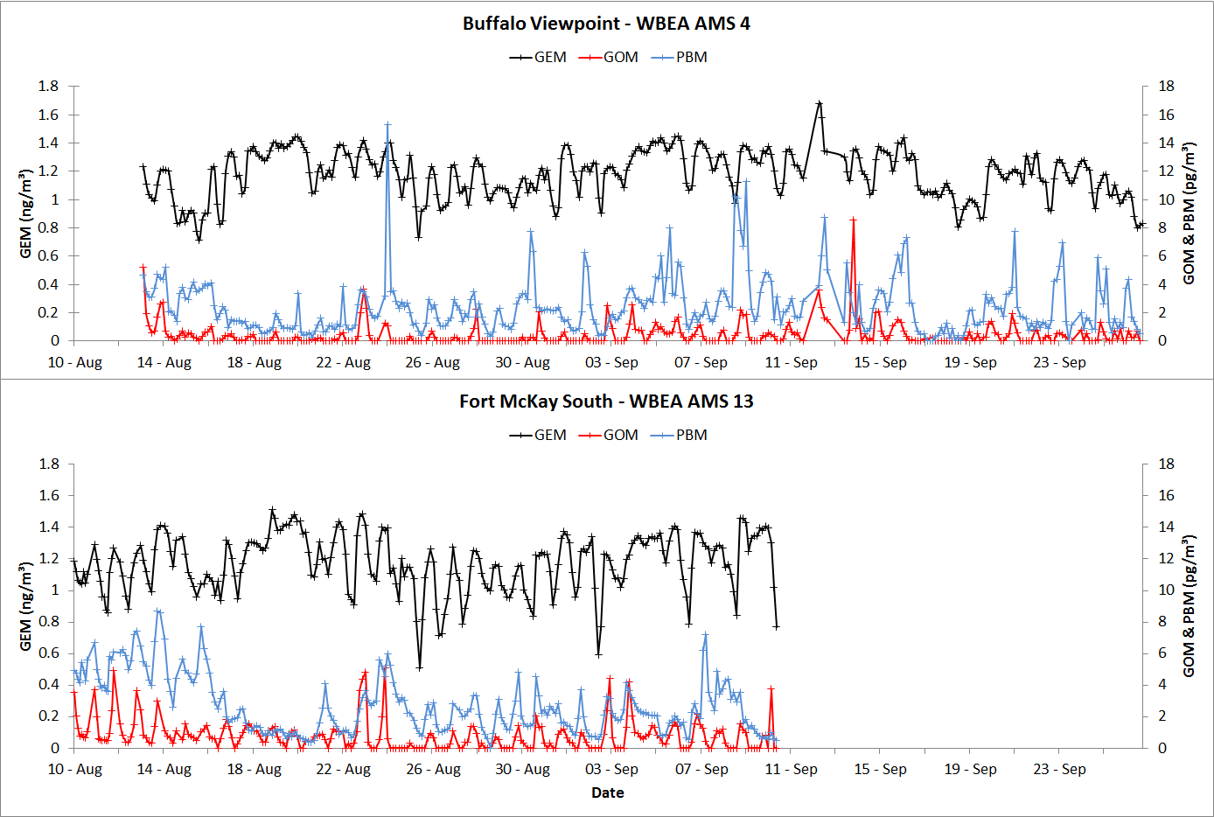
2013 Time Series

Slide 6
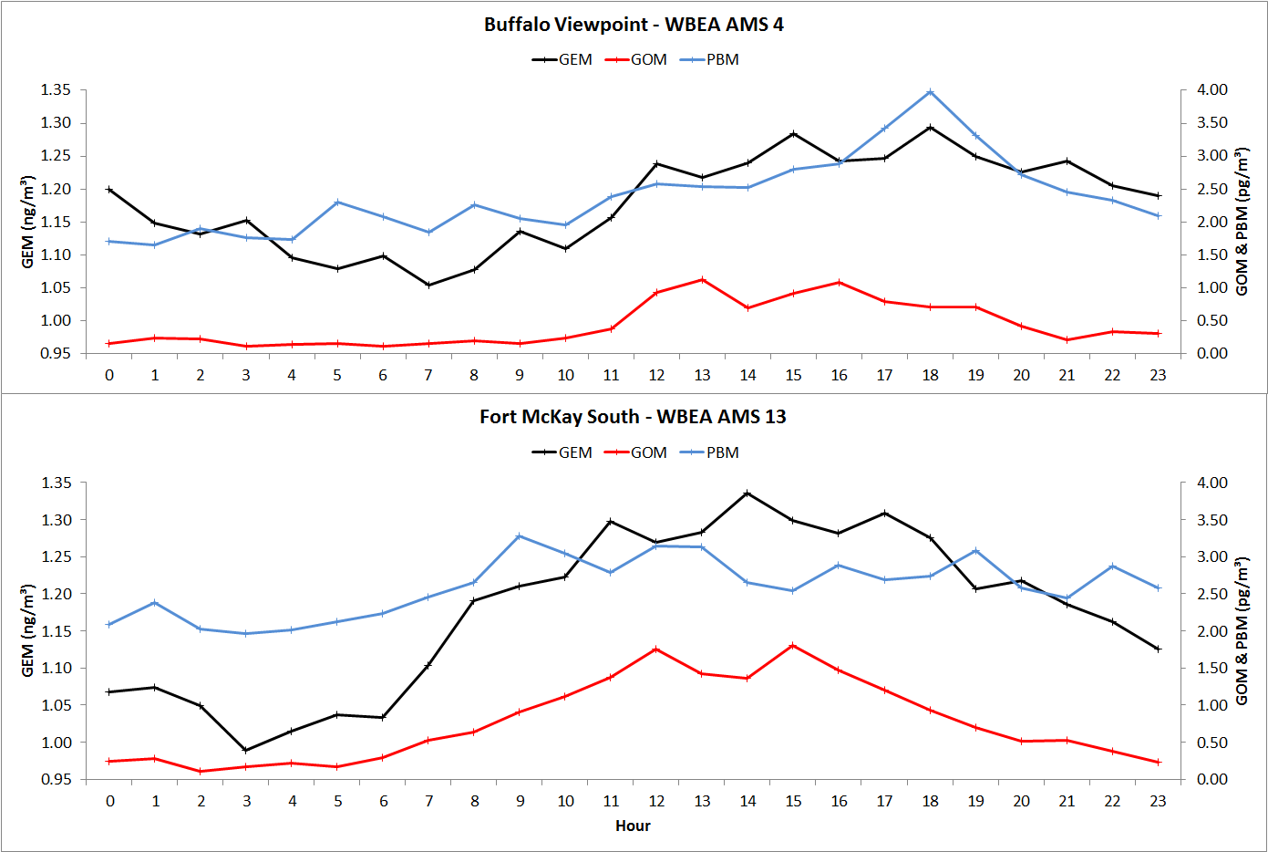
Diurnal Pattern

Slide 7
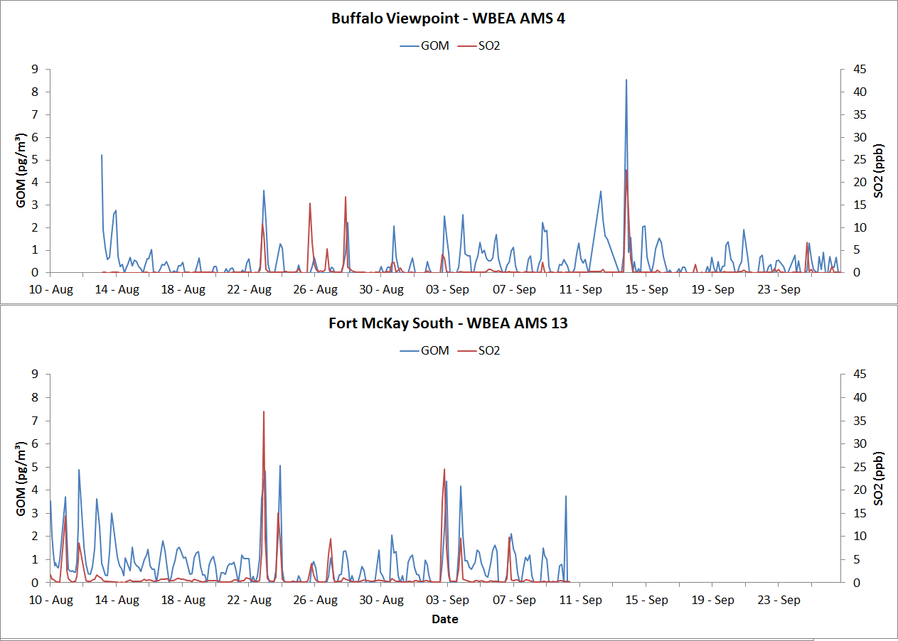
GOM and SO₂

Slide 8
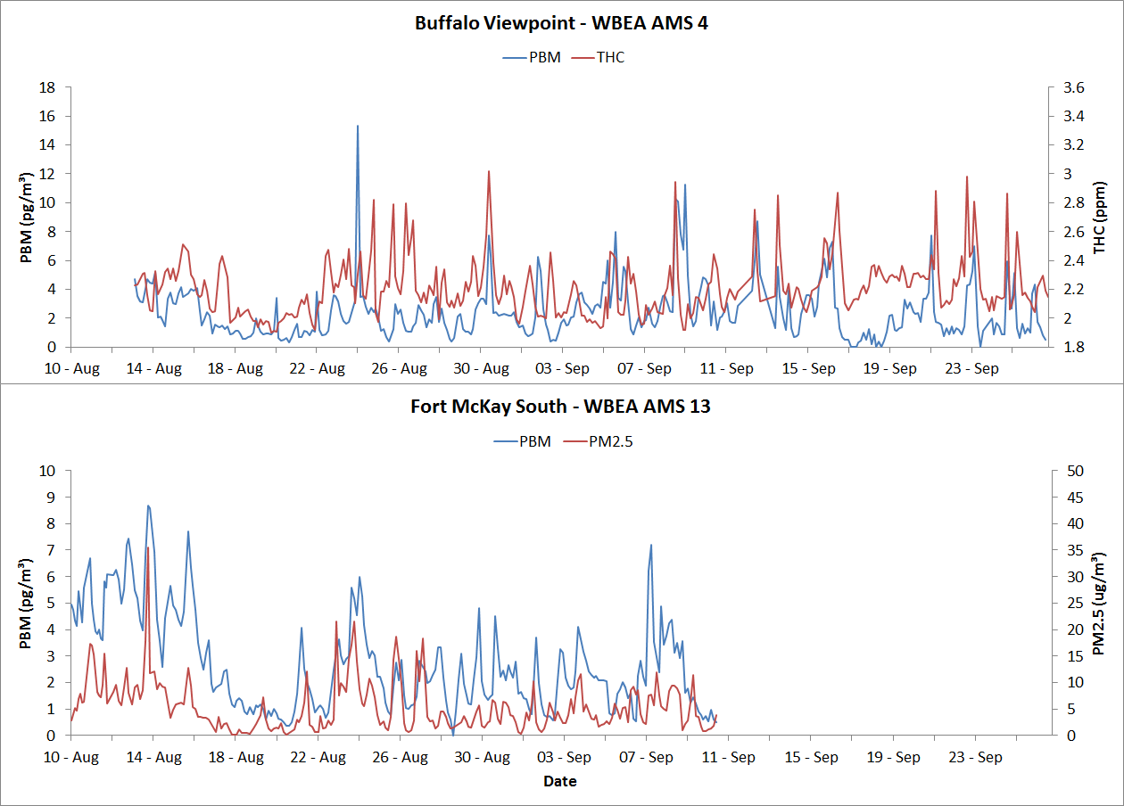
PBM
THC (Total Hydrocarbon)

Slide 9
Next Steps
More in-depth analysis of the speciated mercury datasets
Collection of data from our new installation at Fort McKay South with co-located speciated mercury with PM_{2.5} and PM₁₀ inlets, along with TGM, and speciated particulate matter

Slide 10
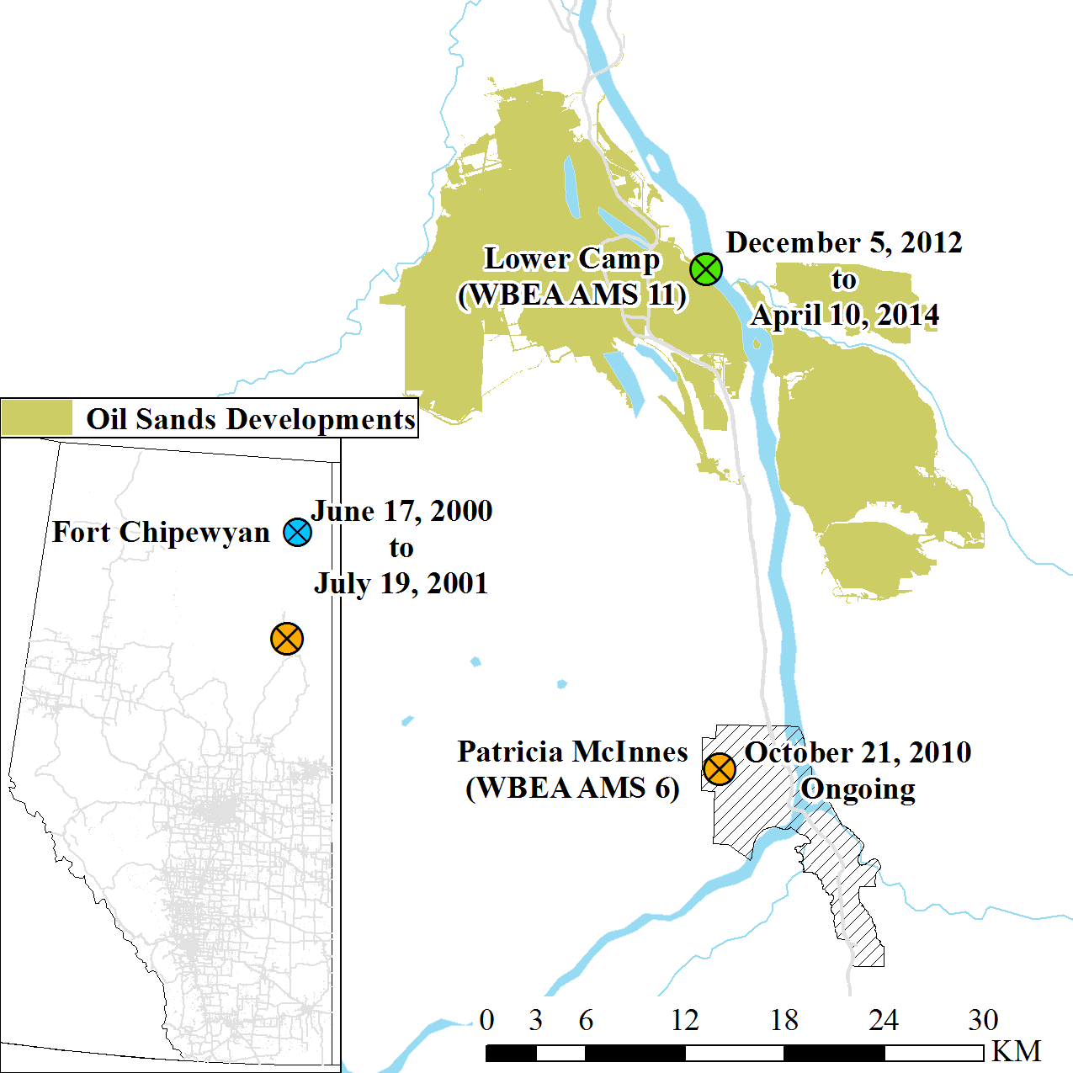
10
TGM Sites

Slide 11
Comparison of TGM in Oil Sands Region
Station | Fort Chipewyan | Patricia McInnes | Lower Camp
 | TGM – ng/m³ | TGM – ng/m³ | TGM – ng/m³
Average | 1.37 ± 0.17 | 1.42 ± 0.20 | 1.34 ± 0.18
Max | 2.18 | 4.43 | 2.89
Min | 0.55 | 0.54 | 0.51
N | 6908 | 21861+ | 8549+
Date | 17/06/2000 – 19/07/2001 | 21/10/2010 – 31/12/2013 | 5/12/2012 – 31/12/2013

Slide 12
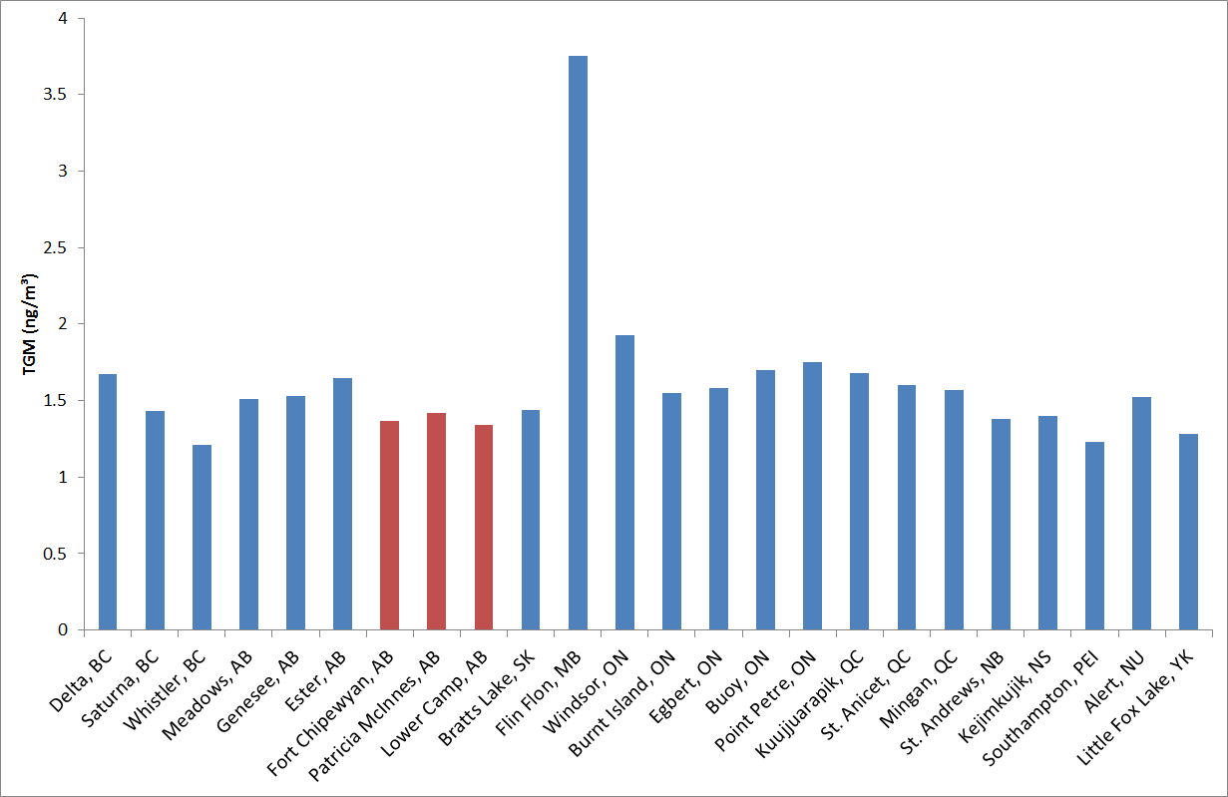
Mean TGM Concentrations over various years across Canada
Alberta locations

Slide 13
Time Series of Hourly TGM
Deviations from Normal?
Patricia McInnes October 2010 – May 2013

Slide 14
Seasonal
Dependence?
Patricia McInnes October 2010 – May 2013
No Smoke Smoke

Slide 15
Seasonal Diurnal Profile of Mean TGM and Relationship to T and O₃
Patricia McInnes October 2010 – May 2013

Slide 16
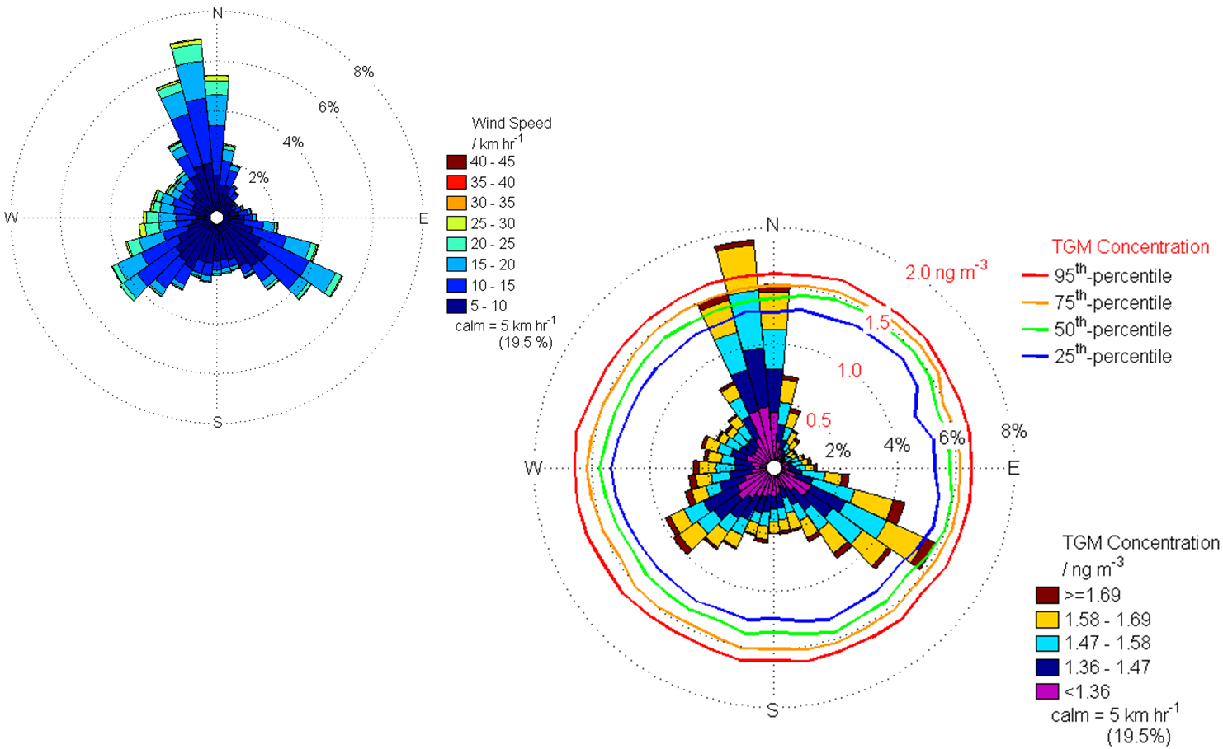
Local Sources of TGM?
Patricia McInnes October 2010 – May 2013

Slide 17
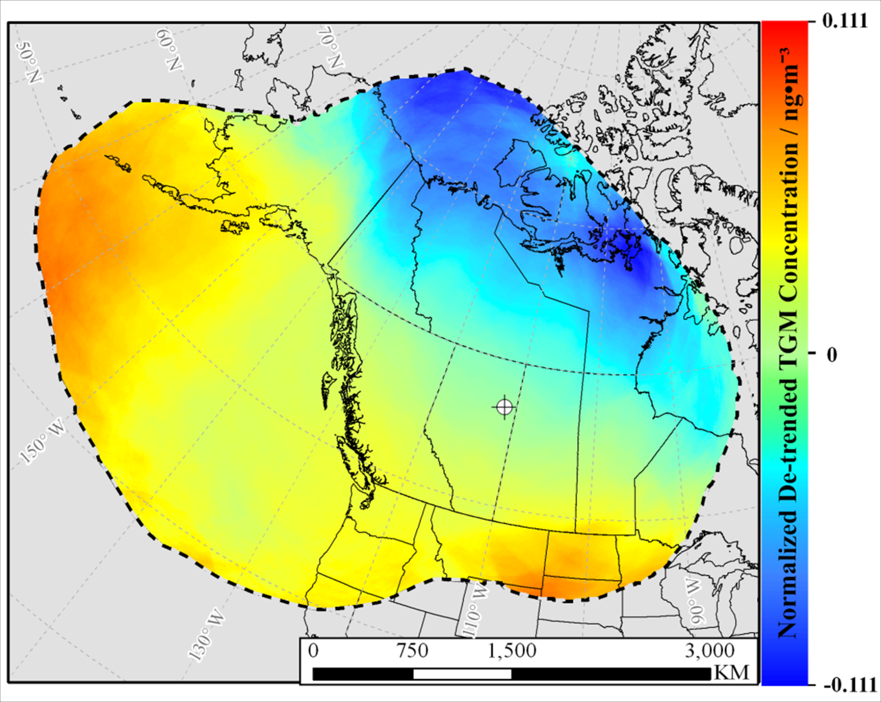
Long Range Transport?
Patricia McInnes October 2010 – May 2013

Slide 18
Patricia McInnes – Key Findings
TGM concentrations are similar to other sites in Alberta.
PCA shows TGM is not significantly correlated with typical anthropogenic pollutants such as NO_{x} and SO₂.
Unseasonably high TGM concentrations associated with forest fire smoke and air from regions to the southeast and west. Unseasonably low concentrations associated with air moving in from arctic regions.
TGM concentrations undergo seasonal and diel trends, with high values in the spring and midday, and low values in the fall and early morning.

Slide 19
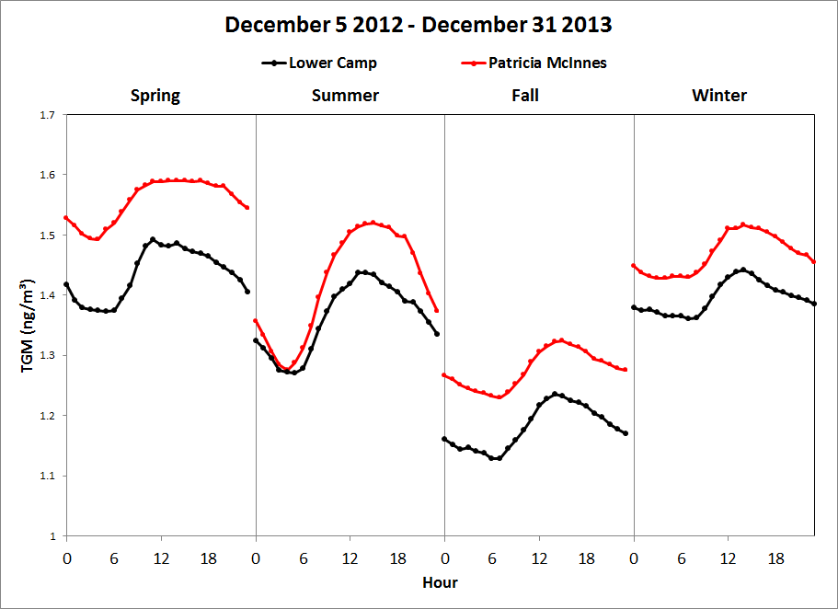
Seasonal Diurnal Profile of TGM

Slide 20
Lower Camp - Preliminary Findings
Scatter plot of TGM at Patricia McInnes versus Lower Camp : slope = 0.97, R² = 0.74
Concentrations at Lower Camp are generally lower than Patricia McInnes, and show similar diurnal and seasonal trends.
Low concentration events at Lower Camp mirror low concentrations at Patricia McInnes, supporting the back trajectory analysis.

Slide 21
Conclusions
TGM concentrations in the region are comparable to other rural areas in Alberta impacted by local industry.
TGM concentrations at Lower Camp and Patricia McInnes show seasonal and diurnal similarities.
Speciated mercury measurements are needed to provide additional information on mercury sources and chemistry.

Slide 22
Acknowledgments
Thank the Wood Buffalo Environmental Association (WBEA www.wbea.org) staff responsible for local site maintenance, operations, and logistics.

Slide 23
Questions???
References
http://www.jointoilsandsmonitoring.ca/
http://www.mdpi.com/2073-4433/4/4/472
Parsons MT, McLennan D, Lapalme M, Mooney C, Watt C, Mintz R. Total Gaseous Mercury Concentration Measurements at Fort McMurray, Alberta, Canada. Atmosphere. 2013; 4(4):472-493.

