Slide 1
Genotoxicity and Industry:
Utilizing genetic toxicity assays to support pharmaceutical development
Dan Roberts, MS
Research Scientist
Genetic Toxicology, Drug Safety Evaluation
Bristol-Myers Squibb Company
PhD Candidate, JGPT Rutgers
August 24, 2015

Slide 2
Outline
Numerous modalities to consider
  Small molecules, antibody therapies, proteins, peptides, oligonucleotides
    Focus will be on small molecule (API) development
Multiple therapeutic areas (TAs)
  Oncology vs. Orphan TA vs. Virology
    Focus will be on non-oncogenic common medical conditions
Main goal: Describe genetox testing requirements for:
  Assessing risk after hazard identification
  Enabling and progressing through clinical trials

Slide 3


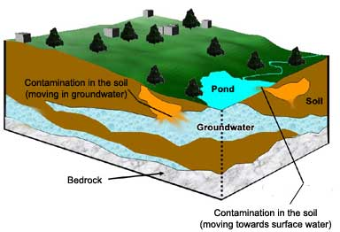
The Pharma Perspective
Some clear differences in assay selection and conduct due to the population that’s impacted.
Accidental Environmental Release
Patient Safety
Worker Safety
Notes:
Talking points: Environmental hazards impact all, pharmaceuticals are designed for a target population. While endpoints are the same, the order and testing requirements for api are different.

Slide 4
Drug Development & Genetox
Discovery
Pre-Clinical
Clinical
Lifecycle Management
Developmental Goals
Overall Goal:
∙ Identify efficacious candidate
∙ Basic hazard ID
Exploratory Studies
∙ Mutagenicity
∙ Clastogenicity
∙ In silico
Overall Goal:
∙ Set safety margins
∙ IND Package
∙ Address GTI’s
GLP Studies
∙ Mutagenicity
∙ In vivo & in vitro
clastogenicity
Overall Goal:
∙ Establish human efficacy and safety
∙ Enable the NDA
Genetox Work
∙ Metabolites
∙ Impurities/
Reagents (manufacturing)
Overall Goal:
∙ Improve market efficiency
Genetox Work
∙ Impurities/
Reagents (manufacturing)
Genetox Work

Slide 5

Drug Discovery Screening Tests
Hits
Rationale Drug Discovery
Combinatorial chemistry flop
In silico assessment for structural alerts
Neg in vitro test results move a compound forward
Triage (SAR) elimination of hazardous moiety
Lead(s)
In silico mutagenicity assessment
Ames assay
Clastogenicity
Neg & Pos
Neg
Ames assay
Stop Development or Triage
Proceed to IND enabling GLP studies
Neg
Pos
Clastogenicity

Slide 6

IND Enabling Studies
No
Hazards
Or build costly WoE
Clastogenic
Hazard
Mutagenic
Hazard
ICH S2 Option 1
ICH S2 Option 2
Park Molecule
Depends on identified hazards
Ames Assay (GLP)
Mammalian Cell Assay (GLP)
Rat PB-MNT plus Comet (GLP)
“Piggyback” Rat PB-MNT (GLP)

Slide 7
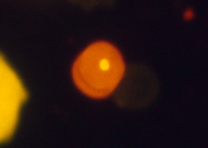
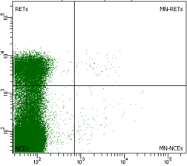
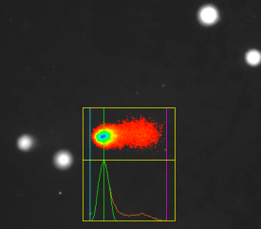
Clastogenic “Follow-Up”
Must demonstrate lack of risk
  Reproducibility in another cell line
  Rat Study with ≥2 tissues evaluated
    Micronucleus assessment
      Blood or bone marrow; additional tissue(s) as needed
    Comet assay (alkaline version, median %TI reported)
      Duodenum (site of contact) & liver (metabolic capacity)
  6 mo. HRAS
  Tg assay
    Build WoE
    against
    carcinogenic risk
Micronucleus Readout
Comet Assay
Microscopy
Flow Cytometry

Slide 8
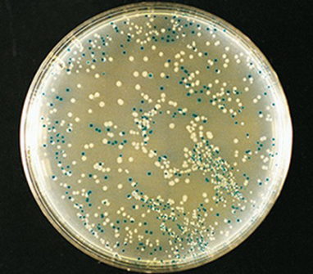
Mutagenic “Follow-Up”
Must demonstrate lack of risk
  Bacterial specific positive results
    Nitroreductase activity
  1-month transgenic rodent study for in vivo relevance
    Generally, phage cII reporter (Lac I or LacZ gene targets)
      Big Blue®, MutaTMMouse, [Gpt∆ (new)]
      Blue (wt)/white (mut) colony counting
  Pig-a gene mutation assay?
    Approved for GTI’s but not yet for API
  6 mo. HRAS Tg assay
    Build WoE against carcinogenic risk
White/Blue Colonies

Slide 9
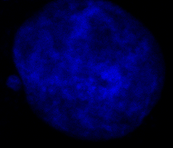
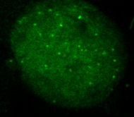
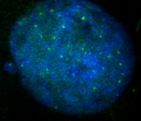
Aneugenic “Follow-up”
The in vitro MN test is able to detect indirect genotoxicants
  Human cells: Use γ-H2AX with H3PS10 and 4N content
  Rodent cells: Quantify hypodiploid frequencies
Kinetochore or CREST labeling to confirm aneugenicity
Threshold argument for human safety margins, BM MNT
DAPI
AF488
Merge

Slide 10
Clinical Progression
During clinical progression as well as in post-market surveillance:
  Human metabolite evaluation; qualification of unique or disproportionate metabolites
  Long-term stability study: degradant evaluation and qualification (as needed)
  Controlling exposure to GTI’s (rapidly growing niche)
  Occupational and environmental safety (REACH)

Slide 11
Summary
Genetox supports drug development and is needed for enabling FIH studies.
  Genetox used for patient safety, but also worker and environmental safety (REACH and Banding).
In house screening strategies enable rapid identification of potential hazards, which hastens therapeutic area development.
Positive in vitro test results only identify a hazard, to understand risk an in vivo test system should be used.

Slide 12




Acknowledgments
BMS Genetox
  Laura Custer
  Jim Wojciechowski
Toxicology 2015 Summit
  Marcelo Larramendy
  Ofelia Olivero
  Meeting Organizers
Any Questions?
Thanks for your time!

Slide 13
Back up slides

Slide 14
International Regulations
ICH M3 specifies timing of preclinical safety testing and which test must be conducted based upon clinical trial design and theraputic area (eg eIND, single dose, oncology)
ICH S9 specifically covers oncogenics
ICH S6 covers biologics
ICH S2(R1) defines genotoxicity testing options
ICH M7, Q3A/B/C cover impurities & degradants
REACH and OSHA cover environmental & worker safety testing

