Slide 1
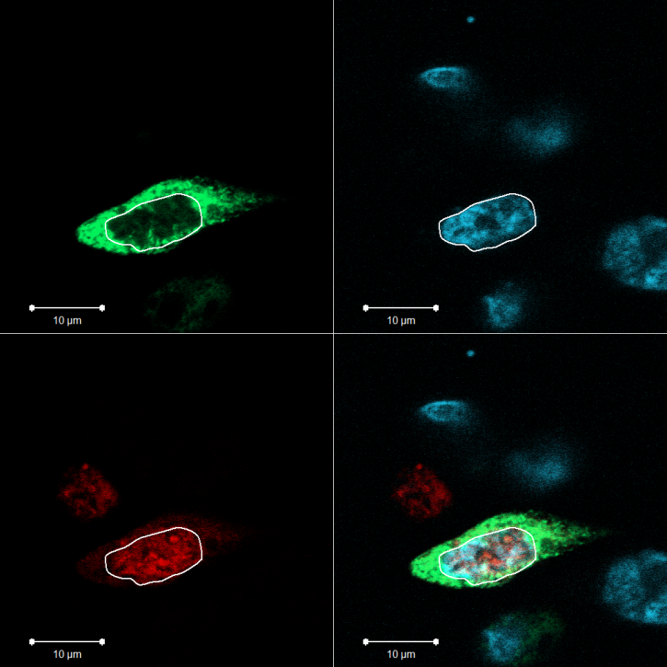
Osaka Proteomics. 22nd May, 2017
A new secreted protein expressed from the
unknown and nameless gene “C4orf48”
is a novel regulator of cell differentiation and
comprises an unusual signal peptide that
translocates to the cell nucleus.
C4orf48

Slide 2
Why study secreted proteins?
Why look for new secreted proteins?
Are there, out there, new secreted proteins to be discovered?
Is there Biological Meaning and Function to Signal Peptides above and beyond their role as simple “directors of protein secretion”?

Slide 3
Secreted proteins are the biological mediators, released from one cell, binding to another, mediating interaction and communication
“talk” between cells
This intercellular “talk” alters cell behavior-
effecting changes in cell growth, development and differentiation.
As such, secreted proteins are of supreme biological importance.

Slide 4
EXAMPLES:
Insulin
Growth Hormone
Erythropoietin
GM-CSF
Cytokines- Interferons
Chemokines
Bone Morphogenic Proteins (BMPS)- TGF-β
Exceptionally important for the well-being of mankind!!!

Slide 5
EXAMPLES:
Insulin (many $Bs)
Growth Hormone (many $Bs)
Erythropoietin (many $Bs)
GM-CSF (many $Bs)
Cytokines- Interferons (many $Bs)
Chemokines
Bone Morphogenic Proteins (BMPS)- TGF-β
So I guess secreted proteins are really important!

Slide 6
Are there new functions for Signal Peptides above and beyond their role as “directors for protein secretion”?
We think yes!
We have discovered:
* nuclear localization of “n-regions” derived from unusual Signal
Peptides directing secretion of ZPBP, neuregulin and C4ORF48,
indicating nuclear functions for unusual Signal Peptides.

Slide 7
Are there, out there, new secreted proteins to be discovered?
We think yes!
We have discovered:
* a new secreted protein (C4ORF48) that is involved in neo-neurogenesis and in pancreatic endocrine function

Slide 8
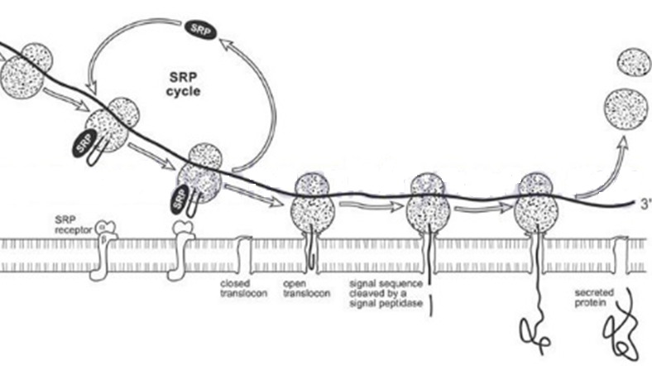
Protein secretion
SRP
Cytosol
N
SRP
nascent polypeptide
SRP receptorg
SRP
ER membrane
h
secreted
protein
closed
translocon
h
open
translocon
signal sequence-
cleaved by
signal peptidase
cleaved protein in ER lumen
ER lumen

Slide 9
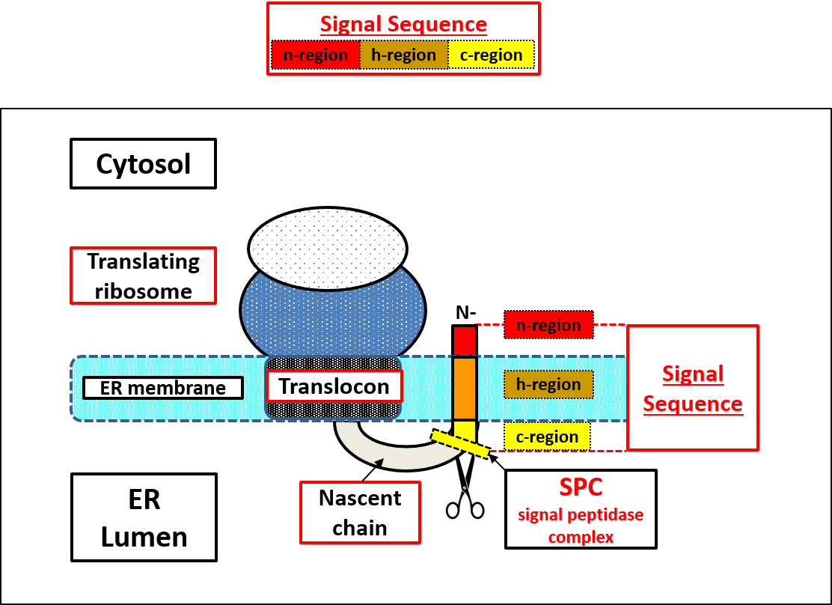

Slide 10
+ +
CS
c-region
Mature
Protein
M
n-region
h-region
c-region
n-region:
usually 1-5 aa.
n-region
n-region
>hINSULIN
M
ALWM
R
LLPLLALLALWG
PDPAAA
i
F
VNQHLCGSH.....
3
>
h
GH1
M
ATGS
R
TS
LLLAFGLLCLPWL
QEGSA
i
F
PTIPLSRLF
...
6
>hEPO
MGVHECPAWLWLLLSLLSLPLGLPVLGiAPPRLICDSR...
6
>CSF2
MWLQSLLLLGTVACSISiAPARSPSPST...
4
>IFNB1
MTNKCLLQIALLLCFSTTALSiMSYNLLGFLQ...
4

Slide 11
+ +
c-region
CS
Mature
Protein
M
n-region
h-region
c-region
h-region (hydrophobic) :
usually 7-15 aa.
contains sequential stretch of hydrophobic residues.
h-region
h-region
>hINSULIN
M
ALWM
R
LLPLLALLALWG
PDPAAA
i
F
VNQHLCGSH.....
12
13
>hEPO
MGVHECPAWLWLLLSLLSLPLGLPVLGiAPPRLICDSR...
16
>CSF2
MWLQSLLLLGTVACSISiAPARSPSPST...
8
>IFNB1
MTNKCLLQIALLLCFSTTALSiMSYNLLGFLQ...
10

Slide 12
cleavage
+ +
-1
+1
CS
c-region
Mature
Protein
M
n-region
h-region
c-region
c-region:
usually 3-7 aa.
c-region
c-region
>hINSULIN
M
ALWM
R
LLPLLALLALWG
PDPAAA
i
F
VNQHLCGSH.....
6
5
>hEPO
MGVHECPAWLWLLLSLLSLPLGLPVLGiAPPRLICDSR...
4
>CSF2
MWLQSLLLLGTVACSISiAPARSPSPST...
4
>IFNB1
MTNKCLLQIALLLCFSTTALSiMSYNLLGFLQ...
6

Slide 13

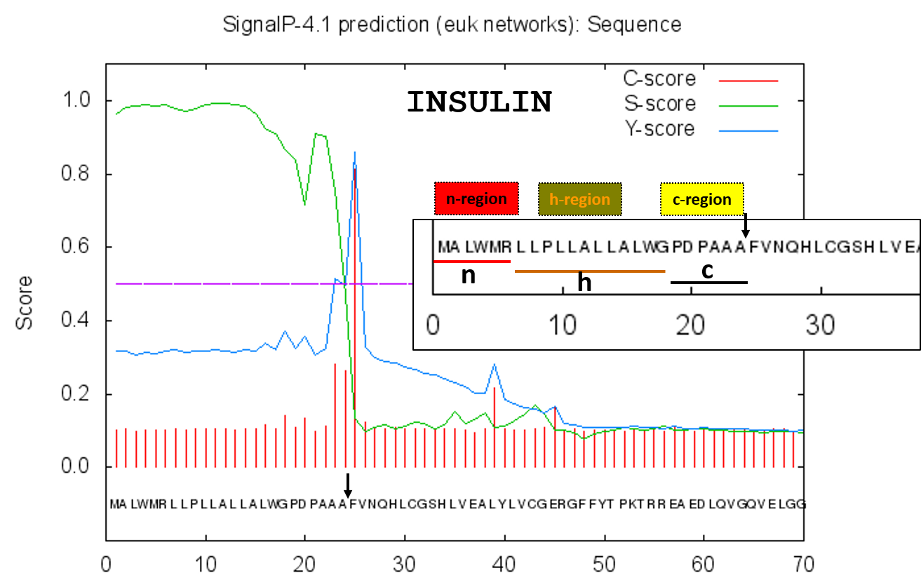

Slide 14
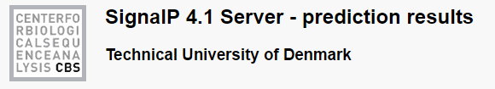
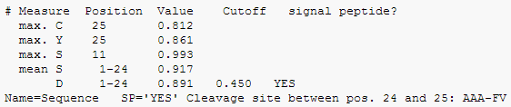
YES
AAA-FV

Slide 15
Are there unusual secretory Signal Peptides with new Biological Functions to be discovered?
Are there new important secreted proteins
to be discovered?
We think yes!
Our initial focus was on an almost completely unknown
very small (61 amino acids) secreted protein,
derived from the C4orf48 gene.

Slide 16

Why look at C4orf48?
It does not even have a name!!!
PubMed shows only ONE publication for C4ORF48!
and for the only ONE publication on C4orf48… there are zero citations!!!!

Slide 17
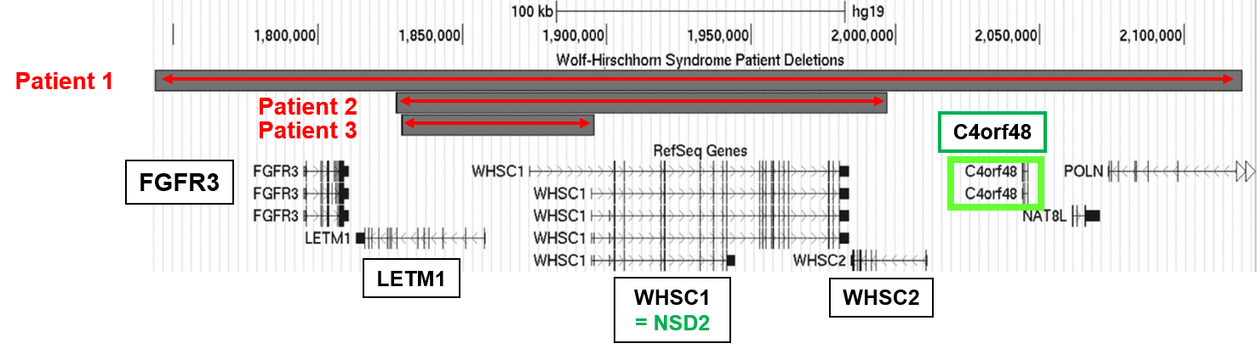
Theoretical Considerations that directed our interest to C4orf48:
C4orf48 is located in a very interesting genomic locus on the short arm of chromosome 4.
Hemizygous deletions in this region result in the Wolf-Hirschhorn syndrome- a contiguous gene syndrome.
Patients with bigger deletions show a more severe phenotype.

Slide 18
The Wolf-Hirschhorn syndrome involves defects in the regulation of bone growth and many other growth defects.
{The most common characteristics of the Wolf-Hirschhorn syndrome include a distinct craniofacial phenotype that also involves:
defective bone growth {microcephaly, micrognathia [mandibular hypoplasia= small jaw]},
short philtrum,
prominent glabella (area between eyes and above the nose],
ocular hypertelorism,
dysplastic ears and periauricular tags,
growth and mental retardation,
muscle hypotonia,
seizures, and
congenital heart defects. }
Yet the actual gene whose mutation leads to WHS has not been identified.
Rather, a genomic region comprising several genes has been implicated in the appearance of WHS.

Slide 19
Theoretical Considerations that directed our interest to C4orf48.
The WHSC1 gene also called NSD2 codes for a histone-lysine N-methyltransferases ( a chromatin regulator) and the gene format FGFR-NSD [FGFR juxtaposed to an NSD] has been triplicated at three different genomic loci:
FGFR3-NSD2 (chromosome 4)
FGFR4-NSD1 (chromosome 5)
FGFR1-NSD3 (chromosome 8)
H-chr 4
NSD2
FGFR3
LETM1
WHSC1
NSD2
H-chr 5
NSD1
FGFR4
NSD1
H-chr 8
NSD3
FGFR1
LETM2
WHSC1L1
NSD3

Slide 20
The WHSC1 gene also called NSD2 codes for a histone-lysine N-methyltransferases ( a chromatin regulator) and the gene format FGFR-NSD [FGFR juxtaposed to an NSD] has been triplicated at three different genomic loci:
FGFR3-NSD2 (chromosome 4)
FGFR4-NSD1 (chromosome 5)
FGFR1-NSD3 (chromosome 8)
Nuclear receptor-binding SET domain protein 1 (NSD1) prototype is a family of mammalian histone methyltransferases
NSD1,
NSD2/MMSET/WHSC1,
NSD3/WHSC1L1
that are essential in development and are mutated in human acute myeloid leukemia (AML), overgrowth syndromes, multiple myeloma and lung cancers.

Slide 21
Theoretical Considerations that directed our interest to C4orf48.
Mutations at all three loci are associated with many growth/developmental defects-
at FGFR3-NSD2 (WHS)-locus: Wolf-Hirschhorn syndrome
H-chr 4
NSD2
FGFR3
LETM1
WHSC1
NSD2
at FGFR4-NSD1 locus: Beckwith syndrome, Sotos syndrome
H-chr 5
NSD1
FGFR4
NSD1
at FGFR1-NSD3 locus: many growth/developmental defects
H-chr 8
NSD3
FGFR1
LETM2
WHSC1L1
NSD3
Mutations at all three loci are associated with many growth/developmental defects-
* at FGFR3-NSD2 (WHS)-locus: Wolf-Hirschhorn syndrome
* at FGFR4-NSD1 locus: Beckwith syndrome = Pre- and postnatal overgrowth, and macroglossia, Sotos syndrome = Pre- and postnatal overgrowth, developmental delay, mental retardation, advanced bone age, and abnormal craniofacial morphology.
* at FGFR1-NSD3 locus: many growth/developmental defects

Slide 22
H-chr 4
100kb
C4orf48
FGFR3
LETM1
FGFR3
LETM1
WHSC1
=NSD2
WHSC2
Because the FGFR3/WHSC1 locus is involved in the regulation of growth and development,
Because C4orf48 is juxtaposed to the FGFR3/WHSC1 locus, and
Because C4orf48 is a highly phylogenetically conserved, secreted protein
We hypothesized that:
The C4orf48 protein is likely an important secreted protein that mediates processes related to cell growth and differentiation, and that its deletion may take part in the WHS phenotype.

Slide 23
BUT what completely convinced me that C4orf48 is likely a very important secreted protein, is that (as far as I know) NOBODY in the world is looking at C4orf48...

Slide 24


BUT what completely convinced me that C4orf48 is likely a very important secreted protein, is that (as far as I know) NOBODY in the world is looking at C4orf48...
except for NOVO NORDISK,
the world’s largest manufacturer of INSULIN.

Slide 25
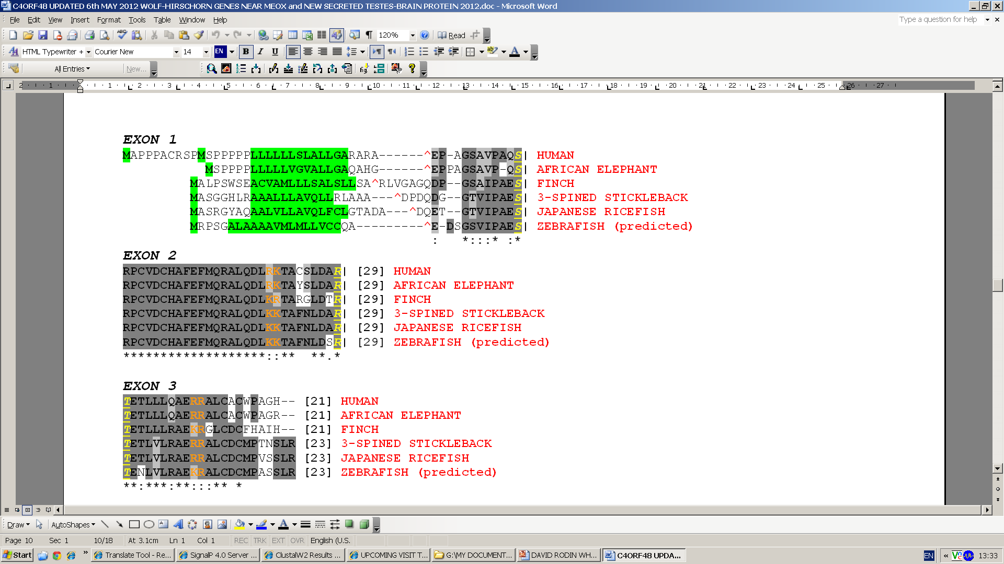
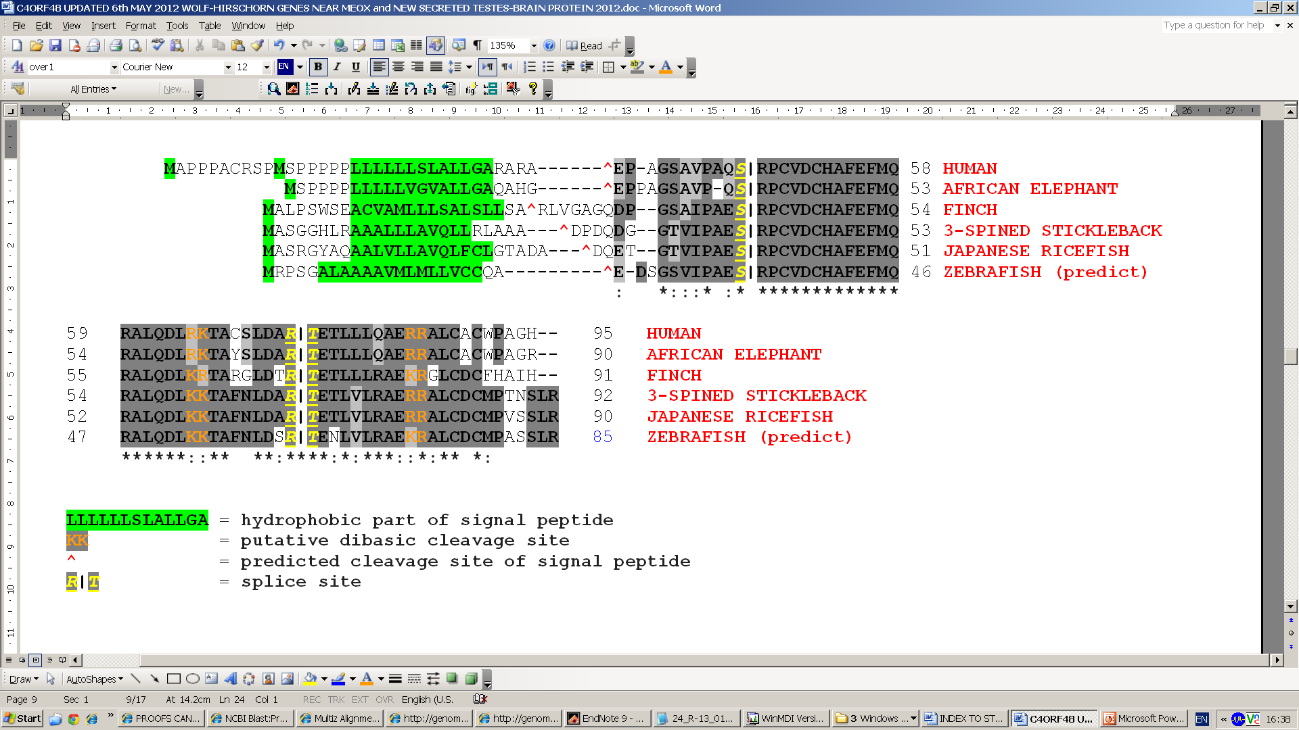
C4orf48 is a highly conserved protein and contains a predicted signal peptide
Our experimental confirmation of
N-terminal amino acid of secreted protein

Slide 26
C4orf48 is a small highly conserved protein and contains a predicted signal peptide

Slide 27
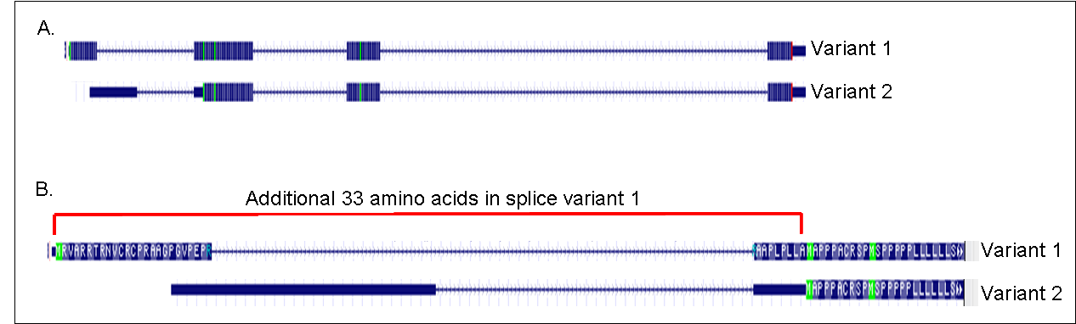
C4orf48 produces two splice variants
hC4ORF48-SP_{nBIG}
hC4ORF48-SP_{nSmall}
additional 33 amino acids in Variant 1

Slide 28
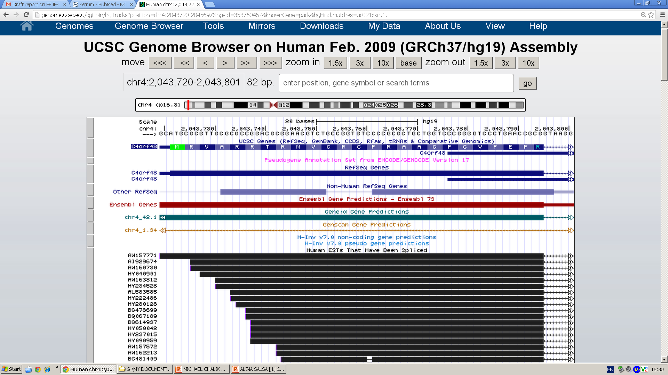
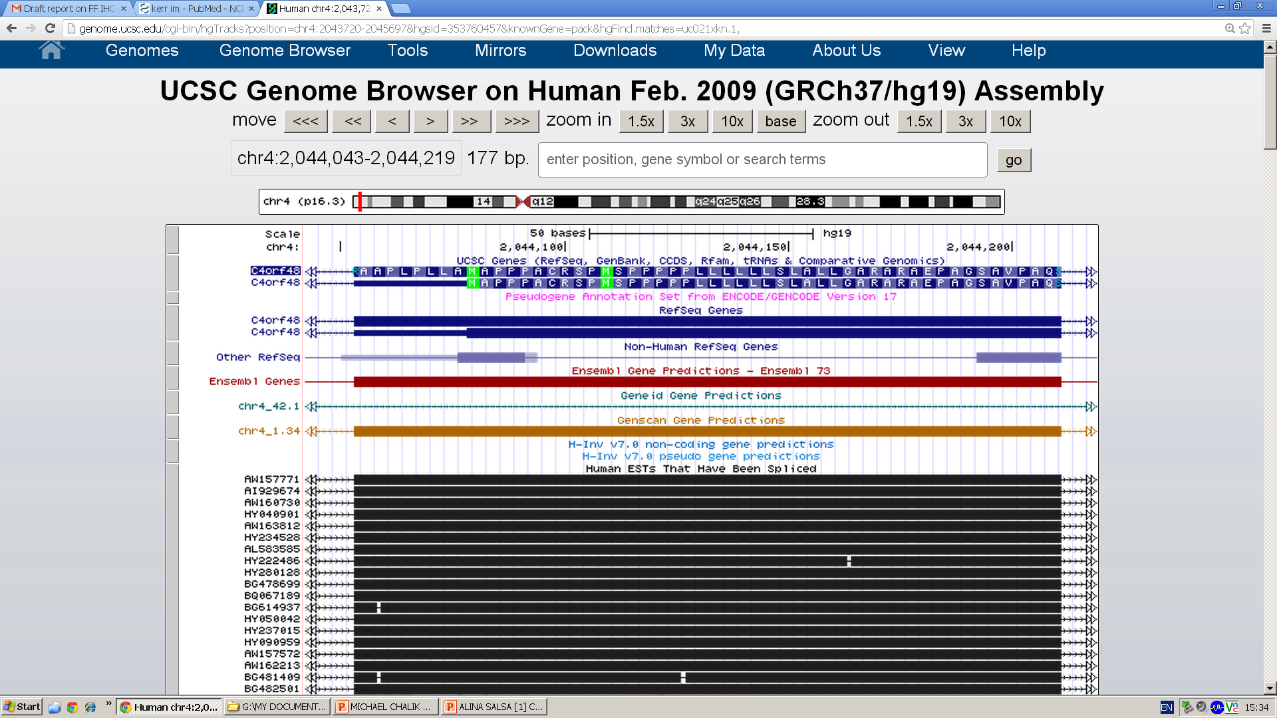
C4orf48 produces two splice variants
additional 33 amino acids in Variant 1
[h-region]
SP
hydrophobic region [h-region] in SP
SP

Slide 29
C4orf48 produces two splice variants:
They only differ in the size of their Signal Peptides
hC4ORF48-SP_{nBIG}
SP_{nBIG}
67 aa
C4orf48
61 aa
34 aa
61 aa
hC4ORF48-SP_{nSmall}
SP_{nSmall}
C4orf48

Slide 30
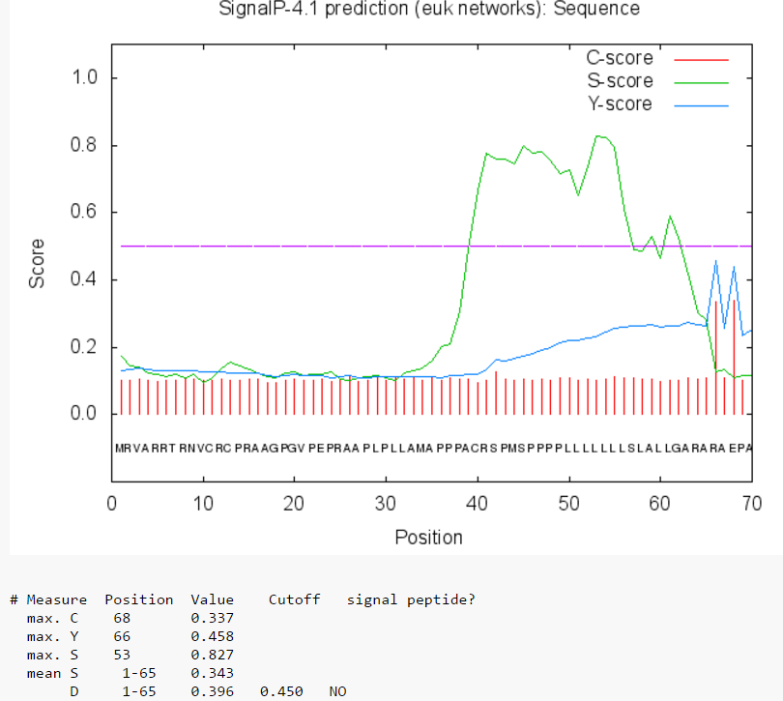
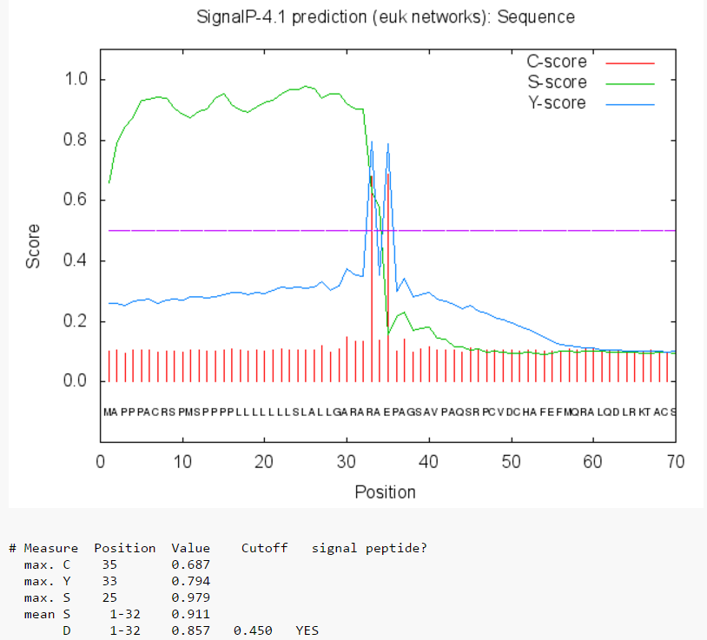
SignalP does NOT predict a Signal Peptide for SPbig,
because SignalP does NOT “like” SPbigs,
that do not fit to consensus SPs!
BIG
small
BIG
SP- no
*
small
SP- yes

Slide 31
1. Because in all species expressing C4ORF48 Nature has made two splice variants: C4ORF48-SPnBig and C4ORF48-SPnSmall, and
2. Because proteins coded by C4ORF48-SPnBig and C4ORF48-SPnSmall are both secreted from the cell, and
3. Because the N-termini of the mature secreted proteins coded by C4ORF48-SPnBig and C4ORF48-SPnSmall are identical, and
4. Because the C4ORF48 secreted proteins themselves derived from C4ORF48-SPnBig and C4ORF48-SPnSmall are identical,
We asked ourselves:
...why should Nature “bother” to make two splice variants that differ solely in in their SP-”n-regions”?
We thus investigated whether there is “Biological Meaning” to SP-nBig.

Slide 32
To follow the fate of C4ORF48-SPnBIG and C4ORF48-SPnSmall
we monitored their intracellular localization by immunofluorescent studies
α-myc
α-hFc
M
67 aa
hC4ORF48-SP_{nBIG}
SP_{nBIG}
61 aa
hFc
myc
h
C4orf48
TEV
c
M
hC4ORF48-SP_{nSmall}
SP
61 aa
hFc
c
C4orf48
TEV
myc
h
_{nSmall}
34 aa

Slide 33
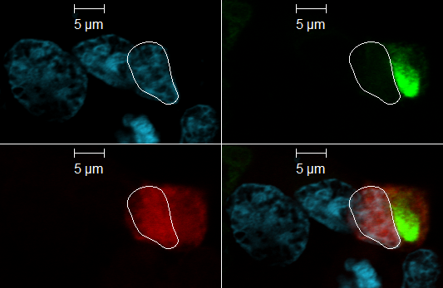
α-myc
α-hFc
M
67 aa
hC4ORF48-SP_{nBIG}
SP_{nBIG}
61 aa
hFc
myc
h
C4orf48
TEV
c
1. as expected for a secreted protein the “hFc” portion localizes to the Golgi.
2. surprisingly the “n-big” portion of C4ORF48, as visualized with α-myc antibodies, localizes primarily to the nucleus.
This pattern of expression was seen in all cells analyzed, in 5 separate experiments.
1
2

Slide 34
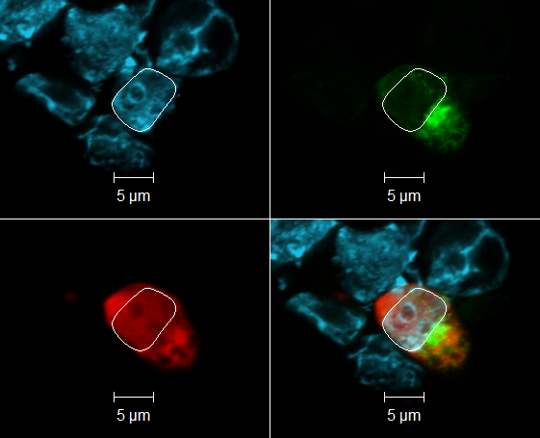
α-”n-big”
α-hFc
M
hC4ORF48-SP_{nBIG}
SP_{nBIG}
61 aa
hFc
myc
h
C4orf48
TEV
c
1. “n-big” portion of C4ORF48, visualized with α-myc antibodies, localizes primarily to nucleus.
3. “n-big” portion of C4ORF48, visualized with α-”n-big” antibodies, also localizes primarily to nucleus.
1
3

Slide 35
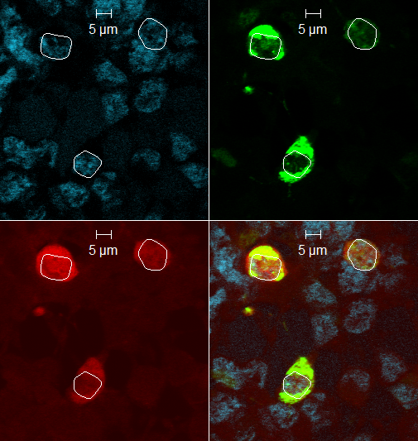
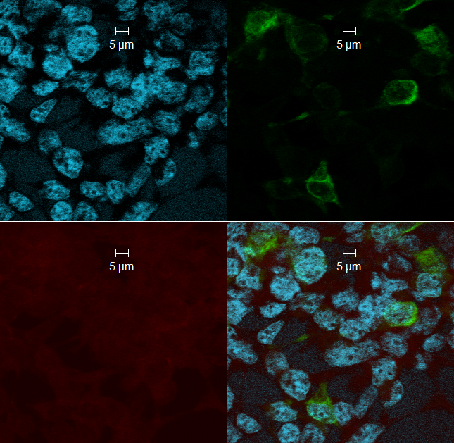
α-myc
α-hFc
M
67 aa
hC4ORF48-SP_{nBIG}
SP_{nBIG}
61 aa
hFc
myc
h
C4orf48
TEV
c
M
hC4ORF48-SP_{nSmall}
SP
61 aa
hFc
c
C4orf48
TEV
myc
h
_{nSmall}
34 aa
4. “n-big” portion of C4ORF48, as visualized with α-myc antibodies, localizes primarily to the nucleus-
“n-small” of C4ORF48-SPnSmall is not seen, and is apparently degraded.
hC4ORF48-SP_{nBIG}
hC4ORF48-SP_{nSmall}

Slide 36
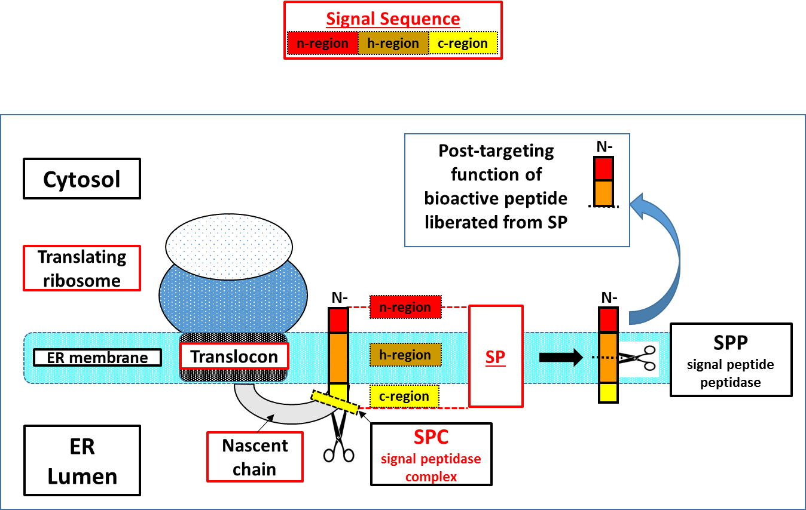
How does the “n-region” of C4ORF48-SPnBig get to the nucleus?
Adapted from Andreas Weihofen, PhD thesis, 2003

Slide 37


I
RIP
ectodomain sheddase
II
TM
domain
SPPL
Signal Peptide Peptidase-Like
h-region
ICD
Cytosol
Nuclear translocation of ICD (Intra-Cellular Domain) liberated from TM domain of a transmembrane protein
Transcriptional Regulation
For example:

Slide 38
Interim Summary:
1. “n-big” portion of C4ORF48, visualized with α-myc antibodies, localizes primarily to nucleus.
2. “n-big” portion of C4ORF48, visualized with α-”n-big” antibodies, also localizes primarily to nucleus.
3. “hFc” portion localizes to the Golgi, as expected for a secreted protein.
4. “n-small” of C4ORF48-SPnSmall is not seen, and is apparently degraded.
α-myc
α-hFc
M
67 aa
hC4ORF48-SP_{nBIG}
SP_{nBIG}
61 aa
hFc
myc
h
C4orf48
TEV
c
M
hC4ORF48-SP_{nSmall}
SP
61 aa
hFc
c
C4orf48
TEV
myc
h
_{nSmall}
34 aa

Slide 39
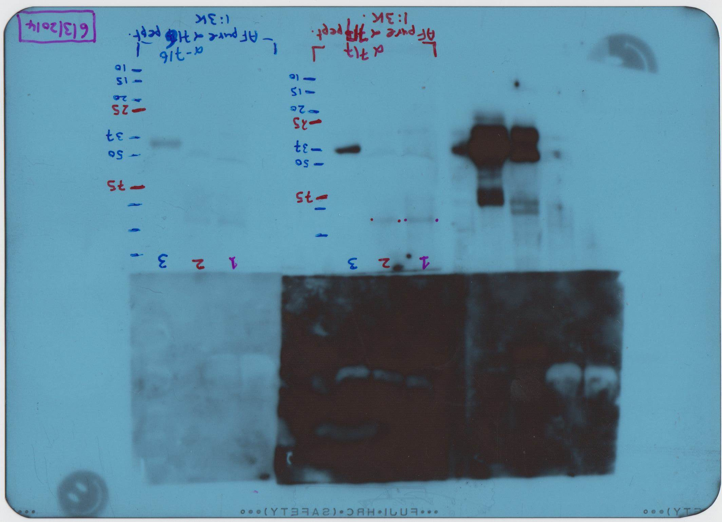
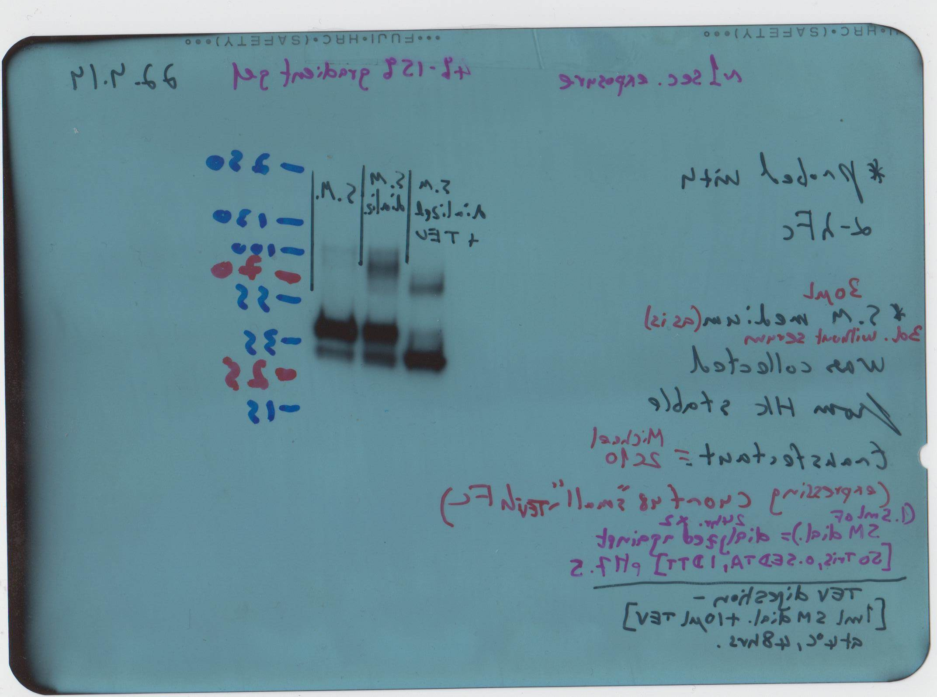
C4orf48 is a secreted protein
Experimentally we find that both C4orf48-Nsmall AND C4orf48-Nbig
are in fact secreted from the cell-
Both forms yield a secreted protein comprising the same N-terminus: EPA….
EPA…
C4orf48
human Fc (hFc)
SPsmall
TEV
EPA…
C4orf48
human Fc (hFc)
SPbig
TEV
HEK293
spent medium
HEK293-C4orf48
spent medium
55
55
37
37
25
25
_
Mock
TEV protease
+
C4orf48big
C4orf48big transfect.
IB anti-C4orf48
IB anti-hFc

Slide 40
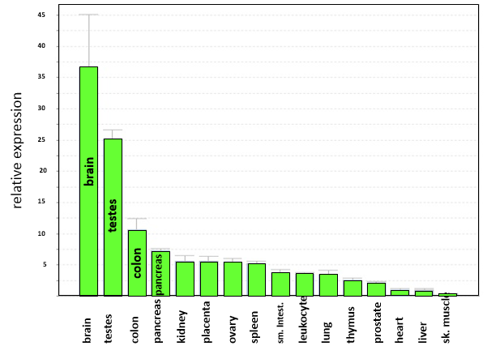
Our qPCR analyses show that C4orf48 is expressed in almost all tissues- however expression is highest, by far, in brain followed then by testes. Far behind are colon and pancreas
So we looked at some features of C4orf48 expression in these selected tissues:
Brain- by in-situ hybridization and qPCR analyses of brains from neonatal and adult mice.
Testis- by qPCR analyses of testes from neonatal and adult mice.
Pancreas- by anti-C4ORF48 immunofluorescent staining of pancreatic sections from neonatal and adult mice.

Slide 41
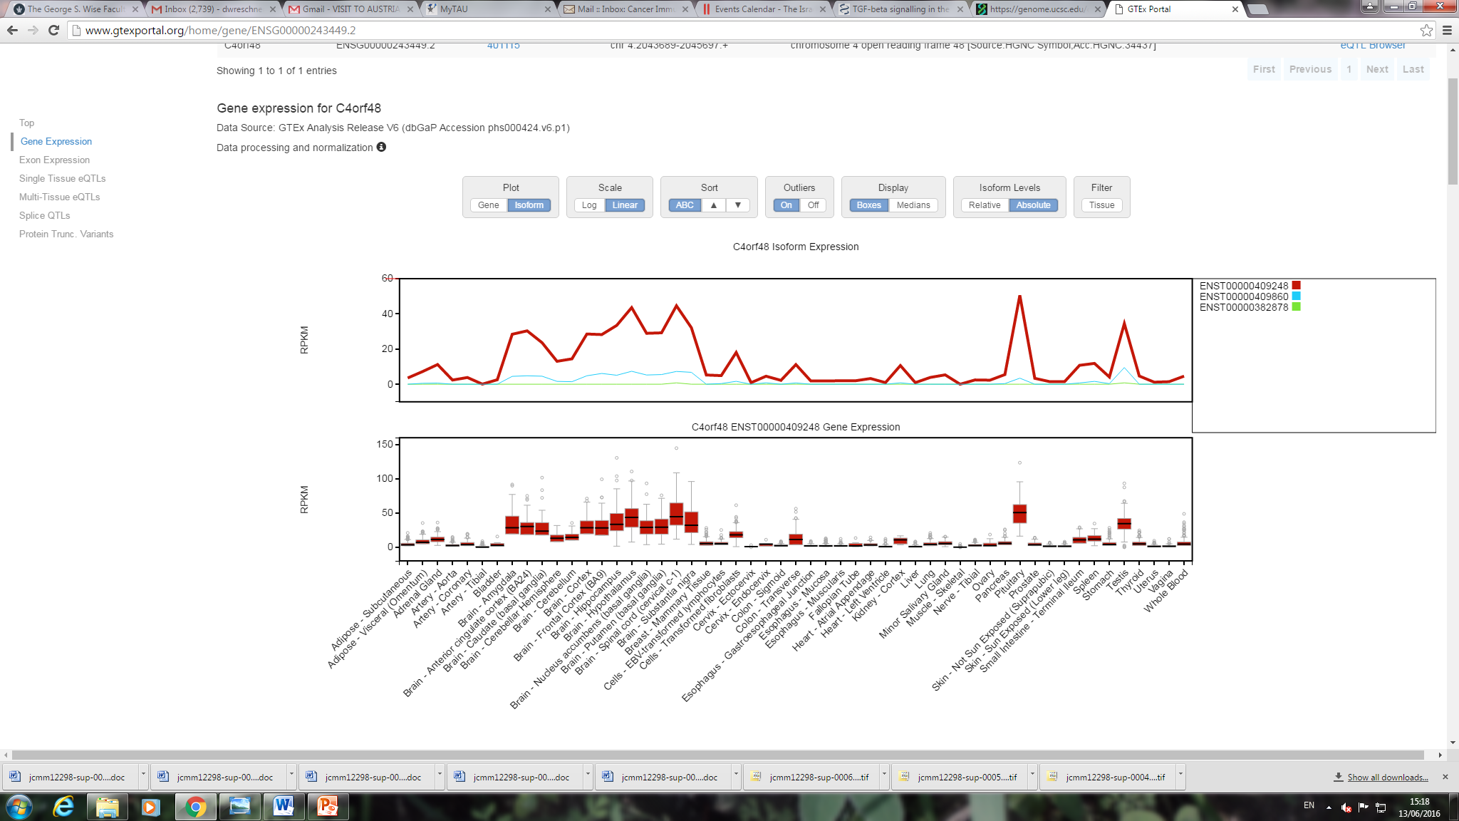
Corroborating our findings are RNA-seq data available at the UCSC genome browser –
they show highest C4orf48 expression in brain (including pituitary) followed by testis and then colon.
Different brain regions
pituitary
testis
colon

Slide 42
RNA-Seq analysis of isoform expression shows much higher expression of
C4orf48-Nbig as compared to C4orf48-Nsmall.
>C4orf48 length=128= ENST00000409248
MRVARRTRNVCRCPRAAGPGVPEPRAAPLPLLA
MAPPPACRSPMSPPPPPLLLLLLSLALLGARARAEPAGSAVPAQSRPCVDCHAFEFMQRALQDLRKTACSLDARTETLLLQAERRALCACWPAGH
Different brain regions
pituitary
testis
colon

Slide 43
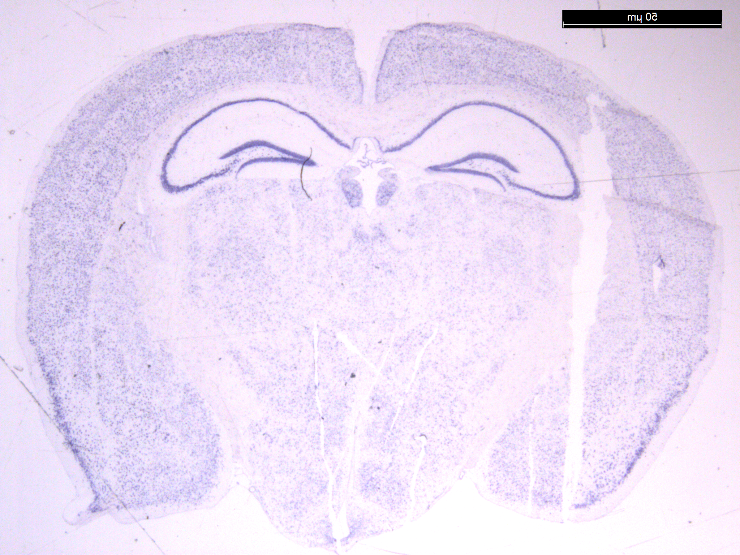
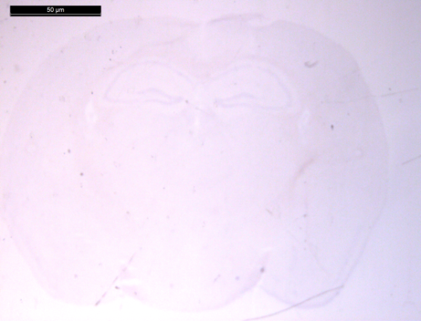
C4orf48 is expressed in the adult mouse hippocampus.
CA1
DG
CA3
ISH C4orf48 Antisense probe
We see strong C4orf48 expression in the hippocampus!
In adults, neurogenesis is restricted to very few brain regions:
the hippocampus and the subventricular zone.
ISH C4orf48
Sense probe
done in collaboration with Pascal Dolle, IGBMC, Strasbourg

Slide 44

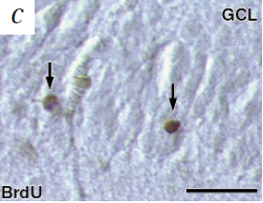
The Dentate Gyrus (DG) of the Hippocampus is one of the few regions where adult neurogenesis takes place

Slide 45
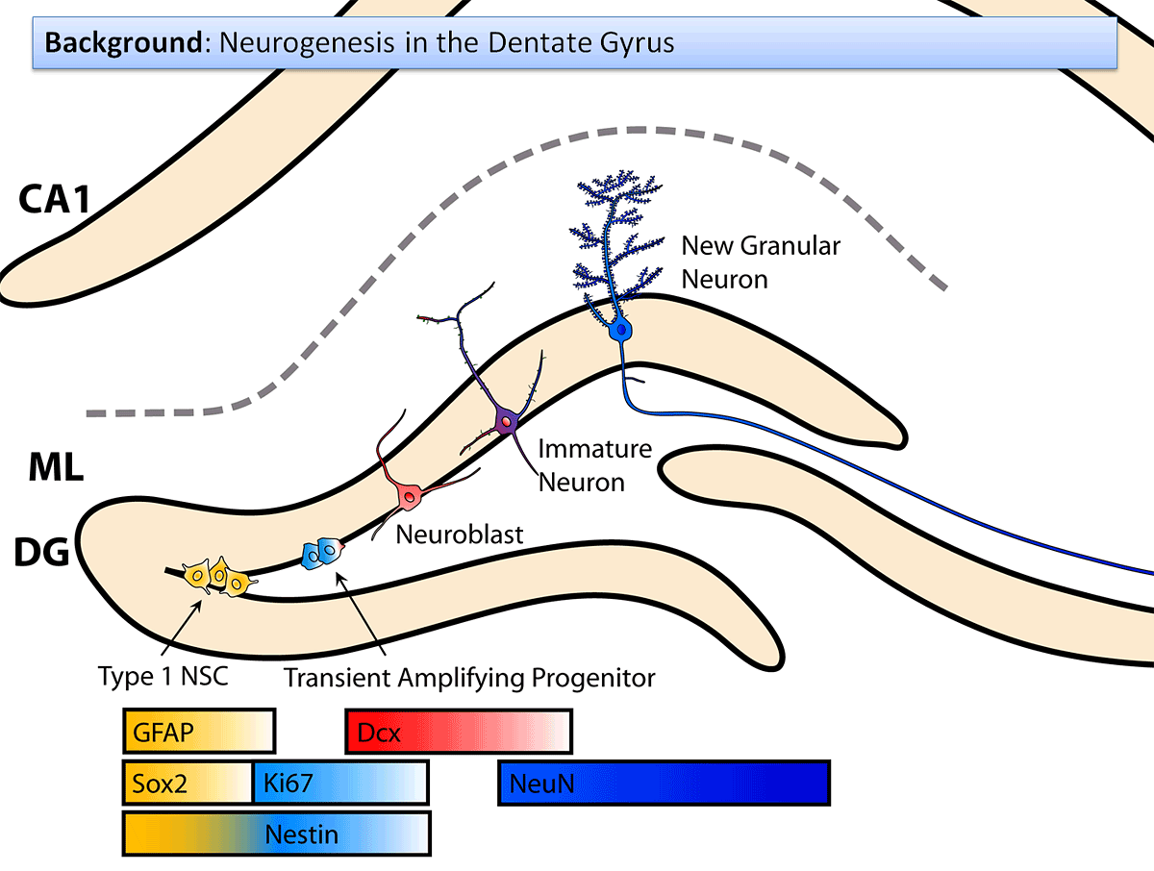
The Dentate Gyrus (DG) of the Hippocampus is one of the few regions where adult neurogenesis takes place
Peter S. Eriksson et. al. Neurogenesis in the adult hippocampus, 1999

Slide 46
These are the precise locations where we see C4orf48 expression
CA1
DG
CA3
dentate gyrus
The Dentate Gyrus (DG) of the Hippocampus is one of the few regions where adult neurogenesis takes place,
and this where we see C4ORF48 expression!
ISH C4orf48 Antisense probe
ISH C4orf48
Sense probe
done in collaboration with Pascal Dolle, IGBMC, Strasbourg

Slide 47
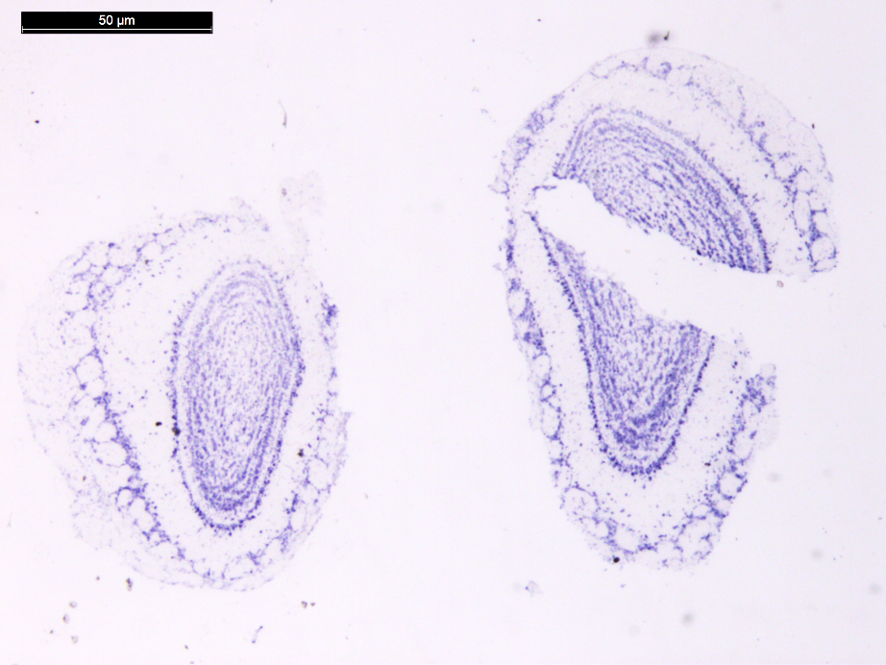
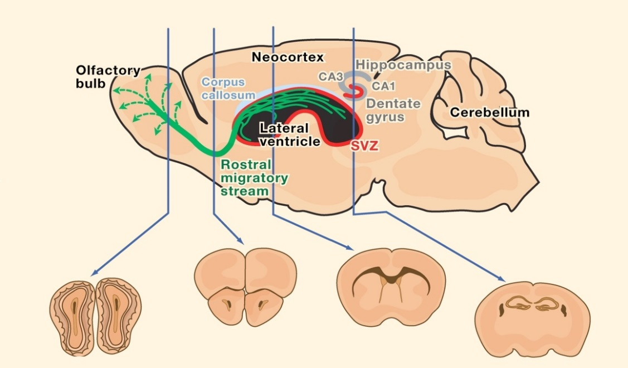
C4orf48 is also expressed in the mouse olfactory bulb
ISH C4orf48
Antisense probe
“Postnatal neurogenesis- IV. Cell proliferation and migration in the anterior forebrain, with special reference to persisting neurogenesis in the olfactory bulb” Joseph Altman 1969

Slide 48
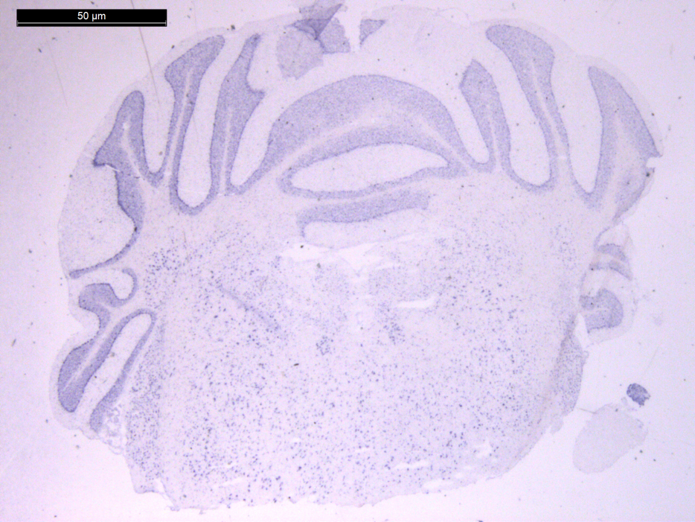
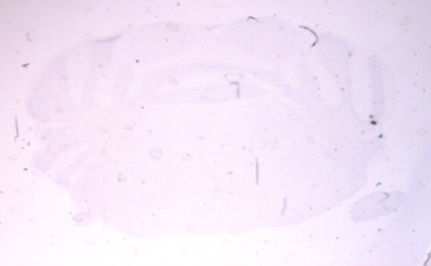
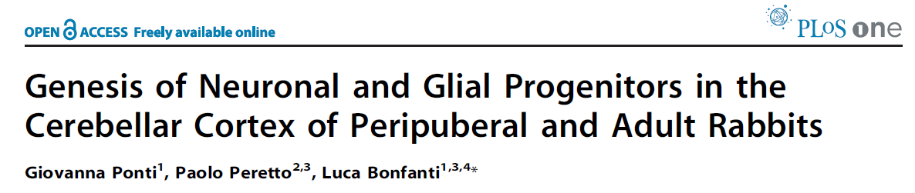
C4orf48 is expressed in the adult mouse Cerebellar Cortex
50 microns
ISH C4orf48 Sense probe
ISH C4orf48 Antisense probe
2008

Slide 49
C4orf48 expression in brain is 2.5-3.5 fold higher in postnatal mice as compared to adult mice.
4
C4orf48 expression
n=3
3
n=3
2
n=3
1
3 dpp
5 dpp
adult
During the embryonic and the early postnatal periods extensive neurogenesis occurs in most regions of the mammalian brain.
Adult neurogenesis in mammals is at much lower rate, as compared to pre- and the early postnatal periods, and is restricted to very few brain regions: the hippocampus and the subventricular zone.

Slide 50
C4orf48 expresson in brain and testes
C4orf48 is upregulated when there is extensive cellular differentiation:
in the brain- in newborn mice,
in the testis- in adult/sexually mature mice.
4
brain
testis
C4orf48
3
3
2
2
1
1
m-1
m-2
m-3
m-4
m-5
m-6
m-7
m-8
m-9
m-10
m-11
m-12
3dpp
adult
13dpp
adult

Slide 51
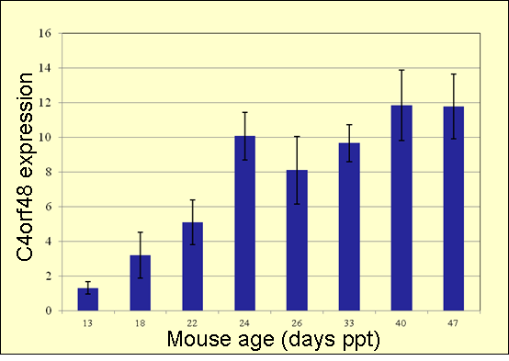
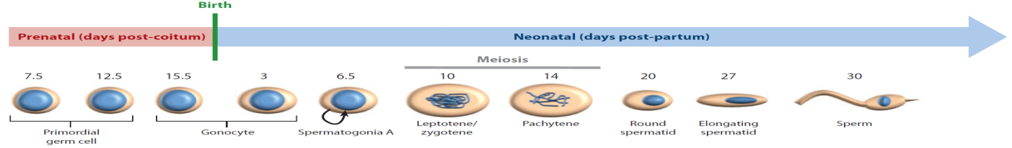
C4orf48 expression level in mouse testes at different ages.
C4orf48 expression is up-regulated in mouse testes as the differentiation of precursor germ cells progresses till mature spermatozoa.

Slide 52
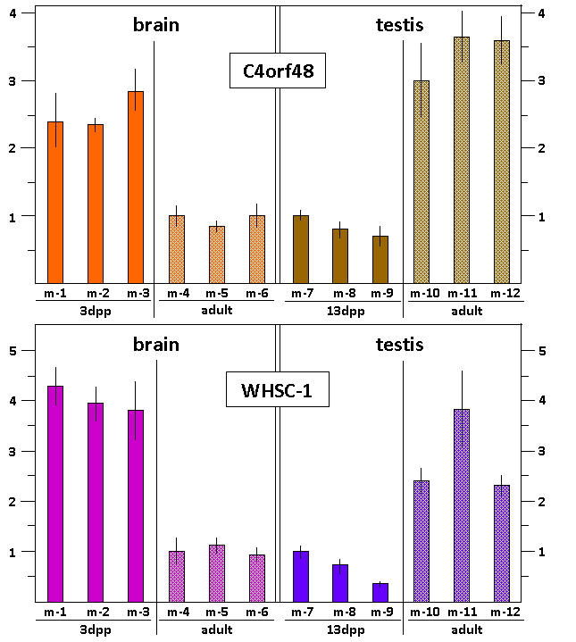
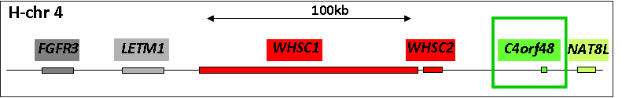
C4orf48 and WHSC1 expresson in brain and testes tissues

Slide 53
C4orf48 expression in pancreas assessed by RNA-Seq-
C4orf48
WHSC1
5.5X
pval 1.9E-12
1675
700
685
1400
600
1200
500
quiescent
1000
replicating
quiescent
replicating
400
800
300
544
600
200
400
125
100
200
beta cells
acinar cells
beta cells
Klochendler, A et al, Diabetes, 2016
Pancreatic cells

Slide 54
mouse pancreas-p5
PANCREAS-8
anti-Muc1
anti-C4orf48
anti-insulin
merge
m-p5
series 20
m-p5
series 22

Slide 55
mouse pancreas-p5
PANCREAS-8
anti-Muc1
anti-C4orf48
anti-insulin
merge
m-p5
series 22

Slide 56
anti-C4orf48
PANCREAS-8
anti-insulin
merge
mouse adult pancreas series 003

Slide 57
Interim Summary
*THE SIGNAL PEPTIDE- there likely is biological meaning to long n-regions.
*C4orf48, a secreted protein with a long n-region, is preferentially expressed in brain and testis- in the brain and testis its temporal and spatial expression profile corresponds to high levels of cell differentiation.
*C4orf48, in the pancreas, is more highly expressed in the p5-post-natal pancreas than in the adult-in both young and adult pancreas it is preferentially expressed in cells directly adjacent to beta cells.

Slide 58
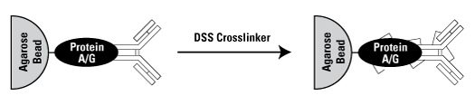
Affinity purification of C4orf48 interacting proteins
hFC
C4orf48
TEV
N-terminus
+TEV protease
hFC
C4orf48
N-terminus
HEK293
spent medium
HEK293-C4orf48
spent medium
55 u
55 u
37 u
37 u
25 u
25 u
C4orf48
_
+
Mock
TEV protease
IB anti-C4orf48
IB anti-hFc

Slide 59
Affinity purification of C4orf48 interacting proteins
Protein identified by mass spec.
Numbers are mass spec values estimating relative protein abundance
Criteria for proteins seen in C4orf48 samples
* probability >95%
* peptide coverage>15%
zero peptides in control sample (MUC1-X)
= MUC1-Xex-TEV-hFc protein + solubilized brain membranes
= C4orf48-TEV-hFc protein + solubilized brain membranes
C4ORF48
10
0
60
MUC1
0
NELL2
53
0
16
This experiment was independently repeated a total of 4 times, all with similar results.
Tenascin C
0
RPTPβ
0
4

Slide 60


Slide 61

Affinity purification of C4orf48 interacting proteins
NELL2
53
0
Nell2- Neural tissue-specific epidermal growth factor-like repeat domain-containing protein-
a secreted protein
EGF-domain
thrombospondin-like domain (TSP-N)
Cysteine rich domain
Expressed predominantly in the brain with highest level in the
hippocampus.
Nell2 supports the survival of neurons from the hippocampus and cerebral cortex.
“NELL2 promotes motor and sensory neuron differentiation and stimulates mitogenesis in DRG in vivo” 2004

Slide 62
Affinity purification of C4orf48 interacting proteins
Protein identified by mass spec.
Numbers are mass spec values estimating relative protein abundance
Criteria for proteins seen in C4orf48 samples
* probability >95%
* peptide coverage>15%
zero peptides in control sample (MUC1-X)
= MUC1-Xex-TEV-hFc protein + solubilized brain membranes
= C4orf48-TEV-hFc protein + solubilized brain membranes
C4ORF48
10
0
60
MUC1
0
NELL2
53
0
16
This experiment was independently repeated a total of 4 times, all with similar results.
Tenascin C
0
RPTPβ
0
4

Slide 63
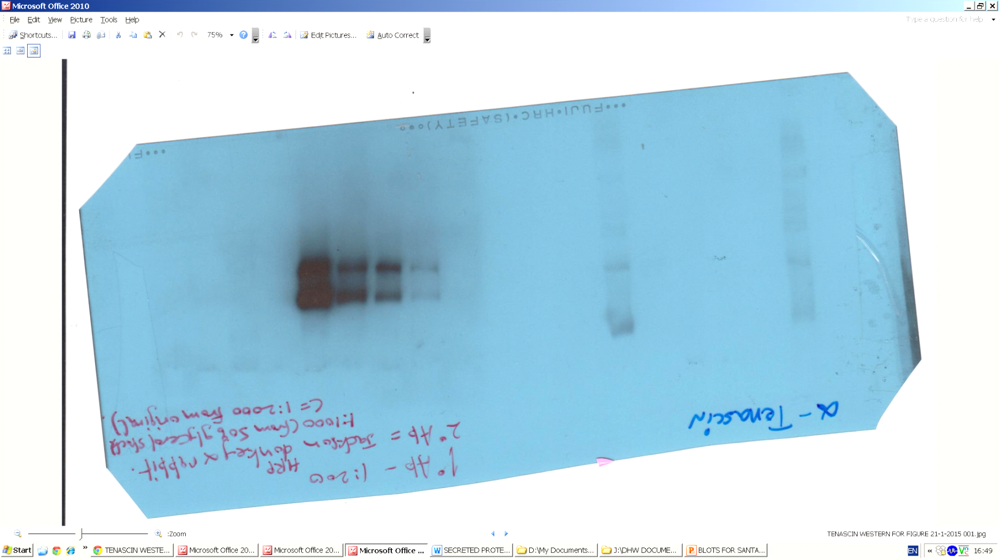

Affinity purification of C4orf48 interacting proteins-
western blot confirmation of C4orf48 interaction with tenascin C (TNC)
C4orf48 MUC1-X
1 2 3 4
u
250
u
150
u
100
u
75
brain extract
- + - +
anti-Tenascin C (TNC)

Slide 64

Affinity purification of C4orf48 interacting proteins
Tenascin C
16
Interacts with RPTPβ
0
Tenascin C (TNC)- a secreted protein
EGF like domain
Globular N-terminal assembly domain
Fibrinogen like domain
Fibronectin type 3 domain
EGF like domain
Expressed mainly in the developing nervous system and is downregulated during adulthood.
Prominently expressed in adult germinal zones where neural stem cells reside.
TNC regulates responses of neural stem/progenitor cells to EGF and FGF.
An ECM protein mainly found in the neural system

Slide 66
Control
Angiogenesis-sprouting assay with pulmonary endothelial cells
C4orf48
FGF2

Slide 67
Concluding Summary
*THE SIGNAL PEPTIDE- there likely is biological meaning to long n-regions.
*C4orf48, a secreted protein with a big n-region, is preferentially expressed in brain and testis, where its temporal and spatial expression profiles correspond to high levels of cell differentiation.
*C4orf48, in the pancreas, is more highly expressed in the p5-post-natal pancreas than in the adult-in both young and adult pancreas it is preferentially expressed in cells directly adjacent to beta cells.
*C4orf48 interacts with proteins such as NELL1, Tenascin C, RPTP-beta (all by co-IP), TGF-beta and NELL2 (BioGrid) all proteins actively participating in regulation of cell differentiation.
*C4orf48 directly shown in a cell-sprouting assay to act similarly to FGF2.

Slide 68
Are there, out there, new secreted proteins to be discovered?
We think yes!
The C4orf48 gene and the secreted C4orf48 protein product(s).
Likely a novel secreted protein, talking to other cells and regulating cell differentiation and growth.

Slide 69
and THANKS TO:
MICHAEL CHALIK, PhD student
RAVIT ZIV, my very capable lab assistant

Slide 70
C4orf48 is a secreted protein
myc
EPA…
C4orf48
human Fc (hFc)
SPsmall
TEV
myc
C4orf48
human Fc (hFc)
SPbig
TEV
So what is the biological function of the N-big sequence in C4orf48-Nbig ???
To try to answer this question, we started out by looking for other proteins, known to be secreted, that also have long N-big regions

Slide 71
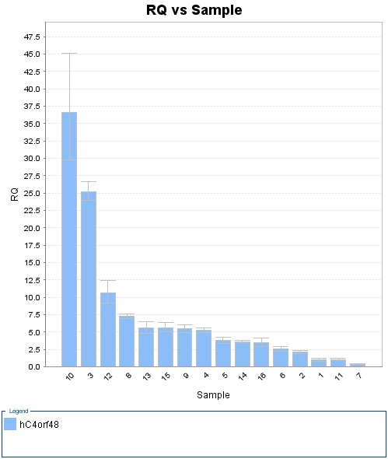
Our qPCR analyses show that C4orf48 is expressed in almost all tissues-
However expression is highest, by far, in brain followed then by testes, then colon and pancreas
45
40
35
relative expression
30
25
brain
20
testes
15
10
colon
pancreas
sm. Intest.
5
brain
testes
colon
pancreas
kidney
placenta
ovary
spleen
leukocyte
lung
thymus
prostate
heart
liver
sk. muscle

Slide 72
C4orf48 is expressed in the adult mouse hippocampus- it is also expressed in the mouse olfactory bulb
ISH C4orf48
Antisense probe

Slide 73
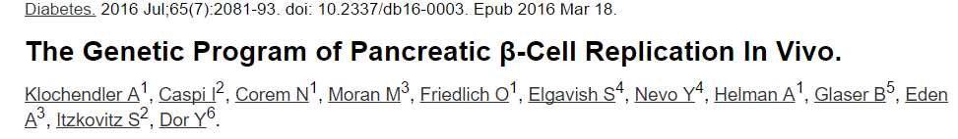
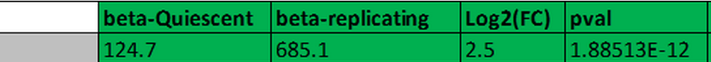
C4orf48 in pancreas
C4orf48 expression in pancreas assessed by RNA-Seq-
* in beta cells and NOT in acinar cells
* in replicating beta cells / quiescent beta cells = 5.5 fold
5.5X
pval 1.9E-12
700
600
“The molecular program underlying infrequent replication of pancreatic β-cells remains largely inaccessible. Using transgenic mice expressing green fluorescent protein in cycling cells, we sorted live, replicating β-cells and determined their transcriptome. Replicating β-cells upregulate hundreds of proliferation-related genes, along with many novel putative cell cycle components.”
500
quiescent
replicating
400
300
200
100
beta cells
acinar cells
Pancreatic cells
Gm1673
[C4orf48]

Slide 74
Affinity purification of C4orf48 interacting proteins
RPTPβ
Interacts with tenascin C
0
4
Receptor type protein tyrosine phosphatase β -a membrane and secreted protein
TM
highly glycosylated domain
tyrosine phosphatase
Carbonic anhydrase domain (CAH)
Fibronectin type 3 domain
Expressed primarily on glial cells in the developing nervous system.
Mediates cell adhesion and signaling events during development.
Involved in maturation of oligodendrocytes.
Promotes bidirectional signaling between glia and neurons.

