Slide 1

Biological and Functional Analysis of Biosimilar TNFα Drugs
Daniel N Galbraith
Chief Scientific Officer, BioOutsource Ltd.
Reliable quality, on time, every time

Slide 2
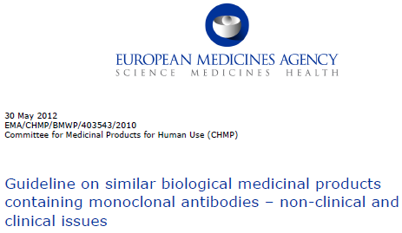
Drug Characterisation Activities
Functional Analysis
Impurities Analysis
Structural Analysis
Characterisation

Slide 3
Overview of the Biosimilar Characterisation Process
Range
Setting
Comprehensive evaluation of Proposed Biosimilar product across a wide range of methodologies
Late
Phase
Extended evaluation across an increased number of methods. Requirements are driven by Regulators based upon molecule characteristics.
Clone & Process
Evaluation of clones against Reference Product range and evaluation of process using critical methods.
Early
Phase
Determination of Critical Quality Attributes of Reference Product using methods
Performance of a selection of Validated Methods
Lot Release

Slide 4

Infliximab (Remicade)
First approved in 1998. Now a multibillion dollar product.
Approved for
  Rheumatoid arthritis, psoriatic arthritis, ankylosing spondylitis, Crohn's disease, ulcerative colitis, moderate to severe chronic psoriasis and juvenile idiopathic arthritis.
Mechanism of Action:
  The antibody targets the TNFα protein either as a membrane bound or soluble form.
  The primary mechanism of action is the neutralisation of circulating TNFα and reducing inflammation
  Secondary actions include the mediation of ADCC, CDC and other methods
Popular target as a BioSimilar after losing its patent in Europe this year and in the USA in 2018.

Slide 5



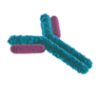





Overview of TNF-α Biology
TNF-α Producing Cell
Apoptosis
via Reverse Signalling
Cytokine
Suppression
mTNF-α
TACE
A
sTNF-α
B
sTNFR1
sTNFR2
TNFR2
TNFR1
TNFR2
TNF-α Sensitive Cell

Slide 6


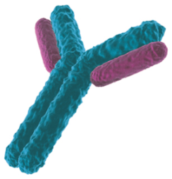
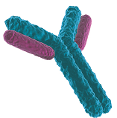
Neutralisation of Soluble TNF-α
Cytokine Production
Apoptosis
Adhesion Molecules
Inflammation
Proliferation
sTNF-α
TNFR1
TNF-α Sensitive Cell
TNFR2

Slide 7
Bioassays: Key Concepts
Measures the effects in a living system
  The only analytical method that provides information on the biological activity
Relative Potency
  Comparison of test drug with a standard preparation
  Minimises the impact of assay to assay variability ensuring consistent reporting of results
Assay Limitations: Single Mechanism of Action
  Multiple methods required to understand drugs with complex mechanisms of action
  Difficulty in correlating bioassay results with therapeutic efficacy

Slide 8
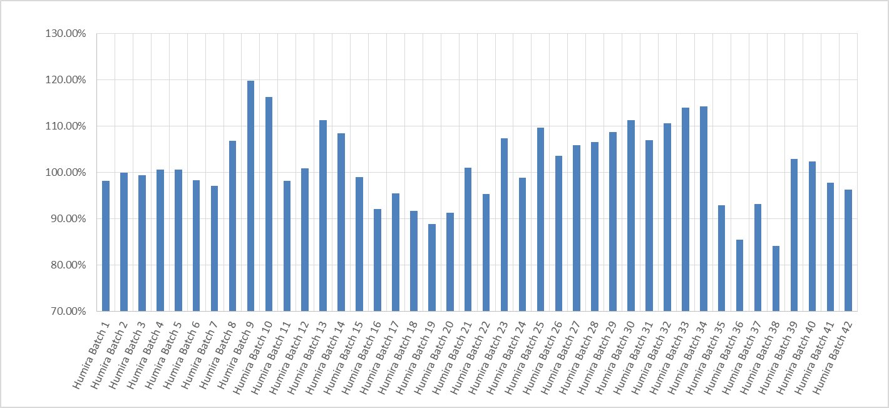
Bioassay Potency Measurements in Monoclonal Antibody Batches – Innovator Variability
42 samples of drug assessed against a common reference standard.
  Accuracy and Precision of the assay <10%
  Relative Potency range of 85% to 120%.
  Primary measure of potency of these drugs is the TNF-α neutralising assay

Slide 9
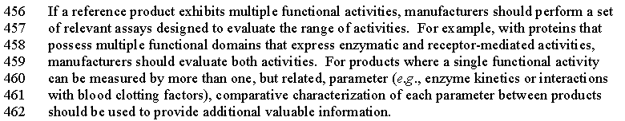
FDA Guidance
FDA is clear that there should be comprehensive orthogonal measurement of key functional activities of the Biosimilar compared with the Innovator molecule

Slide 10
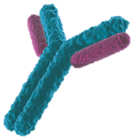
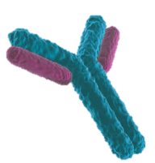

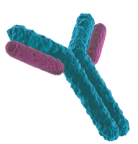
Death of TNF-α Producing Cells
ADCC
via
FcγRIIIa of
NK Cells
TNF-α Producing Cell
Reverse Signalling
Apoptosis
Cytokine Suppression
ADCP
via
FcγRI/II/III Binding
CDC

Slide 11
Characterisation Package
Fab Binding (TNF-α )
Direct ELISA
Competition ELISA
Cell Based ELISA
SPR
Fc Binding
C1q
FcRn
Fcγ Receptors
Fc Functional
ADCC
Surrogate ADCC
ADCP
Surrogate ADCP
CDC
Fab Functional
Various TNF-α Neutralisation Assays
Reverse Signalling (Apoptosis)

Slide 12
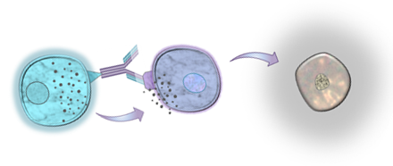
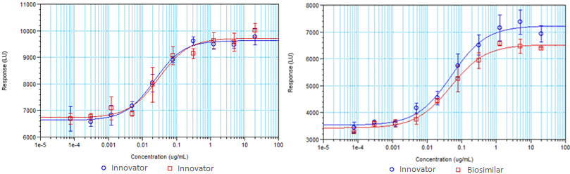
Effector Function Assays:
Relative Potency & Relative Responses (ADCC)
Fc Receptor
Antibody
Effector Cell
Target Cell
Cell Lysis by ADCC

Slide 13
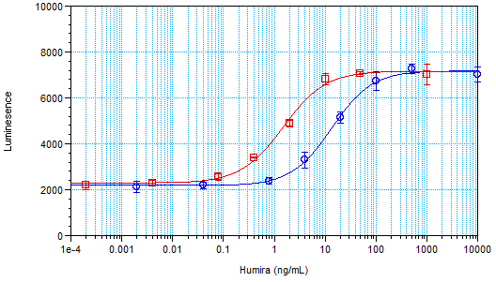
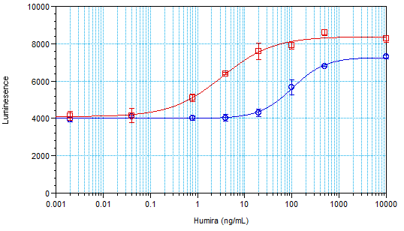
Relative Potency and Parallelism
“Meaningful” Relative Potency
Humira
Less “Meaningful” Relative Potency
Enbrel (or biosimilar Adalimumab)

Slide 14
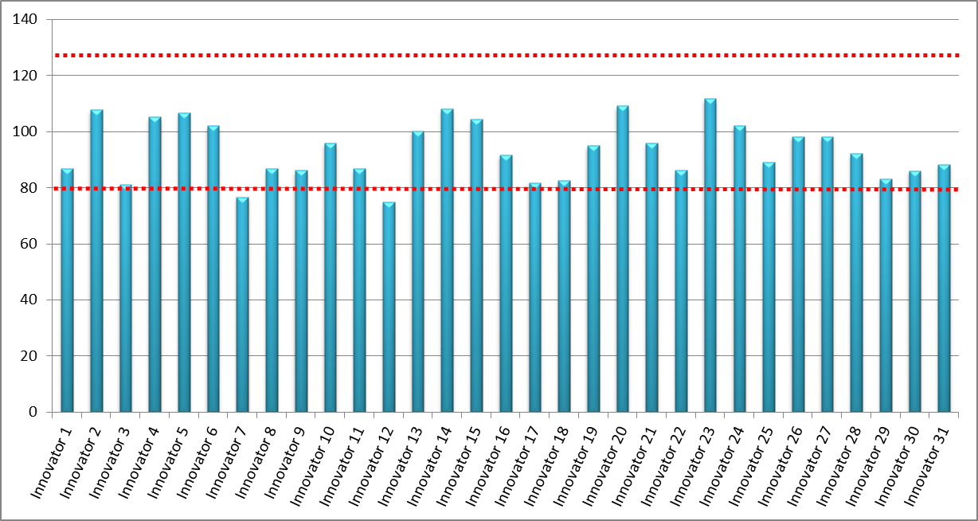
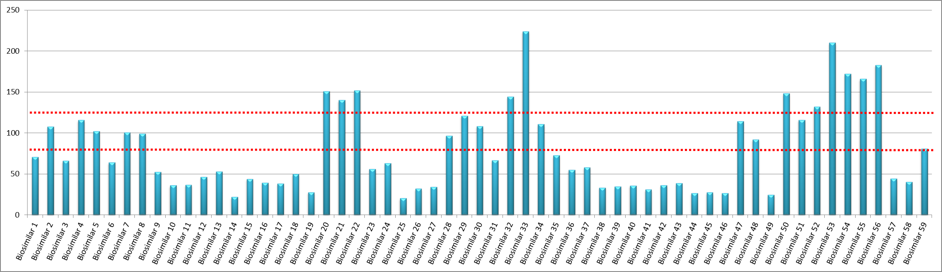
“Fc” Case Study:
Humira ADCC Comparability Data

Slide 15
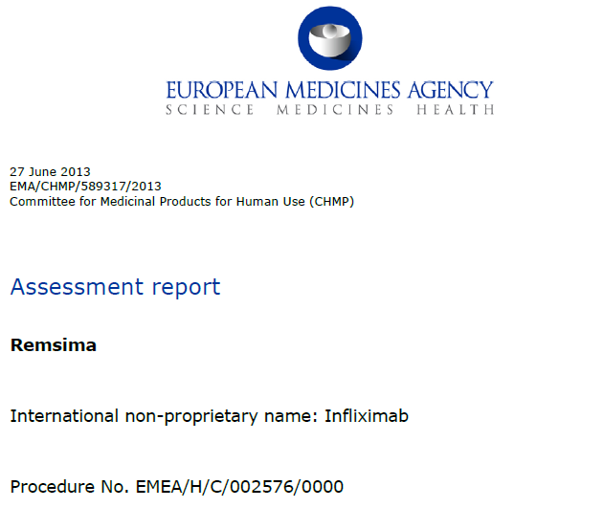

Remsima/Inflectra Approvals
EMA first approved Monoclonal Antibody Biosimilar
Approved June / September 2013
Marketing Holder – Celltrion Hungary
The active substance of Remsima is infliximab, Chimeric Human Mouse monoclonal which binds sTNF-alpha and tmTNF-alpha
Approved for Psoriasis, Psoriatic arthritis, Adult and Paediatric Crohn’s disease, Ulcerative colitis, Paediatric ulcerative colitis , Ankylosing spondylitis and Rheumatoid arthritis.
Characterisation

Slide 16
Comparative ADCC Assessments
Target Cells | Effector Cells | Disease State | Genotype | Result
mTNF-α Jurkat | PBMC | Healthy Donor | Not Specified | Comparable Response
mTNF-α Jurkat | NK | Healthy Donor | V/F | Comparable Response
mTNF-α Jurkat | PBMC | Crohn’s disease | V/F, F/F | Comparable Response
mTNF-α Jurkat | NK | Crohn’s disease | F/F | Comparable Response
mTNF-α Jurkat | NK | Crohn’s disease | V/V, V/F | Differences Detected*
mTNF-α Jurkat | Whole Blood | Healthy | Not Specified | Comparable Response
mTNF-α Jurkat | Whole Blood | Crohn’s disease | Not Specified | Comparable Response
LPS-Stimulated Monocytes | NK | Healthy | V/F | No ADCC Response
LPS-Stimulated Monocytes | PBMC | Crohn’s disease | V/F | No ADCC Response
*Shown to be the most sensitive assay

Slide 17
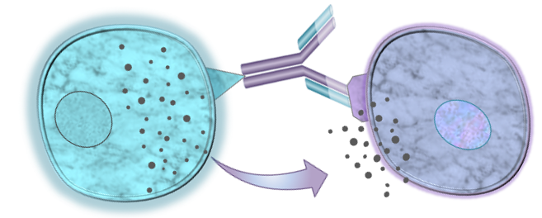
Two Dimensions to ADCC Design
NK Cells from Crohn’s disease patients (V/V, V/F Genotypes)
Sensitivity
High Expressing tm-TNF-α
Engineered cell line
Whole Blood
Relevance
Activated Monocytes / Macrophages

Slide 18
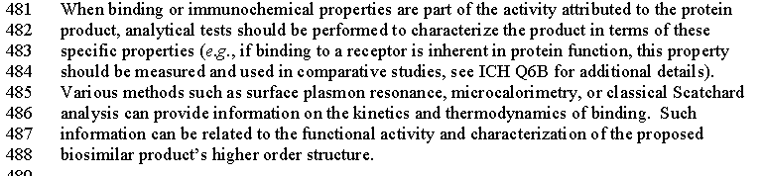
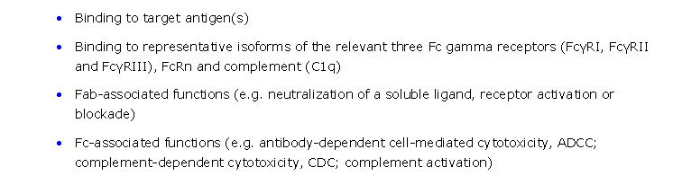
FDA Guidance
FDA and EMA expects the binding characterisation of molecules to be understood – in relation to on and off rates and relate this to functional activity

Slide 19
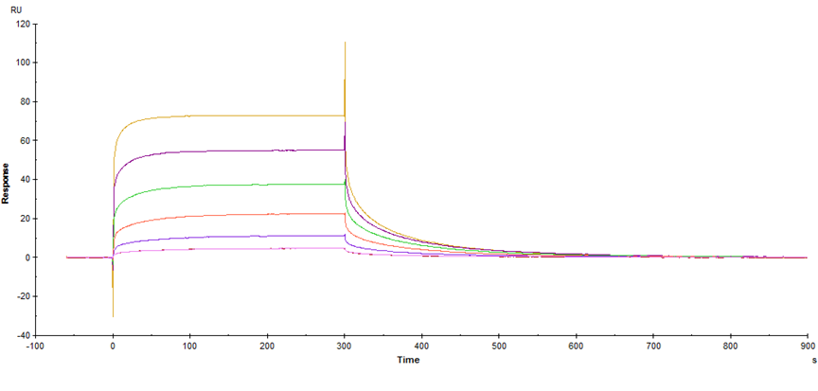
Sensorgrams IV
Association phase
Dissociation phase
Rate of initial association is determined by Biacore evaluation software and designated k_{a}
K_{a} is measured in 1/Ms and is affected by sample concentration
Equilibrium of binding is achieved when the binding response does not change with time .
It is not always possible to reach equilibrium, particularly with high affinity interactions where the dissociation is typically very slow
Rate of dissociation is determined by Biacore evaluation software and designated k_{d}
K_{d} is measured in 1/s and is independent of sample concentration

Slide 20
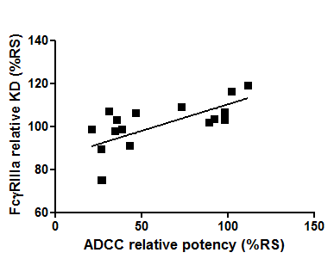
The Orthogonal Approach
Correlation between FcγIIIa and ADCC
Relative KD – compared with a reference standard - reported as a ratio to reference standard
Factors out assay or machine variation

Slide 21
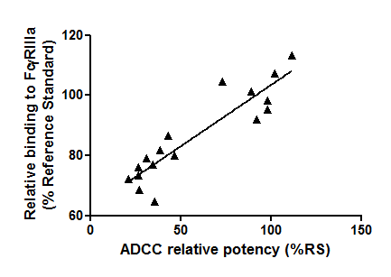
Correlation between IIIa and ADCC
Signal at saturation point for each conc. To provide a dose response curve against the reference standard.
Most sensitive to measure differences between samples
Celltrion did not present this type of analysis.

Slide 22
Remsima conclusions
Remsima has the correct glycan structure from Mass Spec analysis
SPR show differences in the binding of Remsima and Remicade to FcγIII
ADCC data showed differences in Patient cells vs Healthy donors with a lower dose response curve. However this was not considered to be clinically relevant.
Celltrion went to an extraordinary extent to measure these activities in very challenging assays but in the end this was useful as it showed that the difference seen in the SPR data had no clinical significance.

Slide 23
Conclusions
Understanding the Biological Activity of a Drug is the critical measure of the likely clinical efficacy.
Biological Assays are complex and sometimes variable in quality of data.
Biosimilars studies require these assays to be more robust and accurate than any other type of drug.
Product variability needs to be considered carefully when assessing Biosimilars – drug data libraries become a key aspect of this
We are still in our infancy of understanding all of the biological aspects of some drugs and this will become more important moving forward.

Slide 24
Thanks to
BioSimilar Team: Dr Jen Lawson
Dr Cat Thomson
Dr Sarah Jones
Dr Andrew Baron
Dr Alan Patterson
Nat Calvert
Osman Mehmood
Nathan Rendall
Nicola McDonagh
Hannah McLean
Kathryn Carrick
Sarah Marfo
John Carruthers
Richard McKendrick
Tech Services Team: Andy Upsall
Dr Debbie Allan
Dr Terry Gray
Dr Stefan Termen
Dr Laura Munro

