Slide 1
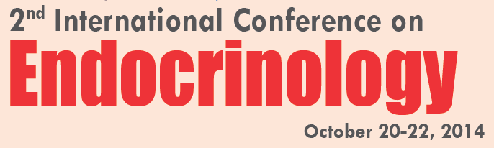

Several reproductive stressors induce stress enzyme- mediated differentiation of placental trophoblast stem cells to produce hormones of early but not later placental lineages
Yufen Xie*, Sichang Zhou*, Yu Yang, Zhongliang Jiang, Jing Dai, Elizabeth Puscheck, Icksoo Lee, Graham Parker, Maik Hüttemann, and Dan Rappolee

Slide 2
Endocrine hormones cellular receptors and intracellular signaling and outcomes.
Stress stimuli Stem cells differentiation Endocrine hormones (first lineage>later lineages.

Slide 3
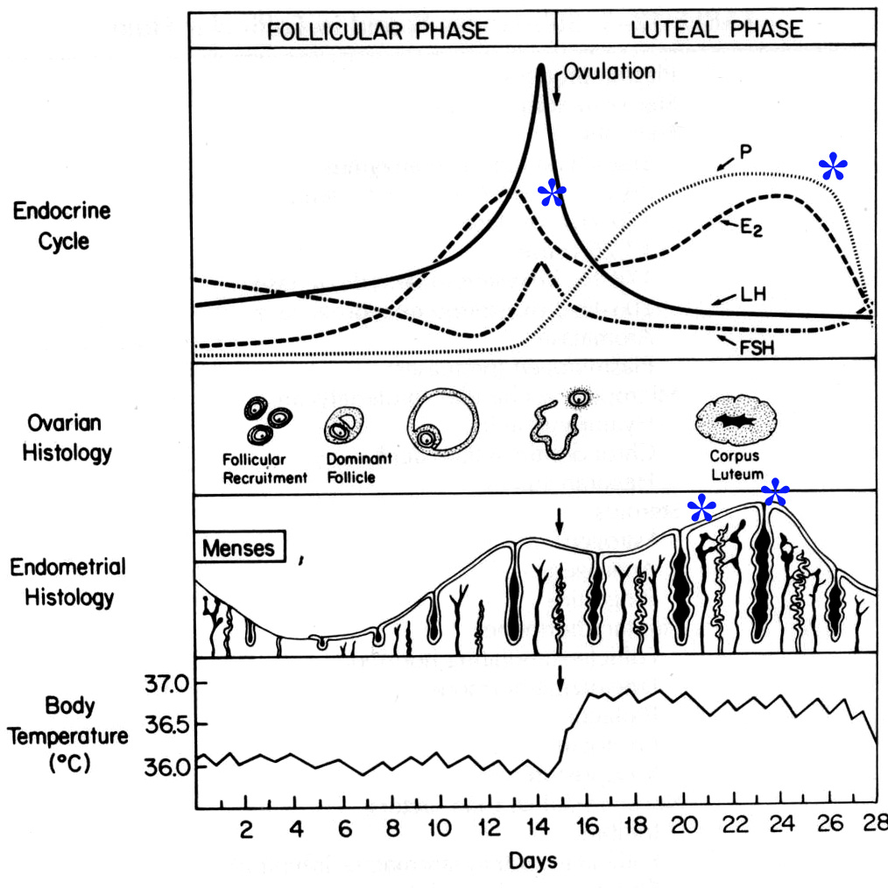

=zygote to implanting embryo
*
PROGESTERONE
*
Fertilization
In Humans and mice, the embryo implants and must induce ovarian proges-terone ( ) synthesis in just a few days or it is menstruated away. Placental lactogen (PL)1
aids in maintaining progesterone in the mouse.
The embryo is in a race to survive.
What would happen if stress occurs during this race?
*
hCG
PL1
Implantation
Modified from William’s Endocrinology, 8th Ed.

Slide 4
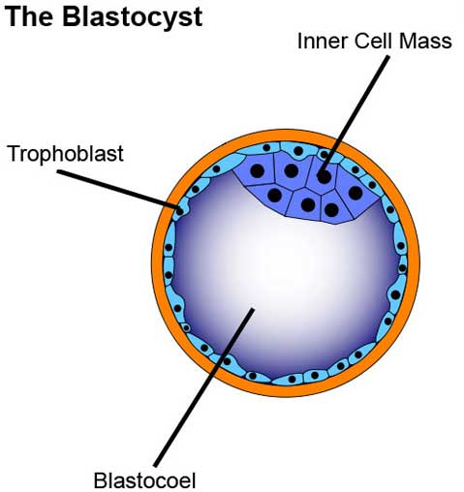
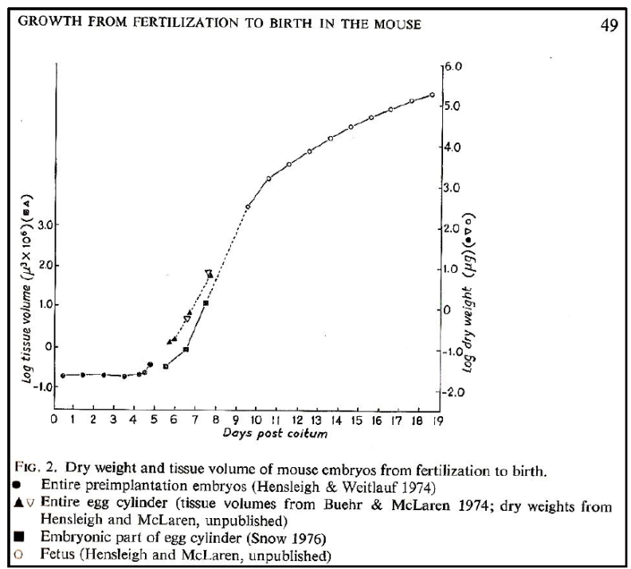
TSC=placental trophoblast stem cells/FGF4
100 cells at implantation
PROBLEM, the embryo is small, maternal blood volume is large
FGF4
How to solve the “small embryo” problem?
McLaren. CIBA
Foundation Mammalian embryogenesis, 1976
20% O₂

Slide 5
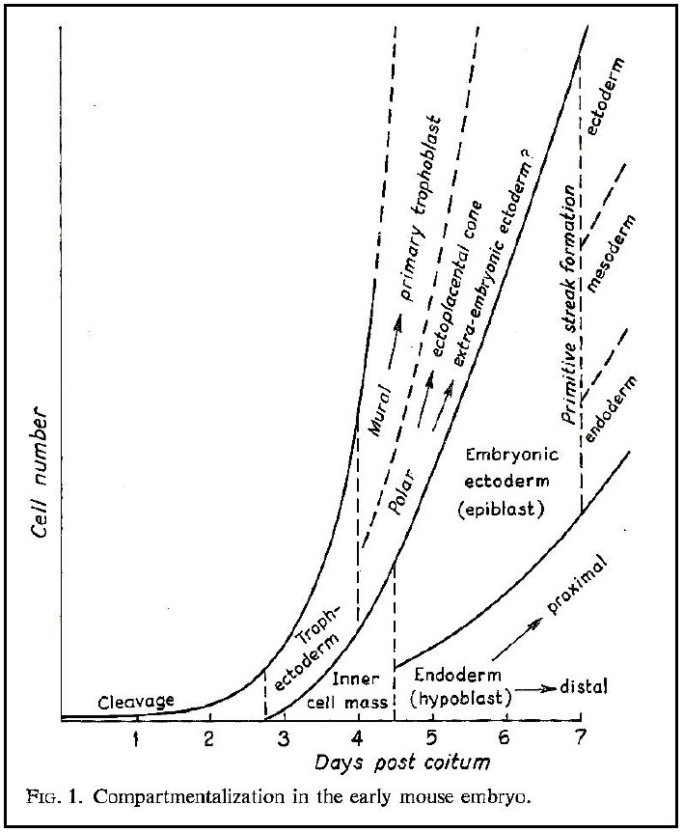
TSC=placental trophoblast stem cells/FGF4
100 cells at implantation
PROBLEM, the embryo is small, maternal blood volume is large
FGF4
How to solve the “small embryo” problem?
McLaren. CIBA
Foundation Mammalian embryogenesis, 1976
20% O₂
20% O₂

Slide 6
TSC=placental trophoblast SC
ESC=embryonic SC
FGF4
Stem cells
Stress
Stress
enzymes
Transcription
factors
Cell Lineage
Choice
Endocrine
Hormones

Slide 7
Stress
IVF techniques, media in incubator, ambient handling media, pipetting embryos, Single variables; hyperosmotic stress (sorbitol, salt), inflammatory TNFα, genotoxic benzopyrene (BaP), dioxin, shear stress, microgravity, incorrect oxygen during culture. COMMON OUTCOME fewer stem cells

Slide 8
Stress
IVF techniques, media in incubator, ambient handling media, pipetting embryos, Single variables; hyperosmotic stress (sorbitol, salt), inflammatory TNFα, genotoxic benzopyrene (BaP), dioxin, shear stress, microgravity, incorrect oxygen during culture. COMMON OUTCOME fewer stem cells
Stress
enzymes
Screened inhibitors for 50 enzymes/500 in the kinome and narrowed focus to two enzymes; SAPK which induces differentiation but does not affect potency, and AMPK which mediates stress-induced loss of potency.

Slide 9
Transcription
factors
DIFFERENTIATION Hand1 for first lineage (Giant cells with polyploid nuclei that secrete PL1 and Plf). Gcm1 later chorionic exchange labyrinthine placenta. TPBPa and MASH2; markers of ectoplacental and restricted stem cell for giant cells of the marginal zone. POTENCY factors that are lost; Cdx2, inhibitor of differentiation (ID)2, Eomes, ErrB, MASH2.

Slide 10
Transcription
factors
DIFFERENTIATION Hand1 for first lineage (Giant cells with polyploid nuclei that secrete PL1 and Plf). Gcm1 later chorionic exchange labyrinthine placenta. TPBPa and MASH2; markers of ectoplacental and restricted stem cell for giant cells of the marginal zone. POTENCY factors that are lost; Cdx2, inhibitor of differentiation (ID)2, Eomes, ErrB, MASH2.
Cell Lineage
choice
Placental lactogen (PL)1 (human hCG), Proliferin (first giant cells), later lineages syncytin A (chorion), Ctsq and PL2 (sinusoidal giant cells of chorion). Hormones of later lineages PL2, PLPA NOT .

Slide 11
TSC=placental trophoblast SC
ESC=embryonic SC
FGF4
Stem cells
Stress
Stress
enzymes
Transcription
factors
Cell Lineage
choice
AMPK
SAPK

Slide 12
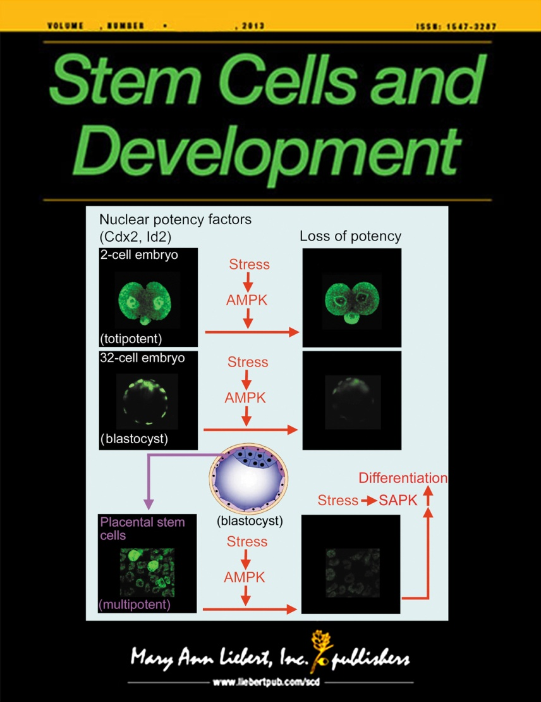
TSC=placental trophoblast SC
ESC=embryonic SC
FGF4
Stem cells
Stress
Stress
enzymes
Transcription
factors
Cell Lineage
choice
AMPK
SAPK
Potency factor loss
Differentiation factor gain
Terminal differentiation markers

Slide 13
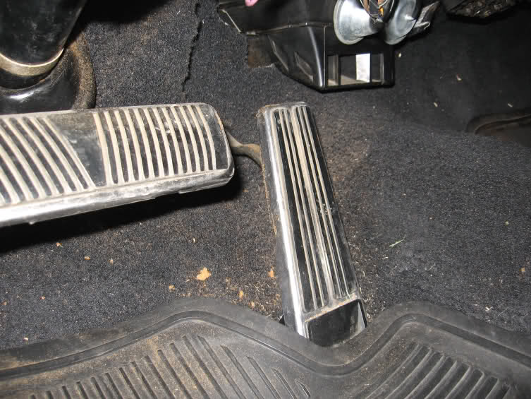
TSC=placental trophoblast SC
ESC=embryonic SC
FGF4
Stem cells
Stress
Stress
enzymes
Transcription
factors
Cell Lineage
choice
AMPK
SAPK
Potency factor loss
Differentiation factor gain
Terminal differentiation markers
AMPK
SAPK
POTENCY
DIFFERENTIATION

Slide 14
TSC=placental trophoblast SC
ESC=embryonic SC
FGF4
Stem cells
Stress
Stress
enzymes
Transcription
factors
Cell Lineage
choice
AMPK
SAPK
Potency factor loss
Differentiation factor gain
Terminal differentiation markers
PL1 E5.0
Proliferin E7.5
PLII R=E9.0
PLPA E8.0
Prioritized
Differentiation

Slide 15
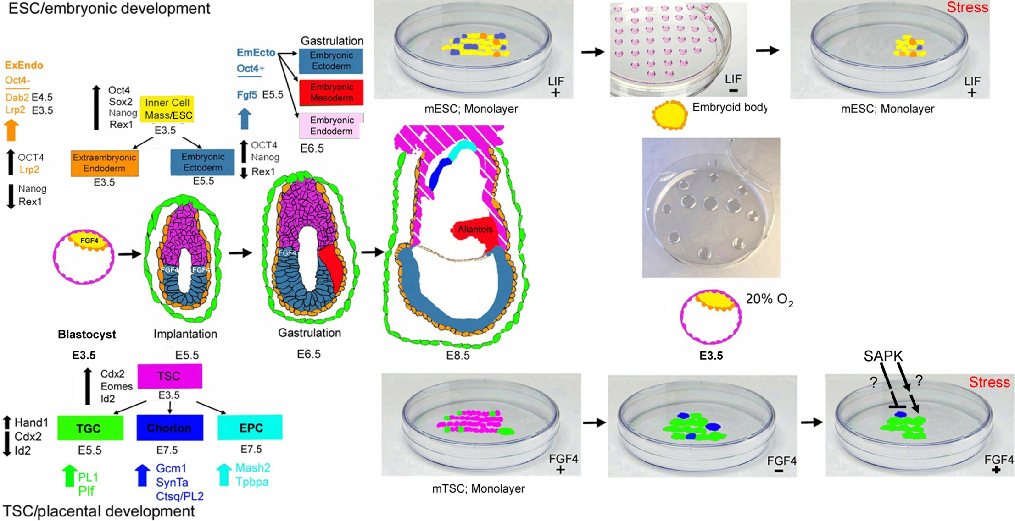
Today; non-morbid levels of many stressors, where TSCs grow but at diminished rates, stress induced differentiation that is prioritized.

Slide 16
Today; non-morbid levels of many stressors, where TSCs grow but at diminished rates, stress induced differentiation that is prioritized.
Stress also induces prioritized differentiation of embryonic stem cells (ESCs). Slater et al Stem Cells & Devel. 2014

Slide 17
Placental TSC First differentiated placental giant cell
Hand1 /E47
Hand1 PL1
Id2

Slide 18
When stress diminishes stem cell population expansion fewer cells make more differentiated product/cell
Liu et al, 2009, Placenta “Omics”, prioritized
Zhong et al,2010, Reproduction AMPK ID2
Awonuga et al, 2011, Mol Repro Dev SAPK HAND1, PL1
Placental TSC First differentiated placental giant cell
pSAPK
Hand1 /E47
Stress Hand1 PL1
Id2
pAMPK
Hyperosmotic

Slide 19
When stress diminishes stem cell population expansion fewer cells make more differentiated product/cell
Xie et, 2010, Mol Repro Devel AMPK ID2
Xie et al, 2009, Fert Steril SAPK HAND1
Placental TSC First differentiated placental giant cell
pSAPK
Hand1 /E47
Stress Hand1 PL1
Id2
pAMPK
Benzopyrene

Slide 20
When stress diminishes stem cell population expansion fewer cells make more differentiated product/cell
Zhou and Xie et al, 2011, Placenta SAPK Hand1
Yang et al, 2014, Placenta submitted AMPK ID2, not Errβ
Xie and Zhou et al, 2014, Stem Cell Res SAPK HAND1, PL1
Prioritized; Gcm1
Placental TSC First differentiated placental giant cell
pSAPK
Hand1 /E47
Stress Hand1 PL1
Id2
pAMPK
Hypoxic

Slide 21
Two studies of hypoxic stress effects on decreased potency and increased differentiation of cultured mouse TSCs

Slide 22
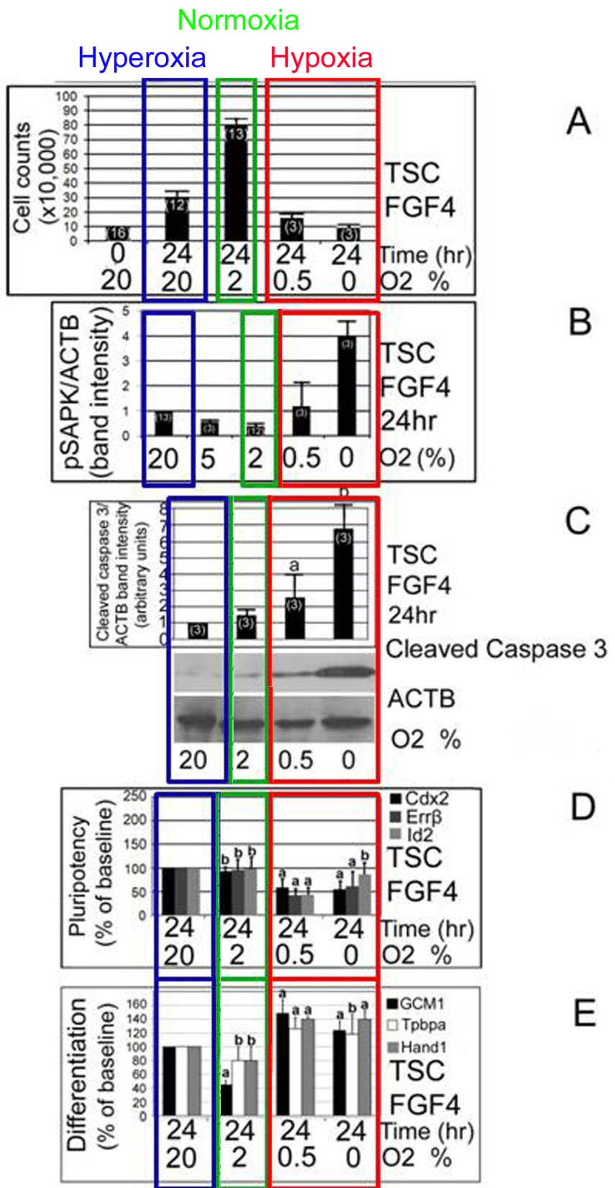
Modified from:
Zhou and Xie et al, 2011, Placenta

Slide 23
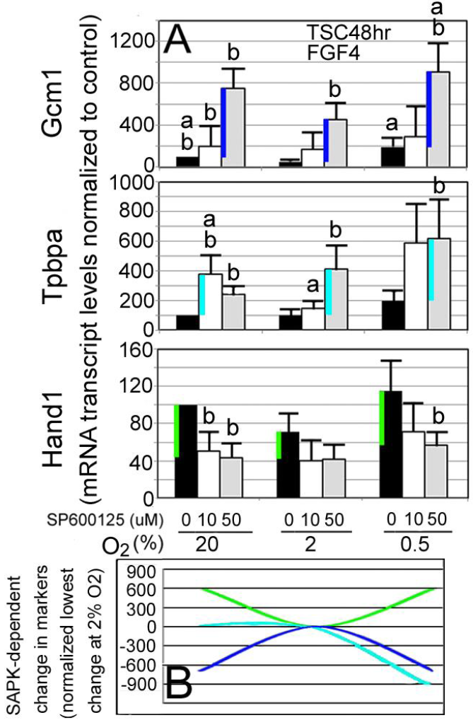
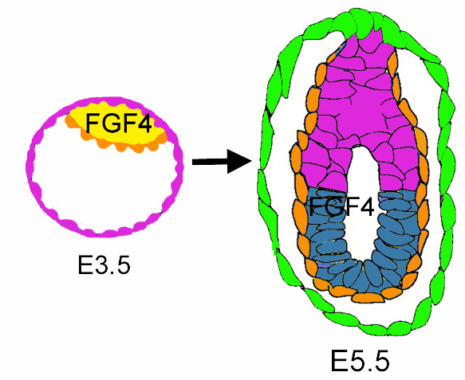
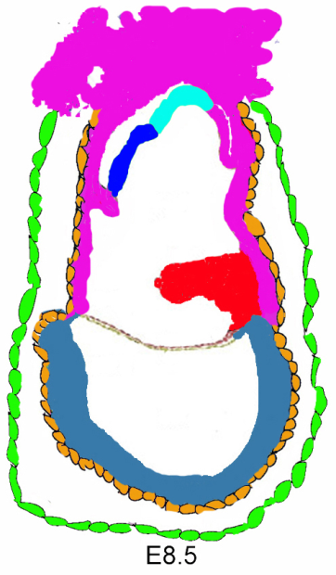
Xie and Zhou et al, 2014, Stem Cell Research

Slide 24
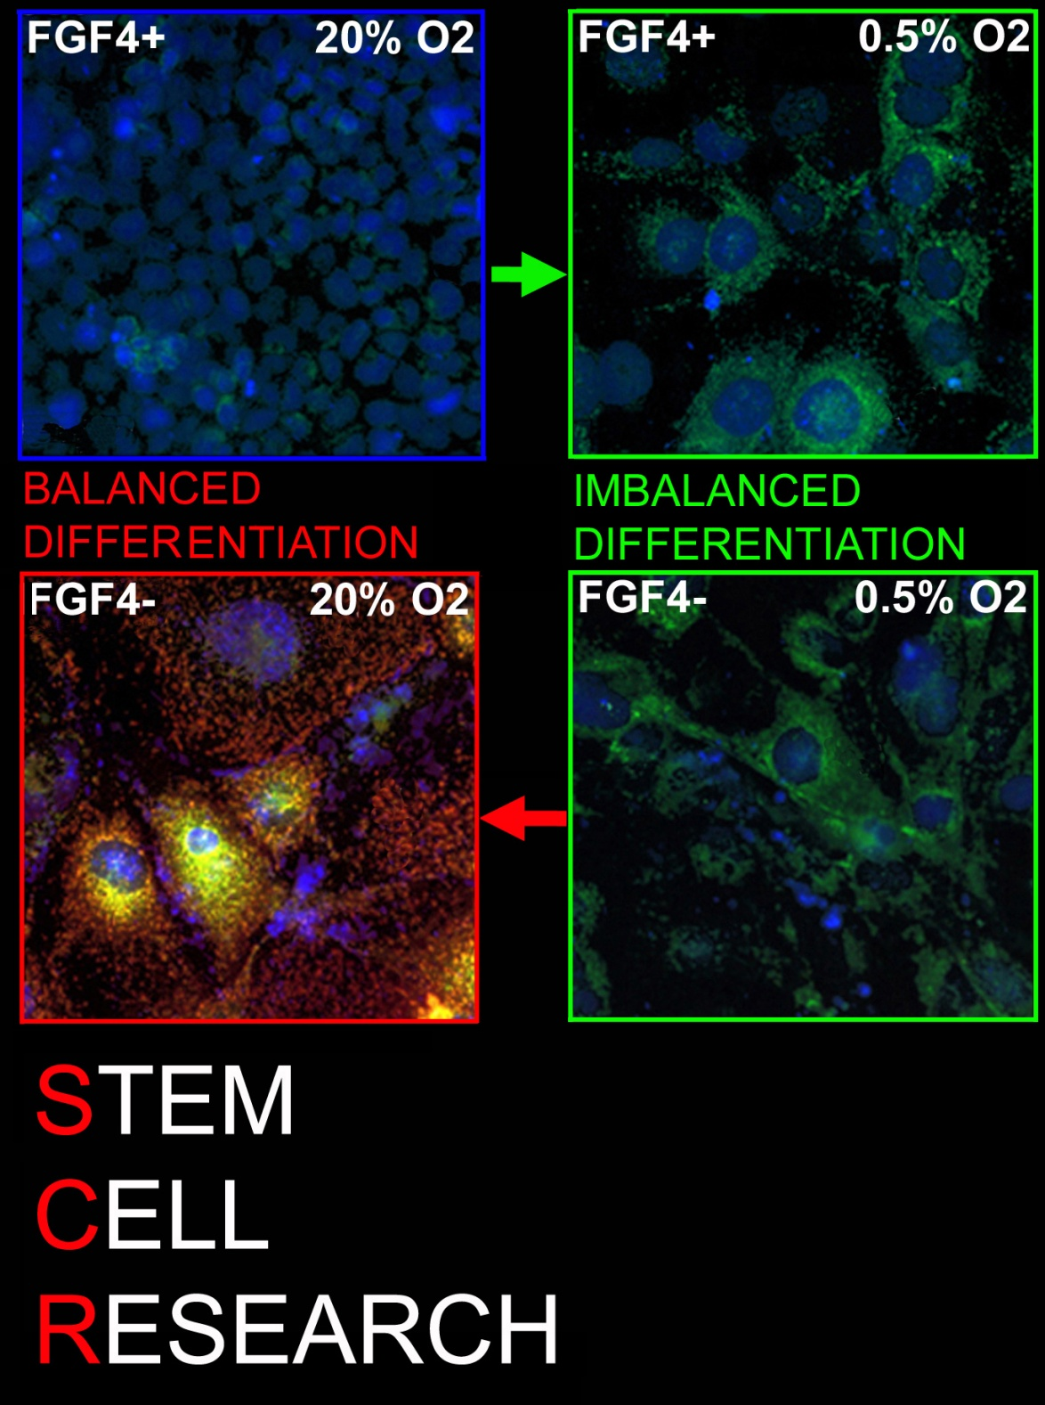
Hypoxia drives morphological differentiation despite FGF4.
Xie and Zhou et al, Stem Cell Research 2014

Slide 25
But PL1 is low at low green mitochondrial charge and high PL1 is only at high charge;
Thus hypoxia can’t complete
Differentiation.
Xie and Zhou et al, Stem Cell Research 2014

Slide 26
SUMMARY
Stressors decrease stem cell population expansion
(pathogenic impact 1)
Stressors induce differentiation to compensate for smaller stem cell population (pathogenic impact 2)
Hypoxia induces compensatory and prioritized differentiation by low oxygen levels do not support differentiation. (unique pathogenic impact 3)
Limitations
Studies primarily In cultured mouse embryos and ESCs and TSCs.

Slide 27
Hypotheses for future research :
We hypothesize that stress-induced prioritized differentiation occurs in embryos in vitro and in vivo.
We hypothesize that prioritized differentiation also occurs in human TSC
We are making viable reporter TSCs (and ESCs) for Potency factor promoter-GFP, Potency factor promoter-RFP, and first lineage differentiation marker promoter- GFP/RFP

Slide 28
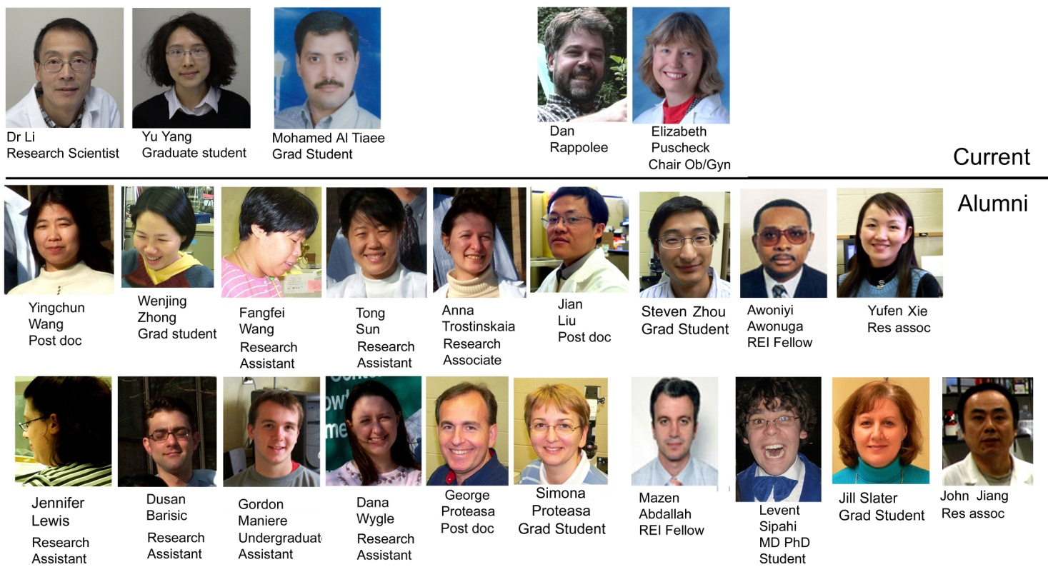

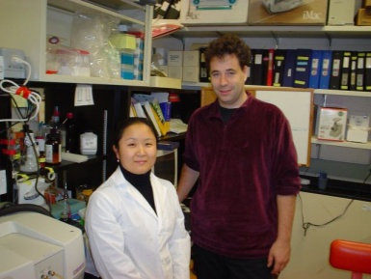
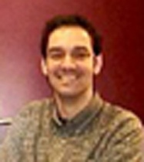
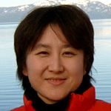
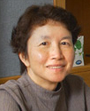
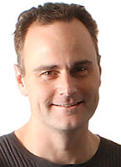
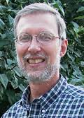



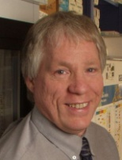
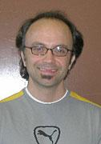
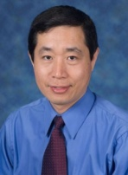
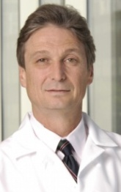
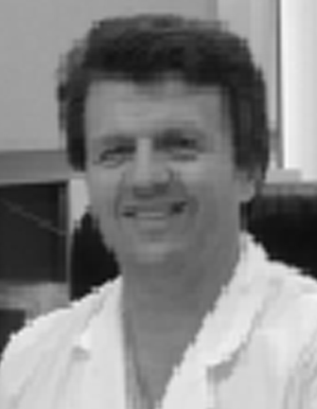

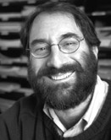







Alan Bolnick
REI Fellow
Edmond Rings Groningen Holland
Maik Huttemann and Ick Soo Lee, WSU
QT Wang UI Chicago
Hayley Shen Clarkson University
David Brigstock Ohio State University
John Reiners, WSU
Nardhy Gomez-Lopez WSU
Sascha Drewlo WSU
Zhengpeng YI WSU
Stephen Lye
U Toronto
Emin Maltepe UCSF
Kezhong Zhang WSU
Rick Leach Michigan State University
Tony Johnson Baylor
Ron Davis Stanford
Funding support
Josh Zimmerberg NICHD

Slide 29
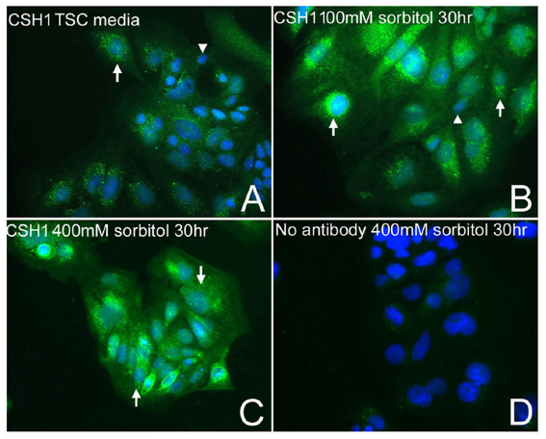
Awonuga et al, 2011, Mol Repro Dev.

Slide 30
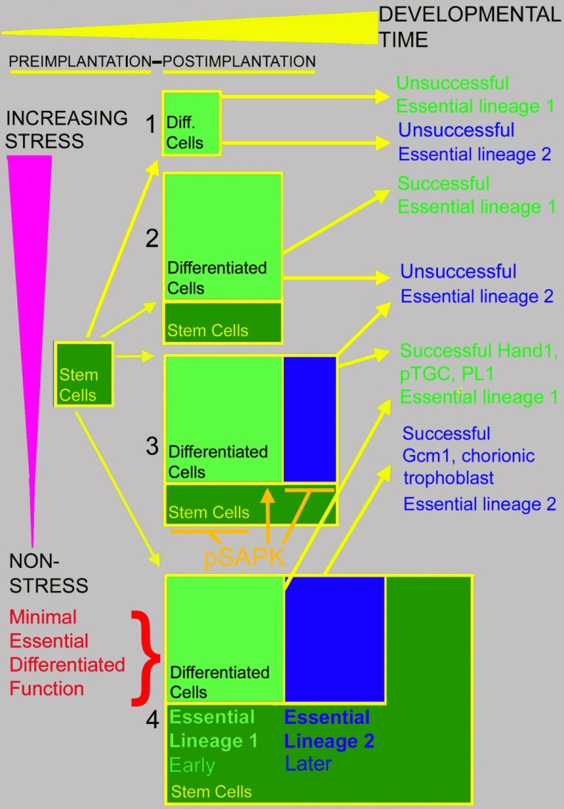


Puscheck et al, 2014, Molecular Biology of the Stress Response in the Early Embryo and its Stem Cells, Cell Signalling During Mammalian Early Embryo Development, Ed Leese.

