Slide 1


Utilization of microalgal-derived ash as a mineral reinforcement material in biocomposite formulation with poly(vinyl alcohol)
Biopolymers and Bioplastics, August 10-12, 2015 San Francisco, USA
TRAN DANG THUAN, Ph.D
Advanced Biomass R&D Center, Republic of Korea
Notes:
Cover

Slide 2
Contents
Introduction
Experimental
Characterization of materials
Properties of composite materials
Summary & conclusions
Notes:
Contents

Slide 3
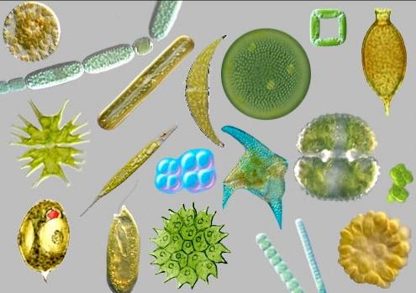

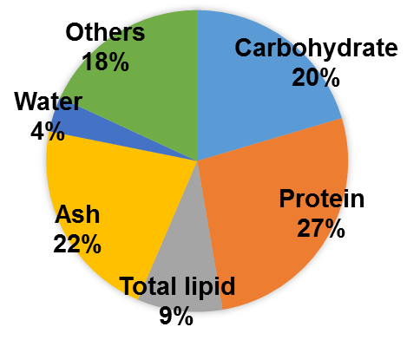
I. Introduction
Best Microalgae strain
Lipid Extraction
Biodiesel Production
Harvest
Cultivation
Best Microalgae strain
Lipid Extraction
Biodiesel Production
Cultivation
Harvest
Nannochloropsis salina
Lipid-extracted algal biomass (LEA)
(C, H, N, S, mineral element, etc.)
Element | Average (%) | STDEV
N | 5.63 | 0.01
C | 42.81 | 0.33
H | 6.25 | 0.06
S | 3.94 | 0.15
Chemical composition of LEA
Carbon-rich
material for
gasification

Slide 4
I. Introduction
Lipid-extracted algal biomass (LEA)
(C, H, N, S, mineral elements, etc.)
Potential filler for
composite fabrication
How to utilize it?
Gasification
Steam (CO, H₂, etc.)
Tar, Soot, Sulfer compounds
Ash (SiO₂, CaO, MgO, P₂O₅, SO₃, etc.)
Hirano A, Hon-Nami K, Kunito S, Hada M, Ogushi Y. Catal Today 1998;45(1–4):399–404.

Slide 5
II. Experimental
Lipid-extracted algal biomass (LEA)
(C, H, N, S, mineral elements, etc.)
Simple Gasification
Burning in a Furnance
(575 ºC, 3 hrs)
Raw ASH (RASH)
Activation
Characterization
Composite Fabrication

Slide 6
II. Experimental
RASH
NaOH 1N (10 g RASH/60 mL NaOH)
110 ºC, 400 rpm, 1 hrs
Hydro-chemical Activation
Filter & Wash until pH 7.0
Dry (105 ºC, 24 hrs)
PASH

Slide 7
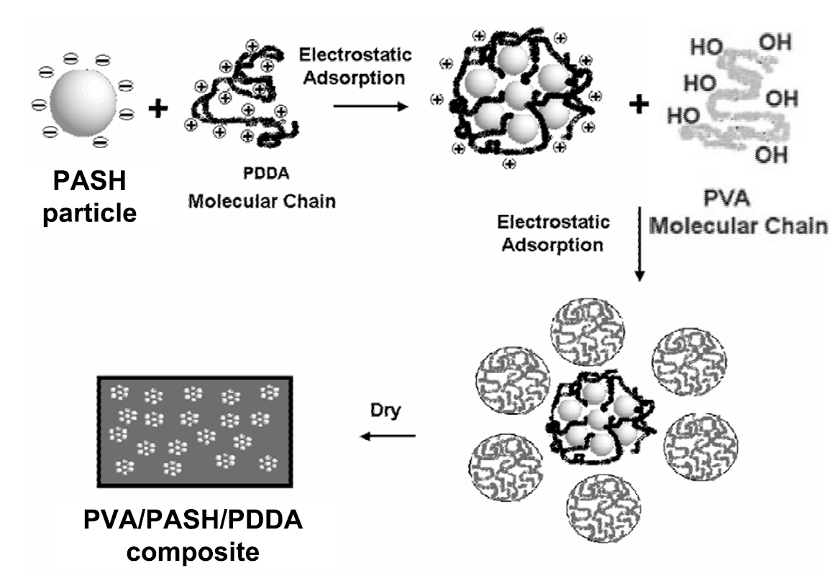
II. Experimental
PASH dispersed in H₂O
pH adjusted with NaOH 1N to 10
Poly(diallyldimethylammonium chloride) (PDDA)

Slide 8
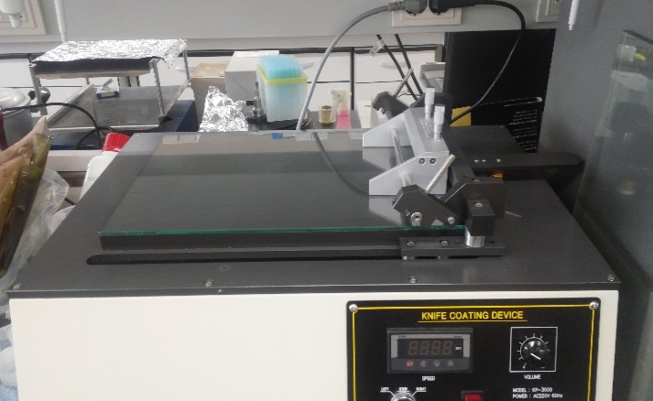
II. Experimental
1. Heating & stirring Solution
2. Casting
3. Ambient drying
Hot plate
Knife coating device
Composite films
Storage
(ASTM E104-02)
Saturated K₂CO₃, 25 ºC, RH = 43.2%
Mechanical properties
Thermal properties

Slide 9
III. Characterization of RASH and PASH
Chemical composition determined by XRF
RASH |  | PASH
Component | Proportion (wt%) | Component | Proportion (wt%)
B₂O₃ | 4.71 | C | 3.21
Na₂O | 1.86 | Na₂O | 2.39
MgO | 2.57 | MgO | 2.99
Al₂O₃ | 4.34 | Al₂O₃ | 4.96
SiO₂ | 24.40 | SiO₂ | 27.80
P₂O₅ | 13.20 | P₂O₅ | 17.10
SO₃ | 23.30 | SO₃ | 3.61
K₂O | 2.13 | K₂O | 0.96
CaO | 17.60 | CaO | 22.20
TiO₂ | 0.51 | TiO₂ | 0.60
MnO | 0.09 | MnO | 0.11
Fe₂O₃ | 4.45 | Fe₂O₃ | 4.64
ZnO | 0.53 | ZnO | 0.60
Others | 0.31 | Others | 8.83
Surface area (m²/g) | 4.8 | Surface area (m²/g) | 65.2

Slide 10
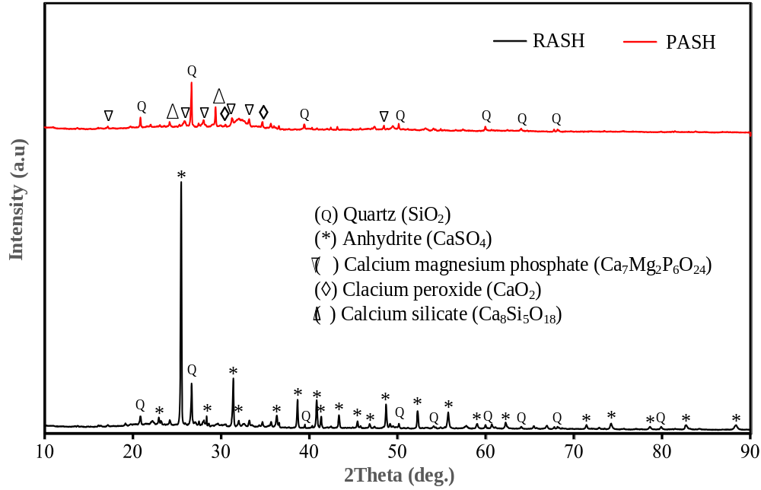
III. Characterization of RASH and PASH
Crystal composition determined by XRD

Slide 11
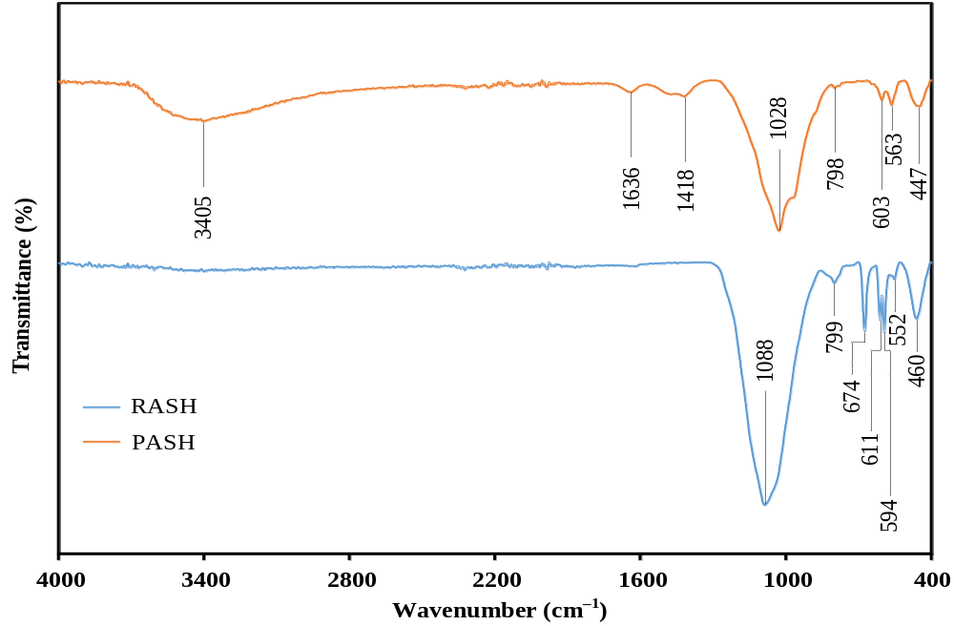
III. Characterization of RASH and PASH
IR spectra of RASH and ASH determined by FT-IR
C─O and/or C─H bonds in carbonates
O-H stretching
Si⁴⁺ in silicate Ca₈Si₅O₁₈
formation of relative larger interparticle pores
Si─O and Si─O─Al asymmetric stretching vibrations

Slide 12
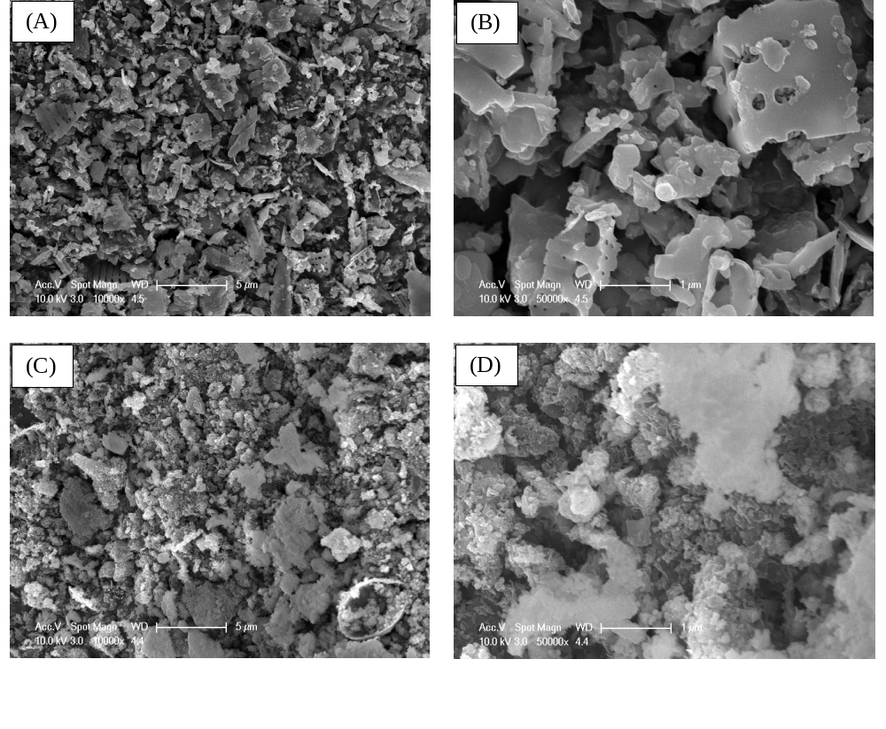
III. Characterization of RASH and PASH
FE-SEM micrographs of RASH and PASH
RASH
Platelet-like particles
with smooth surface
PASH
Particles with irregular
shape, rough, and craters
on its surface

Slide 13
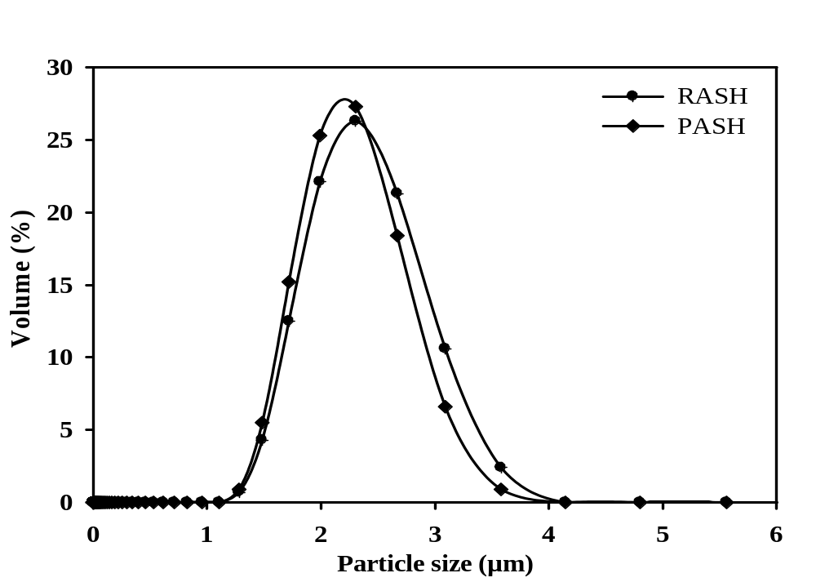
III. Characterization of RASH and PASH
Particle size distribution of RASH and PASH determined by DLS
Shifting of particle size distribution to left side

Slide 14
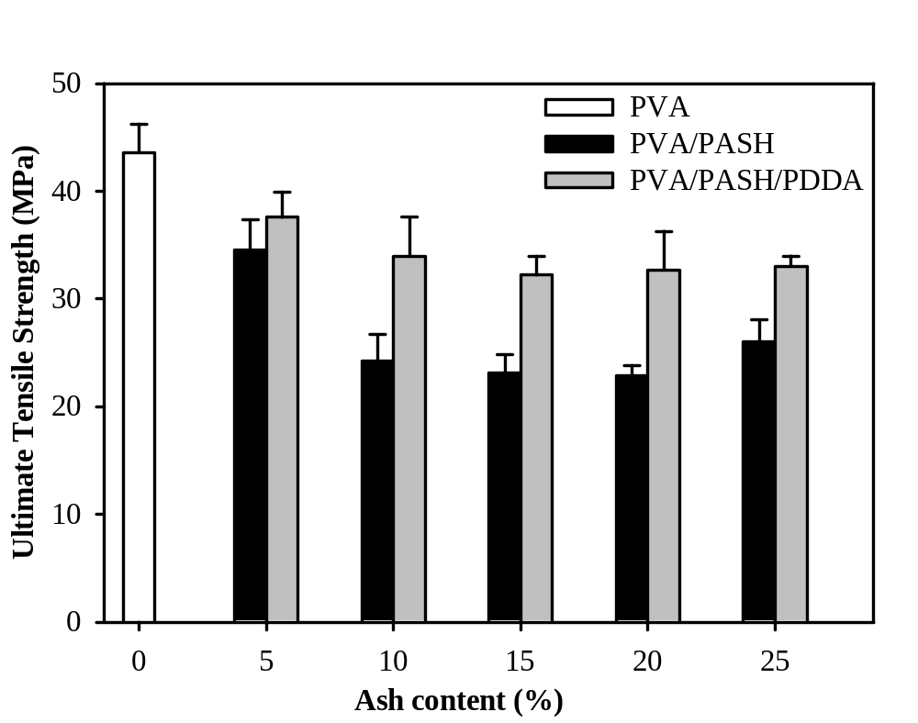
IV. Mechanical properties
UTSs of neat PVA, PVA/PASH, and PVA/PASH/PDDA composites

Slide 15
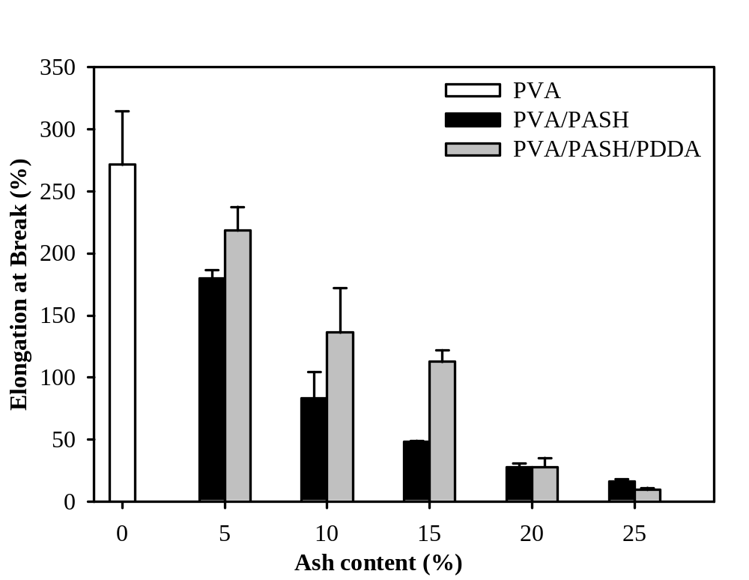
IV. Mechanical properties
EBs of neat PVA, PVA/PASH, and PVA/PASH/PDDA composites

Slide 16
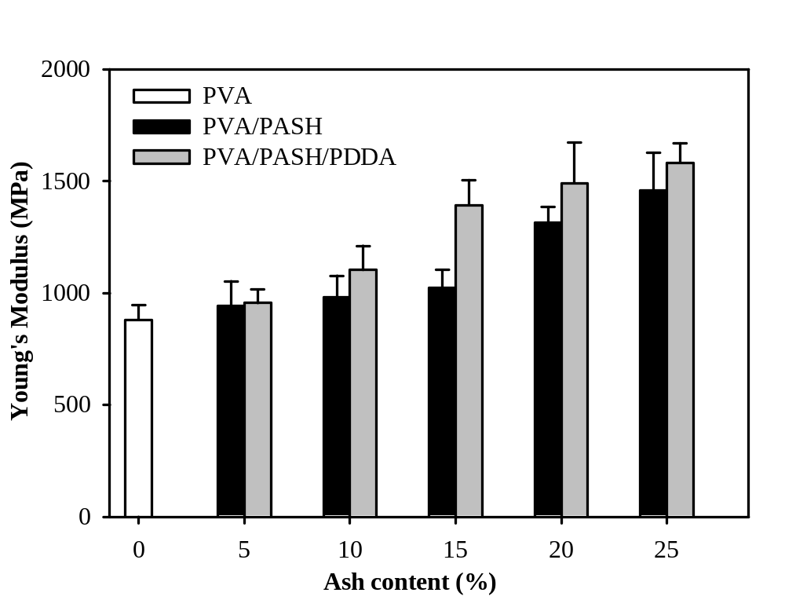
IV. Mechanical properties
YMs of neat PVA, PVA/PASH, and PVA/PASH/PDDA composites
~ 1.6 GPa

Slide 17
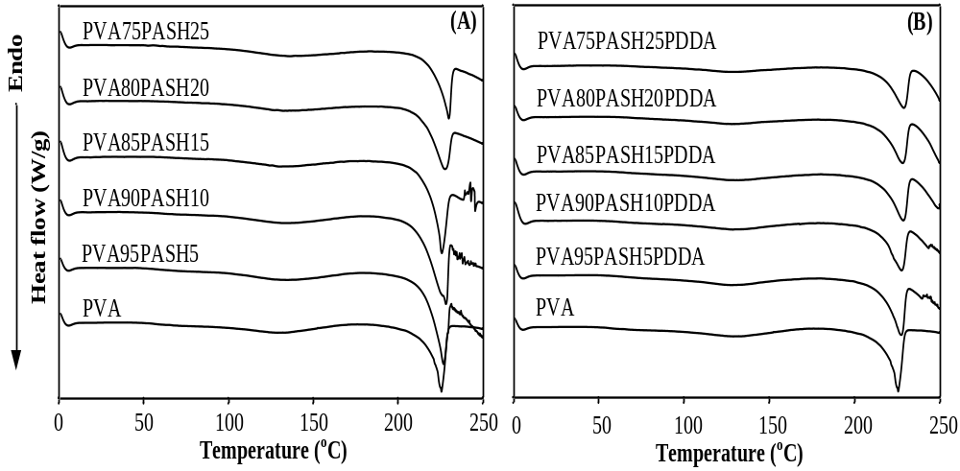
IV. Thermal properties
DSC thermograms of PVA, PVA/PASH and PVA/PASH/PDDA
T_{g}
T_{m}
T_{g}
T_{m}

Slide 18
IV. Thermal properties
Thermal properties of PVA, PVA/PASH and PVA/PASH/PDDA
Sample | T_{c} (ºC) | T_{m} (ºC) | ΔH_{m} (J/g) | ΔH_{f} (J/g) | Crystallinity (%)
PVA | 133.5 | 225.5 | 34 | 71.83 | 51.83
PVA95PASH5 | 134.4 | 226.7 | 36.41 | 49.94 | 37.93
PVA90PASH10 | 133.1 | 227.9 | 34.25 | 63.37 | 50.80
PVA85PASH15 | 130.5 | 225.6 | 28.83 | 50.56 | 42.92
PVA80PASH20 | 132.4 | 227.3 | 28.34 | 43.64 | 39.36
PVA75PASH25 | 135.7 | 229.8 | 32.15 | 38.60 | 37.13
PVA95PASH5PDDA | 127.7 | 227.1 | 30.67 | 52.12 | 39.58
PVA90PASH10PDDA | 128.6 | 227.3 | 28.51 | 47.63 | 38.18
PVA85PASH15PDDA | 131.8 | 228.3 | 28.76 | 53.20 | 45.49
PVA80PASH20PDDA | 127.9 | 227.9 | 24.75 | 51.55 | 46.49
PVA75PASH25PDDA | 127.0 | 228.6 | 24.64 | 49.14 | 47.27
T_{m}
Heat resistance improvement

Slide 19
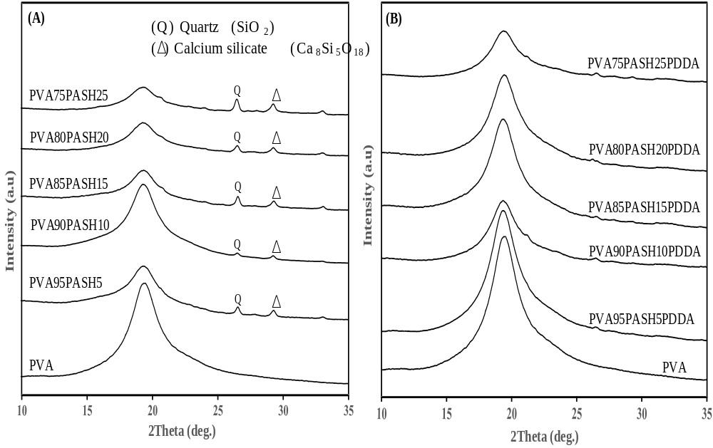
IV. XRD pattern analysis
Characteristics of semi-crystalline polymers

Slide 20
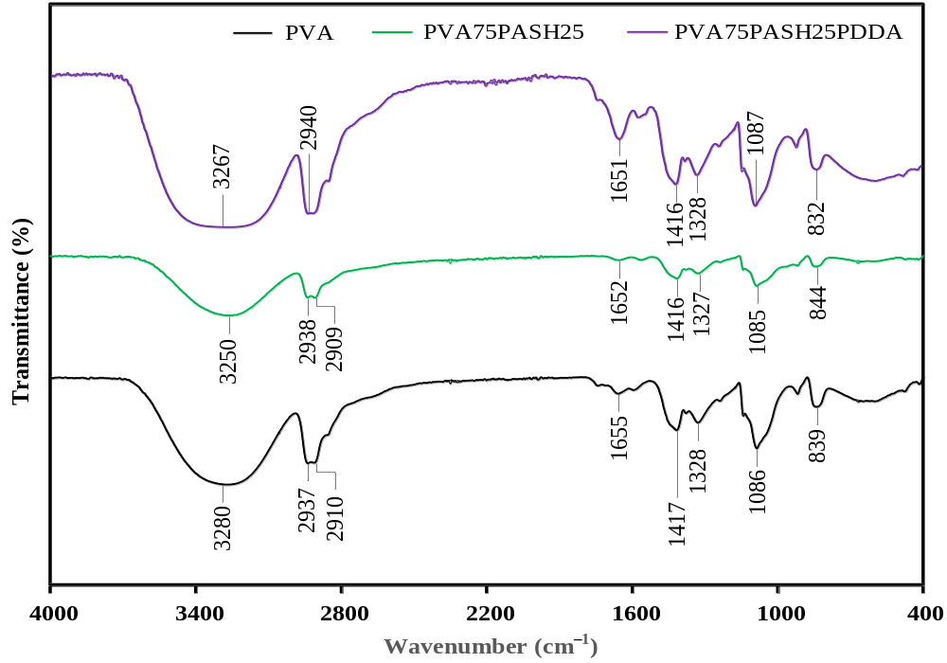
IV. IR spectra analysis
C=O and C─O stretching
O-H stretching
Shifting to lower wave number, and higher intensity

Slide 21
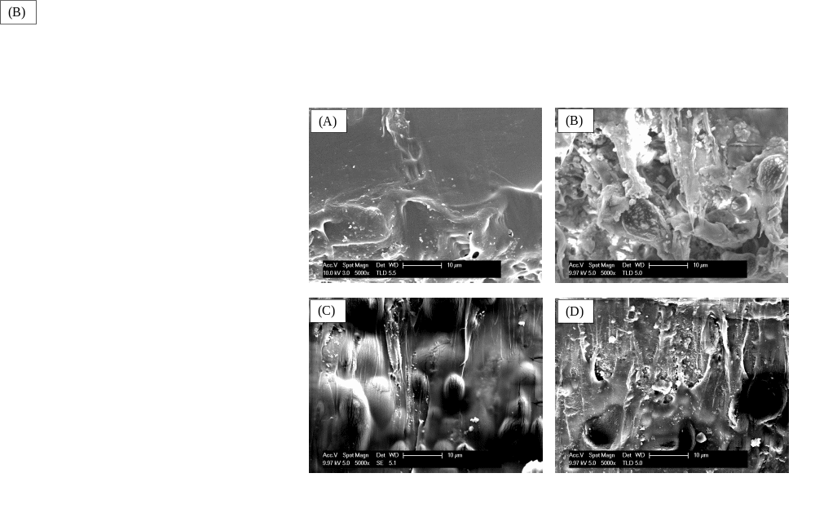
IV. Morphological analysis (SEM)
PVA95PASH5
PVA75PASH25
Partial full coverage
Abundance
interfacial voids
bridge-like connection
brittle failure, poor filler-matrix adhesion
PVA95PASH5PDDA
PVA75PASH25PDDA
Full coverage
Very little voids
better polymer-reinforcement adhesion

Slide 22
V. Summaries & Conclusions
Hydrochemical activation made RASH become PASH with smaller size, rough and crater surface, and high surface area
Better dispersion and adhesion of PASH in PVA was observed in presence of polycations (PDDA)
Result in higher tensile strength of PVA/PASH/PDDA compared to PVA/PASH composites at every loading of the filler
The process of pretreatment of RASH, utilization of PASH by composite formulation with PVA and polycation is easy and efficient, which can be integrated in downstream processing of microalgae-based biorefinery
Value-added composites produced from microalgal ash can partially improve economical feasibility of microalgal industry

Slide 23
Acknowledgements
This research was financially supported by the Advanced Biomass R&D Center (ABC) of Korea Grant funded by the Ministry of Science, ICT and Future Planning (ABC-2010-0029728).
Supervised supports from
  Prof. Ji-Won Yang (CBE, KAIST)
  Prof. Min S. Park (CBE, ABC, KAIST)
  Prof. Yong Keun Chang (CBE, ABC, KAIST)
Many helps from my student
  Hyun-Ro Lee (M.S., CBE, KAIST)

Slide 24
Thank you for your attention!

