Slide 1
Practice Management Structures: CEO and Physician Perspectives
Dana L. Jacoby, MBA

Slide 2


Research 2012-2015
BSM has been conducting studies specific to the business and operations of urology hospitals and groups for the past five years.
BSM has conducted on-site field visits, phone surveys, and one-on-one interviews with urology groups to identify areas of opportunity and best practices around operations, management structures, and consolidation strategies.

Slide 3
Management Structures Secret Sauce
  Strong synergies/communication between the physician lead and operations lead
  Culture conducive to alignment and collaboration
  A good balance between four elements: clinical, financial, operational, and vocational
  A sense of responsibility, accountability, transparency, and outcomes toward the management of the group
No matter what the practice model, these are the qualities that exist in “best practice” management models:

Slide 4
History and Evolution of the Large Urology Group Practice

Slide 5
Benefits of Consolidation
“Strength in numbers” for legal, regulatory, financial considerations
Group practice purchase decisions
Third-party payer and vendor negotiations
Streamlined patient care with integrated model
  “One-stop shop”; referrals may remain in-house
Overhead can be shared among “divisions” rather than covered by a few physicians

Slide 6
Drawbacks of Consolidation
Compensation, culture clashes, and c-suite creation
Clinical integration may be difficult
Belief systems of physicians and administrators are inconsistent across divisions
Many health systems and physician groups lack the ability to “move fast” with the upcoming changes in healthcare
Human resource and personnel issues

Slide 7
Creating Optimal Group Governance

Slide 8
Successful Group vs. Successful Physicians
There’s a world of difference between a successful medical group and a group of successful physicians
Collaboration
Bound by common vision, mission, and purpose
Accountability to the group
Integration and/or interdependence
vs.
Collegiality
Bound by professional background
You do what you want and I do what I want
Autonomy and independence

Slide 9
Emerging Business Models in Healthcare:
  Volume to value pay structure, outcomes, protocols
  Doctors will be required to work more closely and collaboratively than ever before
  There will have to be stronger emphasis on coordination of care across the continuum
  Continuous pressure on utilization and price
  Improved IT connectivity between doctors, patients, hospitals
  Increasing prevalence of population health management and risk-based contracting
Emerging business models demand a higher degree of physician alignment:

Slide 10
Creating a Successful Coordinated System of Care
  Develop a plan that supports their group’s strategic goals. Create rigor around integration and alignment.
  Physicians and Healthcare leaders must participate and lead planning governance processes
  Physician plan must be integrated with the organization’s overall strategic plan
  Detailed strategic and financial projections must exist to ensure the availability of capital
  Service line offerings, facilities, technology, and other resources must be aligned
  Quality, efficiency, growth, access, and patient satisfaction must be benchmarked
To be successful urology groups and health systems must learn to:

Slide 11
Building a Collaborative Enterprise
According to Harvard Business Review article, “Building a Collaborative Enterprise”, authors Paul Adler, Charles Heckscher and Laurence Prusak list four key areas for developing a culture based on trust and teamwork:
A shared purpose
An ethic of contribution
1
2
The institution of independent processes
The creation of a collaborative infrastructure
3
4
Source:Adler, P., Heckscher C., Building a Collaborative Enterprise, 2011 http://hbr.org/2011/07/building-a-collaborative-enterprise/ar/1
Notes:
Adler, P., Heckscher C., Building a Collaborative Enterprise, 2011 http://hbr.org/2011/07/building-a-collaborative-enterprise/ar/1

Slide 12

Critical Factors for Optimal Performance:
One of the most important factors in developing a sustainable business model is an investment in the creation of a mutual identity with a shared mission, vision, and values.
In the case of groups contemplating a merger, these discussions should take place prior to going through the time, trouble, and expense of completing the transaction. Unfortunately, this step is frequently overlooked by group leaders as they fixate on imminent legal, financial, and operational considerations.

Slide 13
MD Survey: Insight into Gap Analysis of Culture/Collaboration
Partner Survey | Rating Scale
Urology Group XYZ has developed a shared vision, mission, values that is supported by its strategy and processes. | 1 | 2 | 3 | 4 | 5
Physician and Board leadership are balanced and effective. | 1 | 2 | 3 | 4 | 5
A strong, respected physician leader(s) is in place to drive mission-critical decision-making. | 1 | 2 | 3 | 4 | 5
Transparency and accountability exist throughout the group and is exhibited throughout day-to-day operations. | 1 | 2 | 3 | 4 | 5
There is a process to achieve economic and clinical goals through collaboration and integration. | 1 | 2 | 3 | 4 | 5
Financial incentives are aligned with group values and drive the right behavior for group mission, vision, values. | 1 | 2 | 3 | 4 | 5
Variation in group practice patterns, quality and operational performance measures are minimal. | 1 | 2 | 3 | 4 | 5

Slide 14
MD Survey: Insight into Gap Analysis of Culture/Collaboration
Partner Survey | Rating Scale
Partner excellence is rewarded appropriately by group leadership. | 1 | 2 | 3 | 4 | 5
Incentives are aligned appropriately for quality, patient satisfaction, and citizenship. | 1 | 2 | 3 | 4 | 5
There is a process in place to address rogue or isolated partners who do not 'fit' the partner excellence structure. | 1 | 2 | 3 | 4 | 5
There is a process in place to drive collaborative planning and decision making. | 1 | 2 | 3 | 4 | 5
Communication across the group is fluid, honest, and open. | 1 | 2 | 3 | 4 | 5
There is a culture of accountability for leadership, MDs and staff. | 1 | 2 | 3 | 4 | 5

Slide 15
Key Success Factors
Key success factors with effective group governance include, but are not limited to:
Governing documents with clear lines of authority and decision making criteria.
Effective delegation from the Board to several functional operating committees. Each committee should have its’ own charter and guiding principles.
Accountability from each operating committee to the Board for regular communications including status reports on key committee initiatives.
Board commitment to providing resources and support to develop the business skills and strengths of the leadership team.
A well-thought out succession plan focused on developing a leadership “bench” that will insure long-term stability in leadership and management of the practice.
Board commitment to a formal strategic planning process that will bring continued focus on the company’s vision, mission, core values, strategies, and tactics.

Slide 16
Strong Leadership: A Key to Successful Healthcare Management
As mentioned, having a strong, visionary leader or leaders is one of the biggest defining factors of successful urology group practices. Effective leaders should have the following qualities:
1
2
3
4
5
Adhere to influential and authoritative, but benevolent leadership principles.
Motivate, inspire, and influence physicians and staff.
Own conflict resolution management and work effectively toward successful outcomes with administrative personnel.
Innovate toward strategies for creation of best practices and optimal group efforts.
Focus on improving health care outcomes.
6
7
8
9
Focus on providing opportunities for employee development while attaining financial and operational results.
Develop leadership opportunities for other members of the team and find creative solutions to short and long-term challenges.
Develop confident, principled and ethical ways to approach their job responsibilities.
Garner the respect of leadership, physicians, and staff.

Slide 17

Compensation Structures Must Be Clear and Comprehensive
The keys to success in designing a compensation structure include:
Align the plan with the group’s vision and values.
Recognize individual differences in production and resource consumption.
Promote transparency and accountability and as such, encourage shareholders to continually strive for improvement in patient care and practice efficiency.
Share the risk and benefit of investments made in passive income sources such as an ambulatory surgical center and employed non-owner providers.
Avoid making the plan too complicated to administer or requiring continuous tweaks to satisfy individual shareholder requests.

Slide 18


Model #1: Productivity with Shared Resource Allocation
There are two primary compensation models most often seen in urology group practices.
The first model is one where revenue from all sources is pooled, overhead is paid “off the top” and profits are shared between the owners.
With this type of model there is some variability among groups in terms of how the net profits are shared. In most instances, some agreed upon percentage of net income is shared equally with the remainder allocated based on the individual production of the shareholders. In most instances, production is measured based on net collections (gross receipts minus patient refunds). The work component of Medicare Relative Value Units (RVUs) traditionally is used as a measure of productivity.

Slide 19
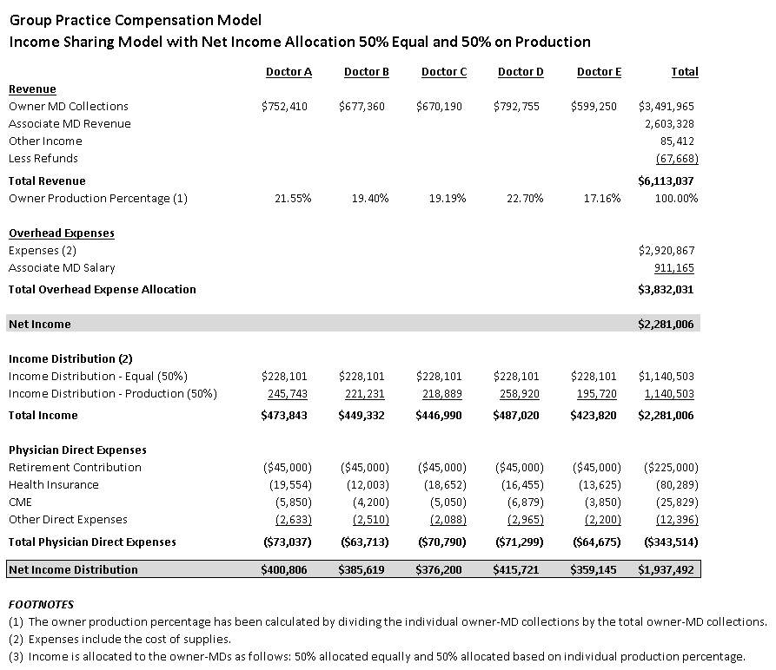

Slide 20

Model #2: Productivity-Based Model
The second approach to compensation commonly found in urology group practices is a more “individualistic” approach where revenue is allocated to individual shareholders and overhead expenses are assigned based on an agreed upon formula. In these models, there are several categories of overhead expense including direct overhead, shared and non-shared expenses.
Direct expenses would include the items noted above and relate directly to the production of revenue. Shared expenses include the general and administrative expenses associated with operating the practice. Non-shared overhead items include the physician direct expenses noted above and are generally allocated by individual shareholder.

Slide 21
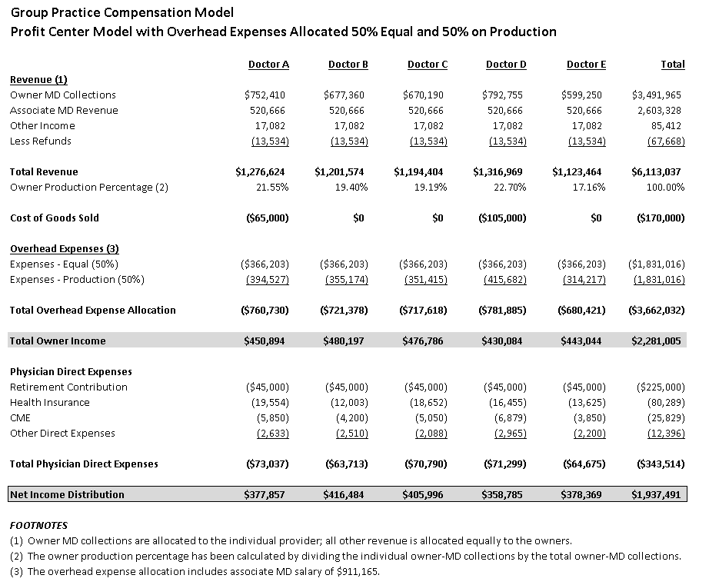

Slide 22
THANK YOU

