Slide 1


The Sackler Faculty of Medicine
Dr. Miriam and Sheldon G. Aldeson Graduate School of Medicine
Department of Clinical Microbiology and Immunology
Tel Aviv University
Feverlike Temperature is a Virulence Regulatory Cue Controlling the Motility and Host Cell Entry of Typhoidal Salmonella
Dana S. Elhadad, PhD candidate
Infectious Disease Unit
Sheba Medical Center
Advisors: Dr. Ohad Gal-Mor
Prof. Galia Rahav

Slide 2
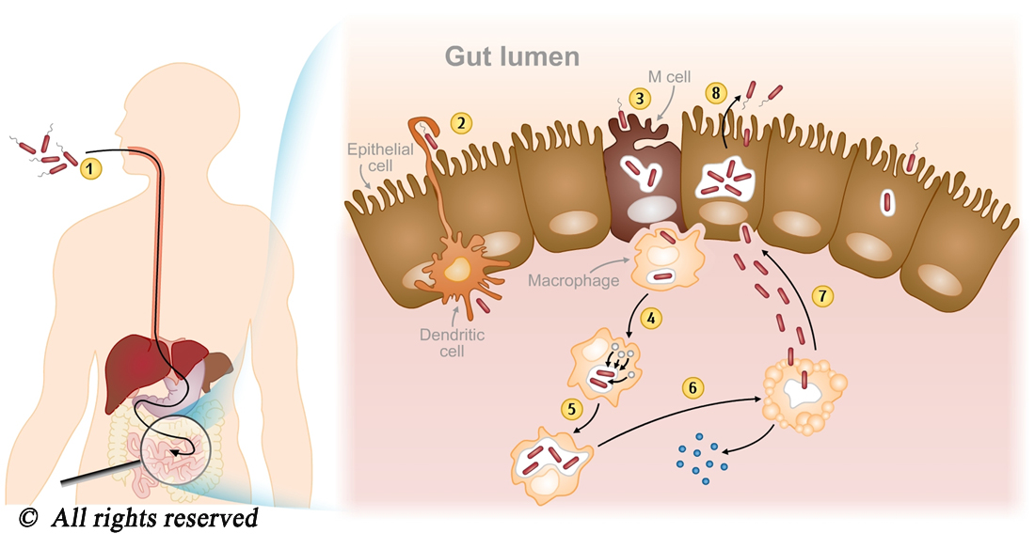
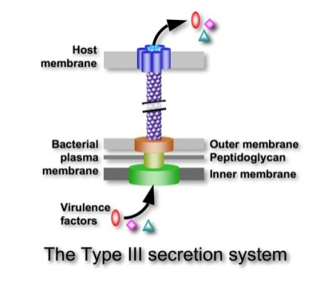
Salmonella Taxonomy : the family Enterobacteriaceae
    Gram-negative
    Facultative intracellular
Fecal-Oral Route
Possesses two classical T3SSs : Salmonella pathogenicity island 1 (SPI-1) and 2 (SPI-2)
Predominantly flagellated

Slide 3

Salmonella Taxonomy : the family Enterobacteriaceae
Different degree of host adaptation:
Host generalist :
S. Typhimurium
S. Enteritidis
Host restricted :
S. Sendai, S. Typhi
and S. Paratyphi A
VS.
Non-Typhoidal Serovars: Gastroenteritis
Localized
Short incubation period
Brief duration
Symptoms :
Diarrhea
Nausea
Typhoidal serovars:
Enteric Fever
Systemic
Long incubation period
Long duration
Symptoms:
Fever
Generalized pain
Gal-Mor, Ohad, Erin C. Boyle, and Guntram A. Grassl. "Same species, different diseases: how and why typhoidal and non-typhoidal Salmonella enterica serovars differ." Frontiers in microbiology 5 (2014).

Slide 4
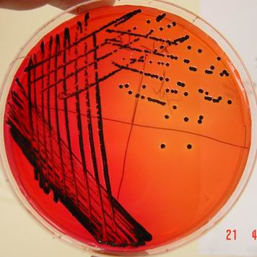
Typhoid Fever and Public Health
Global annual estimation of over 25 million cases, resulting in more than 200,000 deaths
Increasing rates of S. Paratyphi A infections
Lack of a commercially available vaccine
Steadily increasing resistance to antibiotics
S. Paratyphi A infections are a growing and significant public health concern
Gal-Mor, O., Suez, J., Elhadad, D., Porwollik, S., Leshem, E., Valinsky, L., & Rahav, G. (2012). Molecular and cellular characterization of a Salmonella enterica serovar Paratyphi A outbreak strain and the human immune response to infection. Clinical and Vaccine Immunology, 19(2), 146-156.

Slide 5
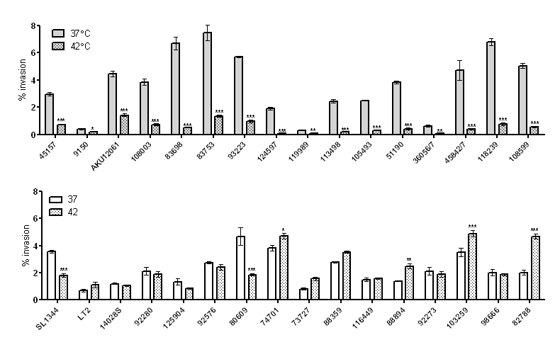
Host Cell Entry by Salmonella at Fever Temperature
Typhoidal serovar :
S. Paratyphi A
NTS serovar:
S. Typhimurium
S. Paratyphi A invasion is significantly affected by elevated temperatures
Elhadad, D., McClelland, M., Rahav, G., & Gal-Mor, O. (2014). Feverlike Temperature is a Virulence Regulatory Cue Controlling the Motility and Host Cell Entry of Typhoidal Salmonella. Journal of Infectious Diseases, jiu663.

Slide 6
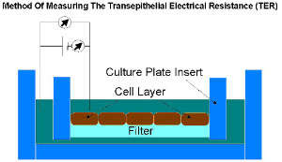
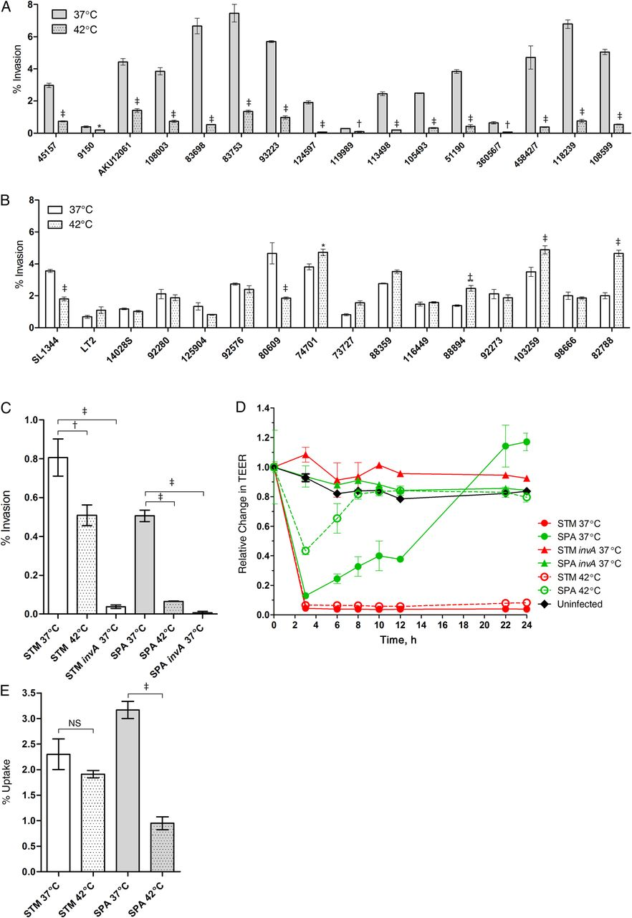
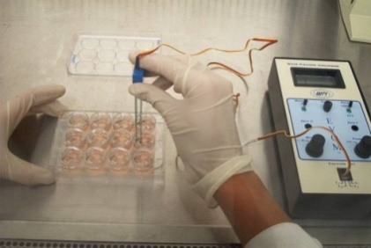
Transepithelial Electrical Resistance (TEER) of Caco-2 cells Following Salmonella Invasion
Elevated temperature affects S. Paratyphi A ability to disrupt epithelial monolayer integrity

Slide 7
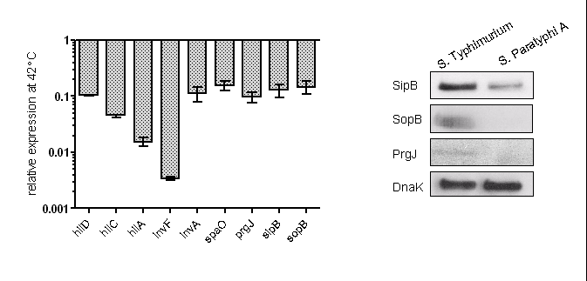
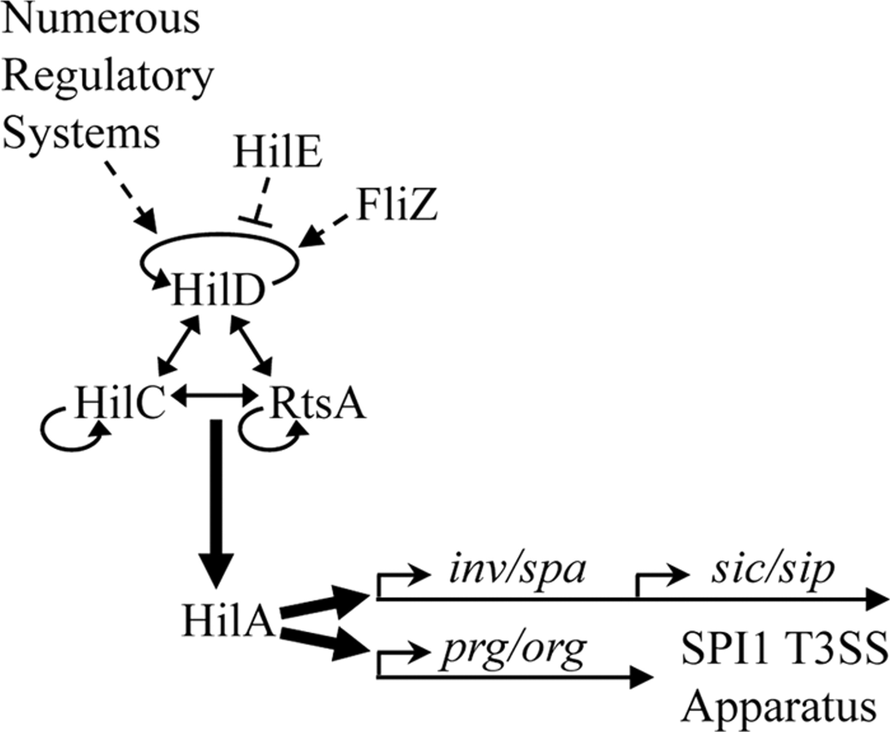
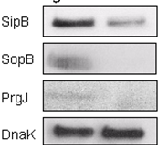
SPI-1 Expression Under Fever-like Temperatures
STM
SL1344
SPA
45157
Regulators
Structural
Effector
SPI-1 expression is significantly lower at 42°C in S. Paratyphi A relative to S. Typhimurium

Slide 8

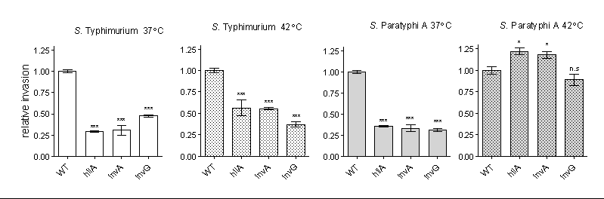
SPI-1 Mediated Invasion Under Fever-like Temperatures
STM SL1344 37°C
STM SL1344 42°C
SPA 45157 37°C
SPA 45157 42°C
The impaired invasion of S. Paratyphi A at the fever temperature occurs in a TTSS-1-independent manner

Slide 9
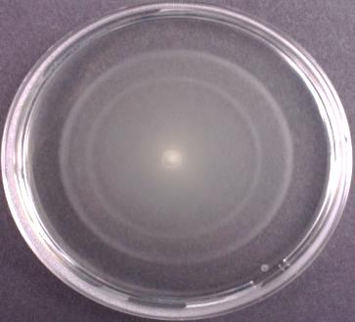
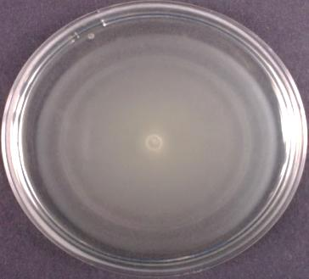
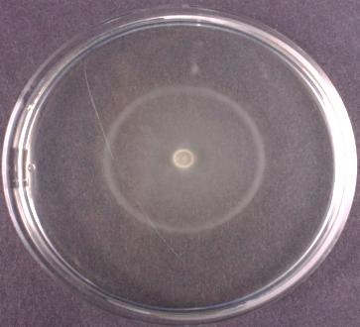
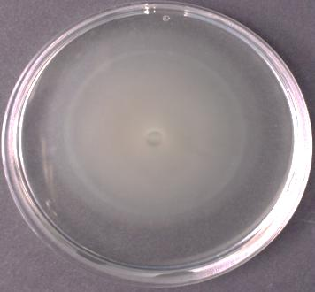
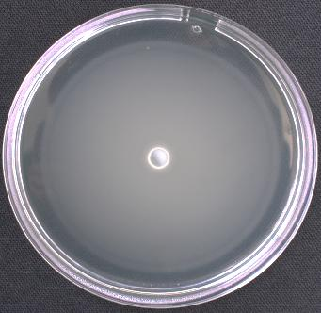
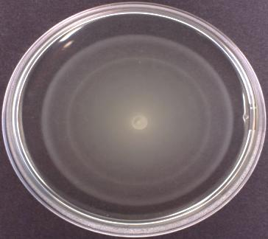
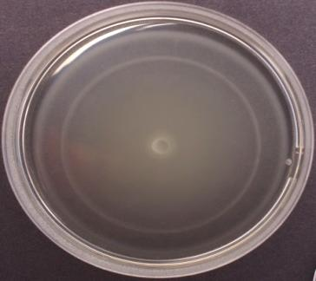
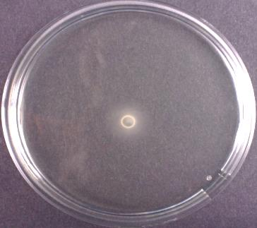
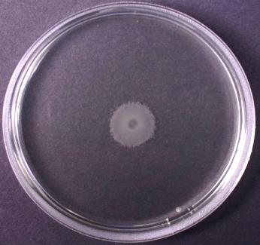
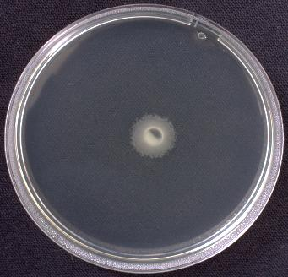
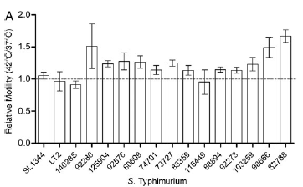
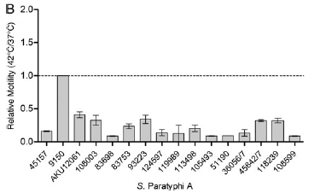
Thermoregulated motility : 0.3% agar swim plates
NTS serovars
Typhoidal serovars
S. Typhimurium
S. Enterititis
S. Paratyphi A
S. Typhi
S. Sendai
37°c
42°c

Slide 10
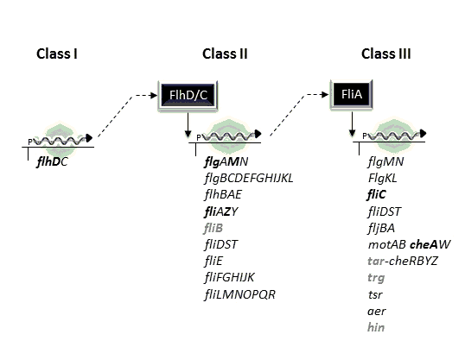
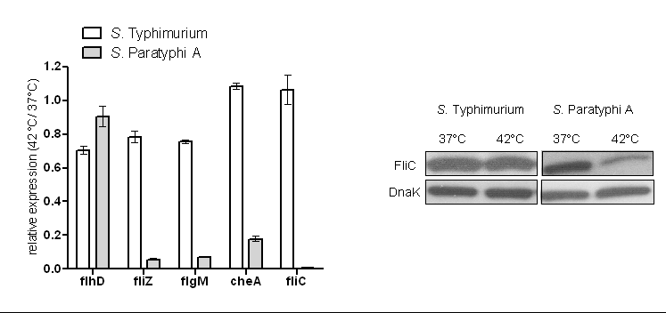
Thermoregulated motility : 0.3% agar swim plates
STM SL1344
SPA 45157
STM SL1344
SPA 45157
STM SL1344
SPA 45157
Class
I
II
III
Specifically class II and III genes of the flagella/ chemotaxis regulon in S. Paratyphi A, but not in S. Typhimurium are down-regulated at 42°C

Slide 11
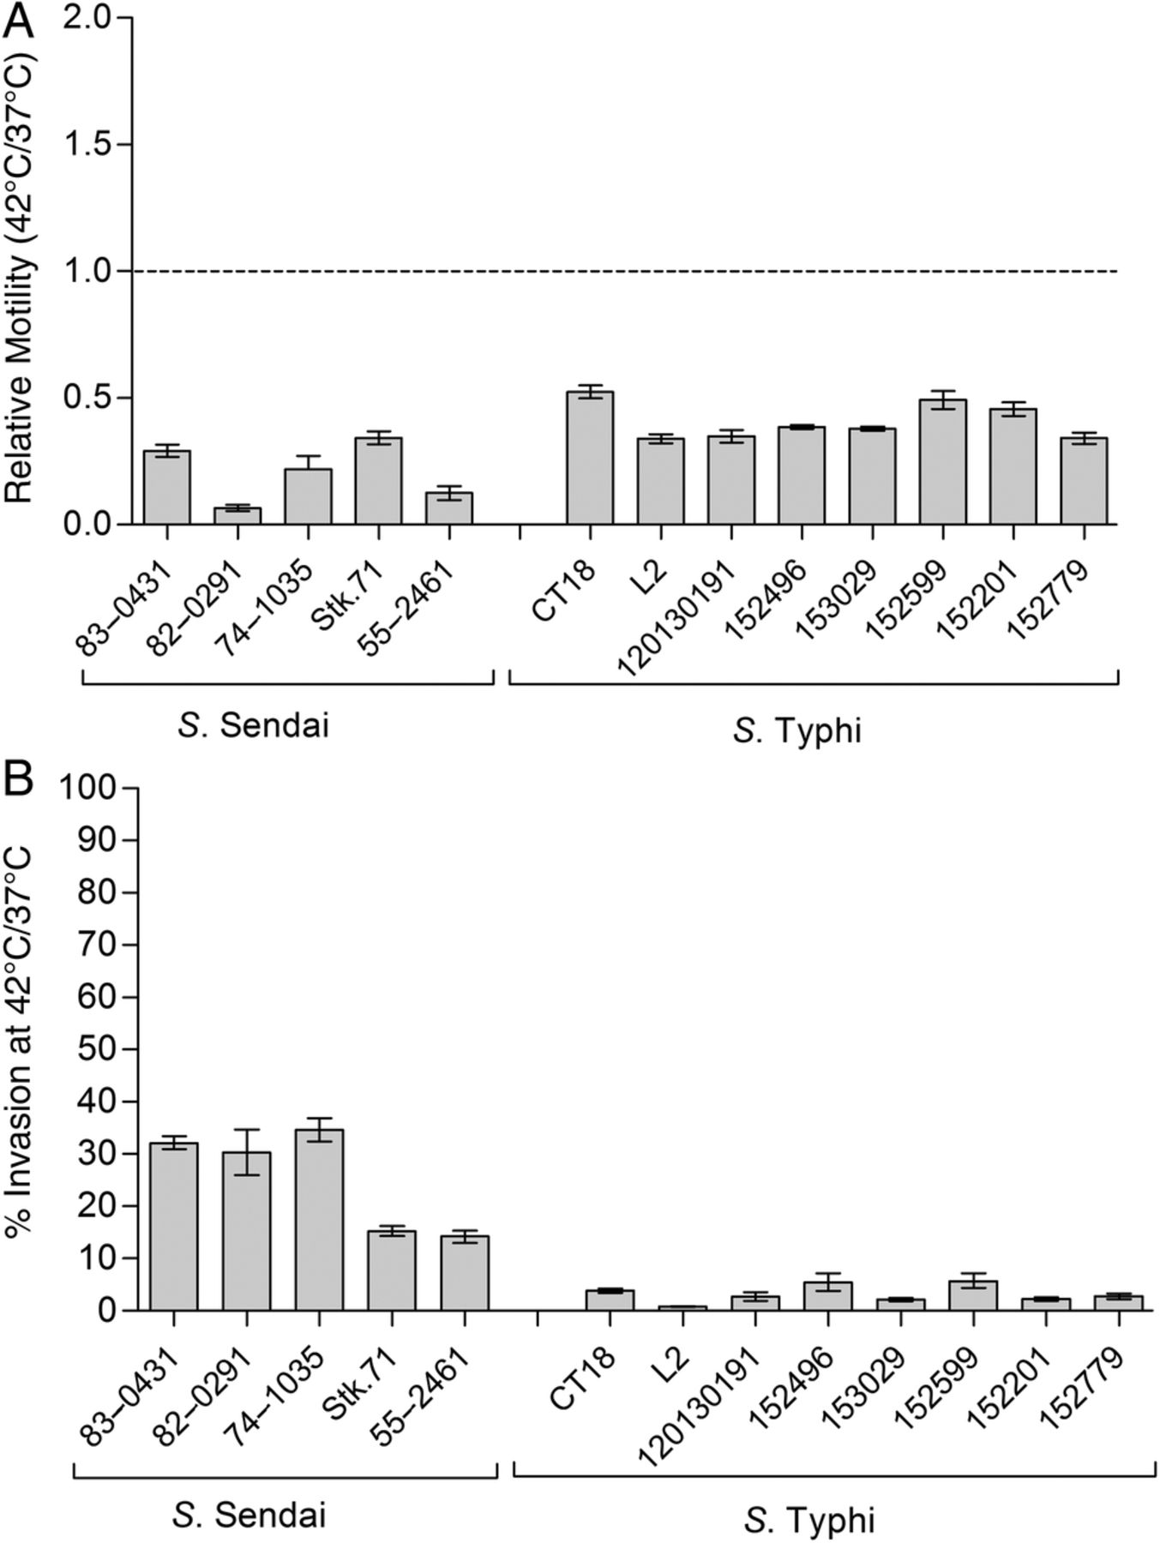
Motility and Invasion at Fever Temperature of Typhoidal Serovars
Impaired motility and invasion at fever temperature are common to typhoidal serovars

Slide 12
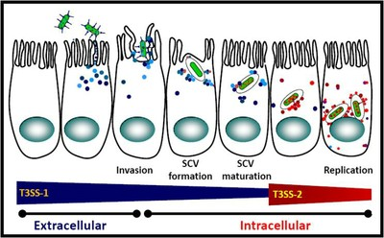
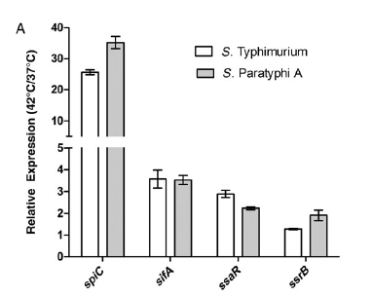
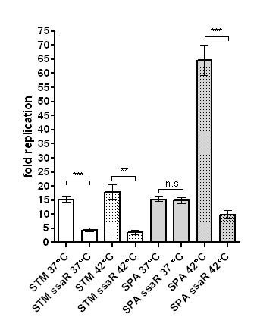
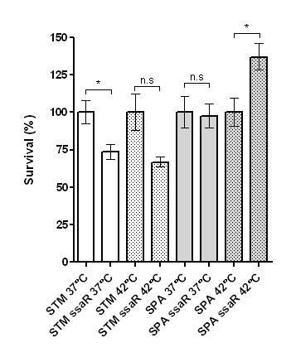
Effect of Elevated Temperatures on SPI-2 Expression
Caco2
THP-1
STM SL1344
SPA 45157
Up-regulation (2–40-fold) in the expression of SPI-2 genes at the elevated temperature, in both S. Typhimurium and S. Paratyphi A
Increased intraepithelial replication of S. Paratyphi A

Slide 13
Conclusions
Epithelial cell invasion by S. Paratyphi A is impaired at 42°C
The invasion of S. Paratyphi A at 42 °C is T3SS-1-independent
S. Paratyphi A motility is impaired at 42°C
The class II and III of the flagella/ chemotaxis regulon is down-regulated in S. Paratyphi A at 42°C
Impaired motility and invasion at elevated temperatures is common to all human-adapted Salmonella serovars
Our results suggest that the clinical symptom of fever is used by typhoidal serovars as a key environmental cue affecting host-pathogen interaction during infection
Notes:
We hypothesize that this cue may signal the pathogen to switch from the initial invasive stage of the infection (SPI-1 and motility-dependent) to the later persistent phase.
It is possible that reducing invasion, uptake by phagocytic cells and motility at a later stage of the infection facilitates the persistence of the pathogen in niches such as the gallbladder epithelium [21, 22] and lessens repetitive cycles of reseeding from the gut back to systemic sites.
An additional possible benefit from such a thermoregulated response might be limiting the number of organisms crossing epithelial tissues to the lymphatic system in order to control bacterial load in the blood, avoid sepsis and consequently host death.
Indeed, typhoidal serovars are rarely associated with septic shock, in contrast to many other Gram-negative pathogens [23].

Slide 14
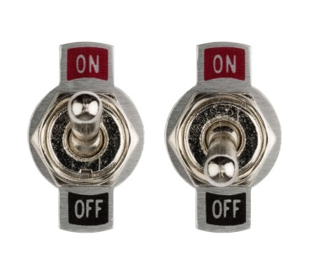
Conclusions
Epithelial cell invasion by S. Paratyphi A is impaired at 42°C
The invasion of S. Paratyphi A at 42 °C is T3SS-1-independent
S. Paratyphi A motility is impaired at 42°C
The class II and III of the flagella/ chemotaxis regulon is down-regulated in S. Paratyphi A at 42°C
Impaired motility and invasion at elevated temperatures is common to all human-adapted Salmonella serovars
Fever
Initial invasive stage of the infection
required to reach deeper tissue
Persistent phase
lessens repetitive cycles of reseeding
Control bacterial load in the blood, avoid sepsis and host death
Notes:
We hypothesize that this cue may signal the pathogen to switch from the initial invasive stage of the infection (SPI-1 and motility-dependent) to the later persistent phase.
It is possible that reducing invasion, uptake by phagocytic cells and motility at a later stage of the infection facilitates the persistence of the pathogen in niches such as the gallbladder epithelium [21, 22] and lessens repetitive cycles of reseeding from the gut back to systemic sites.
An additional possible benefit from such a thermoregulated response might be limiting the number of organisms crossing epithelial tissues to the lymphatic system in order to control bacterial load in the blood, avoid sepsis and consequently host death.
Indeed, typhoidal serovars are rarely associated with septic shock, in contrast to many other Gram-negative pathogens [23].

Slide 15


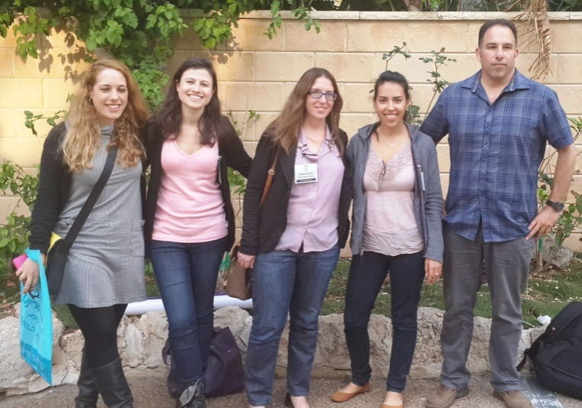
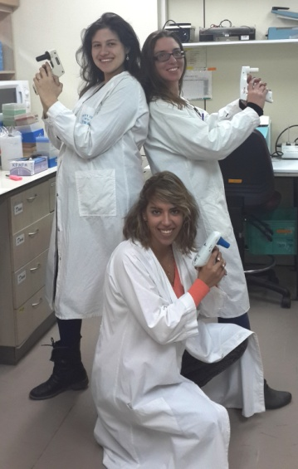
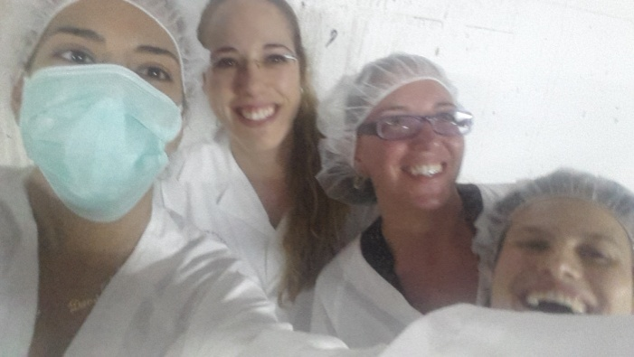
Acknowledgements
The Infectious Diseases Laboratory Tel-Hashomer
Advisors :
Dr. Ohad Gal-Mor
Prof. Galia Rahav
Lab Members :

Slide 16
The most exciting phrase to hear in science, the one that heralds new discoveries, is not “Eureka” but “That's funny...”
—Isaac Asimov (1920–1992)

