Slide 1



Role of pharmacists in children’s health education, Alexandria, Egypt
Dalia Yehia AboZahra
Assistant Lecturer, Faculty of Pharmacy, Pharos University, Alexandria, Egypt
Fatema EL-Amrawy
Ministry of Health, Alexandria, Egypt

Slide 2
Agenda
Background.
Pharmacist role in public health.
Why Children?
Our Campaigns.
Our Results.
Conclusion.
Recommendations.

Slide 3
Background

Slide 4
Public health refers to all organized measures (whether public or private) to prevent disease, promote health, and prolong life among the population as a whole.
Its activities aim to provide conditions in which people can be healthy and focus on entire populations, not on individual patients or diseases.
(World Health Organization)

Slide 5
Public health professionals monitor and diagnose the health concerns of entire communities and promote healthy practices and behaviours to ensure that populations stay healthy.

Slide 6
Pharmacist Role in Public Health

Slide 7
Health Education
Health education is any combination of learning experiences designed to help individuals and communities improve their health, by increasing their knowledge or influencing their attitudes

Slide 8
Health education
Primary prevention includes measures taken to either eliminate patients’ risk factors or increase their resistance to disease.
Pharmacists can educate their patients about interventions that require no treatment, such as changes in lifestyle, nutrition, and their environment.

Slide 9
The expanded role of pharmacists will position them to have greater impact in the shifting landscape of health care and public health.
Beyond the dispensing of medications, pharmacists also provide a spectrum of prevention services to help improve health outcomes.

Slide 10
Pharmacists who are trained to recognize and properly communicate with a patient who has low health literacy will positively impact public health through improved population health outcomes and, ultimately, decreases in mortality and healthcare costs.

Slide 11
Pharmacists can bridge communication gaps that exist as a result of cultural differences and health literacy disparities among public.
Pharmacists can help bridge the health-disparities gap by addressing medication adherence and lifestyle modifications, specifically with patients who have chronic diseases.

Slide 12
About us:
Association of Applying and Developing Pharmacy (AADP) is a pharmacy profession specialized nonprofit NGO located at Alexandria, Egypt.
Our Vision:
To be the lead NGO in Egypt and MENA that is specialized in pharmacy profession development.

Slide 13
Our Mission:
Improvement and development of pharmacy profession through bridging the gap between current state of pharmacy education and the real-life pharmacy practice and ensuring better patients health through activation of pharmacist role in patient education.

Slide 14
To achieve our mission we have launched many programs serving three main target populations:
Community.
Undergraduate pharmacy students
Graduate pharmacists.
We are working mainly in Alexandria with few activities done at other governorates like Cairo, Baihaira and Minia where we have contact persons helping us in making some events there.

Slide 15
Public Health Promotion Programs:
  Know Your Medicine.
  Pilgrims with Better Health.
  Protect Your Child.

Slide 16
  1. Know Your Medicine:
  Patient education sessions about disease and medication; eg, diabetes and hypertension.
  In specific occasions like Ramadan, Al Adha Feast, where nutritional changes occurs.
  For elderly in geriatric homes where poly pharmacy exists.

Slide 17
2.Pilgrims with Better Health
  Health education events during Hajj and Umrah seasons for medications and health instruction during pilgrimage.

Slide 18
3.Protect Your Child
Protect your child is a partnership between Association of Applying and Developing Pharmacy (AADP) and Healthy Egyptians.
Healthy Egyptians is an Egyptian Non-Governmental Organization (NGO)
Its vision is: A population of healthy Egyptians empowered with health education to make healthier choices in life, have a
better quality of life and become more productive in the community.

Slide 19
Protect Your Child is committed to fight the lack of health education in Egypt.
This is done through the dissemination of health education in innovative ways to the different strata of the community with the help of dedicated and enthusiastic young volunteers.

Slide 20
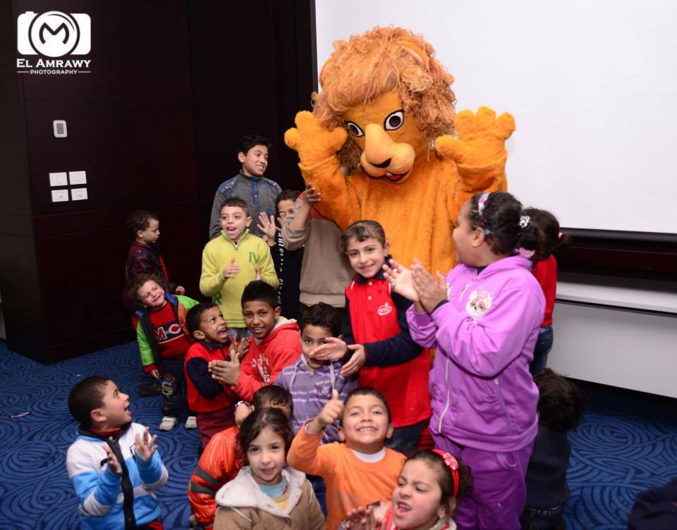
Why children?

Slide 21
Early years represents a window of intervention to encourage healthy growth and development for infants and children.
Children are among the vulnerable groups in the community who have great impact on their families.
Healthy behaviors can be modified easily in children.
Lacking of a comprehensive health education program in our schools necessitates the pharmacists’ participation in health education for children as a part of their role in public health.

Slide 22
Health education builds students' knowledge and positive attitudes about health which helps students learn skills they will use to make healthy choices throughout their lifetime.

Slide 23
Tell me and I forget,
Teach me and I may remember,
Involve me and I learn.
Benjamin Franklin

Slide 24
On going campaigns for child health:
Montaser Overcomes Pneumonia.
Montaser Overcomes Anemia.
Hand washing workshops.
Healthy nutrition basics.
Parents program for child health.

Slide 25
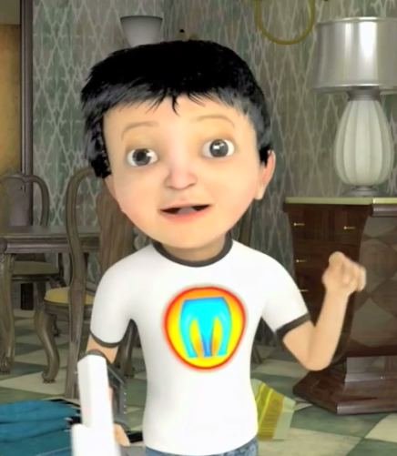
Montasser Overcomes
A story called Montasser Overcomes has been
created by Healthy Egyptians.
In this story, Montasser (an Arabic name for Victor) is a young Arabic boy who either contracts a disease or one of his friends does
during the journey of the story, the readers get educated about the signs, symptoms, treatment, risk factors and prevention of the disease.

Slide 26
The story has been transformed into coloring comic books, 3D cartoon movie, a puppet show.

Slide 27
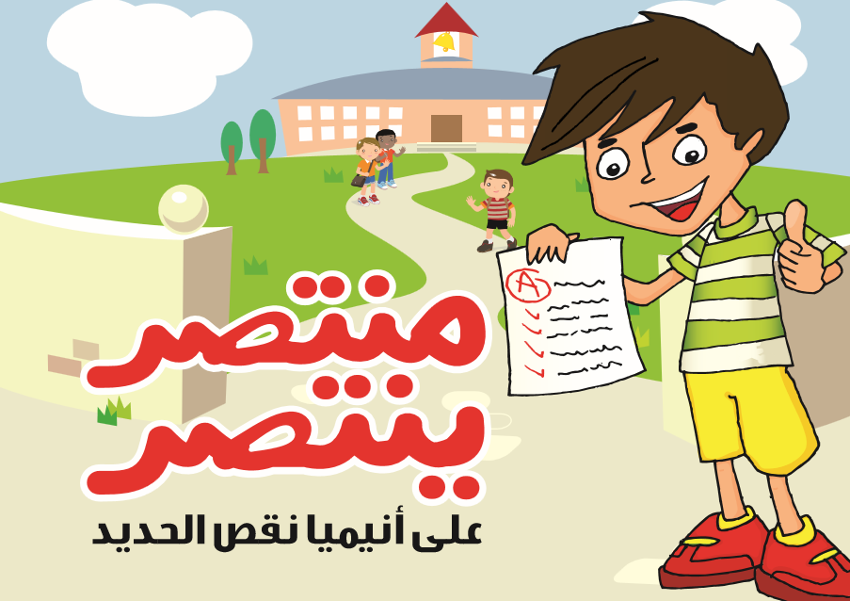

Slide 28


Slide 29
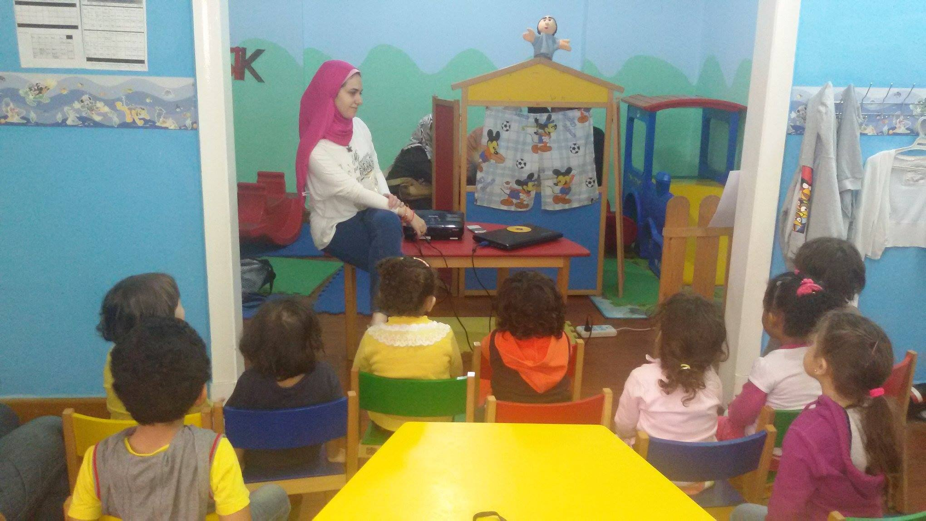

Slide 30
Validation
The used tools have been tested by Healthy Egyptians team, among children using pre- and post-intervention questionnaires to assess the current lifestyle behaviors of the children and any modifications in their habits following the delivery of the health educational messages.

Slide 31
Montasser overcomes Pneumonia
Pneumonia, is the number one cause of mortality among children under five years old, taking the lives of an estimated 1.8 million children per year

Slide 32
Montaser Overcomes Pneumonia
Montasser, who follows an unhealthy lifestyle until he contracts pneumonia from the evil villains, Hemo and Nemo (named after Hemophilus influenza and Streptococcus pneumonia, the two leading bacterial strains that cause pneumonia).

Slide 33
Montasser then sees a doctor who advises him on how to lead a healthy life i.e. wash his hands, do not eat anything that has fallen on the ground, cover his mouth when coughing and sneezing, etc. and how to overcome the illness.

Slide 34
Montaser Overcomes Anemia
Expanding the Montasser Overcomes comic book series to next focus was on nutrition, with a special focus on iron deficiency anemia.

Slide 35

Hand washing
Handwashing can be a critical measure in controlling pandemic outbreaks of respiratory infections.
Handwashing with soap has been cited as one of the most cost-effective interventions to prevent diarrhoeal related deaths and diseases.

Slide 36
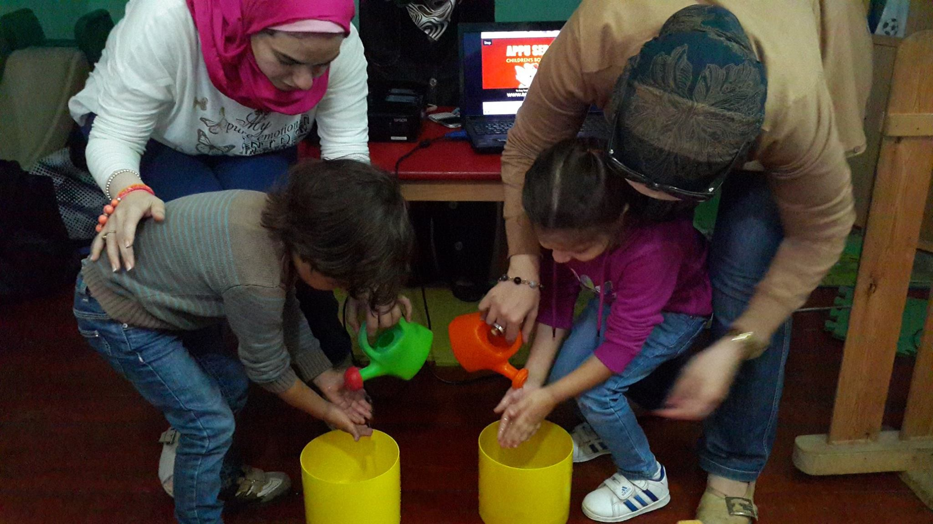
Handwashing with soap at critical times - including before eating or preparing food and after using the toilet - can reduce diarrhoea rates by more than 40 per cent.

Slide 37
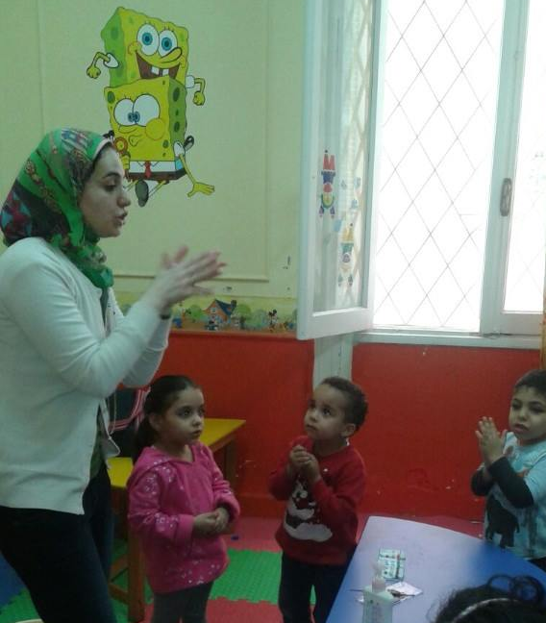
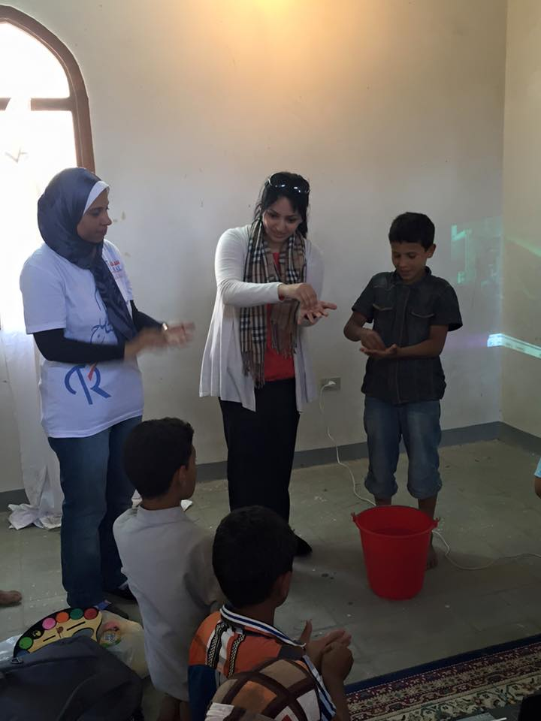
37
Teaching Kids Hand washing Technique

Slide 38
New studies suggest that hand washing promotion in schools can play a role in reducing absenteeism among primary school children.
Studies in China, Egypt, and Kenya have shown that a school hygiene promotion campaign can reduce absence and absence due to illness by between 20% and 58%, in some cases, specifically for girls.
Bowen et al., 2007; Freeman et al., 2012; Nandrup-Bus, 2009; Talaat et al., 2011

Slide 39
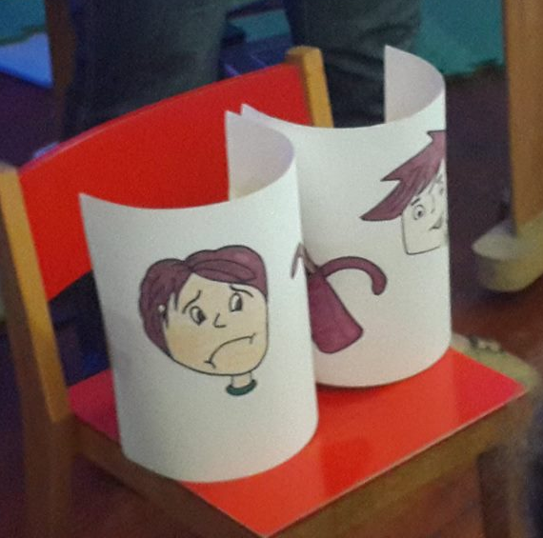
Healthy Nutrition
Kids are encouraged to participate in an activity “Sad & Happy Face exercise” in which they were asked to comment on some pictures & tell if the photo is a healthy food by picking happy face ,or unhealthy by picking sad face.

Slide 40
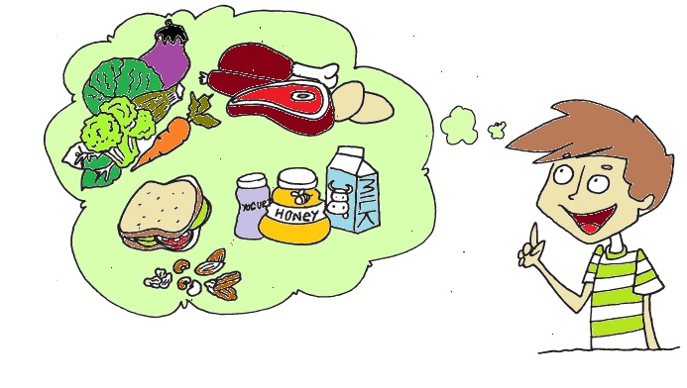

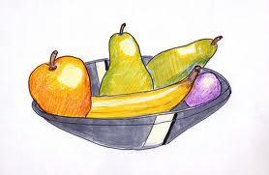

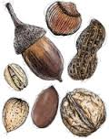









Honey
Notes:
10 children
Score out of 12

Slide 41
Parents program for child health
Some of our workshops involve families, where education is delivered to both children and their parents.
Some families had biannual sessions and we noticed enhanced outcomes when parents are involved.

Slide 42
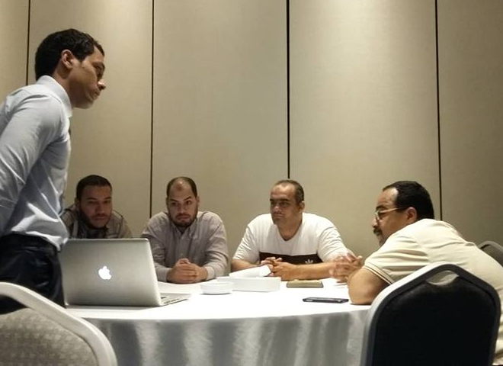
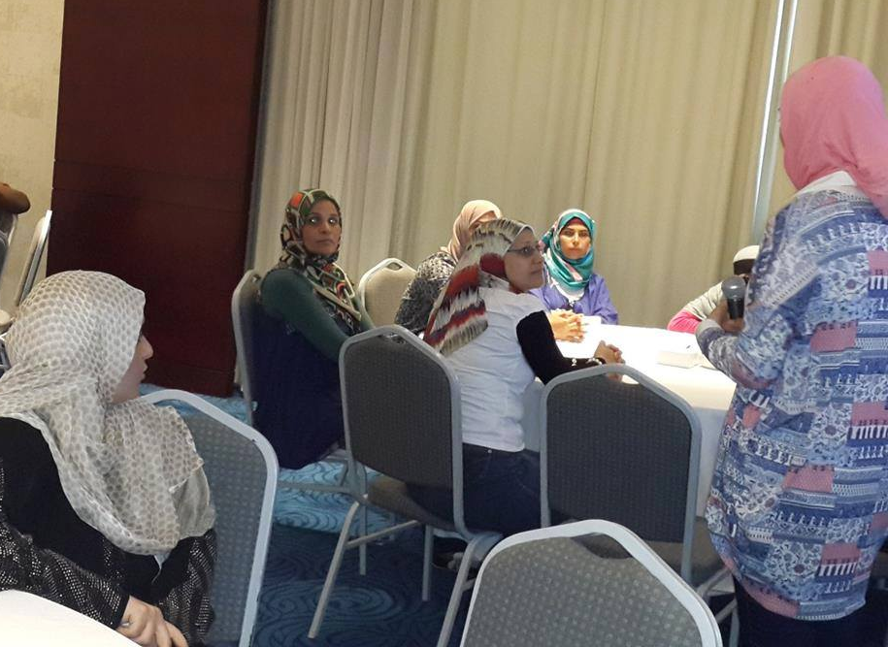
Parents program for child health

Slide 43
Our results

Slide 44
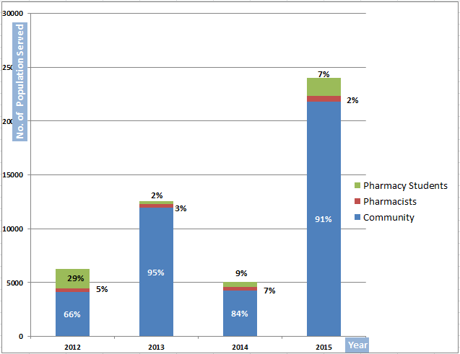
Progress of the Number of Population and % of
Sectors Received AADP Service

Slide 45
Through working in different practice settings, we delivered our services among children in schools, nurseries, hospitals and in the country side.
Also through working with other associations and NGOs who focus on serving families and children through interactive workshops.

Slide 46
Number of Beneficiaries
We started in September 2014 where we have contributed in the one-to-one education of 325 child.
During 2015 we reached 1205 child, and 148 adults (representing parents).
2014
2015

Slide 47
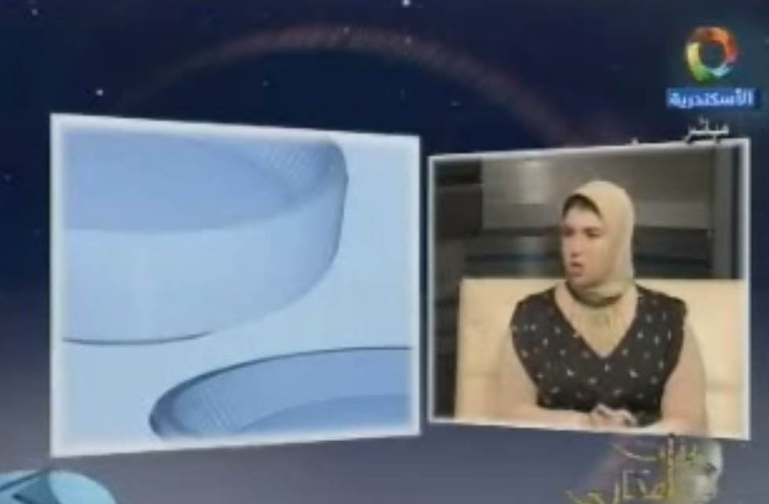
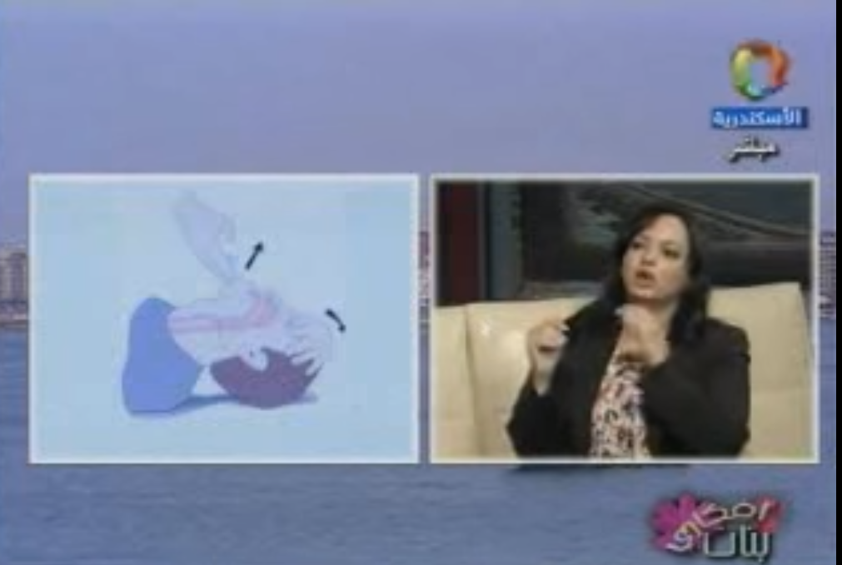
Media
We also represented our association in Alexandria national Radio and Television to reach more audience.

Slide 48
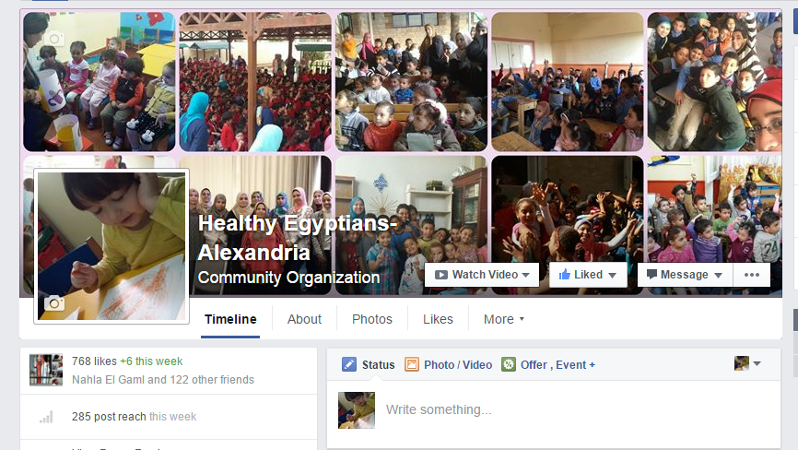
Social Media

Slide 49
Conclusion

Slide 50
Involvement of pharmacists in educating children through the use of creative ways are among the forgotten areas of practice.
An important part of reducing burden of disease specially in the future includes health education for children.

Slide 51
Recommendations

Slide 52
The health education for children would be more effective if parents are involved, so we recommend the use of workshops/ education seminars which are directed to families.
Further researches are needed to measure the impact of educating children on reducing disease and changing lifestyles.

Slide 53
The addition of health education program to school curriculum using interesting ways.
Providing school cafeteria with healthy food like low-fat meals that support the good nutritional decisions by children.

Slide 54
Knowledge is Power
Educating the youth about their health and the surrounding health hazards, will empower them to take better choices in their lives and become more healthy citizens.
Notes:
A healthier citizen is more like to be more
productive in his community and this will in turn affect the country’s economy positively, besides the fact that
health education and preventive medicine are far more cost-effective when compared to therapeutic
medicine, thus again affecting the economy positively and sparing more resources to the development of the
country.

Slide 55
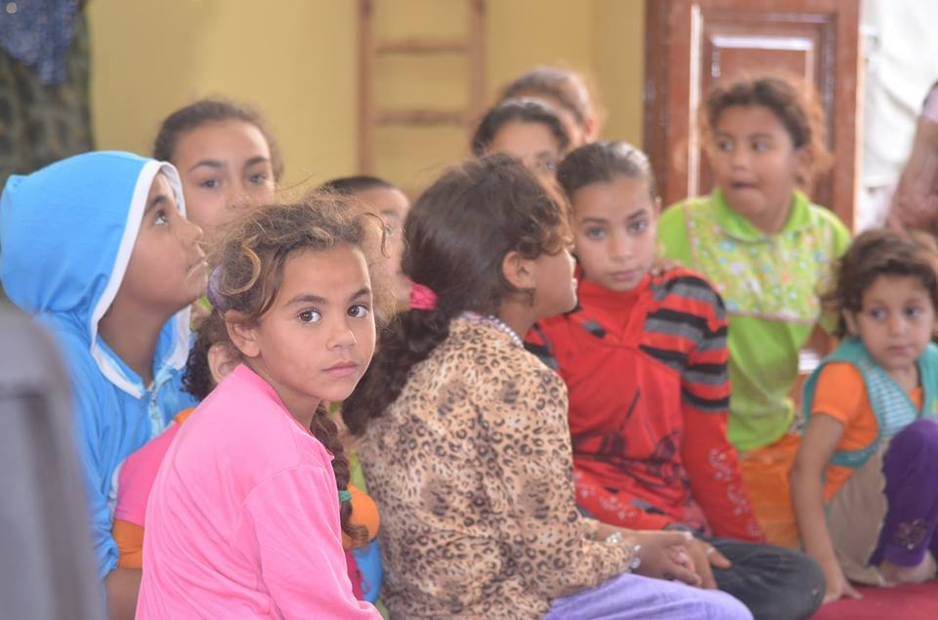

Slide 56

THANK YOU
Any questions?
daliayehia80@yahoo.com
dyehianadia@gmail.com

