Slide 1
Novel Chalcone Derivatives: Synthesis, Evaluation of Anti-prostate Cancer Activities Through Cathepsin B Inhibition And In-Silico Studies.
Dalia Hussein Soliman
PhD. Pharm. Chem.
Assoc. Prof. Pharm. Al-Azhar University,
Egypt Russ. Univ. Egypt

Slide 2
Prostate cancer
is one of the most frequently diagnosed malignancies in men.
High mortality rate could be mainly attributed to the invasiveness and metastasis.
Increased rate of proteolytic activity is observed in malignant cells.
Many proteolytic enzymes are involved in the degradation of the extracellular matrix.

Slide 3
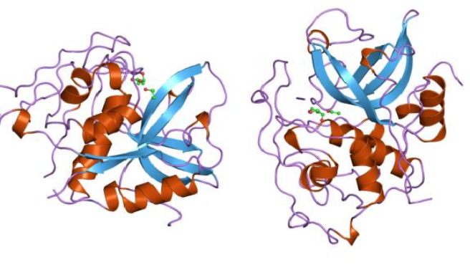
Cathepsin B (Cat B)
is a lysosomal cysteine protease that has been implicated in many pathological conditions such as cancer, immunological and inflammatory disorders, Alzheimer’s disease, and infectious diseases.
In prostate cancer, increased expression of cathepsin B plays a crucial role in invasion and metastasis.
Interestingly, Cat B proved to be a prognostic marker for prostate cancer

Slide 4
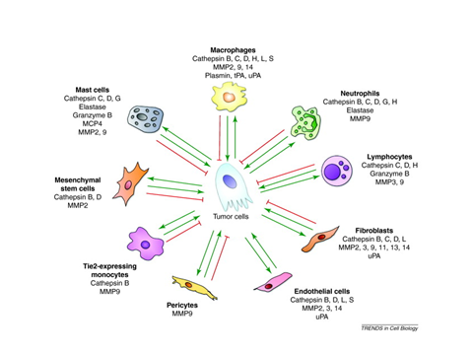

Slide 5
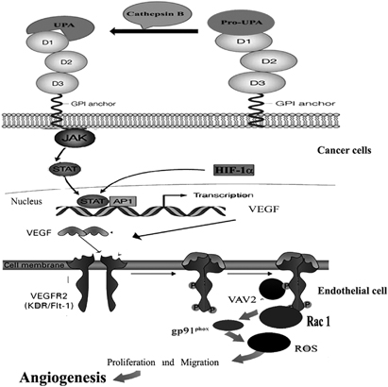
Schematic representation of the proposed molecular mechanism of and cathepsin B-mediated regulation of angiogenesis in glioma, caner gene therapy

Slide 6
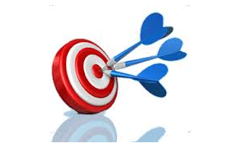

Where is the bright side here???
Targeting
molecules involved in metastasis could be considered an effective mode for treatment of prostate cancer.
Search
for selective cathepsin B inhibitors is considered an active area of research, because its inhibition reduces both tumor cell motility and invasiveness.
However, to date, none of these inhibitors have been clinically approved.

Slide 7
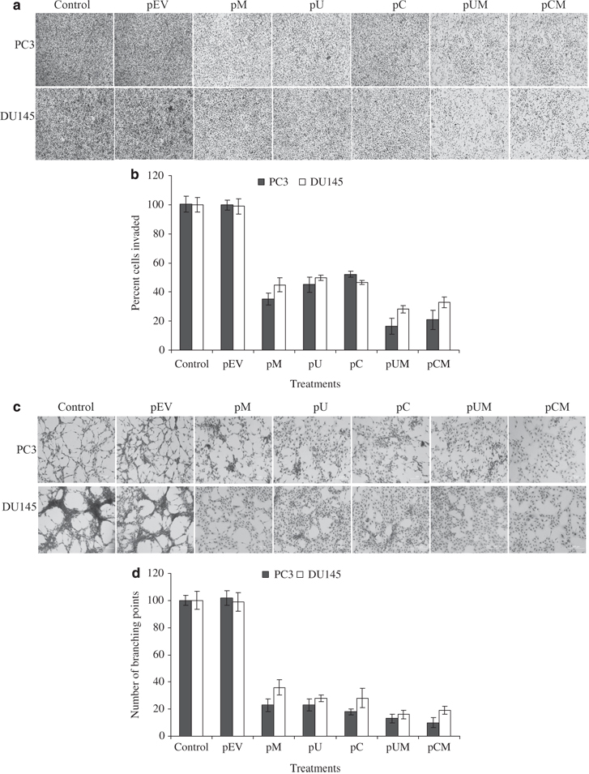
Cancer Gene Therapy (2010)

Slide 8
Chalcones as Anticancer and as Inhibitors of Cat B
Chalcones are widely occurring natural plant products.
Belong to the flavonoid family
Pharmacologically active: anti-oxidative, anti-cancer, anti-mutagenic, anti-microbial, anti-protozoal, anti-histaminic, anti-inflammatory, analgesic and immune-modulator properties

Slide 9
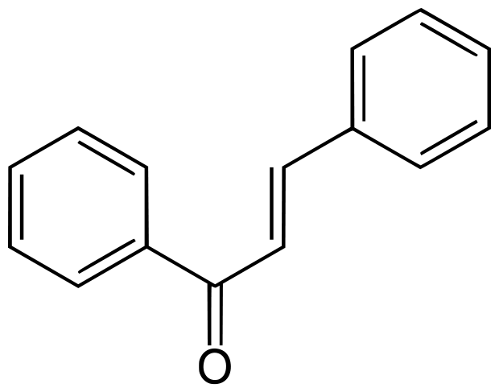
Chalcones contain a common 1, 3-diphenyl, propenone template that can be easily modified to alter the biological potential of these molecules.
Even minor structural modification can results distinct cellular and molecular alterations.
The diversity of the chalcone family led to broad-spectrum biologic applications in oncology, particularly for the development of novel targeted therapies.
Why Chalcones ?????

Slide 10
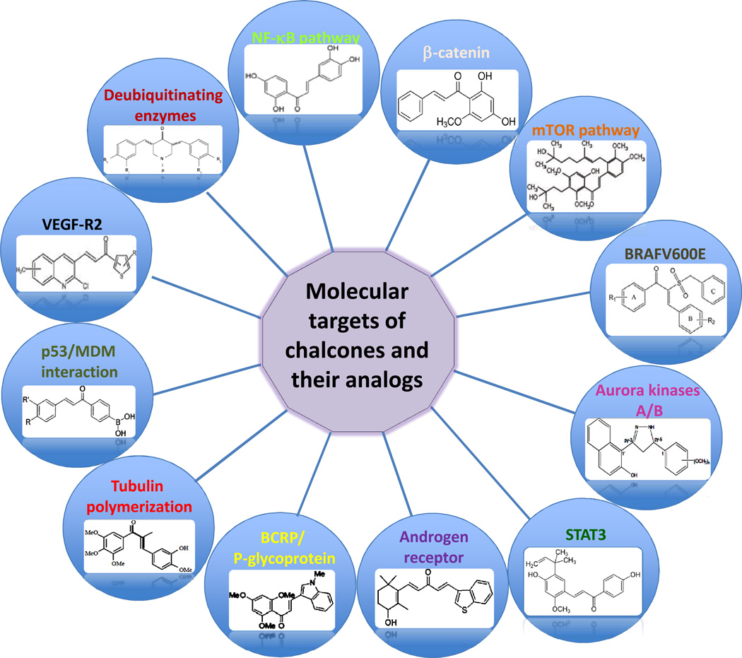

Slide 11
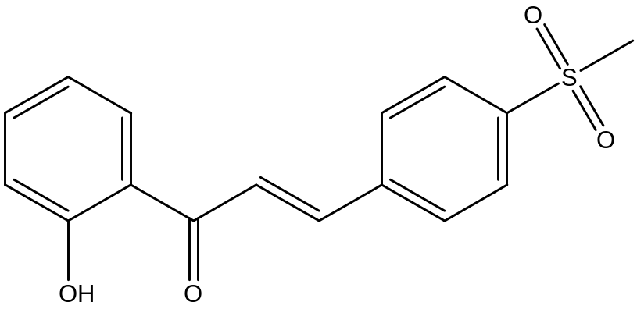
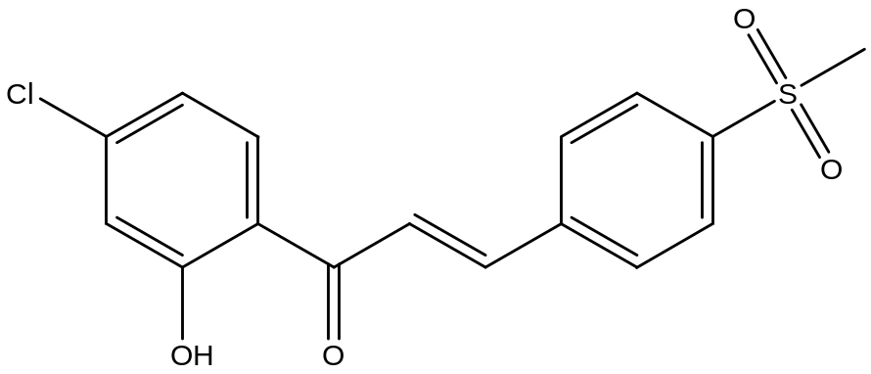
Chalcones as anti-prostate cancer
RG003
RG005
They act through apoptosis on PC3 cell line.
Bioorg. Med. Lett. (2013)

Slide 12
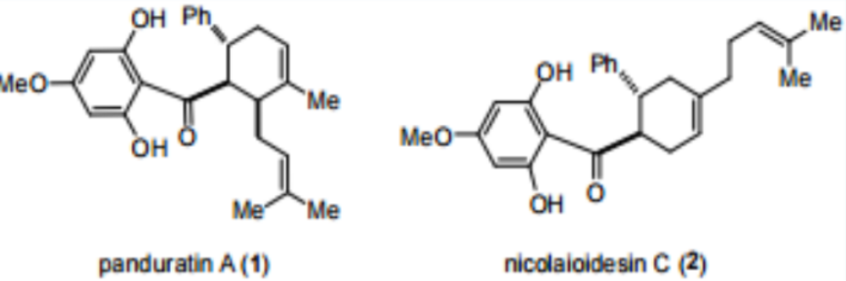

Natural chalcones
Cell cycle arrest, PC3 cell line.
Cysteine protease inhibitors specially Cathepsins , PC3 cell line.
J Am Chem Soc , (2010)

Slide 13
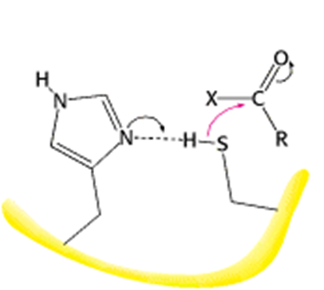
Cat B inhibition mechanism
Thiol trapping pharmacophore
Catalysis proceeds through the formation of a covalent intermediate and involves a cysteine and a histidine residue.
The nucleophile is a thiolate ion that is stabilized through the formation of an ion pair with imidazolium group of His. The attacking nucleophile is the thiolate-imidazolium ion pair in both steps.

Slide 14
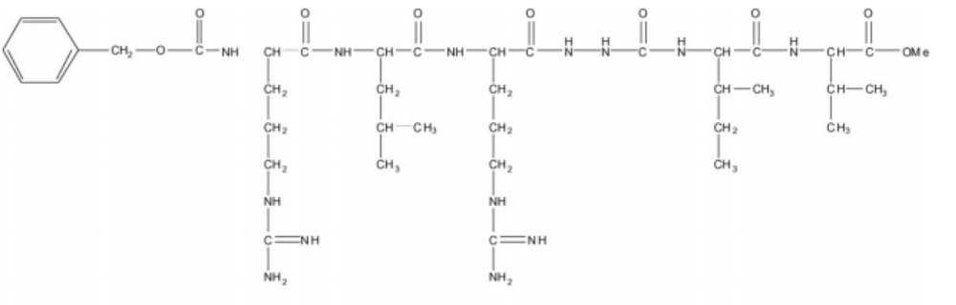
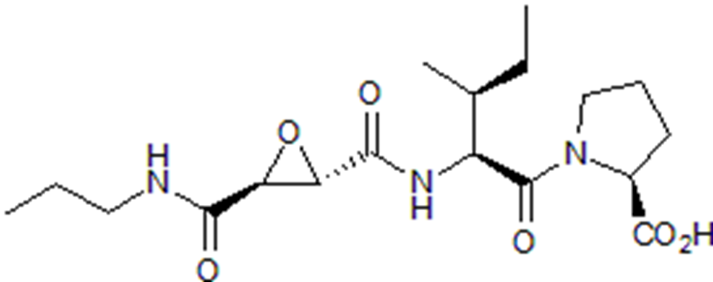
ZRLR: Specific cathepsin B inhibitor
A cell permeable azapeptide, Immunology lett, (2009)
CA 074: Epoxysuccinyl peptide
A selective inhibitor FEBS Lett, (2011)

Slide 15
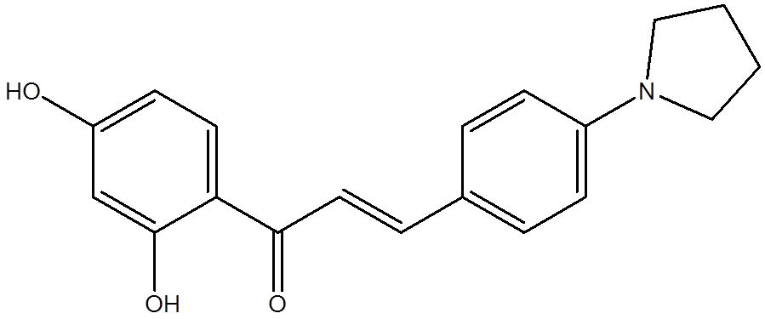
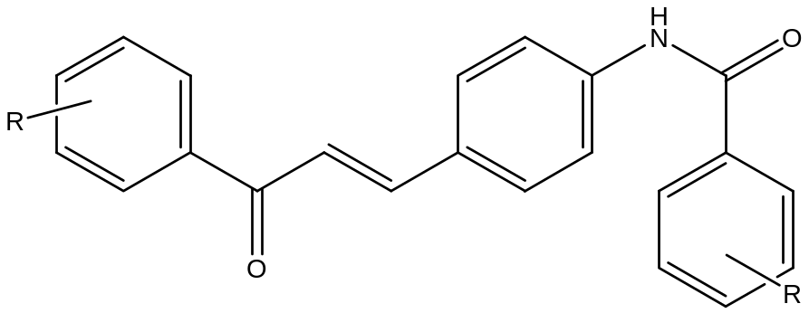


Design of the novel compounds
Bioorganic & Medicinal Lett. (2013)
5a-p

Slide 16
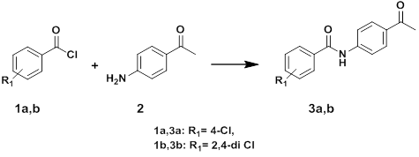
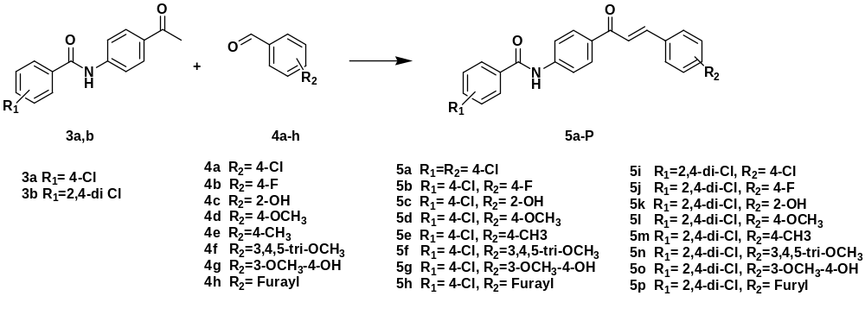
Scheme 1: Synthesis of the key synthons N-(4-acetylphenyl)benzamide 3a,b.
Scheme 2: Synthesis of N-(4-3(phenyl)-1-prop-2-en-1-one phenyl)benzamide

Slide 17
Anticancer activities

Slide 18
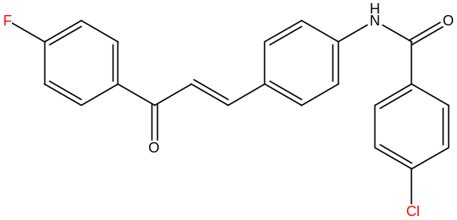
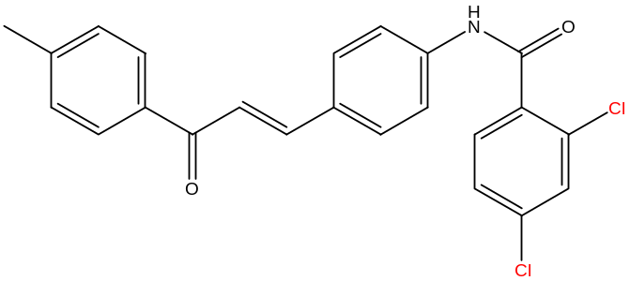
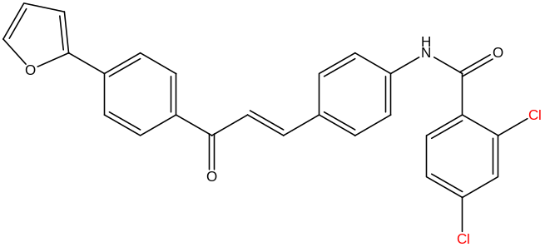
Table 1. Cytotoxicity of the studied compounds towards prostate cancer cell line, PC3.
Cpd. No. | IC50 PC-3 (μΜ) | Cpd. No. | IC50 PC-3 (μΜ) | Cpd. No. | IC50 PC-3 (μΜ) | Cpd. No. | IC50 PC-3 (μΜ)
5a | 151.3 | 5e | 18.18 | 5i | 982.6 | 5m | 9.069
5b | 8.849 | 5f | 332.1 | 5j | 152.0 | 5n | 75.67
5c | 109.1 | 5g | 19.82 | 5k | 100.6 | 5o | 17.32
5d | 302.8 | 5h | 84.93 | 5l | 12.83 | 5p | 5.597
Doxorubicin | 0.925
5b 5m 5p

Slide 19
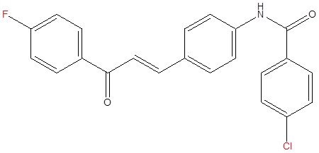
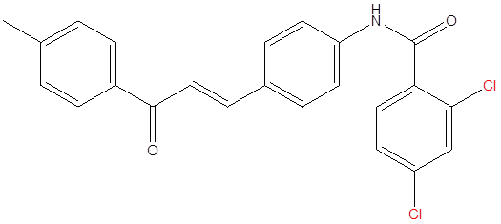
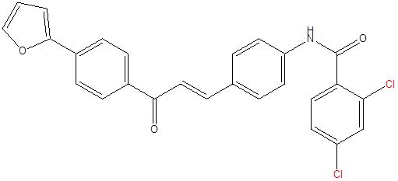
Table 2. Growth inhibition percent of the selected compounds against cathepsin B
Cpd.No. | inhibition (%) | Cpd.No. | inhibition (%)
5b | 56.6 | 5m | 53.2
5e | 39.6 | 5o | 39.5
5g | 33.3 | 5p | 50.4
5l | 45
5b
5m
5p

Slide 20
In silico Studies
3D-QSAR pharmacophore modeling
2D QSAR
Docking Studies

Slide 21
3D-QSAR pharmacophore
The 3D QSAR Pharmacophore Generation protocol (Catalyst HypoGen algorithm), run by means of the DS 2.5 software (Discovery Studio 2.5, Accelrys, Co., Ltd., San Diego, CA, USA).
Training set of the 16 synthesized compounds
Hydrogen bond acceptor, hydrogen bond donor, hydrophobic, ring aromatic and positive ionizable features.

Slide 22
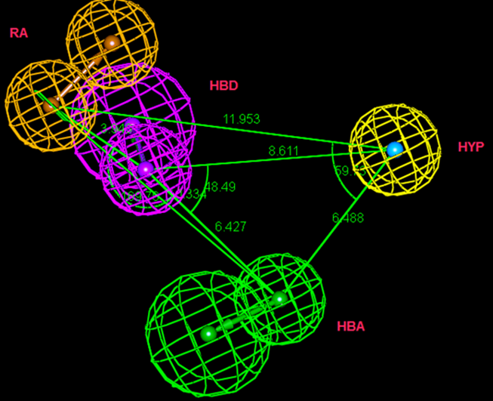
3D-QSAR pharmacophore model
Fig. 1 Constraint distances and angles between features of the generated top pharmacophore model with the features considered hydrogen bond acceptor (HBA) colored in green, hydrogen bond donor (HBD) colored in magenta and aromatic ring (RA) colored in orange, hydrophobic (HYP) colored in cyan.
Fischer validation: confidence level was 98%, and the significance of the best generated pharmacophore was 94%. correlation coefficient, 0.72.

Slide 23
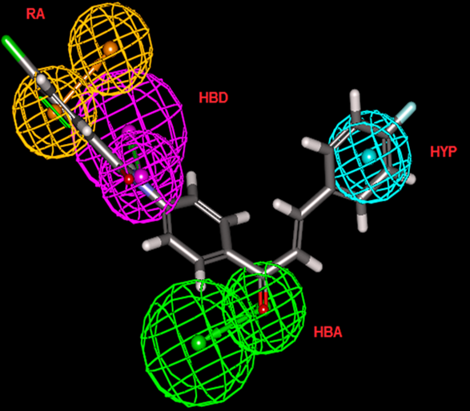
Fig. 2 The best generated pharmacophore hypothesis with the features considered hydrogen bond acceptor (HBA) colored in green, hydrogen bond donor (HBD) colored in magenta and aromatic ring (RA) colored in orange, hydrophobic (HYP) colored in cyan and the synthesized structure 5b fitted in the pharmacophore with fit value 10.98.

Slide 24
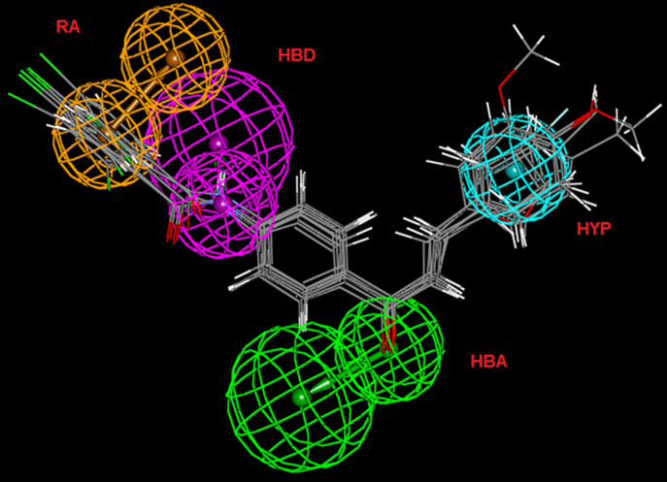
Fig. 3 The best generated pharmacophore hypothesis with the features considered hydrogen bond acceptor (HBA) colored in green, hydrogen bond donor (HBD) colored in magenta and aromatic ring (RA) colored in orange, hydrophobic (HYP) colored in cyan and the synthesized structure 5b, e, g, l, m, o and p fitted in the pharmacophore.

Slide 25
Table 3. Fit values and estimated activities for the synthesized compounds
mapped with the generated 3D-pharmacophore model.
Cpd. No. | Predicted activity (IC₅₀μM) | Experimental activity (IC₅₀μM) | Fit values
5a | 95.65 | 151.3 | 10.61
5b | 41.00 | 8.84 | 10.98
5c | 29.02 | 109.1 | 11.13
5d | 56.18 | 302.8 | 10.84
5e | 73.59 | 18.18 | 10.72
5f | 67.55 | 332.1 | 10.76
5g | 19.82 | 195.35 | 7.30
5h | 113.33 | 84.93 | 10.54
5i | 308.49 | 982.6 | 10.10
5j | 225.29 | 152 | 10.24
5k | 100.55 | 100.6 | 10.59
5l | 31.18 | 12.83 | 11.10
5m | 41.23 | 9.06 | 10.98
5n | 44.41 | 75.67 | 10.94
5o | 22.01 | 17.32 | 11.25
5p | 7.58 | 5.59 | 11.71

Slide 26
2D QSAR Study
16 Ligands with their measured pIC50s against PC3 cell line, were used to calculate the molecular properties by using the Calculate Molecular Properties protocol. Genetic function approximation (GFA) was applied to search for the best possible QSAR regression equation capable of correlating the variations in the biological activities of the training set compounds with variations in the generated descriptors.
The linear Multiple Linear Regression (MLR) model was then constructed.
The analysis was run by means of the DS 2.5 software (Discovery Studio 2.5, Accelrys, Co., Ltd., San Diego, CA, USA).

Slide 27
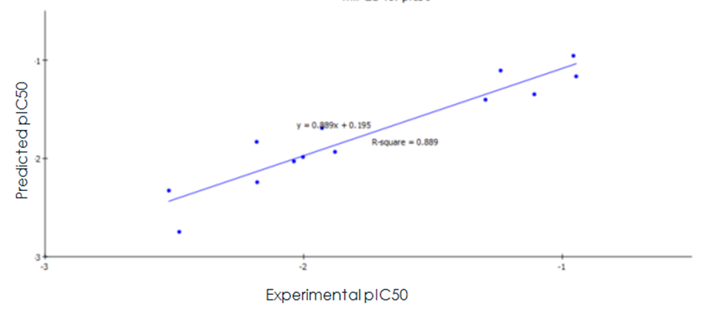
Fig. 4 Predicted versus experimental pIC 50 of the tested compounds against PC3 cell line according to equation (1), r² = 0.889.
Equation (1): −logIC50 = 3.6539 + 0.5232 CHI_V_3_P + 0.30038 Jurs_RNCS − 14.288 Shadow_YZfrac

Slide 28
Table 4. Experimental activities of the synthesized derivatives against the predicted
activities according to equations 1.
Compd | Experimental activity pIC50 | Predicted activity pIC50 | Residuals
5a | -2.17984 | -2.24178 | 0.0619385
5b | -0.946452 | -1.16476 | 0.218304
5c | -2.03782 | -2.02937 | -0.00844524
5d | -2.48116 | -2.74738 | 0.266215
5e | -2.52127 | -2.32713 | -0.194141
5f | -1.92906 | -1.69092 | -0.23814
5h | -2.18184 | -1.83118 | -0.350656
5j | -2.0026 | -1.98501 | -0.0175905
5k | -1.10823 | -1.34712 | 0.238893
5l | -0.957128 | -0.955122 | -0.00200613
5m | -1.87892 | -1.93298 | 0.0540609
5n | -1.23855 | -1.10519 | -0.133357
5o | -1.2971 | -1.40202 | 0.104925
r² = 0.886, r² (adj) = 0.851, r² (pred) = 0.741, Least-Squared error = 0.218

Slide 29
Docking Study
First, the protocol of the docking was validated by reproducing the binding structure of the diphenyl nitrile (DPN) ligand to active site of cathepsin B protein in the crystal complex (PDB code:1GMY).
Accelrys Discovery studio 2.5

Slide 30
Table 5. Docking scores of the tested compounds and DPN.
Compounds | CDOCKER Energy (Kcal/mol) | CDOCKER Interaction Energy (Kcal/mol)
DPN | -38.565 | -28.953
5b | -20.462 | -39.370
5l | -12.141 | -35.8066
5m | -16,282 | -37.069
5p | -13.444 | -32.947

Slide 31
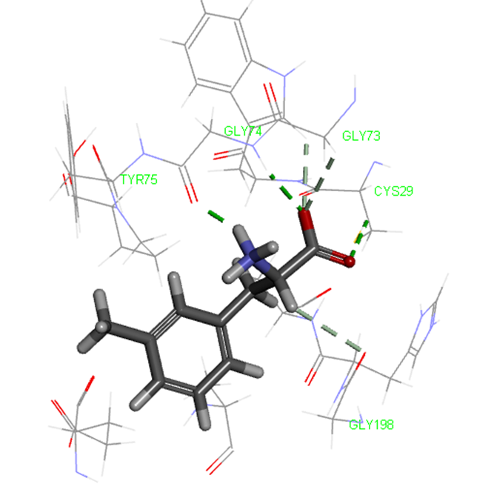
The binding mode of DPN into the active site of CatB, PDB code 1GMY, showing the important key binding interactions.

Slide 32
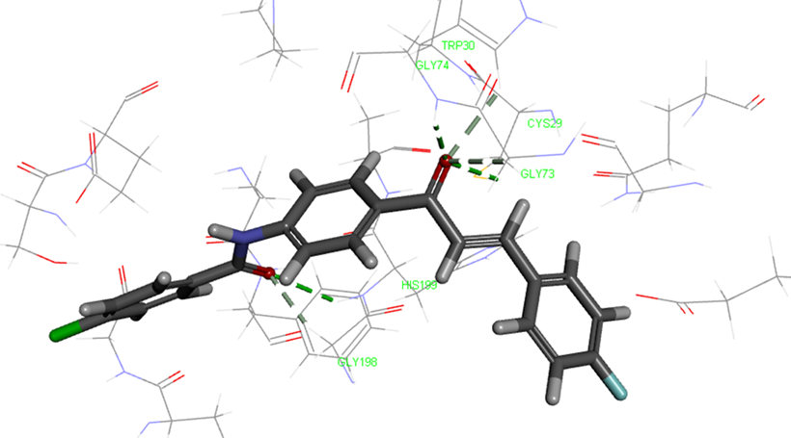
The binding mode of 5b into the active site of CatB, PDB code 1GMY, showing the important key binding interactions.

Slide 33
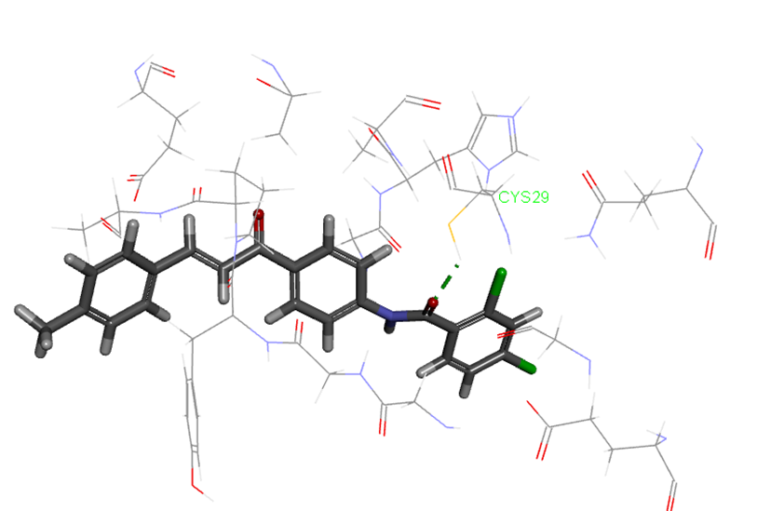
The binding mode of 5m into the active site of CatB, PDB code 1GMY, showing the important key binding interactions.

Slide 34
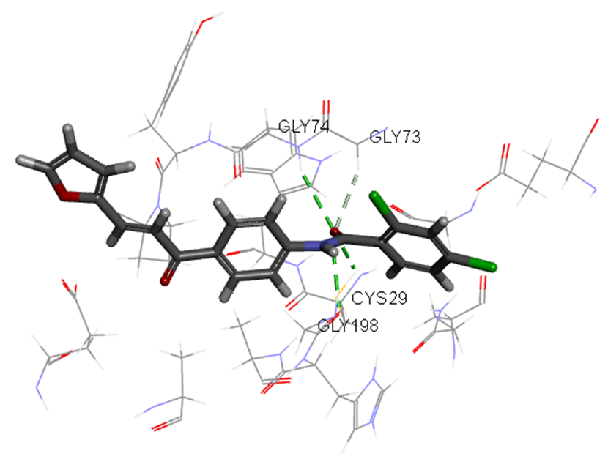
The binding mode of 5p into the active site of CatB, PDB code 1GMY, showing the important key binding interactions.

Slide 35
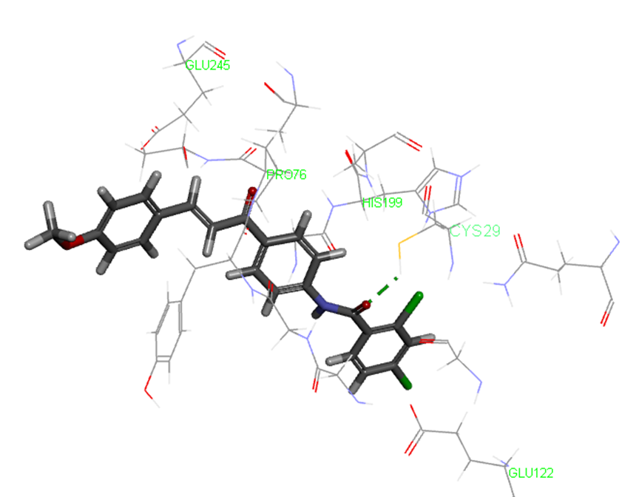
The binding mode of 5l into the active site of CatB, PDB code 1GMY, showing the important key binding interactions.

Slide 36
Conclusions
Compounds 5b, 5m and 5p showed good activity both as antiproliferative and as inhibitors of Cathepsin B production.
The developed QSAR model is statistically significant and has good predictive power as evidenced from the results of internal and external cross-validation parameters.
Docking studies were also in agreement with the experimental results.
Chalcones are promosing scaffolds from which other effective Cat B inibitors could be developed.
Finally, inhibition of cyctiene proteases as Cat B is an active area of research.

Slide 37



Acknowledgements
Dr. Amel Mostafa Farrag.
Al-Azhar University, pharmaceutical Chemistry lab.
Egyptian Russian University
Pharmacology lab at Ain Shams University

Slide 38
Thank you

