Slide 1



Azole Antifungals: A prophylactic Therapy in Hematological Cancer Patients
Dalia A. Hamdy
PhD, RPh, MRSC
Assistant Professor
Faculty of Pharmacy
Alexandria University
dr.daliahamdy@gmail.com
3rd November 2015

Slide 2

Outline
Introduction to Azole antifungals in Acute Lymphoblastic Leukemia patients
Posaconazole an azole antifungal
Effect of hyperlipidemia on PSZ Pharmacokinetics and Pharmacodynamics
Effect of hyperlipidemia on VCR pharmacokinetics
Erythropoietin: a possible antidote?
Dr. Dalia Hamdy-PharmaMiddleEast-November2015

Slide 3

Hematological Cancer
Blood cancer affect the production and function of the blood cells
There are main three types of blood cancer:
Leukemia
Lymphoma
Myeloma
Dr. Dalia Hamdy-PharmaMiddleEast-November2015
Notes:
Leukemia is a type of cancer found in your blood and bone marrow and is caused by the rapid production of abnormal white blood cells. These abnormal white blood cells are not able to fight infection and impair the ability of the bone marrow to produce red blood cells and platelets.
Different types of leukemia:
Acute lymphocytic leukemia (ALL)
Acute myelogenous leukemia (AML)
Chronic lymphocytic leukemia (CLL)
Chronic myelogenous leukemia (CML)

Slide 4
Acute Lymphoblastic Leukemia (ALL)
ALL is the most common form of childhood leukemia
The treatment regimen for patients with ALL is determined primarily by
  Philadelphia chromosome status of the leukemia
  Age of the patient
Dr. Dalia Hamdy-PharmaMiddleEast-November2015
Notes:
ALL is found in adults and children however it is the …….

Slide 5
Acute Lymphoblastic Leukemia (ALL)
Treatment recommendations for ALL patients include
  induction, consolidation and maintenance therapy
  CNS prophylaxis
Vincristine (VCR), an antineoplastic agent, is common in treatment of ALL
Dr. Dalia Hamdy-PharmaMiddleEast-November2015
Notes:
Mention VCR mechanism of action time dependant!

Slide 6
Azoles Antifungals : Prophylactic therapy
Invasive fungal infections are common complications following hematological treatment
Afebrile patients with neutropenia usually receive prophylactic azole antifungal
    posaconazole
    voriconazole
    Itraconazole
    fluconazole
Dr. Dalia Hamdy-PharmaMiddleEast-November2015
Notes:
Mention what neutropenia means

Slide 7

Posaconazole
The latest oral triazole antifungal drug
Chiral drug that is clinically administered as (R,R,S,S) enantiomer
Dr. Dalia Hamdy-PharmaMiddleEast-November2015

Slide 8
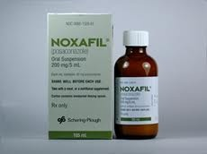
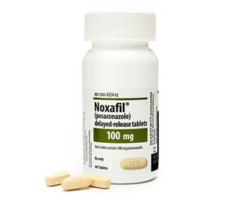
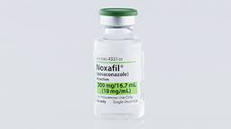
Posaconazole
Lipophilic drug water insoluble
It is commercially available as
  Oral suspension (40 mg/mL)
  Delayed release tablets (100 mg)
  IV vials (300mg/vial)
Dr. Dalia Hamdy-PharmaMiddleEast-November2015
Notes:
Log P=4.7, 2005 suspension, 2013 vial and iv

Slide 9
Posaconazole
Oral suspension or delayed-release tablets
for prophylaxis of invasive Aspergillus and Candida infections in severely immunocompromised patients
    Hematopoietic stem cell transplant recipients with GVHD,
    Hematologic malignancies with prolonged neutropenia from chemotherapy
Dr. Dalia Hamdy-PharmaMiddleEast-November2015
Notes:
Talk about the privileges of PSZ over other antifungal drugs

Slide 10
Posaconazole
New
Oral suspension is also used for
treatment of oropharyngeal candidiasis refractory to itraconazole and/or fluconazole
Dr. Dalia Hamdy-PharmaMiddleEast-November2015

Slide 11
PSZ Absorption
Erratic absorption that can be enhanced by
      Co-administration with high fat meals
      Dividing the total daily dose
      (400 mg BID/ or 200 mg QID or TID)
      PPIs: decrease PSZ bioavailability
      Cmax is within 3-5 h
Dr. Dalia Hamdy-PharmaMiddleEast-November2015

Slide 12
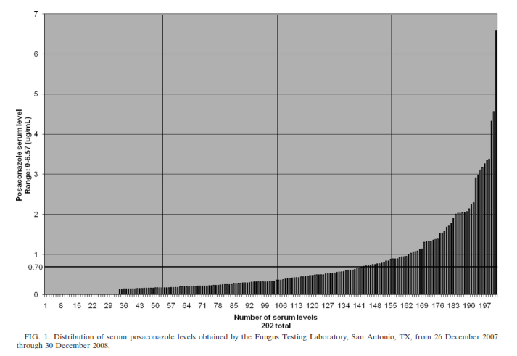
PSZ TDM?!
-70% less than 0.7ug/mL
-FDA reported to place patients at increased risk
Dr. Dalia Hamdy-PharmaMiddleEast-November2015
Notes:
-However, the average posaconazole levels were 0.611 g/ml in patients who developed
Breakthrough infection and 0.922 g/ml in those who remained uninfected
78% of the 202 samples were less than 0.922

Slide 13
PSZ Metabolism and Elimination
It is mainly through Phase II metabolism
UDP-glucuronosyltransferase (UGT)
Enterohepatic recirculation, second peak
Half life (t_{1/2}) is ~31 h
Dr. Dalia Hamdy-PharmaMiddleEast-November2015

Slide 14
PSZ Pharmacodynamics
It is a CYP450 3A4 inhibitor
Drug-Drug interactions
a. Cyclosporine, tacrolimus, midazolam availability
b. PSZ-Vincristine (VCR) coadministration
VCR neurological side effects
(Seizures in children)
Dr. Dalia Hamdy-PharmaMiddleEast-November2015

Slide 15
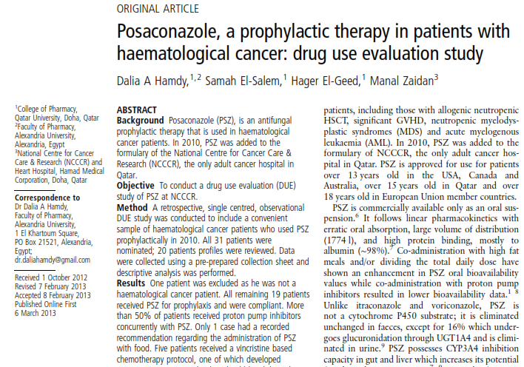
Rationale
PSZ is a newly introduced drug in Qatar
Hypothesis
PSZ regulations and use in Qatar is similar to the practice worldwide
Objective
Perform Drug use evaluation study from Al-Amal Hospital (Doha-Qatar) in 2010
Hamdy DA et al. Eur J Hosp Pharm. 2013; 20(4) :223-226.
Dr. Dalia Hamdy-PharmaMiddleEast-November2015

Slide 16
Results
Inclusion Criteria
          Hematologic cancer patients
          Used PSZ Prophylactically
          Received the drug in 2010
Ethical approvals
          Qatar University Institutional Review Board
          Hamad Medical Corporation Ethics Committee
PSZ was introduced to Qatar in 2009.
Al-Amal Hospital Formulary in 2010.
Used for patients > 15 years
Hamdy DA et al. Eur J Hosp Pharm. 2013; 20(4) :223-226.
Dr. Dalia Hamdy-PharmaMiddleEast-November2015

Slide 17
Results
Inclusion Criteria
          Hematologic cancer patients
          Used PSZ Prophylactically
          Received the drug in 2010
Ethical approvals
          Qatar University Institutional Review Board
          Hamad Medical Corporation Ethics Committee
In Qatar it is used in:
    Febrile and afebrile neutropenic patients with hematologic cancers for prophylaxis
    Future use as prophylaxis in bone marrow transplantation unit
Hamdy DA et al. Eur J Hosp Pharm. 2013; 20(4) :223-226.
Dr. Dalia Hamdy-PharmaMiddleEast-November2015

Slide 18
Results
Thirty one patients received PSZ in 2010.
20 patients’ files were visited
200 mg TID
except for 1 case , No clear recommendation about taking with/without meals
>50% PPIs concurrently (TDM?!)
3 patients VCR (Seizure)
Hamdy DA et al. Eur J Hosp Pharm. 2013; 20(4) :223-226.
Dr. Dalia Hamdy-PharmaMiddleEast-November2015

Slide 19
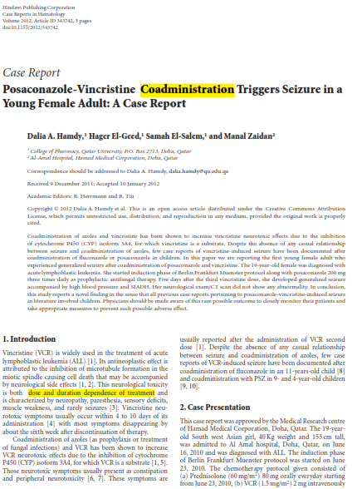
Results
3 patients were also on VCR chemotherapy
one (19 Y) concurrently
    Seizure
WHY???
Hamdy DA et al. Case Reports in Hematology. 2012; 2012:1-3.
Dr. Dalia Hamdy-PharmaMiddleEast-November2015

Slide 20
Conclusions
  The PSZ regulations in Qatar are similar to that reported by the FDA and other health organizations.
The practice in Al-Amal Hospital is abiding by the recommendations, but:
  Clear recommendations regarding administering with meals
  PPIs and VCR coadministration!
Hamdy DA et al. Eur J Hosp Pharm. 2013; 20(4) :223-226.
Dr. Dalia Hamdy-PharmaMiddleEast-November2015

Slide 21
STDF 2014
Rationale
Posaconazole is a lipophilic drug
Hypothesis
Hyperlipidemia alters the Pharmacokinetics and Pharmacodynamics of PSZ
Objective
Study the effect of hyperlipidemia on posaconazole-vincristine drug-drug interaction in rat
Dr. Dalia Hamdy-PharmaMiddleEast-November2015

Slide 22
PSZ-VCR Assay in rat plasma
We need an in house assay for simultaneous determination of VCR-PSZ in rat to be used in PK studies!
Dr. Dalia Hamdy-PharmaMiddleEast-November2015

Slide 23
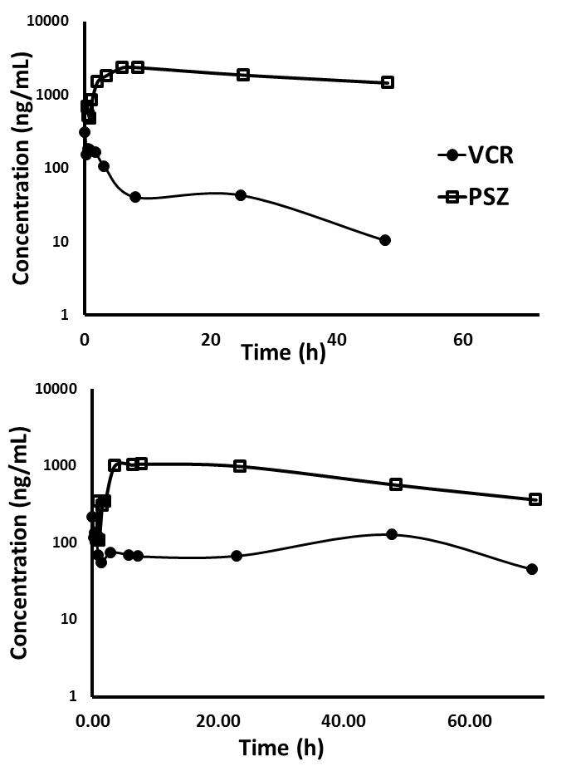
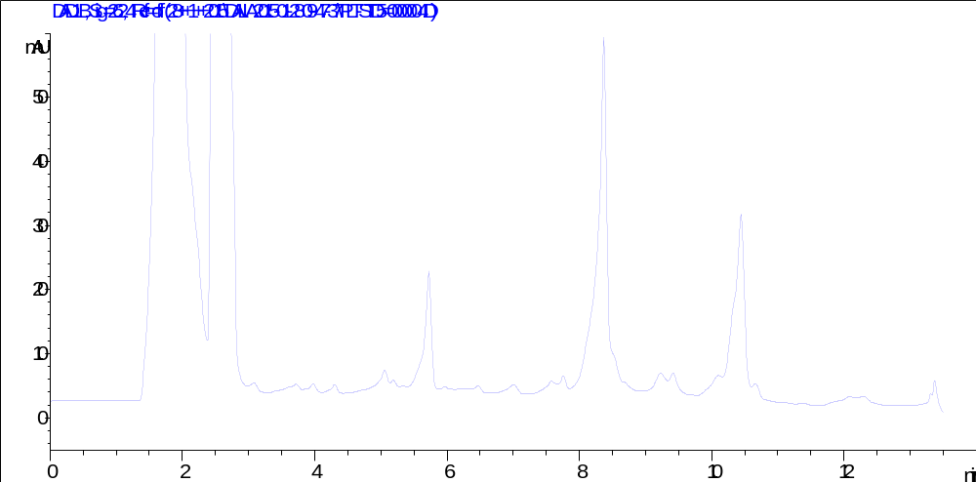
PSZ-VCR Assay in rat plasma
Submitted manuscript!
PSZ
ITZ
VCR
range: 50-5000 ng/mL
Wavelength: VCR 220nm, PSZ 262nm
C18 column, gradient system
Runtime: 12 minutes
Dr. Dalia Hamdy-PharmaMiddleEast-November2015

Slide 24
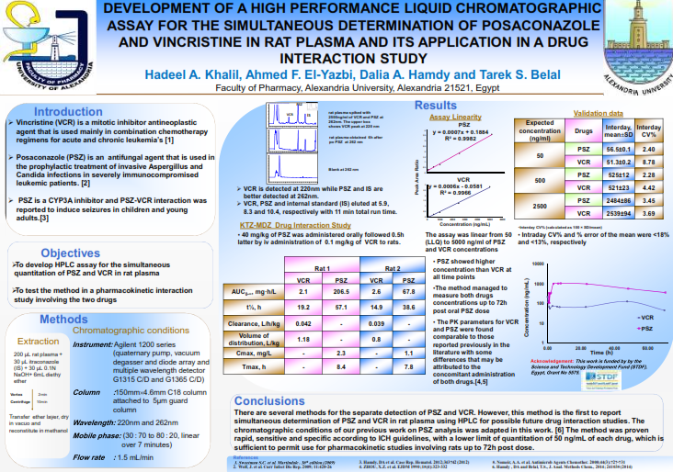
PSZ-VCR Assay in rat plasma
Khalil HA et al. J Pharm Pharm Sci. Vol.18, No. 3, Abstract 112 (2015)

Slide 25
STDF 2014
Rationale
Posaconazole is a lipophilic drug
Hypothesis
Hyperlipidemia alters the Pharmacokinetics and Pharmacodynamics of PSZ
Objective
I. Study the effect of hyperlipidemia on posaconazole PK and PD in rat
Dr. Dalia Hamdy-PharmaMiddleEast-November2015

Slide 26

Hyperlipidemia
Definition:
An elevation of one or more lipids including cholesterol, cholesterol esters, phospholipids and triglycerides in the bloodstream
Causes:
genetic effect
diet
drugs
diseases
Dr. Dalia Hamdy-PharmaMiddleEast-November2015

Slide 27
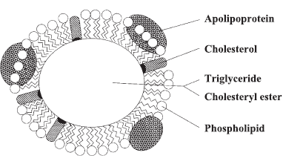
Lipoproteins
The packages via which lipid movement is accomplished through the body
classified into:
      Chylomicrons
      VLDL
    LDL
    HDL
    Apolipoproteins responsible for identification and uptake by lipoprotein receptors
Dr. Dalia Hamdy-PharmaMiddleEast-November2015

Slide 28
Hyperlipidemia and PK
Recent studies have shown that HL could influence PK of some highly lipophilic drugs.
Protein Lipoprotiens
Unbound fraction
Dr. Dalia Hamdy-PharmaMiddleEast-November2015

Slide 29
Hyperlipidemia and PK
Recent studies have shown that HL could influence PK of some highly lipophilic drugs.
Metabolising enzymes
Clearance and volume of distribution
Dr. Dalia Hamdy-PharmaMiddleEast-November2015

Slide 30
Effect of HL on PSZ PK
Manuscript under preparation!
Protein Binding!
*
*⁺
Dr. Dalia Hamdy-PharmaMiddleEast-November2015
Notes:
We used HL induced poloxamer model in rat

Slide 31
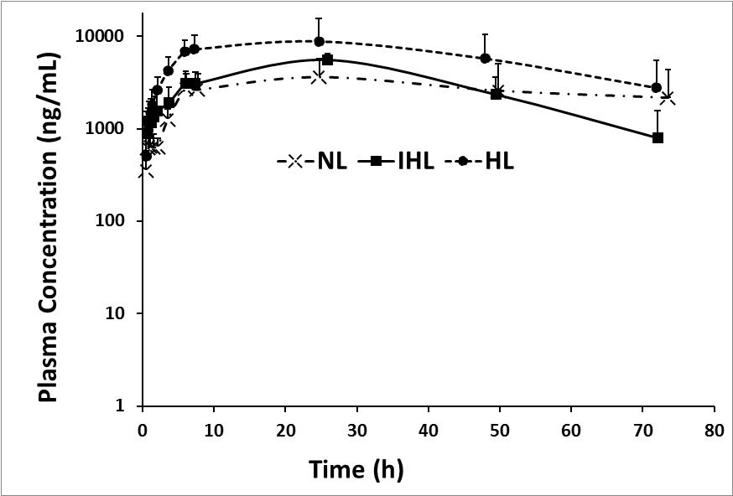
Effect of HL on PSZ PK
Manuscript under preparation!
 | NL | IHL | HL
Cmax (i) (mg/L) | 2.87±1.26† | 3.43±1.02* | 8.87±2.35
C_{max} (ii) (mg/L) | 3.76±2.15 | 5.57±0.96 | 6.67±1.90
AUC (0-24h) [mg/(h L)] | 66.8±26.7† | 95.5±19.5* | 154.6±37.8
AUC_{0-∞} [mg/(h L)] | 922.9±841.4 | 239.9±95.4 | 606.3±450.4
Vd/f (L/kg) | 10.5±7.21 | 3.07±0.59 | 2.98±2.29
t_{1/2}(h) | 62.6±28.9≠† | 13.2±7.60 | 25.6±15.9
Khalil HA et al. ICAPS-PUA-October 2015
Notes:
Define each curve
Enterohepatic recirculation phenomena
No effect on clearance
Variability and significance
ANOVA test

Slide 32
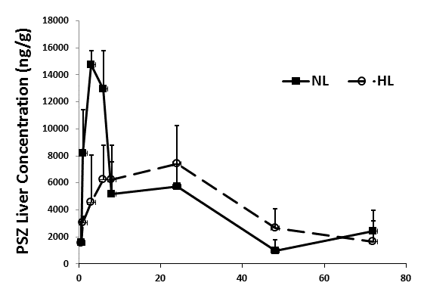
Effect of HL on PSZ PK
Manuscript under preparation!
Liver Distribution
*
*
*
 | NL |  | HL
 | AUC_{0-8h} | AUC_{0-72h} | AUC_{0-8h} | AUC_{0-72h}
Liver (mg.h/Kg) | 85.37±11.5* | 293.6±22.9 | 37.10±13.0 | 318.9±51.0
Dr. Dalia Hamdy-PharmaMiddleEast-November2015
Notes:
Possible altered effect on its drug-interaction through CYP-P450 inhibition during the first 8h

Slide 33
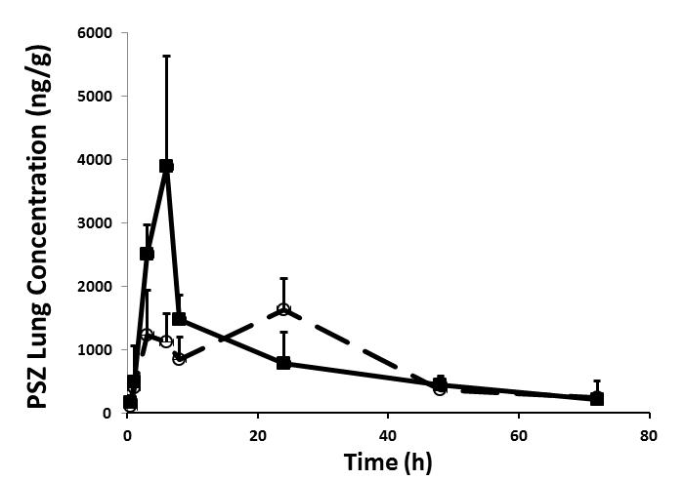
Effect of HL on PSZ PK
Manuscript under preparation!
Lung Distribution
*
 | NL |  | HL
 | AUC_{0-8h} | AUC_{0-72h} | AUC_{0-8h} | AUC_{0-72h}
Lung (mg.h/Kg) | 18.11±2.90* | 58.24±5.85 | 7.24±1.97 | 58.34±8.74
*
*
*
Dr. Dalia Hamdy-PharmaMiddleEast-November2015
Notes:
Possible altered effect on its activity in lung during the first 8h

Slide 34
Conclusion
Elevated blood cholesterol and triglycerides could influence the PK and tissues distribution of PSZ
This can affect its
  potential drug interactions due to CYP-P450 inhibition
  activity against organisms that require lung penetration
Dr. Dalia Hamdy-PharmaMiddleEast-November2015

Slide 35
STDF 2014
Rationale
Posaconazole is a lipophilic drug
Hypothesis
Hyperlipidemia alters the Pharmacokinetics and Pharmacodynamics of PSZ
Objective
II. Study the effect of hyperlipidemia on VCR in rat
Dr. Dalia Hamdy-PharmaMiddleEast-November2015

Slide 36
Effect of HL on VCR PK
Work in progress!
Protein Binding!
Dr. Dalia Hamdy-PharmaMiddleEast-November2015
Notes:
We used HL induced poloxamer model in rat

Slide 37
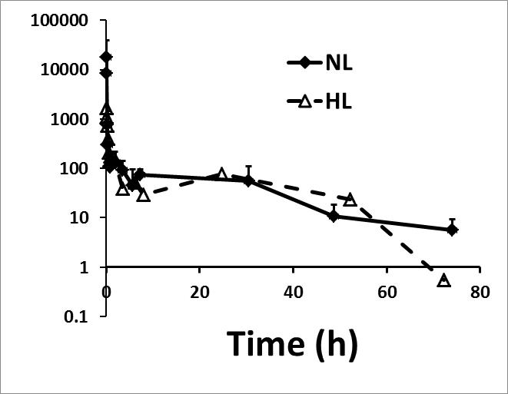
Effect of HL on VCR PK
Work in progress!
Dr. Dalia Hamdy-PharmaMiddleEast-November2015
Notes:
We used HL induced poloxamer model in rat

Slide 38

Preliminary Data
Rationale
Finding a prophylactic therapy/model to VCR-PSZ induced neurotoxicity
Hypothesis
Erythropoietin have a possible protective role against VCR toxicity
Objective
1.To develop a rat model to study vincristine-induced SAIDH
2. To determine the possible role of erythropoietin in reducing the hyponatremia and survival rate associated with vincristine-induced SAIDH
Dr. Dalia Hamdy-PharmaMiddleEast-November2015

Slide 39
Erythropoietin
A renal glycoprotein hormone used to treat anemia
Commonly used in treatment protocols of leukemic patients.
It affects the sodium and potassium levels
Dr. Dalia Hamdy-PharmaMiddleEast-November2015
Notes:
Why is erythropiotein?

Slide 40
Erythropoietin
Hypersecretion of ADH was associated with an increase in EPO secretion.
EPO have a reversal role against vincristine-induced peripheral neuropathy through
  decreasing N-methyl-D-aspartate receptor expression
  increasing calcitonin gene-related peptide expression centrally and peripherally
Dr. Dalia Hamdy-PharmaMiddleEast-November2015

Slide 41
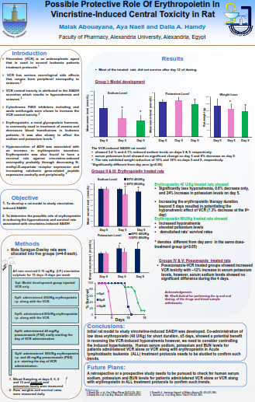
E-Poster
Abouayana M. et al. Pharma Middle East 2015

Slide 42
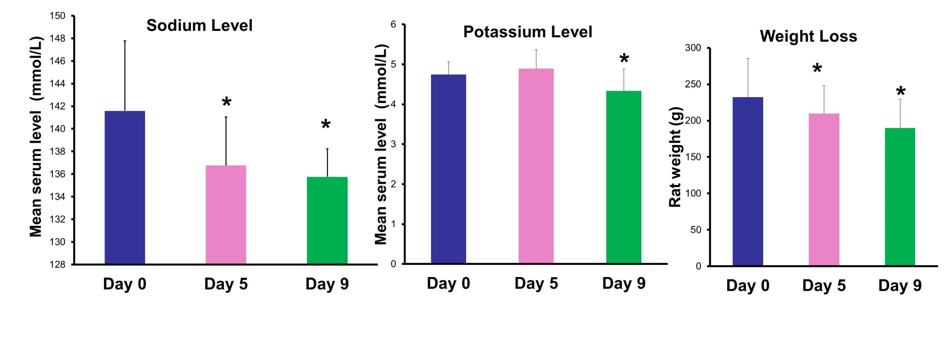
Preliminary Model Development
Dr. Dalia Hamdy-PharmaMiddleEast-November2015

Slide 43
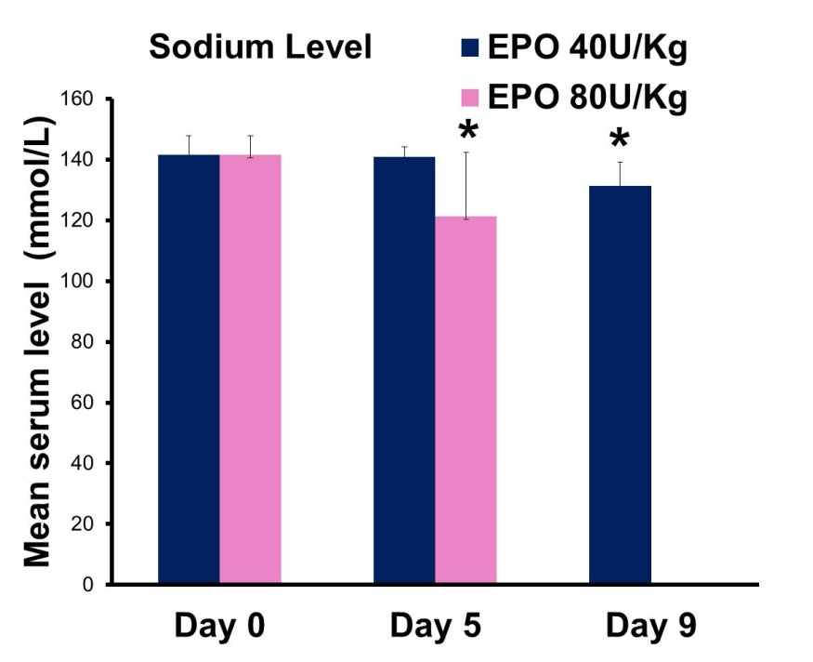
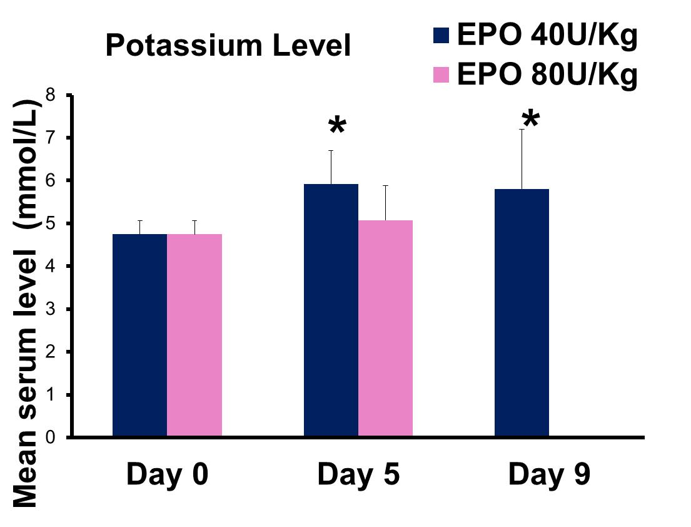
Erythropoietin Possible CNS Protective Role?
Co-administration of low dose erythropoietin (40 U/Kg) for short duration, ≤5 days, showed a potential benefit in reversing the VCR-induced hyponatremia. However, we need to consider controlling the induced hyperkalemia.
Dr. Dalia Hamdy-PharmaMiddleEast-November2015

Slide 44
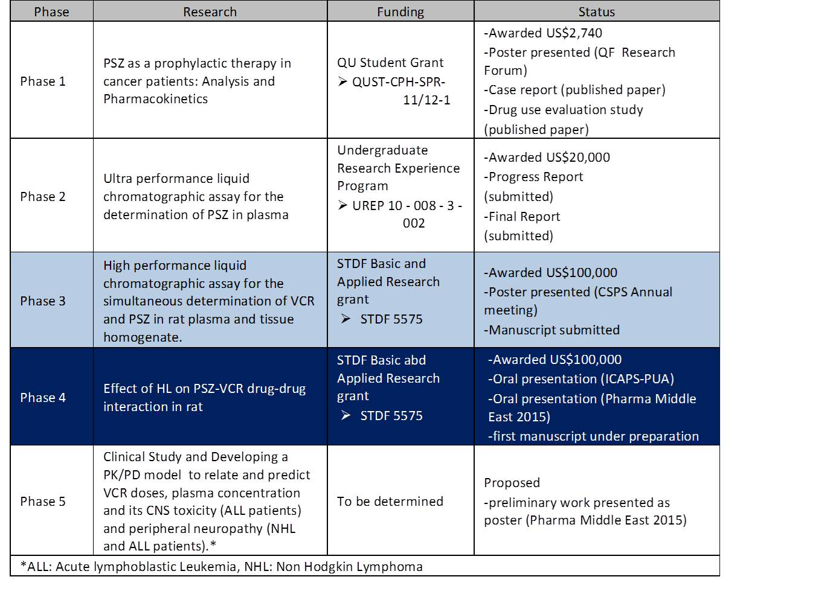
FUTURE PLANS
Dr. Dalia Hamdy- November 2014

Slide 45




Acknowledgments
Colleagues
Manal Zaidan, PharmD
Tarek S. Belal, PhD
Hanan El-Goweily, PhD
Ahmed F. El-Yazbi, PhD
Team members
Hagar El-Geed, PharmD
Samah El-Salem, PharmD
Heba Mohammed, PharmD
Lylia Meckideche, PharmD
Hadeel Adel, BSc. Pharm
Mai Elnaggar, BSc. Pharm
Malak Abouayana, undergraduate student
Aya Naeil, undergraduate student
Universities
Funding agencies
Laboratory members
Mr. Khalil Sharaf
Ms. Sarah Khalil
Ms. Doaa Abd el dayem

