Slide 1
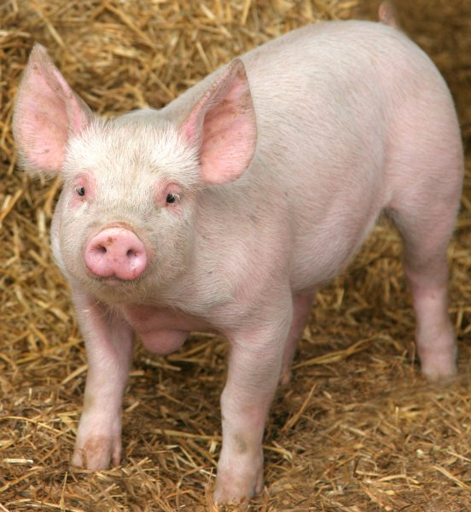
The immune response against Chlamydia suis genital tract infection partially protects against re-infection
E. De Clercq¹, B. Devriendt², L. Yin¹, K. Chiers³, E. Cox² and D. Vanrompay¹
¹Faculty of Bioscience Engineering
Laboratory for Animal Immunology and Biotechnology
Ghent University, Belgium; ²Faculty of Veterinary Medicine, Laboratory for Veterinary Immunology,
Ghent University, Belgium; ³Faculty of Veterinary Medicine, Veterinary Pathology, Ghent University, Belgium
UGhent Center for Strategic Prophylaxis and Vaccine Development

Slide 2
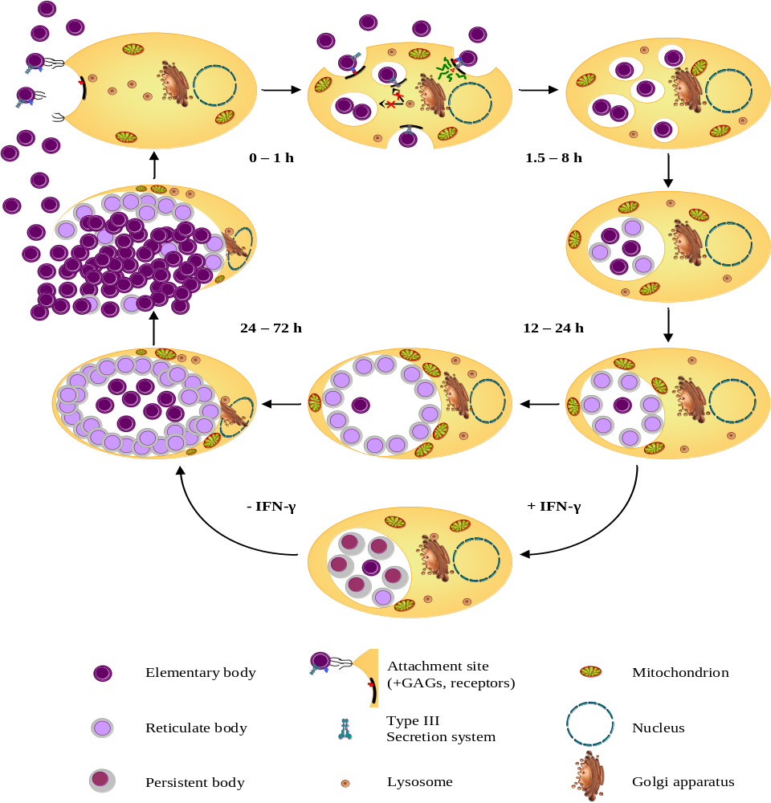
INTRODUCTION
Chlamydiaceae
Obligate intracellular gram-negative bacteria

Slide 3
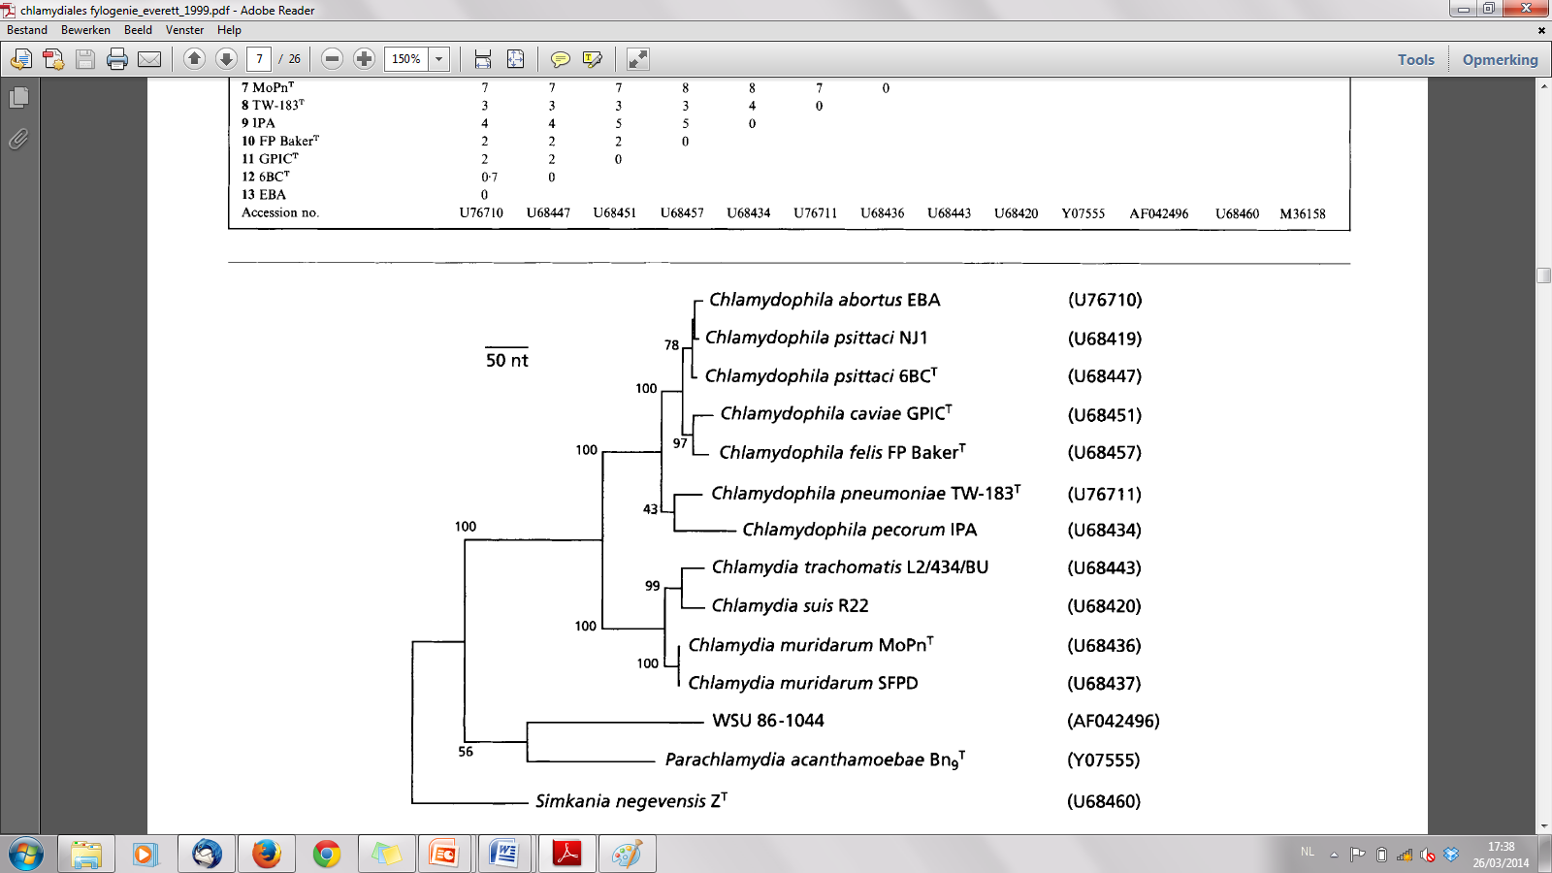
INTRODUCTION
Chlamydia suis & trachomatis
C. suis phylogenetically highly related to C. trachomatis
C. trachomatis and C. suis
  Sexually transmitted disease
    Reproductive failure
  Kerato-conjunctivitis
    Trachoma and blindness
Chlamydia suis zoonosis
  Eye infections in humans
    Trachoma patients in Nepal (Dean et al., 2013)
    Swine abattoir employees in Belgium (De Puysseleyr et al., 2014)

Slide 4
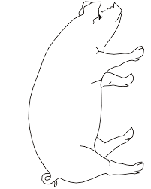
INTRODUCTION
Chlamydia suis in pigs
High prevalence of Chlamydia suis in the pork industry
  Subclinical infections (as in humans)
  Clinical infections (as in humans)
    Economic losses
REPRODUCTIVE TRACT
Early embryonic death
Low number of piglets
Non-uniform piglet weight
Inferior semen quality
EYE
Conjunctivitis

Slide 5
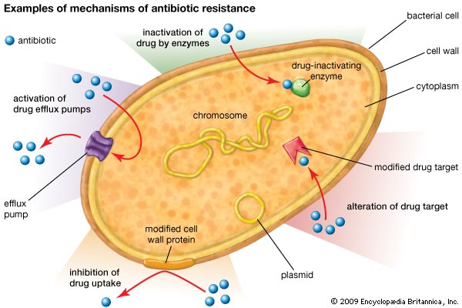
INTRODUCTION
Tetracycline resistance
Treatment of chlamydial infections
  Tetracyclines
    Broad spectrum, low toxicity, tissue distribution, inexpensive
Tetracycline resistant Chlamydia suis
  tet(C) gene
  Many countries
    United States
    The Netherlands
    Belgium
    Switzerland
    Italy
    Cyprus
    Israel
    Germany

Slide 6
Experimental vaginal C. suis infection and re-infection in gilts
Chlamydia vaginal experimental infection model SPF pigs
  Vanrompay et al., Infect. Immun, 2005; De Clercq et al., Vet. Res., 2014
Experimental infection and re-infection of gilts
Vaginal infection (10⁷ IFU of C. suis strain S45) using 3 groups (n = 5) of gilts:
1. Macroscopic lesions at autopsy + histopathology
2. Vaginal excretion and C. suis replication in tissues
3. Immune response:
- Serum and mucosal IgM, IgG and IgA antibodies (ELISA)
- T cell proliferation assays on PBMC, spleen and lnn MC
- Flow cytometry on PBMC, spleen and lnn MC
- Cytokine & chemokine ELISA’s on PBMC, spleen and lnn MC

Slide 7
Materials and methods
GROUP TREATMENT | 1 Controls (n = 5) | 2 Infection group (n = 5) | 3 Infection/re-infection group (n = 5)
C. suis S45 D13: age 9 weeks | PBS | PBS | Primary infection
C. suis S45 D69: age 17 weeks | PBS | Primary infection | Secondary infection
Euthanasia D90: age 20 weeks | ✟ | ✟ | ✟

Slide 8
Results: macroscopic lesions
Macroscopic lesions at euthanasia
Infection group
All pigs large amounts of serous fluid in the urogenital tract, strong congestion of the ligaments + mucosae and enlarged local draining lnn, sometimes with congestion
Re-infection group
4 of 5 pigs no serous fluid and all severely enlarged local draining lnn, but no congestion of the lnn
Scores for macroscopic lesions significantly higher in the infection group as compared to the re-infection group

Slide 9
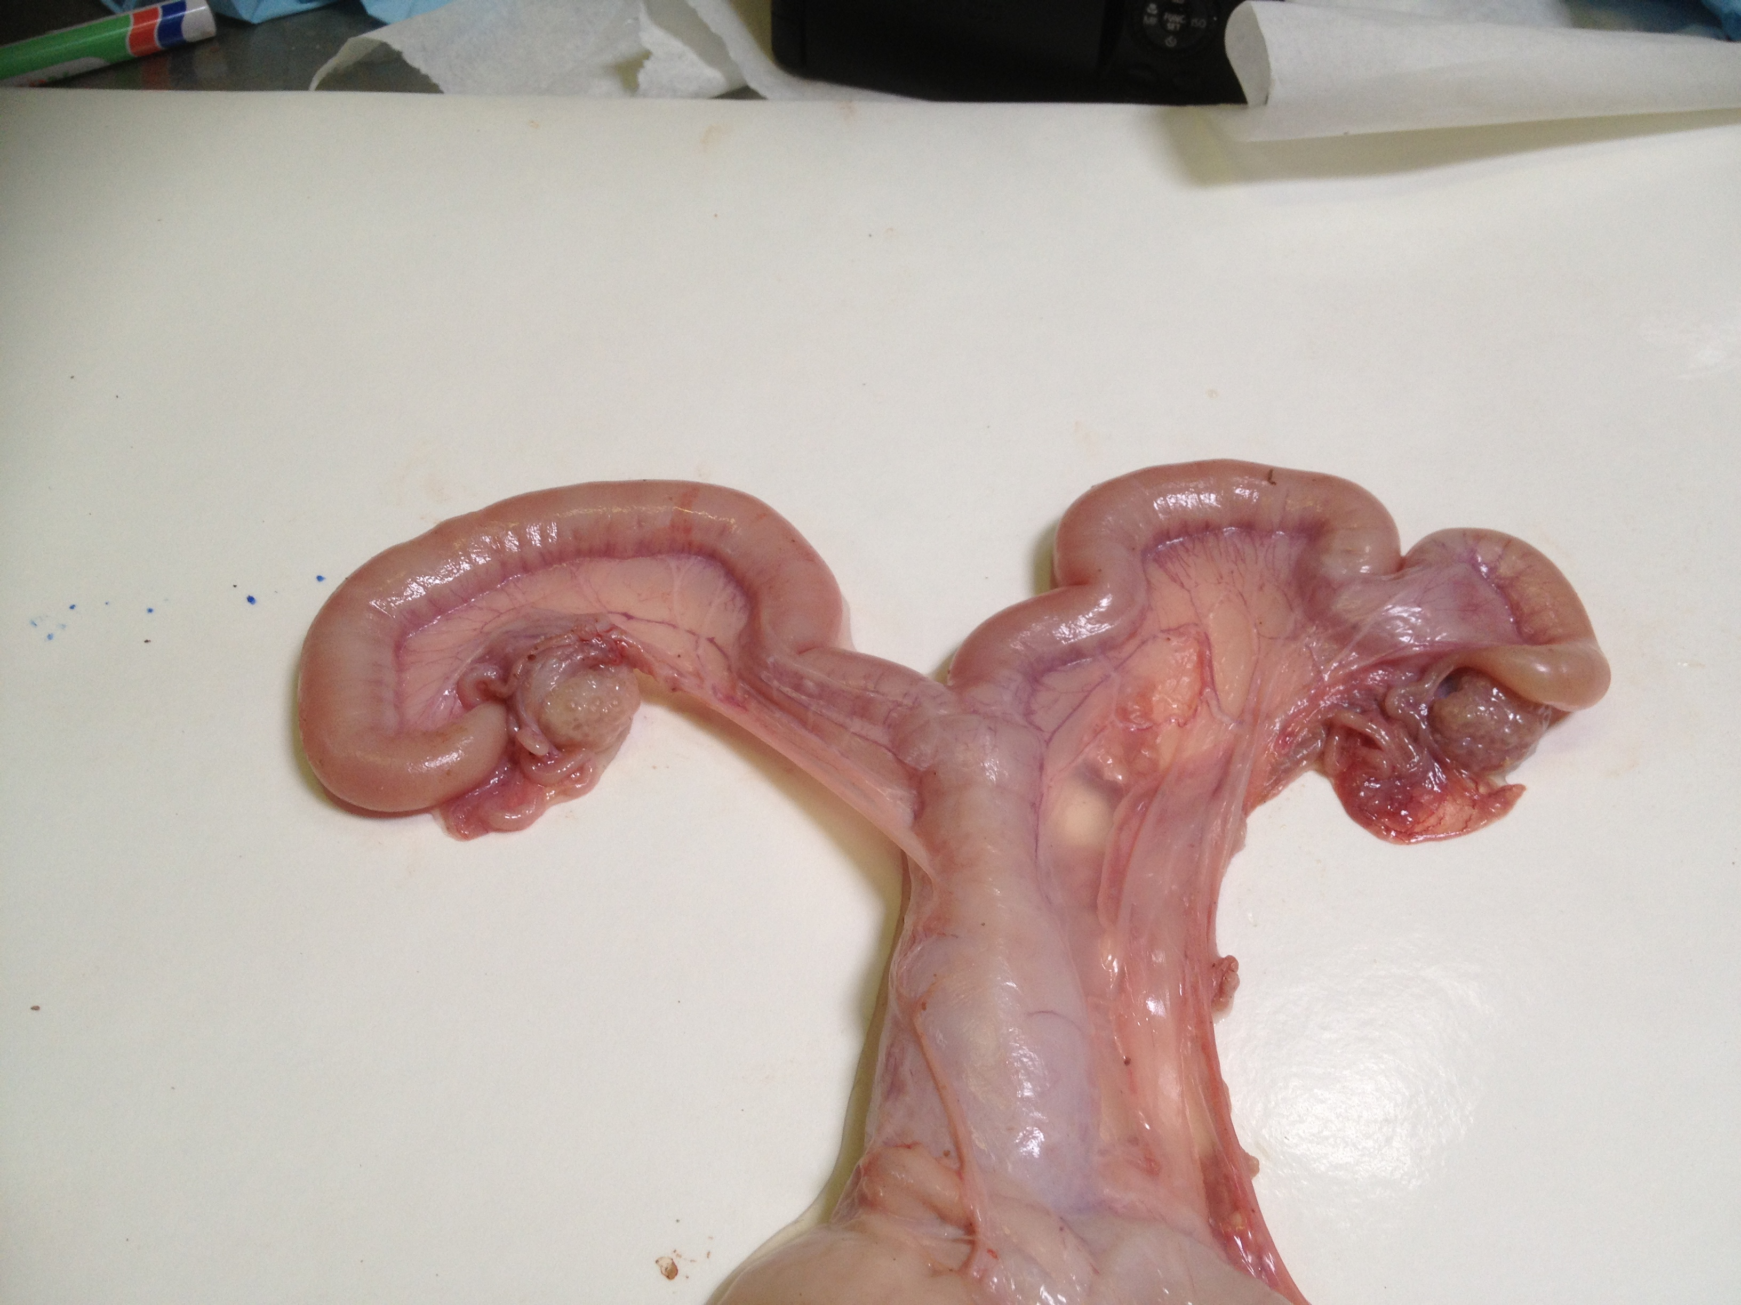
Non infected control gilt

Slide 10
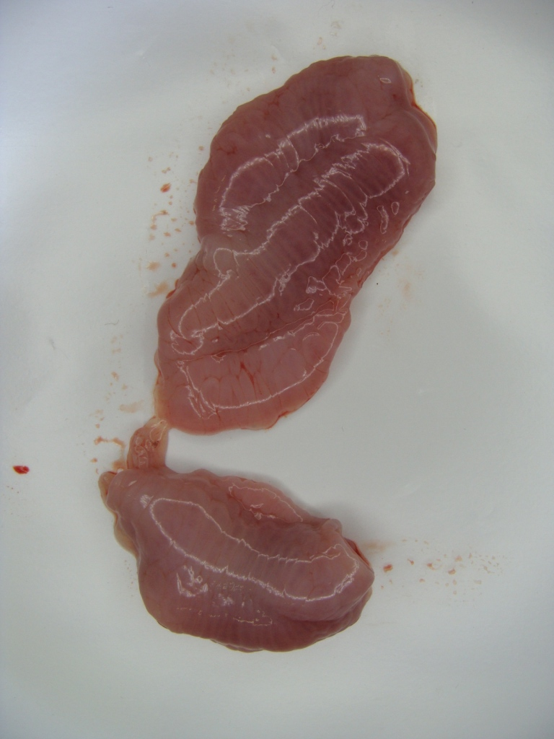
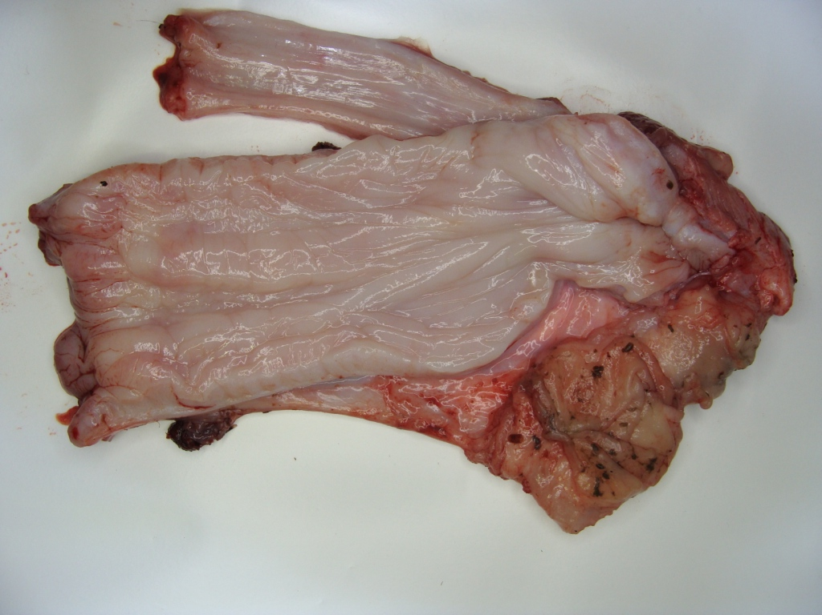
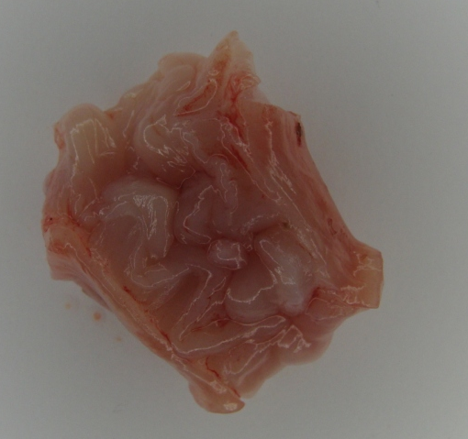
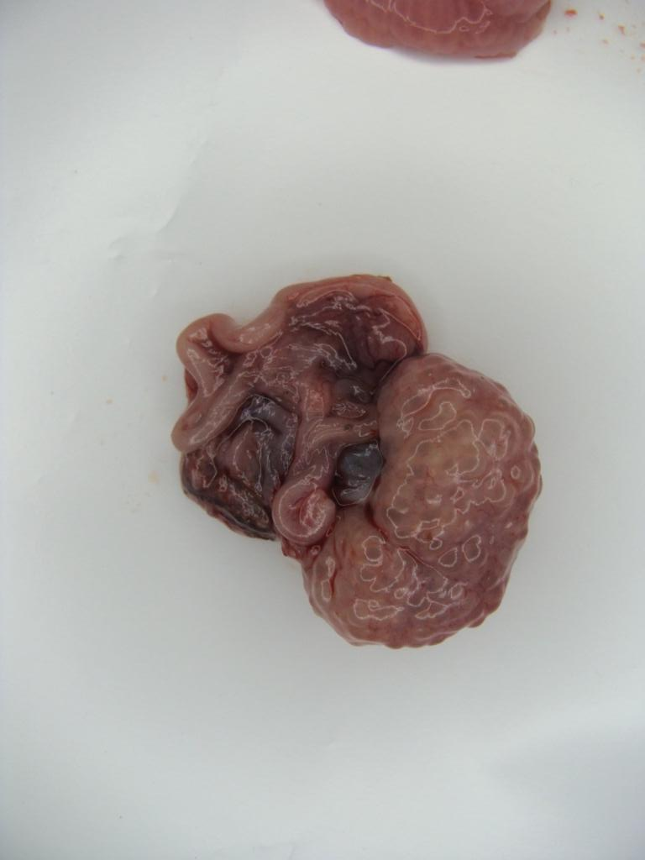
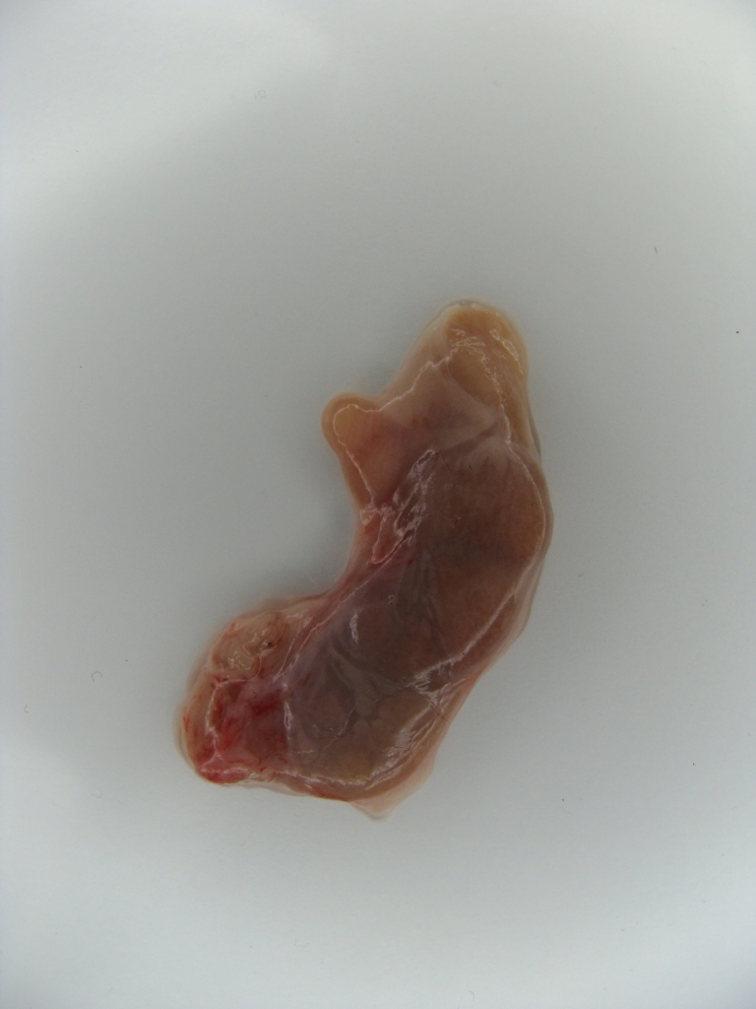
Non infected control pig
A
B
C
D
E

Slide 11
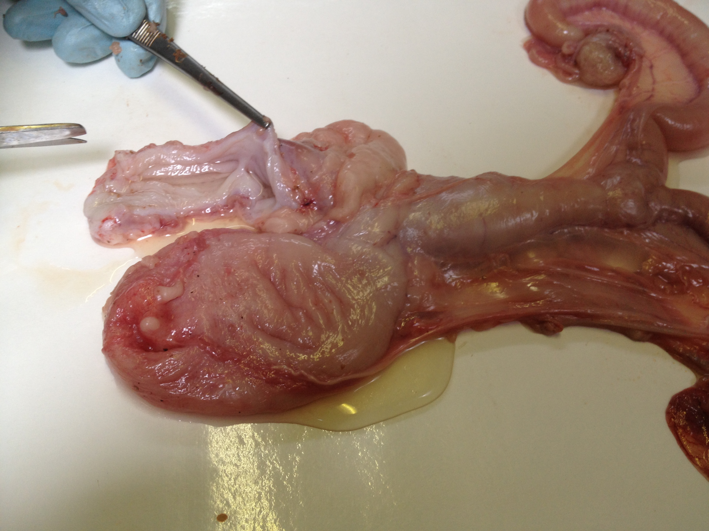
Vaginal infection with C. suis (S45)
Incision in the vagina

Slide 12
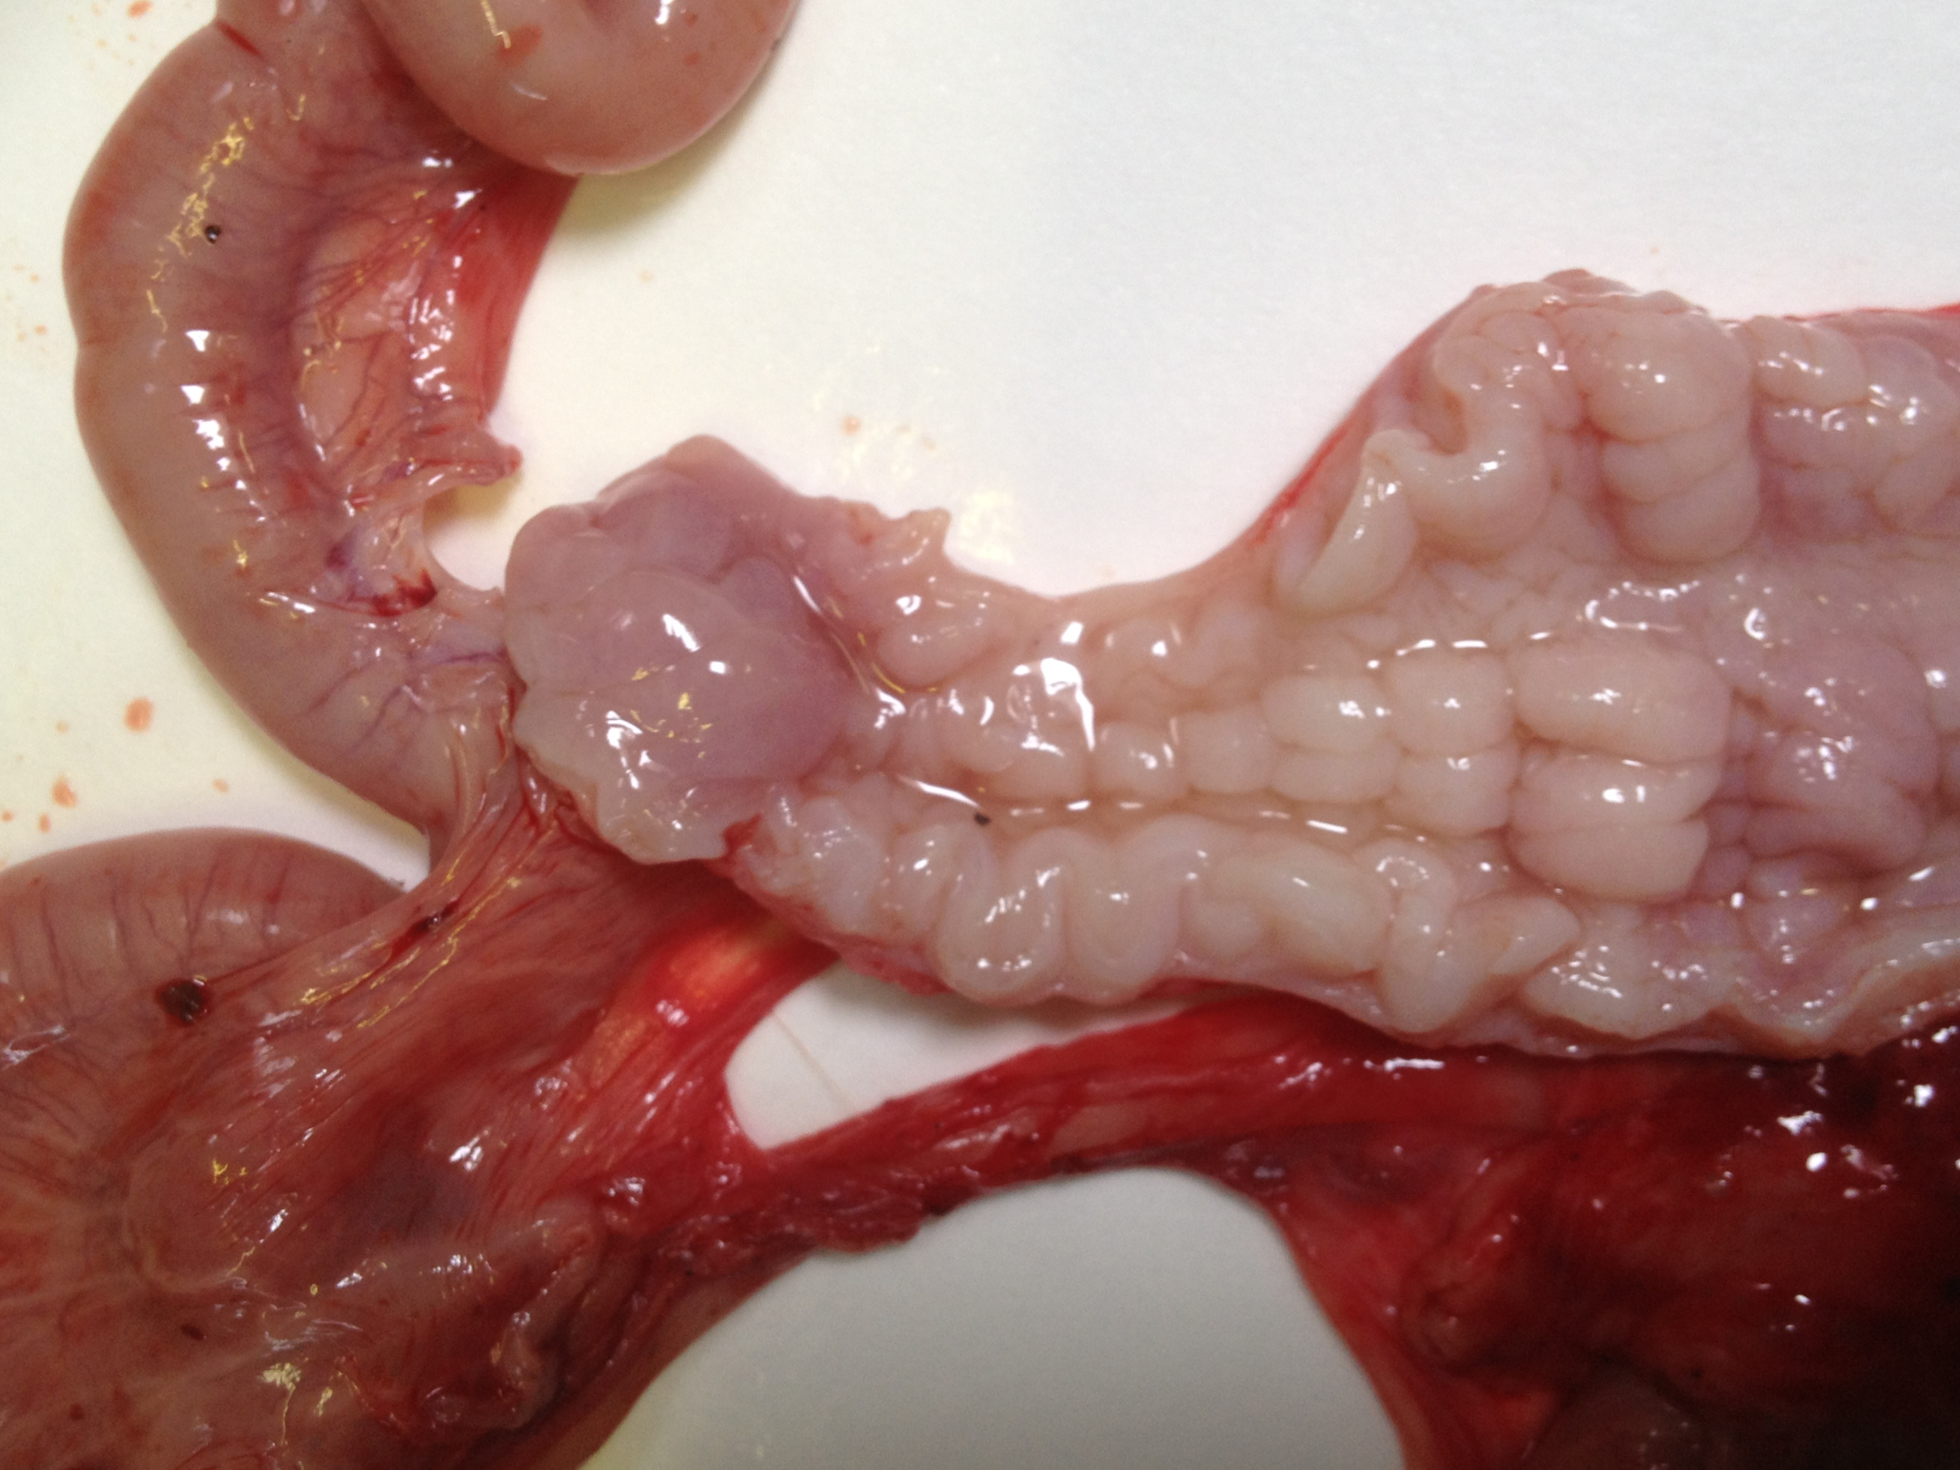
Vaginal infection with C. suis (S45)
Incision cervix and corpus uteri

Slide 13
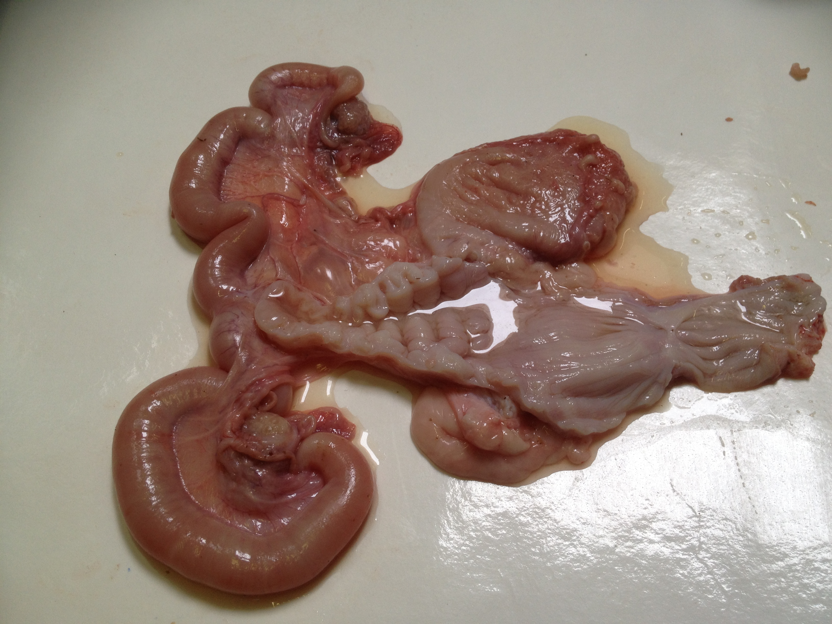
Vaginal infection with C. suis (S45)
Congestion mesosalpinx/mesovarium
Congestion
lig. latum uteri
Serous fluid
Swollen uterus horns (cornu uteri)

Slide 14
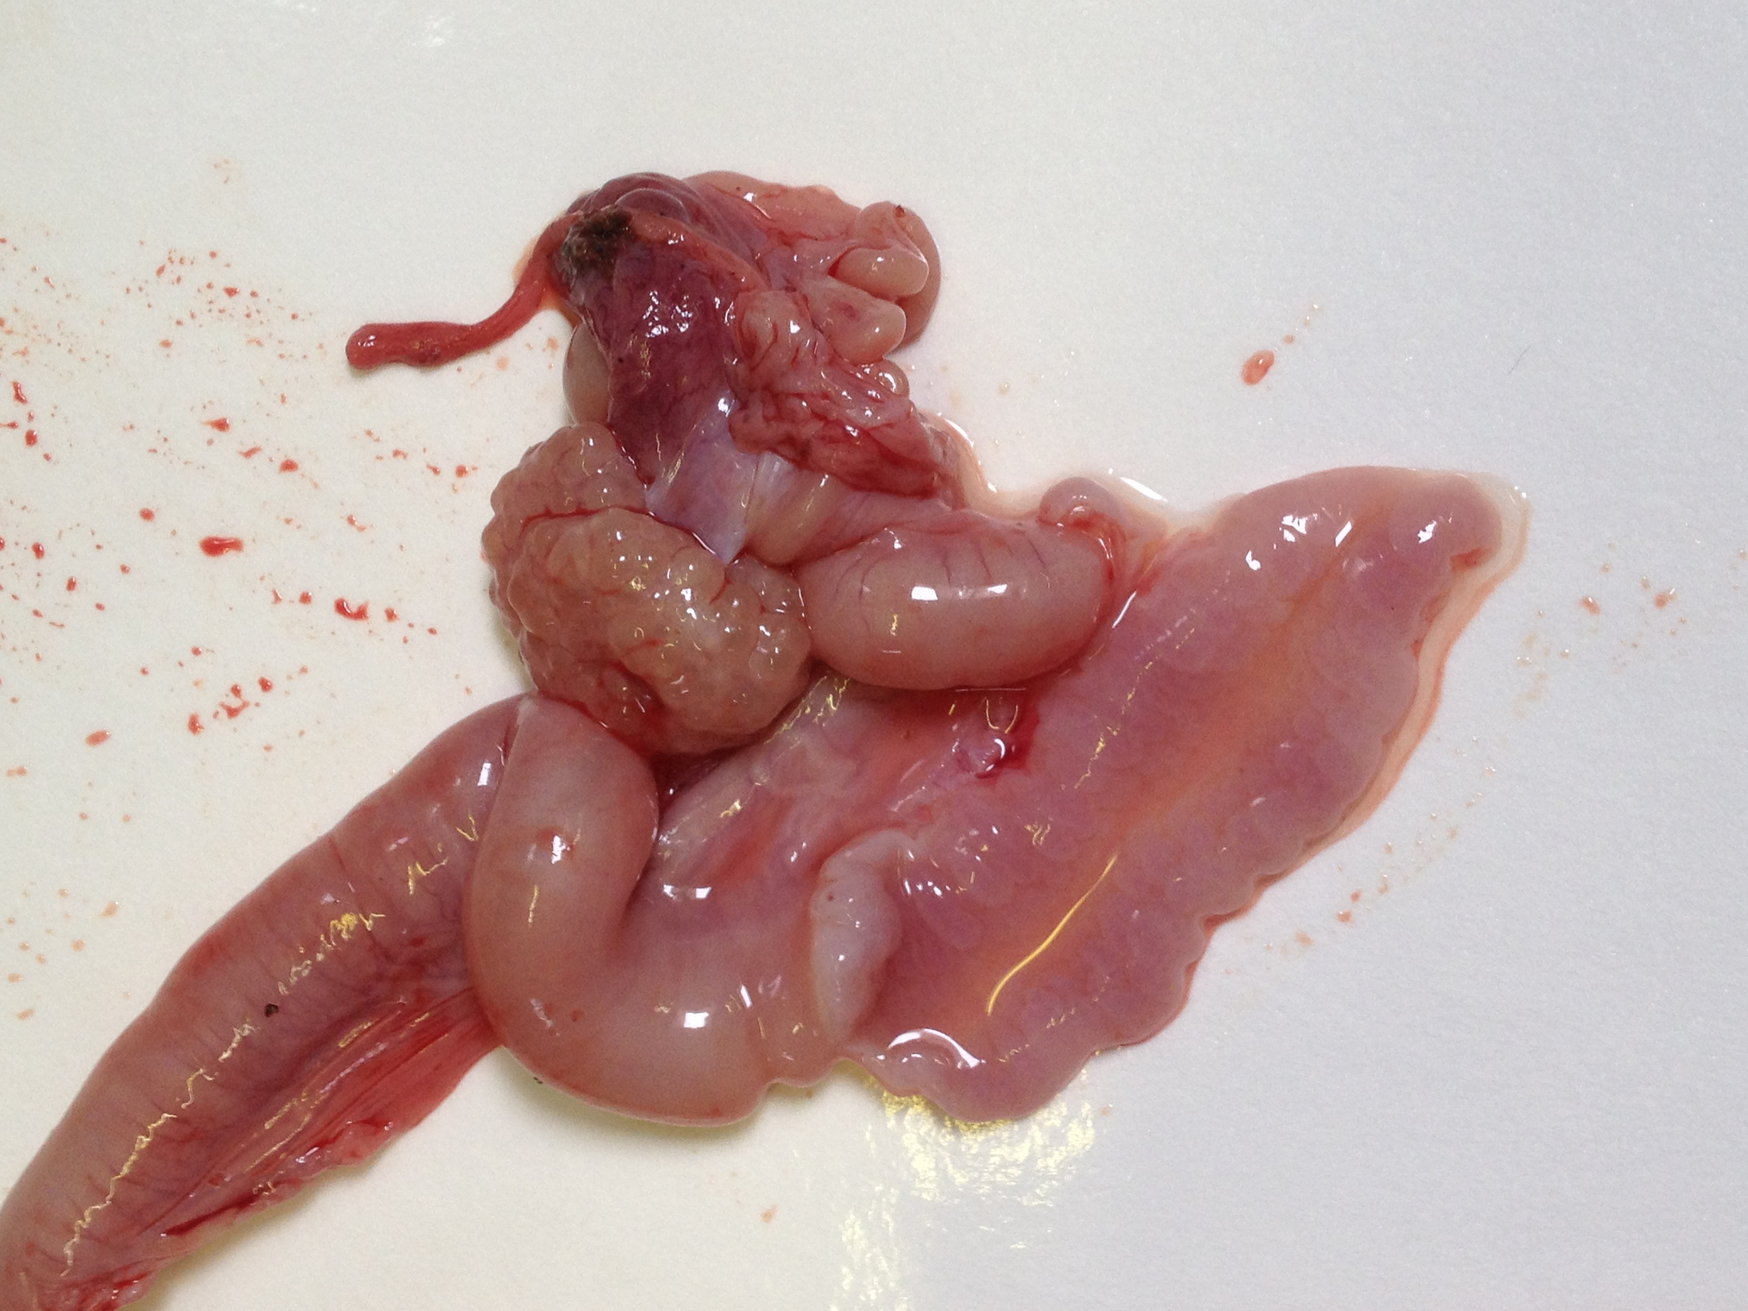
Vaginal infection with C. suis (S45)
Congestion mesosalpinx/mesovarium
Opened uterus horns
Mucosal congestion
Oedema
Serous fluid
Congestion

Slide 15
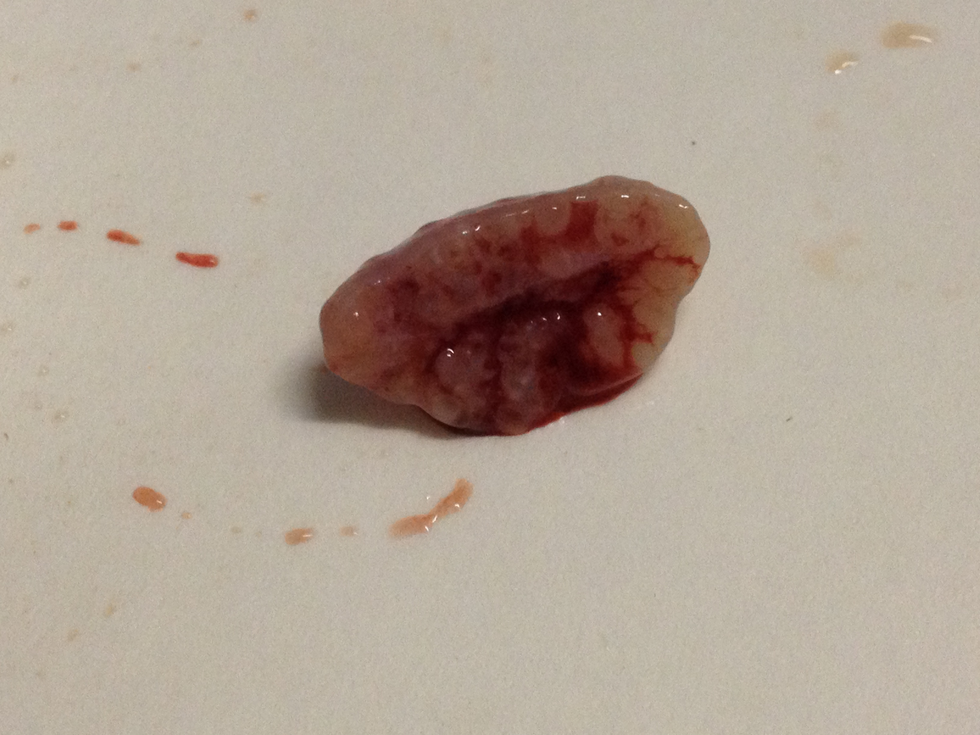
Vaginal infection with C. suis (S45)
Swollen, congested ovarium

Slide 16
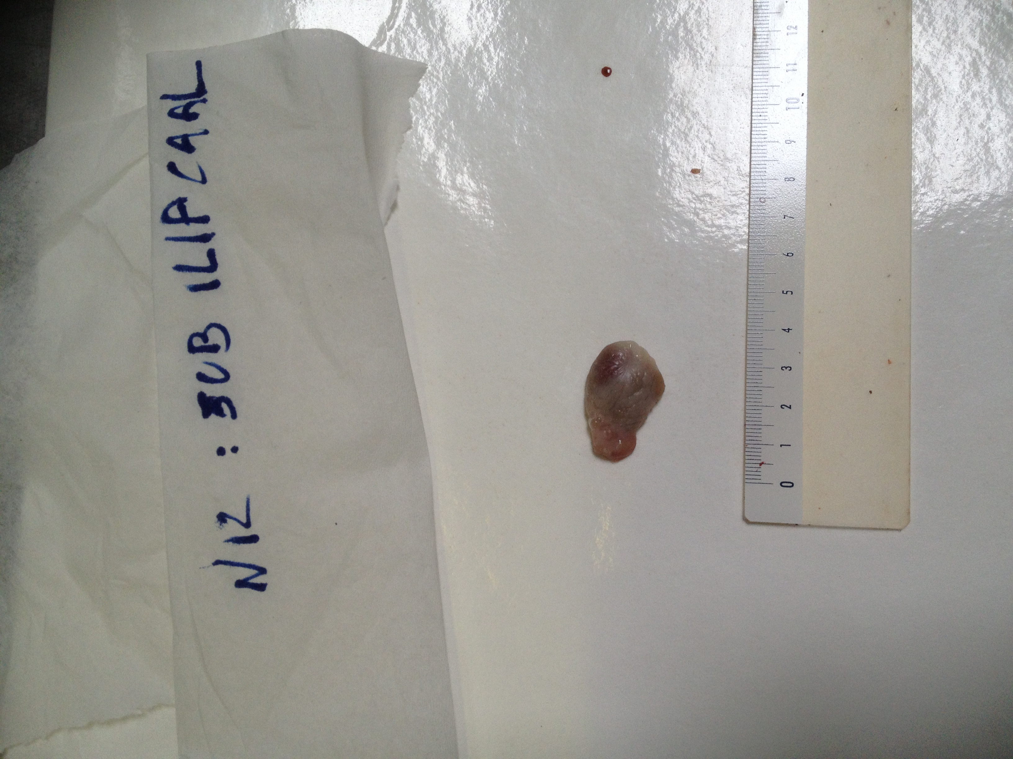
Vaginal infection with C. suis (S45)
Congested local draining lymph node (ln. subiliaci)

Slide 17
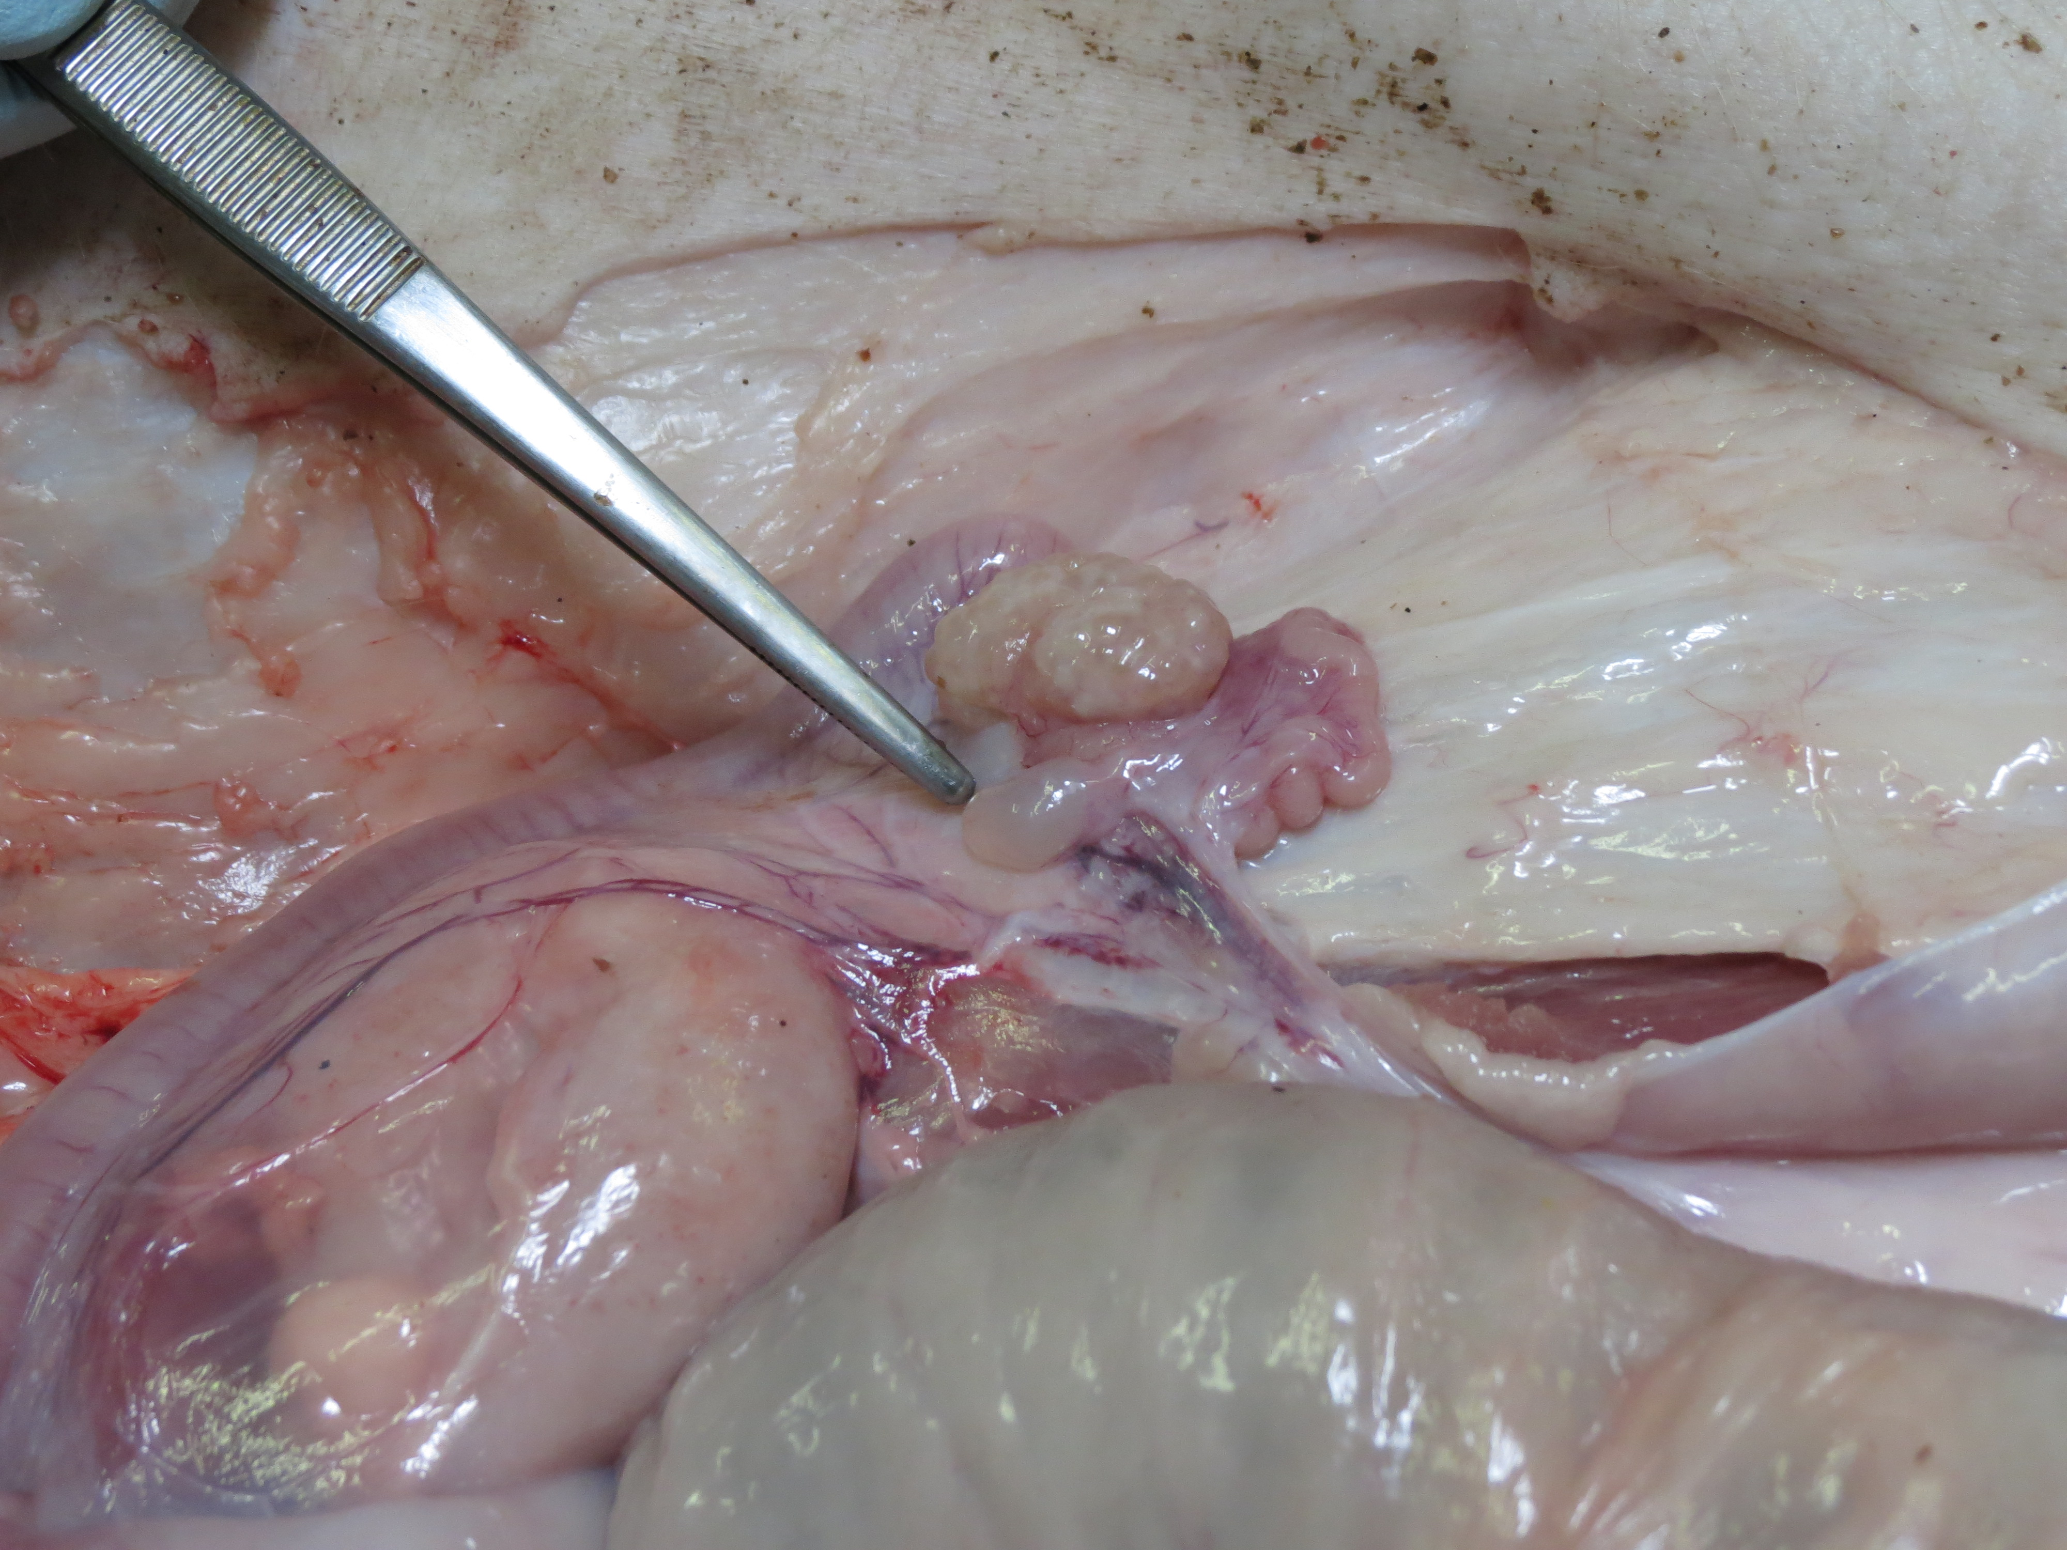
Infection and re-infection with S45
Ovarium, mesovarium normal
No serous fluid
in uterus horns
Oviduct, mesosalpinx
normal
Lig. latum uteri normal

Slide 18
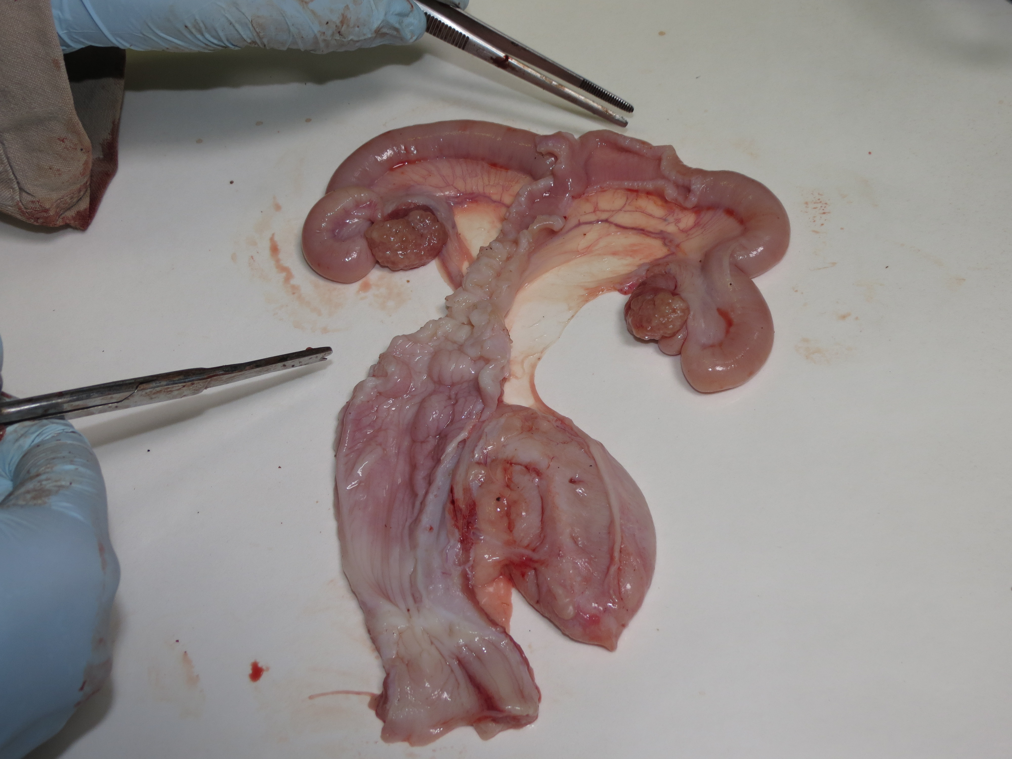
Slight congestion uterus,
but no serous fluid.
Congestion
lig. latum uteri
Ovarium, oviduct and ligaments normal
Congestion upper
vaginal mucosa,
towards the cervix
Infection and re-infection with S45

Slide 19
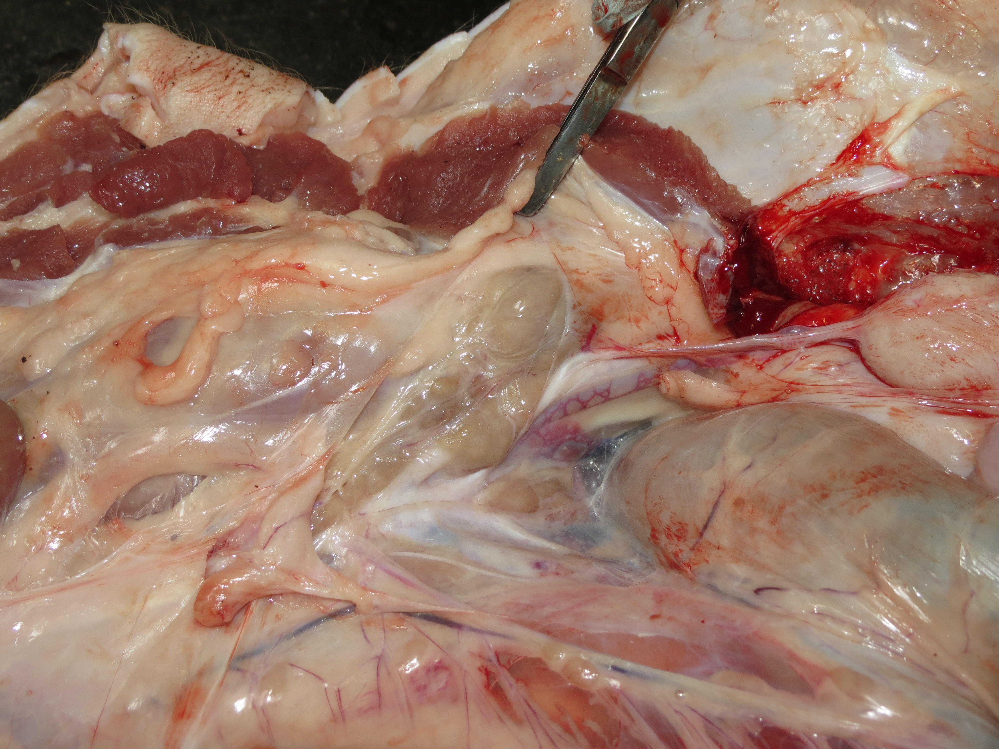
Severely enlarged local draining lnn
Infection and re-infection with S45

Slide 20
Results: histology and immunohistochemistry
Histology
Caecum, liver, spleen, ovaria, oviducts, uterus horns, corpus uteri, cervix, vagina and urethra
    Reinfection group: significantly higher infiltration of lymphocytes, plasma cells, monocytes/macrophages in the mucosa of the urogenital tract as compared to the controls and the infected group.
    Mobilization of memory cells in response to re-infection?
Notes:
Moet ik hier veel extra uitleg bij geven? Want hier weet ik zelf nog niet zo veel over....

Slide 21
Results: Vaginal C. suis excretion
Mean scores per group ± standard deviation for vaginal C. suis shedding, at euthanasia, 21 days post infection 2.
Age | Day p.i. | Infection group | Infection / reinfection group
6 weeks | 0 | 0,00 ± 0,00 | 0,00 ± 0,00
 | 3 | 0,00 ± 0,00 ª | 3,40 ± 0,55 ^{b}
 | 7 | 0,00 ± 0,00 ª | 3,40 ± 0,55 ^{b}
 | 10 | 0,00 ± 0,00 ª | 3,20 ± 0,45 ^{b} *
 | 14 | 0,00 ± 0,00 ª | 2,60 ± 0,89 ^{b} *
 | 21 | 0,00 ± 0,00 ª | 2,60 ± 0,89 ^{b}
 | 28 | 0,00 ± 0,00 ª | 3,40 ± 0,55 ^{b}
 | 35 | 0,00 ± 0,00 ª | 2,00 ± 1,15 ^{b}
 | 42 | 0,00 ± 0,00 ª | 1,40 ± 0,89 ^{b}
 | 49 | 0,00 ± 0,00 ª | 1,00 ± 0,00 ^{b}
17 weeks | 56 (= infection 2) | 0,00 ± 0,00 ª | 0,75 ± 0,50 ^{b} ↑
 | 59 | 3,20 ± 0,45 ^{b} | 2,60 ± 0,55 ^{b}
 | 63 | 3,40 ± 0,55 ^{b} | 3,40 ± 0,55 ^{b}
 | 66 | 3,60 ± 0,55 ^{b} | 2,80 ± 0,45 ^{c} * ↓
 | 70 | 1,80 ± 1,10 ^{b} | 3,00 ± 0,00 ^{c *} ↑
20 weeks | 77 | 2,75 ± 0,50 ^{b} | 2,75 ± 0,50 ^{b}
Control group negative throughout the experiment. All animals per group excreted Chlamydia.
Mean scores with a different superscript within a row are significantly different (p < 0.05).
* Statistically the same within a column.
Re-infection had no marked influence on C. suis excretion

Slide 22
Results: C. suis in tissues
Mean scores per group ± standard deviation (% positives/group) for the presence of C. suis in tissues, at euthanasia, 21 days post infection 2 at the age of 20 weeks.
Tissue | Infection group | Infection / reinfection group
Vagina | 1,80 ± 1,10 (100) | 2,00 ± 1,41 (100)
Cervix | 2,00 ± 1,87 (60) | 0,40 ± 0,55 (40)
Corpus uteri | 0,80 ± 0,45 (80) | 0,20 ± 0,45 (20)
Uterine horn R | 1,40 ± 0,89 (100) | 0,40 ± 0,55 (40)
Uterine horn L | 0,20 ± 0,45 (20) | 0,40 ± 0,55 (40)
Oviduct R | 0,80 ± 1,30 (40) | 0,80 ± 1,30 (40)
Oviduct L | 1,40 ± 0,89 (100) | 0,50 ± 0,58 (40)
Ovary R | 1,60 ± 1,34 (80) | 0,20 ± 0,45 (20)
Ovary L | 0,80 ± 1,30 (40) | 0,00 ± 0,00 (0) *
Urethra | 1,20 ± 1,30 (60) | 1,20 ± 1,10 (80)
Caecum | 0,00 ± 0,00 | 0,00 ± 0,00
Spleen | 0,00 ± 0,00 | 0,00 ± 0,00
Liver | 0,00 ± 0,00 | 0,00 ± 0,00
Mean scores with * within a row are significantly different (p < 0.05).
Infection: 100% pigs with an ascending infection up to the ovaries
Re-infection: 80% pigs with an ascending infection
Number of pigs with C. suis in tissues generally lower in re-infection group

Slide 23
Results: Serum antibodies
Controls remained negative. Primo-infection induced serum IgM and IgG (both Dpi 7), but no IgA.
IgG still present at re-infection time point (Dpi 56).
Seven days after re-infection, mean serum IgM and IgG titers increased again and kept
on raising till euthanasia indicative for a secondary antibody response. IgA appeared

Slide 24
Results: mucosal antibodies
Controls remained negative. Primo-infection induced vaginal IgM and IgG (Dpi 14), but no IgA.
No vaginal antibodies present at re-infection time point (Dpi 56).
Seven days after re-infection, mean serum IgM and IgG titers again present and one
week later IgA also appeared.

Slide 25
Results: T cell proliferation assay
The C. suis primary infection did not induce a significanlty higher S.I. for PBMCs
  No statistical differences between the control group and the infected group.
Re-infection did induce a significanlty higher S.I. for PBMCs
Mean stimulation index (SI) ± standard deviation of PBMCs, 7 days post re-infection (Dpi 63).
Stimulation | Control group | Infection group | Infection / re-infection group
C. suis S45 | 2,03 ± 1,42ª | 2,15 ± 1,23ª | 8,80 ± 5,46^{b}
Mean scores with a different superscript within a row are significantly different (p < 0.05).
3. At euthanasia (Dpi 77): proliferative responses of PBMC and of MC from the spleen and the lymph nodes were statistically the same for all groups.

Slide 26
Conclusions C. suis nfection and re-infection in pigs
Conclusions
C. suis causes an ascending infection with pathology (cfr. C. trachomatis)
Re-infection induces “partial” protection - significant reduction of:
  macroscopic lesions, number of pigs still positive in the genital tract at euthanasia
Re-infection ➔ partial protection with significant higher:
  IgG and IgA titers in sera and vaginal secretions
  Proliferative responses (S.I.) of PBMC’s
  Flow cytometry
    Percentages of B cells, monocytes and CD4⁻CD8⁺ T cells in PBMC
    Percentages of CD4⁺CD8⁻ T cells and CD3⁻CD4⁺CD8⁻ spleen MC (contain pDC)
    Percentage of CD4⁻CD8⁺ T cells in pelvic lnn
  Production of IL-10 and IFN-γ by PBMC’s

Slide 27
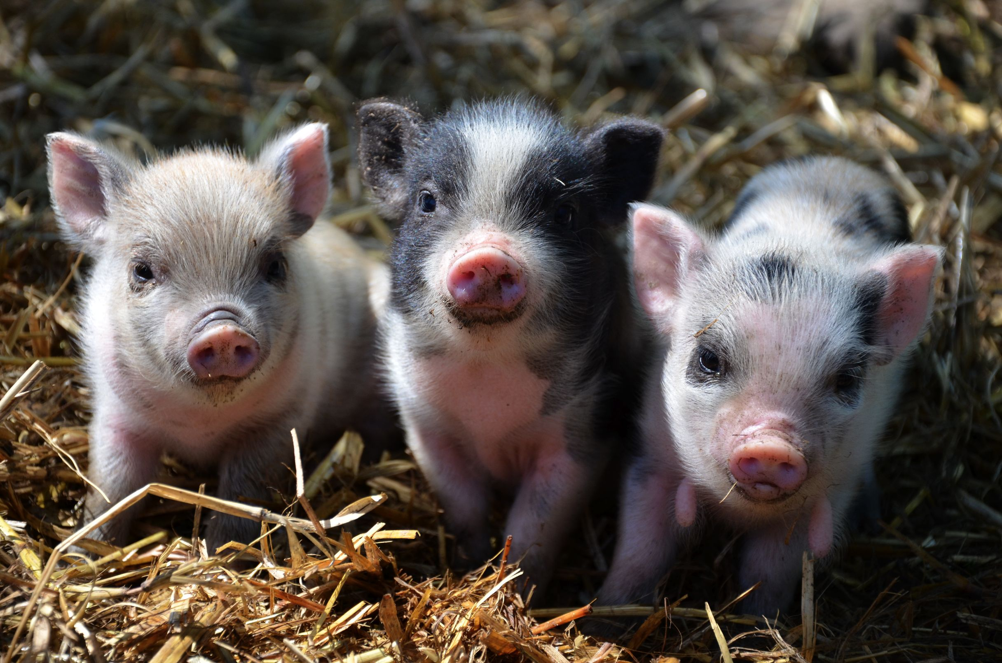
Future research & perspectives
Development of a vaccine (mucosal vaccine)
  C. suis
  C. trachomatis using the vaginal infection model in pigs
Genomics - proteomics of C. suis
C. suis bacterium-host cell interactions

Slide 28
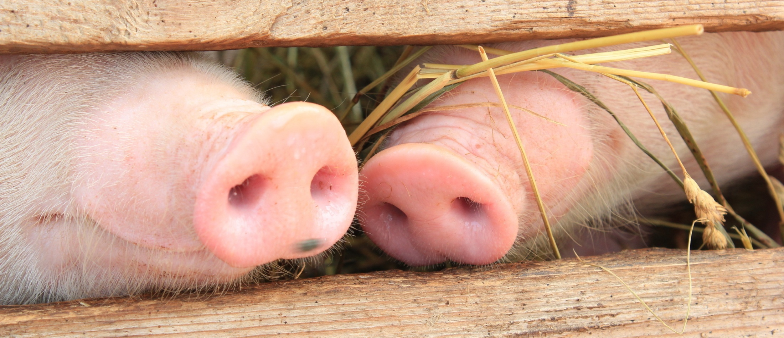



Acknowledgements
Animal Health Care Flanders
IOF
Belgian Federal Department Public Health, Food Safety and Environment

