Slide 1

Innovative test to predict
drug-induced neurotoxicity
and psychiatric side effects
Dinah WEISSMANN
Toxicogenomics 2015, Valencia

Slide 2

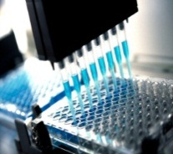
ALCEDIAG develops new tools for personalized medicine
ALCEDIAG develops innovative solutions for medical diagnosis with a first focus on psychiatric disorders
The tests are based on proprietary technologies for drug toxicology screening assay and, in the patient, biomarkers to improve diagnosis and management of treatments

Slide 3

Psychiatric disorders: major healthcare burden
WHO, Global burden 2004
World
Americas
Europe
Very frequent: ¼ of population
Most disabling: 1st world rank
Highly costly: 240Md€ in Europe
Unipolar depressive disorders 151 22.7 22.2
Bipolar affective disorders 29.5 4.1 4.4
Schizophrenia 26 3.9 4.4
Prevalence expressed in million patients
An unmet medical need
Lack of objective tools
Uncertain diagnosis
Delay in the management of treatment
Poor efficiency of treatment
Drug adverse effects (suicide)

Slide 4
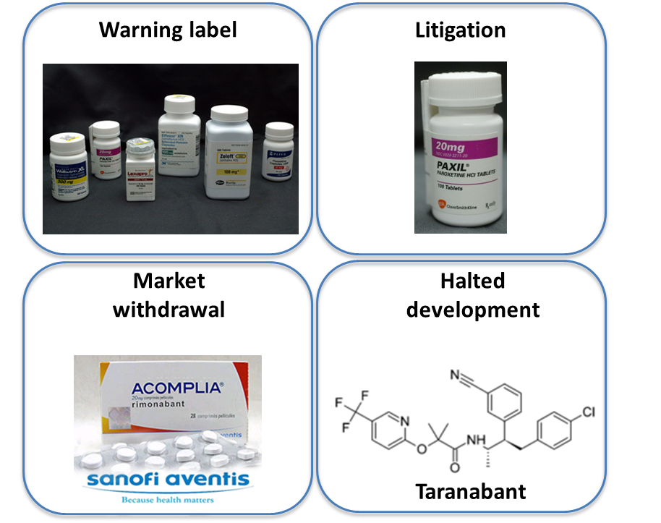
Preventing suicide: a global imperative
(WHO report 2014)
Treatments have been withdrawn from the
market because of their adverse effects
(suicide)
Animal models are poorly predictive and
raised ethical concerns
EDITOX ®: a Toxicogenomic solution
to assess drug-induced suicidality

Slide 5
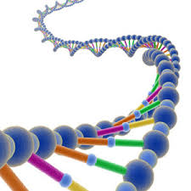

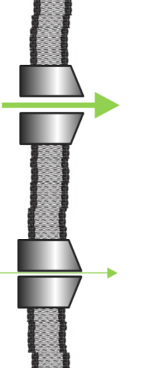
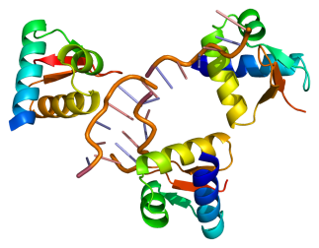

EDITOX mechanism: RNA Editing
Transcription
Traduction
Neurotransmitter
function
DNA
RNA
Protéines
A
A
A
A
Non edited
Editing (A to I)
I
A
I
I
Edited
Altered Function
Enzymes
ADARs
PATHOLOGICAL DYSFUNCTION
SEROTONIN 2C R: psychiatry
AMPA: cancer, cognitive deficits
Ion channel: cardiovascular
PDE8A: psychiatry, autoimmune disease, lupus
PHARMACOLOGICAL DYSFUNCTION
Drug induced depression/suicide (5HT2C R)
FDA Alerts: antidépressant, anti- obesity, anti- convulsants, anti-nicotinic…

Slide 6
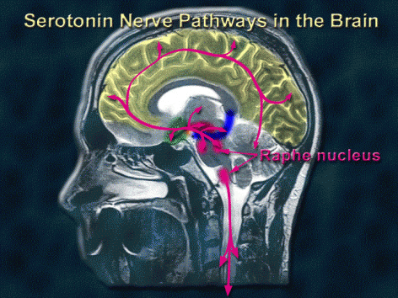
: Suicide & serotonin 2C receptor RNA editing
Serotonergic system tightly linked to psychiatric disorders (e.g. depression and suicide).
Serotonin 2C receptor (5-HT2CR) RNA is subjected to RNA editing.
Alteration in 5HT2CR editing in the prefrontal cortex in psychiatric disorders and suicide.
Neuropsychiatric disorders have also been linked to immune system activation (neuroinflammation).
Sodi et al. 2001 Mol. Psychiatry
Niswander et al. 2001 Neuropsychopharmacology
Gurevich et al. 2002 Neuron
Weissmann et al. Patents and unpublished data.
Dracheva et al. 2003. J. Neurochem.
Yang et al. 2004 Mol. Brain Research
Baganz et al. 2013 ACS Chem. Neurosci
Di Narzo et al. 2014 Human Mol. Genetics
Interferon treatment in patients induces severe psychiatric side effects (depression/suicidal ideation).

Slide 7



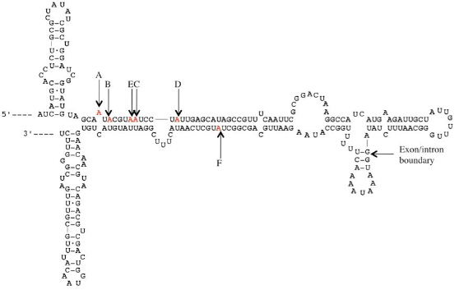
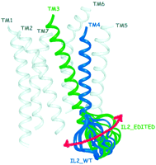
RNA editing regulates post-synpatic response
32 RNA isoforms
24 receptors
Physiology
Editing sites
Structural impact of RNA Editing
A
Loop conformational change
Modulation of
G Protein binding
5HT2C Receptor 2nd Intracellular Loop

Slide 8
Altered 5-HT2CR editing impacts post-synpatic response
32 RNA isoforms
24 receptors
Drug/disease
Editing sites
Structural impact of RNA Editing
A
Loop conformational change
Modulation of
G Protein binding
5HT2C Receptor 2nd Intracellular Loop

Slide 9
ALCEDIAG benefits from 10 years experience
in RNA editing research
Alcediag identified a specific signature (molecular modifications) in the brain of suicide patients (patents granted in 2012, USA, Canada, Europe)
Alcediag identified an “at risk” profile for drugs tested on a specific cell line (patents granted in 2014 & Cavarec et al 2013 Neurotox.Res)
This “at risk “drug profile is similar to the profile found in the brain of suicide patients
Alcediag identifed specific biomarkers in the blood of depressed/suicide patients (patents granted in 2014)

Slide 10



Alcediag Tools for personalized medicine
BloodTest
Cell Test
RNA editing mesurement platform
RNA Editing Profile of the patient
EDITDIAG®
RNA Editing Profile of drugs
EDITOX®

Slide 11
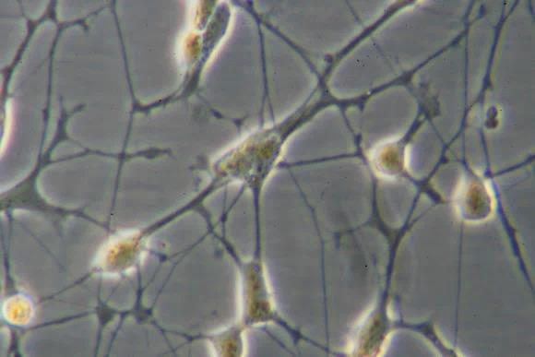
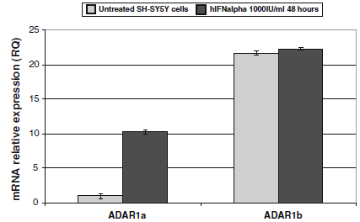
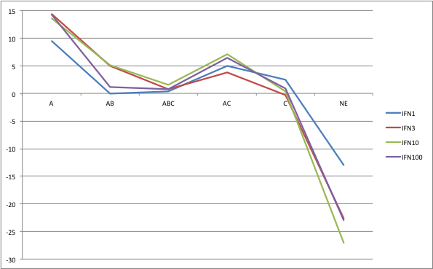
EDITOX® cell model
SH-SY5Y
SH-SY5Y human neuroblastoma cells express 5HT2CR, ADAR1a, ADAR1b and ADAR2 at comparable levels compared to prefrontal cortex neurons (Cavarec et al 2013) .
SH-SY5Y cells respond to Interferonα (IFNα)
treatment.
Interferon a ( IFN antiviral), an inducer of editing enzymes, triggers depression/suicide in patients and exhibits a editing profile similar to that found in post mortem suicide brain

Slide 12

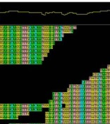
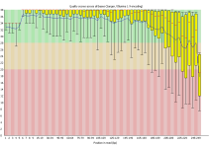

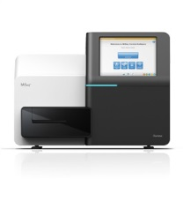







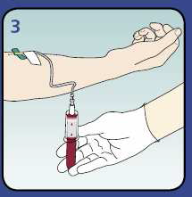


ALCEDIAG platform
Cell culture:
Drug screening
NGS Bioinformatics pipeline
Pos: 1292 Depth:41637 ==> site C
G......G...G.....GG..G.G...G.G......G...G..G...GG..G.........GGCG.....G.G.G..G..G....G..G......G.
At risk profile
Pre-processing & Quality Control
RNA Sequence Alignment
RNA Editing sites search
New Generation
Sequencing NGS
Files FASTQ
Human expertise
Server computing
Storage capacity
Software
NGS Computing Ressource & Infrastructure

Slide 13
EDITOX® Validation
Design of study
54 marketed molecules of different therapeutical and chemical classes were double-blinded tested
Editing profiles were generated
FDA alerts and case reports on drug-induced depression/suicide were reported : 30 compounds with FDA alert for suicide and 24 without
A proprietary algorithm was created to assess the neurotoxicity risk of the compounds
Cavarec et al, 2013, Neurotox Res

Slide 14






Marketed compounds tested
Antidepressant
Antipsychotics
Antiepileptic/mood
Stabilizing agent
Anorectic
Phentermine
Rimonabant
Taranabant
Amoxapine
Buproprion
Citalopram
Clomipramine
EHNA
Fluoxetine
Imipramine
Ketamine
Nortriptyline
Paroxetine
Sertraline
Venlafaxine
Amisulpride
Aripiprazole
Bifeprunox
Clozapine
Loxapine
Olanzapine
Paliperidone
Perospirone
Perphenazine
Quetiapine
Sertindole
Zotepine
Carbamazepine
Felbamate
Gabape,tine
Lamottrigine
Levetiracetam
Lithium carbonate
Mephenytoin
Topiramate
Valproic acid
Zonisamide
Others
Isotretinoin
Dexamethasone
Diphenhydramine
Hydralazine
Ketoconazole
Meta-chloro- phenylpiperazine
Nadolol
Ondansetron
Prednisone
Varenicline
Yohimbine
Anti viral
Ribavirine
Interferon

Slide 15
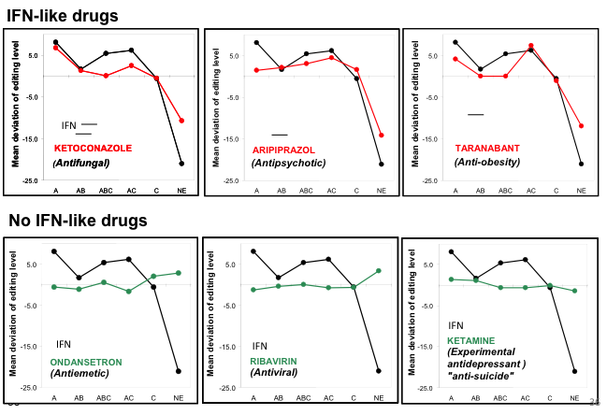
RNA editing profiles of tested compounds
IFN editing profile in black
Compound tested
With FDA alerts
IFN editing profile in black
Compound tested
Without FDA alerts
Cavarec et al,Neurotox Res. 2013
Neurotoxicity is found with all class of compounds tested

Slide 16
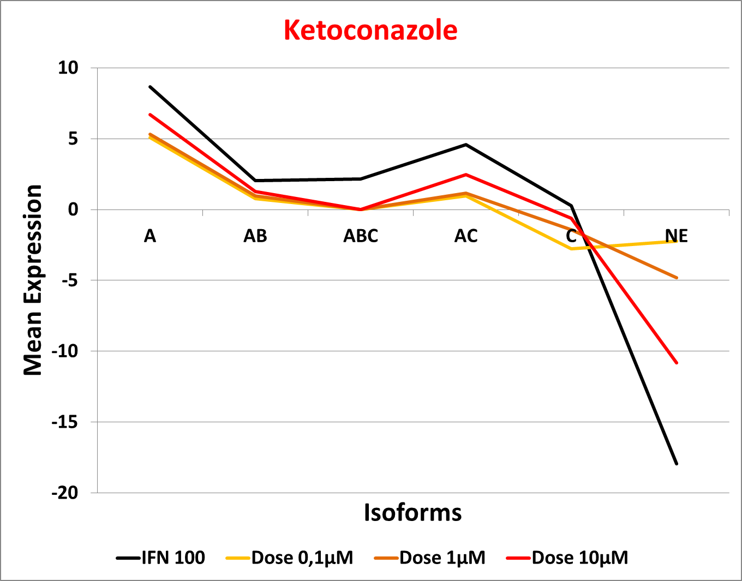
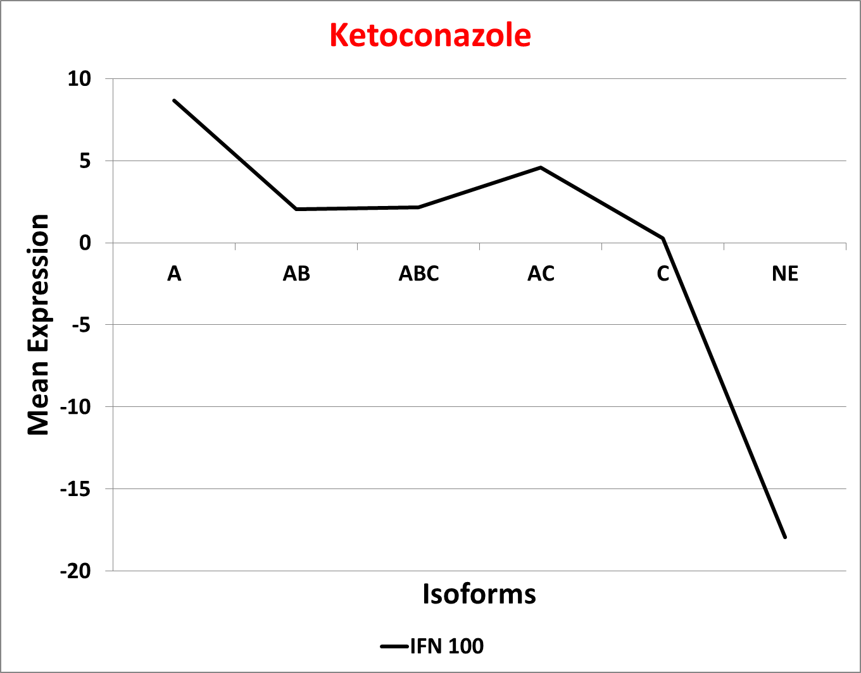
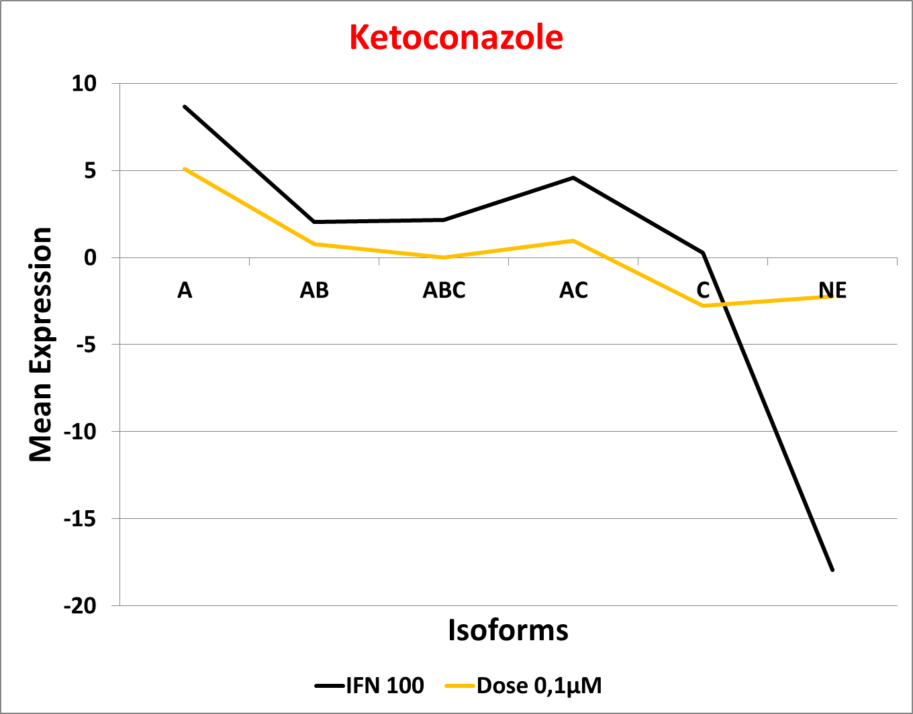
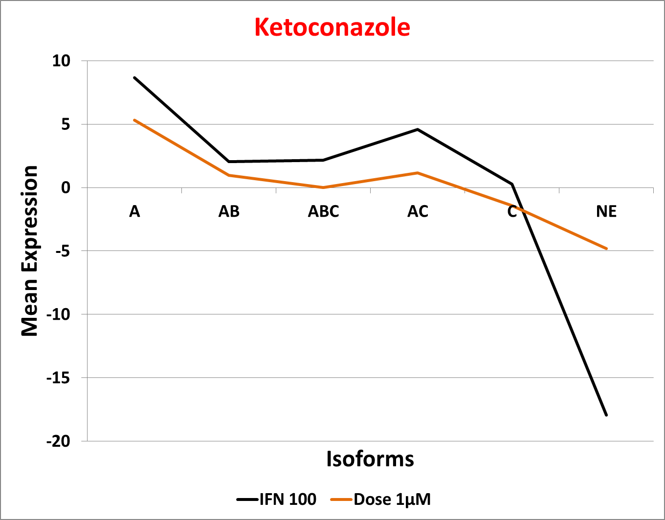
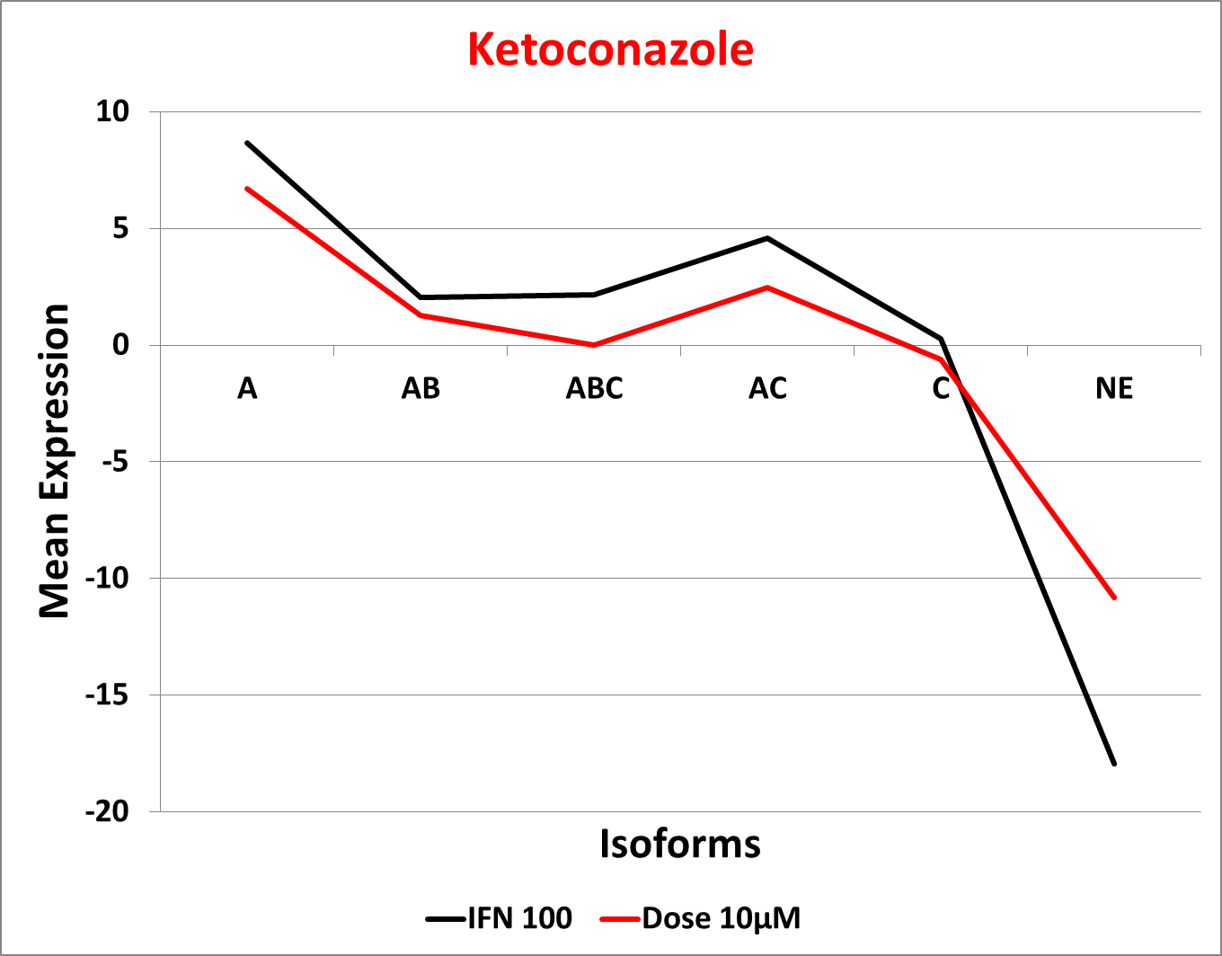
RNA editing profiles of tested compounds
….But varies with concentration

Slide 17
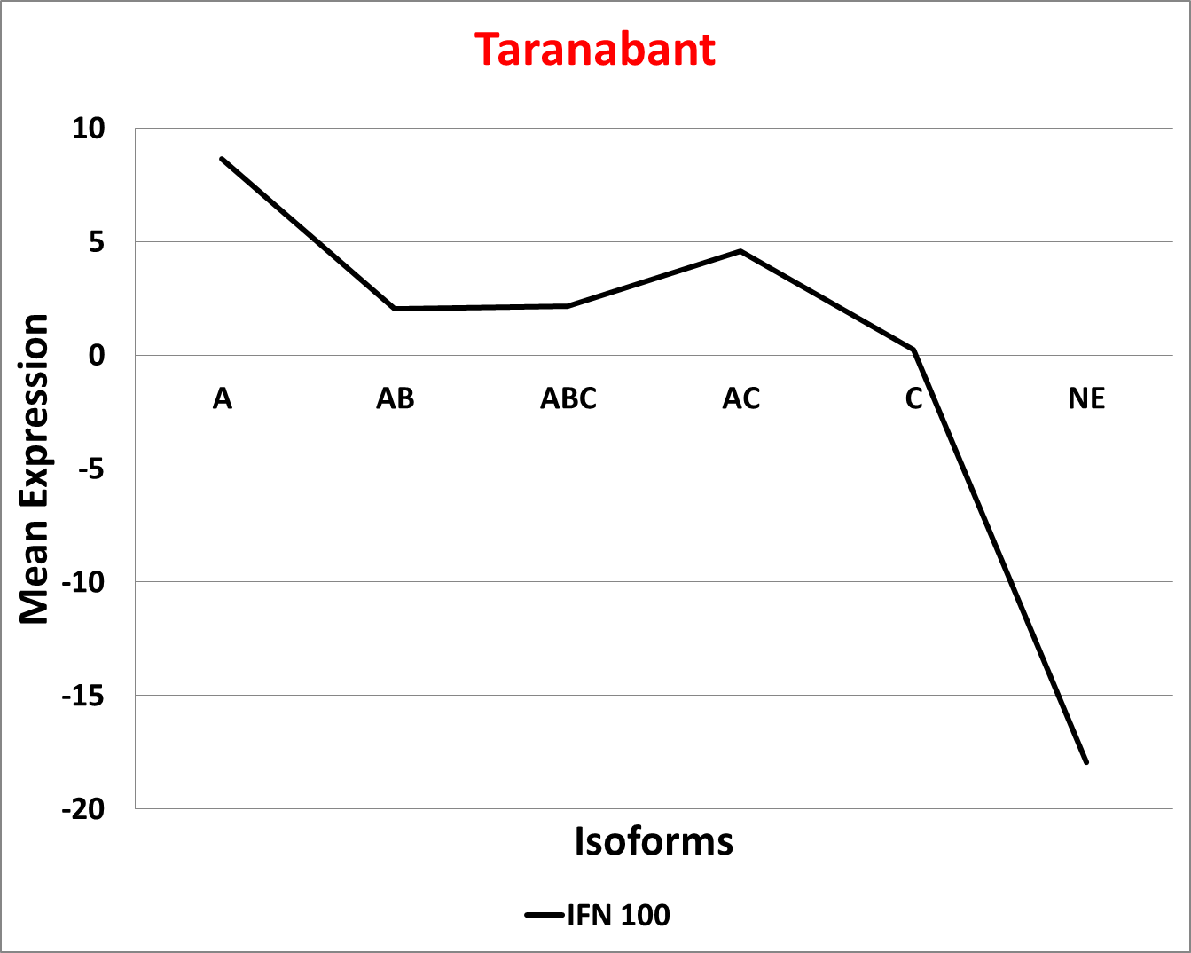
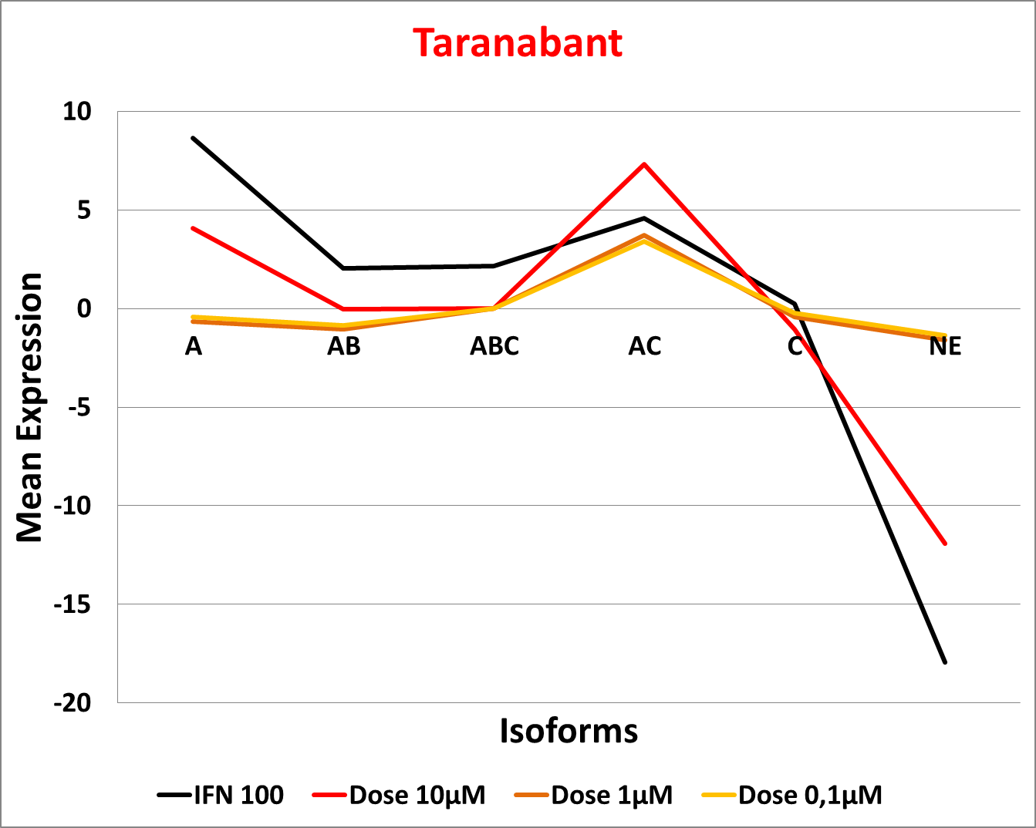
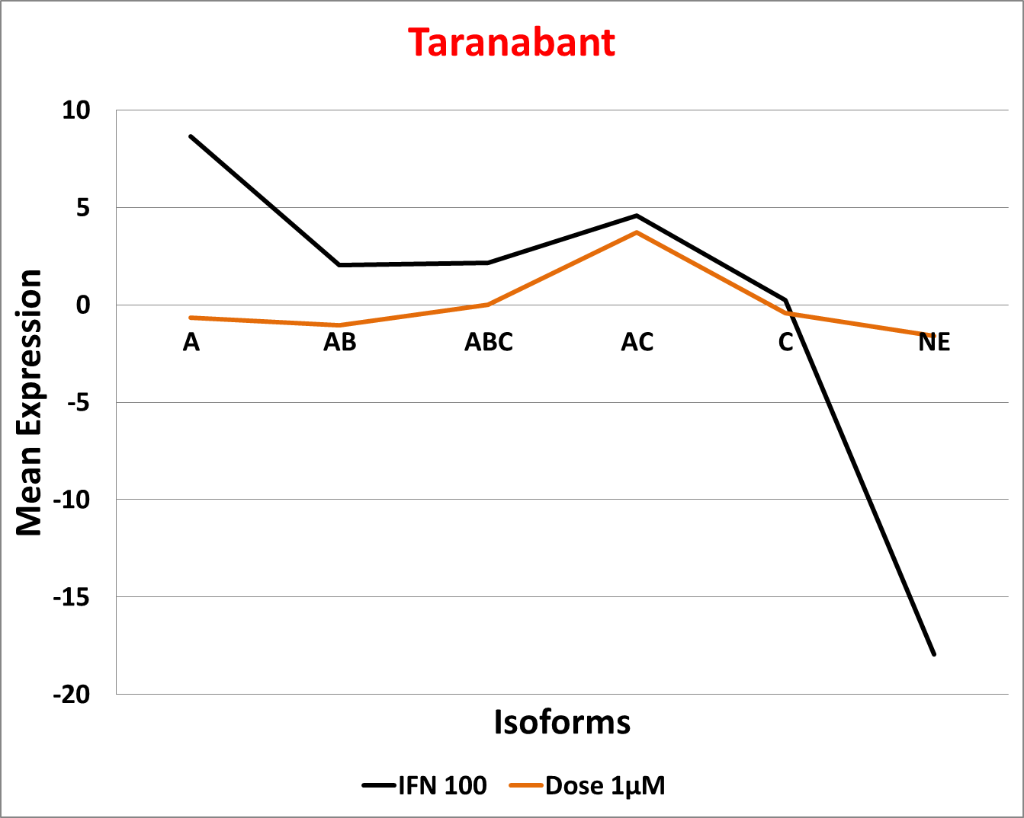
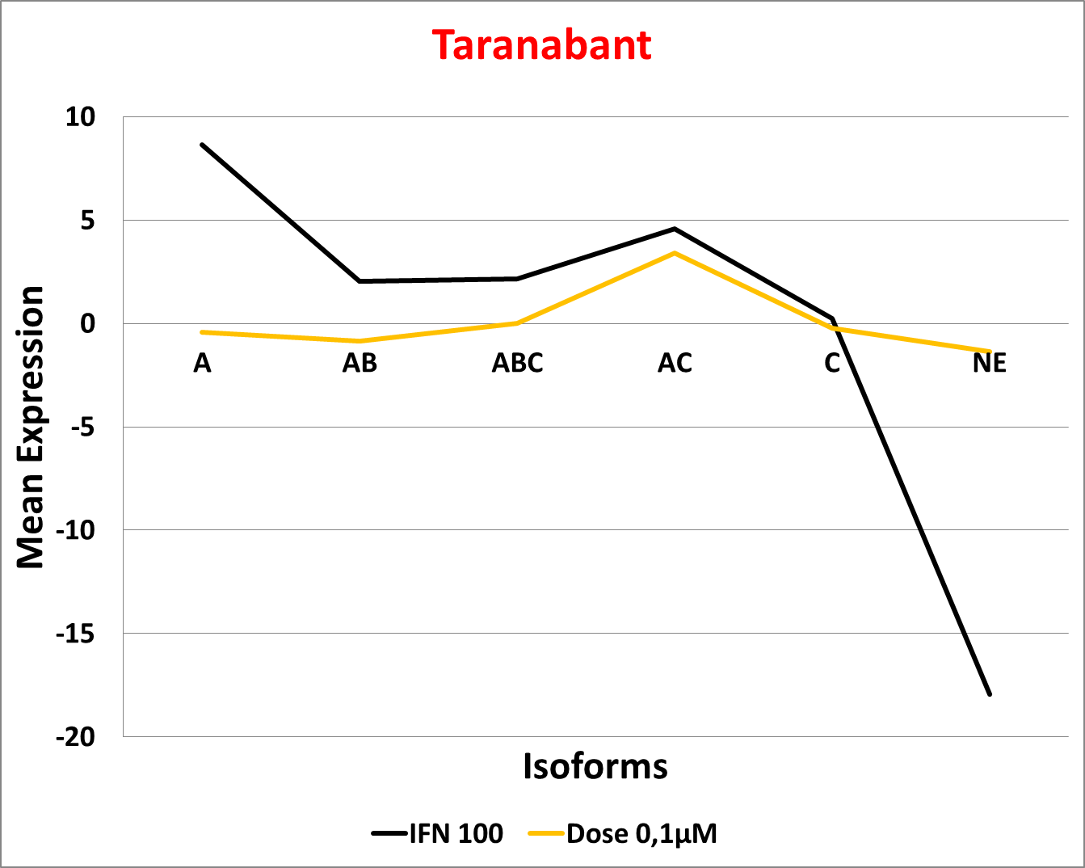
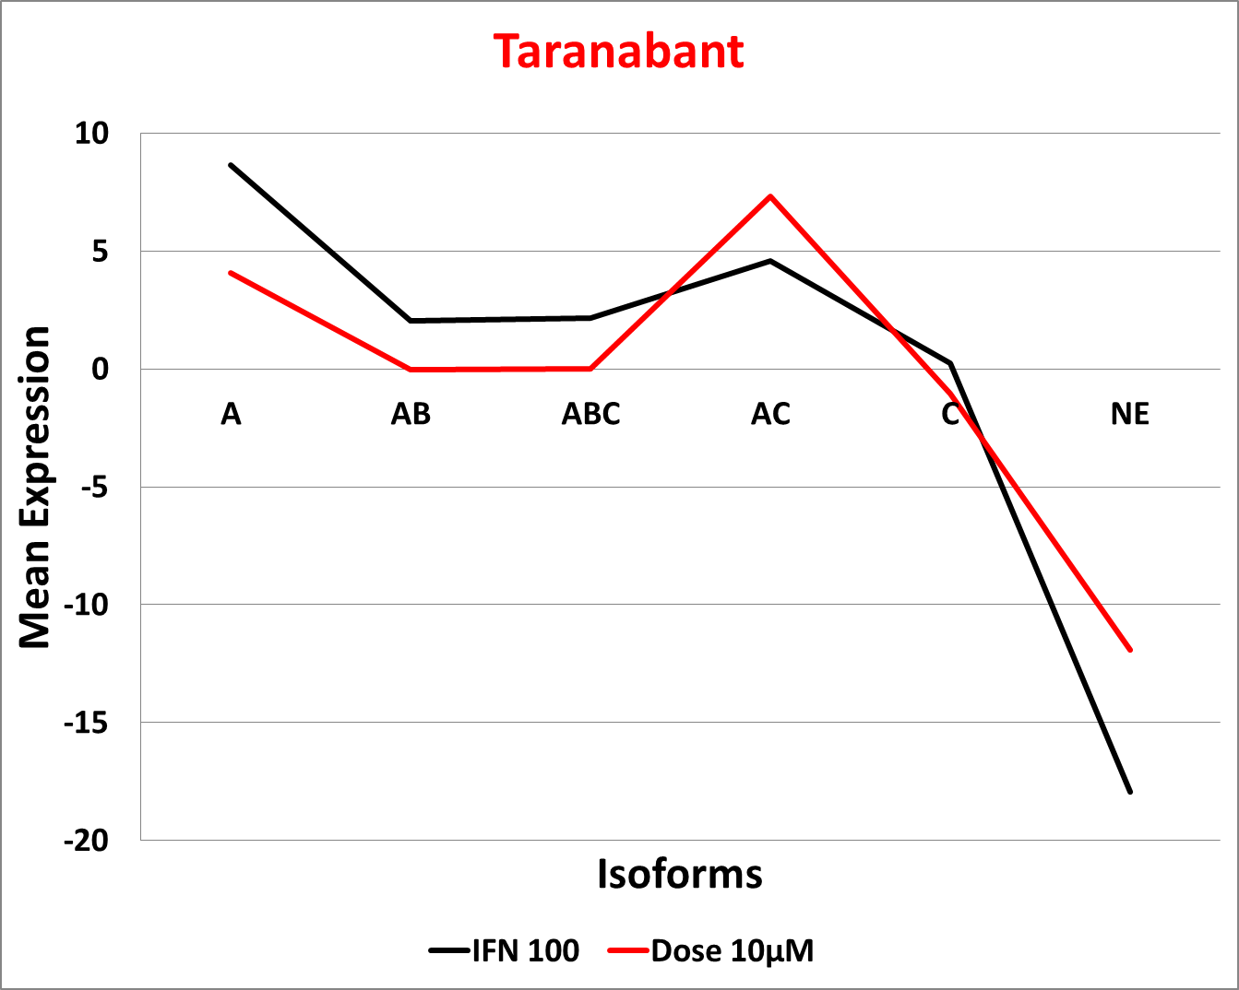
RNA editing profiles of tested compounds

Slide 18
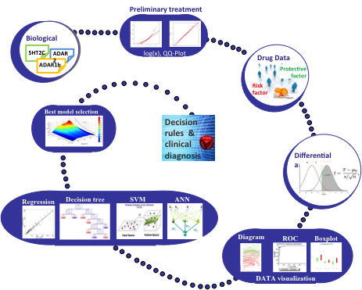
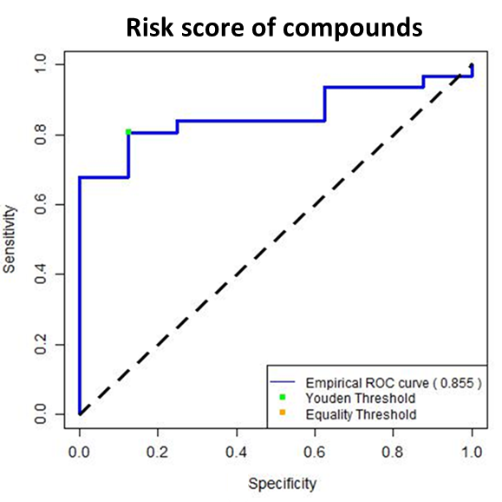
EDITOX®: A test with high specificity and sensitivity
A proprietary algorithm was created to assess the risk of suicide adverse effect of compounds
Specificity >87%
Sensitivity >80%
On going study on
1000 compounds
Alcediag patent US &EU issued in 2014
18

Slide 19
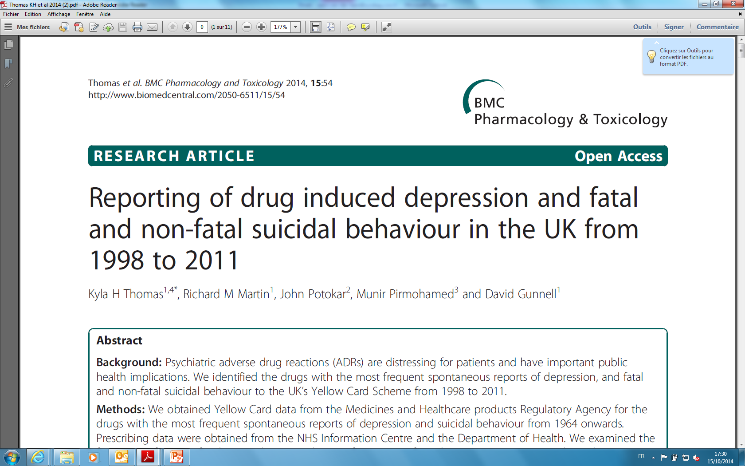
Reporting of drug induced depression/suicide
2014
Study from 1998-2011 on adverse drug reactions in UK
On 11 000 patients treated with 1493 drugs
The Top five medicines for reports of psychotoxicity (depression) were Varenicline, Bupropion, Paroxetine, Isotretinoin, Rimonabant
For suicide attempts: Paroxetine, Varenicline, Citalopram Fluoxetine, Clozapine
Those compounds were detected « at risk » by EDITOX®

Slide 20
EDITOX®
A tool to assess suicidal behaviour adverse effects induced by drugs
EDITOX®screening test identifies at risk compounds for psychiatric adverse effects
High specificity and sensitivity
Could be used as rule out test in early preclinical stage or to get informations on the compound mechanism of action later on
Reduces the risk during drug development and Save money

Slide 21
Suicide risk : the new concept
Genetic and epigenetic factors involved in suicide behavior:
Vulnerability to suicidal behavior is likely mediated by an
underlying genetic predisposition interacting with environmental
and probable epigenetic factors throughout the lifespan to modify
the function of neuronal circuits, thus rendering an individual more
likely to engage in a suicidal act. (P.Courtet et al, Transl Psychiatry
2011)
ALCEDIAG develops simple blood tests to objectively assess suicide risk and monitor patient’s states over time
This test EDITDIAG® identifies at risk individuals for suicidal behavior through the identification of epigenetic biomarkers

Slide 22
EDITDIAG®: Current results in blood
77 depressed patients with and without suicidal behavior have been tested (collaboration with Pr P.Courtet, CHU Montpellier, and Pr Saiz, CHU Oviedo)
4 blood biomarkers
Patients with suicidal behavior are significantly different from controls
Specificity >89%
(identification of healthy patients)
Sensitivity >80%
(identification of sick patients)

Slide 23
ALCEDIAG Tools for personalized medicine
BloodTest
Cell Test
RNA editing mesurement platform
RNA Editing Profile of the patient
EDITDIAG®
RNA Editing Profile of drugs
EDITOX®
0
Personalized Medicine
Diagnostic,
Patient stratification
Treatment monitoring

Slide 24
Conclusion
Alcediag epigenetic plateform allows to identify RNA modifications
EDITOX®: A cell test to assess suicidal behaviour adverse effects induced by drugs with high specificity and sensitivity
EDITDIAG®: A blood test to characterize the pathological state of patients and its evolution during treatment (responder/no)
Used together, these tests allow personalized medicine in psychiatry i.e deliver the good treatment to the good patient with the less adverse effects

Slide 25

Thank you!
              dweissmann@alcediag-alcen.com
              www.alcediag-alcen.com

