Slide 1
EFFECT OF REPLACING INORGANIC ZINC WITH A LOWER LEVEL OF ORGANIC ZINC (ZINC PROPIONATE) ON PERFORMANCE, BIOCHEMICAL CONSTITUENTS AND MINERAL STATUS IN BUFFALO CALVES
D. Nagalakshmi
Professor & Head
Department of Animal Nutrition
College of Veterinary Science
Korutla, Karimnagar- 505 326

Slide 2
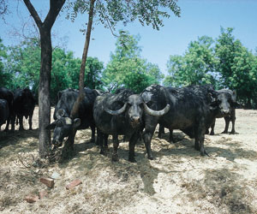
Introduction
Major contributor of milk (55% of total)
India -first in buffalo population - 56.3% of world population
Buffalo productivity- compromised- great economic loss to farmers
Issues:
Low growth rates
High calf mortality
Poor reproductive efficiency
Causes:
Nutritional
Managemental

Slide 3
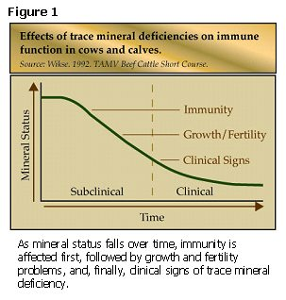
Nutrition
Min. & Vit. deficiency affect the appetite, growth, immunity & reproduction
Trace mineral deficiency (Zn, Se, Mn & Cu) - ovarian inactivity, decreased immune response & growth
Zn, Cu & Se integral component of antioxidant system in body
Trace mineral deficiency are mostly submarginal
to marginal

Slide 4
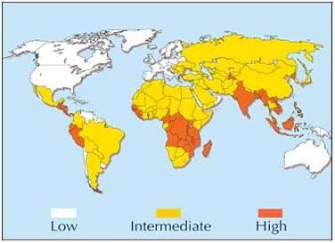
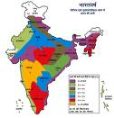
Zinc- an important mineral
Zn is very critical mineral
Need to optimize requirements of Zn for proper growth, immune response and reproduction
Half of soils in world are Zn deficient (Nielson,2004)
Same is reflected in feeds & fodder & hence animals
Concentration of Zn in livestock feeds & fodders is critically deficient in AP (Nagalakshmi et al., 2007 & 2009) and most parts of the country (Gowda et al., 2009)

Slide 5
Form of mineral supplementation
Inorganic form (sulphates, oxides, carbonates, chlorides)
Organic form (chelated minerals)
Inorganic minerals
Relatively cheaper
Readily available
Form the basis of NRC mineral requirement

Slide 6
Problems with inorganic minerals
Low bioavailability 4-22%
Variable availability in market
Presence of contaminants (Heavy metals: ZnO & CuSO4 are from residues of steel industry (have high levels of Cd, F and Pb)
Purity of inorganic salts in market
Various processing conditions used in manufacturing likely reduce biological availability
These uncertainities: inorganic minerals supplemented 2-10 times NRC requirement

Slide 7
Excess supplementation of Inorganic minerals
Damage in nutrient absorption
Reduces mineral bioavailability
Causes environmental pollution (soil & ground water)
Led to focus on chelated/organic minerals

Slide 8
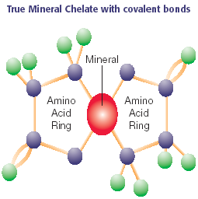
Organic/chelated minerals
Complexing inorganic element with organic compound (amino acid(s), peptides, proteins, polysaccharides, organic acids, vitamins)
Chelation- complex formed between an organic molecule and a metallic ion. Metal held with in the organic molecule as if by a “claw”.
Chelate -Greek word - ‘Claw’
Naturally occurring chelates : Chlorophyll, Cytochrome, Haemoglobin, Vitamin B₁₂

Slide 9
Mineral absorption in gut
Antagonist + Metal & Mineral
Interactions
Excretion
Free metal
ion
Ligand + Metal
Enterocyte
Absorption

Slide 10
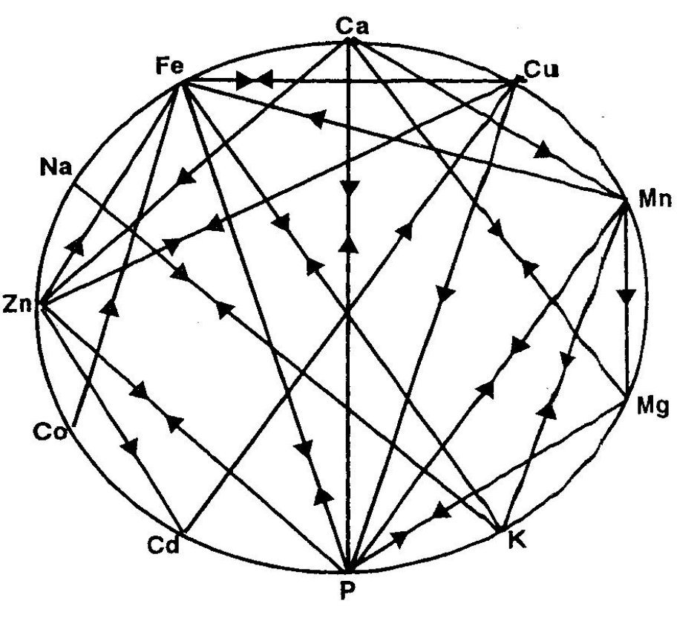
Mutual antagonism
Major factor in reducing mineral absorption & metabolic rates
Competition of same or similar carrier protein
Replacement of 1 metal by another in metalloenzyme molecule affects efficiency
Ca- impairs absorption of Cu, Zn
Mo- impairs absorption of Cu & vice-versa
Mn & Fe compete for similar absorption mech.

Slide 11
Advantages of organic minerals
Reduction of antagonism, interferences and competition among minerals.
Improve the bioavailability of minerals (1.2-1.85 times higher than inorganic)
Counteract antinutritional factors that affect mineral utilization
Hence improvement in performance, health & reproduction
Protect environment by reducing metal pollution.
Metal (specific amino acid) Complex
Metal Amino acid Complex
Metal Amino acid Chelate
Mineral proteinates
Mineral polysaccharide complex
Metal organic acids
Types

Slide 12

Metal organic acids
Metal propionate
Resulting of combining soluble metals with soluble organic acids like propionates
Zn-propionate
P Acid
PA
Zn

Slide 13
Organic minerals are costly compared to inorganic source
1. To supplement at lower concentration than the standard recommendation
2. To replace a portion of inorganic minerals with organic source

Slide 14
Experimental Design
Animals | 12 buffalo calves (9-15mon. age)
Dietary treatments | 2 (6 animals in each group)
Diets (sorghum stover based complete diet) | 80ppm Zn supplementation- ZnSO4 60ppm Zn supplementation- Zn-prop
Duration | 120 days
Design | CRD

Slide 15
Composition of basal diet
Ingredient | Composition (%)
Sorghum stover | 40.0
Maize | 40.0
Soyabean meal | 6.5
Molasses | 8.5
Red gram chunni | 1.41
Urea | 1.0
Limestone powder | 0.8946
Mono-calcium phosphate | 1.3503
Salt | 0.2086
Trace mineral and vitamin premix* | 0.2079
Zinc (ppm) | 29.72
*Trace mineral premix provided (mg/kg diet): Iron, 41; manganese, 21; copper, 10; cobalt, 0.1; Iodine, 0.27; selenium, 0.3. Vitamin A, D and E were provided to supply 2927 IU; 1097 IU and 39 IU per kg diet, respectively.

Slide 16
Zinc propionate supplementation on fortnightly body weight in buffalo calves
Attribute | ZnSO4-80 | Zn-prop-60 | SEM | P value
Start | 195.6 | 191.0 | 68.00 | 0.912
First | 202.1 | 195.4 | 66.78 | 0.870
Second | 201.6 | 195.8 | 65.51 | 0.887
Third | 208.0 | 204.1 | 67.83 | 0.925
Fourth | 210.2 | 204.8 | 62.46 | 0.888
Fifth | 225.6 | 216.4 | 66.02 | 0.821
Sixth | 234.7 | 226.5 | 68.26 | 0.847
Seventh | 245.8 | 238.2 | 70.73 | 0.861
Eighth | 257.4 | 256.0 | 70.99 | 0.975
Weight gain (kg) | 61.75 | 65.00 | 10.649 | 0.621

Slide 17
Zinc propionate supplementation on performance in buffalo calves
Attribute | ZnSO₄-80 | Zn-prop-60 | SEM | P value
Start BW (kg) | 195.6 | 191.0 | 68.00 | 0.912
End BW (kg) | 257.4 | 256.0 | 70.99 | 0.975
ADG (g) | 514.6 | 541.7 | 88.742 | 0.621
FCR | 9.83 | 9.75 | 1.859 | 0.943
DMI/100kg BW (kg) | 2.42 | 2.53 | 0.562 | 0.758

Slide 18
Zinc propionate supplementation on serum biochemical constituents in buffalo calves
Attribute | ZnSO₄-80 | Zn-prop-60 | SEM | P value
ALP (U/L) | 11.85a | 25.23b | 9.040 | 0.003
Total protein (g/dl) | 5.81a | 7.97b | 2.077 | 0.069
Globulin (g/dl) | 2.43 | 4.35 | 2.115 | 0.120
Albumin (g/dl) | 3.38 | 3.61 | 0.601 | 0.521
Creatinine (g/dl) | 2.53 | 2.70 | 0.268 | 0.296
Glucose (mg/dl) | 103.8b | 89.01a | 13.369 | 0.049

Slide 19
Zinc propionate supplementation on serum mineral status of buffalo calves
Mineral | ZnSO₄₋80 | Zn-prop-60 | SEM | P value
Zinc (ppm) | 2.44 | 2.50 | 0.424 | 0.879
Copper (ppm) | 0.903 | 0.854 | 0.210 | 0.706
Manganese (ppm) | 0.201 | 0.214 | 0.0415 | 0.590
Iron (ppm) | 2.67 | 2.72 | 0.326 | 0.797

Slide 20
Zinc propionate supplementation on lipid peroxidation and antioxidant enzyme activity in buffalo calves
Attribute | ZnSO₄-80 | Zn-prop-60 | SEM | P value
Lipid peroxidation ( µmol MDA/mg Hb) | 2.05 | 1.98 | 0.170 | 0.481
Glutathione peroxidase (μmole NADPH oxidized/g Hb/min) | 7.64a | 20.92b | 10.796 | 0.024
Glutathione reductase ( µmol/mg Hb) | 6.53 | 6.91 | 1.869 | 0.742
RBC Catalase (mmol/mg Hb) | 4.81 | 5.01 | 1.686 | 0.848
SOD (IU/mg protein) | 0.118 | 0.145 | 0.039 | 0.233

Slide 21
Zinc propionate supplementation on humoral immune response in buffalo calves
Days PS | ZnSO₄-80 | Zn-prop-60 | SEM | P value
B. abortus (log 2 titres)
7 | 7.40a | 9.40b | 1.549 | 0.016
14 | 6.40 | 7.60 | 1.304 | 0.114
21 | 5.80 | 6.20 | 1.282 | 0.613
28 | 4.40 | 4.49 | 1.062 | 0.999
Chicken RBC (log2 titres)
7 | 6.20 | 5.80 | 1.132 | 0.566
14 | 5.00 | 4.60 | 0.836 | 0.433
21 | 3.60 | 3.62 | 0.467 | 0.999
28 | 2.40 | 2.60 | 0.641 | 0.613

Slide 22
Zinc propionate supplementation on cell mediated immune response (increase in skin fold thickness, mm) in buffalo calves

Slide 23
Conclusion
Organic Zn supplementation in diets as 75% of inorganic Zn had no effect on performance and mineral status in buffalo calves
Supplementation of 60ppm Zn propionate resulted in higher immune response in calves than 80ppm Zn from Zn sulphate.

Slide 24

Thank you

Slide 25
Absorption of minerals
Small intestine- mostly duodenum
Requires prior solubilisation of mineral (stomach/abomasum)
Ionized mineral are further transported thru cell membrane using protein carriers
Absorption depends on capacity of element to bind to transport protein
Bound minerals are then transported into cell cytoplasm thru active or passive diffusion

Slide 26
Factors affecting mineral absorption
Solubility of mineral salt
pH in stomach and intestine
Dietary factors (fibre, phytate, oxalate)
Mineral antagonism
Contaminants
Heavy metals (Pb inhibits enzymatic synthesis of carrier protein for Hb)

Slide 27
Organic minerals: Bioavailability
More bioavailable: 1.2-1.85 times higher than inorganic
Reasons
Ring structure protects the mineral from unwanted chemical reactions in GIT
Chelates easily pass intact through the intestinal wall into blood stream
Passive absorption increased by reducing interactions between mineral & other nutrients
and by increasing water and lipid solubility of minerals
Mineral is delivered in form similar to that found in body
Each mineral in chelate facilitates the absorption of other minerals in chelate
Chelates carry negative charge so absorbed & metabolized more efficiently
Chelation increases solubility & movement thru cell membranes
Chelation increases stability at low pH
Chelates are absorbed by the amino acid transport system

