Slide 1
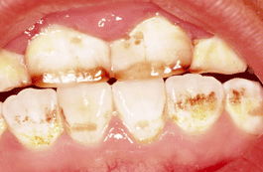

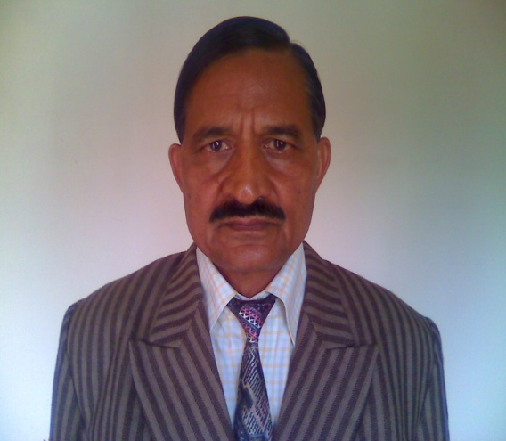
Effect of dental fluorosis on intelligence of tribal Children in barkagaon, hazaribag, Jharkhand, India
Presented By :
Dr. D. N. Sadhu
P.G. Department of Zoology,
Vinoba Bhave University
Hazaribag - 825319, Jharkhand, India
Email : dns_hzb@yahoo.com

Slide 2
3rd Seminar on Hydrology and meteorology, Sept. 15-16, 2014, HICC, Hyderabad.
Introduction:
Earth is gifted with water, a primary, essential resource for all .
Available drinking water on earth (about 1%) rendered unfit due to various factors including our injudicious activities.
Fluoride is essential for calcification of bones and teeth.
Excess (more than 1.5 mg/lit.) fluoride in drinking water may cause different ailments such as dental fluorosis consequently affecting intelligence .
Excess fluoride in water is coming from geogenic activity.
Keeping in view our study deals with the fluorosis and I.Q. among tribal dominated school children (06 to 14 yrs) in Barkagoan, Hazaribag, Jharkhand.

Slide 3
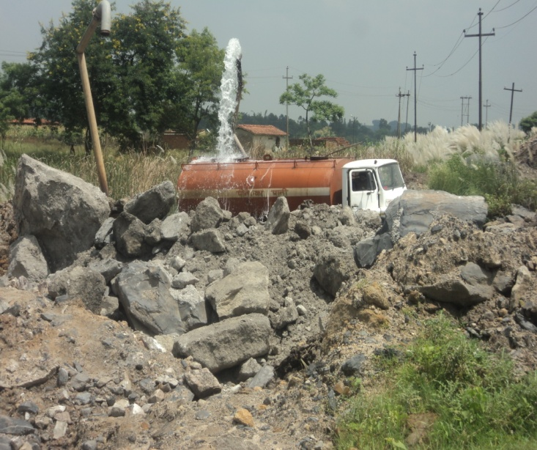
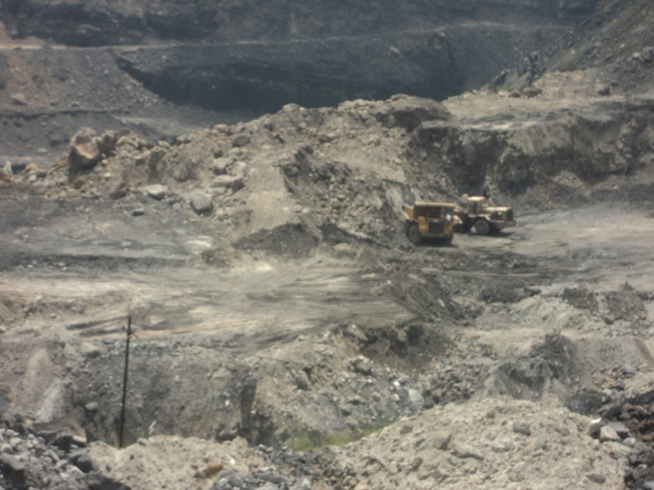
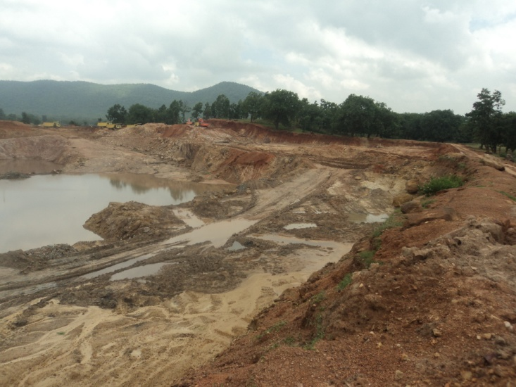
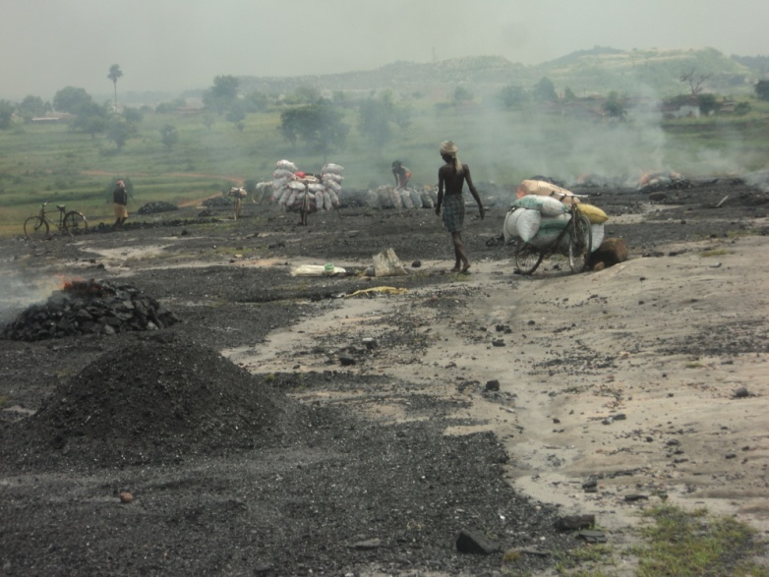
3rd Seminar on Hydrology and meteorology, Sept. 15-16, 2014, HICC, Hyderabad.
Mining Activities

Slide 4
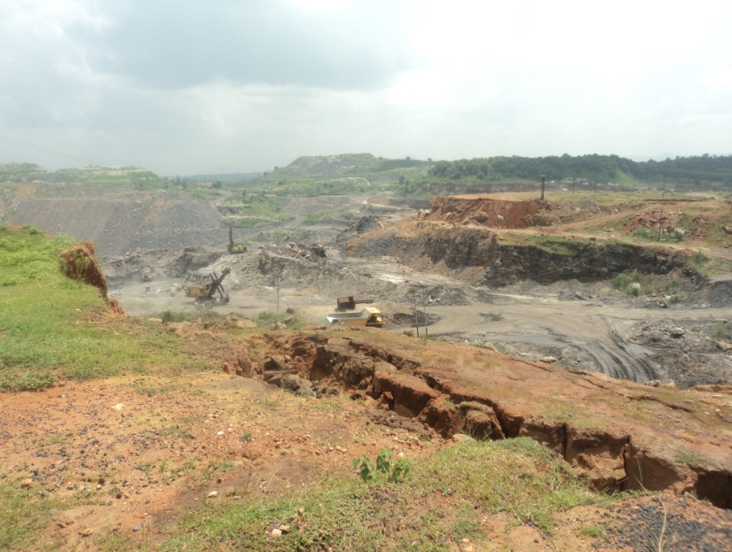
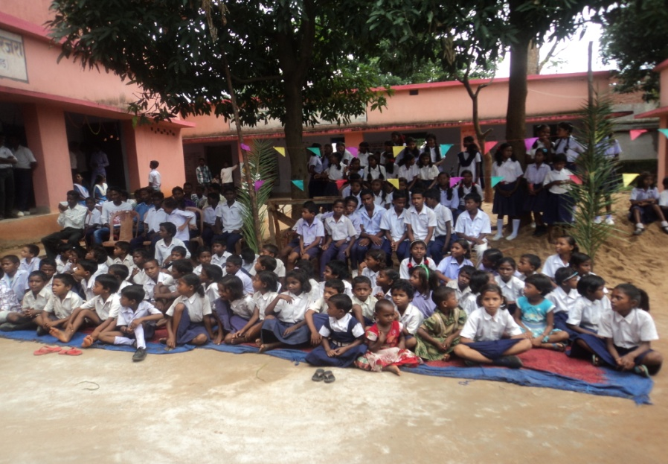
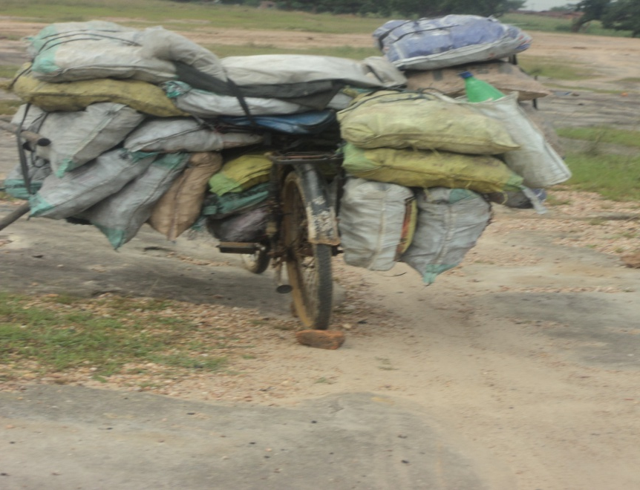
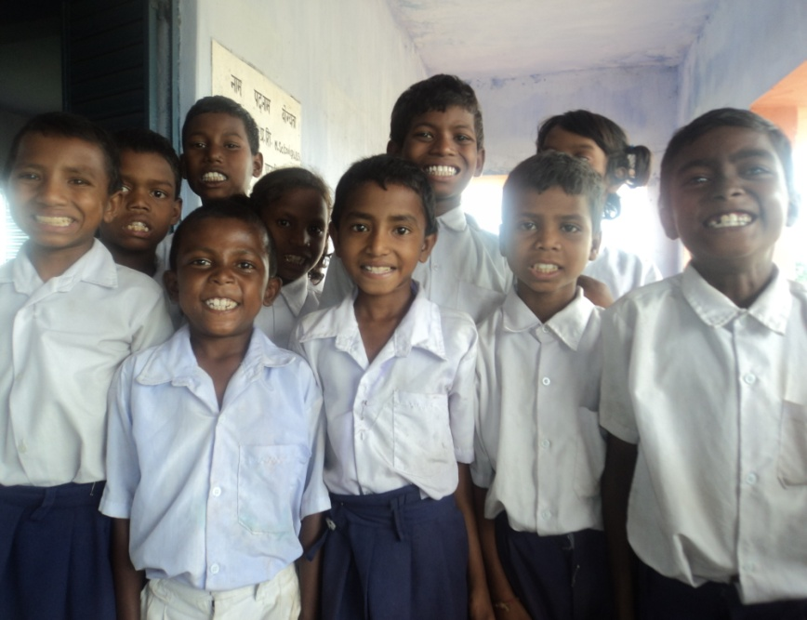
Coal mining activities
Health awareness camp
Illegal coal transportation
Children with affected teeth

Slide 5
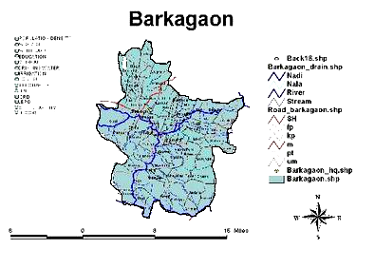
Study Area:
Five sampling stations are Potanga Basti, Jojotola, Murgatola, Garsulla Basti and Bihad Basti of Barkagoan as shown.
3rd Seminar on Hydrology and meteorology, Sept. 15-16, 2014, HICC, Hyderabad.
Potanga Basti
Jojotola
Murgatola
Garsulla Basti
Bihad Basti

Slide 6
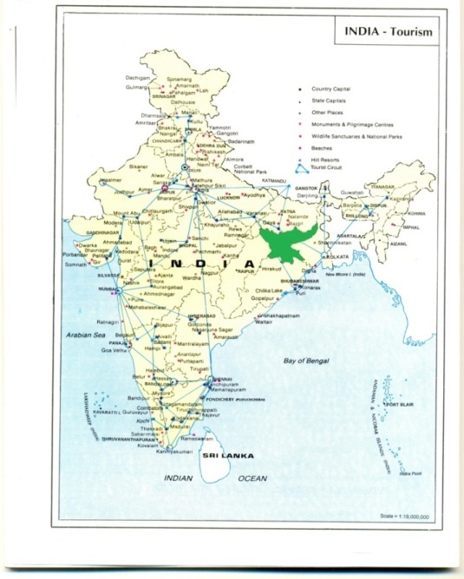
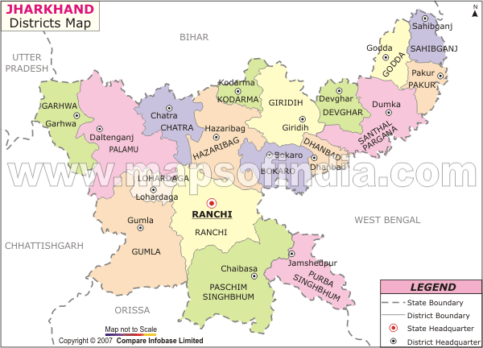
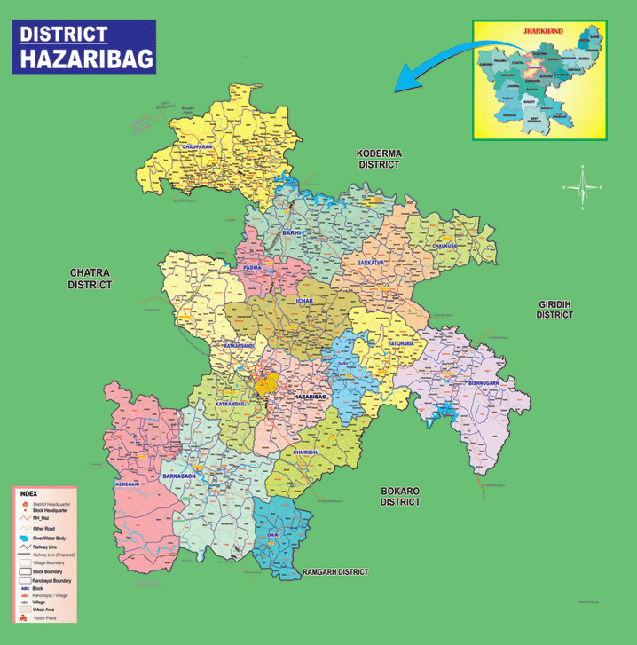
3rd Seminar on Hydrology and meteorology, Sept. 15-16, 2014, HICC, Hyderabad.
Fig-1: Showing the location of the Study Area
(23⁰ 52′ 5′′ N latitude and 85⁰ 14′ 15′′ E longitude)
(Not to scale)

Slide 7
Material and Method:
Water samples from July 2011 to June 2013, analyzed for fluoride content as per protocol adopted after APHA, 2005.
Samples were also tested in State Geological Laboratory, Hazaribag for confirmation.
Characteristics of teeth among school children ( 06 to 14 yrs.) was assessed by Dean’s Index(1934).
Intelligence quotient (I.Q.) of school children is determined by Raven’s Colored Progressive Matrices ( RCPM, 1992),which is a non verbal multiple choice, for each test item, the child was asked to identify the missing part to complete the model, having 30 problems beginning with easy and ending with difficult one with time limit of 30 minutes.
3rd Seminar on Hydrology and meteorology, Sept. 15-16, 2014, HICC, Hyderabad.

Slide 8
3rd Seminar on Hydrology and meteorology, Sept. 15-16, 2014, HICC, Hyderabad.
Impact of fluoride in human system (Ghosh et al., 2013)
Fluoride intake
Absorbed fluoride
F-excreted in Urine
Stomach
Plasma
F-excreted in Sweet
Small Intestine
Soft Tissue
Bone
Teeth

Slide 9
3rd Seminar on Hydrology and meteorology, Sept. 15-16, 2014, HICC, Hyderabad.
Table 1: Effect of fluoride concentration on Teeth
Sl. No. | Fluoride concentration in mg/L | Effect
01. | Less than 1.5 | No effect
02. | 1.5 to 3.0 | Dental Fluorosis (discoloration, mottling and pitting of teeth)
03. | 3.0 to 6.0 | Mild skeletal fluorosis
04. | More than 6 | Crippling skeletal fluorosis

Slide 10
3rd Seminar on Hydrology and meteorology, Sept. 15-16, 2014, HICC, Hyderabad.
Result:
Table-2: Seasonal variations of fluoride content in ground water of the study area
Season | Month | V I L L A G E S
 |  | *Mean+S.E. in mg/l | *Mean+S.E. in mg/l | *Mean+S.E. in mg/l | *Mean+S.E. in mg/l | *Mean+S.E. in mg/l
 |  | Garsullabasti | Jojotola | Murgatola | Potangabasti | Bihadbasti
Rainy | July11 & 12 | 2.14±0.7 | 2.25±0.8 | 2.45±0.7 | 2.50±0.7 | 2.17±0.7
 | Aug 11&12 | 1.80±0.7 | 1.90±0.6 | 1.75±0.8 | 1.95±0.8 | 1.65±0.8
 | Sept 11&12 | 1.84±0.6 | 1.75±0.7 | 1.92 ±0.6 | 2.20±0.7 | 1.95±0.5
 | Oct 11 & 12 | 2.17±0.6 | 1.93±0.6 | 2.66 ±0.6 | 2.10±0.7 | 2.25±0.7
 | AV:Values | 1.99±0.8 | 1.95±0.7 | 2.19±0.6 | 2.18±0.7 | 1.98±0.7
Winter | Nov 11&12 | 2.20±0.7 | 2.80±0.8 | 2.30±0.7 | 2.90±0.8 | 2.42±0.7
 | Dec 11&12 | 1.98±0.7 | 2.90±0.8 | 2.76±0.8 | 3.50±0.8 | 2.65±0.7
 | Jan 12&13 | 2.20±0.7 | 3.16±0.9 | 2.95±0.8 | 3.90±0.9 | 2.90±0.8
 | Feb 12&13 | 2.42±0.7 | 3.30±0.9 | 3.51±0.9 | 3.39±0.9 | 3.35±0.9
 | AV:Values | 2.20±0.7 | 3.04±0.9 | 2.88±0.8 | 3.42±0.9 | 2.57±0.7
Summer | March12&13 | 2.55±0.7 | 3.40±0.9 | 3.42±0.8 | 3.60±0.9 | 3.54±0.8
 | April 12&13 | 2.94±0.8 | 3.65±0.9 | 3.70±0.8 | 3.85±0.9 | 3.75±0.8
 | May 12&13 | 3.02±0.7 | 3.35±0.8 | 2.75±0.7 | 3.25±0.7 | 3.30±0.7
 | June 12&13 | 3.40±0.7 | 4.90±0.9 | 4.53±0.9 | 4.75±0.7 | 3.92± 0.7
 | AV:Values | 2.98±0.7 | 3.82±0.9 | 3.85±0.9 | 3.86±0.8 | 3.60±0.8
* 10 Samples

Slide 11
3rd Seminar on Hydrology and meteorology, Sept. 15-16, 2014, HICC, Hyderabad.
Table-3: Showing the percentage occurrence of fluoride - affected teeth of children as per Dean’s Index
Sl. No. | Villages | Number of cases (06-14 yrs) | Dean’s Index
 |  |  | Normal | Questiona-ble | Very mild | Mild | Modera-te | Severe
01. | Garsullabasti | 145 | 16.67% | 18.42% | 21.05% | 19.30% | 11.40% | 13.16%
02. | Jojotola | 84 | 28.58% | 11.90% | 8.34% | 25% | 19.04% | 7.14%
03. | Murgatola | 88 | 30.69% | 12.50% | 10.22% | 25% | 14.78% | 6.81%
04. | Potangabasti | 155 | 18.18% | 19.48% | 7.79% | 23.38% | 20.78% | 10.39%
05. | Bihadbasti | 95 | 20.64% | 11.11% | 14.28% | 28.58% | 19.08% | 6.35%
Total Percentage of F– affected teeth |  |  | 22.78% | 15.02% | 12.91% | 23.70% | 16.44 % | 9.15 %

Slide 12
3rd Seminar on Hydrology and meteorology, Sept. 15-16, 2014, HICC, Hyderabad.
Table-4: Showing the percentage occurrence of Intelligence Quotient of children as per Raven’s Index
Sl. No. | Villages | Number of cases (06-14 yrs) | Raven’s Index
 |  |  | Extremely Low I.Q.<70 | Border Line I.Q. 70-79 | Low Average I.Q. 80-89 | Average I.Q.90-109 | High average I.Q.110-119 | Superior I.Q.>120
01. | Garsullabasti | 145 | 22.52% | 25.42% | 21.67% | 16.30% | 7.83% | 5.26%
02. | Jojotola | 84 | 26.64% | 24.90% | 22.58% | 15.32% | 6.43% | 4.13%
03. | Murgatola | 88 | 28.22% | 25.55% | 19.69% | 15.76% | 5.92% | 4.86%
04. | Potangabasti | 155 | 29.79% | 26.58% | 19.68% | 15.46% | 4.86% | 3.63%
05. | Bihadbasti | 95 | 23.88% | 25.81% | 20.64% | 18.78% | 6.80% | 4.09%
Total Percentage of I.Q. |  |  | 26.21 | 25.65 | 20.85 | 16.32 | 6.36 | 4.39

Slide 13
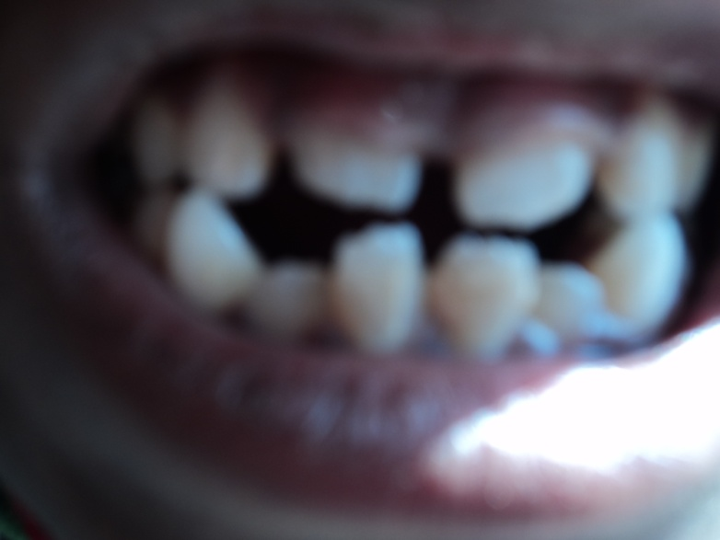
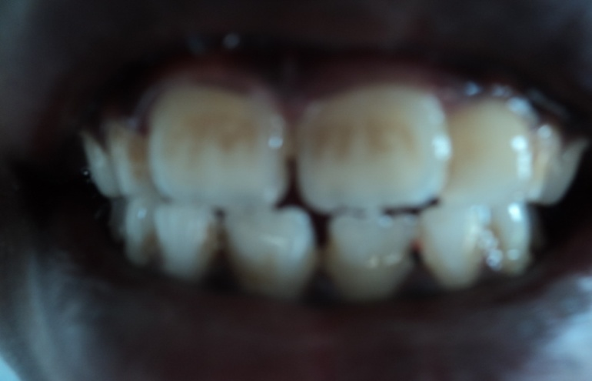
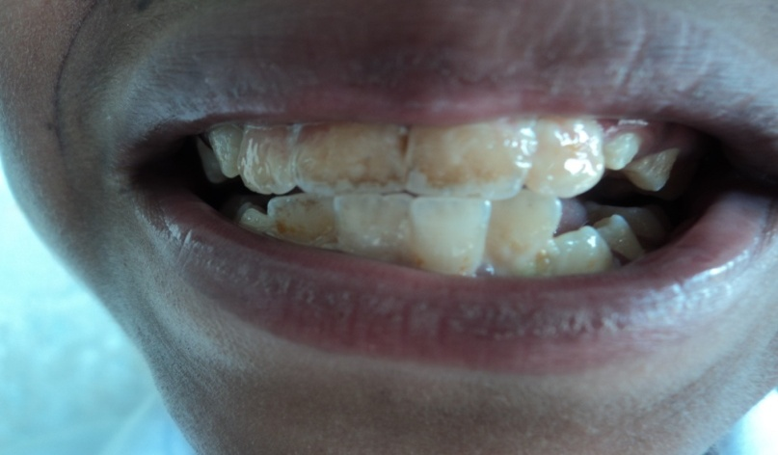
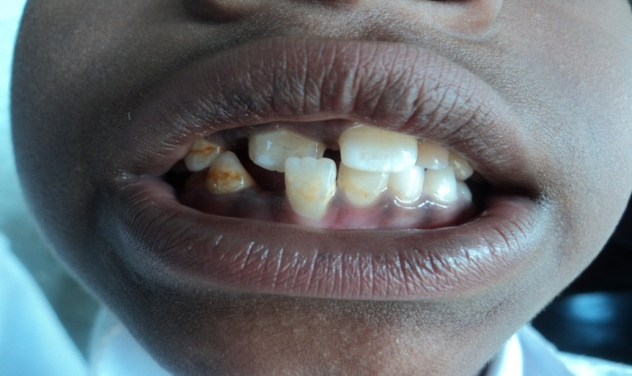
3rd Seminar on Hydrology and meteorology, Sept. 15-16, 2014, HICC, Hyderabad
Fluoride affected teeth of the study area.
Severe
Moderate
Very Mild
Mild (Irregular)

Slide 14
3rd Seminar on Hydrology and meteorology, Sept. 15-16, 2014, HICC, Hyderabad.
Fig. 3: Showing the degree of fluorosis on children’s teeth in Column

Slide 15
3rd Seminar on Hydrology and meteorology, Sept. 15-16, 2014, HICC, Hyderabad.
Discussion:
ALL THE WATER SAMPLES SHOWED HIGHER CONCENTRATION OF FLUORIDE THROUGHOUT THE YEAR (RANGE 1.98 ± 0.5 TO 4.9 ± 0.8mg/lit.)
THE HIGHER FLUORIDE CONCENTRATION IN THE STUDY AREA IS PROBABLY DUE TO EXCESS EXPLOSION AND MINERAL EXPLOITAION.
STUDY ON 567 SCHOOL CHILDREN REVEALS THAT ABOUT 77% CHILDREN HAVING DENTAL FLUOROSIS.
ALMOST 73% CHILDREN WERE LOW AVERAGE TO EXTREMELY LOW.
BOTH THE RESULTS INDICATE THAT DENTAL FLUOROSIS AND I.Q. IS DIRECTLY RELATED TO FLUORIDE CONCENTRATION IN DRINKING WATER.

Slide 16
3rd Seminar on Hydrology and meteorology, Sept. 15-16, 2014, HICC, Hyderabad.
Conclusion:
Water is life but quality drinking water is not sufficiently available in the study area. Most of the sources of drinking water are unsafe to use without some sort of treatment including defluoridation otherwise people will face a lot of health hazards.
Naturally occurring Bethonite candle may be used in removing extra fluoride in drinking water (Gupta et al., 2014).
Unit of oral health and hygiene should be established in the area for proper assessment, guideline and monitoring of drinking water quality with the help of State and Central Govt., Health Department. Since the area is tribal dominated, special care should be taken for their proper survival.

Slide 17
3rd Seminar on Hydrology and meteorology, Sept. 15-16, 2014, HICC, Hyderabad.
REFERENCES:
1. APHA, 2005: Standard methods for the examination of water and waste water. 21th edition. American Public Health Association. New York, U.S.A. pp. (4) 82-89.
2. B.I.S. 2003: Drinking water quality, Bureau of Indian standard, New Delhi, I.S. 10500:1991, Edition 2.1, (1993-01).
3. Brouwer I.D., Backer Dirks O., De Bruin A., Hantvast J.G.A.J., 1988: Unmitablity of WHO Guidelines for fluoride concentration in drinking water in Senegal, Lancent 30, pp. 223-225.
4. Census report, 2001, Government of India.
5. Dean, H. Trendley, 1934: As Reproduced in “Health Effects of Ingested Fluoride” National Academy of Sciences, 1993, pp. 169.
6. Dev Burman, G.K., Singh, B., and Khatri, P., 1995: Fluoride in environment: Hydro geochemical studies of groundwater having high fluoride content in Chandrapur district. Gond.Geol.Magz.9, pp. 71-80.

Slide 18
THANKS

