Slide 1

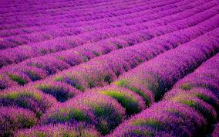


RAPID CLONAL MULTIPLICATION AND CONSERVATION OF
LAVENDULA ANGUSTIFOLIA
AN AROMATIC AND MEDICINAL PLANT
USING APICAL BUDS AND ROOT USING IN VITRO TECHINQUES
Dr. D. LEELAVATHI
MESCOLLEGE,
MALLESWARAM,
BANGALORE KARNATAKA
INDIA

Slide 2
INTRODUCTION
Aromatic plant Lavandula angustifolia L. is commercially important perennial plant and are conventionally propagated by seed and stem cuttings. Lavandula angustifolia L. is a shrub belonging to the family Lamiaceae. It is in great demand for the lavender oil it yields which is used in perfumery, cosmetics, flavouring, toilet soap, talcum powders and pharmaceutical industries, in insect repellant and household products. Due to its delighfully refreshing odour blends well with ;many other essential oils.
Such aromatic plants are gift of nature it should be protected and propagated. Although these aromatic plants can be propagated vegetatively, the poor rooting ability of the stem cuttings, as well as the lack of selected clones, restrain industrial exploitations.
Further, limited tissue culture work has been done on aromatic plants to date as suggested by Segura and Calvo (1991) and Quazi (1980)
Therefore, it is imperative to develop efficient protocols In order to meet the growing demand of lavender oil, in vitro techniques are being used as alternative method for large scale multiplication and ex-situ conservation. In the present investigation, in vitro apical bud explants , in vitro roots and synthetic seeds of Lavandula angustifolia was cultured.

Slide 3
MATERIAL AND METHODS
In vitro apical bud explants of Lavandula angustifolia L., were used as explants and were inoculated on Murashige and Skoog’s basal medium (MSBM) supplemented with cytokinins and auxin for initiation and multiplication of shoots.
Multiple shoots were subcultured on the same medium to obtain well developed, elongated multiple shoots.
All the cultures were maintained at a temperature of 25±2⁰Cwith photon flux density of 30-5o µEM⁻² S⁻¹ under photoperiodic regime of 16h light and 8h dark cycles.

Slide 4
The in vitro raised plants with well developed roots were subjected for hardening in a potting mixture, containing peat : perlite: vermiculate (1:1:1 v/v). After 65 days of hardening, the plants were transferred to the soil with 80 % survival frequency.
The principle component linalool both in in vitro and in vivo leaves and stem of L. angustifolia were determined by Gas Chromatography.
The in vitro apical buds were used for synthetic seed production using Sodium alginate and Calcium chloride as matrix and complexing agent for encapsulation of apical buds of L. angustifolia

Slide 5
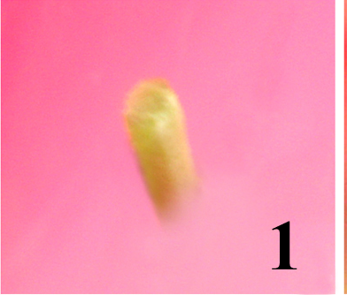
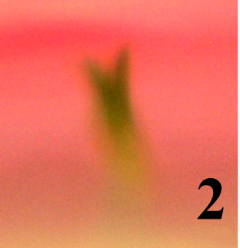
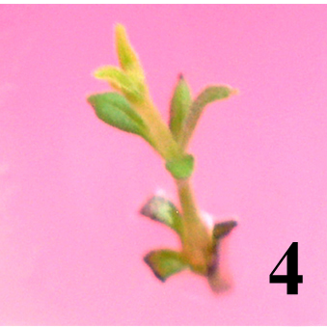
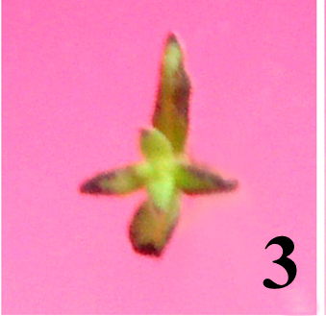
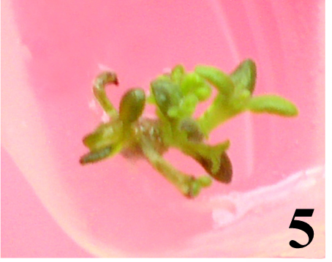
RESULTS
The in vitro apical bud explant were inoculated on MS Basal Medium (Fig.1)
Shoot initiation with tiny leaf primordium (Fig.2), was observed after 1o days of culture on all the concentrations of growth regulators studied with varying percentage of response (55-90%) of response (Table.1,Graph -1).
The highest response-90 % on MSBM+ BAP 8.88µM +NAA 2.68µM.
After 25 days of culture on the same medium shoot with 4-6 leaves were noticed (Fig.3).Further elongation and growth of the shoot was observed after 40 days of culture (Fig.4).
5-6 multiple shoots were noticed after 50 days of culture (Fig.5)

Slide 6
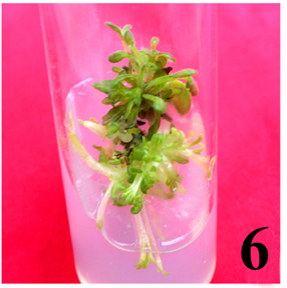
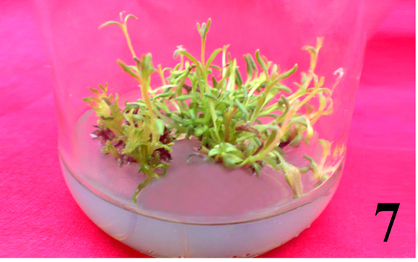
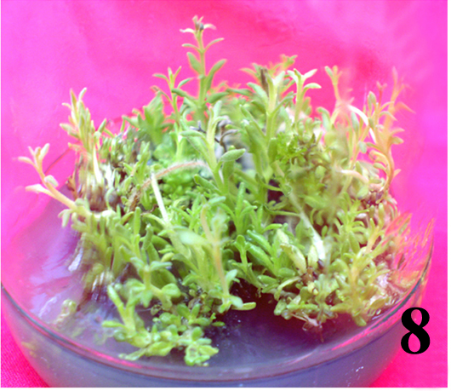
…
After 40 days of subculture clump 10-12 multiple shoots (Fig.6) were observed.
After 60 days of subculture 10-20 healthy elongated well developed multiple shoots were noticed (Fig.7).
The 60 days old culture when subcultured on the same medium, produced more number of shoots .
Clump of 20-30 healthy multiple shoots were observed after 49 days of subculture, 4-5 cms in height (Fig.8).

Slide 7
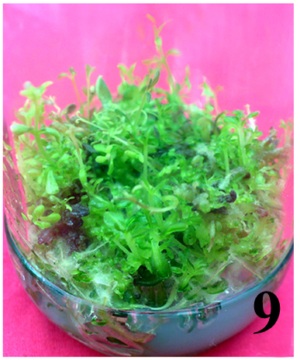
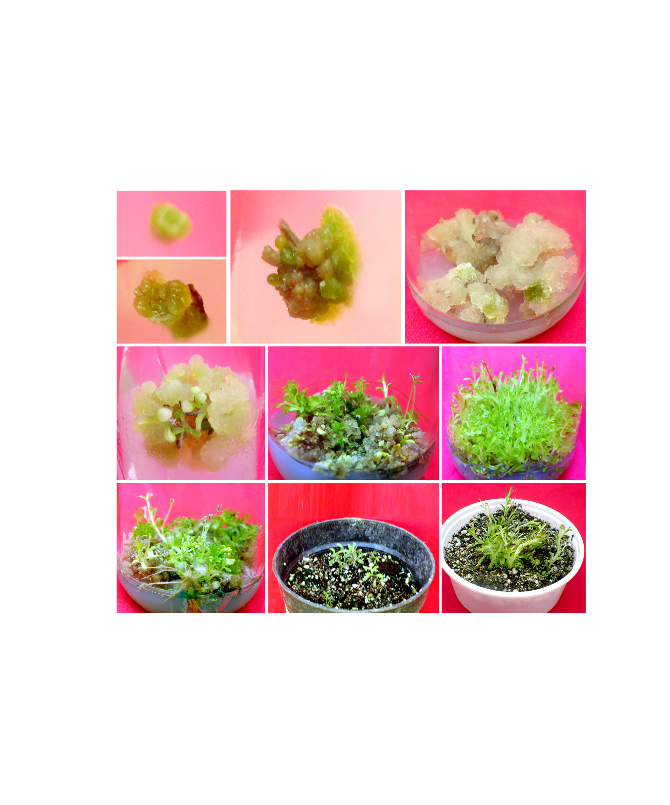
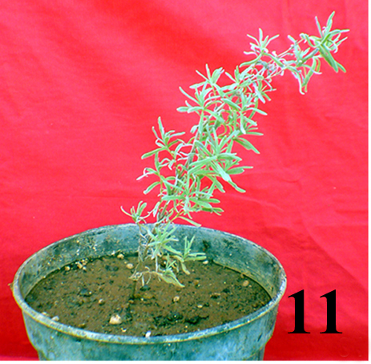
Roots….
These multiple shoots developed roots on the root initiating media on MSBM fortified with BAP (8.88µΜ) + NAA (2.68µΜ) + IBA (4.92 µΜ) (Fig.9).
30-40 multiple shoots with roots were observed after 63 days of culture (Fig.9).
30-40 multiple shoots with roots were observed after 70 days of culture (Fig.10).
Later the cultured plants were subjected to hardening (Fig.11).
10

Slide 8
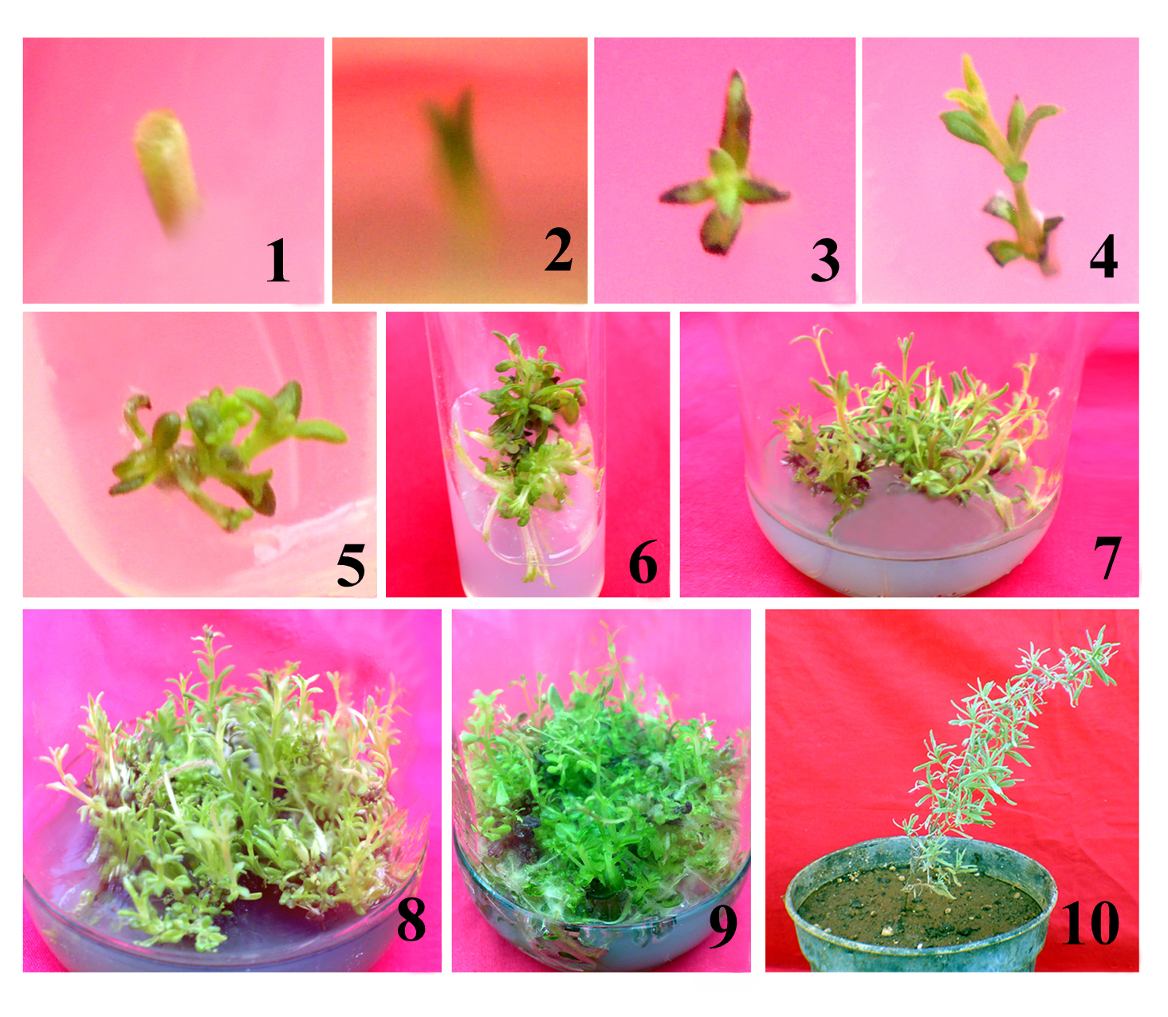

Slide 9
TABLE 1 Effect of different concentrations of growth regulators for initiation and multiplication of shoots from in vitro apical bud explant of Lavandula angustifolia
Basal media | BAP (µM) | BAP (mg/l) | NAA (µM) | Response (%) | No. of shoots / explant X + SD
MS | 4.44 | 1.0 | 2.68 | 70 | 18.0 ± 1.41
MS | 6.66 | 1.5 | 2.68 | 85 | 22.5 ± 2.33
MS | 8.88 | 2.0 | 2.68 | 90 | 30.2 ± 2.63
MS | 11.11 | 2.5 | 2.68 | 80 | 24.8 ± 2.85
MS | 13.32 | 3.0 | 2.68 | 70 | 20.5 ± 1.50
 | Kinetin (µM) | Kinetin (mg/l)
MS | 4.64 | 1.0 | 2.68 | 60 | 16.30 ± 1.84
MS | 6.96 | 1.5 | 2.68 | 72 | 18.30 ± 1.41
MS | 9.28 | 2.0 | 2.68 | 78 | 22.30 ± 2.23
MS | 11.60 | 2.5 | 2.68 | 62 | 18.00 ± 1.62
MS | 13.92 | 3.0 | 2.68 | 55 | 16.00 ± 1.94
Note: * : Mean of 10 replication
** : Significance F Value @ 5%level
SV | DF | SS | MSS | F_{cal} ratio | F_{tab}value** | CD
Treatment | 9 | 1746.89 | 194.09 | 41.73 | 2.00 | 4.28
Errors | 90 | 418.50 | 4.65
Total | 99 | 2165.39

Slide 10
Graph 1
 | Graph 1 Effect of different concentrations of growth regulators on initiation
 | and multiplication of shoots from in vitro apical bud explant of
 | Lavandula angustifolia

Slide 11
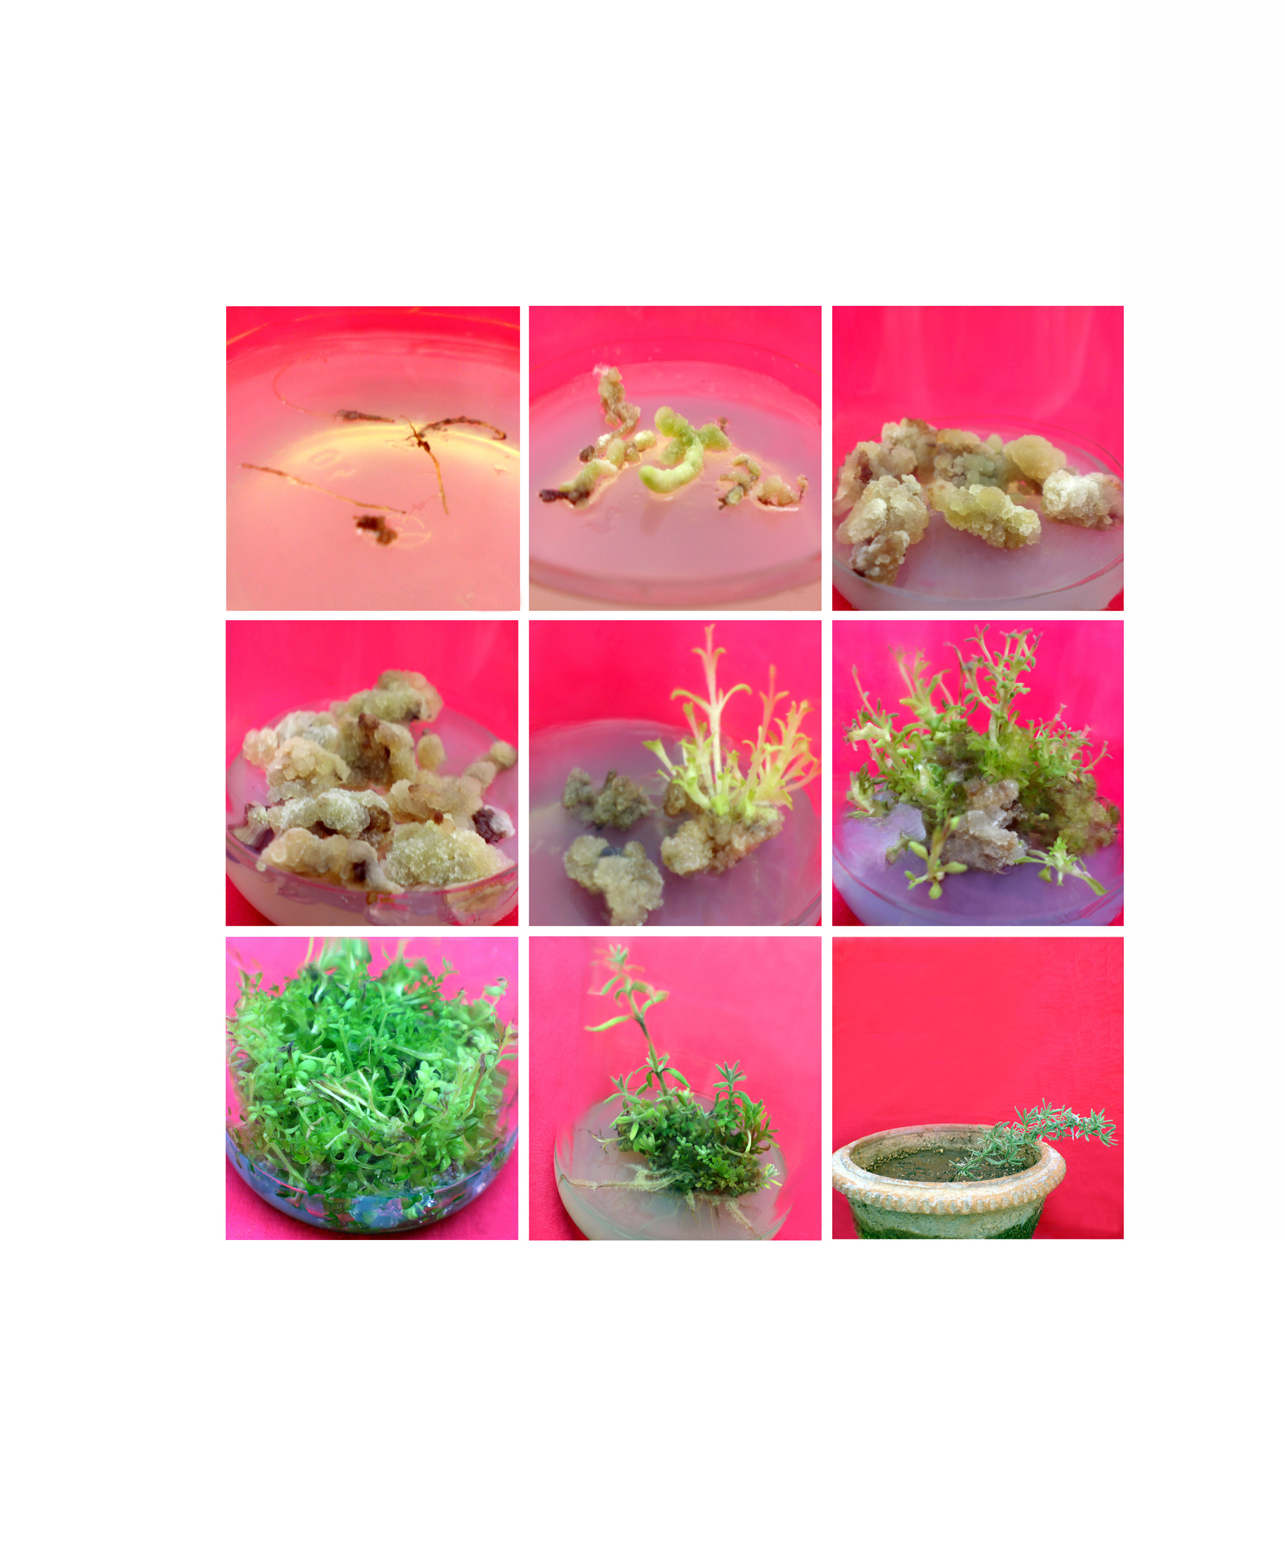

ROOTS
The root explants of L.angustifolia were excised from in vitro raised plants. They were cultured on MS basal medium (Fig.12 ) and fortified with BAP 8.88µM + NAA in different concentrations ranging from(2.68µM, 5.36µM, 8.05µM,10.74µM & 13.42µM) and 2,4-D ranging from 2.26µM, 4.52µM, 6.78µM, 9.04µM & 11.30µM respectively in order to induce callus (Table.2).
After 18 days of culture, explant callused (Fig.13) on all the concentrations tried with varying frequency of response (40-87 %) (Table 2 , Graph 2). The highest frequency of response (87%) was observed on MSBM + BAP (8.88 µΜ) + NAA (5.36 µΜ) and the lowest (40%) on MSBM + BAP (8.88 µΜ) + 2,4-D (11.30 µΜ) (Table 2, Graph 2.).
Fig.12
Fig.13

Slide 12
After 36 days of culture, moderate greenish white callus and large amount of creamish and greenish compact callus was observed on MSBM supplemented with BAP (8.88 µΜ) + 2,4-D 11.30 µΜ (Fig.14) and BAP (8.88 µΜ) + NAA 5.36 µΜ (Fig.15.) respectively .
The highest amount of callusing was observed on MSBM + BAP (8.88 µΜ) + NAA (5.36 µΜ) with fresh weight 17.45 gms and dry weight 2.43 gms when compared to 2,4-D in which moderate amount of callusing was observed on MSBM + BAP (8.88 µΜ) + 2,4-D (11.30µΜ) with fresh weight 13.08 gms and dry weight 0.86 gms ( Table 3)
The 36 days old moderate creamish, greenish white and creamish and greenish compact callus was subcultured on MSBM fortified with different concentrations of BAP ranging from (2.22µΜ, 4.44 µΜ 6.66 µΜ, 8.88µΜ, 11.11µΜ) and Kn ranging from (2.32 µΜ, 4.64 µΜ, 6.96 µΜ, 9.28, 11.60 µΜ) and NAA 2.68µΜ and 2,4-D 2.26 µΜ respectively to study their morphogenetic ability.
Fig.14
Fig.15

Slide 13
After 21 days of subculture, shoot initiation was observed on all the concentrations of BAP, Kn, NAA and 2,4-D tried with varying frequency of response (47- 95 % ) (Table 4). The highest frequency of response ( 95 %) was observed on MSBM + BAP (4.44 µΜ) + Kn (4.64 µΜ) + NAA (2.68 µΜ)
lowest frequency of response( 47% ) on MSBM + BAP (2.22 µΜ) + Kn (2.32 µΜ) + 2,4-D (2.26 µΜ).
After 28 days of subculture (Fig.16) 8-10 shoot bud was observed only from creamish and greenish compact callus on MSBM + BAP (4.44 µΜ) + Kn (4.64 µΜ) + NAA (2.68 µΜ).
15-20 shoot buds were noticed after 42 days of subculture (Fig.17).
Fig.16
Fig.17

Slide 14
35-40 well developed healthy, elongated multiple shoots were observed after 70 days of subculture (Fig18.)
These shoots later developed roots when inoculated on root inducing medium on MSBM fortified with BAP (8.88µΜ) + NAA (2.68 µΜ) + IBA (4.92 µΜ) (Fig 19.)
after 28 days of culture and the axenic plants were subjected hardening (Fig.20).
Fig.19
Fig.18
Fig.20

Slide 15
Table 2 Effect of different concentrations of cytokinin and auxins on in
vitro root explants of Lavandula angustifolia for callus induction
Basal media | BAP (µM) | NAA (mg/l) | NAA (µΜ) | Culture duration | Response (%)
MS | 8.88 | 0.5 | 2.68 | 18 days | 65
MS | 8.88 | 1.0 | 5.36 | 18 days | 87
MS | 8.88 | 1.5 | 8.05 | 18 days | 70
MS | 8.88 | 2.0 | 10.74 | 18 days | 60
MS | 8.88 | 2.5 | 13.42 | 18 days | 51
 |  | 2,4-D (mg/l) | 2,4-D (µΜ)
MS | 8.88 | 0.5 | 2. 26 | 18 days | 50
MS | 8.88 | 1.0 | 4.52 | 18 days | 65
MS | 8.88 | 1.5 | 6.78 | 18 days | 50
MS | 8.88 | 2.0 | 9.04 | 18 days | 45
MS | 8.88 | 2.5 | 11.30 | 18 days | 40

Slide 16
Table 3 Effect different concentrations of cytokinin and auxins for the growth of the callus from in vitro root explants of Lavandula angustifolia
Basal media | BAP(µΜ) | NAA(mg/l) | NAA(µΜ) | Culture duration | Quantity of callus | Fresh Weight X *+ SD | Dry Weight X *+ SD
MS | 8.88 | 0.5 | 2.68 | 36 | + | 13.01±0.31 | 0.86±0.38
MS | 8.88 | 1.0 | 5.36 | 36 | +++ | 17.45±0.46 | 2.43±0.38
MS | 8.88 | 1.5 | 8.05 | 36 | ++ | 14.10±0.56 | 0.90±0.37
MS | 8.88 | 2.0 | 10.74 | 36 | ++ | 12.09±0.51 | 0.77±0.30
MS | 8.88 | 2.5 | 13.42 | 36 | ++ | 10.18±0.38 | 0.65±0.14
 |  | 2,4-5(mg/l) | 2,4-5(µΜ)
MS | 8.88 | 0.5 | 2.26 | 36 | + | 10.04±0.56 | 0.50±0.28
MS | 8.88 | 1.0 | 4.52 | 36 | ++ | 13.08±0.51 | 0.86±0.34
MS | 8.88 | 1.5 | 6.78 | 36 | ++ | 10.11±0.47 | 0.54±0.24
MS | 8.88 | 2.0 | 9.04 | 36 | ++ | 9.09±0.41 | 0.36± 0.17
MS | 8.88 | 2.5 | 11.30 | 36 | + | 8.12±0.50 | 0.32±0.14
ANOVA TABLE (Fresh Weight )
SV | DF | SS | MSS | F_{cal}ratio | F_{tab}value** | CD
Treatment | 9 | 710.38 | 78.93 | 72.41 | 2.00 | 1.00
Errors | 90 | 98.62 | 1.09
Total | 99 | 809.00
ANOVA TABLE (Dry Weight )
SV | DF | SS | MSS | F_{cal} ratio | F_{tab} value** | CD
Treatment | 9 | 32.81 | 3.64 | 45.50 | 2.00 | 0.07
Errors | 90 | 7.72 | 0.08
Total | 99 | 40.53
Note: *: Mean of 10 replication
**: Significance F Value @ 5%level
+ : Scanty. ++ : Moderate +++ : Abundant

Slide 17
TABLE 4 Effect of different concentrations of cytokinins and auxins
for regeneration from the callus of in vitro root explants
of Lavandula angustifolia
Basal media | Growth regulators (µM) |  |  | Root
 | BAP | Kn | NAA | Response % | No. of shoots /culture
MS | 2.22 | 2.32 | 2.68 | 71 | 30
MS | 4.44 | 4.64 | 2.68 | 95 | 40
MS | 6.66 | 6.96 | 2.68 | 80 | 34
MS | 8.88 | 9.28 | 2.68 | 71 | 30
MS | 11.11 | 11.60 | 2.68 | 66 | 28
 | BAP | Kn | 2,4-D
MS | 2.22 | 2.32 | 2.26 | 47 | 28
MS | 4.44 | 4.64 | 2.26 | 76 | 32
MS | 6.66 | 6.96 | 2.26 | 66 | 28
MS | 8.88 | 9.28 | 2.26 | 66 | 24
MS | 11.11 | 11.60 | 2.26 | 57 | 20

Slide 18
Graph-3 Effect of different concentrations of auxins on the growth of the callus from in vitro root explants of Lavandula angustifolia
Graph-2 Effect of different concentrations of auxins on in vitro root of Lavandula angustifolia for callus induction

Slide 19
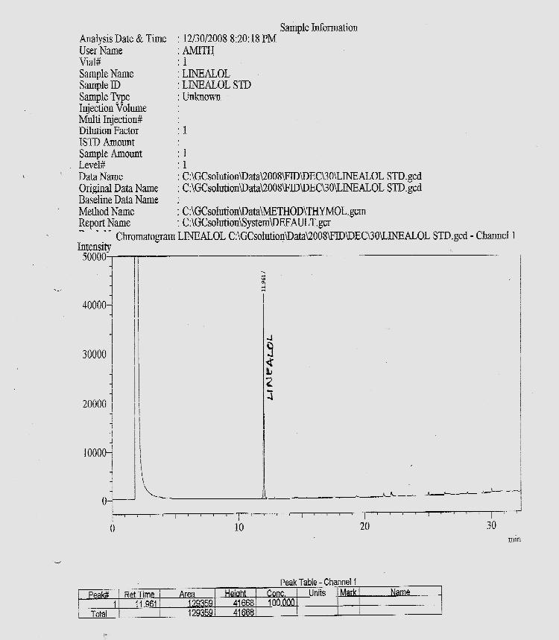
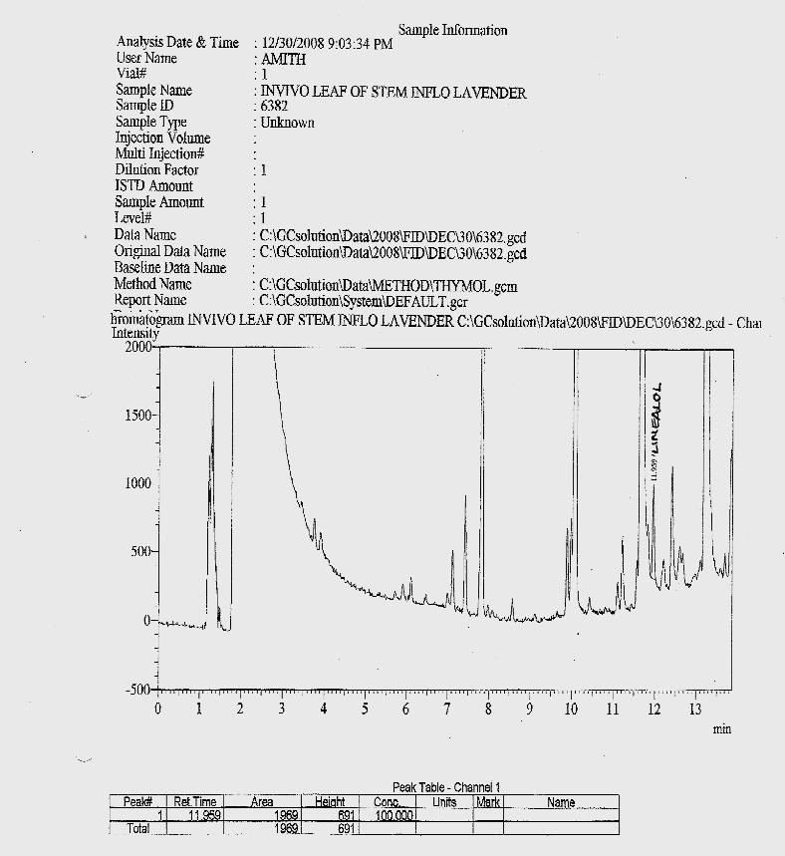
STANDARD CHROMATOGRAM OFLinalool
CHROMATOGRAM OFLinalool
IN VIVO LEAF AND STEM OF L. angustifolia

Slide 20
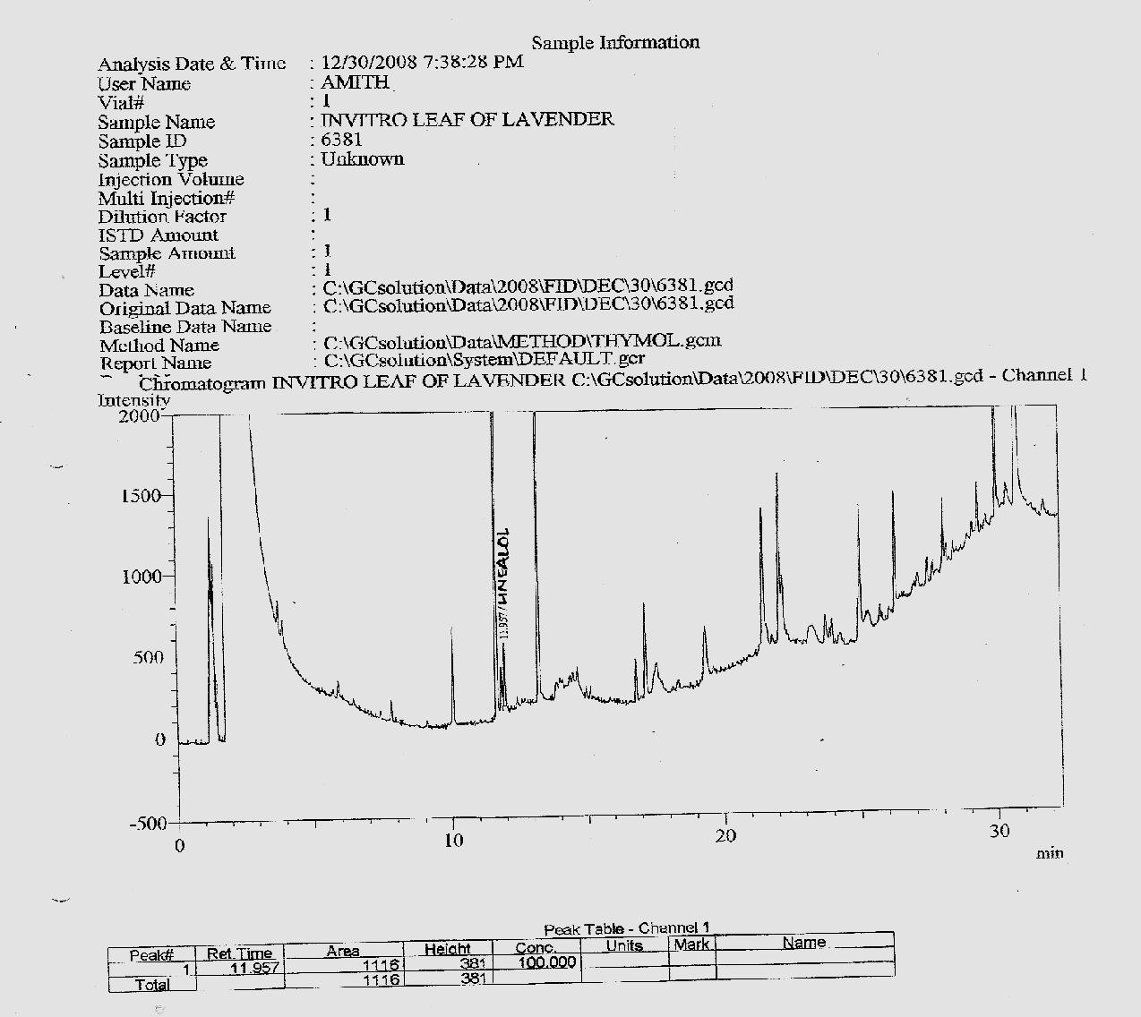
CHROMATOGRAM OF Linalool in IN VITRO LEAF AND STEM OF L. angustifolia
Leaves and stem of in vitro and in vivo of L. angustifolia were subjected to phytochemical analysis for the determination and comparison of the principle component Linalool

Slide 21
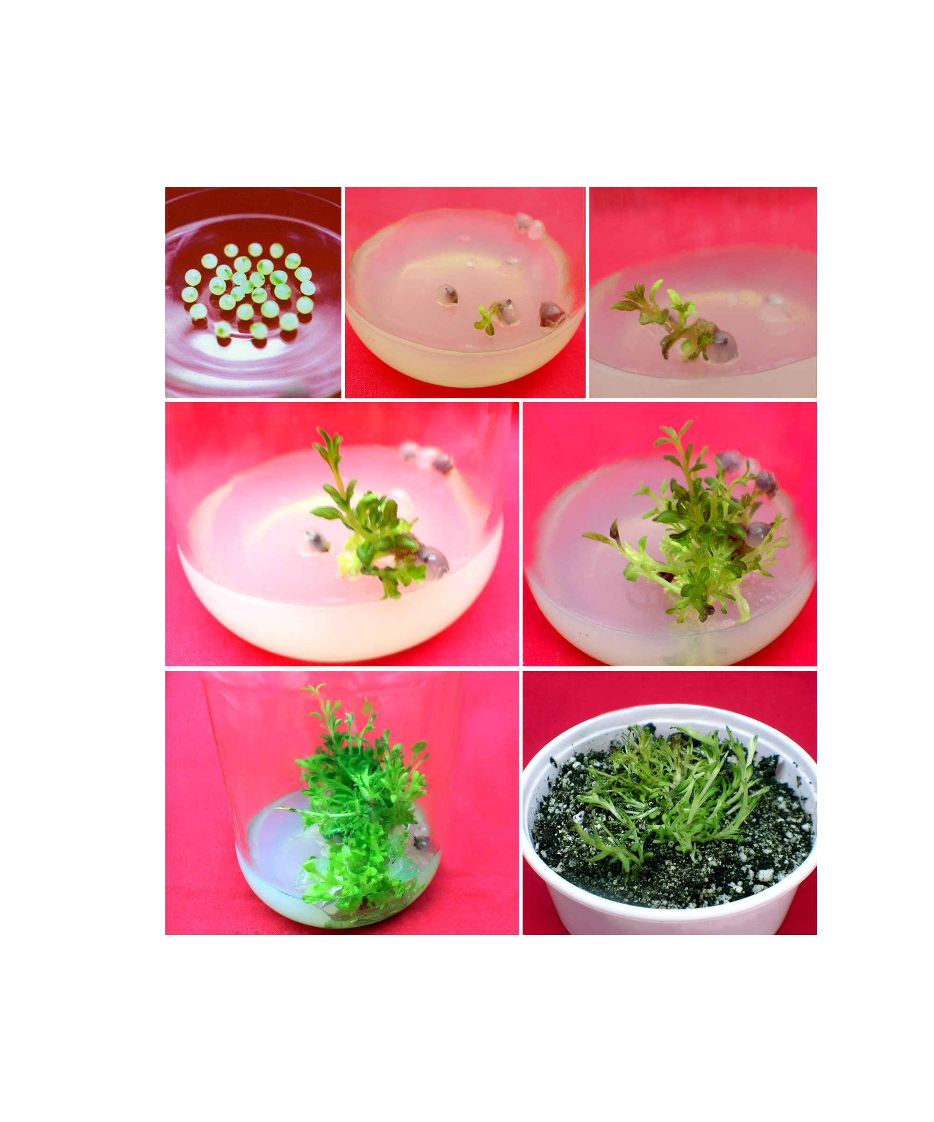

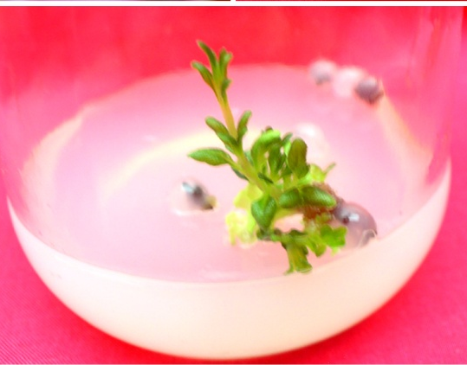
ENCAPSULATION OF IN VITRO APICAL BUDS OF O. BASILICUM
Sodium alginate was selected for encapsulation in comparison with Carboxyl methyl cellulose which failed to complex with CaCl₂, 4% concentration of sodium alginate was the best matrix and 50mM CaCl₂ was found to be the best complexing agent for 40 min. exposure to obtain firm, transparent and uniform beads.
The encapsulated apical buds of L.angustifolia (Fig .21). were inoculated on regenerating medium on MSBM fortified with BAP (8.88 μΜ) in order to retrieve the plantlets. Seeds germinated after 18 days of culture with 94 % of response (Fig 22).
After 25 days of culture, 1-2 shoots with 5 –7 leaves (Fig.23) was noticed. After 32 days of culture the shoot buds increased in length with 2-3 multiple shoots (Fig .24).
Fig-21
Fig-22
Fig-23
Fig-24

Slide 22



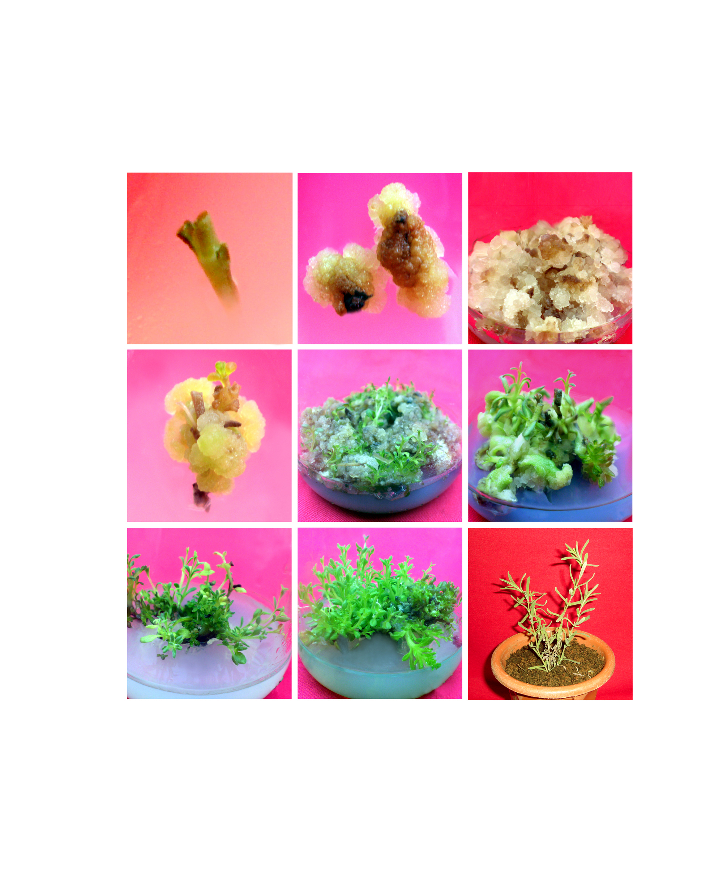
Cont….
Further, elongation and multiple shoot formation was observed (8-10) after 42 days of culture (Fig.25).
Healthy, elongated multiple shoots (20-25) were observed after 56 days of culture (Fig.26)
which formed roots on the same medium after 63 days of culture.
The well developed multiple shoots with roots were subjected to hardening process (Fig.27)
Hardened plant (Fig.28)
Fig-25
Fig.26
Fig-27
Fig-28

Slide 23
Table.5 Effect of different concentrations of sodium alginate and carboxy methyl cellulose , concentration of calcium cholarate and duration of exposure to calcium cholarate for synthetic seed formation of aseptic apical buds of Lavandula angustifolia
Types of matrix (hydrogel) | Concentration % of (hydrogel) | NO. Of beads produced | Quality of beads | Concentration of CaCl₂ | Quality of beads Formed at different conc. Of CaCl₂ | Duration in minutes | Quality of beads formed at different duration of time (Mins)
Sodium Alginate | 2 | 30 | soft | 25mM | Soft and Transparent | 20 | Soft
 | 4 | 30 | Firm
 | 6 | 30 | hard | 50mM | Firm and Transparent | 30 | Soft
 | 8 | 30 | hard
Carboxy methyl Cellulose | 2 | 30 | Soft | 75mM | Hard | 40 | Firm
 | 4 | 30 | Soft
 | 6 | 30 | Soft | 100mM | Very hard | 50 | Hard
 | 8 | 30 | soft |  |  | 60 | Very Hard

Slide 24
Table 6: Percentage of germination of synthetic seed of L.angustifolia
Basal media | Growth regulators BAP (µM) | Duration Months | No. of beads stored (4⁰c) | Culture duration | Germination % Apical bud Lavandula angustifolia
MS | 8.88 | 0 | 30 | 2 weeks | 95
MS | 8.88 | 1 | 30 | 2 weeks | 90
MS | 8.88 | 2 | 30 | 2 weeks | 88
MS | 8.88 | 3 | 30 | 2 weeks | 86
MS | 8.88 | 4 | 30 | 2 weeks | 84
MS | 8.88 | 5 | 30 | 2 weeks | 70
MS | 8.88 | 6 | 30 | 2 weeks | 52

Slide 25
Graph 4 Percentage of germination response of encapsulated apical buds of Lavandula angustifolia

Slide 26
DISCUSSION
It was found in the present study, MS basal medium supplemented with BAP 8.88µM +NAA 2.68µM.
BAP (8.88 μΜ +NAA 2.68µM. ) was the best medium for in vitro apical bud initiation and shoot multiplication of L.angustifolia .This agrees with the findings of Miugel and Maria (1996) who have reported the micropropagation of L. latifolia through axillary bud culture on MSBM supplemented with BAP and NAA
It was found in the present study, that MS basal medium supplemented with BAP (8.88 μΜ + NAA 2.68µM ) was the best medium for in vitro apical bud initiation and shoot multiplication of L.angustifolia . This does not agrees with the findings of Sudria et al., (1999) they have reported LS basal medium supplemented with BAP and IBA for multiple shoot production in L. dentate.
Synthetic seed technology would be valuable tool for long term germplasm conservation of aromatic plants. At present, the use of synthetic seed technology for aromatic plants is limited as reported byJaydip et al.,(2000).
.

Slide 27
Cont…
Further, the in vivo and in vitro leaf and stem of L. angustifolia revealed the major compounds such as Linalool 0.0079 % percent in the in vivo leaf and stem of lavender when compared with in vitro leaf and stem (0.004 %).
In the present study 4% Sodium alginate upon complexation with 50mM Calcium Chloride (CaCl₂) for 40 mins was found to be best hydrogel and complexing agent for encapsulation of apical bud. Further, the firm and uniform beads so obtained resulted in retrieval of plants through in vitro germination of syn seeds.
The synthetic seeds of apical buds can be stored at 4ºC in sterile water upto six months
They germinate and develop into plants when transferred to room temperature on MS basal medium fortified with BAP (8.88µΜ) for Lavandula angustifolia

Slide 28
REFERENCES
Anamaria Jordan, M. C., Calvo M. C., and Segura, J. 1998. Micropropagation of adult Lavandula dentata plants. Journal of Horticultural Sciences and Biotechnology, 73(1): 93-96.
Anwar Shahzad and Saeeda Siddiqui. 2000. In vitro organogenesis in
Ocimum sanctum. –A multipurpose herb. Phytomorphology, 50 (1) : 27-3
Dias, M.C., Almeida,. R. and Romano A 2002. Rapid clonal multiplication of Lavandula viridis L’He’r through in vitro axillary shoot proliferation. Plant cell, Tissue and Organ Culture, 68: 99-102.
DHAR A.K. 2002. Sweet basil Ocimum basilicum –a review. Journal of Medicinal and Aromatic plant Sciences , 24 : 738-755.
Miguel Carlos Sanchez- Gras and Maria Del Carmen Calvo. 1996. Micropropagation of Lavandula latifolia through nodal bud culture of matured plants. Plant cell, Tissue and Organ Culture, 45: 259-261.
Jaydip Mandal, Sitakanta Patnaik, and Pradeep k. Chand 2000. Alginate encapsulation of axillary buds of Ocimum americanum L. (Hoary basil), O. basilicum L.(Sweet basil), O.gratissimum L. (Shrubby basil), and O. sanctum L. (sacred basil). In vitro Cell, Dev- Biol- Plant , 36 : 287
Panizza, M. and Tognoni, F. 1988. Clonal Propagation, Callus formation and regeneration of Lavandin. Scientia Horticulturae, 37: 157-163.
Leelavathi, D. and Nrendran Kuppan. Protocol for rapid clonal multiplication using in vitro apical bud of Lavandula angusfolia . IOSR Journal of Pharmacy and Biological Sciences (-jpbs 2013,(7).96-98.

Slide 29
Cont..
Maria Carmen Calvo and Juan Segura .1989. In vitro propagation of Lavender. Hort Science, 24(2): 375-376.
Melissa Sicurani, Emanuele Piccioni and Alvaro Standardi 2001. Micropropagation and preservation of synthetic seed in M.26 apple rootstock I: Attempts towards saving labor in the production of adventitious shoot tips suitable for encapsulation. Plant Cell, Tissue and Organ Culture, 66: 207- 216.
Andrade, L.B, Echeverrigaray, S., Fracaro, F., Pauletti G. F. and Rota, L. 1999. The effect of growth regulators on shoot propagation and rooting of common lavender (Lavandula vera DC). Plant cell, Tissue and Organ Culture, 56: 79-83.
Panizza, M. and Tognoni, F. 1988. Clonal Propagation, Callus formation and regeneration of Lavandin. Scientia Horticulturae, 37: 157-163.
Malathy Suryanarayanan and Jagadish S. PAI. 1998. Studies in micropropagation of Coleus forskohlii. Journal of Medicinal and Aromatic plant Sciences, 20: 379-382.uazi M. H. 1980. In vitro multiplication of Lavandula spp. Annuals of Botany, 45: 361-362
Narendra Kuppan^{1*} , Leelavathi.D² IN VITRO ASEPTIC, REGENERATION OF LAVANDULA ANGUSTIFOLIA L.- AN IMPORTANT MEDICINAL PLANT USING AXILLARY BUD EXPLANTS. INTERNATIONAL JOURNAL OF PHARMACEUTICAL RESEARCH AND DEVELOPMENT December - 2013 / Volume - 5/Issue – 10

Slide 30

THANK YOU

