Slide 1


Breeding elite rice lines resistant against rice tungro virus disease
Dr. D. Krishnaveni
Principal Scientist (Plant Pathology)
Directorate of Rice Research
Hyderabad, Andhra Pradesh

Slide 2
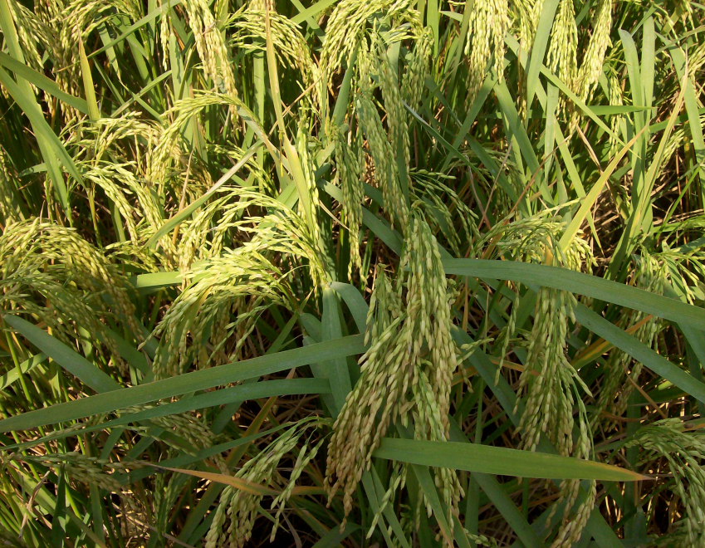

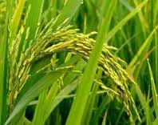
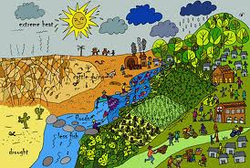
Rice is the most important food crop in India and plays a key role in delivering global food security.
Due to changed cultivation practices and apparent changes in the climate, there has been increased incidence of many pests and diseases.

Slide 3
Rice is a natural host for more than 25 viruses.
About 15 viruses may seriously affect rice yield.
rice bunchy stunt,
rice black-streaked dwarf,
rice gall dwarf,
rice dwarf,
rice transitory yellowing,
rice grassy stunt,
rice giallume,
rice necrosis mosaic,
rice ragged stunt,
rice stripe necrosis,
rice stripe,
rice hoja blanca,
rice tungro bacilliform,
rice tungro spherical,
and rice yellow mottle viruses.
“yellow dwarf” a disease of mycoplasma origin.
The distribution of each virus is generally restricted to only one or two of the continents in which rice is grown

Slide 4
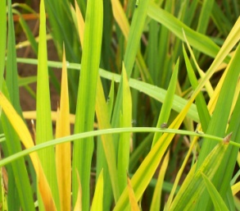
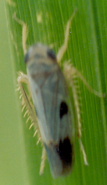
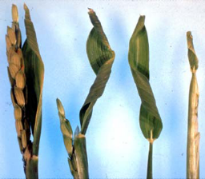
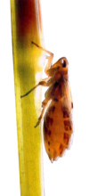
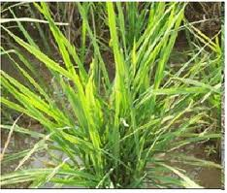
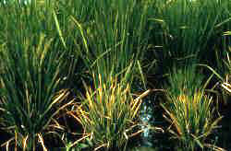

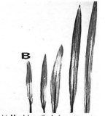
Rice viruses- symptoms and vectors
S.No | Virus/Phytoplasma | Typical symptoms |  | Reports in India | Transmission
1 | Rice tungro spherical virus and rice tungro bacilliform virus |  | Severe stuntung Reduced tillering Yellow to orange discolouration Interveinal chlorosis Twisting of leaf tip | 1966 –till today Raychaudhuri et al 1967 | Green leafhopper Nephotettix virescens
2 | Rice ragged stunt virus |  | stunting, abnormal leaves with serrated edges twisted leaf tips, vein swelling or galls on the underside of the leaf blades | 1979 Ghosh et al 1979 | Brown planthopper Nilaparvata lugens
3 | Rice grassy stunt virus |  | severe stunting profuse tillering. leaves are stiff and narrow interveinal chlorosis & bronzing. | 1972-84 Kulshreshtha et al 1974 Mariyappan et al 1984 | Brown planthopper Nilaparvata lugens
4 | Rice necrosis mosaic virus |  | Stunting with reduced tillering Mosaic mottling on the upper leaves Necrotic lesions on the basal parts of the stems and sheaths | 1979 (Ghosh 1979) | Mechanical and Soil transmission
5 | Rice yellow dwarf (Candidatus Phytoplasma oryzae ) |  | Yellowing of the newly formed leaves Stunted plant Increased tillering Conspcuous on the ratoon crop | 1976 (Muniyappa and Ramakrishna 1976) | Green leafhopper Nephotettix virescens N. nigropictus

Slide 5
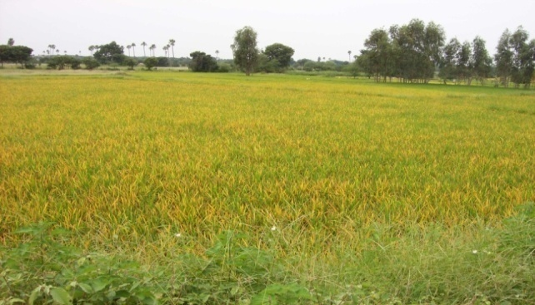
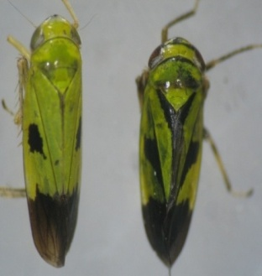
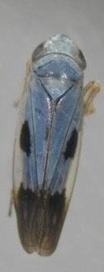

Rice tungro virus disease
Rice tungro virus disease (RTD) - a destructive disease of rice.
Tungro is caused by two unrelated viruses Rice tungro bacilliform virus (RTBV),- a DNA virus, Rice tungro spherical virus (RTSV), an RNA virus.
Transmitted by green leafhoppers (GLH)- Nephotettix virescens and N. nigropictus in a semi-persistent manner.

Slide 6
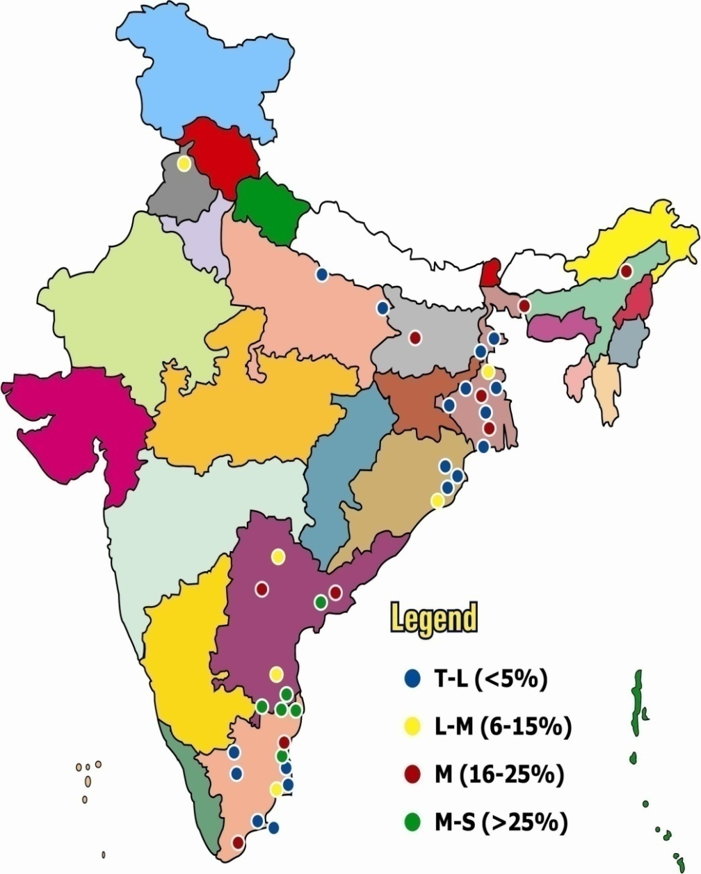
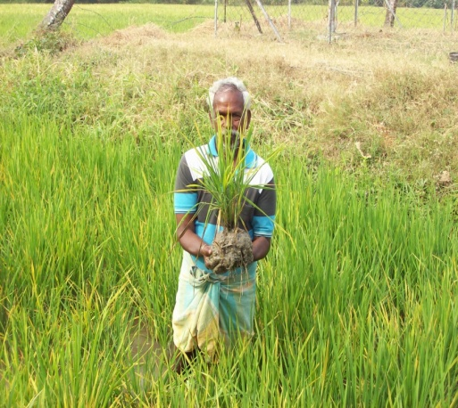
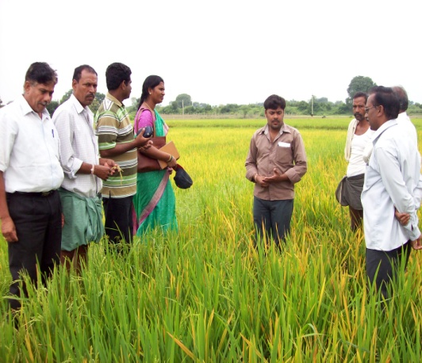
Rice tungro virus distribution in India
1967: First reported from West Bengal.
1969: Eastern U.P., West Bengal and northern parts of Bihar.
Subsequently, the disease reported from A.P., Assam, Kerala, Puducherry, Tamil Nadu and other rice growing areas.
1973 &1974: Many parts of Orissa
1977: Krishna district of A.P.
1981: Many parts of West Bengal
1998: Gurdaspur and Amritsar districts of Punjab, in an area of 0.45 million ha
2003: Nalgonda district of A.P.
2003-2006: Kanyakumari and Tirunelveli districts of Tamil Nadu.
2007: Karimnagar and Medak districts of AP in an area of >19000 acres.
2010: Kanyakumari, Tamil Nadu
Besides obvious endemism, reasons for periodical epidemics are not known

Slide 7
As chemicals are not very effective for the control of tungro…..,
……host plant resistance has become the most important alternative for the management of this disease
Ever since the identification and confirmation of tungro virus incidence in India, attempts were made to identify donors and develop breeding lines resistant to tungro disease

Slide 8
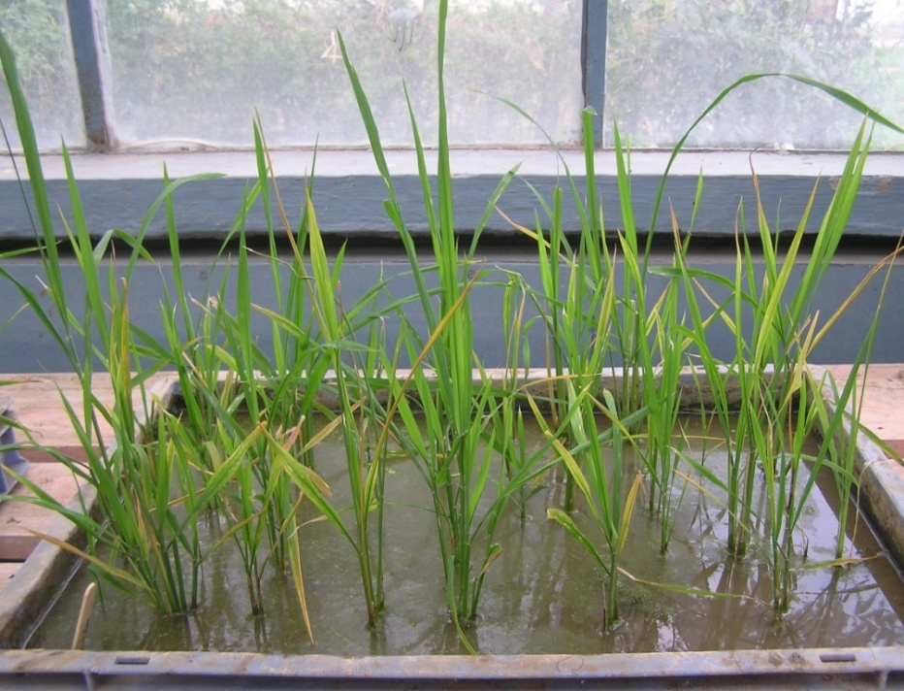
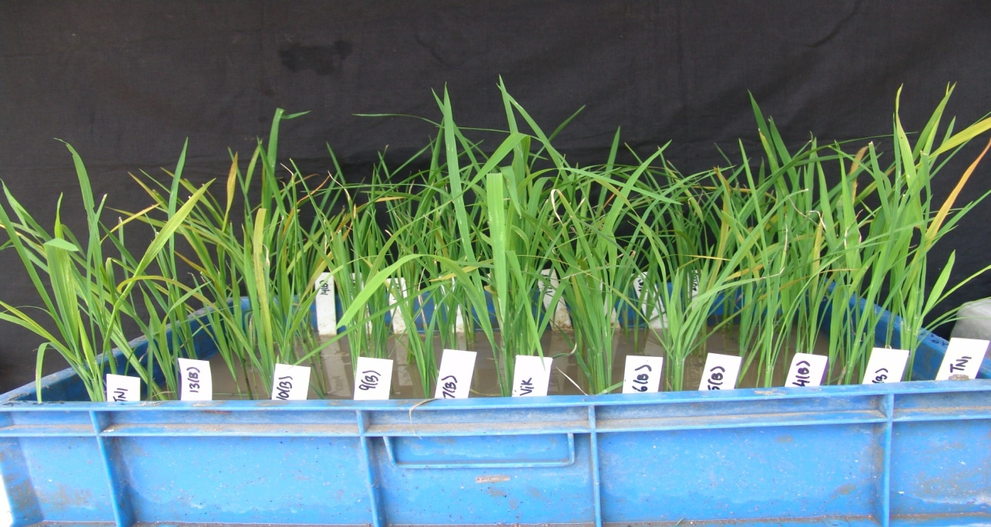
SES Scale (IRRI 1996) for RTV
Score | Description
1 | No symptoms
3 | 1-10% plant height reduction with no distinct leaf discoloration.
5 | 11-30% plant height reduction with no leaf discoloration.
7 | 31-50% plant height reduction and yellow to orange leaf discoloration
9 | More than 50% plant height reduction and yellow to orange leaf discoloration.
RTV screening

Slide 9
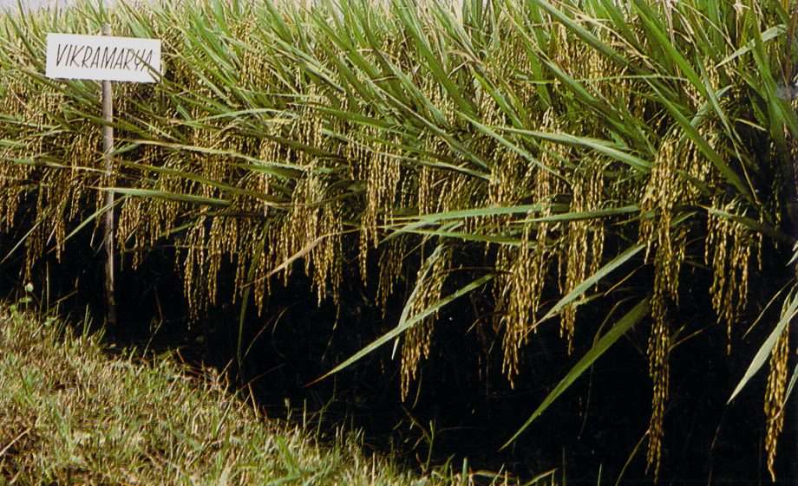
Vikramarya
IET 7302
Cross: RPW 6-13/ PTB 2;
with long bold grains;
Released in AP during 1986
Duration: 130 days;
Resistance to tungro, GLH and blast
Though varieties are bred/released for RTV resistance, these varieties are not popular and popular varieties are prone to RTD

Slide 10
Nature of resistance in rice genotypes.
Studies on genetics of inheritance of the donors suggest the involvement of single gene to multiple loci governing the resistance
Prasad GSV, Krishnaveni, D. Subramanian N, Neeraja CN and Muralidharan K. 2004. Genetics of resistance to rice tungro virus disease. J.Mycol.Pl.Pathol 34(3):846-849

Slide 11
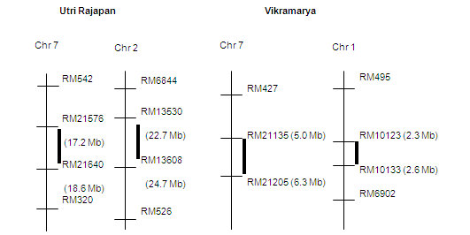
Molecular mapping of resistance genes
In variety ARC11554, RTSV and green leafhopper (GLH) resistance was reported on chromosome 4 and being fine mapped.
In Utri Merah, RTV resistance was mapped on chromosome 7.
Two well known donors for Rice Tungro Disease resistance ‘Utri Rajapan and ‘Vikramarya’ were targeted for mapping.
Two QTL for RTD resistance were identified in ‘Utri Rajapan’ on chromosomes 7 and 2 explaining 40.8% and 21.6% of the phenotypic variance.
In ‘Vikramarya’, another two QTL for RTD resistance were detected on chromosomes 7 (different location) and 1 explaining 18.7% and 16.4% of PV

Slide 12
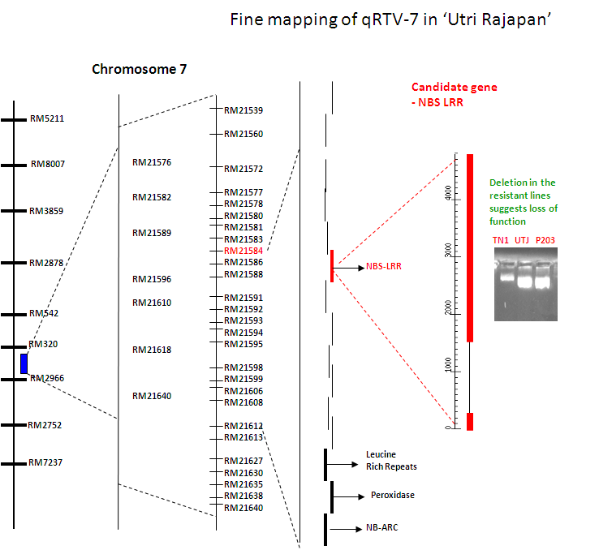
The major QTL qRTV-7 from Utri Rajapan was fine mapped.
Out of two QTLs identified for tungro disease resistance, the major QTL, qRTV-7 was fine mapped using rice genome sequence information. This QTL was located within ~17.69 and 19.39 Mb of chromosome 7 genome sequence spanning 18 BAC clones corresponding to ~1.74 Mb of the sequence (AP008213).

Slide 13
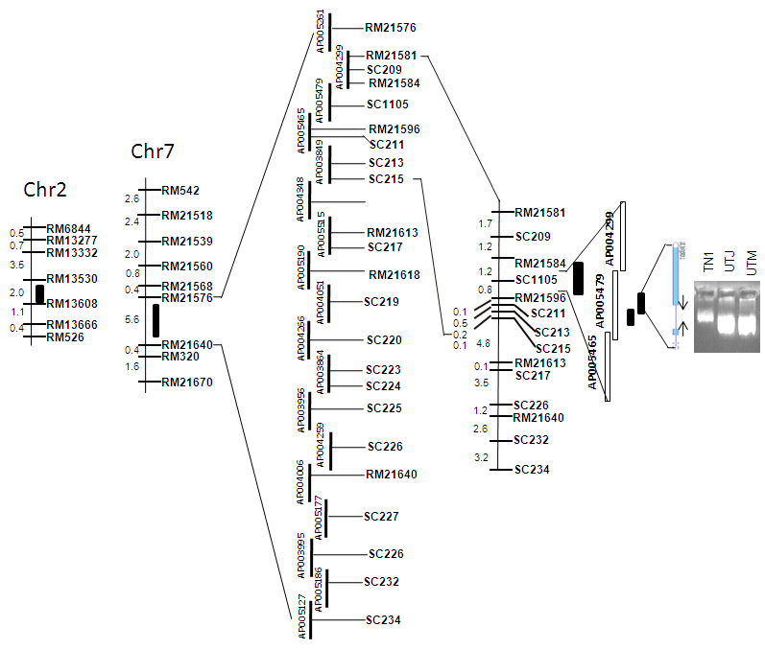
Cloning of the candidate gene
The complete gene (LOC_Os07g29820) covering 5.2 kb is being successfully amplified after standardization of several combinations of primers.
Bioinformatics of three BACs viz., AP004299; AP005479 and AP005465 showed 52 annotated genes in the region in addition several hypothetical and unknown proteins

Slide 14
Two candidate genes viz., LOC_Os07g29810 and LOC_Os07g29820 with predicted product of putative nucleotide-binding leucine-rich-repeat proteins were more focused because of their reported involvement in disease resistance.
Several candidate gene based primers were designed for detection of structural polymorphism and screened for their utility as markers
Primers/Markers studied | Number of primer pairs
RM microsatellite markers | 32
Designed microsatellite markers | 39 + 29
LOC_Os07g29810 | 22
LOC_Os07g29820 (primers for sequencing) | 48
Designed candidate gene based markers (other than two disease resistance genes) | 140 targeting 48 genes
RT primers for expression analyses (including candidate genes) | 120

Slide 15
Expression analysis of candidate gene
The expression analysis of candidate gene (LOC_Os07g29820) in the infected and healthy tissues has been standardized
Differential gene expression is detected in resistant (Utrirajapan) and susceptible (TN1) and it was found that there is differential expression after six hours of infection in susceptible and resistant genotypes

Slide 16
From the Production Oriented Survey (DRR), a few regions across country were identified as endemic for RTV.
The popular varieties grown in these regions which are found to be susceptible to RTV were selected for introgression of qRTV-7.
This objective has been fulfilled with five popular varieties introgressed with qRTV-7 with foreground and background selection.
Breeding elite rice lines with identified RTV resistance genes

Slide 17
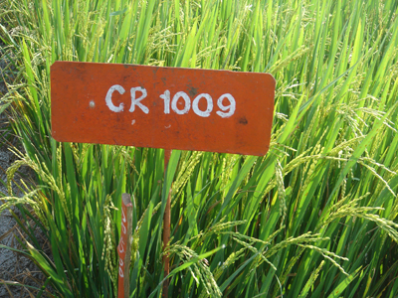
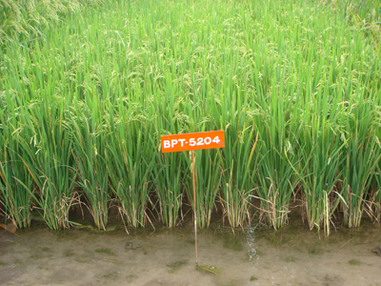
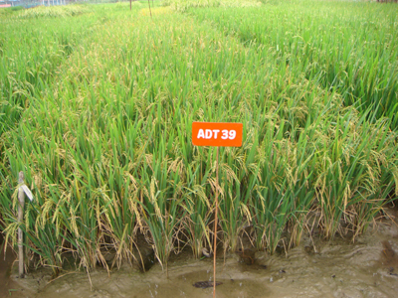
Details and stage of backcross populations
The major QTL qRTV-7 was being introgressed into IR64 (BC2F2), BPT5204 (BC2F2), MTU1010 (BC2F2), ADT39 (BC2F2) and CR1009 (BC1F2).
Female Parent | Male Parent | Stage of BC
IR64 | Utri Rajapan (Resistant parent) | BC2F4
BPT5204 | Utri Rajapan | BC1F4
MTU1010 | Utri Rajapan | BC2F4
ADT39 | Utri Rajapan | BC1F4
CR1009 | Utri Rajapan | BC1F1

Slide 18

Thank you !!

