Slide 1
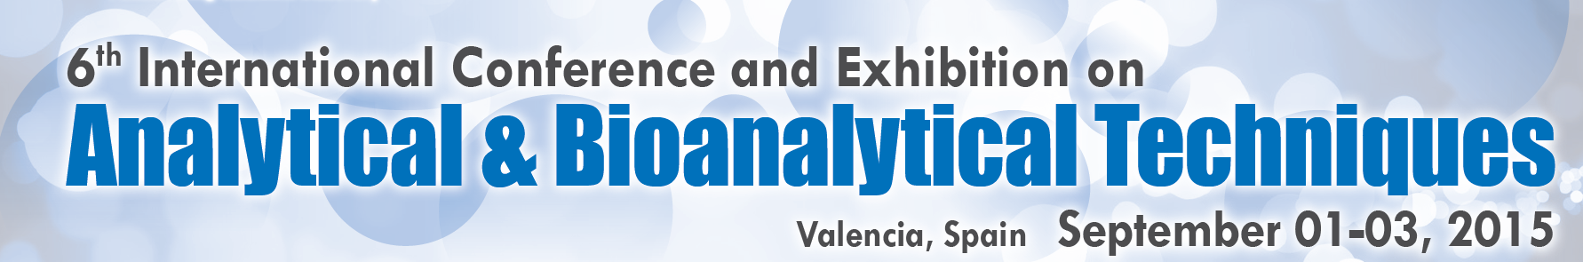

Recent Progress of DUV-LED
Analytica-2015,
Thursday, September 3, 2015
Session: Applications of Analytical and Bio analytical Methods
Session Introduction
Cyril Pernot
Crystal Growth Section, Hakusan Factory, Manager
cyril.pernot@nikkiso.co.jp,
Bld No14, Meijo University, 1-501, Shiogamaguchi Tenpaku
Nagoya 468-0073, Japan
1

Slide 2
Presentation Outline
Introduction
  UV LED market trend, UV LED advantages and applications
Performance of DUV-LED
  Fabrication of DUV-LED
  Layer Structure
  Characteristics
  Packages
Applications for DUV-LED
  Disinfection Applications
  Analytical Applications
    - Dialyse Dose Monitor
    - Chromatography
Conclusion

Slide 3
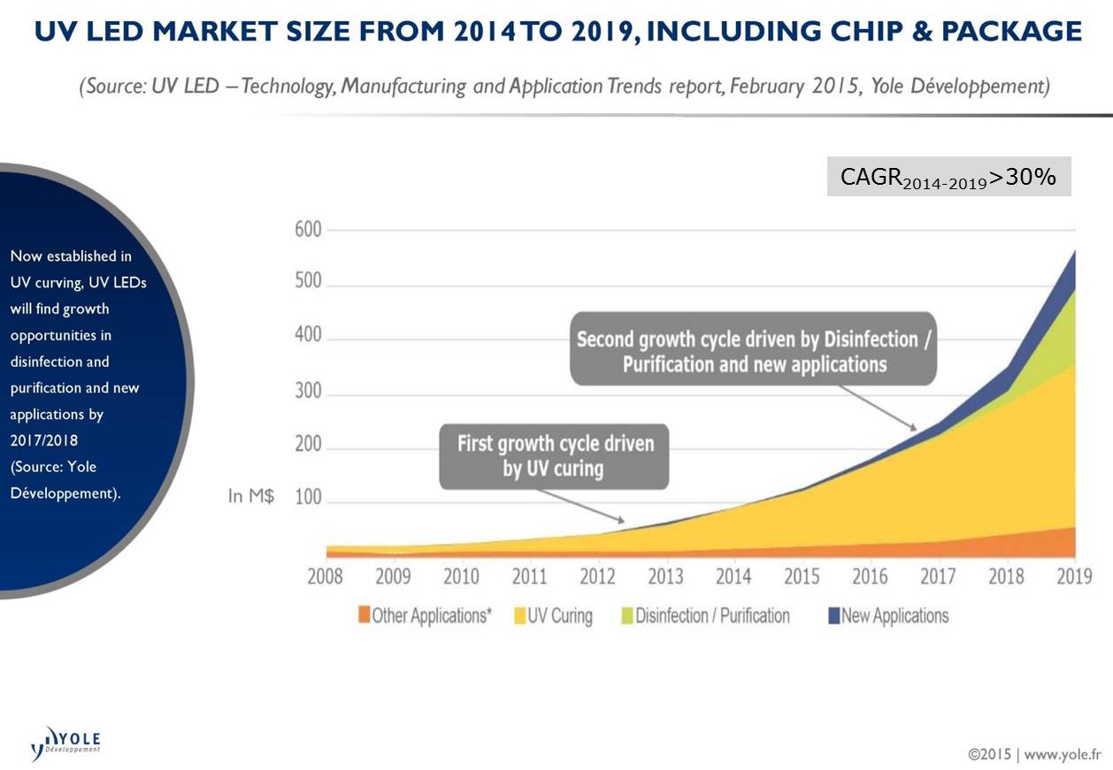
UV-LED Market

Slide 4
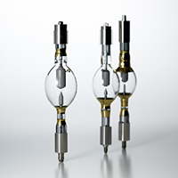
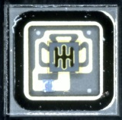
Advantage of UV LED Systems
Source of UV:
・Gas-discharge lamps (mercury, deuterium, xenon…)
・UV-LED
3,5x3,5mm-sq SMD
UV-LED Systems Benefits:
Shock resistant semiconductor
customizable emission wavelength
Easy integration (design flexibility, simple driving circuits, low voltage operation)
Instant on/off => No warm-up/cool-down cycles, No shutter needed
Diode Life time in excess of 10,000 hours
No mercury-filled UV bulbs
No ozone production => No system exhaust
By the Minamata Convention on Mercury, regulation on mercury will be strict from 2020.
LED has low environmental impact, and has the potential to replace mercury lamps.
4
Notes:
Thinking about LED itself + package & module

Slide 5
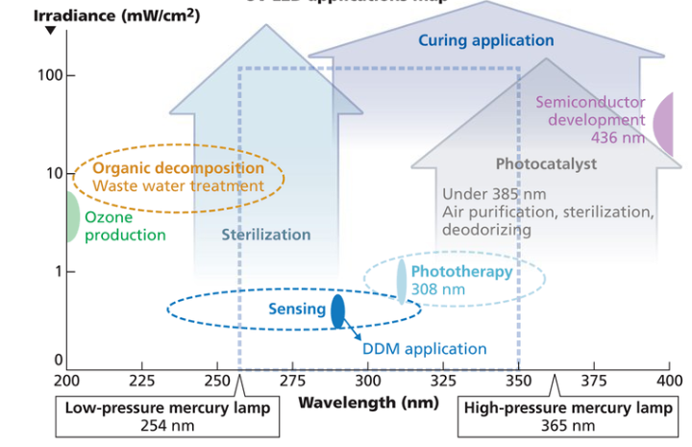
UV-LED Applications Map
Disinfection
UVC
(100-280nm)
UVB
(280-315nm)
UVA
(315-400nm)

Slide 6
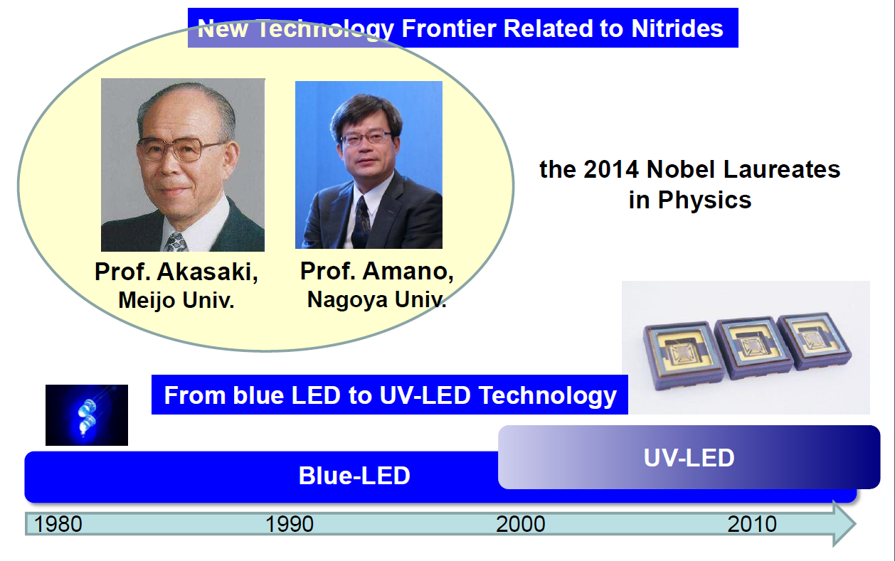
From Blue to UV LED

Slide 7
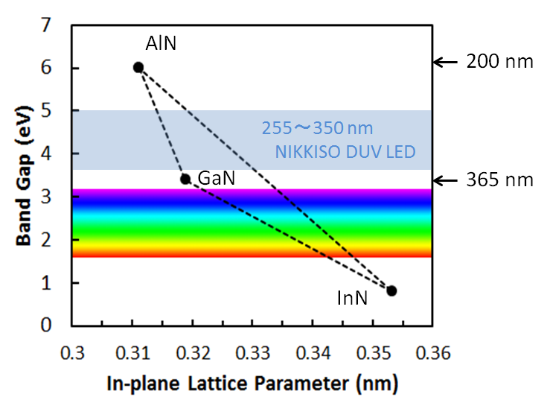
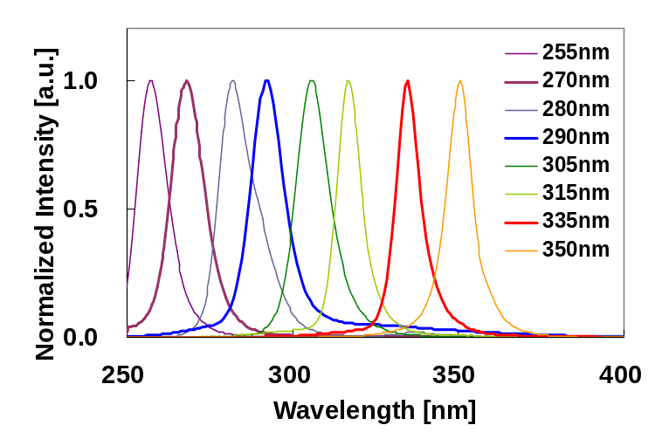
Band gap and emission wavelength
AlGaN-based UV LED

Slide 8
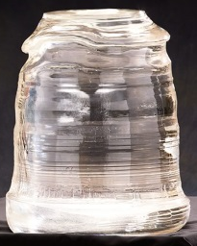
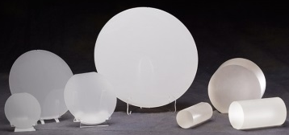
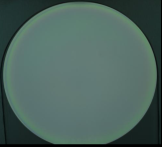
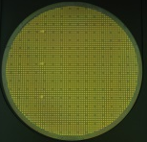
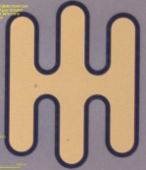
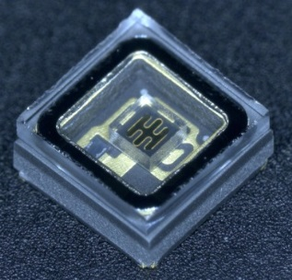
Flow Chart for LED Fabrication
Bulk Crystal
Slicing/Polishing
Substrate
Epitaxial Growth
EpiWafer
Process
ProcessWafer
Dicing/Sorting
LED Chip
Flip-chip/Package
FEED BAC
@ NIKKISO
DUV-LED

Slide 9
Standard DUV-LED Structure
electrodes
X
pGaN
pAlGaN
electrodes
Active Region
nAlGaN
X
AlN
X
Sapphire
Internal Efficiency > 70%
Light Extraction Efficiency < 10 %

Slide 10
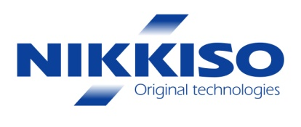
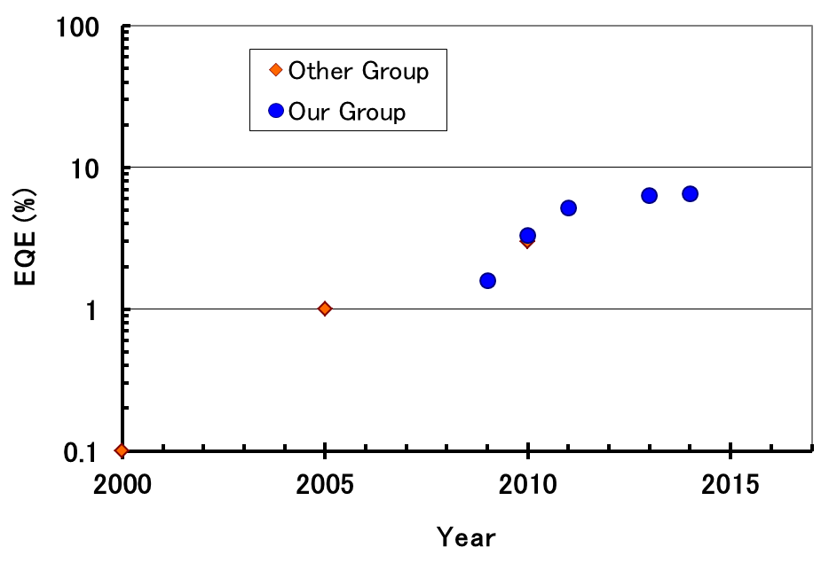
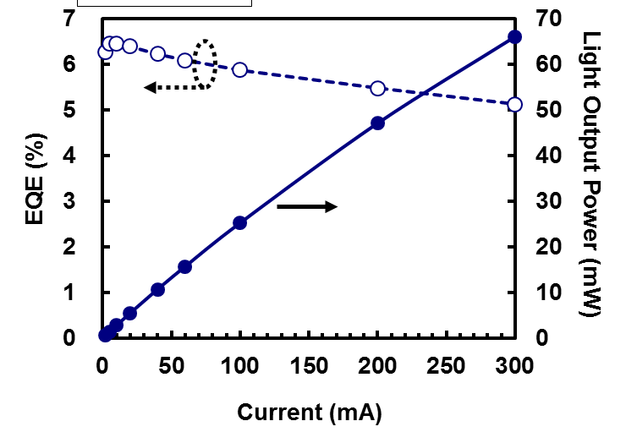
EQE and max Power
Evolution of EQE
Bare chip measurement under same condition for 280-290nm LED
289nm bare chip (2013)
EQE Limit for LEE of 10 %
Improvement obtained thanks to:
- Better crystal quality
- Better device layer structure
But still need improvement for Light Extraction:
- Reflective electrodes
- Encapsulation
WPE = 5.0 % @ 10mA

Slide 11
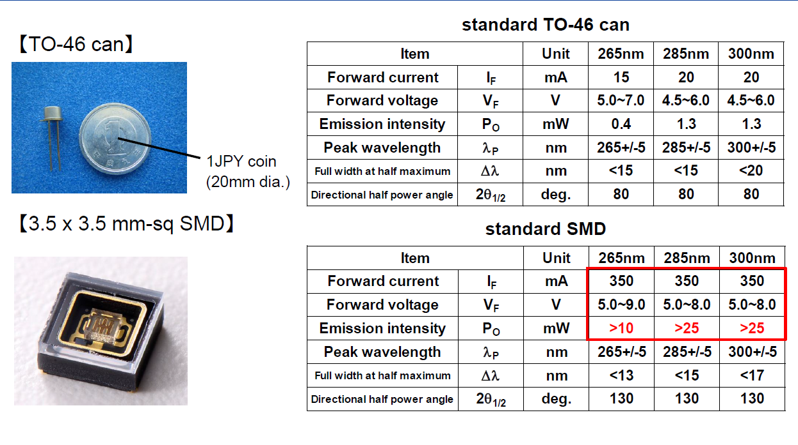
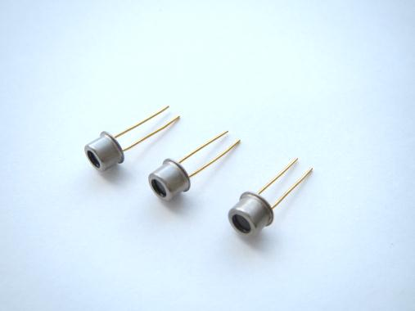
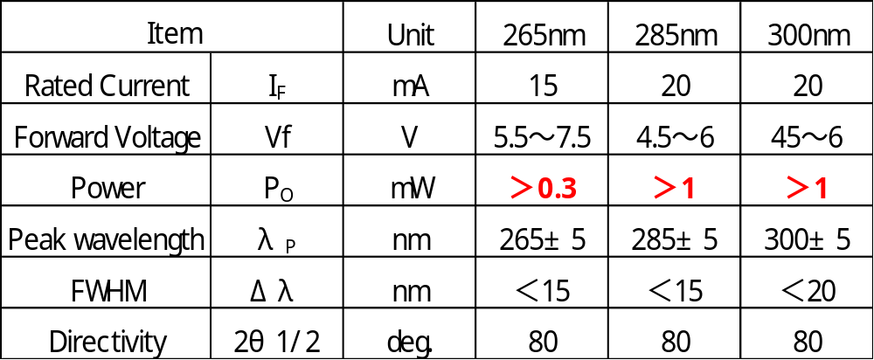
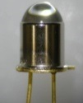
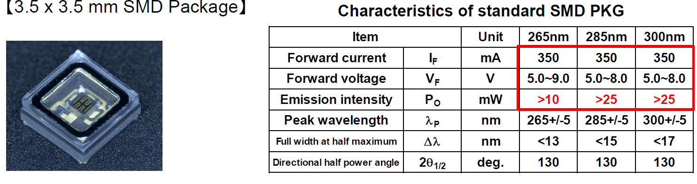
DUV LED Products and Characteristics
●Low Power Type（IF=20mA）
TO-46
w/ lens
flat window
●High Power Type（IF=100mA or 350mA）

Slide 12
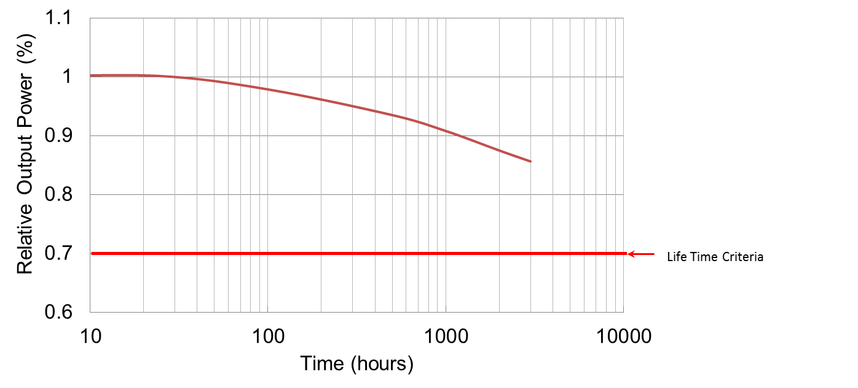
Lifetime ・ Degradation
Temperature and driving current are affecting lifetime of the DUV-LED device
but origin and mechanism of degradation are still unclear
By growing high quality DUV-LED, life time over 10000 hours can be achieved.
Output power degradation for 285 nm DUV-LED driven at 350 mA with Ts of 40℃

Slide 13


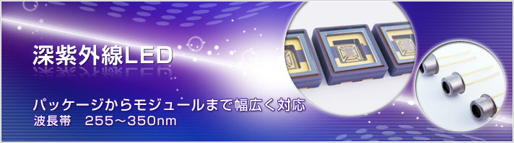
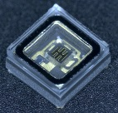
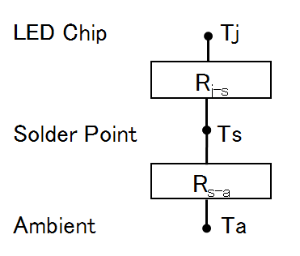
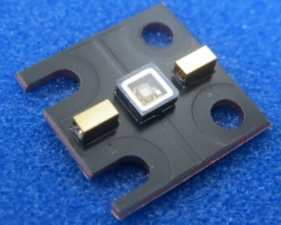
Package & thermal resistance
Package | Thermal Resistance | Maximum CW operating current for keeping power over 80%
CAN PKG | >20℃/W | 20 mA, Power > 1mW
SMD PKG (2013 Product) SMD PKG (2014 Product) | 18℃/W 15℃/W | 200mA, Power > 15mW 350mA, Power > 25mW
New PKG Under development) | < 10℃/W | >350mA , Power> 50mW
Tj(℃)=Ts(℃)+IF(A)×VF(V)×R_{j-s}（℃/W）,

Slide 14
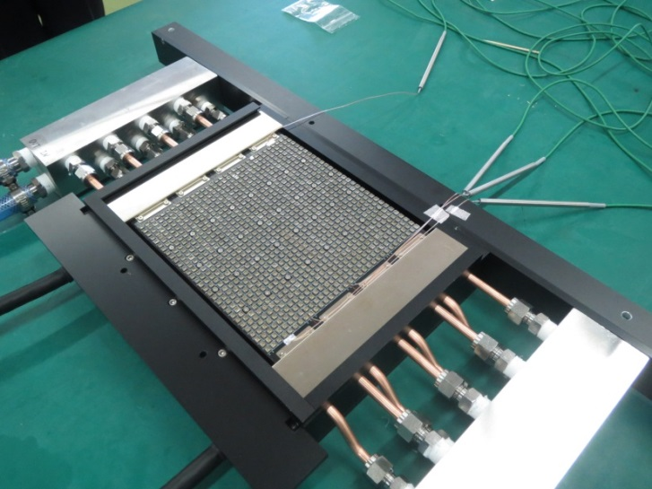
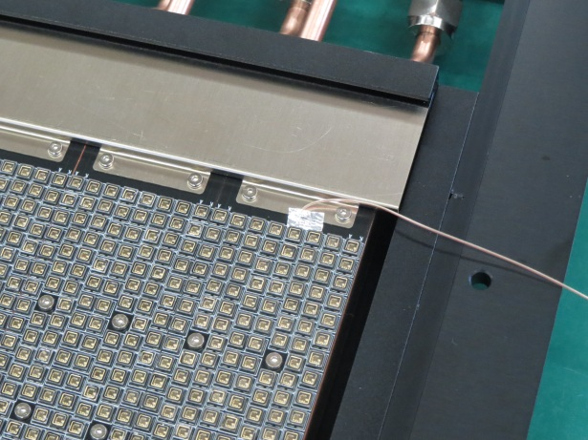
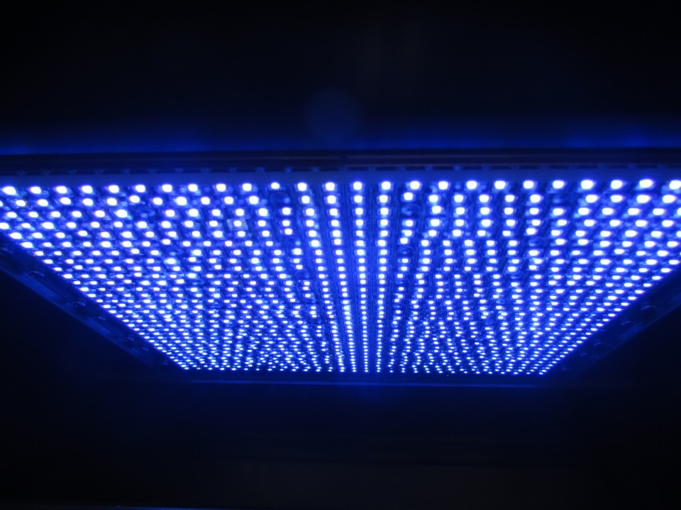
High Packing Density Lighting Module
8 modules of 112 x 3.5mm-packages each
Irradiance of 80 mW/cm²
at a working distance of 10 mm
over an area of 25 x 25 cm².
(Water Cooling)

Slide 15
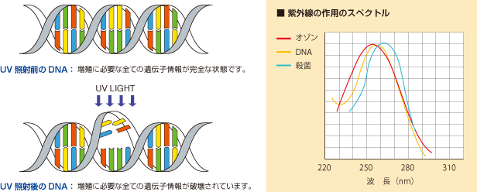
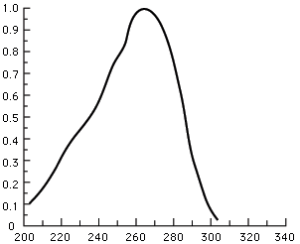
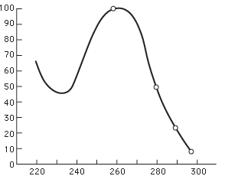
Disinfection by UV Light
When living microorganisms such as bacteria are exposed to UV-C light between 250nm and 280nm (germicidal action spectra), their DNA can be destroyed and inactivated by UVC effectively; DNA cannot reproduce itself => Disinfection
Principle
DNA:DeoxyriboNucleic Acid
DNA can be destroyed and inactivated by UV light irradiation.
DNA (before Irradiate UV LIGHT)
DNA (after Irradiating UV LIGHT)
Absorption Coefficient
Disinfection Effect
Wavelength(nm)
15
Wavelength(nm)

Slide 16
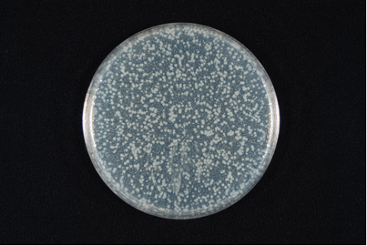
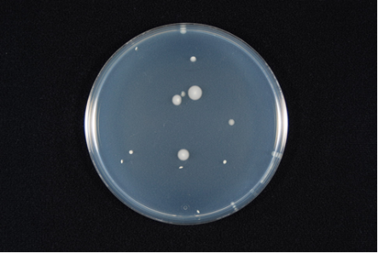

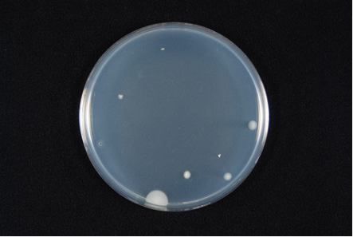
Disinfection Test Result by UV-LED
UV-LED Specifications
Wavelength : 265nm and 285nm
Forward Current : 60mA
Lighting Intensity :
265 nm : 1.33 [mW/cm²]
285 nm : 2.41 [mW/cm²]
Irradiation Distance ：10mm
Reference
No Irradiation
285nm
265nm
Bacterial
1) Escherichia coli NBRC3972
265nm
285nm
After 360sec
After 420sec
Demonstration of effective Disinfection
using DUV LED for the following Bacteria ⇒
2) Bacillus substills, NBRC3134
3) Staphylococcus aureus subsp.sureus, NBRC 12732
4) Salmonella enterica subsp.enterica, NBRC 3313
5) Vibrio parahaemolyticus, RIMD 2210100
6) Cladosporium cladosporioides, NBRC 6348
7) Aspergillus niger, NBRC 105649
16

Slide 17
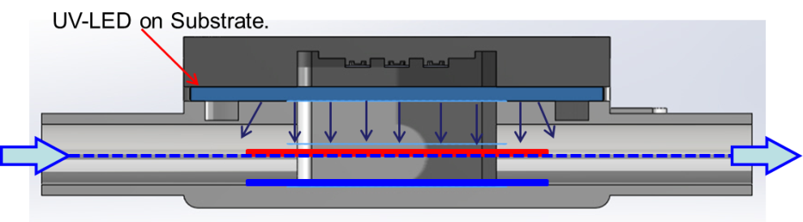
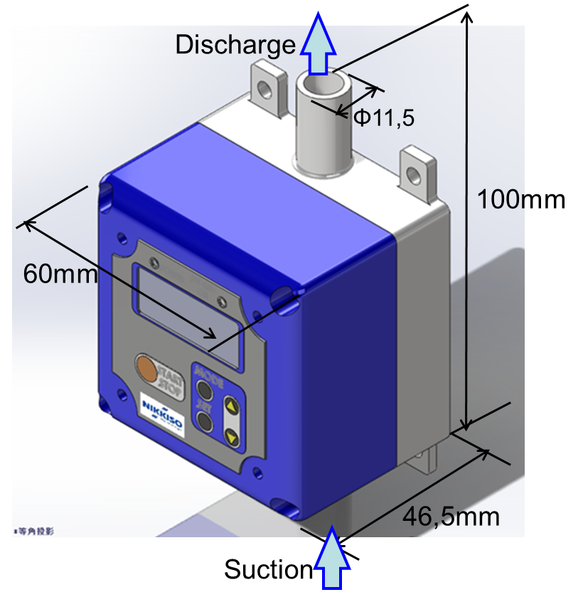
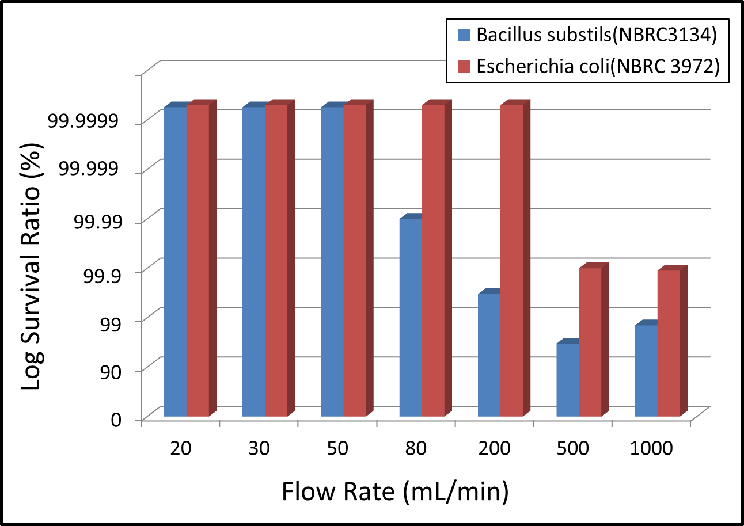
Water Disinfection Prototype Module
Application example of low flow rate water disinfection module
DUV-LED on substrate
Log Reduction Ratio
Product release in 2014
Fig. 1 Pass disinfection performance
Disinfection Performance of 99,9% (3Log)
E.Coli : 500mL/min B.substils : 100mL/min

Slide 18
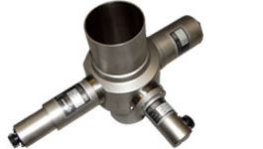
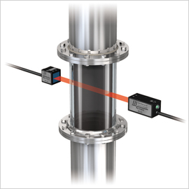
DUV-LED for Sensing Application
Technology Type | Area | Usage
Photo-absorption Type | Medical | Dialysis Dose Monitor (DDM) Blood analysis device.
 | Food Manufacturing | Measurement of amount of enzyme reaction.
 | Water Quality Measurement | Measurements of hypochlorite, enzyme reaction and COD.
Original Light Strength
【L₀】
Light Detecting Element
Compact
Light Source
Electric Signal
a. Compact and light weight.
b. No need for optical filter.
c. Easy to control (Instant start ,
Pulse lighting)
d. Mercury free
e. Wavelength is adjustable.
Sample
Weakened Light after Absorption. 【L₁】
Light Absorption
18

Slide 19
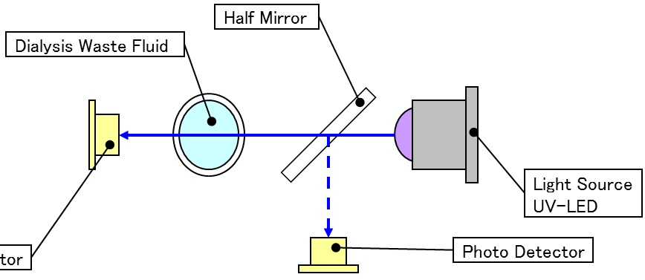
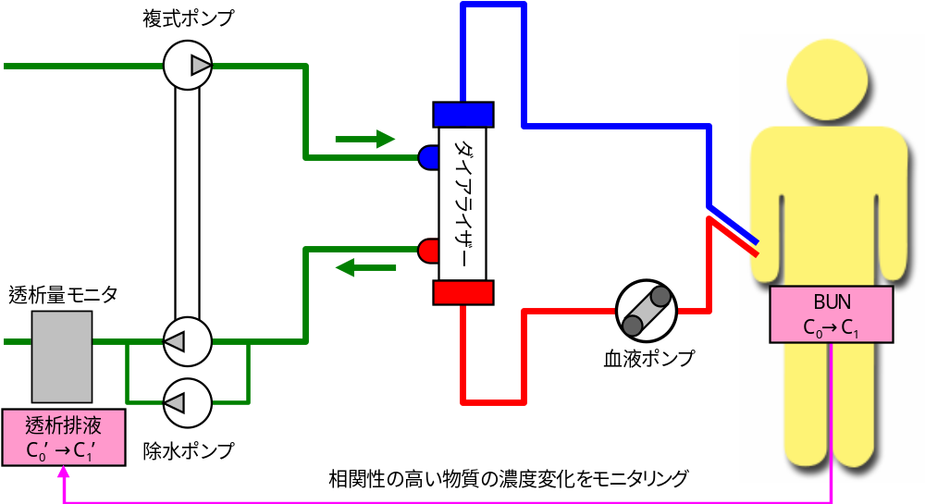
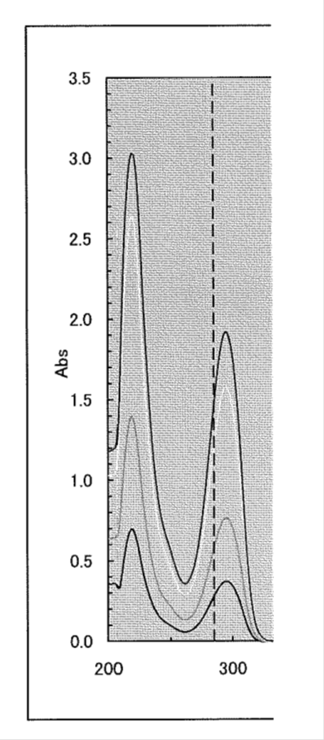
UV-LED for Sensing Application
What is DDM?
Dialysis Dose Monitor → DDM.
Measurement of uric acid concentration contained in dialysis waste fluid
Uric acid is measured by absorption spectroscopy with UV-LED as light source
λ:285nm
Dialyzer
Pump
Dialysis Waste Fluid
285nm
D.D.M.
Blood Pump
Pump
Monitoring for Uric Acid
19

Slide 20
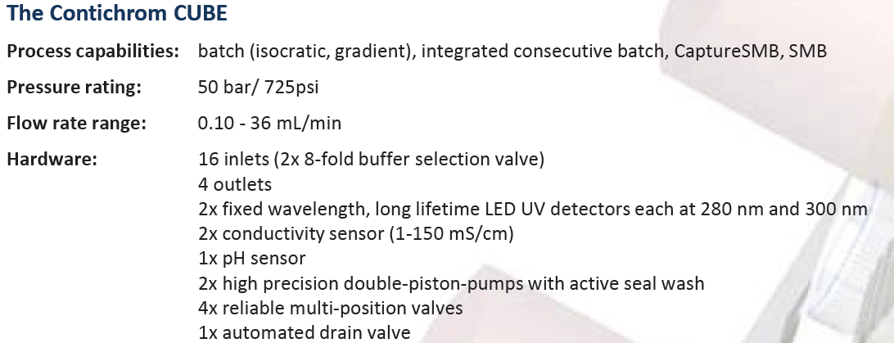
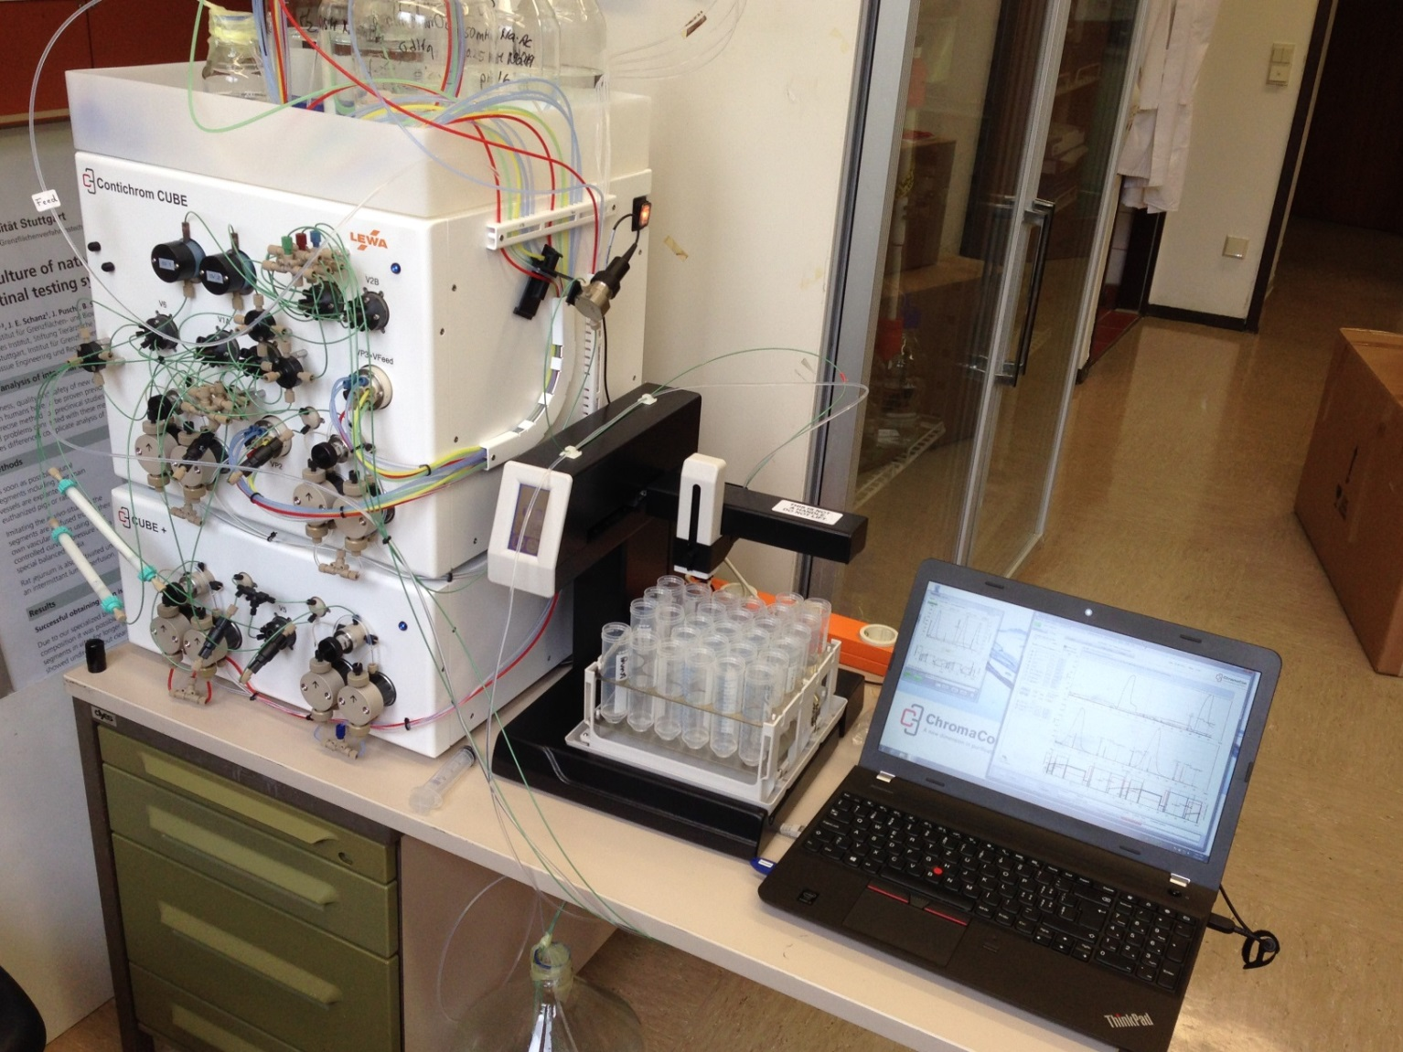
Chromatography setting
UV Light source:
2 fixed wavelength
280 nm LED
300 nm LED

Slide 21
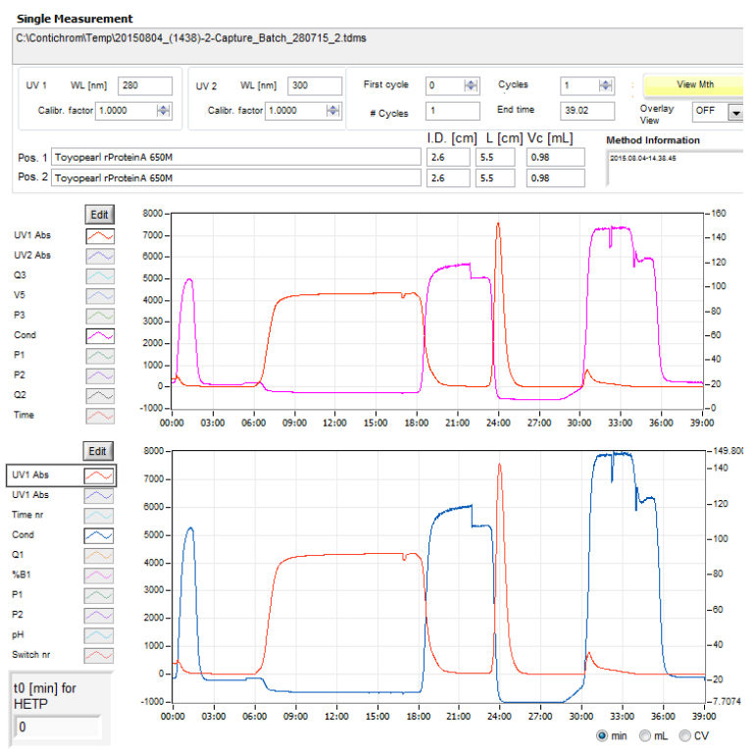
Chromatography process using UV-LED
Advantages of UV LED:
-More robust
-No need for spectrometer
-No need for shutter
-Small Footprint
-Light weight
-Instant On/Off
(lower power consumption)
-Low Voltage operation
(simple driving unit)
-Longer Life time

Slide 22
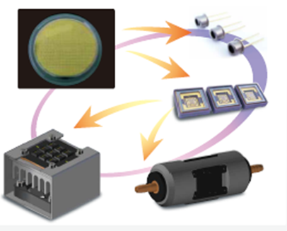
Conclusion
DUV-LED has some clear advantage compared with traditional UV light source
Significant improvement in the DUV-LED performance recently: possible to address a large range of market
more development is needed not only in the LED-chip performance but also in package, module design (arrays, cooling and optics)
Nikkiso Started Production in a new factory dedicated to DUV LED
By controlling all the fabrication steps, from wafer epitaxy
to chip packaging, including quality control and
UV-module development, we target higher
device performance, higher production yield ,
allowing to decrease the Cost-per-Watt
Customized Modules designs are possible thanks
to Nikkiso know-how in optics, fluid dynamic
and thermal analysis

Slide 23
Thank you for your attention !

