Slide 1

Deploying Physical Activity for Cognitive Health in Persons at Risk for
Cristy Phillips, PT, MSPT, SCCT, EdD
Department of Physical Therapy
Arkansas State University
Novel Physiotherapies Conference, 2015

Slide 2
Objectives
Discuss key features of AD pathology
Discuss mechanisms by which physical activity can mitigate AD pathology
Review protocols used to mitigate AD pathology in animal and clinical studies
Highlight implications for physical therapists

Slide 3
Alzheimer’s Disease (AD)
Chronic, neurodegenerative disorder that adversely affects neurons in the brain.
Results in a loss of memory and language, behavioral disturbances, and dependence on caregivers.
The strongest risk factor for AD is aging, a risk that doubles every 5 years after the age of 65.
Currently 26 million people affected worldwide, a number that is projected to reach 106 million by 2050.

Slide 4
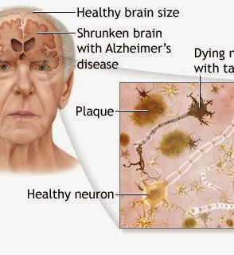
Characteristic changes
synaptic number and function
neurogenesis
neurotrophin levels
plaques and tangles
immune function
circadian disturbances

Slide 5
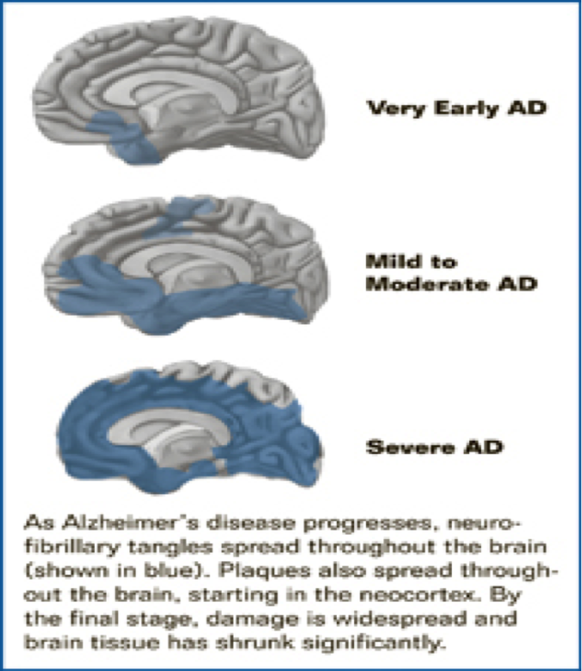
Progression of AD
These features are critical to
the progression of AD
the development of impairments in cognition
Cognition defined as a combination of attention, learning, memory, language, visual spatial skills, and executive function.

Slide 6
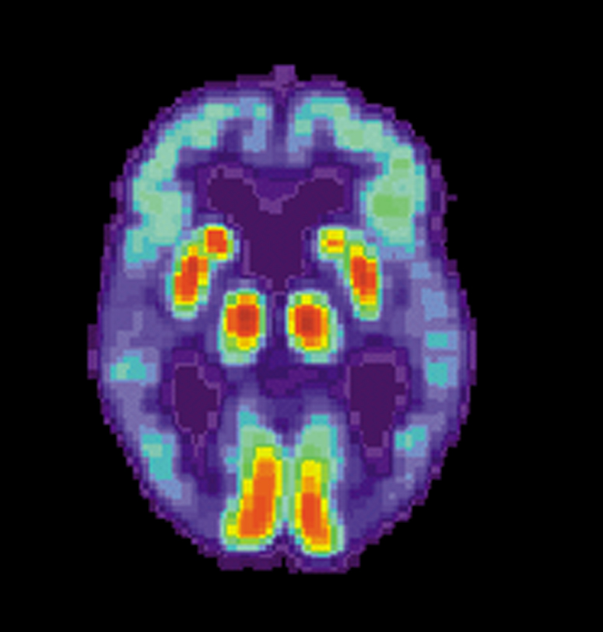
diagnosis and treatment
Clinical diagnosis based on neurological and neuropsychological symptoms
Advanced medical imaging (CT, MRI, SPECT, PET)
Post-mortem confirmation
Therapeutics offer transient symptomatic relief: Namenda, Razadyne, Exelon, Aricept, Cognex
Lack of disease-modifying options make it imperative to diversify the search for effective interventions.

Slide 7
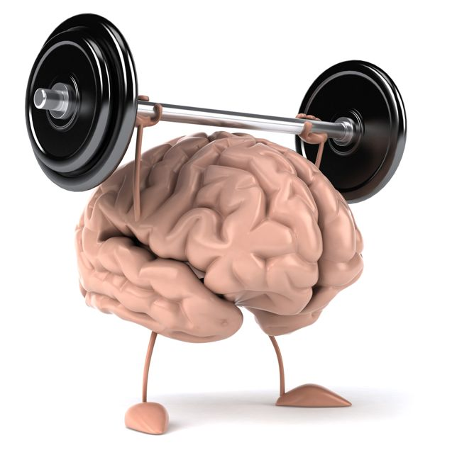
physical activity has neuroprotective effects
Reduce amyloid beta and tau deposition
Optimizes synaptic number and function
Restores neurogenesis
Increases neurotrophin levels
Positively alters immune function
Mitigates circadian disturbances

Slide 8
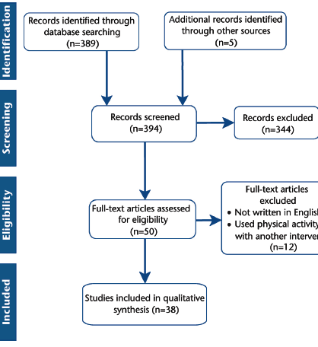
Systematic Review
Medline
Key words “Alzheimers” and “exercise”
Manual searches of references
Dates including January 2007 to September 2015 (n=394)

Slide 9
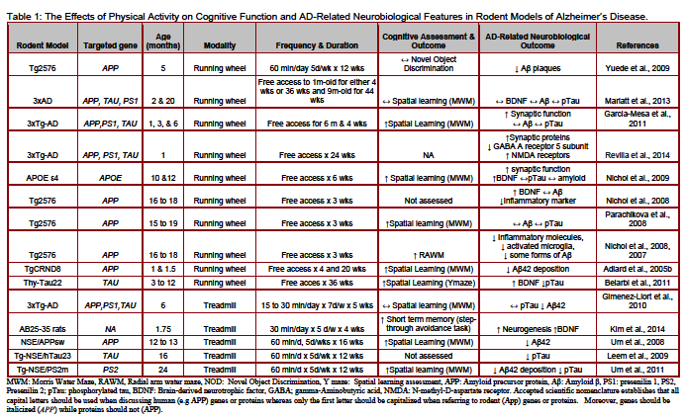
Physical activity in animal models of alzheimer’s disease

Slide 10
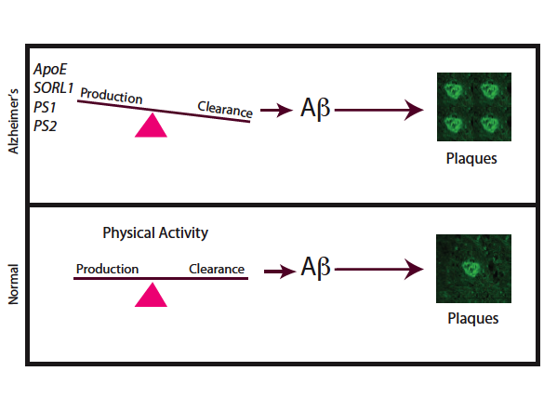
physical Activity reduces amyloid beta Deposition

Slide 11
Physical Activity
Reduces amyloid beta Deposition
Amyloid plaque formation is problematic because its accumulation is believed to trigger a cascade of events that trigger neuronal dysfunction and death of neighboring neurons.
Led to the hypothesis that methods that reduce amyloid plaque deposition might reduce neurodegenaration.

Slide 12
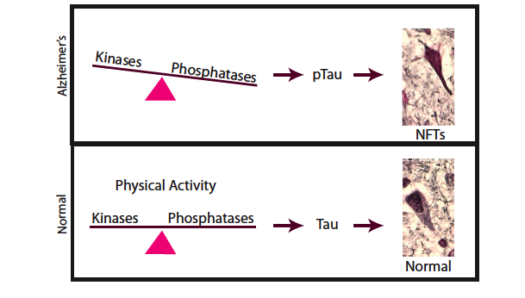
Physical Activity
Reduces TAU Deposition

Slide 13
Physical Activity
Reduces TAU Deposition
Microtubules are structure that transport a variety of molecules within neurons.
Typically tau binds to microtubules and stabilizes them.
Chemical alterations in tau by kinases and phosphatases can interrupt binding to microtubules, cause it to disengage and disassemble, and ultimately clump together with other tau threads to form neurofibrillary tangles.
Lack of internal transport causes atrophy and dysfunction of neurons.

Slide 14
Physical Activity
Reduces TAU Deposition
PA appears to modify tau and kinase activity.
Leem demonstrated that transgenic mice exposed to treadmill training 12 weeks exhibited reduced glycogen synthase 3B levels & excess tau phosphorylation.
Um demonstrated 3 months of treadmill training significantly reduced tau phosphorylation in extremely old mice.
Belarbi demonstrated free access to running wheel reduced neurofibrillary tangle formation.

Slide 15
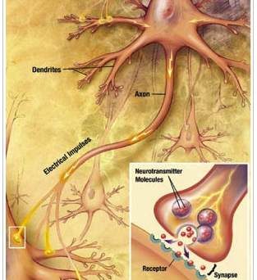
Physical Activity optimizes synaptic number and function
Synapses serve as fundamental sites of neuronal communication.
Alterations in synapses adversely affect cognitive function by altering local and regional communication.
Quantification of post-mortem AD samples reveal reduction in synaptic number in hippocampus and association cortices.
As AD progresses, neurons increasingly shrink and disconnect making it difficult to encode new memories.
Chronic PA (free access to running wheels) for 4, 6, 24 weeks improves synaptic number and function in hippocampus.
Pajonk demonstrated that healthy individuals who exercised (aerobic, 3x week/30 min session/12 weeks) demonstrated improved hippocampal volume on MRI.

Slide 16
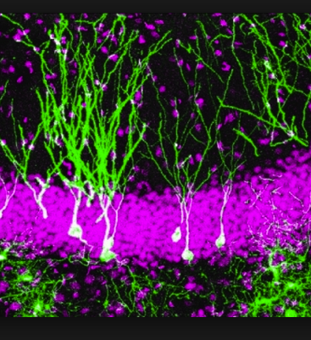
Physical activity increases Neurogenesis
In mammals 700 neurons are produced daily in subventricular and subgranular zone of hippocampus.
20,000,000 generated over the course of a lifetime to become integrated in memory and learning circuits.
Neurogenesis decreased in aging and AD.

Slide 17
Physical activity increases Neurogenesis
Marlatt demonstrated 1and 9 month free access to running wheel led to increased neurogenesis in hippocampus.
Kim exposed rats to treadmill training (30 min per day, 5d/wk, 4 weeks) and restored neurogenesis following injection of amyloid beta.
Recent clinical trial demonstrated positive association between neurogenesis and declarative memory in humans.

Slide 18
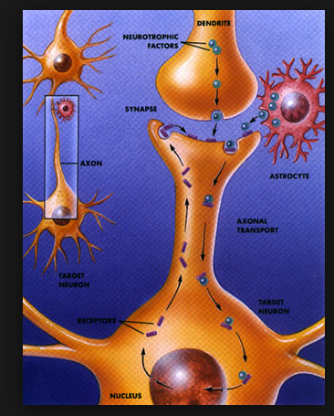
Physical Activity Increases Neurotrophin Levels
Vital proteins known to contribute to survival, growth, differentiation, maintenance of neurons.
BDNF is activity-dependent and reduced in AD.
Belarbi demonstrated that 9 months of voluntary wheel running increased BDNF in brain.
Number of investigators demonstrated that voluntary wheel running associated with increases in BDNF gene expression in hippocampus and the changes endure for weeks.
Healthy persons acutely exercising (85% of max capacity) shown to increase plasma levels of BDNF.

Slide 19
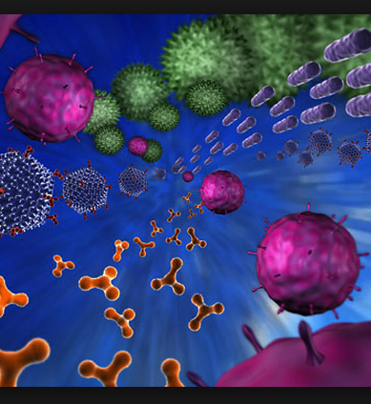
Physical Activity optimizes immune function
In the brain, immune activity is characterized by activation of inflammatory cells (astrocytes and microglia) and release of inflammatory molecules (interleukin 1B, interleukin 6, and TNFa).
Secreted molecules recruit other immune molecules (monocytes and lymphocytes) to cross the blood brain barrier.
Altered immune activity has been demonstrated in AD.

Slide 20
Physical Activity optimizes immune function
Animal and human studies demonstrate that PA reduces markers of neuroinflammation in AD.
Notably, Nichol and colleagues demonstrated that APP mice exposed to 3 wks of wheel running showed reduced inflammatory markers that approached normal.
Epidemiological studies demonstrate that habitual PA is correlated with reduced systematic inflammation.
A RCT in adults who were healthy and participated in progressive aerobic activity (15 min increasing to 40 min) 2x per week x 6 mo revealed significant normalization of immune function.
A study of elderly women who participated in 60 min of aerobic exercise, 3x per wk, x 16 wks also reported normalization of immune function.

Slide 21
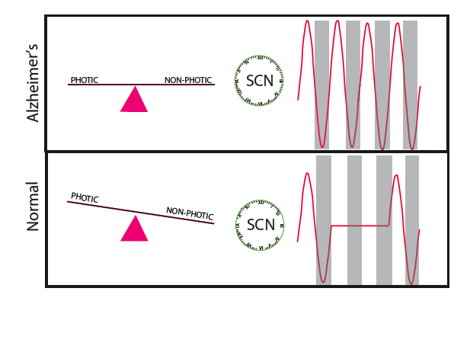
Physical Activity
Mitigates circadian disturbances

Slide 22
Physical Activity
Mitigates circadian disturbances
Feeding behavior, motor activity, hormonal secretion, and autonomic nervous system function exhibits naturally occurring rhythms referred to as circadian rhythmicity.
Central to this is the SCN, an anterior hypothalamus structure that regulates body function according to a 24-hour cycle.
Disturbances in SCN function are linked to AD and result in sleep fragmentation, changes that precede cognitive impairments.
Given that intrinsic and extrinsic factors regulate SCN activity, it is postulated that PA may mitigate circadian disturbances by regulating body temperature or altering projections to SCN).

Slide 23
Physical Activity
Mitigates circadian disturbances
Recent cross-sectional study in people diagnosed with lung cancer found a positive correlation between self-reported PA and sleep time and quality.
Hooghiemstra noted a significant correlation between PA and severity of rest-activity rhythm disturbances, leading them to advocate PA for persons with AD-related dementia.
Nascimento reported that 6 months of PA (e.g., walking, circuit training, stretching, balance, agility) decreased the frequency of sleep disturbances in people with mild to moderate AD.

Slide 24
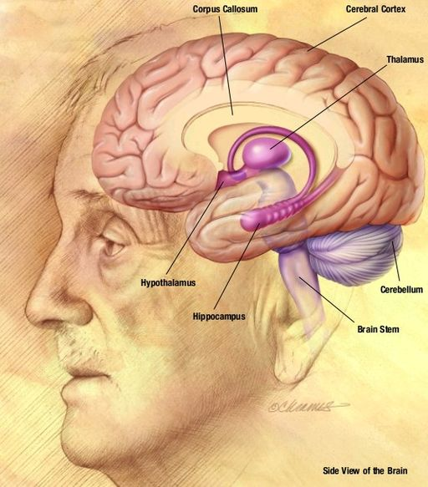
PA improves cognition in aging Adults
Most RCTs have reported positive results between PA and cognitive function.
Training ranges of 2-3 hrs per week for 3 months or longer
Modalities varied, with all programs having some form of locomotion activity as a core component except one.
Existence of depression may attenuate the effects.

Slide 25
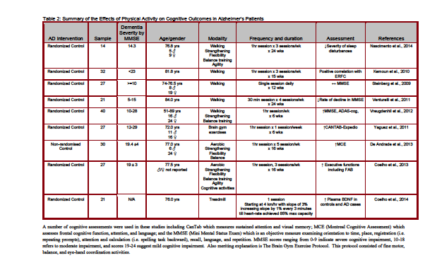
clinical trials

Slide 26
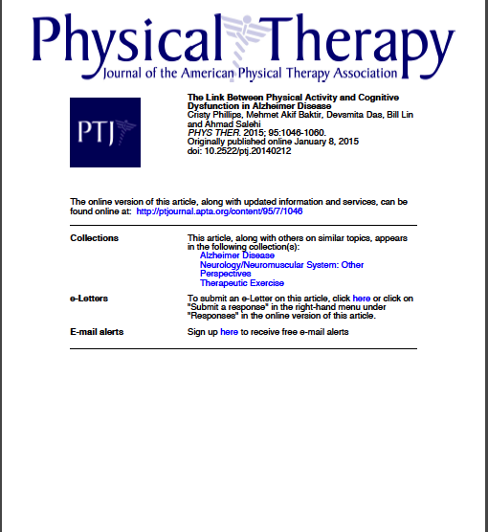
future directions
Earlier application of PA might mitigate pathological processes and assuage cognitive decline.
Urgent need to identify optimum mode, intensity, and duration of PA to mitigate deficits in humans.
Colcombe and Kramer demonstrated aerobic and strength training resulted in greater gains in cognition than aerobic activities alone.
Smith revealed interventions consisting of aerobic and strength improved attention, processing speed, and working memory to a greater extent than did aerobic exercises alone.
1 year of aerobic exercise of moderate intensity has been shown to improve memory and hippocampal volume in older adults who were healthy, reversing age-related volume loss by 1 to 2 years.

Slide 27
acknowledgements
Ahmad Salehi, Mehmet Akif Baktir,
Devsmita das, Bill Linn

