Slide 1


Dr. Cristina Patassini
2° International Conference on Predictive, Preventive and Personalized Medicine and Molecular Diagnostics
Las Vegas, 3-5 november 2014
Notes:
I will briefly present the study that our laboratory carried out to develop a kit that identifies the predisposition to obesity.

Slide 2


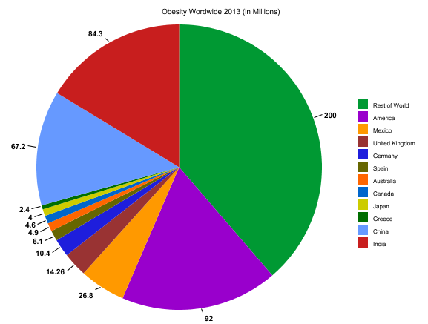
Obesity worldwide
According to the World Health Organization (WHO):
Approximately 1.6 billion adults (age 15+) are overweight
More than 500 million adults were obese
At least 20 million children under 5 years are overweight
The WHO also projected that by 2015, approximately 2.3 billion adults will be overweight and more than 700 million will be obese.
Notes:
According to the World Health Organization (WHO), in the last years, the prevalence of obesity has increased significantly in world population, including more than 500 million people. About 1.6 billion adults and at least 20 million children under 5 years are overweight. The WHO also projected that by 2015, about 2.3 billion adults will be overweight and more than 700 million will be obese.

Slide 3
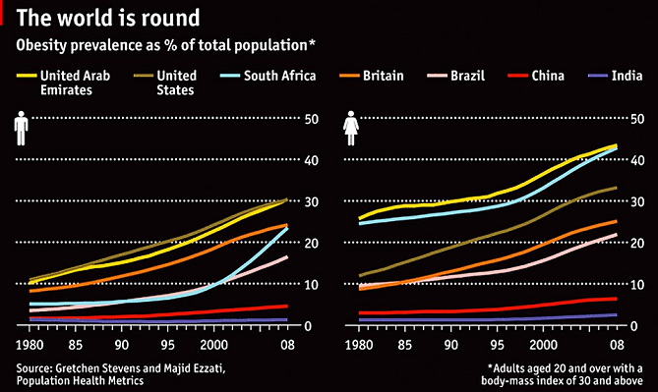
Obesity worldwide
Increased of obesity in populations worldwide
Notes:
In fact, in the last years, the prevalence of obesity has increased significantly in particular in these countries.
For example, are obese about 30% of American and United Arab Emirates males and more than 40% of the female population of the United Arab Emirates and South Africa.

Slide 4
Obesity-related health care
Obesity increased risk of
type 2 diabetes
between 0.7% and 2.8% of a country’s total healthcare expenditures.
U.S.: obesity-related health care = about $200 billion
Europe: obesity-related health care = more than $10 billion (Muller-Riemenschneider et al., 2008; Withrow et al., 2011)
Stroke
coronary artery disease
Hyperlipidaemia
hypertension
several cancers
Economic burden of obesity worldwide
Notes:
A less dramatic, but equally important increase has been seen in its effects on health and the burden it places on healthcare systems.
Obesity is and should be a major public health concern.
In fact, obesity has been found to decrease health-related quality of life and overall life expectancy.
Furthermore, obese patients are at an increased risk of type 2 diabetes, stroke, coronary artery disease, hyperlipidaemia, hypertension and several cancers
(colon, rectum and prostate in male).
Obesity was estimated to account for between 0.7% and 2.8% of a country’s total healthcare expenditures.
Moreover, obese individuals were found to have medical costs that were approximately 30% greater than their normal weight peers.

Slide 5

Personalized Genetic Diet
The ways in which we metabolize food, the modulation of the sense of hunger and the response of our body to physical activity are regulated by several environmental and genetic factors.
Personalization of diet and physical activity, based on genetic characteristics
Not a diet to lose weight in 6 months,
but learn how to eat better for life
Notes:
So learn to eat properly and do regular exercise improves our quality of life from all points of view.
Development of obesity has been associated with inadequate dietary and sedentary habits, as well as a genetic predisposition.
The ways in which we metabolize food, the modulation of the sense of hunger and the response of our body to physical activity
are regulated by several environmental and genetic factors.
Actually it is possible to analyze some of the genes involved in these processes and to derive useful information
for the proper setting of a diet and personalized physical activity.
The diet of the 2000s is based on genetic characteristics to obtain a personalized diet.

Slide 6
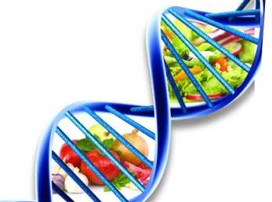
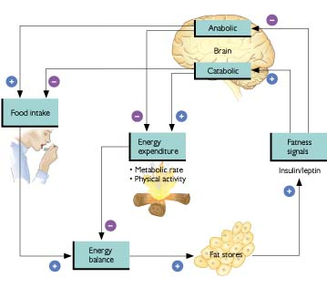
DNA influences how we metabolize food…
Single Nucleotide Polymorphisms (SNPs) in several genes encoding for proteins involved in hypothalamic control of food intake, energy balance and lipid metabolism have been associated with common (non-Mendelian) obesity.
Notes:
The genetic diet is based on the predisposition to obesity assessed by analyzing Single Nucleotide Polymorphisms (SNPs) in several genes encoding for proteins involved in hypothalamic control of food intake, energy balance and lipid metabolism.
The central nervous system plays a primary part in regulating food intake through the brain-gut axis, with the hypothalamus acting as the central regulator, receiving both long- and short-term food intake and energy expenditure feedback from the periphery.

Slide 7




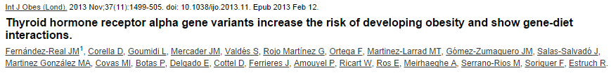

Sense of hunger
FTO
LEPR
DNMT3B
Saturated fatty acids metabolism
THRA
Physical activity
ADRB2
Notes:
Our laboratory, after studying the molecular mechanisms that regulate the obesity onset, has developed a kit for identifying this predisposition.
This kit consists of 3 panels: sense of hunger, saturated fatty acids metabolism and physical activity.
We have developed a panel of SNPs that allows to analyze these 5 genes through real-time PCR.

Slide 8
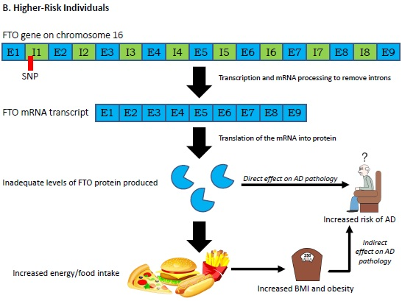
Sense of hunger
GENES | SNPs | MODEL | Mutated variants
FTO Fat mass- and obesity-associated gene | rs9939609 (g.53820527 T>A) | Dominant | TA/AA
LEPR Leptin Receptor gene | rs1137101 (c.668 A>G; Gln223Arg) | Dominant | AG/GG
DNMT3B DNA MethylTransferase 3B | rs992472 (g.31385269 A>C) | Recessive | CC
FTO
Notes:
In particular, in sense of hunger panel are analyzed polymorphisms of the FTO, DNMT3B and LEPR genes.
FTO gene codes for a protein expressed in the hypothalamus that plays an important role in regulating appetite and food intake.
Individuals with low postprandial responses in hunger and satiety are overrepresented among TA/AA carriers compared with TT carriers, independent of BMI.
The association between the postprandial decrease in hunger and this SNP in FTO was mediated by the rs992472 variant in DNMT3B. Individuals with a low postprandial decrease in hunger are overrepresented among carriers of the TA/AA genotype in FTO when accompanied by the CC genotype in DNMT3B, compared with individuals carrying the TT and AA/CA genotype respectively in these SNPs.
In addition, FTO catalyzes DNA demethylation. These findings suggests that TA/AA carriers in FTO are characterized by an increased capacity for DNA demethylation compared with TT carriers. The interaction for the postprandial response in hunger involving SNPs in FTO and DNMT3B could thus result from a decreased capacity for de novo and maintenance of preexisting DNA methylation patterns in DNMT3B together with an increased capacity for DNA demethylation in FTO, thereby decreasing the overall capacity for DNA methylation.

Slide 9
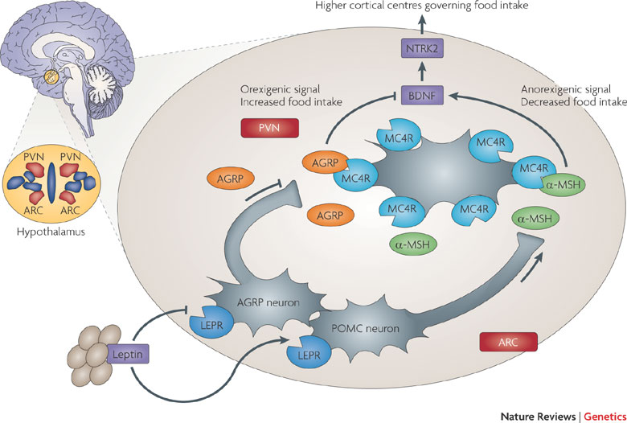
Sense of hunger
GENES | SNPs | MODEL | Mutated variants
FTO Fat mass- and obesity-associated gene | rs9939609 (g.53820527 T>A) | Dominant | TA/AA
LEPR Leptin Receptor gene | rs1137101 (c.668 A>G; Gln223Arg) | Dominant | AG/GG
DNMT3B DNA MethylTransferase 3B | rs992472 (g.31385269 A>C) | Recessive | CC
LEPR
Notes:
The second gene that we analyze in the sense of hunger panel is LEPR that codes for the leptin receptor.
It’s known that leptin is an adipocyte-specific hormone that regulates the amount of adipose tissue through a direct effect on the hypothalamus, modulating the sense of hunger/satiety and energy expenditure of the body. The rs1137101 SNP in LEPR, resulting in amino acid substitution, arginine in place of glutamine, was hypothesized to affect the functionality of the leptin receptor, with reduced leptin sensitivity. Resistance to leptin is known to increase food intake, and in extreme cases results in early-onset morbid obesity. In fact, decreased receptor activity generates an orexigenic signal, whereas increased receptor activity generates an anorexigenic signal, through the inhibition of AGRP (Agouti-related protein) production and the stimulation of POMC (proopionomelanocortin) production.

Slide 10
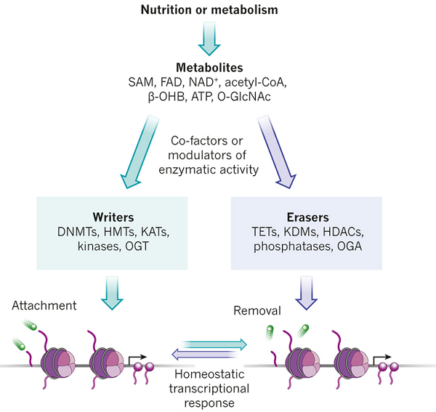
Sense of hunger
GENES | SNPs | MODEL | Mutated variants
FTO Fat mass- and obesity-associated gene | rs9939609 (g.53820527 T>A) | Dominant | TA/AA
LEPR Leptin Receptor gene | rs1137101 (c.668 A>G; Gln223Arg) | Dominant | AG/GG
DNMT3B DNA MethylTransferase 3B | rs992472 (g.31385269 A>C) | Recessive | CC
DNMT3B
Notes:
In addition it is known that DNA methylation and post-translational modifications are involved in homeostatic transcriptional responses. Several intermediary metabolism products change enzymatic activity of chromatin-associated proteins in a dose-dependent manner. In the sense of hunger panel we analyze DNMT3B gene codes for a protein present in many tissues that modulates the status of DNA methylation, important for the regulation of food intake, as mentioned in the previous slide. A decrease in the capacity for de novo and/or maintenance of DNA methylation patterns underlies the overrepresentation of individuals with a low postprandial decrease in hunger among CC carriers in DNMT3B compared with AA/CA carriers.

Slide 11
Sense of hunger
GENES | SNPs | MODEL | Mutated variants
FTO Fat mass- and obesity-associated gene | rs9939609 (g.53820527 T>A) | Dominant | TA e AA
LEPR Leptin Receptor gene | rs1137101 (c.668 A>G; Gln223Arg) | Dominant | AG e GG
DNMT3B DNA MethylTransferase 3B | rs992472 (g.31385269 A>C) | Recessive | CC
Polymorphisms of these 3 genes have a synergistic action
The subjects carrying the mutated variants:
have a more accentuated sense of hunger
are less sensitive to sense of postprandial satiety
consume more willingly biscuits, pastries, fruit, cereals, fatty meats, ice cream and cheese
tend to eat between meals
All this leads to the early onset of obesity:
risk increased 6-8 times in the homozygous mutant of the 3 variants.
Notes:
In conclusion, the effect of the variant in FTO on the postprandial response in hunger appears to be mediated by an epistatic interaction involving variants in DNMT3B and LEPR.
Polymorphisms of these 3 genes have a synergistic action and play an important role in the sense of hunger and satiety: risk of the early onset of obesity increased 6-8 times in the homozygous mutant of the 3 variants.
These individuals should be subjected to a diet that takes into account these characteristics, including several mini-meals throughout the day consist of foods that prolong the sense of satiety.

Slide 12
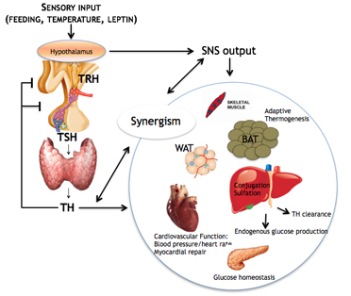
Saturated fatty acids metabolism
GENES | SNPs | MODEL | Mutated variants
THRA Thyroid Hormone Receptor, Alpha | rs1568400 (g.38221108; - 635 A>G) | Recessive | GG
THRA
The subjects with the mutated variant and an high intake of saturated fat have a threefold increased risk of developing obesity.
Notes:
In metabolism of saturated fat panel is analyzed THRA gene that codes for the thyroid hormone receptor alpha, which regulates energy metabolism, thermogenesis, glucose and lipid metabolism, food intake and oxidation of fatty acids. The rs1568400 polymorphism is located in a critical region involved in the regulation of splicing. The subjects with the mutated variant and an high intake of saturated fat (butter, margarine, chocolate, coconut, lamb, etc...) have a threefold increased risk of developing obesity. These subjects show an increased average waist circumference, total cholesterol and fasting triglyceride concentrations. However, this polymorphism was not significantly associated with fasting glucose, low-density or high-density lipoprotein cholesterol.
These patients should undergo a diet that takes into account these characteristics, and in particular that have a low intake of foods containing saturated fats.

Slide 13
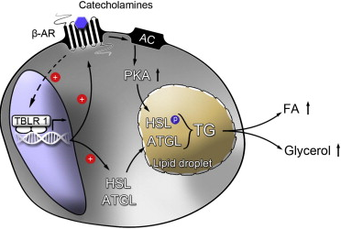
Physical activity
GENES | SNPs | MODEL | Mutated variants
ADRB2 Beta-2-Adrenergic Receptor | rs1042714 (c.79 C>G; Gln27Glu) | Dominant | CG/GG
ADRB2
Notes:
Finally, in physical activity panel is analyzed ADRB2 gene coding for the beta2-adrenergic receptor, involved in the process of lipolysis and in the development of obesity caused by hyperlipidemia, hyperinsulinemia and insulin resistance. The rs1042714 SNP in ADRB2, resulting in amino acid substitution, glutamic acid in place of glutamine, reduces the weight loss induced by physical activity. The carriers of CG/GG genotype are less able to use fat stores as a source of fuel after a period of exercise.

Slide 14
Physical activity
GENES | SNPs | MODEL | Mutated variants
ADRB2 Beta-2-Adrenergic Receptor | rs1042714 (c.79 C>G; Gln27Glu) | Dominant | CG/GG
The subjects carrying the mutated variant have a reduced weight loss after aerobic physical activity and are less able to use fat stores as a source of fuel after intense exercise.
Sport of toning and prolonged exercise
If the subjects do not perform regular physical activity, the diet will account the reduced ability to use fat stores.
Notes:
These individuals should be subjected to a fitness program that consider these characteristics, focusing on sport of toning (Pilates), no sports "cardio" that tend to use carbohydrates stores than fat stores.

Slide 15


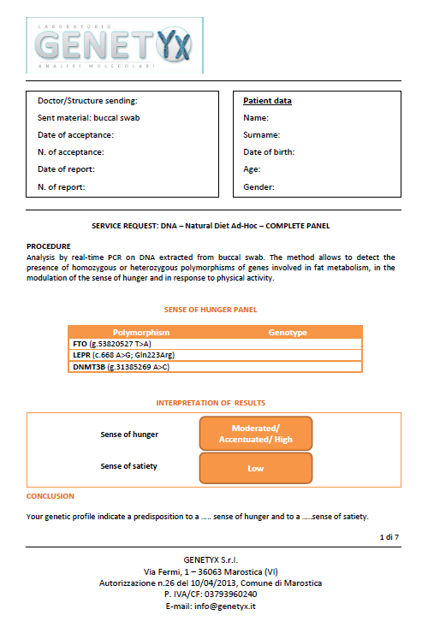
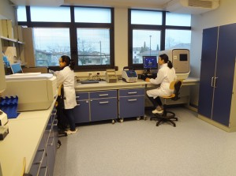
DNA is the Natural Diet Ad-Hoc
SAMPLING AT HOME
ANALYSIS BY GENOTYPING
SPECIALIST COUNSELING
Notes:
Summarizing the DNA-Natural diet ad hoc service consists of sampling at home using a buccal swab to collect saliva, shipment of buccal swabs to the laboratory, analysis by genotyping, reporting, sending of the report by email and specialist counseling. All from the comfort of home.
Below I will show you the format of the report.

Slide 16
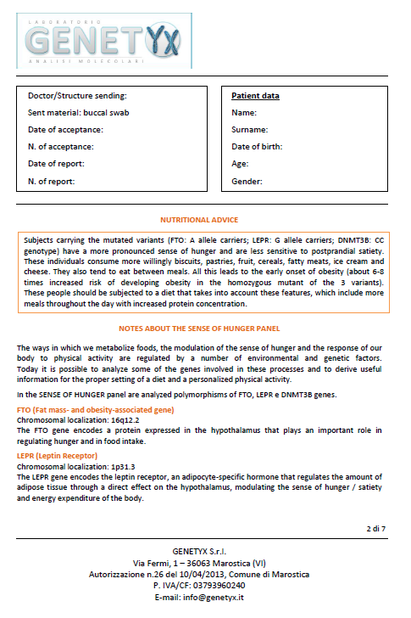
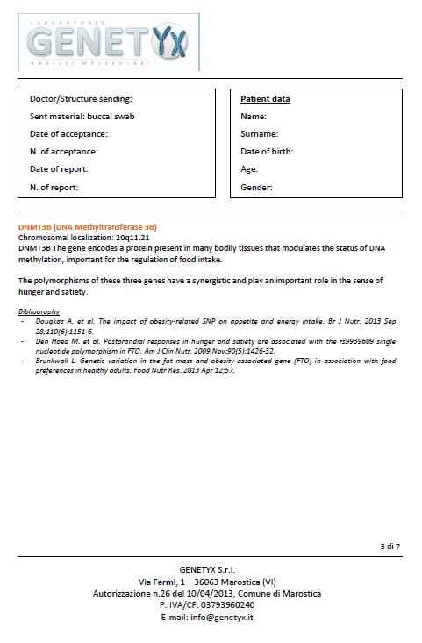
Report
Notes:
In the report, for each panel are shown the genetic analysis, interpretation of results, nutritional advice and technical information, in order to personalize reporting.
This is the report of the sense of hunger panel.

Slide 17
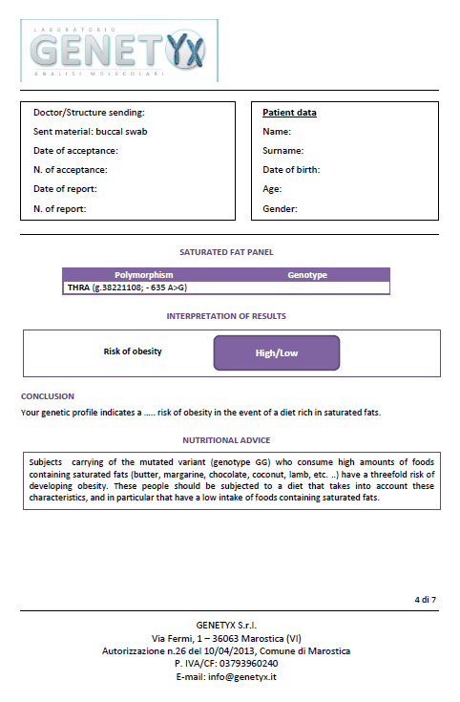
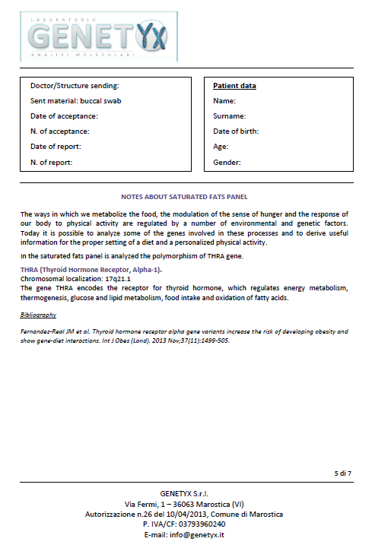
Report
Notes:
This is the report of the panel of saturated fatty acids metabolism

Slide 18
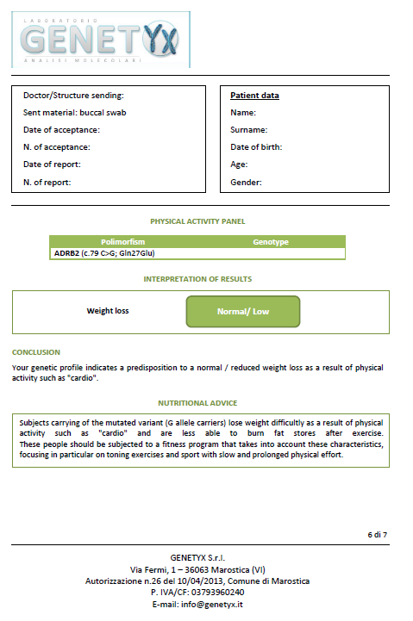
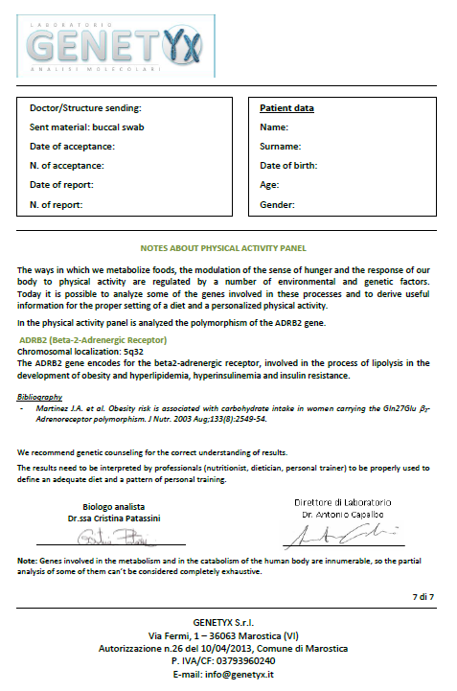
Report
Notes:
and the last is the report of physical activity panel.

Slide 19

Specialist counseling post test
Collaboration with Webmedicine.it: the specialist counseling are provided through video-conference from the comfort of home!
Specialist counseling:
Nutritionist to prepare your personalized diet and fitness plan. Monthly follow-up.
Geneticist to understand the meaning of your genetic variants.
Notes:
As the sampling and reporting, also specialist counseling can be done from the comfort of home through video-conference with the collaboration of Webmedicine, the first website in Italy for online medical counseling. People could choose the counseling with a nutritionist or a geneticist. The nutritionist allows you to draw up a personalized diet and fitness plan. The geneticist allows you to understand the meaning of your genetic variants.

Slide 20


Preliminary results
Mean age: 41
Mean BMI: male 26.6 (30%) overweight
female 23.6 (70%)
Monthly average weight loss: 3.2 Kg
Compliance: 95% at 6 months
Customer satisfaction: 9.5/10
Notes:
In conclusion, these are the preliminary results. The mean age of the subjects who make the test is 41 years. The mean BMI is 26.6 among males and 23.6 among females. Monthly average weight loss is 3.2 Kg. The compliance at 6 months is 95% and customer satisfaction is 9.5 on 10.

Slide 21
www.dnadieta.it
www.webmedicine.it
THANKS FOR YOUR ATTENTION
‘’Genotype-environment interaction arise when the phenotipic response to lifestyle habits is modulated by the genotype of the individual’’

