Slide 1
Evaluation of Aﬃrmative Policies in Health: Discourses, Attitudes and Practices about Racism, Inequalities and
Actions Against Racism in Brazil
Cristina Gomes FLACSO MEXICO
cristinagomesmx@gmail.com

Slide 2
Statement of the Problem:
Racism in Brazil is structural, reﬂects more than four centuries of slavery and it is reproduced in institutions and civil society, in daily and family life.
After 13 years promoting the inclusion of black population in public services, this research evaluates the implementation of the National Policy for Integral Health of Black Population in health services in the municipality of Camacari, State of Bahia, Brazil.

Slide 3
Statement of the Problem:
It is estimated that more than six million Africans were traﬃcked and enslaved in Brazil between the ﬁfteenth and nineteenth centuries; and, even after their release, with the end of empire and the proclamation of the republic in the late nineteenth century, newly freed blacks remained marginalized, and were not included in the labor market or the rights to vote, education, health and land or property (ACNUDH and UNESCO, 2001; Bales and Reitz, 2005; Kevin, 2005; Klein and Ben, 2007; Selfa, 2002).
They occupied marginal areas and survived looking for any kind of work, as they were replaced by millions of European and Asian immigrants in the new republican economy, as workers and as a goal of the government project to “whiten” the Brazilian population (Alencar, 2013, Amaral, 2011; Brasil, 2013; Brasil, 2016)

Slide 4
Statement of the Problem:
The Brazilian population was predominantly black, slave or descendant of enslaved, illiterate and, until the beginning of the XX Century, deﬁned in the newspapers and Brazilian intelligencia as "bestialized" (made beasts), a reason for national shame (Carvalho, 1987).
Brazil was the last country in the world to abolishing slavery, in 1888.
Racism has become an intrinsic part of the formation and development of Brazilian society, and has been reproduced in the present day through a false myth of "racial democracy" and the ideal of the "whitening" of society. A sui generis racism, masked and widespread, persists in all power structures and national, state, municipal institutions, and micro social, both individual and familial (Brasil, 2013; Brasil 2016; Alencar, 2013, Amaral, 2011)
As a result, blacks in Brazil have the worst rates of morbidity, mortality, and illiteracy, and have lower educational levels and higher poverty rates in the population (Brasil, 2013; Travassos and Castro 2008). There are incidents of racism witnessed on a daily basis in the media, social networks, public spaces and institutions and even among members of the same family, but prejudices and discriminatory attitudes are denied and hidden, masked in a belief that in Brazil there is a peaceful miscegenation process and an alleged racial democracy (Brasil, 2013; Brasil 2016; Alencar, 2013; Amaral, 2011; Ribeiro, 2012)

Slide 5
Statement of the Problem:
According to diﬀerent authors, racism in modern Brazil is reproduced according two basic ideas; a) the myth of racial democracy, since Brazilians believed over centuries that miscegenation was a harmonic, speciﬁc and even a glamorous process in the national History, and b) population “whitening” as an ideal promoted by government policies to
attract European migration after the end of slavery and, as a high value, incorporated in intergendered relationships and practices to this day. (Brasil, 2013; Brasil 2016; Alencar, 2013, Amaral, 2011; Ribeiro, 2012)
Brazilian raciality would work under a mask of “racial democracy”.
According to Brazil, 2007 and Ribeiro, 2012 “prejudice plays its daily aggression against black people alternating silences, whispers, speeches and shouts.” The ﬁrst two forms are the most used, because they allow racism to hide while acting to keep the facade of people as "morally intact, mentally healthy" ("good"), which would have "authority" to discriminate and have power over the “other”, since blacks are considered to be in an inferior social position.

Slide 6
Context of population disparities
In Brazil, the “negro” population is composed of people who deﬁne themselves black or mulatto/brown. In 2013, these groups represented 52.9% of the population, around one hundred million of people. In the public health system (SUS), 70% of users are self-deﬁned as black (black and brown). Brazil is the country with the second largest number of
black people - ﬁrst is Nigeria. Bahia is the State with the highest proportion of black inhabitants, as is the Metropolitan Region of Salvador, the capital, where Camacari is included (Brasil, 2016).
The classiﬁcation of "color or race" used in censuses and surveys is collected using induced self-deﬁnition, i.e. the respondent is free to indicate their "color or race" between the ﬁve categories (black, white, brown, Asiatic, indigenous) which are already well accepted as virtually the entire population responds to censuses and surveys and are able to choose their color themselves (Osório, 2003)

Slide 7
Context of population disparities
Civil servants of the federal agencies have more diﬃculties when asked about race or color. Only 40% of the 584,000 active employees completed the question of "color or race" in their record of personal data in 2003; in some institutions only 3% of employees responded to this question (Osório, 2003). Therefore, it is expected that public employees have a greater tendency to deny the existence of racism, and to whiten their skin color and the color of service users.
Available data on color/race show that black population (both black and brown) in Brazil has the highest rates of morbidity and mortality, the highest illiteracy rates and the lowest educational levels, the highest rates of poverty, infant and maternal mortality, mortality from diabetes, hypertension and violent deaths, and accumulate all these social disadvantages, compared to the white population. Diseases are more prevalent in the black population: sickle cell disease, hypertensive disorders of pregnancy, arterial hypertension, and diabetes mellitus amongst others (Brasil, 2016; Batista et al, 2013; Dias et al, 2009; Araújo et al, 2010; Giovanetti et al, 2007; Goes and Nascimento, 2013)

Slide 8
Methodology & Theoretical Orientation:
An triangulated methodology was applied, including a quantitative Survey, participant observation, in-depth interviews and focal groups with workers of public and private health services.
A representative survey was applied to 634 workers of the public and private health services.
The questionnaire included the staﬀ proﬁle: socio-demographic, family and work conditions, and their perceptions, attitudes and practices on racism and race inequalities and policies.

Slide 9
Methods
Correlations between socio-demographic variables and discrimination statements were estimated.
The Pearson correlation coeﬃcient indicates whether or not there is a linear correlation between the variables compared.
Cluster analysis was used as a concise measure applied to diﬀerentiate and to classify several discriminatory statements representing opinions, attitudes and practices about race relations according to their overall impact. This simple measure allowed the comparison of multiple dimensions of racial discrimination and the summarization and classiﬁcation of them.

Slide 10
Findings
Although Brazilians believe that racism is masked in the country, explicit racism is present in some cases, for example, through the opinion that black people are more aggressive than whites is less frequent (almost 15%), but the opinion that jokes humiliating blacks are not racism, but Brazilian culture is the opinion of almost a half of interviewed. Both statements are highly correlated.
The perception of black aggressiveness is highly correlated to religion, while acceptation of humiliating jokes is signiﬁcantly correlated to the colour of the health worker. Both statements are also combined in the ﬁrst group in cluster analysis.
The second group of related variables includes attitudes against focused measures to promote equality. The myth of racial democracy is not so important in descriptive and correlation analysis as explicit racism, and some of these statements compose the third or following groups of variables related as an indicator of of racism.

Slide 11
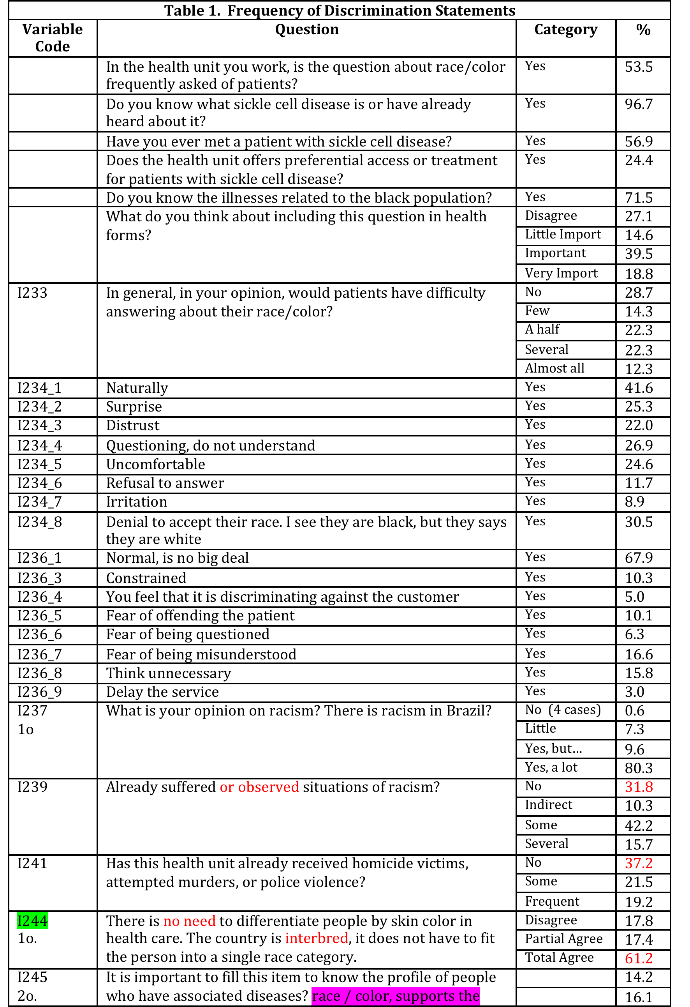
Frequencies of Statements on racism

Slide 12
Findings
Descriptive data show that 68% of the health workers consider that patients would react normally answering their own color.
Maybe this suﬀering to recognize the problem could explain why only four interviewed (among 364) directly assume that racism does not exist in the country, and more than 80% assumes that it exists and it is very frequent. However, asking about expectations about the “others”, patients, a half of them consider answering the color as natural, but several negative expectations are present: the fear that patients would feel bother or do not understand the question, what would be interpreting as some personnel are transferring their own prejudices or feeling of superiority regarding patients.
However, the wide majority believe in racial democracy: 61.2% completely agree and 17.4% partially agree that there is no need to diﬀerentiate people by skin color in health care, because the country would be interbred, it does not have to ﬁt the person into a single race category.
There is no need to diﬀerentiate people by skin color in health care.

Slide 13
Findings
The country is interbred, it does not have to ﬁt the person into a single race category.
64.4 and 12.1 are against quotas.
63.6% It is important to ﬁll this item to know the proﬁle of people who have associated diseases? race / color, supports the treatment and identiﬁes prejudices
Half of interviewed disagree with asking the color of patients, using diﬀerent excuses? 51.4% believe it is not necessary and that's not part of their job; 47% because the community is not used to this; and 50% does not consider natural asking color as asking sex or age, or that treatment would be diﬀerent for teenagers, women, seniors or black people.
50% disagree It is natural to consider the color/race of the population just the same as the age or sex. I cannot treat a white or black in the same way, nor a teenager and a senior citizen, nor a man and a woman
Approximately one out of three agree that it’s hard or embarrassing to ask the color, justifying that it could create unnecessary controversy or oﬀend patients.

Slide 14
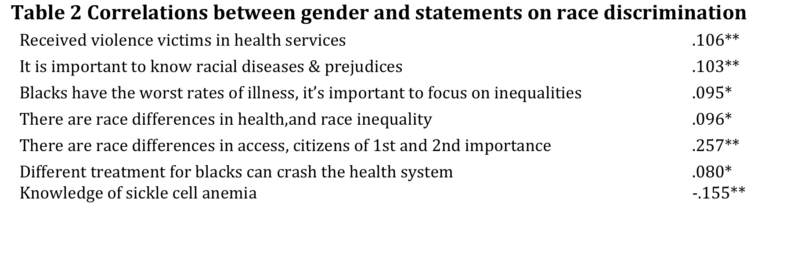
Table 2
a. Gender is positively related to several attitudes on race inequalities; It was perceived that there are diﬀerences in access for blacks and whites (seemingly as citizens of ﬁrst and second
importance), in how victims of violence are received, in the recognition of racial diseases to overcome prejudices, and in the
understanding that there are worse rates of illness among blacks along with race inequalities. However, gender is negatively correlated to knowledge of sickle cell anemia (Table 2 below).

Slide 15
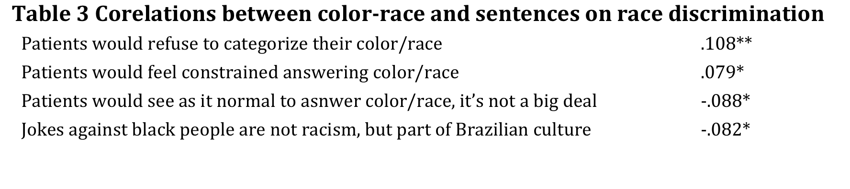
Table 3
b. Color of health personnel is positively correlated to the expectation that patients would refuse to categorize their own color and that they would feel constrained. It is also negatively correlated to the expectation that
patients would categorize their own color naturally; and that the attitude would prevail that jokes against blacks are a normal part of Brazilian culture (Table 3).

Slide 16
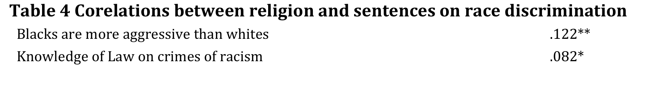
Table 4
c. Religion is positively correlated to the opinions that blacks are more aggressive than whites (.122**) and with the knowledge and opinion on the law condemning crimes of racism (.082*).
•

Slide 17
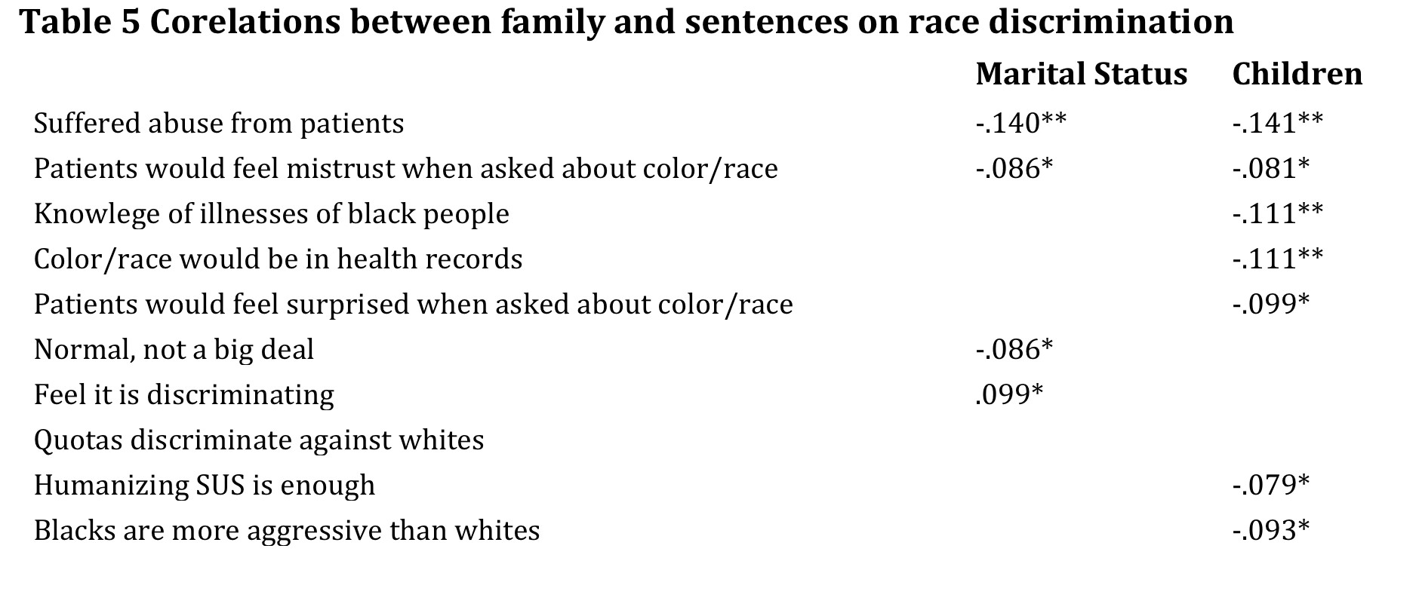
Table 5
d. Marital status and having children are negatively correlated to several statements on discrimination; experiences of abuse from patients, and an expectation that patients would feel mistrust when asked about their color;
And having children is negatively correlated to knowledge of illnesses of black people, to the opinion that color/race should be registered in health record, and that patients would feel surprised to be asked about color/race.
Only marital status is positively correlated to the idea that patients would normally answer the question about color/race and negatively correlated to the expectation of surprise to be asked this question.

Slide 18
Findings
Gender and having children are the variables with the highest correlation coeﬃcients with discrimination statements, particularly regarding to recognition of diﬀerential access to health services, knowledge of sickle cells anemia and other illnesses of black people, agreement that color/race would be in health records; but it is also correlated to suﬀering abuse from patients, knowledge. Religion has a high and very signiﬁcant correlation to the perception that blacks are more aggressive than whites.
It can be concluded that the correlations between the variables representing discriminatory statements and most socio- demographic variables included in the analysis are few, and if it exists, its coeﬃcient is low or the correlation is statistically insigniﬁcant. Therefore there is not enough evidence to apply statistical methods for correlations of variables (such as factor analysis with principal components).
•

Slide 19
Findings
In the 'History of agglomeration' table, it is possible to identify the stage of the classiﬁcation process in which variables are combined. For example, in the ﬁrst stage, the variables grouped were racist jokes and perception of black people as violent (I260 and I261). These represent two explicit demonstrations of racism.
The second group combines two variables: ‘it is not necessary to diﬀerentiate people according color in health services – I244’, inspired on the myth of racial democracy and equalitarian speech (the country is mixed) and the variable ‘politically correct sentence’ referred to everyone are equal according to law - I254). These are two typical masked and defensive sentences, which concludes rejecting aﬃrmative attitudes.
And the third group combines attitudes against asking patient’s color-race in health records, justiﬁed by ‘creating unnecessary controversy – I246’ and ‘people may take oﬀense, feel bad, creating problems – I247’.
The graphic 'Dendogram’ uses a single linkage, and reaﬃrms previous results on the union of the variables according to each stage of the sorting process is observed.
In a previous cluster tested we included the variable “opinion on racism’ in the set of variables. However, although it was the ﬁrst variable to combine with other variables showing explicit racism, it was excluded from the analysis, because the extreme cases aﬃrming that there not exists racism in Brazil had only four cases (among 634). Excluding the inﬂuence of this direct question, the cluster analysis discussed in this article could conﬁrm that explicit racism is not so uncommon in this case.

Slide 20
Findings:
The workers recognize that racism exists in Brazil.
However, their speeches indicate the predominance of a modern or subtle type of racism, based more on social prejudices than on color, mainly among high school professionals, such as physicians, nurses, social workers, etc.
Less educated workers, like technicians, receptionists and watchmen present higher proportions of prejudices based on color, or traditional racism, compared to the more educated workers.

Slide 21
Conclusion & Signiﬁcance:
The results adhere to the cultural approach on racism as ideology (Miles and Brown, 2003), associated to the level of education.
However aﬃrmative policies are rejected by most workers regardless of their level of education.
Recognizing that racism, inequalities and injustices exist does not allow people to assume a
commitment to act collectively to compensate or eliminate the eﬀects of these injustices in their daily life or work, or to support actions to promote real equality.

