Slide 1

Allergen management and need for regulation at factory level
2nd International Conference on
Food Safety and Regulatory Measures
London 06 -08 June 2016
René Crevel
Safety & Environmental Assurance Centre, Unilever

Slide 2
Allergen management
Risk management of food allergens and certain food intolerances - FoodDrinkEurope Allergen management Guidance (2013)
Goal: to protect allergic consumers by avoiding them being exposed to allergens in amounts that would lead to a reaction with adverse health consequences.
Quantitative risk assessment is a sine qua non of managing allergens – in practice, zero risk is not a realistic concept.

Slide 3
risk assessment AND Allergens
Fundamental principle of toxicology:
“The dose makes the poison” (Paracelsus, 15th Century)
Implication: the key parameter is risk not hazard
Risk
  the likelihood that, under particular conditions of exposure, an intrinsic hazard will represent a threat to human health.
  Risk = f (hazard, exposure)

Slide 4
risk assessment AND Allergens: considerations
  Allergens intentionally present are managed through labelling
  Risk assessment applies to unintended allergen presence (UAP), in particular
    Establishing the amount of unintended allergen presence (UAP)
    Establishing the health consequences of that UAP
    Allergen management and UAP can hardly be mentioned without talking about precautionary allergen labelling (PAL)

Slide 5

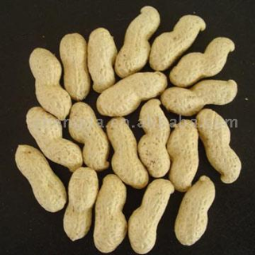
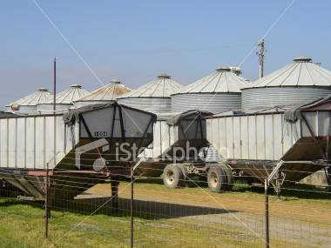
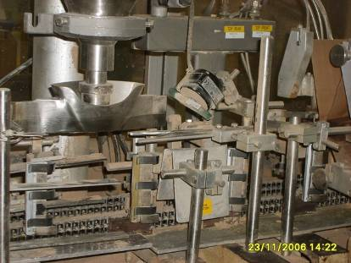
Where does the risk arise?
UAP can occur at all stages from farm to fork:
Raw materials
  Commingling during growing,
  harvest, storage, transport
Manufacture
  Local storage and transport
  Weighing
  Processed ingredients
  Mixing operations
  Packaging
  Risk can only be assessed by reference to appropriate benchmarks

Slide 6
Assessing the risk from food allergens: how much is too much?
How many people are likely to suffer a reaction, and how severe will the reaction be?
Risk
characterisation
Hazard
identification
Exposure
assessment
Hazard
characterisation
How much are people exposed to?
What is the toxicological concern?
What is the relationship between dose and frequency / severity of response?

Slide 7
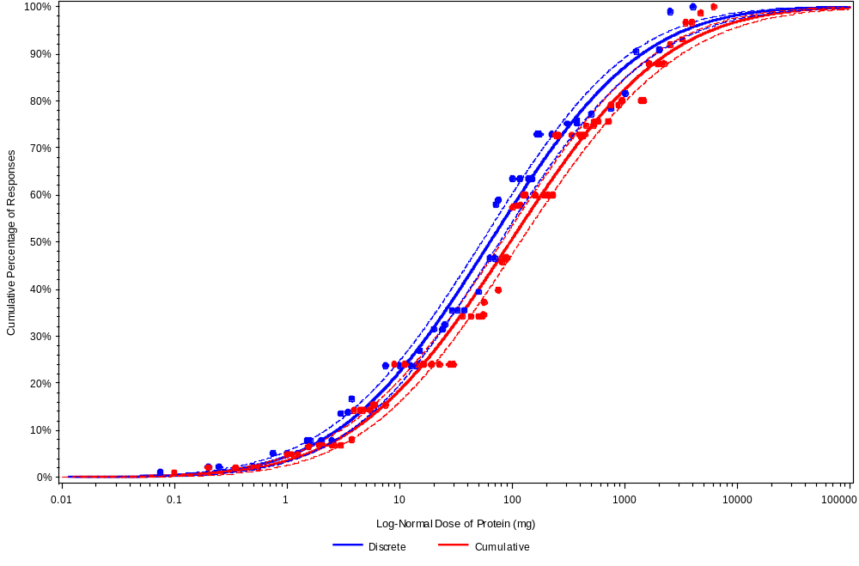
Peanut dose distribution:
Adults and Children combined
ED 05
ED 01
Notes:
7

Slide 8
VITAL Scientific Expert Panel Recommendations and Proposed Action Levels.
Allergen | Reference dose (mg Protein) | VITAL 2.0 action level for 5 g* Serving Size: (ppm) | 50 g Serving Size: Action Level (ppm) | 250 g Serving Size: Action Level (ppm)
Peanut | 0.20 | 40 | 4.0 | 0.80
Milk | 0.10 | 20 | 2.0 | 0.40
Egg | 0.03 | 6 | 0.6 | 0.12
Hazelnut | 0.10 | 20 | 2.0 | 0.40
Soy | 1.00 | 200 | 20.0 | 4.00
Wheat | 1.00 | 200 | 20.0 | 4.00
Cashew | 2.00 | 400 | 40.0 | 8.00
Mustard | 0.05 | 10 | 1.0 | 0.20
Lupin | 4.00 | 800 | 80.0 | 16.00
Sesame | 0.20 | 40 | 4.0 | 0.80
Shrimp | 10.00 | 2000 | 200.0 | 40.00
Celery | Insufficient data
Fish | Insufficient data
*5 g was the amount used to calculate the action levels in VITAL 1.0

Slide 9
Vital 2.0 Reference doses
  Defined by reference to population health-based outcomes (proportion likely to react)
  Serve as benchmarks for allergen management
    Define what is judged safe
    Define when additional risk management measures are required e.g. PAL

Slide 10
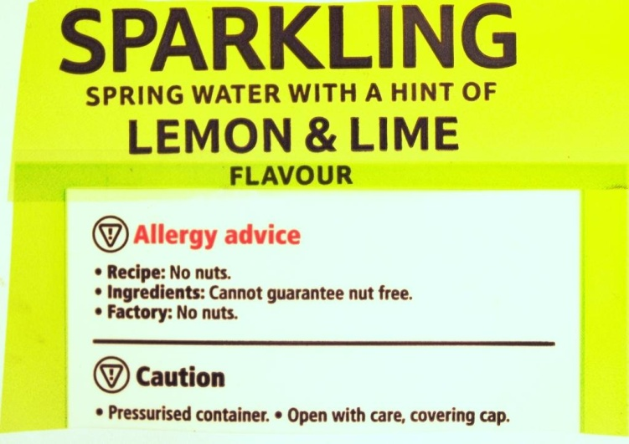
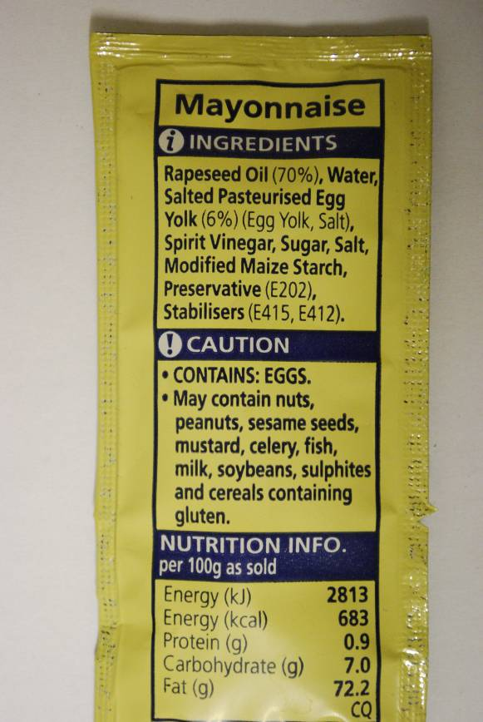
…… Precautionary (advisory – “may contain”) allergen labelling
Introduced in the 1990s
First suggested by CFIA/Health Canada
Voluntary
Twin roles, closely intertwined
  Risk management and risk communication
  Effective outcome: people at risk avoid the product
  Ineffective outcome: people at risk don’t believe it and/or are confused by it and disregard it

Slide 11
Effective use of Precautionary allergen labelling: considerations
100
100
Risk Profile
75
75
Observance of
precautionary labelling (%)
Proportion of
products affected (%)
50
25
50
0
0.1
1
10
100
Reference dose
..we believe that we should set a gluten threshold level for “gluten free” labeling that best assists most individuals with celiac disease in adhering life-long to a “gluten-free” diet without causing adverse health consequences. … ..moving to a definition of “gluten-free” that adopts a criterion that is much lower than < 20 ppm gluten could have an adverse impact on the health of Americans with celiac disease.(US FDA)

Slide 12
…… Precautionary (advisory – “may contain”) allergen labelling today
No consistent standards for application:
use dependent on internal company standards and perception of risks
Negative perception by consumers and health care practitioners
Result: misunderstanding and mistrust, lack of observance and consequently higher risks to allergic consumers
1 Annex II food
10 Annex II foods

Slide 13
What precautionary allergen labelling needs
Clear terminology
Clear consistent rules for its application, understood by all and applied by all FBOs
Defined levels of protection, common to all and accepted by all stakeholders

Slide 14
New requirements for voluntary allergen labelling (FIC reg 1169/2011)
Regulation 1169/2011. Chapter V. Article 36
“3. The Commission shall adopt implementing acts on the application of the requirements referred to in paragraph 2 of this Article to the following voluntary food information:
information on the possible and unintentional presence in food of substances or products causing allergies or intolerances;”
“2. Food information provided on a voluntary basis shall meet the following requirements:
(a) it shall not mislead the consumer, as referred to in Article 7;
(b) it shall not be ambiguous or confusing for the consumer; and
(c) it shall, where appropriate, be based on the relevant scientific data.”

Slide 15
What could it all mean?
shall not mislead: PAL should be accurate, i.e. use must be justified
shall not be ambiguous or confusing: terminology should be clear and limited to one (or a few) well-understood terms
be based on the relevant scientific data: PAL should be based on a thorough risk assessment (preferably quantitative)

Slide 16
Concluding remarks
Precautionary allergen labelling remains a critical tool to manage food allergen risks
However, there is evident and growing dissatisfaction among stakeholders about PAL
PAL needs to operate within a clear and defined framework.
Knowledge and data to achieve this are now adequate and growing
There is good momentum behind allergen activities in Europe, and the tools to put in place an effective regulatory framewoek

Slide 17

Thank you for your attention

