Slide 1


Slide 2

Echo parameters on top of natriuretic peptides and clinical assesment in CHF rehospitalizations
Cornelia Zara, Evelina Iarca, Bianca Neagoe, Liliana Jupoiu, Adina Luta, Ofelia Khazei, Ioana Barsan, Anca Gabor, Vlad Gorgan, Magdalena Craciun, Lilia Manjoub Muntean, Ionut Iarca
- Theracardia, Brasov, Romania -
Gratitude to: Anca Simioniuc, Luna Gargani, Frank Lloyd Dini - Pisa, Italy

Slide 3
Declaration of interest
I have nothing to declare

Slide 4
Contents of the presentation
Background about congestion score, echocardiographic parameters and natriuretic peptides used in HF patients‘ follow-up
Dimension of the issue
Recommendations of the guidelines
Theracardia study
Conclusions

Slide 5
Mortality and readmission in patients hospitalized with
acute heart failure
Gheorghiade M et al. J Am Coll Cardiol 2013; 61:391-403

Slide 6
Length of stay and discharge disposition for patients hospitalized with acute heart failure
Gheorghiade M et al. J Am Coll Cardiol 2013; 61:391-403

Slide 7
Causes of early HF readmission
1. Inadequate initial in-hospital treatment
Administrative pressure to early discharge
2. Inadequate discharge status
How congestive status should be ?
3. Inadequate discharge planning
Medication, follow-up calls , visit , etc

Slide 8
Congestion matters!
Pulmonary / sistemic congestion
Clinical / hemodynamic congestion

Slide 9

Systemic congestion (JVD, edema)
SYMPTOMS
Dyspnea
Increased RV and RA pressure
Alveolar edema
Increased PA pressure
Redistribution in pulmonary vascular bed + interstitial edema
Increased PCWP
Increased LA and LV diastolic pressure
Mitral regurgitation
Abnormal LV function
Gheorghiade M et al. Eur J Heart Fail 2010;12:423-433
Notes:
La cossidetta “congestione emodinamica” è un proceso complesso che precede l’insorgenza dei sintomi e corrisponde alla finestra temporale in cui un eventuale intervento terapeutico può bloccare l’evoluzione verso lo scompenso clinicamente manifesto

Slide 10
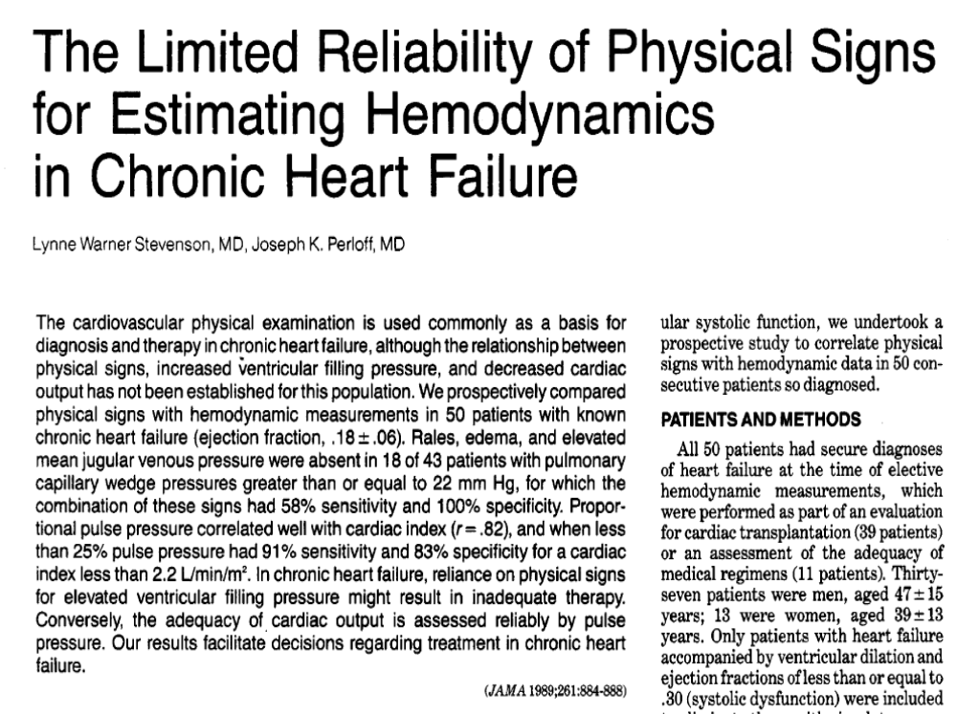
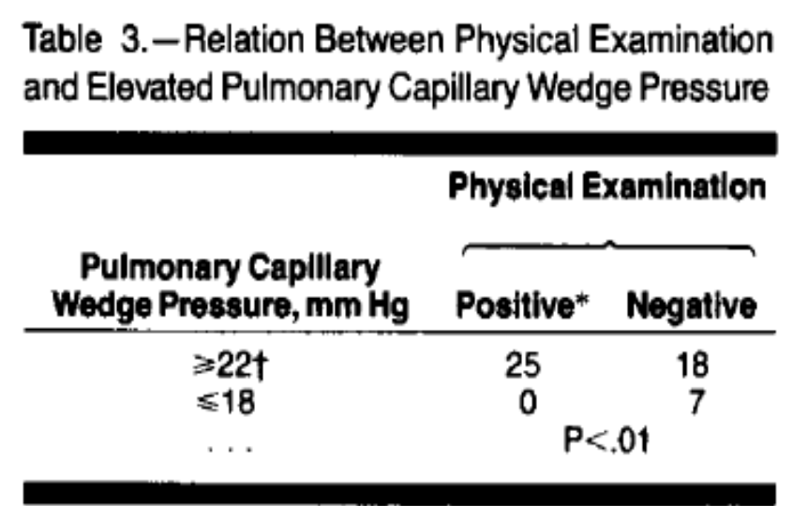

Slide 11
Clinical Profile on Admission
Sato N. Et al. ATTEND Registry, Am Heart J. 2010 Jun;159(6)

Slide 12
CHF : Predictors of all-cause 1-year mortality
Variable – Chronic heart failure (outpatient) | OR (CI 95%) | P-value
Age (every 5 years:IQR=[55 - 60]) | 1.11 (1.04-1.18) | 0.0007
BMI (every 1 kg/m²:IQR=[25 - 26]) | 0.95 (0.93-0.98) | 0.0005
SBP (every 5 mmHg:IQR=[110 - 115]) | 0.94 (0.91-0.97) | 0.0001
Region (N vs S) | 0.47 (0.25-0.90) | 0.0204
NYHA III-IV (yes vs no) | 1.93 (1.50-2.49) | <0.0001
Pulmonary or peripheral congestion (no vs yes) | 0.39 (0.26-0.60) | <0.0001
Third heart sound (yes vs no) | 1.54 (1.07-2.20) | 0.0186
Aortic stenosis (yes vs no) | 1.70 (1.12-2.59) | 0.0135
Atrial fibrillation (yes vs no) | 1.45 (1.13-1.86) | 0.0033
PAD (yes vs no) | 1.62 (1.19-2.19) | 0.0019
Renal dysfunction (yes vs no) | 1.14 (1.09-1.83) | 0.0080
ICD (yes vs no) | 0.67 (0.46-0.98) | 0.0414
EURObservational Research Programme
Heart Failure Long Term registry

Slide 13
Use of Echocardiography and lung ultrasound
for assessment of congestion
E/Ea = 14
Nagueh et al J Am Soc Echocardiography 2016; 29:277-314
Notes:
Eu aici interpretez acest slide in sensul in care ecografia pulmonara ne poate fi de folos la pacientii cu raport E/Ea intermediar. Acele valori intre 8 si 13 care de multe ori ne pun in dificultate pentru a evalua corect functia diastolica a pacientului. Sunt posibil acei pacienti cu un pattern transmitral cu E<A dificil de incadrat ca functie diastolica tipica varstei sau disfunctie diastolica reala.

Slide 14
Reversible restrictive LV diastolic filling with optimized oral therapy predicts more favorable prognosis in chronic HF
100
Percent
86%
Prolonged DT (>125 ms)
80
p<0.0005
Cumulative Survival
60
52%
Persistent short DT (<125 ms)
40
20
0
0
12
24
36
48
Months
Survival free of
all Cardiac Events
100
80
Percent
64%
Prolonged DT (>125 ms)
60
40
p<0.0001
20
14%
Persistent short DT (<125 ms)
0
0
12
24
36
48
Months
Temporelli PG S et al. J Am Coll Cardiol 1998;31:1591.

Slide 15

Elevated filling pressures only with stress or exercise
Elevated filling pressures at supine rest
Physical signs of congestion
Obvious congestive symptoms
LW Stevenson. Circulation, 2006

Slide 16
Natriuretic peptides
High circulating NPs predict unfavourable outcomes in patients with HF
A fall in NP levels during recovery from circulatory decompensation is associated with a better prognosis
Although is plausible to monitor clinical status and tailor treatment based on changes in circulating NPs is patients with HF, published studies have provided different results
This does not enable us to recommend a broad application of such an approach
2016 ESC Guidelines for the diagnosis and treatment of acute and chronic HF

Slide 17
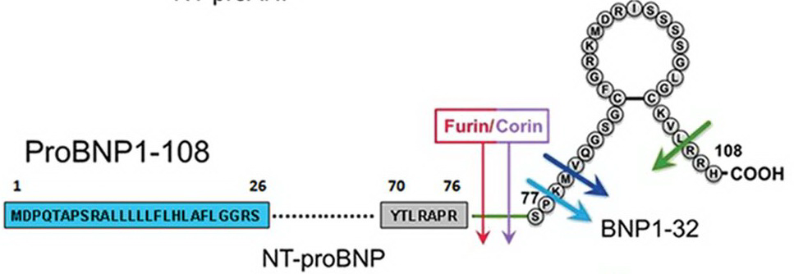
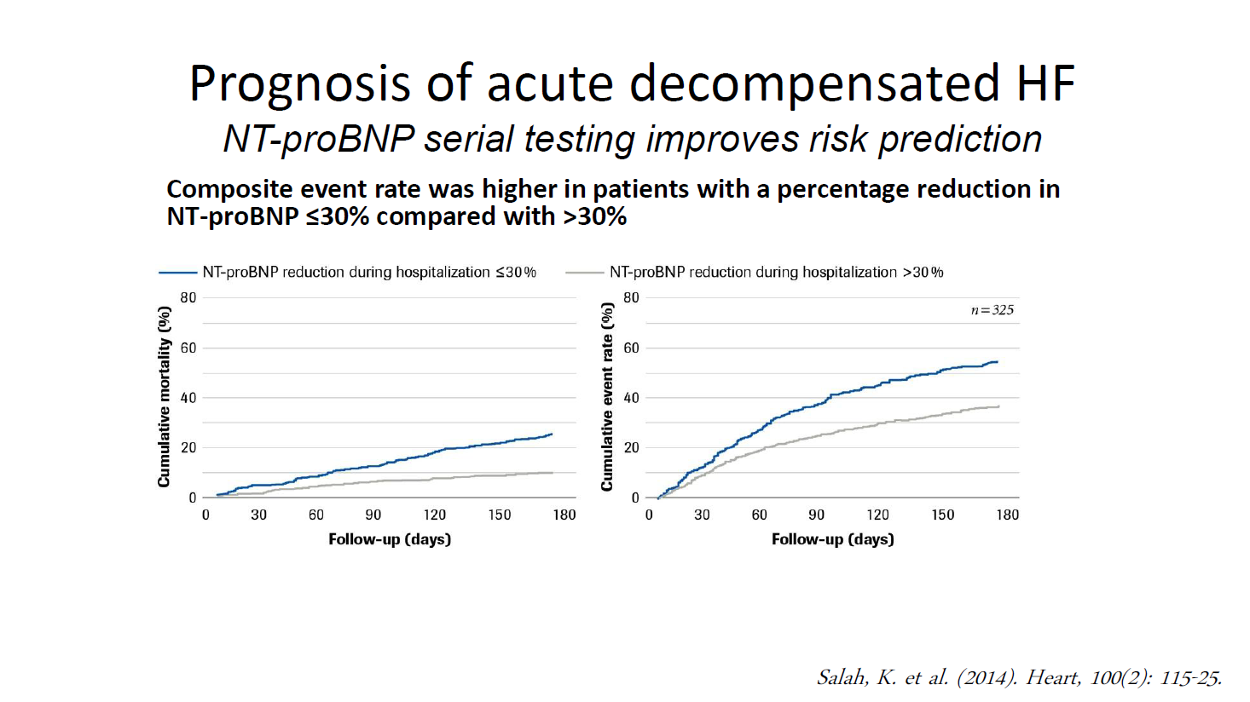
Natriuretic peptides

Slide 18
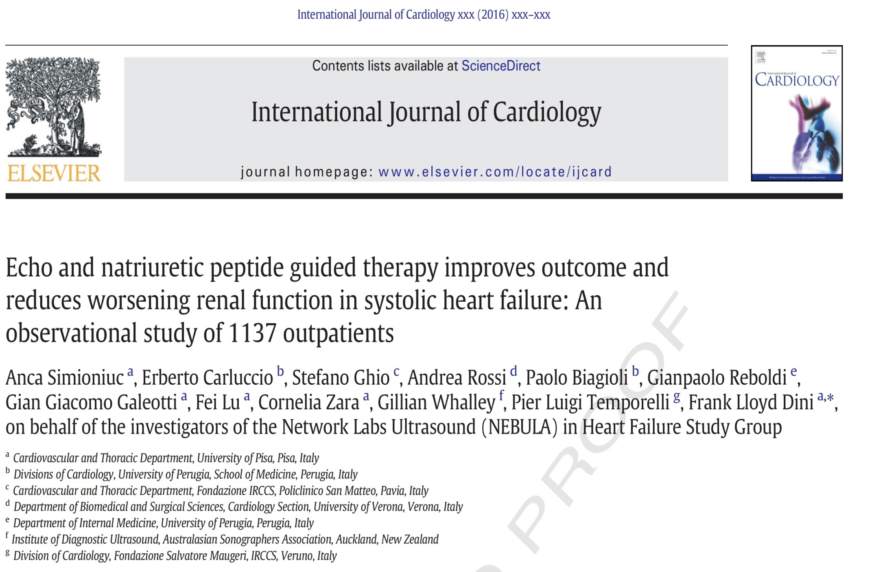

Slide 19
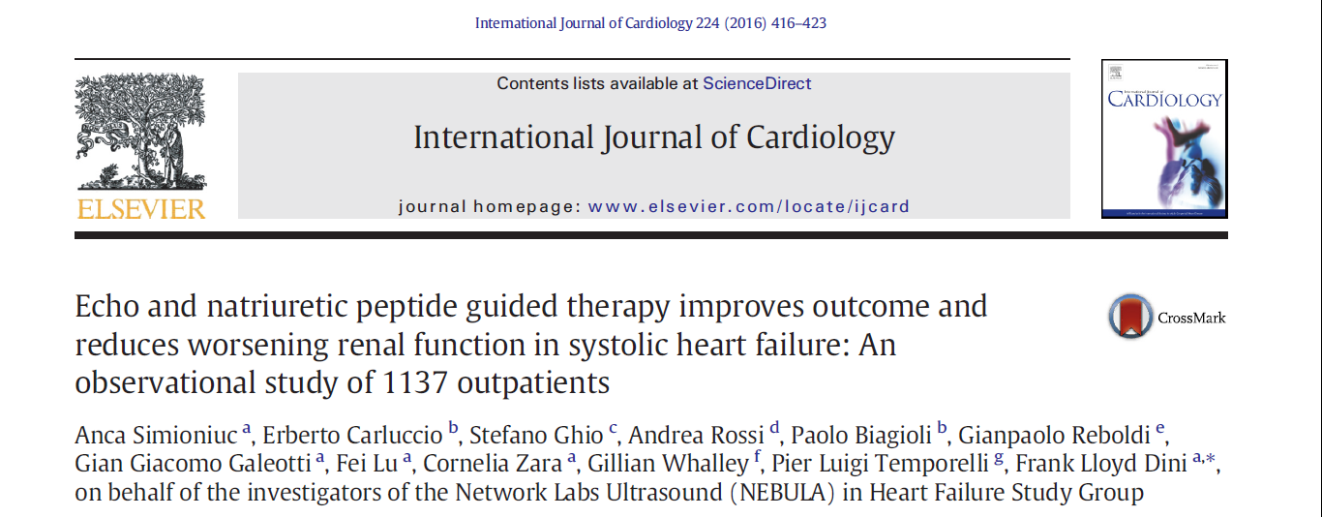
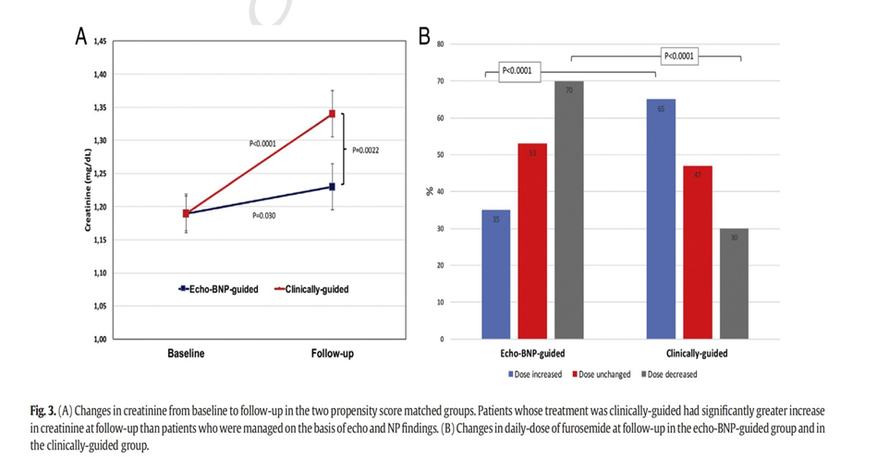

Slide 20
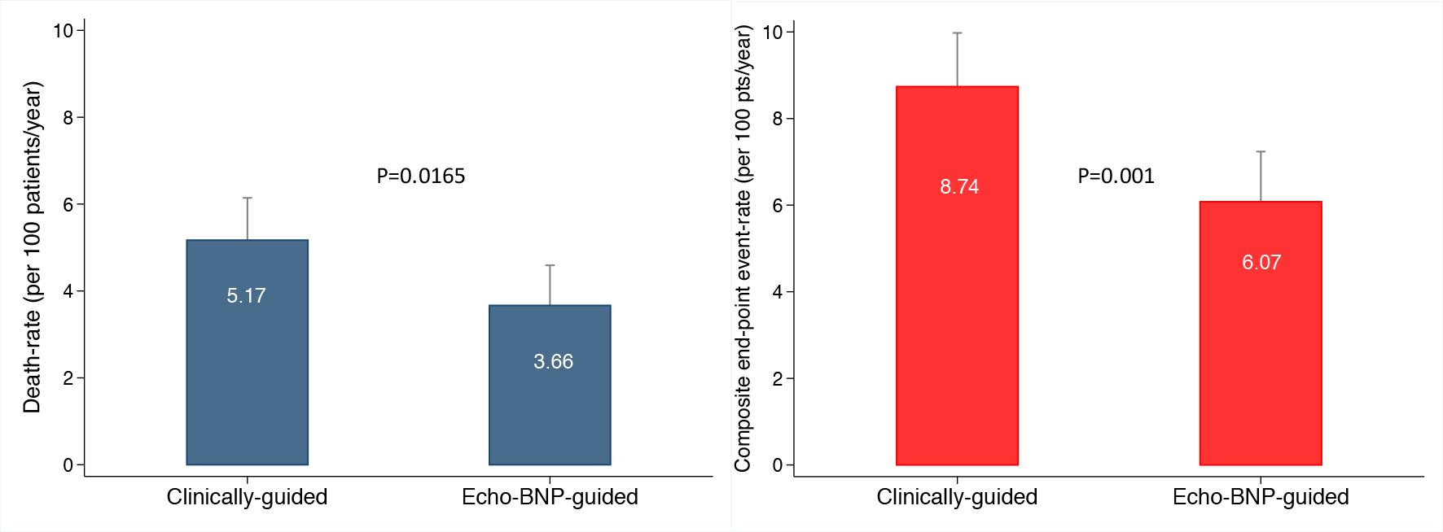
Simioniuc A, et al. Int J Cardiol 2016;224:416.

Slide 21
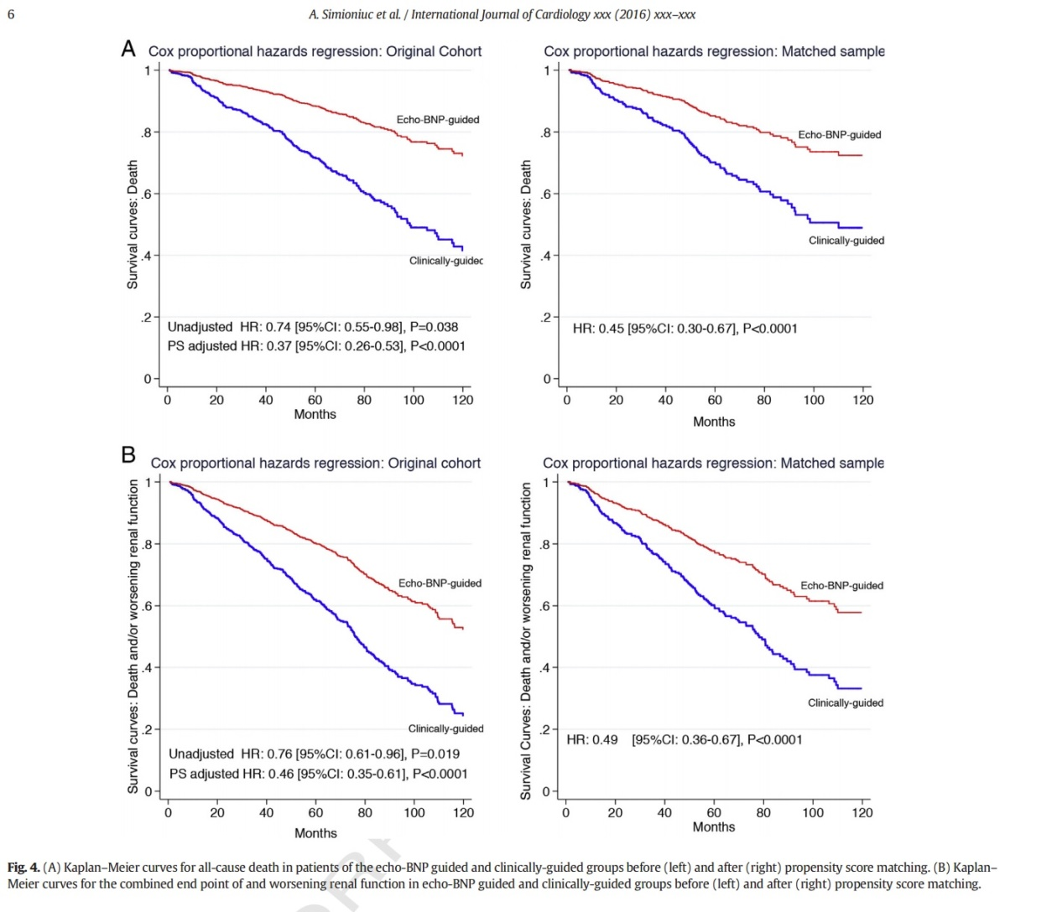

Slide 22
Timing for early follow-up
Ideally contact with a physician or a nurse practitioner within 72 hrs
Depends on local organization and resource and varies among patients
Patients should preferably be :
Enrolled in a disease management programme
Follow up plans must be in place prior to discharge and clearly communicated to the primary care team
Reviewed by their GP within 1 week of discharge
Seen by the hospital cardiology team within 2 weeks of discharge if feasible.
Mebazaa EHJF/EHJ 2015; ESC HF Guidelines 2016

Slide 23
Telemedicine
Remote patient management
Variable clinical trial results
Meta-analyses suggested clinical benefits
Prospectively initiated clinical trials including more than 3700 patients have not confirmed this :
    Tele-HF, TIM-HF, INH, WISH and TEHAF.
Implanted devices : PA pressures (cardio-MEMS), arrhythmic events (IN TIME)
2016 ESC Guidelines for the diagnosis and treatment of acute and chronic HF

Slide 24
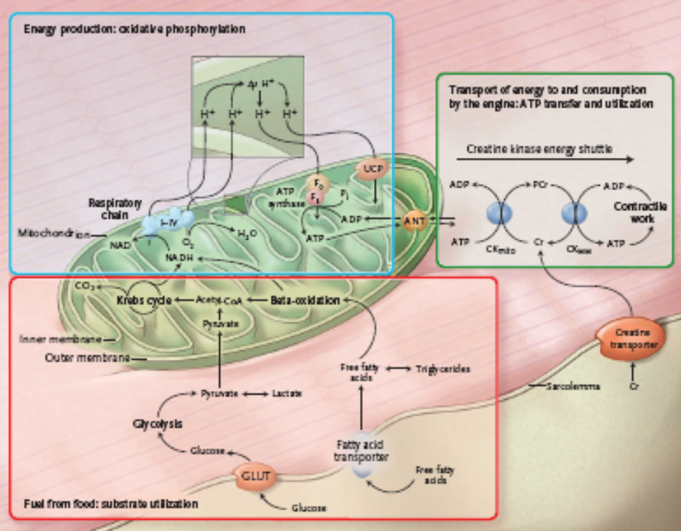
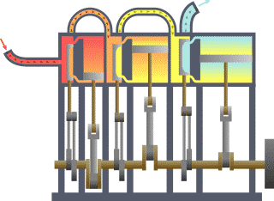
The Failing Heart: An Engine Out of Fuel
Neubauer S. N Eng J Med 2007:356:1140.

Slide 25
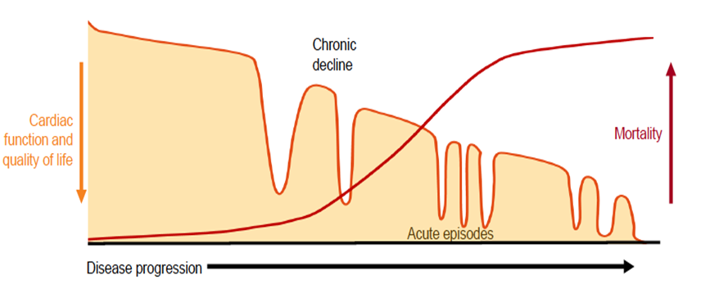
Gheorghiade M et al. Am J Cardiol 2009;53:557-73

Slide 26

THERACARDIA TEAM

Slide 27

To describe predicting factors for HF decompensations

Slide 28

Prospective, longitudinal, non-interventional study
137 HF outpatients, median follow-up of 24 months
Statistical analysis using
SAS-JMP

Slide 29

Complete clinical examination, including 6MWT
Standard transthoracic echocardiography focused on filling pressures parameters
Lung ultrasound exam for detecting B-lines
Biochemistry screening including serum creatinine and NT-pro BNP

Slide 30
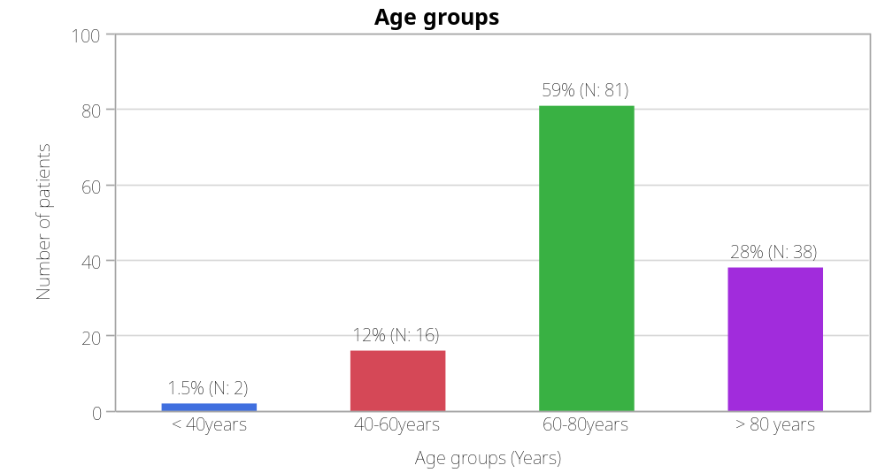
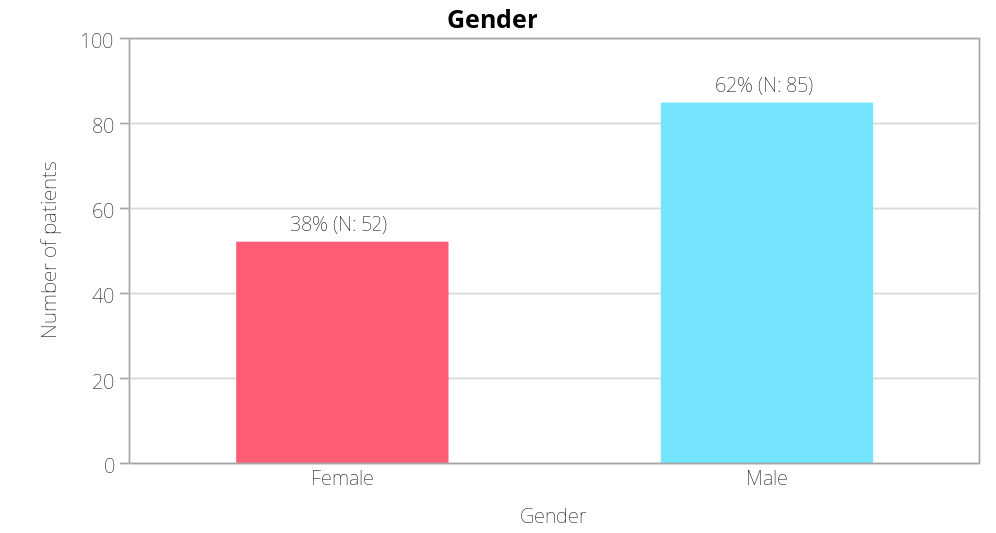
Group characteristics
Notes:
The population age varied between 37 and 94 years, with a mean age of 70 years.
There is a majority of male patients in the group.
Most of patients had a normal weight or were overweight.

Slide 31
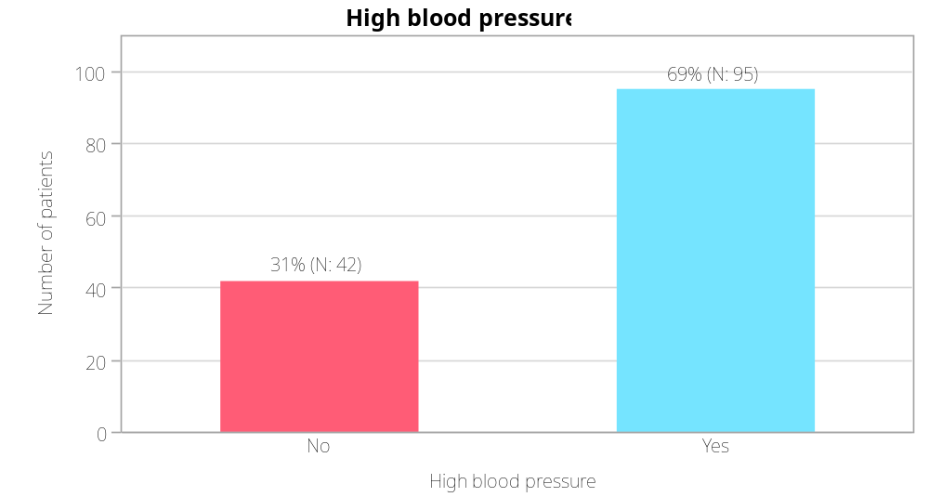
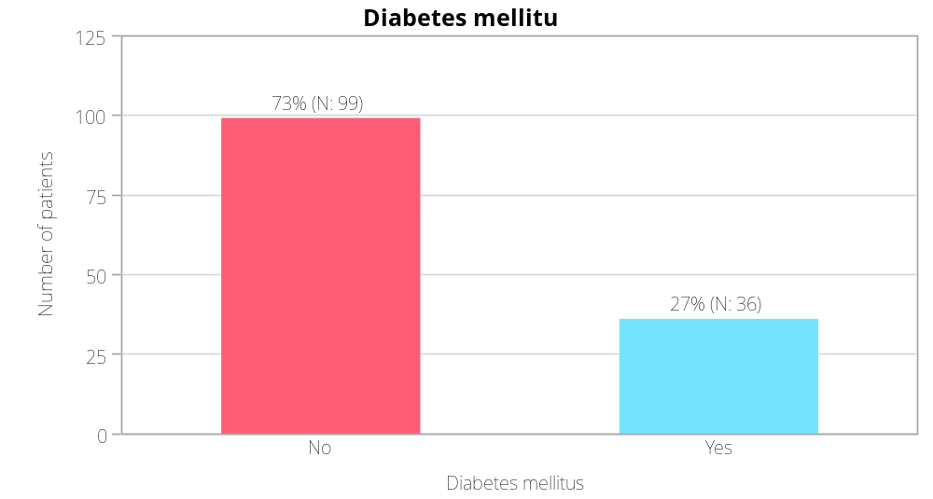
Group characteristics
Notes:
69% of patients had high blood pressure
Only 27% of patients were diabetics
Half of the patients had normal heart rates.
Atrial fibrillation was the baseline rhythm in half of the patients.

Slide 32
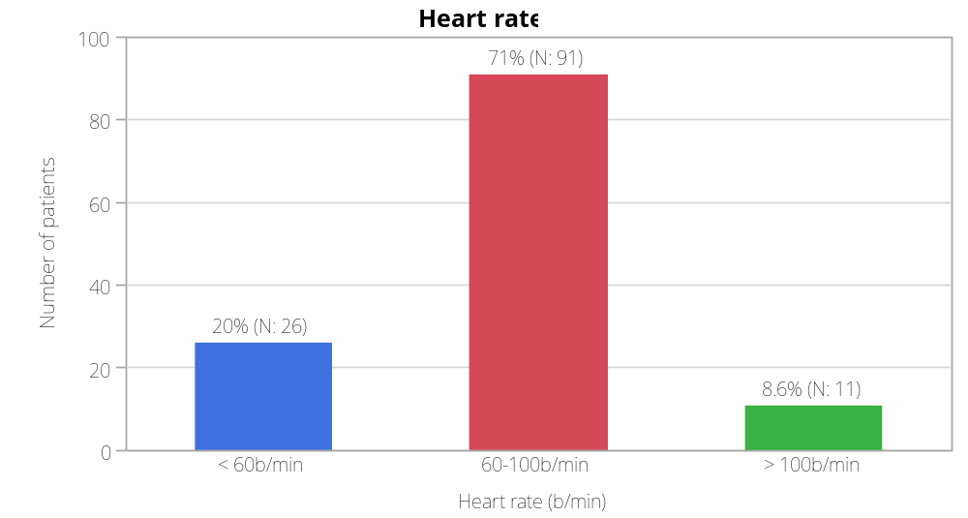
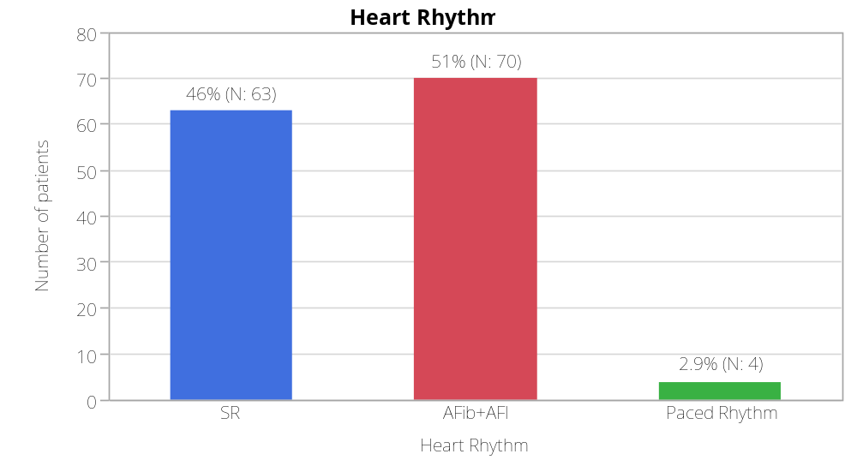
Group characteristics

Slide 33
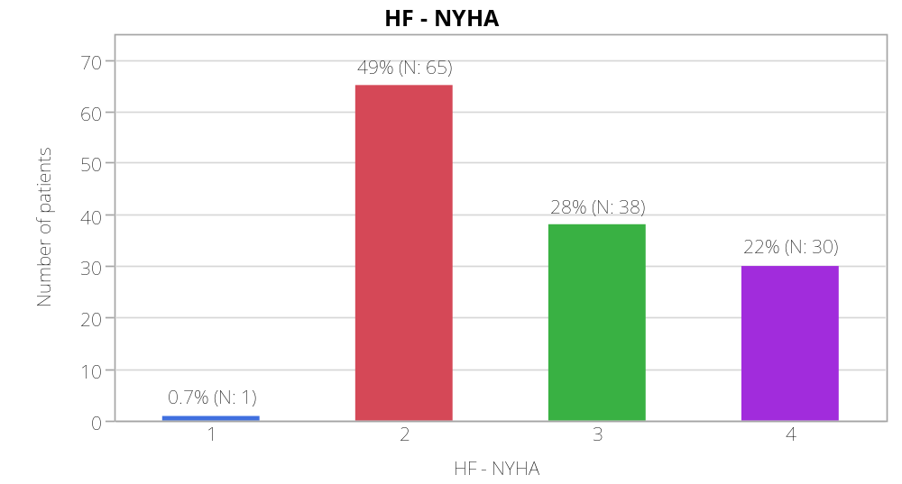
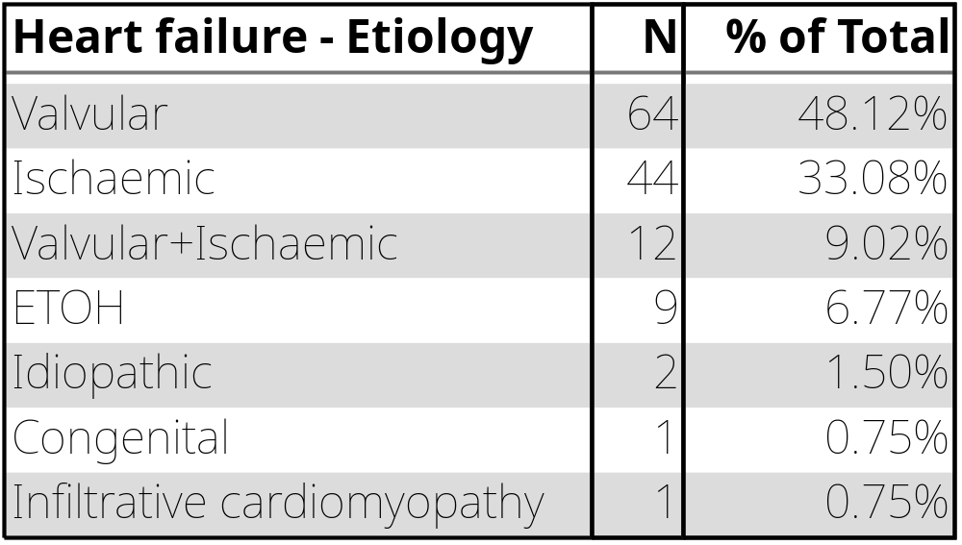
Group characteristics

Slide 34
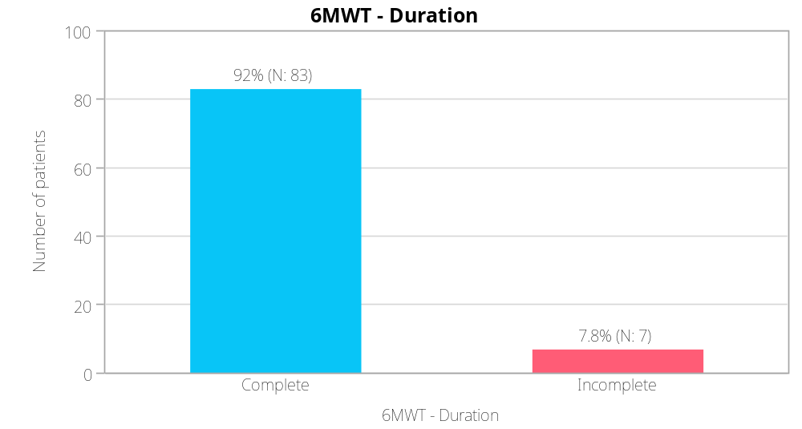
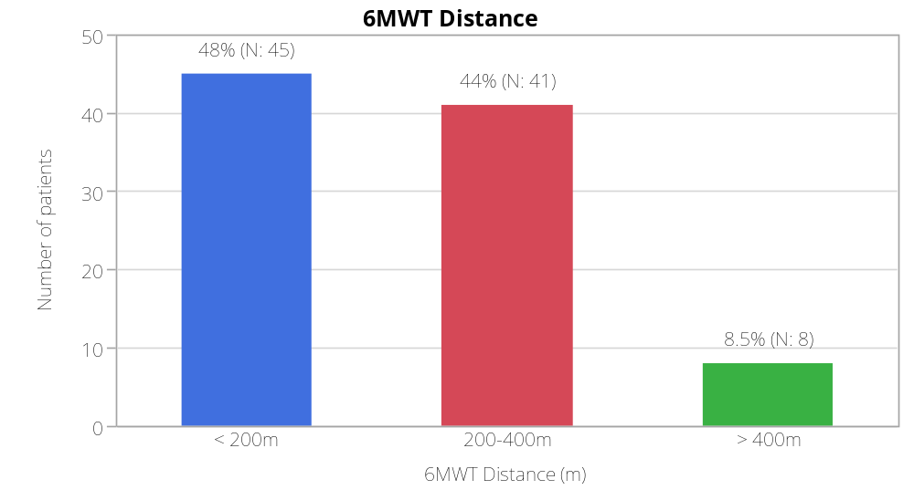
Group characteristics

Slide 35
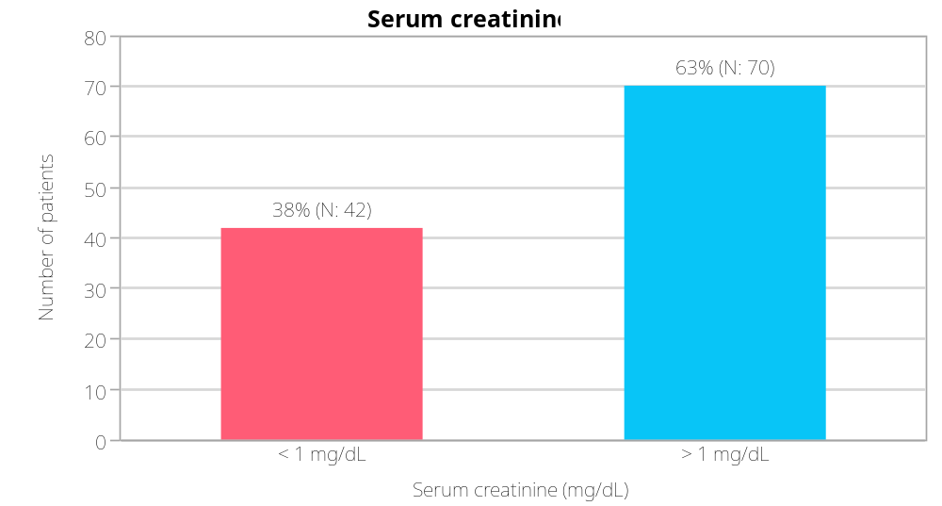
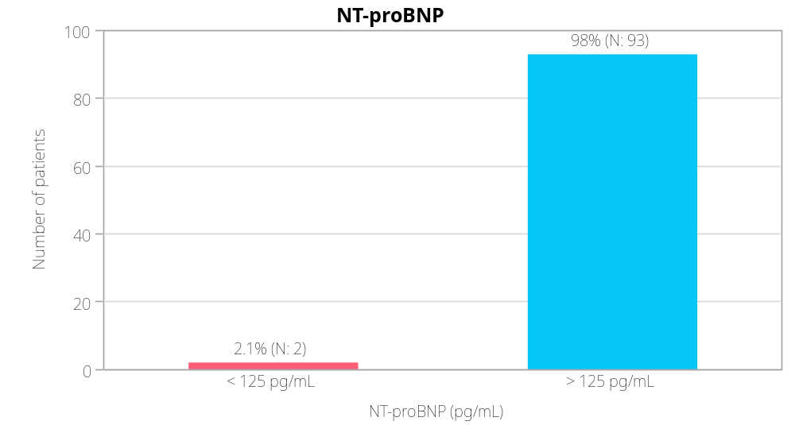
Group characteristics

Slide 36
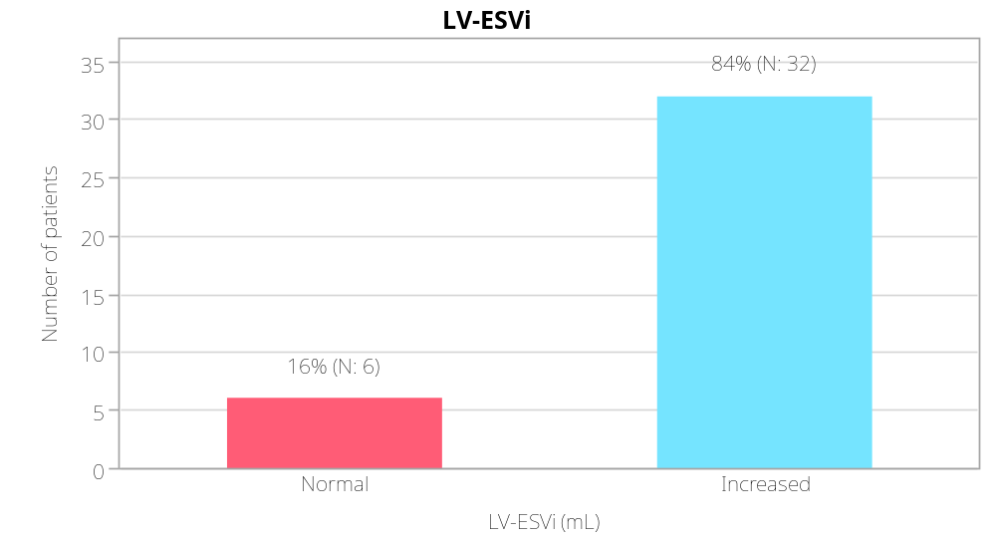
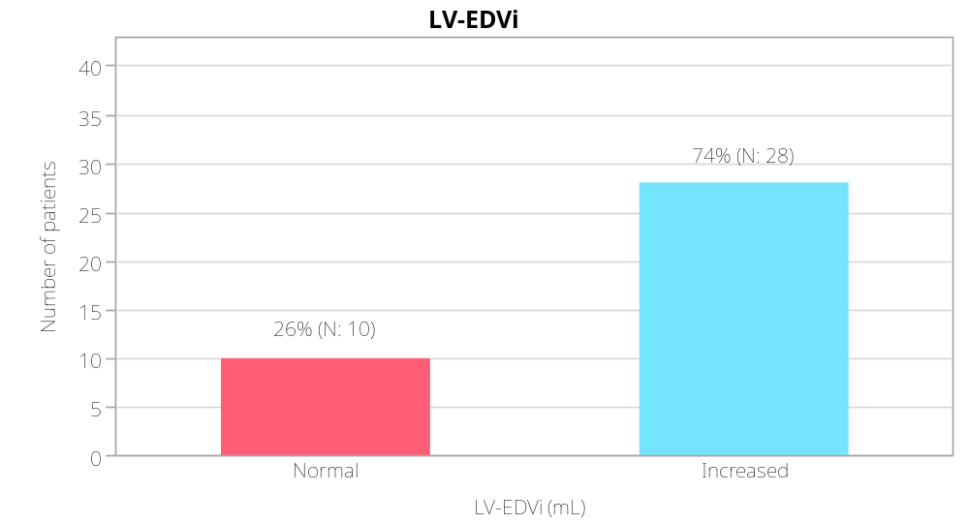
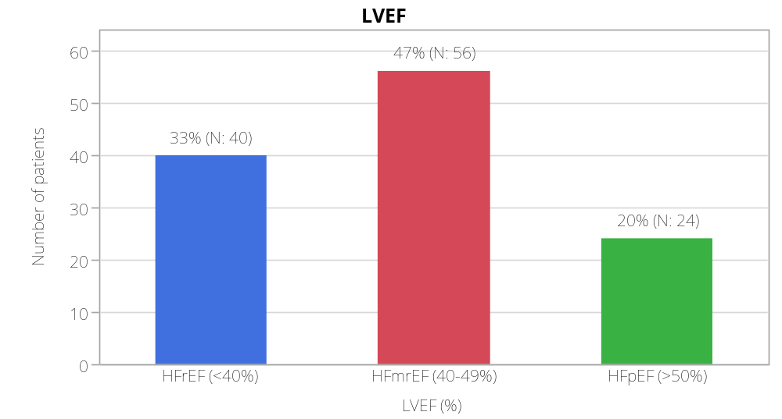
Group characteristics - echo parameters

Slide 37
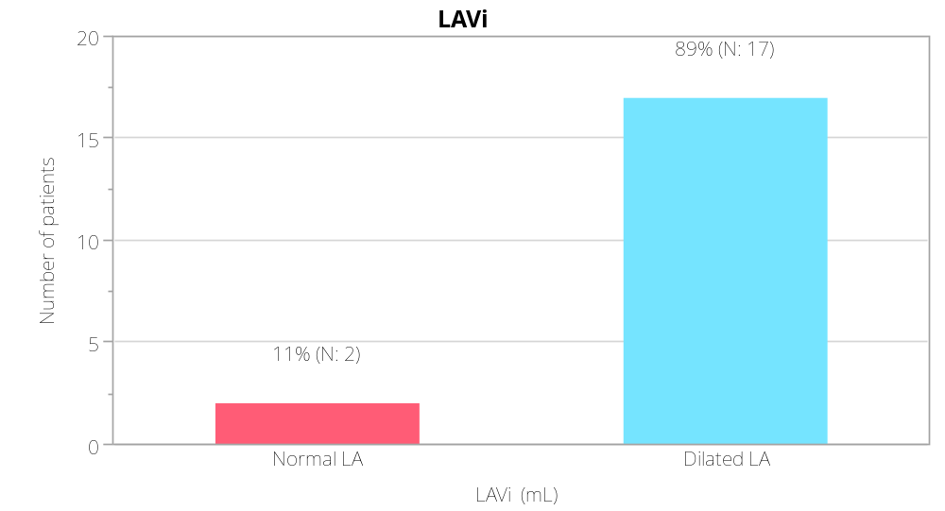
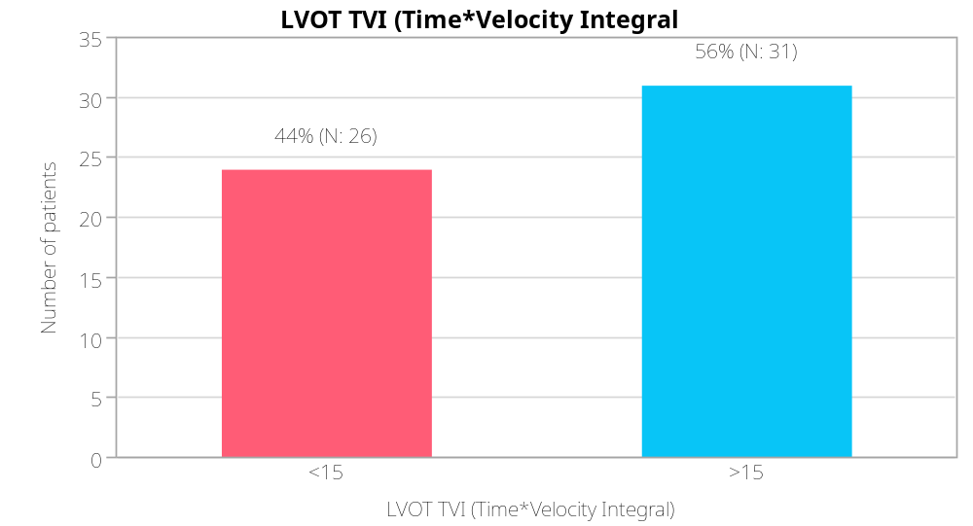
Group characteristics - echo parameters

Slide 38
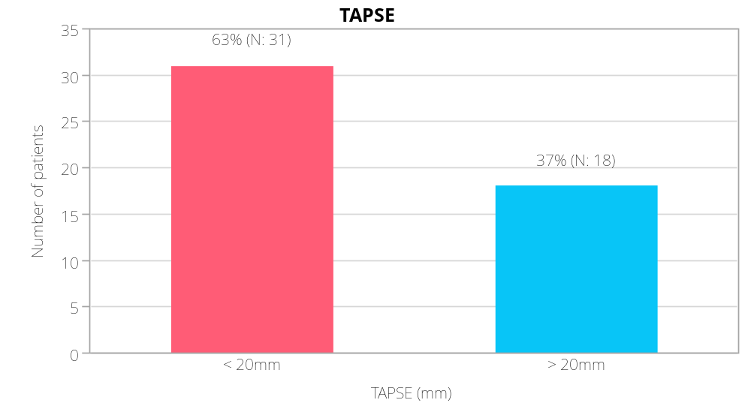
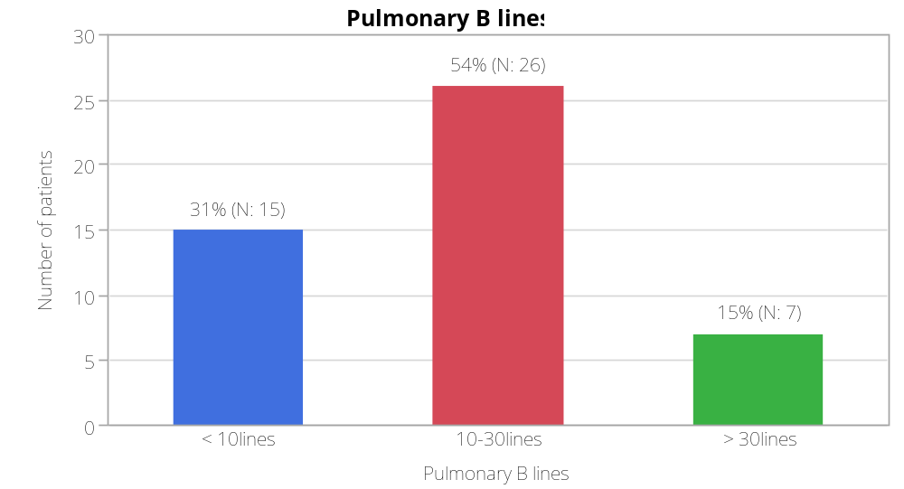
Group characteristics - echo parameters

Slide 39
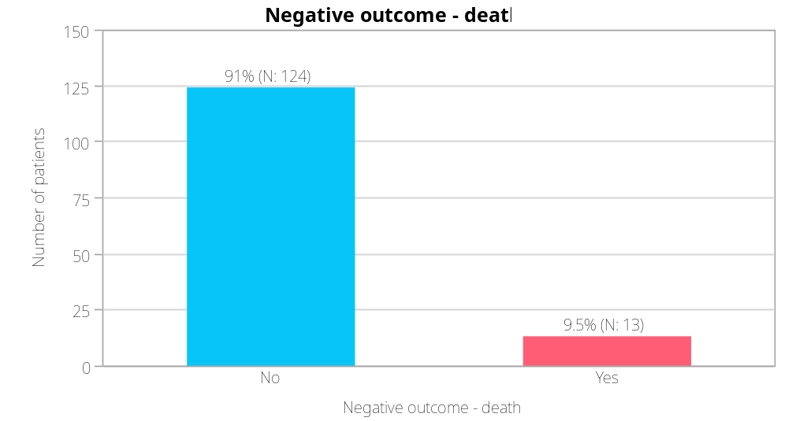
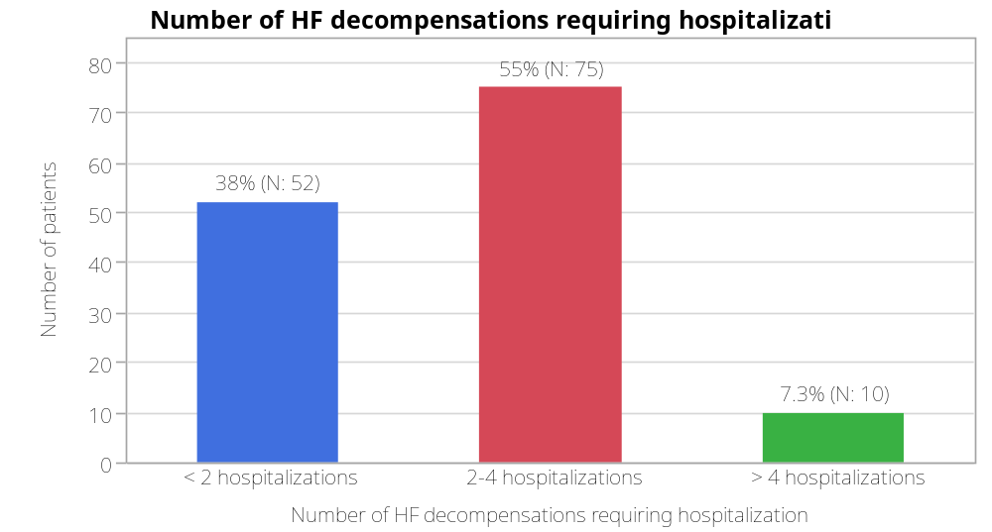
Group characteristics

Slide 40
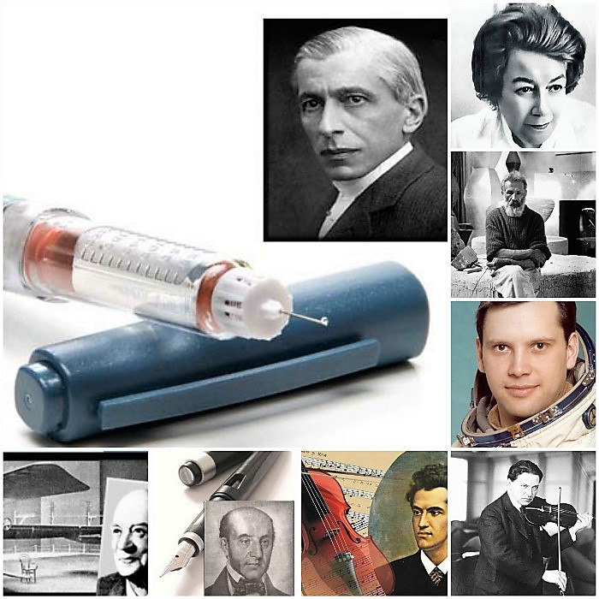

Slide 41

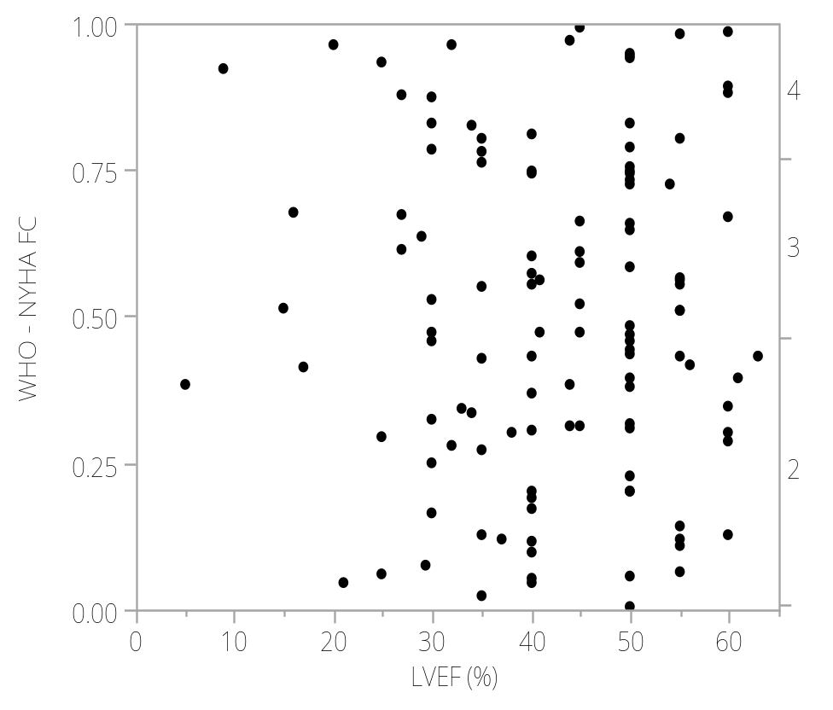
Correlation between LVEF and NYHA functional class
The model explains about 12% of the variation in the data, , the p<0.001 implying that the changes in LVEF values alone are strongly correlated with WHO NYHA FC (for IInd, IIIrd and IVth FC) but accounts only for a small change in WHO NYHA FC of patients.
P<0.001, r²=0.12, ROC= NYHA II-0.69, NYHA III- 0.72, NYHA IV-0.77
LVEF → NYHA
p<0.001

Slide 42
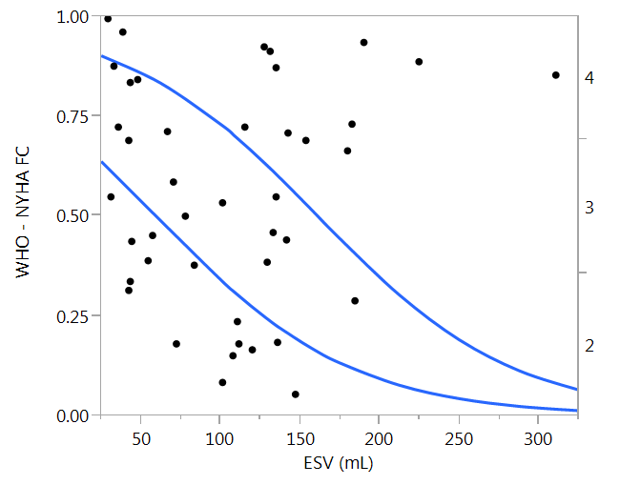
Correlation between ESV and NYHA functional class
High ESV values are associated with an increased WHO NYHA FC (for IIIrd and IVth FC). The model explains about 10% of the variation in the data, the p=0.0024 implying that the changes in ESV values alone are strongly correlated with WHO NYHA FC but accounts only for a small change in WHO NYHA FC of patients.
P=0.0024, r²=0.10, ROC= NYHA III-0.65, NYHA IV-0.77
LV-ESV → NYHA
P=0.0024

Slide 43
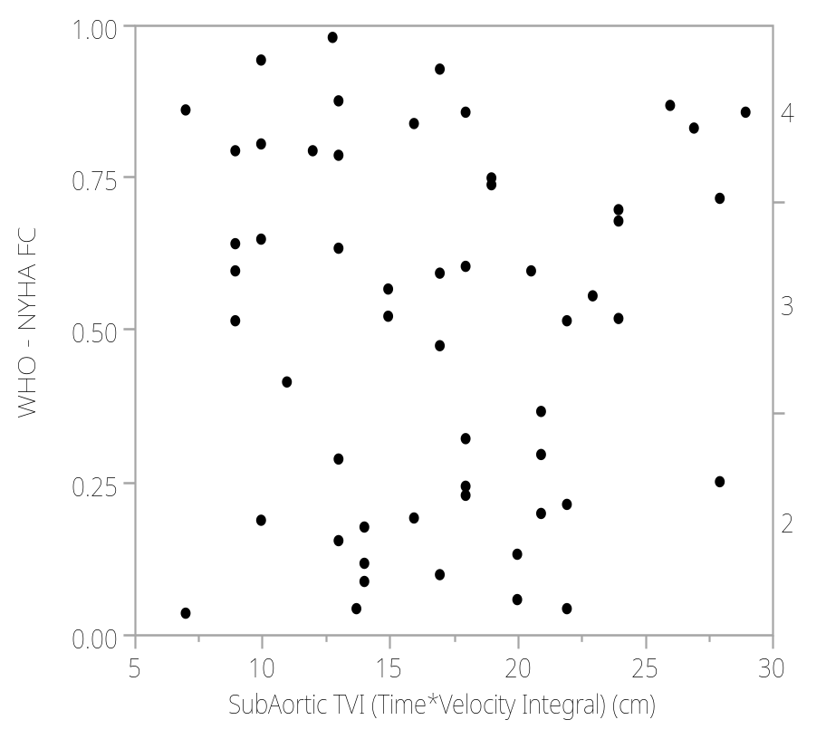
Correlation between SubAortic TVI and NYHA functional class
Low SubAortic TVI values are associated with an increased WHO NYHA FC (for IIIrd and IVth FC).. The model explains about 8% of the variation in the data, the p=0.0021 implying that the changes in SubAortic TVI values alone are strongly correlated with WHO NYHA FC (for IIIrd and IVth FC), but accounts only for a small change in WHO NYHA FC of patients.
P=0.0021, r²=0.08, ROC= NYHA III-0.63, NYHA IV-0.89
LVOT TVI → NYHA
P=0.002

Slide 44
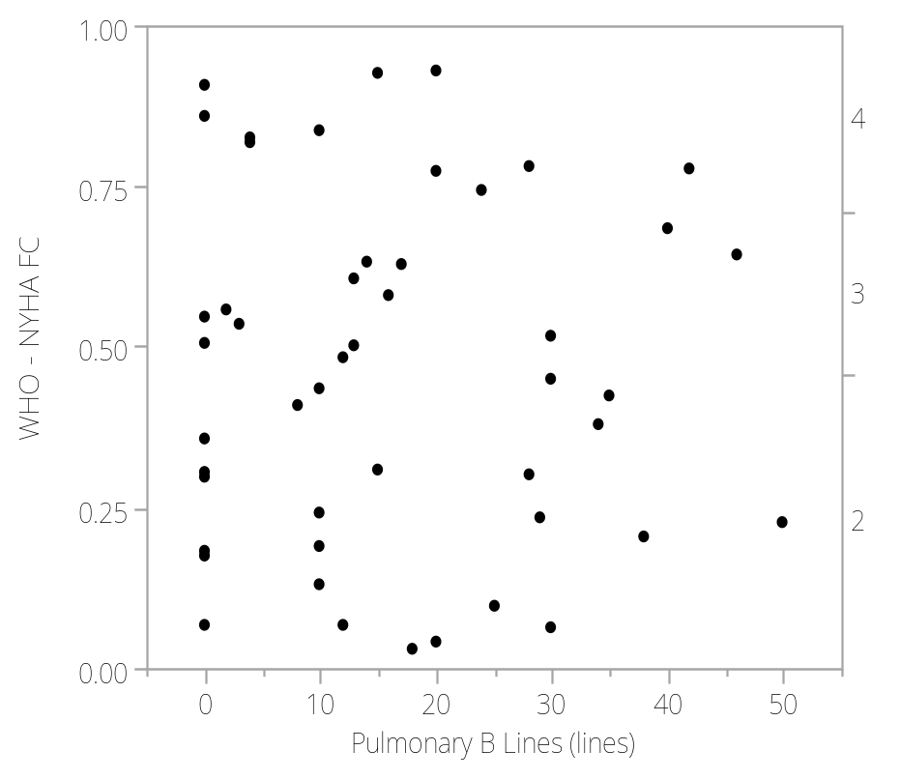
Correlation between pulmonary B lines and NYHA functional class
High number of Pulmonary B Lines are associated with an increased WHO NYHA FC (for IIIrd and IVth FC). The model explains about 29% of the variation in the data, the p<0.0001 implying that the changes in the number of Pulmonary B Lines alone are strongly correlated with WHO NYHA FC (for IIIrd and IVth FC), and accounts for a medium change in WHO NYHA FC of patients.
P<0.0001, r²=0.29, ROC= NYHA III-0.81, NYHA IV-0.95
Pulm. B lines → NYHA
p<0.0001

Slide 45
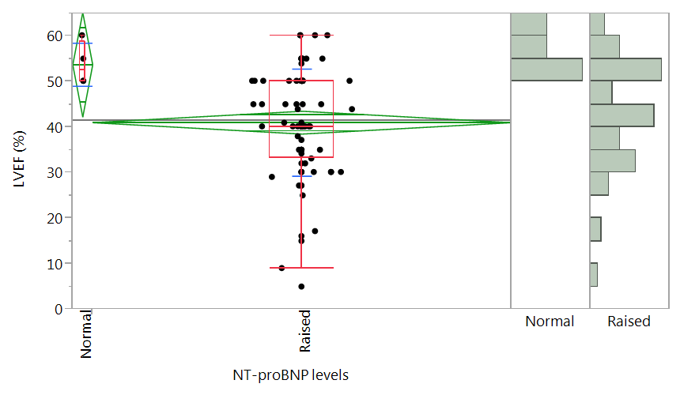
Correlation between NT-proBNP values and NYHA functional class
The model explains about 5% of the variation in the data, the p=0.0345 implying that normal NT-proBNP levels alone are strongly correlated with a normal LVEF, but are associated only with a small change in LVEF.
P=0.0345, r²=0.05
NT-proBNP → LVEF
P=0.0345

Slide 46
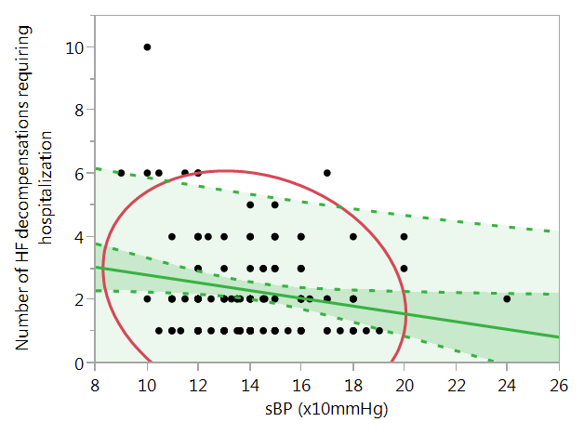
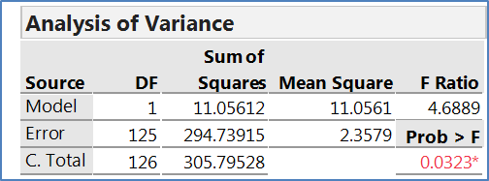
Correlation between SBP and HF decompensations
sBP(mmHg) → #Rehosp
p=0.032
Low sBP values are associated with an increased number of HF decompensations requiring hospitalization, but the change in sBP value does not account for a major change.

Slide 47
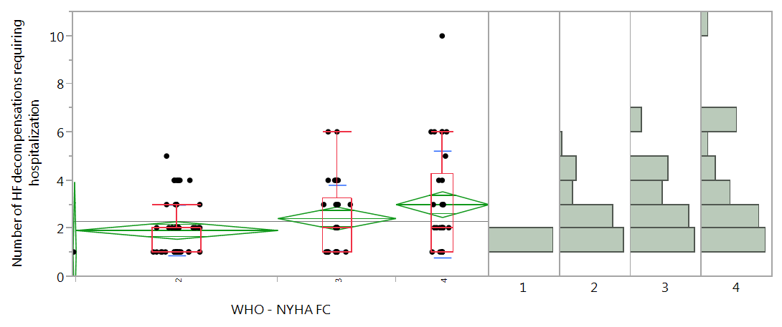
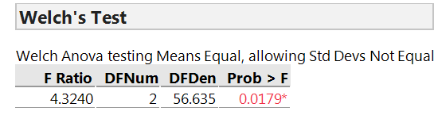
Correlation between NYHA functional class and HF decompensations
NYHA → #Rehosp
p=0.018
Increased NYHA FC are associated with an increased number of HF decompensations requiring hospitalization, WHO NYHA FC II and IV having significantly different number of HF decompensations requiring hospitalization.

Slide 48
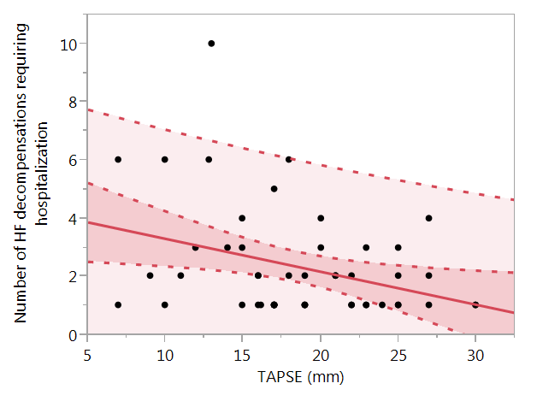
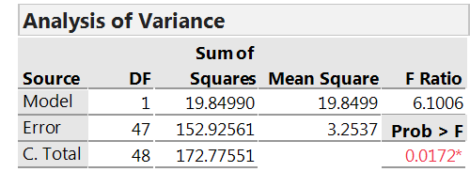
Correlation between TAPSE and HF decompensations
Decreased TAPSE values are associated with an increased number of HF decompensations requiring hospitalization, but the level of change in TAPSE values does not account for a major change in the number of HF decompensations requiring hospitalization
TAPSE → #Rehosp
p=0.017

Slide 49
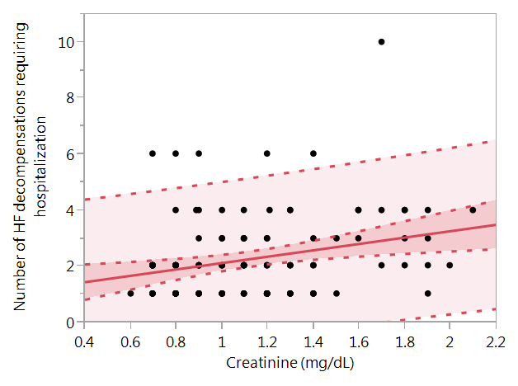
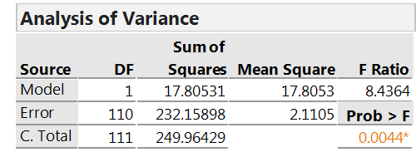
Correlation between serum creatinine levels and HF decompensations
High Creatinine levels are associated with an increased number of HF decompensations requiring hospitalization, but the level of change in Creatinine value does not account for a major change in the number of HF decompensations requiring hospitalization.
Serum creatinine → #Rehosp ↑
p=0.004

Slide 50
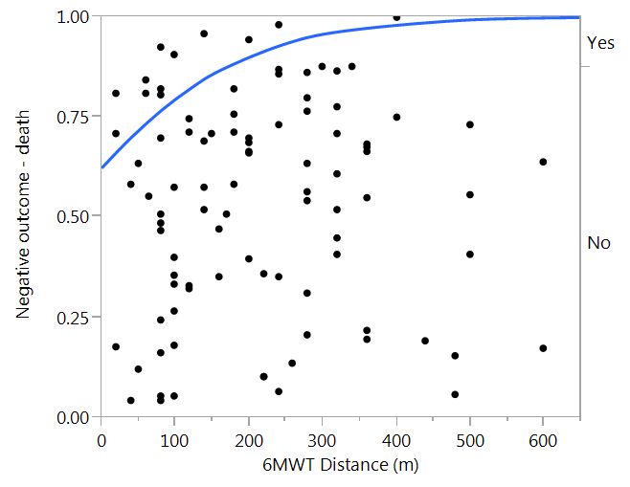
Correlation between 6MWT distance and negative outcome (death)
The model explains about 11% of the variation in the data, the p=0.0049 implying that low 6MWT distance alone is strongly correlated with a negative outcome of the patients, but accounts only for a small change in the number of negative outcomes of patients.
P=0.0049, r²=0.11, ROC= 0.76
6MWTdist. → Negative outcome
p=0.005

Slide 51
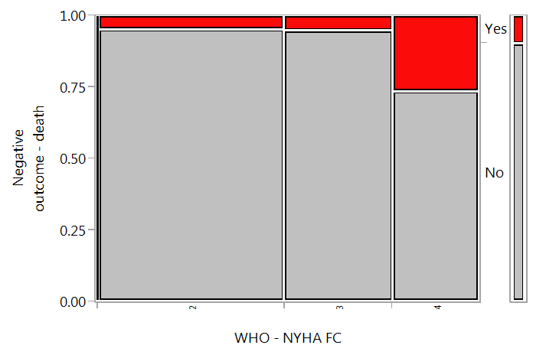
Correlation between NYHA functional class and negative outcome (death)
The model explains about 12% of the variation in the data, the p=0.0143 implying that high WHO NYHA FC alone is strongly correlated with a negative outcome of the patients, but accounts only for a small change in the number of negative outcomes of patients.
P=0.0143, r²=0.12
NYHA → Negative outcome
p=0.014

Slide 52
Conclusions
LVEF
ESV
VTI LVOT advanced NYHA class
B-lines
sBP
NYHA class
RV disfunction rehospitalisation
Renal impairement
6MWT negative outcome
NYHA class

Slide 53
THANK YOU !

