Slide 1
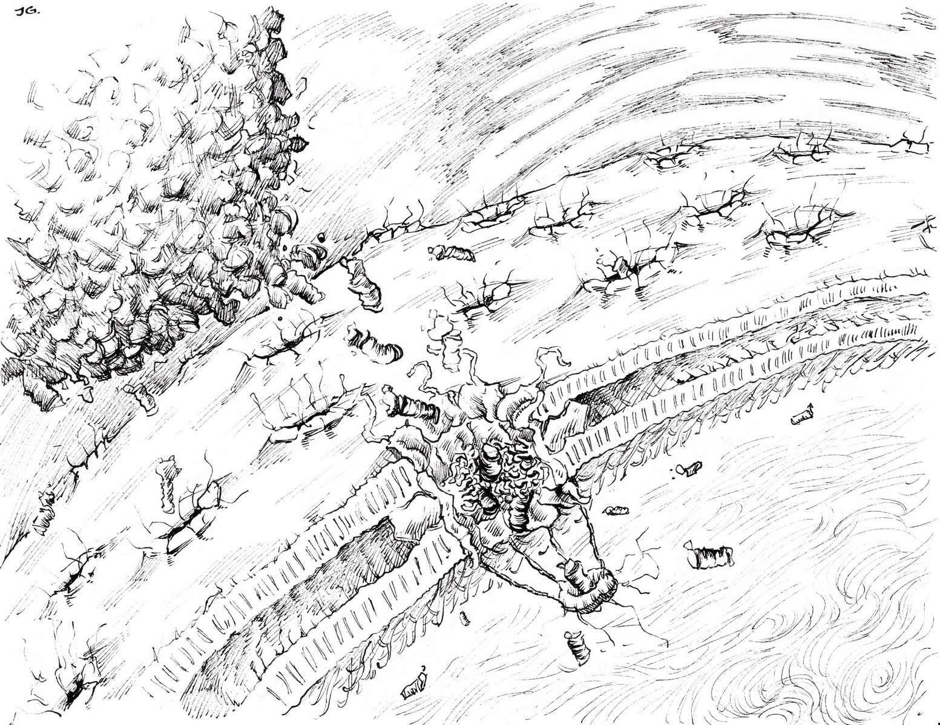

Proteasome Organization
Cordula Enenkel

Slide 2
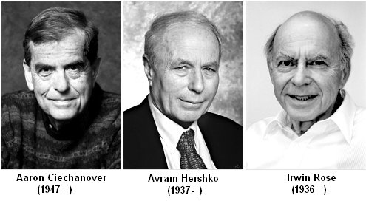
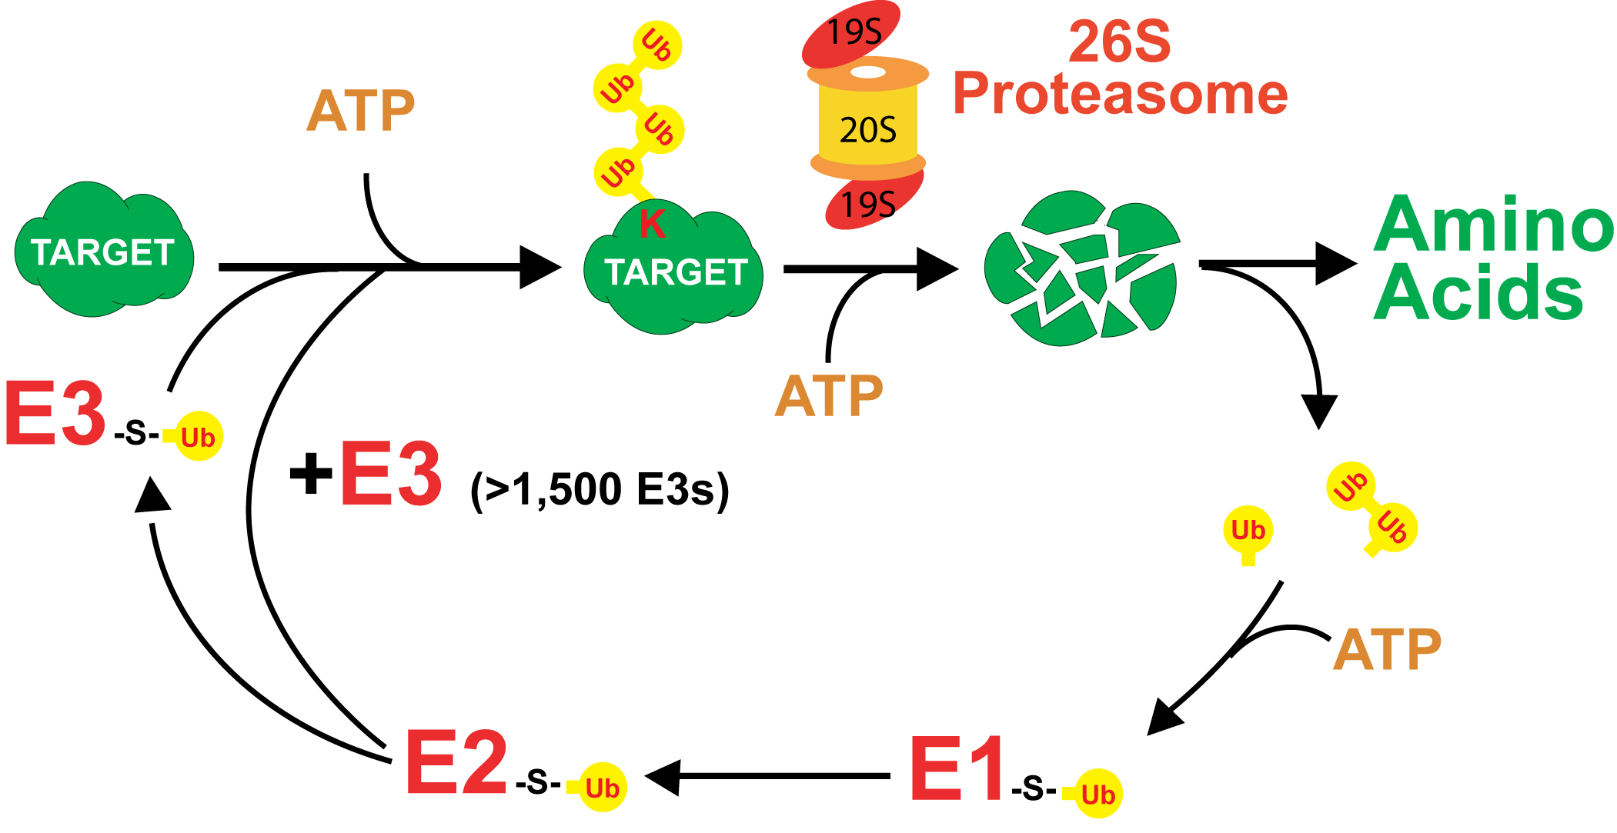
2004 Nobel Prize in Chemistry
"for the discovery of ubiquitin-mediated protein degradation"

Slide 3
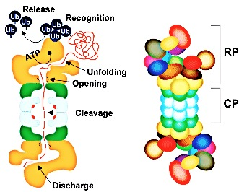
Proteasome – the key protease
of ubiquitin-dependent
protein degradation
19S, ~ 700 kDa
~ 18 subunits
15 nm length
20S, ~ 750 kDa
7 α subunits
7 β subunits
15 nm length
11 nm diameter
Richard Viestra Lab

Slide 4
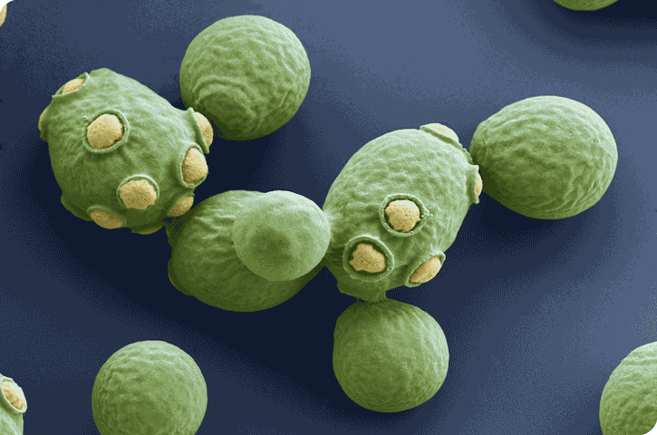

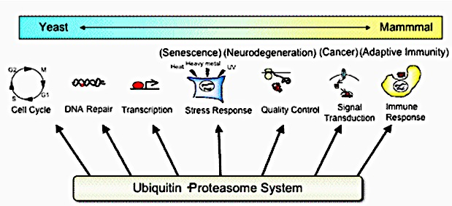
Microbiology online
ClipArt
Graduate School of Pharmaceutical Science
The University of Tokyo

Slide 5
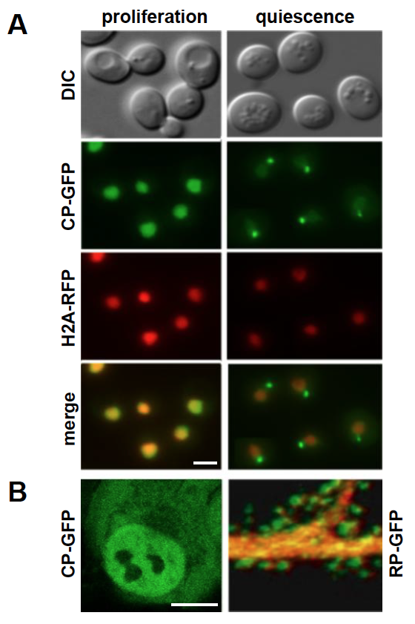
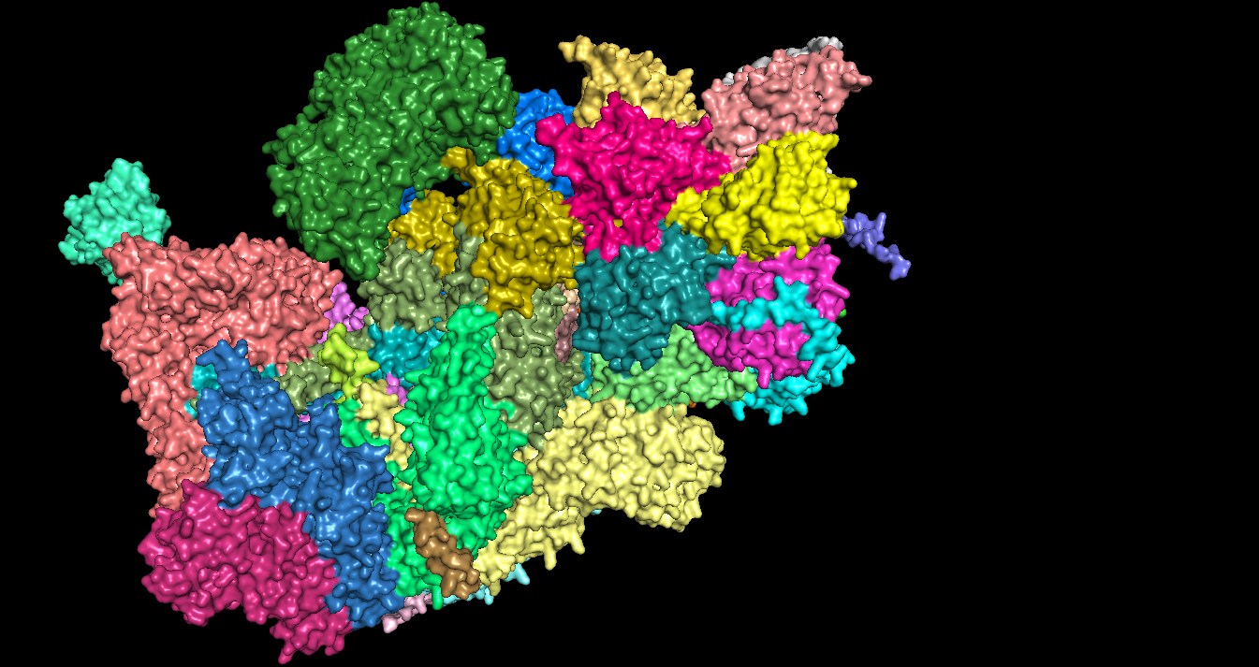
Proteasome Dynamics
CP: 20S core particle
RP: 19S regulatory particle
RP
CP
RP
Enenkel (2014) BBA-MCR
Enenkel (2014) Biomolecules

Slide 6
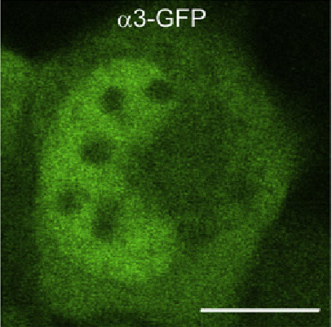



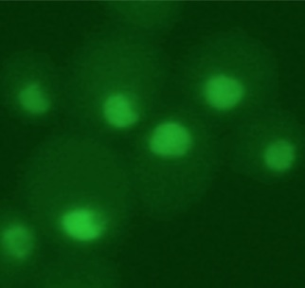
Proteasome localization
during cell division:
nucleus
Degradation of short-lived proteins
regulating
cell cycle progression
gene expression
…
human melanoma
GFP labeled
proteasome
yeast

Slide 7
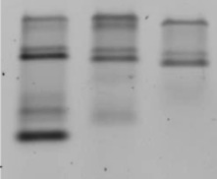
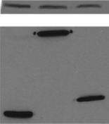
Proteasome assembly during cell division
CP
β5-GFP
RP
Rpn1-GFP
RP
Rpn11-GFP
RP-CP-RP
*
Blm10-CP-RP
RP-CP
Blm10-CP
CP
Kar2
70 kDa
Rpn1
136 kDa
Rpn11
61 kDa
β5 Pre2
50 kDa

Slide 8
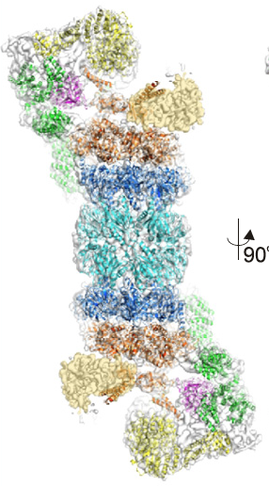
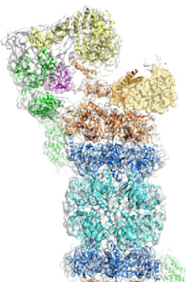
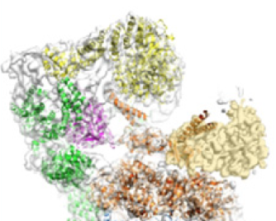
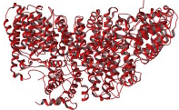
proteasome assembly
during cell proliferation
RP- CP-RP
CP α ring
CP β ring
RP base ATPase ring
RP base Rpn1, Rpn2, Rpn10
RP lid
Blm10-CP-RP
CP-RP
RP and CP precursor
Blm10
Degradation of poly-ubiquitylated proteins

Slide 9
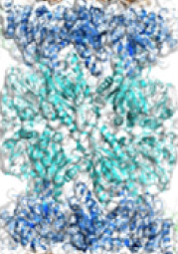
Nuclear import of immature CP precursor
C
half-CP precursor
pro-β
Ump1
α NLS
canonical NLS import by
importin / karyopherin αβ
CP maturation
Saeki-Tanaka-Toh-e, Madura, Enenkel laboratories
2002 - 2010

Slide 10
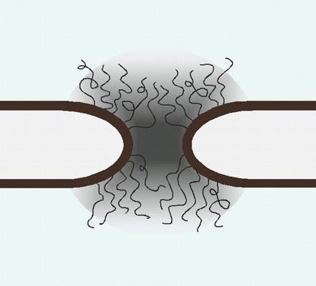
Nuclear import of CP precursor during cell division
CP maturation
cytoplasm
nuclear pore
nucleoplasm

Slide 11
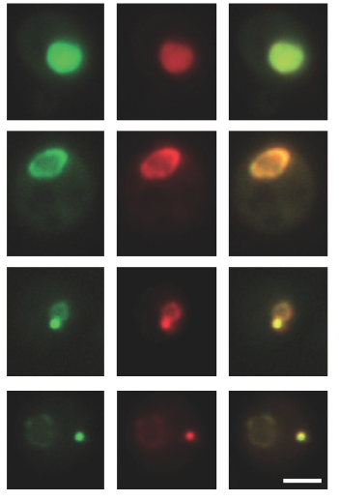
Quiescence: proteasome storage granules (PSG)
CP RP merge
proliferation
quiescence
PSG: Isabelle Sagot
Laporte et al. JCB 2010

Slide 12
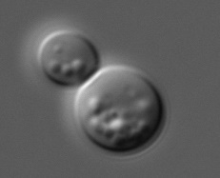
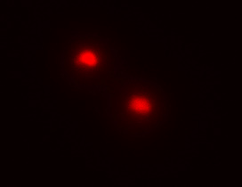
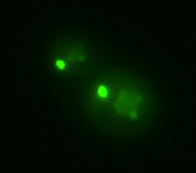
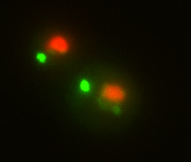
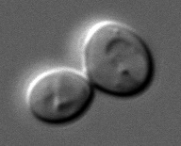
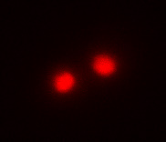
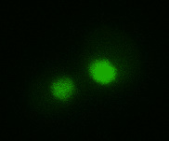
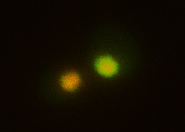
Motile and reversible
proteasome granules
DIC
H2A-RFP
CP -GFP
merge
quiescence
resumption
proliferation
upon exit from quiescence
within minutes

Slide 13
Rapid import of proteasomes into the nucleus
DIC
H2A-RFP
CP -GFP
merge
quiescence
proliferation

Slide 14
Blm10 mediates the interaction with
FG-rich nucleoporins
Ran-GTPase
cytoplasm
nuclear pore
nucleoplasm
Weberruss et al. EMBO J. 2013

Slide 15
Blm10
1st proteasome-intrinsic nuclear transporter
Nuclear Import by Blm10
Proteasome
Storage
Granulus
mature CP
Weberruss et al. EMBO J. 2013

Slide 16
Proteins orchestrating the sequestration of CP and RP into proteasome granules ?
High throughput imaging screens
Mass spectrometry
of X-linked proteasome granules

Slide 17
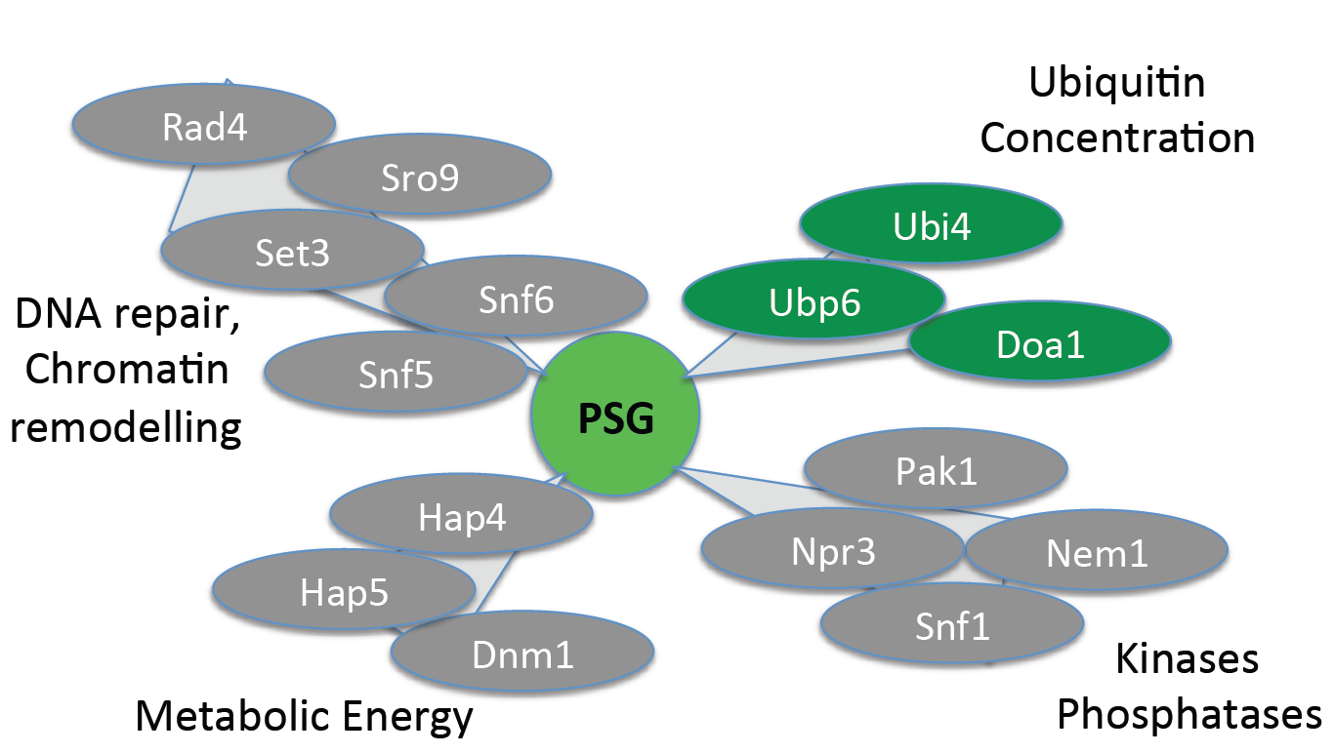
Imaging screen in the yeast null mutant collection

Slide 18
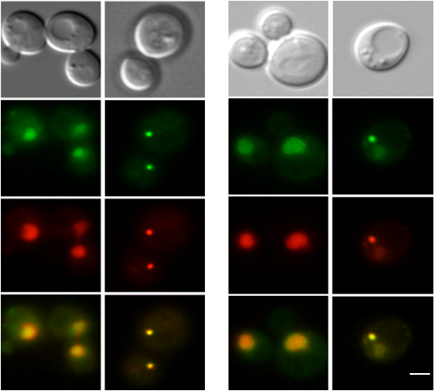
Imaging screen in the yeast GFP library
proliferation
quiescence
proliferation
quiescence
DIC
DIC
GFP-Blm10
Ubp6-GFP
CP-RFP
CP-RFP
merge
merge

Slide 19
Why Ubp6, Ubi4 and Doa1 ?
Ubp6 deubiquitinase is timing the coordination of substrate processing by the proteasome
Ubi4 is required in stationary phase and encodes ubiquitin
Doa1 regulates ubiquitin concentration
Availability of free ubiquitin

Slide 20
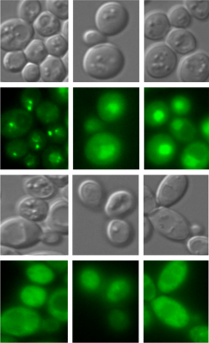
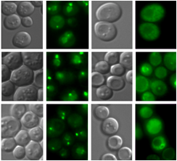

Ubiquitin is required for proteasome granule organization
ubp6Δ +
[Ubp6]
ubp6Δ +
[Ubp6-C118A]
0 min
15 min
45 min
Resumption of growth:
delayed
DIC
Pre2-CP
ubp6Δ + [Ubp6]
ubp6Δ +
[Ubp6]
wt
Pre2-CP
Rpn1-RP
ubp6Δ
ubp6Δ +
[Ubp6-C118A]
DIC
Rpn11-RP
ubp6Δ + [Ubp6-C118A]
Pre2-CP
Phleomycin resistance:
cell fitness
decreased
ubp6Δ + [Ubp6-C118A]
ubp6Δ + [Ubp6-C118A]
ubp6Δ + [Ubp6]
ubp6Δ + [Ubp6]
wt
ubp6Δ
wt
ubp6Δ
55 -
Pre2-GFP
10 -
mono-Ub
proliferation
quiescence

Slide 21
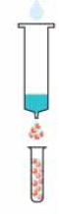
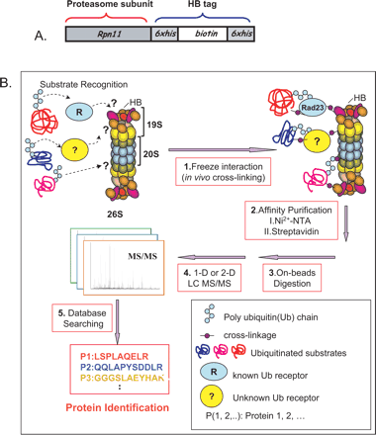
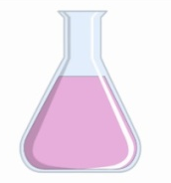

Proteomics of proteasome granules
proteasome granules
His-Biotin PURIFICATION
DATA BASE
SEARCH
QUIESCENCE
YEAST
MASS SPEC
X-LINKING
WT, blm10Δ and untagged strains:
His-biotin-His-tag with urea: proteasomes and ubiquitin
Notes:
My project aimed to reveal the compostion of the PSGs. Therefore I used a method which was used sucessfully to decipher the proteasome structure in dividing cells. I adapted this proteomic approach to decipher PSG interacting proteins approach to quiescent yeast.
The first step in this method is to crosslink cells with formealdehyde, a toxic reagent which forms methylenbonds between neraby nucleophilic atoms.
This way weak interactions between protein are stabilized which would be lost under normal purification conditions .
Without crosslinking it is impossible to purify the proteasome or the PSGs, the would fall apart.
The next steps are purifying the proteasome and analyzing the samples with mass spectrometry.
As is mentioned before this approach is already established for dividing cells and lead to the detection of the full proteasome as well as proteasome interacting proteins.
Now I will show you how I adapted this approach for quiescent yeast.

Slide 22

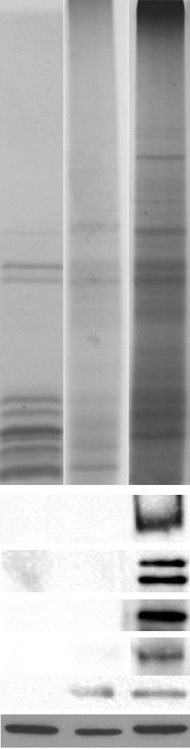
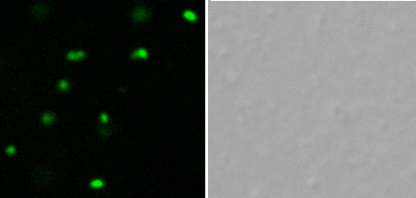

Proteomics of proteasome granules
PSG 3min 95°C
purified CP
PSG o.n. 65°C
soluble fraction
PSG on
sucrose cushion
250
130
pellet of cell debris
95
72
DIC
PSG / DAPI
55
Pre2-GFPS
36
28
CP
subunits
Blm10
2.3M cushion
Rpn1 / Rpn2
2M cushion
Rpn5
lysate
pellet
Rpt1
Pre2-GFP
Rpt6
histone H3
Pre2-GFPS

Slide 23
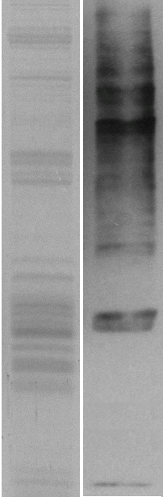
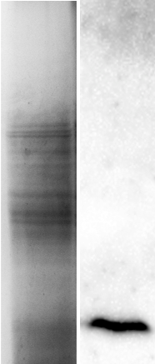
holo-proteasome
anti-ubiquitin
anti-ubiquitin
X-linked PSG
Proteasomes
in proliferation
Proteasomes
in quiescence
95
95
72
72
55
55
poly-ubiquitin chain
36
36
mono-ubiquitin
28
28
10
10

Slide 24
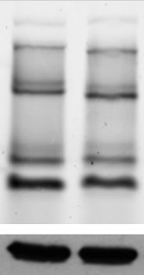
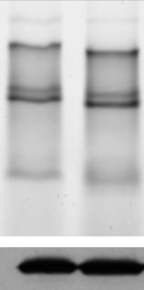
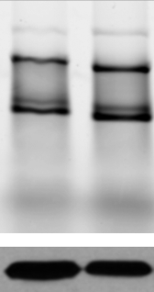
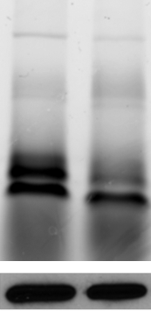
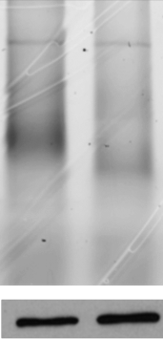
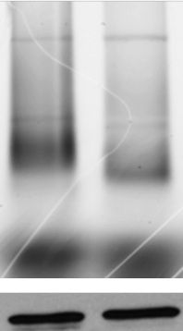
Proteasomes
in proliferation
ubp6Δ
ubp6Δ
wt
wt
wt
ubp6Δ
RP-CP-RP
Blm10-CP-RP
RP-CP
Blm10-CP
CP
anti-GFP
Proteasomes
in quiescence
RP + Ubp6
Blm10-CP
RP – Ubp6
CP
Pre2-GFP
(β5) CP
Rpn1-GFP
RP base
Rpn11-GFP
RP lid

Slide 25
Proteasomes
in proliferation
Proteasomes
in quiescence

Slide 26

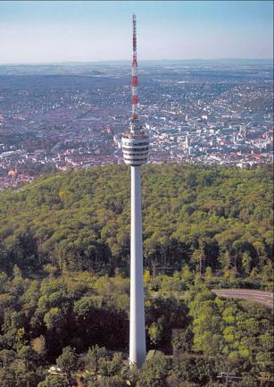
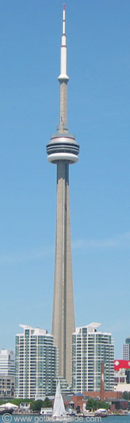




Brenda Andrews
Donnelly Center
University of Toronto
Oliver Ernst
University of Toronto
Exchange students
Marion Weberruss
Julia Jando
Thomas Bissinger
Katharina Bitschar
Johannes Hummel
Maike Kuschel
Leonie Schön
Alexandar Höfler
Carina Scheschka
Ann-Kathrin Pulli
Sarina Norell
Carolin Sailer
Ina Eisenkolb
Verena Burger
Lan Huang
University of California
Irvine
Dieter H. Wolf
Institute of Biochemistry
University of Stuttgart
Cordula Enenkel
Edwin Wu
Zhu Chao Gu
Julianne Burcoglu
Ravi Yedidi
Liang Zhao
Amatullah Fatehi

