Slide 1


Delivering Primary Healthcare in Community Justice Settings: Motivational Interviewing brief Interventions to Reduce Alcohol Consumption in Hazardous Drinkers
Clive Tobutt
University of Surrey, UK

Slide 2
Aim of Talk
To give a brief overview of current evidence for alcohol screening and brief interventions to reduce alcohol consumption for hazardous drinkers in Community Criminal Justice Settings (CJS) in the UK
How Screening and Motivational Interviewing Brief Interventions may be used for those charged with alcohol-related offences in opportunistic teaching moments in CJS practice

Slide 3
Scientific Background
25% prevalence rate of Alcohol Use Disorders (AUD) in the UK population (HSCIC, 2015)
British Crime Survey estimates that up to 50% of violent crime is related to AUD
(Flatley, Kershaw, Smith Chaplin, et al., 2010)
Higher prevalence rates of problem AUD in criminal justice settings (Parkes, MacAskill, Brookes, Jepson, et al., 2011)
Complex relationship between alcohol use and offending behaviours
(Boden, Fegusson & Horwood, 2012)

Slide 4
Alcohol Brief Intervention and the CJS: What is Known
A recent UK systematic review on the prevalence of AUD and the effectiveness of BI across CJS settings (Custody Suite, Prison and Probation) ranged from 51% to 95%
(Newbury-Birch, McGovern, Birch, O’Neill, et al., 2016)
Limited evidence of effectiveness of BI for reduced alcohol consumption
However, SIPS Trial found reduction in offending rates (Newbury-Birch, Coulton, Bland, Cassidy, et al., 2014)

Slide 5
Other Evidence
More focussed intensive interventions such as Motivational Interviewing (MI) are effective in reducing alcohol consumption and related harms in CJS settings (Tobutt & Milani, 2010; Andrews & Bonta, 2010)
There is alcohol SBI focusing on young people (18-30) in the CJS (Foxcroft, Smith, Thomas & Howcutt, 2015; Patton & Boniface, 2015)

Slide 6
Gaps in the Evidence of Alcohol SBI & the CJS
University of Surrey, University of Winchester & University of Southampton are proposing to undertake a mapping exercise of the offender (and victim) journey (from ‘crime’ to ‘time’) in UK CJS settings
To determine novel opportunities (locations, sub-populations – young people) to identify AUD and deliver MI SBI

Slide 7
Health & Justice Care Pathway
Care Not Custody
Care in Custody
Care After Custody
If primary issue is health need then divert to community-based care e.g. Liaison & Diversion Programme
NHS Commissioned Healthcare in Secure & Detained Settings
‘Through the gate’ work;
Ensure continuity of care- GP care summary record etc.
Role of Probation Service Providers
Public Health England, 2016

Slide 8


Slide 9


Slide 10


Slide 11
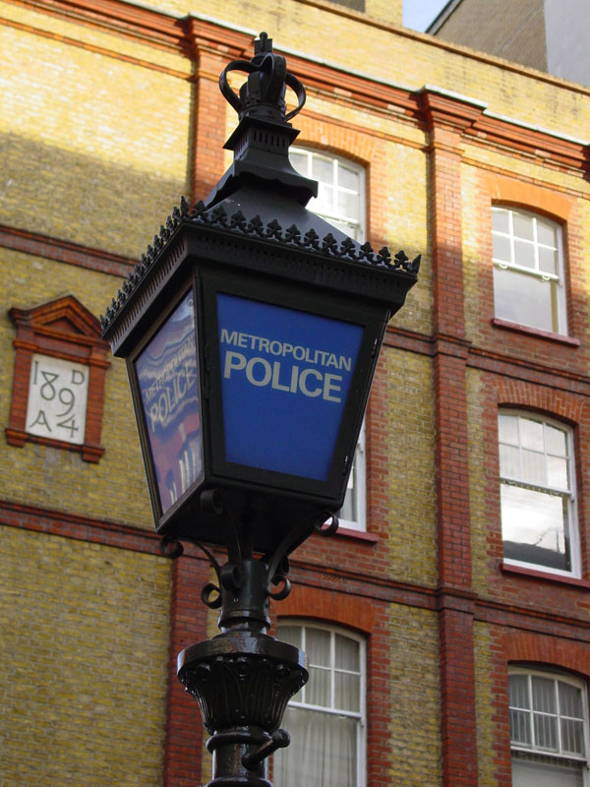
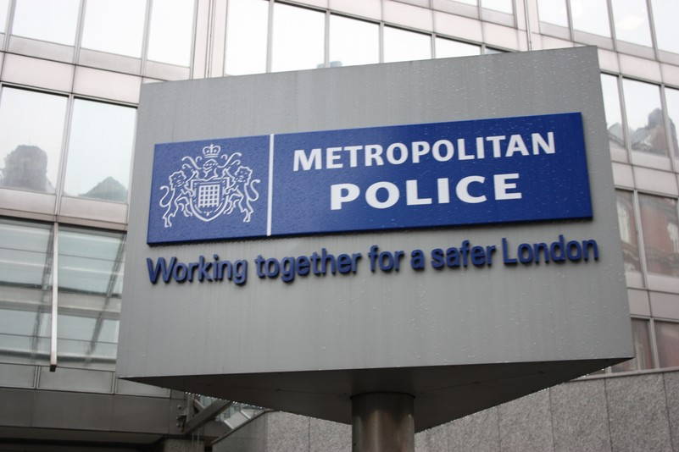

Slide 12


Slide 13
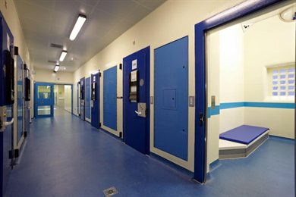

Slide 14
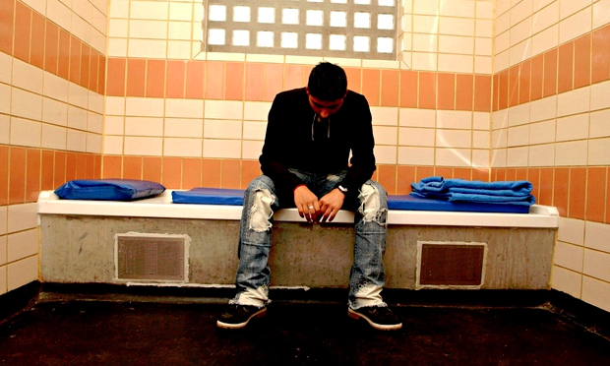

Slide 15


Slide 16
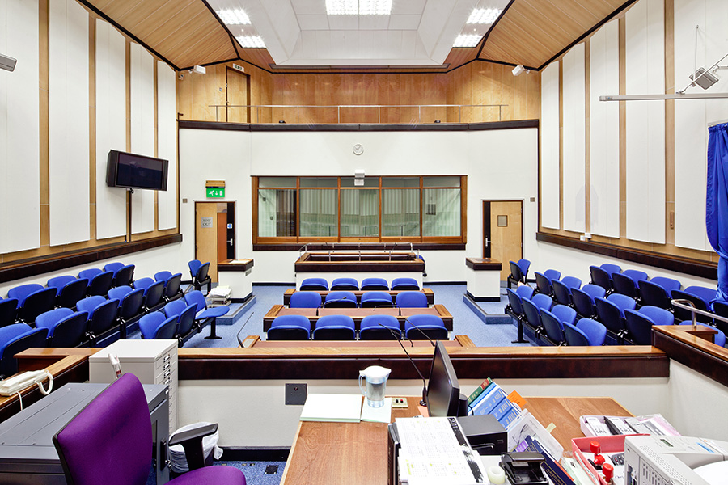

Slide 17
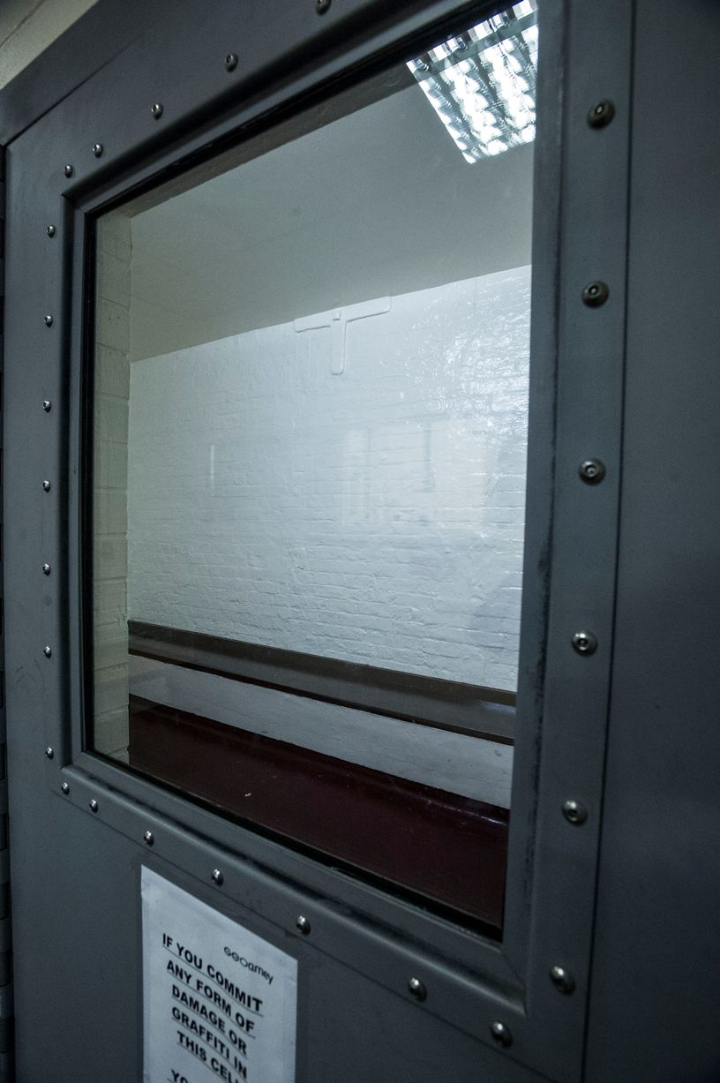

Slide 18
Summary
Limited evidence of SBI in CJS to reduce alcohol consumption and related harms in the UK
Opportunity to use MI SBI in CJS to reduce alcohol consumption and alcohol-related harm by mapping the UK offender’s journey to ascertain opportunities for novel intervention

Slide 19
References
Andrews, D., & Bonta, J. (2010) Rehabilitating criminal justice policy and practice. Psychology, Public Policy and Law, 16(1): 39-55.
Boden, J., Fergusson, D., & Horwood, A. (2012) Alcohol misuse and violent behaviour: findings from a 30-year longitudinal study. Drug & Alcohol Dependence, 122(1-2): 135-41.
Flatley, J., Kershaw, C, Smith, K., Chaplin, R., & Moon, D. (2010) Crime in England and Wales 2009/10. London: Home Office.

Slide 20
Foxcroft, D., Smith, L., Thomas, H., & Howcutt, S. (2015) Accuracy of Alcohol Use Disorders Identification Test for detecting problem drinking in 18-35 year-olds in England: method comparison study. Alcohol and Alcoholism 50(2): 244-250.
Health & Social Care Information Centre (2015) Statistics on Alcohol, England 2015. London: National Statistics Publication.
Parkes, T., MacAskill, S., Brooks, O., Jepson, R., Atherton,I., Doi, L., McGhee, S., & Edie, D. (2011) Prison Health Needs Assessment for Alcohol Problems. Stirling, NHS Health Scotland.
Newbury-Birch, D., McGovern, R., Birch, J., O'Neill, G., Kaner, H., Sondhi, A., & Lynch, K. (2016) A rapid systematic review of what we know about alcohol use disorders and brief interventions in the criminal justice system. International Journal of Prisoner Health, 12(1): 57-70.

Slide 21
Newbury-Birch, D., Coulton, S., Bland, M., Cassidy, P., Dale, V., Deluca, P., Gilvarry, E., Godfrey, C., Heather, N., Kaner, E., McGovern, R., Myles, J., Oyefeso, A., Parrot, S., Patton, R., Perryman, K., Phillips, T, Shepherd, J., & Drummond, C. (2015) Alcohol screening and brief interventions for offenders in the probation setting (SIPS Trial): a pragmatic multicentre cluster randomised controlled trial. Alcohol & Alcoholism, 49(5): 540-548.
Paton, R., & Boniface, S. (2015) Prevalence of hazardous drinking among UK 18-35 year olds; the impact of a revision to the AUDIT Cut Score. Alcohol and Alcoholism, 1-2. 10.1093/alcalc/agv115.
Patton, R. (2014) Alcohol-related presentations to the emergency department among young people: some concerns. Emergency Medicine Journal, 31(3) doi:10.1136/emermed-2013-203317.

Slide 22
Public Health England (2016) Public Health Outcomes Framework – February 2016. Available at: https://www.gov.uk/government/uploads/system/uploads/attachment_data/file/496588/Official_statistics_short_commentary_PHOF_February_2016.pdf
Tobutt, C., & Milani, M. (2010) Comparing two counselling styles for hazardous drinkers charged with alcohol-related offences in a police-custody suite: piloting motivational interviewing brief intervention or a standard intervention to reduce alcohol consumption. Advances in Dual Diagnosis Journal, 3(4): 20-32.

