Slide 1

Real and Perceived Risks in Communities Near Unconventional Shale Gas Activities
Clifford A. Lipscomb, Ph.D., MRICS
Director, Economic Research
Greenfield Advisors
Petrochemistry and Chemical Engineering Conference – Atlanta, GA
December 1, 2015
Notes:
Material is based on the book chapter: Lipscomb, Kilpatrick, Wang, and Hefley. 2015. “Achieving Balance Between Economic, Socio-Demographic, Environmental, and Regulatory Concerns: A Shale Gas Perspective” in Economics of Unconventional Shale Gas Development – Case Studies and Impacts. Springer. ISBN 978-3-319-11498-9.

Slide 2
Greenfield Advisors
  A 39 year-old real estate and financial firm located in Seattle and suburban Atlanta
  Known for forensic economic analysis and property valuation (RMBS and environmental)
  Recent work – using MLS data to determine a reasonable rent for land under a liquid asphalt terminal in Ohio

Slide 3
Continuum of Concern
One Extreme: Fracking ALWAYS causes property values to drop, damages water supplies, and leads to health problems for those in the immediate vicinity.
Other Extreme: Fracking NEVER causes property values to drop, never damages water supplies, and does not cause health problems.
Reality: Fracking MAY cause property value declines, especially if water supplies are contaminated and if residents’ health is adversely affected.

Slide 4
Understand Perception
Raise Awareness
Take Action

Slide 5
Understanding Public Perception
Read local news sites, blogs, and Twitter feeds
Talk to community officials
Read the latest on fracking on Google News
Are risks actual or perceived?
As a case study, let’s look at what’s happening in Scotland.
Notes:
Don’t be behind in the news
Know what is going on in the community regarding fracking.

Slide 6
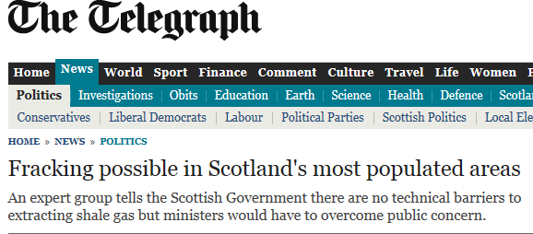


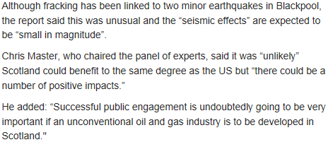

Slide 7
Scotland Socio-Demographic Changes
Housing shortages (permanent/temporary)
Education/job training
Rural to industrial adaptation
Possible increase in out-migration particularly within certain industries (e.g. agriculture)
Notes:
Housing shortages lead to loss of taxation (from income and ad valorem), and make it less likely that workers will migrate to the area. Due to this lack of migration in the US, studies show little impact on K-12 education enrollment (if housing in short supply). However, various states have developed new education programs including trades school and universities due to increase need for a skilled workforce. Influx of industrial activities can change the social fabric of rural (or even residential areas). In high producing areas of the US, monies from leasing and royalties allow for changes in the agricultural sector and those changes seem to vary in the studies to date.

Slide 8
Raising Awareness
Reach out to local news organizations
Post signs on site for plans
Be prepared to answer questions
Exxon agreeing to publicly disclose more details on risks of fracking oil and gas wells [WSJ (U.S. edition), 4/4/2014, p. B3]

Slide 9
Taking Action
Follow all safety guidelines
Use buffers (e.g. tree lines) to mitigate noise
Make sure any issues are dealt with immediately (e.g. contamination, truck traffic)
Remind employees how important community buy-in is for future ventures
Exhaust silencers and sound curtains

Slide 10
Despite best intentions, issues can arise
Environmental contamination
  Parr v. Aruba Petroleum (2014)
Noise (in relation to local noise ordinances)
“Noticeable” disamenities (e.g. visible emissions, well towers)
Truck traffic
Wastewater disposal
Notes:
Tree Lines – Valdosta biomass plant
Marcellusnoise.com/fracking for the silencers and sound curtains
Other view-related things influence value – e.g. cell phone towers, biomass plant stacks, and some kinds of manufacturing plants (Anstine 2003)

Slide 11
What happens when things go wrong
      Public outcry
      Documentaries
      Noise issues
      Possible health effects

Slide 12
The Fallout: Bans
States with some bans/moratoriums:
New York
California
Pennsylvania
Hawaii
Ohio
New Mexico
Others Battling Bans
Notes:
It’s interesting to note that North Carolina seems to be welcoming gas companies with open arms. Think about the example companies could set there. It could open up doors in other communities…or completely close those doors.

Slide 13
The Fallout: Lawsuits and Referenda
Parr v. Aruba Petroleum
Other new cases in Texas and Colorado
Municipalities’ referenda to prevent fracking activity
Related, lots of natural gas pipeline failures seem to be occurring…is this because of the increased supply of natural gas produced in U.S.?
Notes:
Nearly $3 million awarded to a Texas family in first courtroom battle over fracking.
Residents across the US have filed lawsuits to prevent fracking in their communities.
These lawsuits were filed before drilling has begun and are due to the stigma of fracking.

Slide 14
General Uncertainty
Relationship between fracking and earthquakes (e.g. Britain experience; Oklahoma experience)?
Environmental effects on proximal properties (e.g. Muehlenbachs et al. 2012)
Relationship between distance to fracking operations and real estate values
“Jobs and dollars” balanced against negative effects of fracking (e.g. groundwater contamination risk)
Notes:
July 28, 2014 Seattle Times
By MATTHEW KNIGHT
Associated Press
LONDON — Energy firms will be able to bid for licenses Monday to explore for shale gas in Britain, three years after the controversial fracking process caused seismic tremors which led the government to suspend operations.
Business and Energy Minister Matthew Hancock said shale gas has the potential to increase the country's energy supply but stressed national parks will be protected.
"Done right, speeding up shale will mean more jobs and opportunities for people and help ensure long-term economic and energy security for our country," he said.
The new licenses allow firms to start exploring for shale gas, with further permits required before drilling can begin. The government said national parks and other important sites will be protected unless there are "exceptional circumstances."
Drilling for shale gas, a process known as fracking, has proved highly controversial in Britain with large protests disrupting some operations. The fracking process, which involves injecting water, chemicals and sand into shale rock to extract the gas, is firmly opposed by much of the influential environmental lobby.
Louise Hutchins, Greenpeace U.K. energy campaigner, said the protections on drilling in national parks will not satisfy opponents.
"The government has fired the starting gun on a reckless race for shale that could see fracking rigs go up across the British countryside, including in sensitive areas such as those covering major aquifers," she said.
Fracking near Blackpool, a town in northern England, caused two earthquakes in 2011 with magnitudes 2.3 and 1.5 and led the government to stop further operations.
A government investigation into the risks of fracking causing more earthquakes concluded that future operations would have to be cautious and must monitor seismic activity.

Slide 15
An Interesting Solution?
EQT Corp. in Pennsylvania offered nearby residents $50,000 cash to free the company
of all liability
Only one other company has extended the same offer. Experts say the offer could have unintended consequences (i.e. erode confidence in gas companies and cause residents to actually push for more bans).
Notes:
Source: http://www.propublica.org/article/aggressive-tactic-on-the-fracking-front?utm_source=et&utm_medium=email&utm_campaign=dailynewsletter
Reprinted here: http://www.ohio.com/blogs/drilling/ohio-utica-shale-1.291290/eqt-offers-50-000-to-neighbors-to-release-firm-from-any-liability-1.501148

Slide 16
Conclusions
Be cognizant of the concerns of local residents, real or perceived (e.g. attitudes toward fracking likely differ by well/piped water)
Issues today could mean bans tomorrow
Fracking done well means a boon for communities
Fracking done poorly often means litigation

Slide 17
Clifford A. Lipscomb, Ph.D., MRICS
Director, Economic Research
Greenfield Advisors
106 N. Bartow Street | Cartersville, GA 30120 | USA
Office: +1.770.334.3952
Cell: +1.770.289.1923
E-mail: cliff@greenfieldadvisors.com
Web: www.greenfieldadvisors.com
www.BrownfieldBook.com

