Slide 1
FULLERENE BASED HARD DISKS AND PHOTOVOLTAIC CELLS
Claudio Nicolini
President Nanoworld Institute, Italy
JNMNT PAPER
NANOTEK 4
San Francisco, 1 December 2014

Slide 2
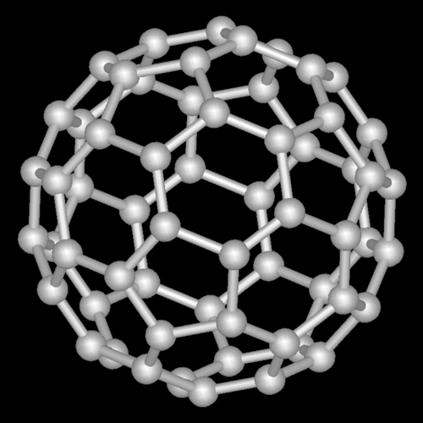
Fig. 1. Chemical structure of the Fullerene-C60 molecule.
.

Slide 3
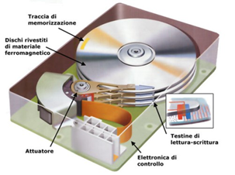
Fig. 2. schematic of a hard disk.

Slide 4

Fig. 3. Illustration of the set up device obtained from a substrate of glass with gold contacts on both sides. The gold contacts were directly connected to the electrometer to collect V/I characteristics of Fullerenes C₆₀ nanoassembled.

Slide 5
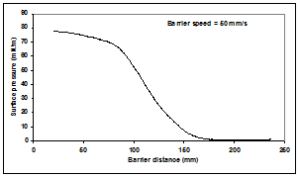
Fig. 4. The π-A isotherm obtained by spreading a solution of fullerenes C₆₀ in toluene having a concentration of 1000 ppm at the air/water interface, barrier speed 0.50 mm/s.

Slide 6
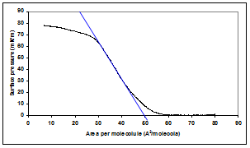
Fig. 5. Calculation of the area per molecule for a solution of fullerenes C₆₀ in toluene having a concentration of 1000 ppm, obtained by considering the intercept on the abscissa of the best fitting of the compression curve.

Slide 7
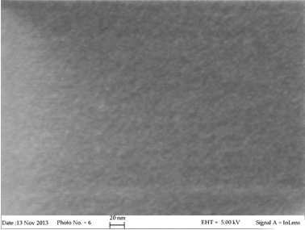
Fig. 6. Study of the morphology from electron microscope FESEM scanning at 5.00 KV. The picture shows the formation of fullerenes C60 molecules clusters having a size varying 5 to 8 nm.

Slide 8
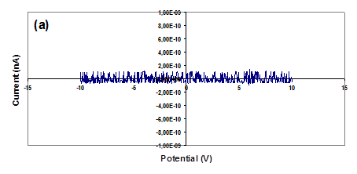
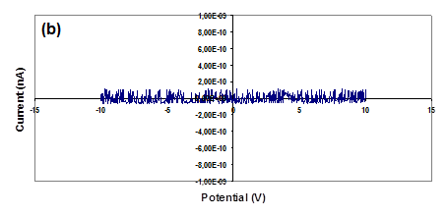
Fig. 7. Fullerenes C₆₀ thin films voltage/current (V/I) characteristics obtained for 1 monolayer (a) and 5 monolayers (b).

Slide 9
The study of V/I characteristics illustrated , obtained from 1 and 5 monolayers, highlighted the non-conducting properties of Fullerenes C₆₀ molecules when assembled in thin films.
Taking into account the thickness of films and its geometry, we calculated the specific conductivity (calculation not shown) by using the following equations:
V = R I Equation 1
R =  l s-1 Equation 2
where the potential V, the current I, and the resistance R are determined experimentally, l is the length of the deposited film and s is the related section. We determined a specific conductivity of 2.0 x 10⁻³ s/cm for 1 monolayer and 1.8 x 10⁻³ s/cm for 5 monolayers, respectively.

Slide 10
Goals
On considering these fullerenes C₆₀ molecules for the fabrication of solid-state disks (SSD) memories as the final goal, the preliminary experimental data obtained from the characterization of these molecules sound very promising. It will be our future goal the "treatment" of fullerenes C₆₀ molecules in order to make them "more tunable" during the deposition/compression process in order to avoid phenomena of clusters formation and reach the required smoothness for the fabrication of prototype SSD memories.

