Slide 1
About OMICS Group
OMICS Group International is an amalgamation of Open Access publications and worldwide international science conferences and events. Established in the year 2007 with the sole aim of making the information on Sciences and technology ‘Open Access’, OMICS Group publishes 400 online open access scholarly journals in all aspects of Science, Engineering, Management and Technology journals. OMICS Group has been instrumental in taking the knowledge on Science & technology to the doorsteps of ordinary men and women. Research Scholars, Students, Libraries, Educational Institutions, Research centers and the industry are main stakeholders that benefitted greatly from this knowledge dissemination. OMICS Group also organizes 300 International conferences annually across the globe, where knowledge transfer takes place through debates, round table discussions, poster presentations, workshops, symposia and exhibitions.

Slide 2
About OMICS Group Conferences
OMICS Group International is a pioneer and leading science event organizer, which publishes around 400 open access journals and conducts over 300 Medical, Clinical, Engineering, Life Sciences, Phrama scientific conferences all over the globe annually with the support of more than 1000 scientific associations and 30,000 editorial board members and 3.5 million followers to its credit.
OMICS Group has organized 500 conferences, workshops and national symposiums across the major cities including San Francisco, Las Vegas, San Antonio, Omaha, Orlando, Raleigh, Santa Clara, Chicago, Philadelphia, Baltimore, United Kingdom, Valencia, Dubai, Beijing, Hyderabad, Bengaluru and Mumbai.

Slide 3
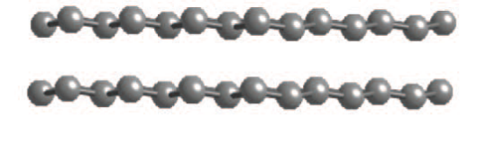
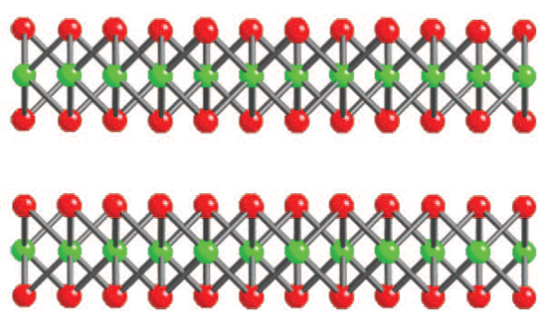
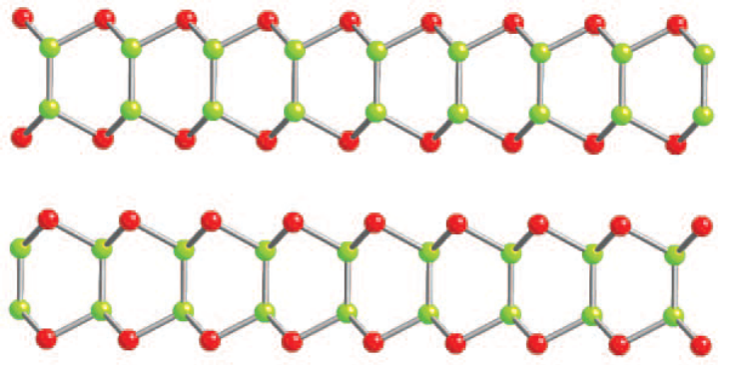
Spectroscopic metrics to detemine size and thickness of
liquid-exfoliated nanosheets in dispersion
Claudia Backes, J. N. Coleman
Trinity College Dublin, Ireland
07/10/2014

Slide 4
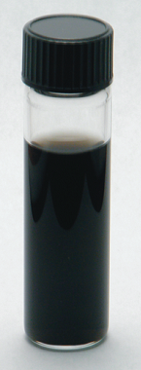
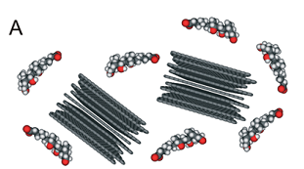
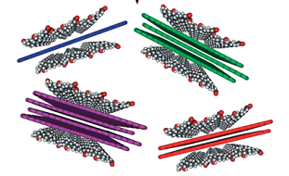

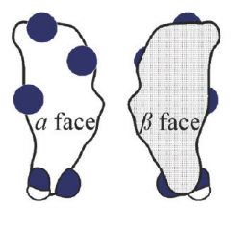
Liquid-phase exfoliation
Dispersion of graphite/graphene in surfactants
Reaggregation can be prevented by the use of surfactants
SDS
SC
R. J. Smith, M. Lotya, J. N. Coleman, New Journal of Physics 2010, 12, 125008.
M. Lotya, P. J. King, U. Khan, S. De, J. N. Coleman, ACS Nano 2010, 4, 3155-3162.

Slide 5
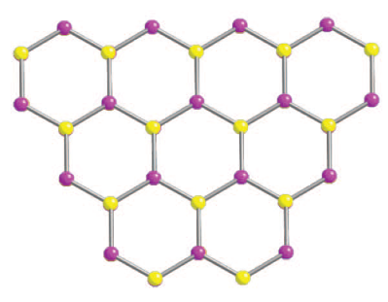
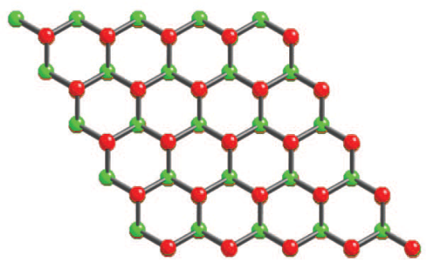
Layered inorganic materials
Boron Nitride
III-VI semiconductors
(e.g. GaS)
= Ga, In
= S, Se, Te
Transition metal dichalcogenides
= S, Se, Te
= Ti, Zr, Hf, V, Nb, Ta, Cr,
Mo, W, Tc, Re, Ni, Pd, Pt
Blue = semiconducting
Red = Metallic
Green = Both depending on S, Se, Te
Also TMOs (MoO₃, MnO₂, TiNbO₅ etc), halides (e.g. MoCl₂)…

Slide 6
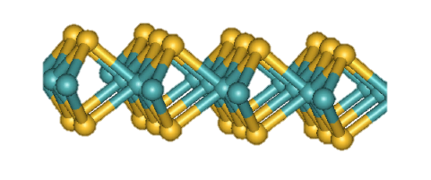
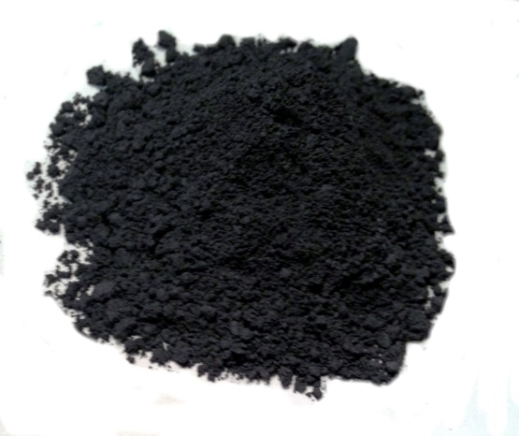
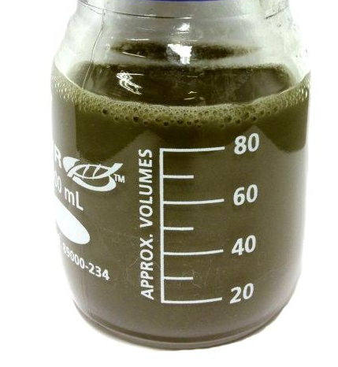
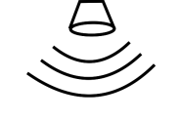
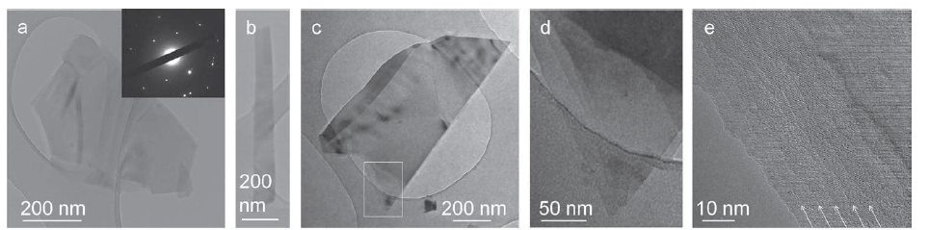
Liquid-phase exfoliation
Surfactant-exfoliated MoS₂
Layered materials can be exfoliated in aqueous surfactant solution
Ultrasound +
Additive
R. J. Smith, …. J. N. Coleman, Adv. Mater 2011, 23, 3944-3948.

Slide 7
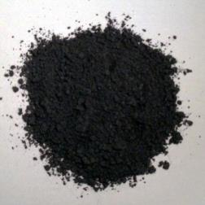
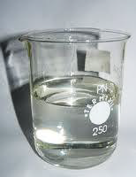
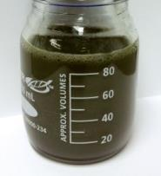
Targets and challenges in liquid exfoliation
Powder + liquid
Control over exfoliation process
Develop novel size selection
Understand physical properties
Size and thickness metrics
Time consuming microscopy
Scale-up
+
Size
Pre-defined size
and properties
Large quantities
MoS₂

Slide 8


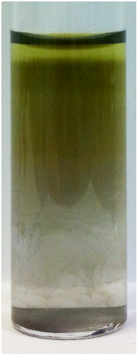
MoS₂ metric
Band sedimentation (rate zonal centrifugation)
Access to different size and thickness distribution within minutes
Extinction spectra change as a function of size
→ can we use this as a metric??
B int.
F1
F1
F2
F2
H₂O-D₂O
F3
F3
F4
F4
Sedimentation velocity
Size
F5
F5
D₂O
F6
F6
F7
F7
C. Backes... J.N. Coleman, Nat. Comm. 2014, 5, 4576.

Slide 9
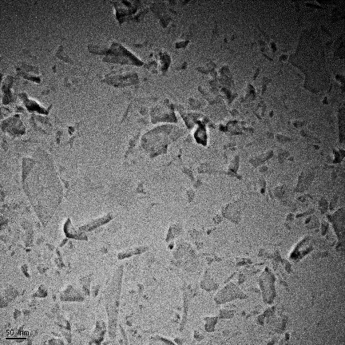
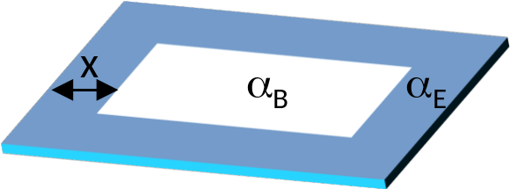
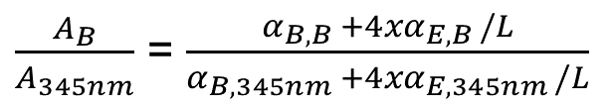
MoS₂ metric
Peak intensity metric
Intensity ratio of B-exciton / 345 nm as a function of length → fits model very well
F1
F6
100 nm
1 µm
$\frac{A_{B}}{A_{345nm}}$ = $\frac{α_{B,B} +4xα_{E,B }/L}{α_{B,345nm} +4xα_{E,345nm }/L}$
C. Backes... J.N. Coleman, Nat. Comm. 2014, 5, 4576.

Slide 10
MoS₂ metric
Peak position metric
Zoom in in region of A-exciton position
Experimentally observed in Lit.: A-exciton position depends on thickness
G. Eda, H. Yamaguchi, D. Voiry, T. Fujita, M. Chen, M. Chhowalla, Nano Letters 2011, 11, 5111-5116.
K. F. Mak, C. Lee, J. Hone, J. Shan, T. F. Heinz, Physical Review Letters 2010, 105, 136805.

Slide 11
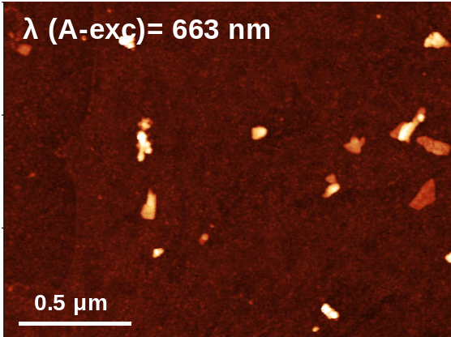
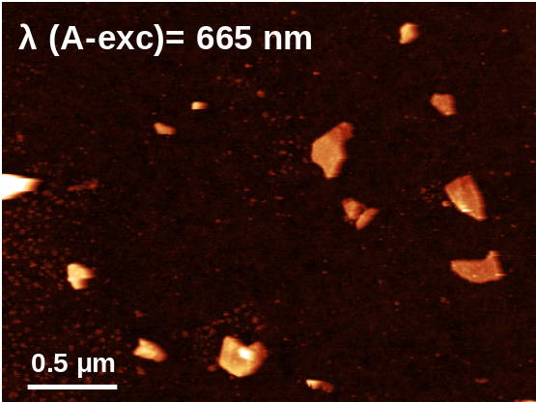
MoS₂ metric
Peak position metric – correlation to thickness?
AFM height statistics → correlation of A-exciton position to thickness/ number of layers
Nat. Comm. 2014, 5, 4576.

Slide 12
MoS₂ metric
The final metric plot
With calibration curves, size and thickness can be quickly determined
Length
Thickness
Nat. Comm. 2014, 5, 4576.

Slide 13
What for?
Luminescence in dispersion
New size selection techniques
Understand exfoliation
Defined sizes → Applications (HER)

Slide 14
Other TMDs
Band sedimentation and extinction with other materials
MoS₂
MoSe₂
What about other materials?
WS₂
WSe₂

Slide 15
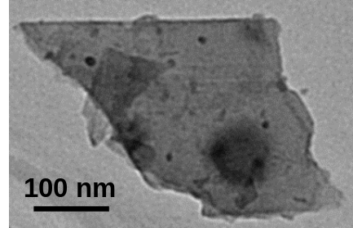
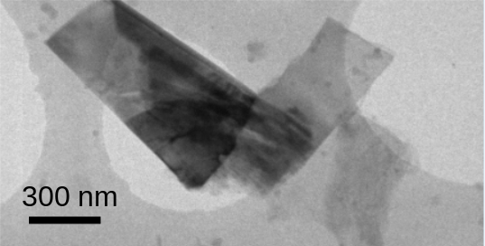
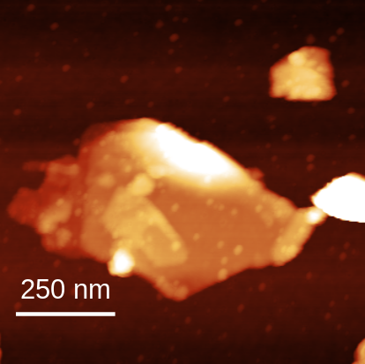
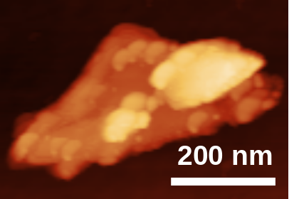
GaS
Liquid-exfoliation of GaS

Slide 16
GaS
Absorbance/extinction/scattering L metric for GaS
Size selection → extinction spectra change as a function of size
Also very clear: scattering and absorbance spectra change with size
Extinction
Absorbance
A int.
Size
Slope
Scattering

Slide 17
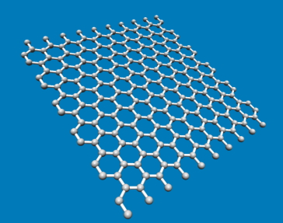

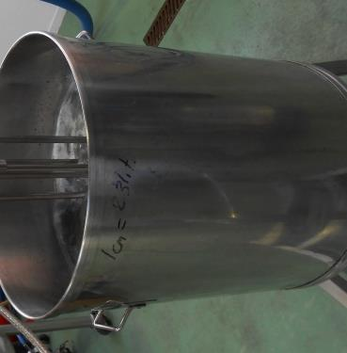
Graphene
Scalable production
Graphite exfoliated to few-layer graphene by shear mixing → scalable!
300 L
K. Paton, E. Varrla, C. Backes... J.N. Coleman, Nat. Mater 2014, 13, 624-630.

Slide 18
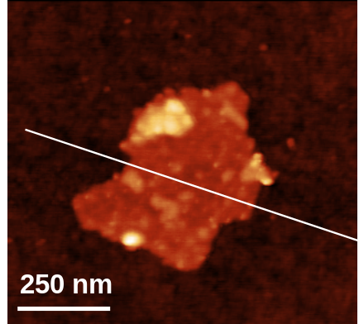
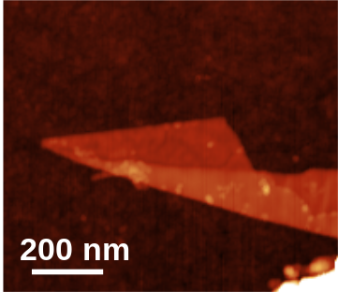
Liquid-phase exfoliation
Scalable production: shear exfoliation
What is dispersed? Few layer graphene (7-8 layers, 300-500 nm)
200 nm
250 nm
K. Paton, E. Varrla, C. Backes... J.N. Coleman,
Nat. Mater 2014, 13, 624-630.

Slide 19
Graphene
Size selection by controlled centrifugation
Raman D/G: changes in L
Raman 2D: changes in N

Slide 20
Graphene
Extinction/absorbance metric FLG
Scattering
Absorbance
Int. 550nm
Slope

Slide 21
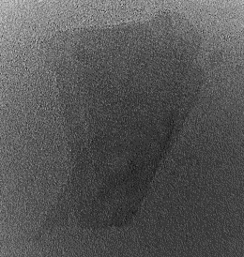
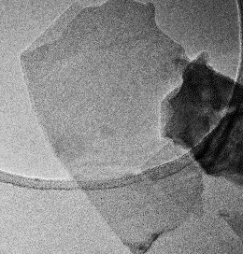
Metrics help!
Summary
Liquid exfoliation: it works for sooo many materials!
Size selection allows production of samples
with varying mean size and thickness
Metrics are everywhere to determine size
and/or thickness in situ
10 nm
100 nm
Huge step forward in understanding dispersion
conditions, improving sample preparation etc
e.g. Observation of PL of TMDs in liquid
Varying N and L independently
Samples with predefined properties
Similar metric for other materials!!!!!

Slide 22




Acknowledgements
Funding (postdoc fellowship)
Jonathan Coleman + group
esp. Ronan, Damien, Keith, Andrew, Eswar, Valerie, Tom, Zahra....
Georg Duesberg + group,
esp. Nina Berner, Niall McEvoy
Thank you for your attention!
John Donegan + group,
esp. David McCloskey
Valeria Nicolosi + group,
esp. Hannah Nerl, Evie Doherty
Werner Blau + group,
esp. Beata Szydłowska
Nils Scheuschner and Janina Maultzsch

Slide 25
MoS₂ metric
Overcoming limitations to length metric: large flakes
Large flakes: only minor changes in extinction spectra → metric limited
Measurement of absorbance in integrating sphere helps!
Absorbance
Scattering
David McCloskey, John Donegan

Slide 26
MoS₂ metric
Overcoming limitations to length metric: large flakes
Scattering exponent is an excellent alternative metric for L!
David McCloskey, John Donegan

Slide 27
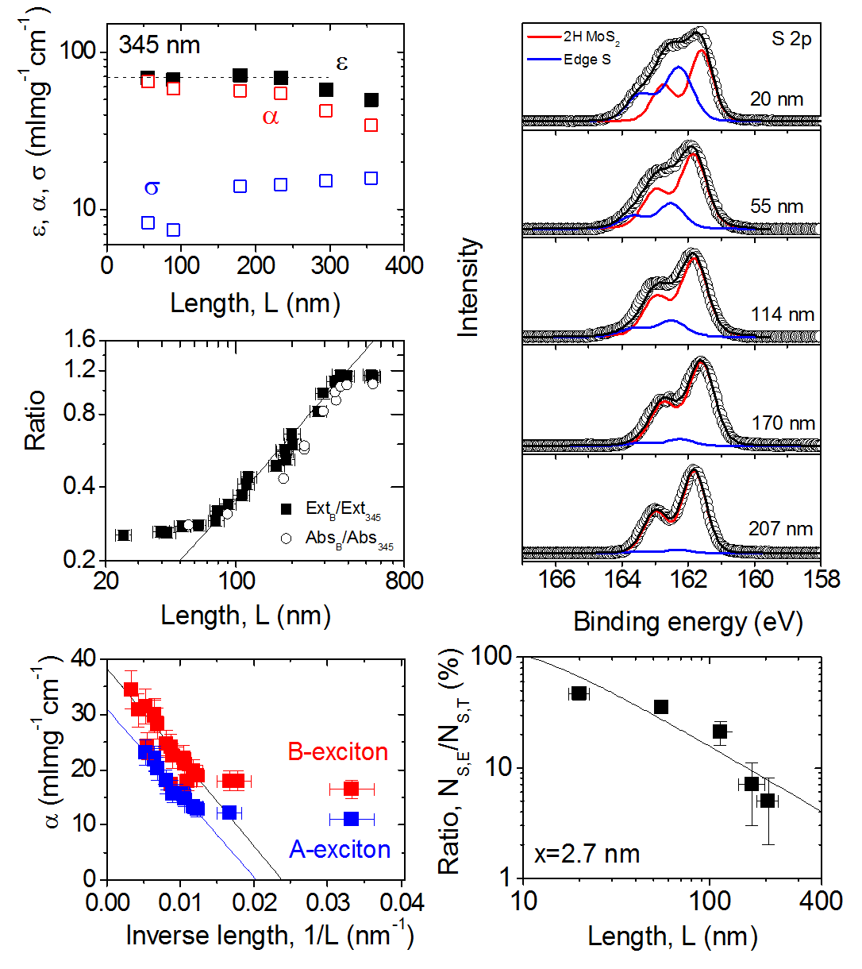
MoS₂ metric
Further evidence for edge effects: XPS
XPS says 3 nm
Final xps
Nina Berner, Georg Duesberg

Slide 28

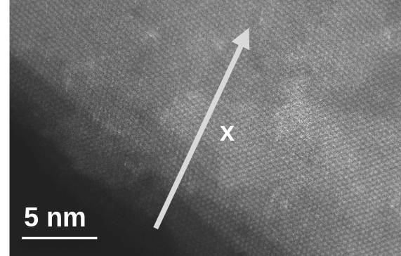
MoS₂ metric
Further evidence for edge effects: EELS
Hannah Nerl, Valeria Nicolosi

Slide 29
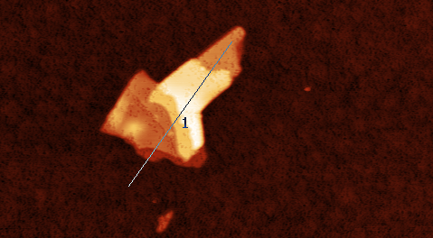
MoS₂ metric
AFM height: correlation to layer number
Analysis of step heights: step height is a function of ~2 nm
0.5 μm

Slide 30
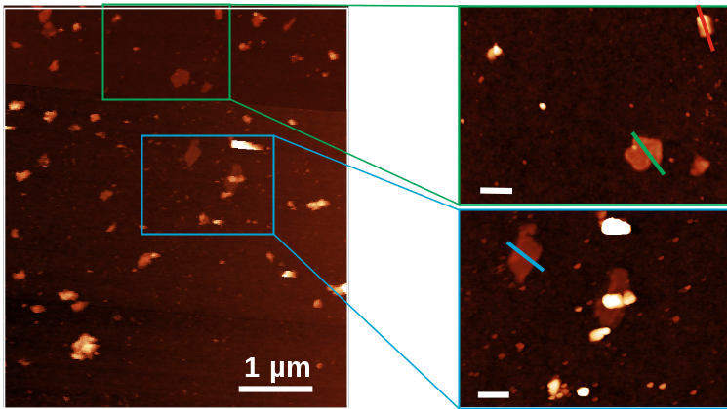
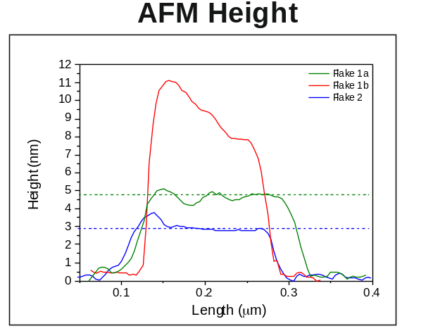
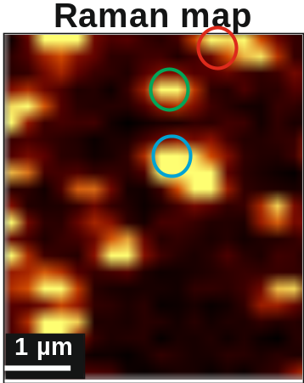
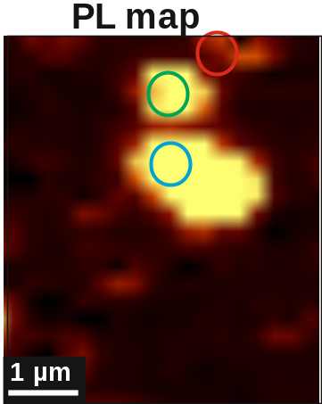
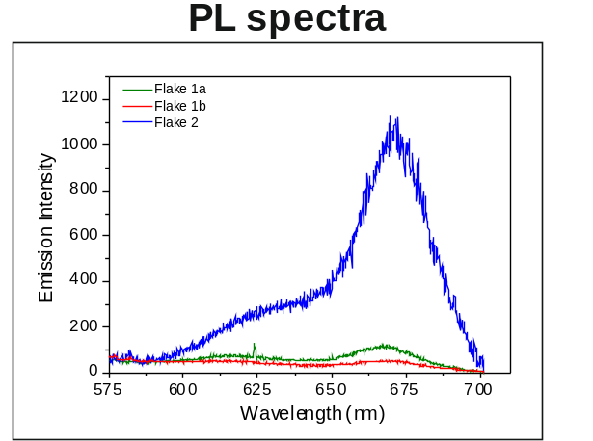
MoS₂ metric
AFM height: correlation to layer number
Height of thinnest flakes 3-4 nm → monolayer?!
Monolayer
Niall McEvoy, Georg Duesberg

Slide 31
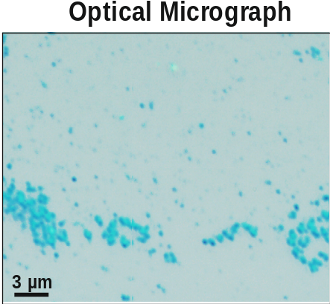
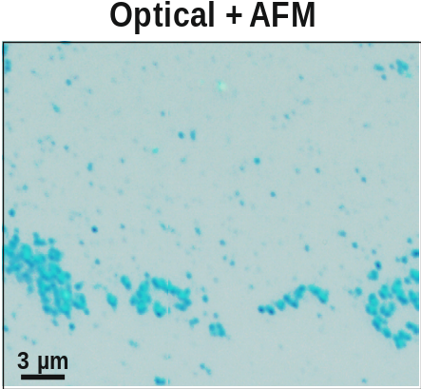
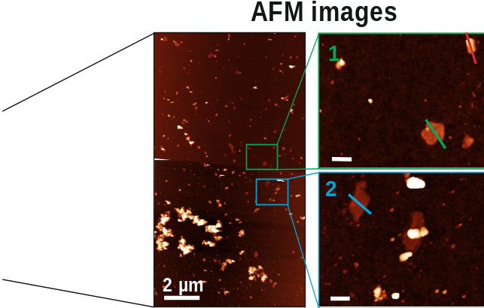
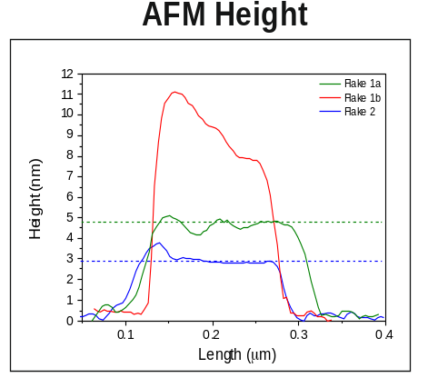
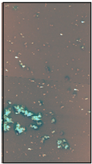

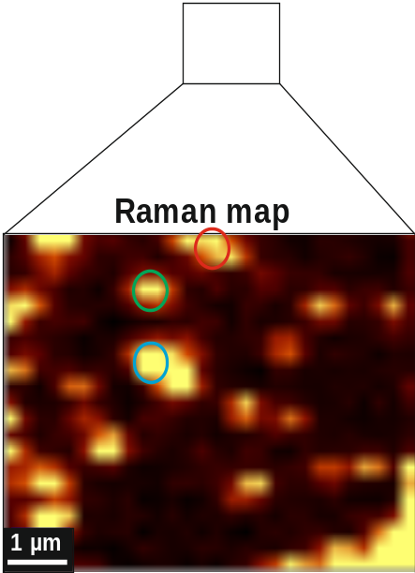
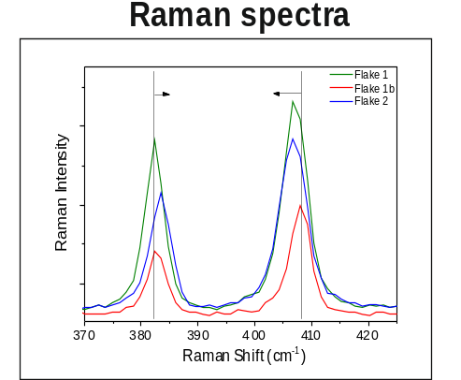
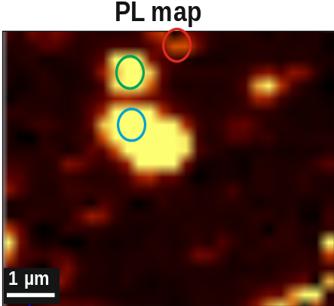
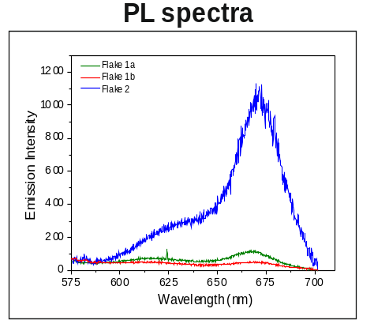
Absorbance Metric
AFM height: correlation to layer number
Height of thinnest flakes 3-4 nm → monolayer?!

Slide 32
MoS₂ metric
Peak position metric – Correlation to thickness!
Apparent height can be converted to number of layers

Slide 33
MoS₂ metric
Fluorescence in dispersion
PL intensity as a function layer number → reduced for very small flakes
→ PL quenching at edges

Slide 34
Absorbance Metric
Determination of peak position A-exciton
Contribution from scattering background (then, peak position not independent from lateral sizes) → peak position of second derivative

Slide 35
Scattering contribution
Absorbance and scattering spectra
Similar to extinction spectra, absorption and scattering spectra also change as a function of size in a similar way

Slide 36
Scattering contribution
Metric plots from absorbance and scattering
For L metric, absorbance, scattering and extinction spectra follow same curve shape
For N metric, for N>8, shift is caused by scattering

Slide 37






PL maps
UC P, 0.008 mg/ml
15kP, 0.009 mg/ml
12.5kP, 0.009 mg/ml
9.5kP, 0.008 mg/ml
5kP, 0.009 mg/ml
3kP, 0.009 mg/ml

Slide 38
Graphene
Extinction/absorbance metric FLG
Descrimination between scattering and absorbance to
extinction spectra by measurement in integrating sphere
Increasing size/thickness

Slide 39

Graphite N metric
Comparison to simulation
Simulation qualitatively confirms trend of abs spectra changing as
function of N

Slide 40
Let Us Meet Again
We welcome you all to our future conferences of OMICS Group International
Please Visit:
http://materialsscience.conferenceseries.com/
Contact us at
materialsscience.conference@omicsgroup.us
materialsscience@omicsgroup.com

