Slide 1

Analysis of sheep SERPINA1 gene expression in milk during lactation
Cinzia Marchitelli
Consiglio per la Ricerca in Agricoltura e l’Analisi dell’Economia Agraria
Animal Production Research Centre
cinzia.marchitelli@entecra.it

Slide 2
Talk outline
Our research
Characterization ovine SERPINA1 cDNA and gene
Overview and related work
Differential expression of sheep SERPINA1 gene during lactation
Conclusion
Future work

Slide 3
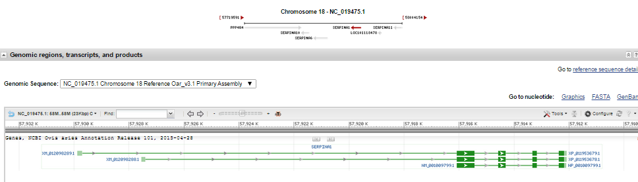
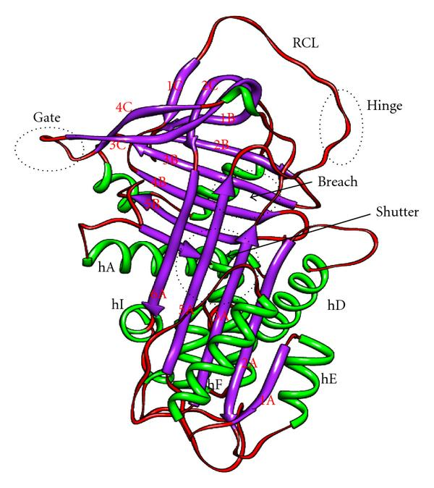
SERPINA1
Expression: liver, muscle, mammary gland, macrophages and neutrophil
Biological processes: blood coaugulation, apoptosis, reproduction, fibrinolysis and inflamamtory responses
Primary fucntion: inactivation of neutrophil elastase
REACTIVE CENTER LOOP
GATE REGION
Fig. 1 3D-structure of SerpinA
HINGE REGION
BREACH REGION
SHUTTER DOMAIN
AAT

Slide 4
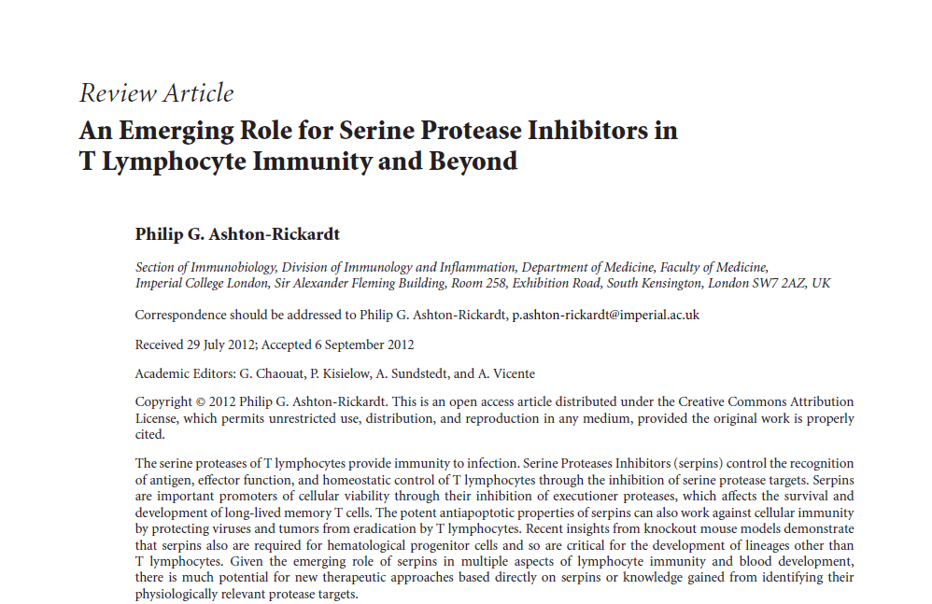
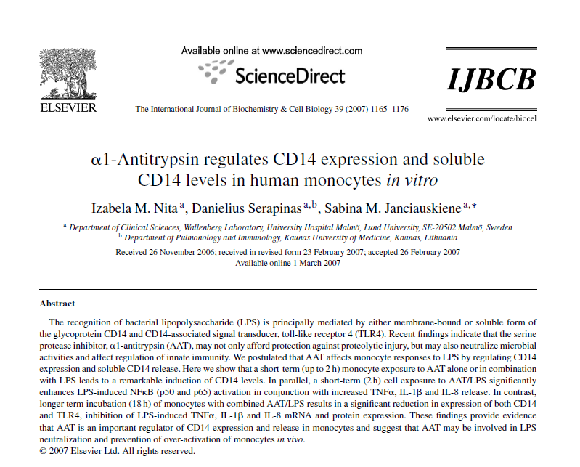
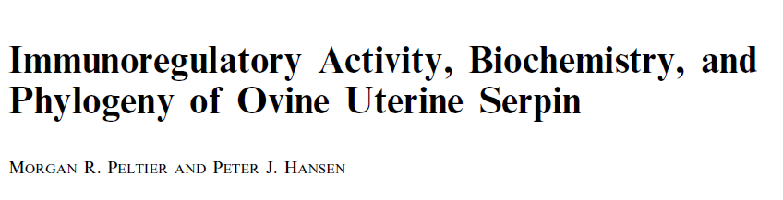
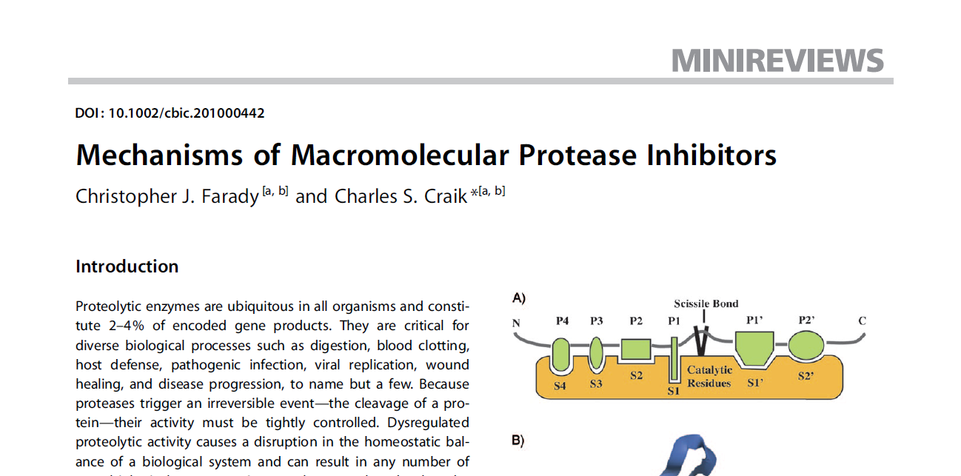
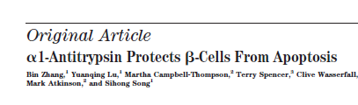
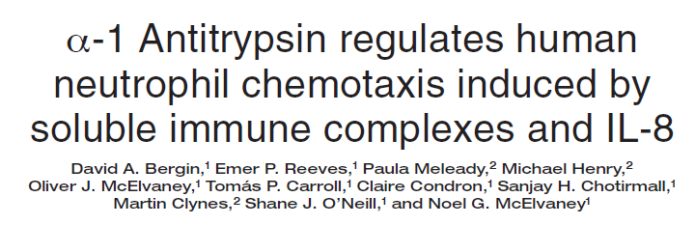
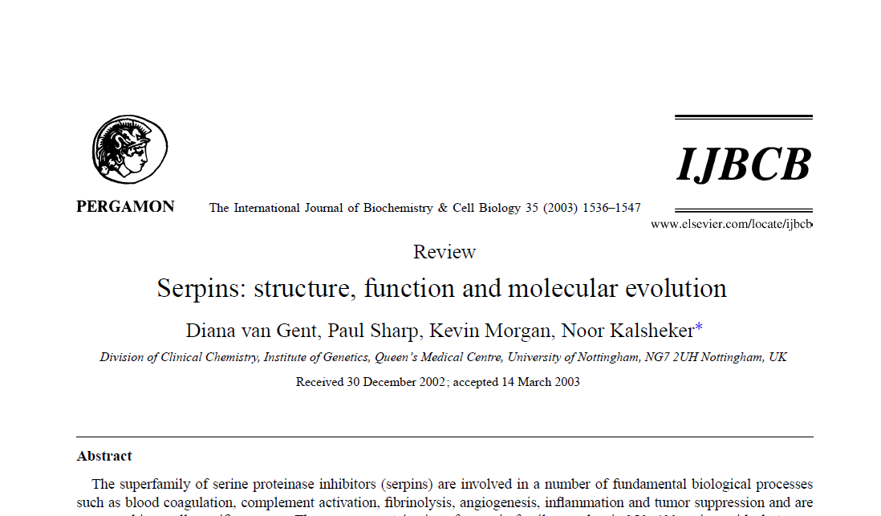
References
ISRN Immunology 2012, Article ID 354365
AJRI 2001, 45: 266-272
DIABETES, VOL. 56, MAY 2007

Slide 5
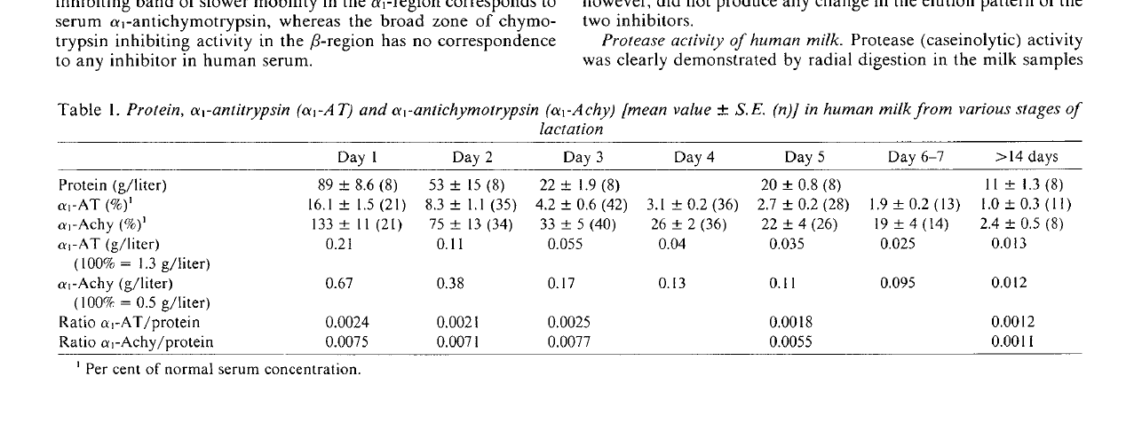
Role of AAT in human milk
By Lindberg et al 1982
Protection of infant liver by inactivation of endogenous proteases
Regulaiton of proteolitic activity in mammary gland
Inactivation of macrophages proteases
Increase of survival of other milk proteins via partial inhibition of proteolisys

Slide 6
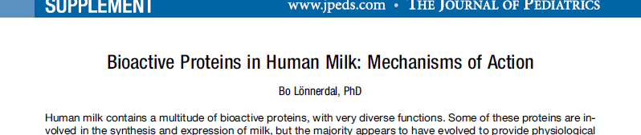
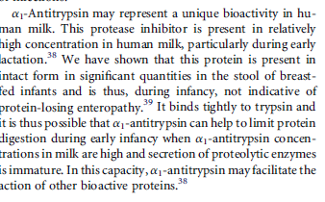
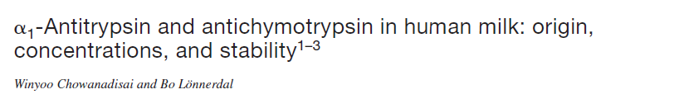
AAT: bioactivity in human milk
AAT: protect other milk protein
from proteolysis

Slide 7
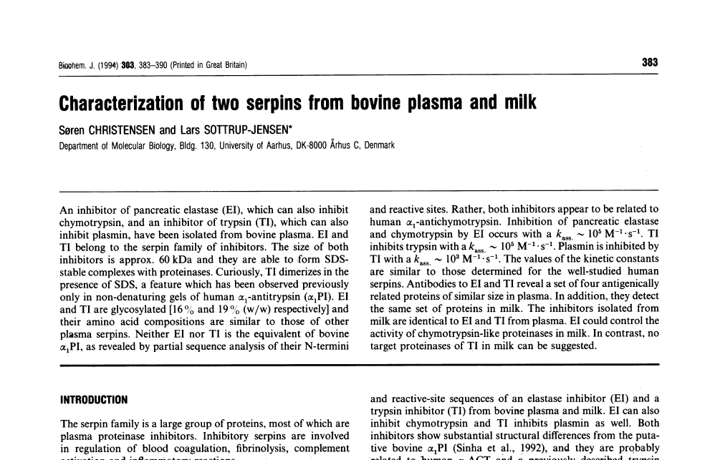
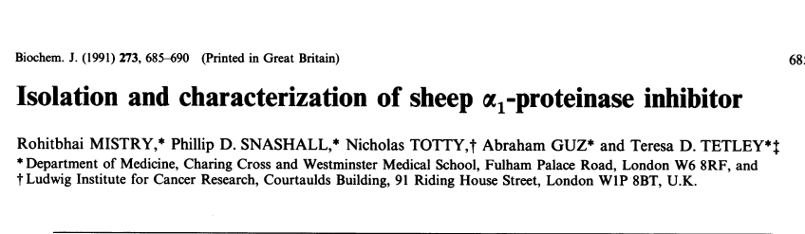
SERPINA1 and AAT in farm animal

Slide 8
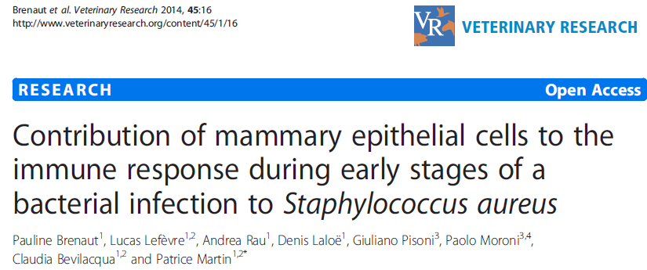
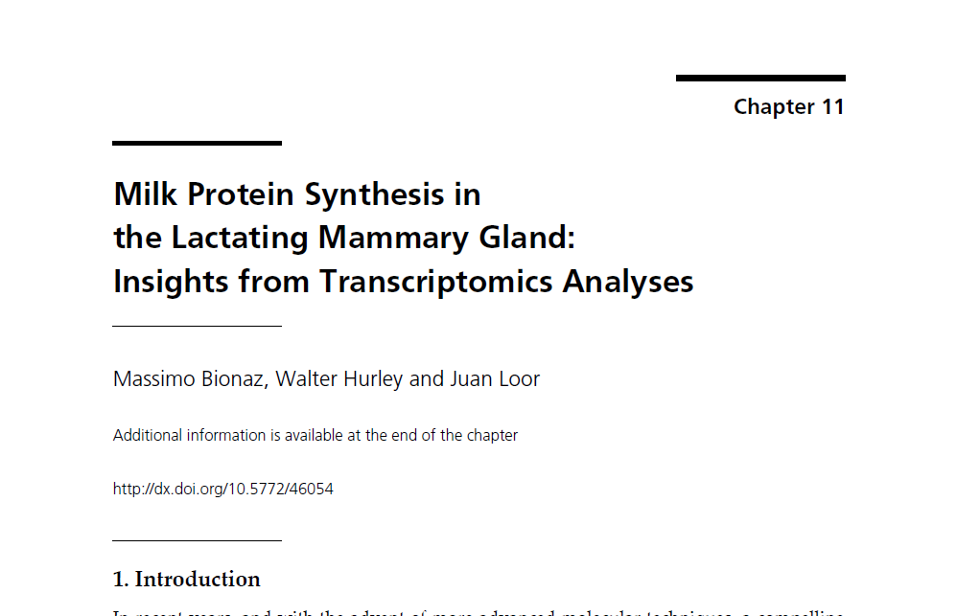
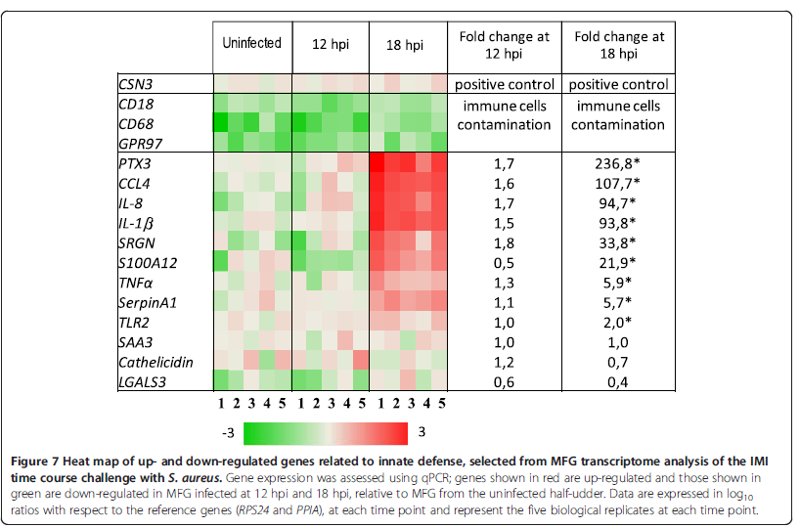
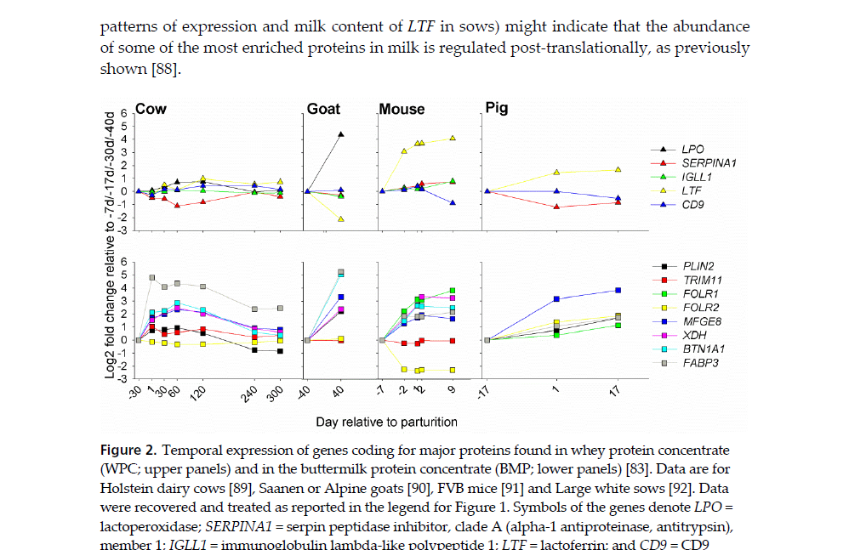

Slide 9
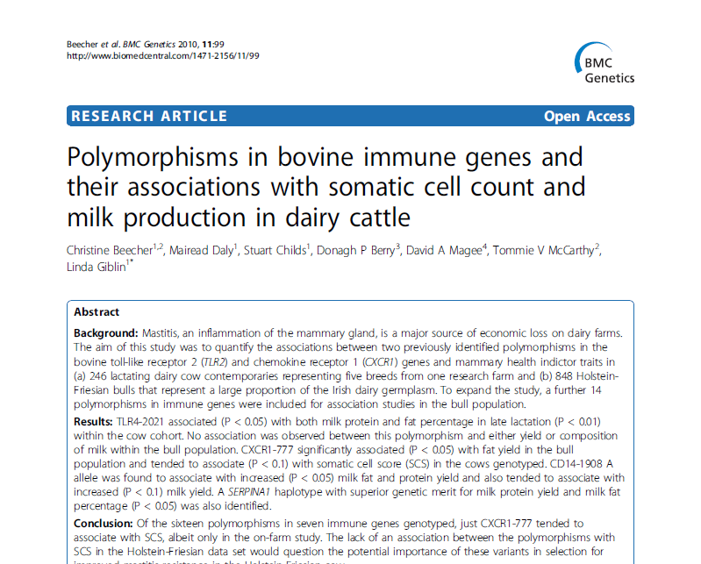
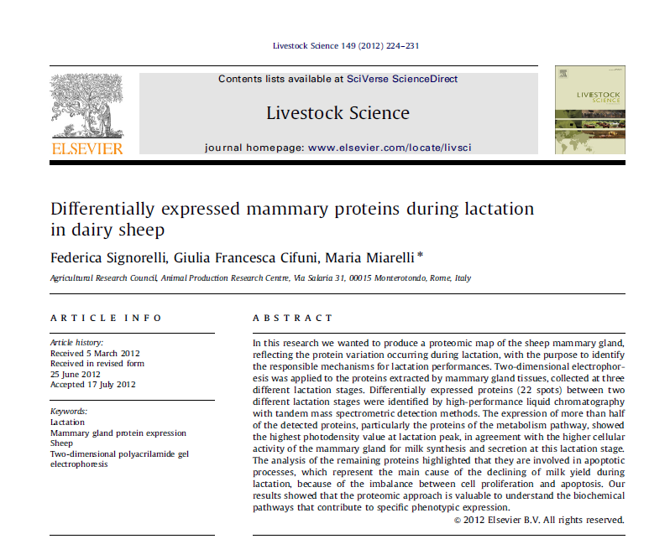
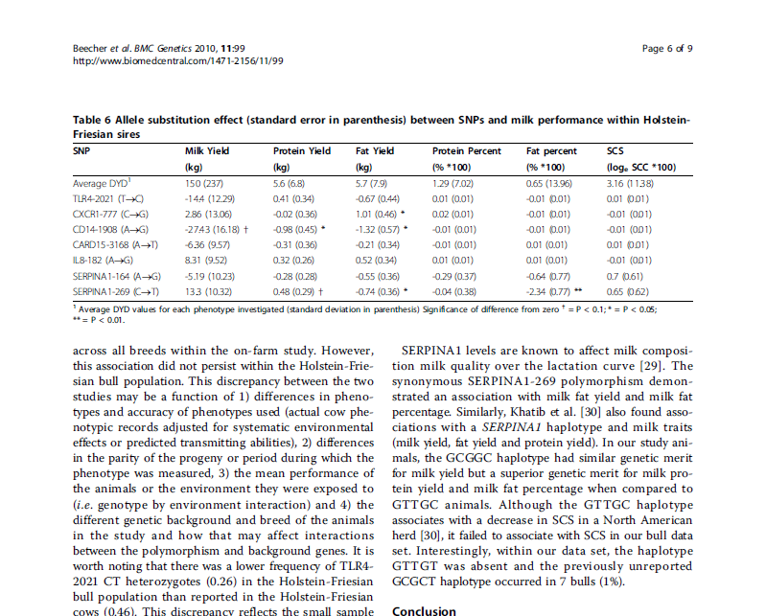
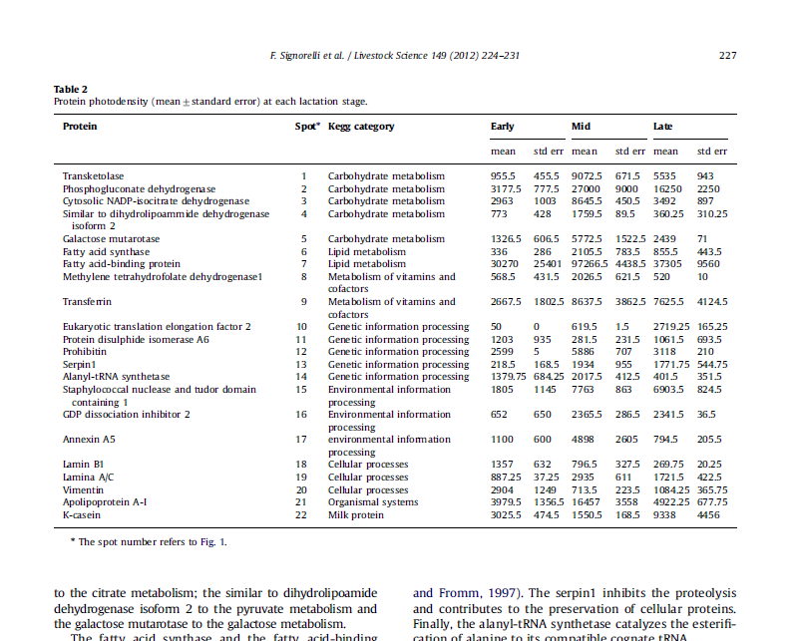
218.5
1934
1171.8

Slide 10
Talk outline
Our research
Characterization ovine SERPINA1 cDNA and gene
Overview and related work
Differential expression of sheep SERPINA1 gene during lactationSecond experiment
Conclusion
Future work

Slide 11
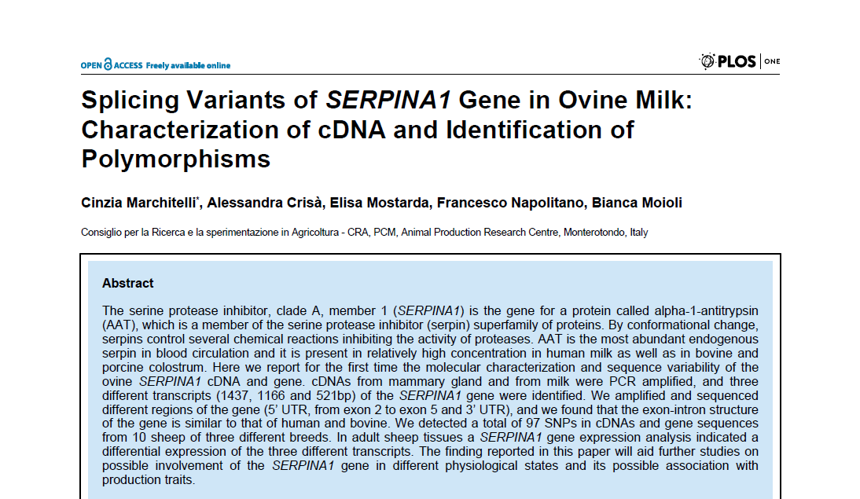

Slide 12
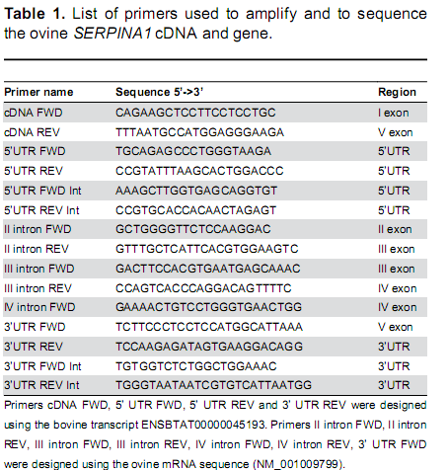
Characterization of cDNA and gene
RNA extraction from milk somatic cells
4 SARDA
3 GENTILE DI PUGLIA
3 COMISANA
RNA extraction from 11 tissues
1 SARDA
1 GENTILE DI PUGLIA
Gene sequencing
4 SARDA
3 GENTILE DI PUGLIA
3 COMISANA

Slide 13
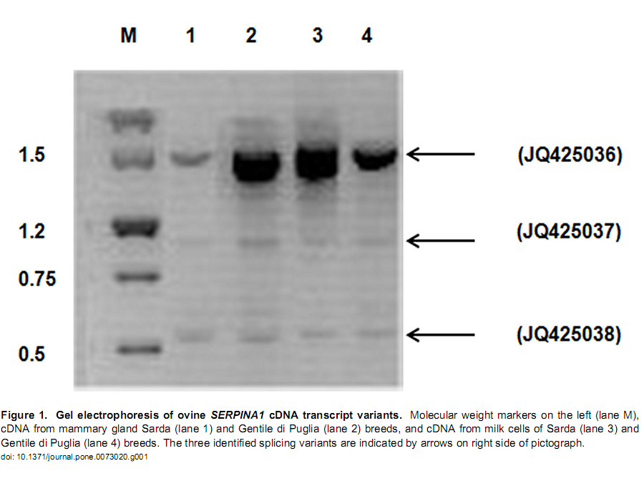
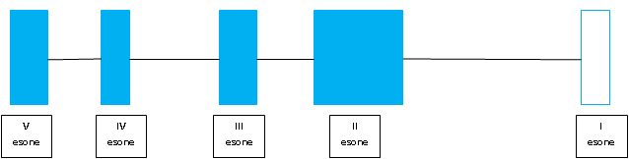
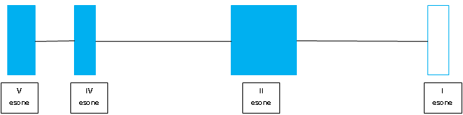
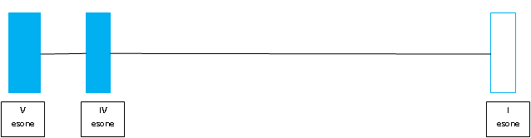
This transcript codes for a protein of 416aa
This transcript codes for a protein of 230aa
This transcript codes for a protein of 112aa

Slide 14
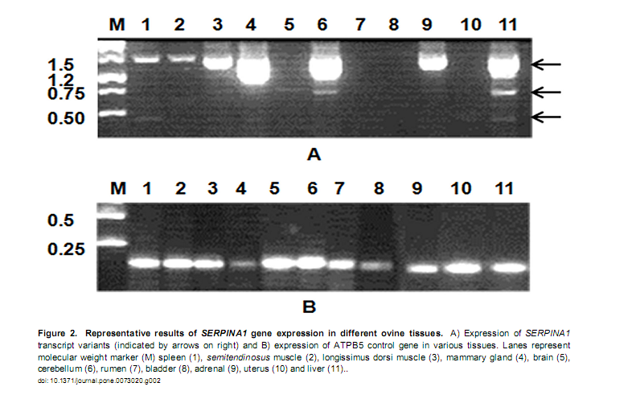
Expression of SERPINA1 trasncripts in tissues

Slide 15
Gene characterization
Amplicone | primers | N° primer | Lunghezza bp | Sequenziamento
Ex1-Ex5 | cDNAFWD-cDNARWD | 1-2 | 9000 | no
5’UTR | 5’UTRFWD-5’UTRRWD | 3-4 | 2009 | si
Ex1-Intr1-Ex2 | cDNAFWD-I IntronRWD | 1-5 | 5000 | No completato
Ex2-Intr2-Ex3 | II IntronFWD-II IntronRWD | 6-7 | 1495 | si
Ex3-Intr3-Ex4 | III IntronFWD-III IntronRWD | 8-9 | 1278 | si
Ex4-Intr4-Ex5 | IV IntronFWD-cDNARWD | 10-2 | 1132 | si
3’UTR | 3’UTRFWD-3’UTRRWD | 11-12 | 2082 | si
11
10
8
6
1
3
12
4
3’UTR
5’UTR
-
V
IV
IIII
II
I
esone
esone
esone
esone
esone

Slide 16
SNP identified in SERPINA1 gene
Region | n° | synonimous | non synonimous
5’UTR | 24 | - | -
I exon | 4 | 4 | 0
II exon | 13 | 4 | 9
II intron | 11 | - | -
III exon | 3 | 0 | 3
III intron | 2 | - | -
IV exon | 6 | 2 | 4
IV intron | 10 | - | -
V exon | 9 | 2 | 7
3’UTR | 15 | - | -
TOTAL | 97 | 12 | 23

Slide 17
Remarks 1
Isolation of 3 different transcripts
Long transcript codes for a complete AAT
Alternative splicing is not influenced by SNPs identified in intron regions
Upstream region to II exon could influence the trasncription of SERPINA1 cDNA
The ovine SERPINA1 gene exon and intron organization is similar to human and bovine
12 of 23 non synonimous aa change could affect AAT function
None aa change is identified in RCL region important for inhibitory action

Slide 18
Talk outline
Our research
Characterization ovine SERPINA1 cDNA and gene
Overview and related work
Differential expression of sheep SERPINA1 gene during lactation
Conclusion
Future work

Slide 19
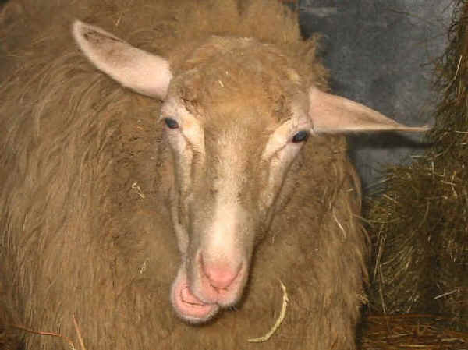
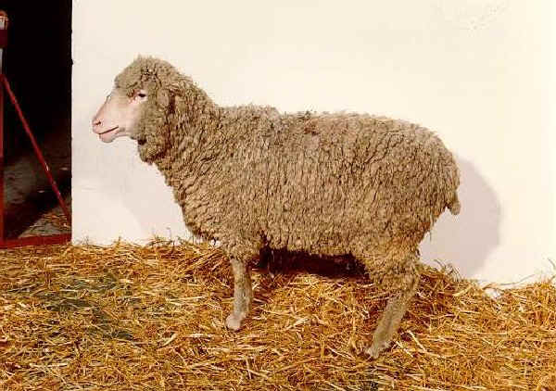
Is there a differential expression in milk of SERPINA1 gene during lactation?
SARDA
GENTILE DI PUGLIA

Slide 20
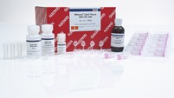
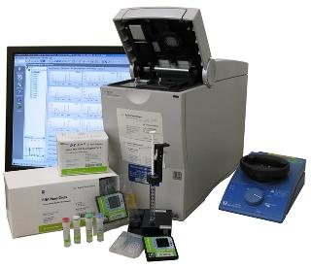
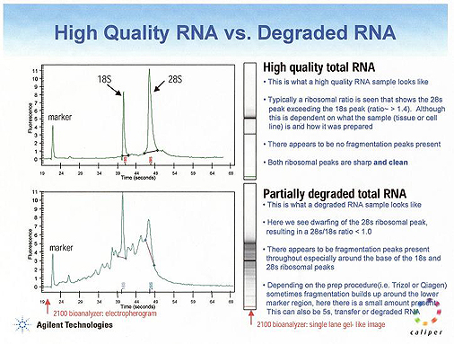
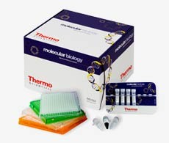
Materials and Methods
1. RNA extraction from a total of 71 milk samples 60, 90, 120 d
RAZZA | STADIO DELLA LATTAZIONE
 | 60 GIORNI | 90 GIORNI | 120 GIORNI
SARDA | 14 | 13 | 13
GENTILE DI PUGLIA | 12 | 10 | 4
RNeasy Lipid Tissue Mini kit QIAGEN
2.RNA quality check: Agilent 2100 and
Bioanalyzer
3. RT-PCR and qPCR
High quality vs degraded RNA

Slide 21
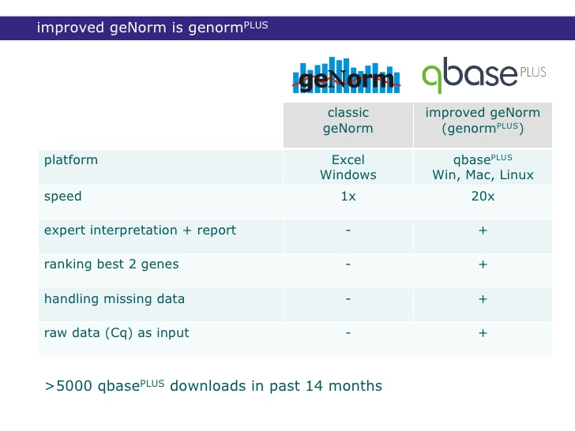
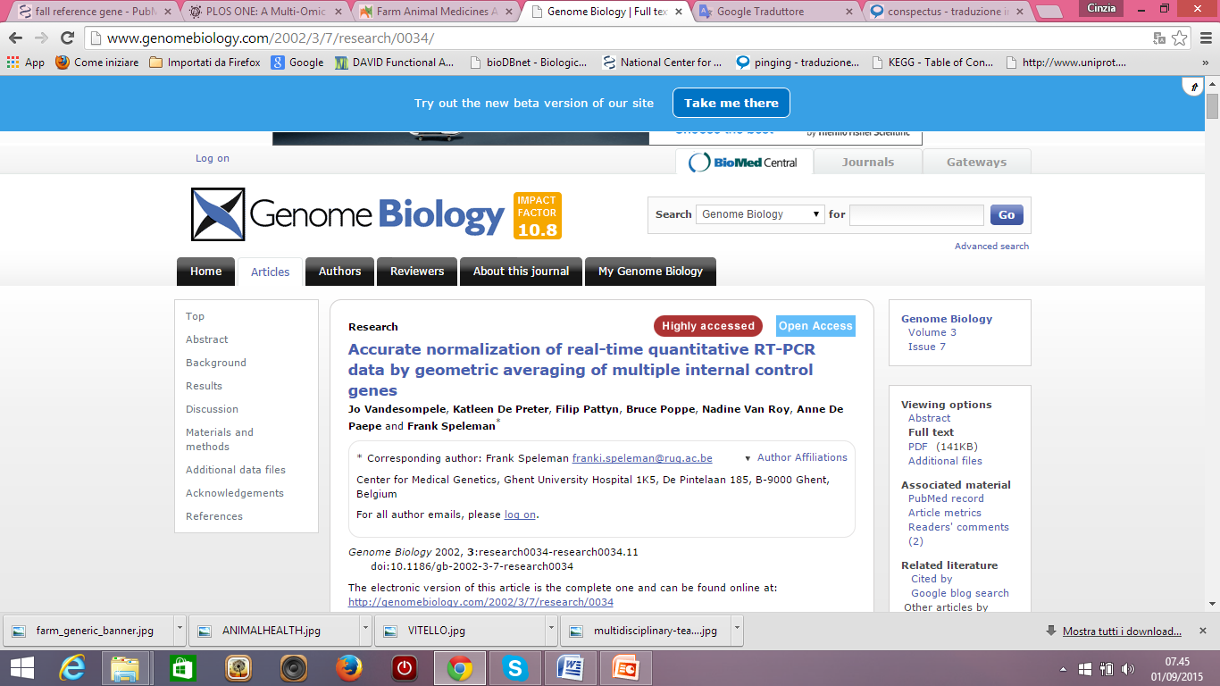
4.qPCR
Gene | Primers | nM | T.a | Amplicon cDNA/DNA
SERPINA1 | 5’AGGGATCACCGAGGAAACAG3’ 5’GTTGCTCATTCACGTGGAAG3 | 300 200 | 58 | 112/900
ATP5B | 5’TTTGGACTCCACGTCTCGCATC3’ 5’TCCTGGAGGGATTTGTAGTCCTG3’ | 200 200 | 61 | 108/NO
EIF2B2 | 5’CCGTTCCCATTATGCTCAACTCCAG3 5’TCCGTGTCCCTTCCAGTTCCAC3’ | 200 100 | 61 | 81/NO
SDHA | 5’ACGATTACTCCAAGCCCATCCAG3’ 5’AACGTAGGAGAGCGTGTGCTTC3’ | 200 100 | 61 | 80/80
POLR2A | 5’ AATGGAAGCATGTCAATGAGGACTCTC3’ 5’ CACAGGCAGCACAGTGACGATC3’ | 100 100 | 61 | 164/164
UXT | 5’TGTGGCCCTTGGATATGGTT3’ 5’GGTTGTCGCTGAGCTCTGTG3’ | 300 300 | 58 | 101/NO
RPS9 | 5’CCTCGACCAAGAGCTGAAG3’ 5’CCTCCAGACCTCACGTTTGTTC3’ | 200 200 | 58 | 54/250
MRPS15 | 5’GCAGCTTATGAGCAAGGTCGT3’ 5’GCTCATCAGCAGATAGCGCTT3’ | 300 300 | 58 | 151/2100
a. Evaluation of the optimal set of reference genes
b. SERPINA expression analyses
Tab.1 Primer sequences, concentration, T.a., amplicon lenght

Slide 22
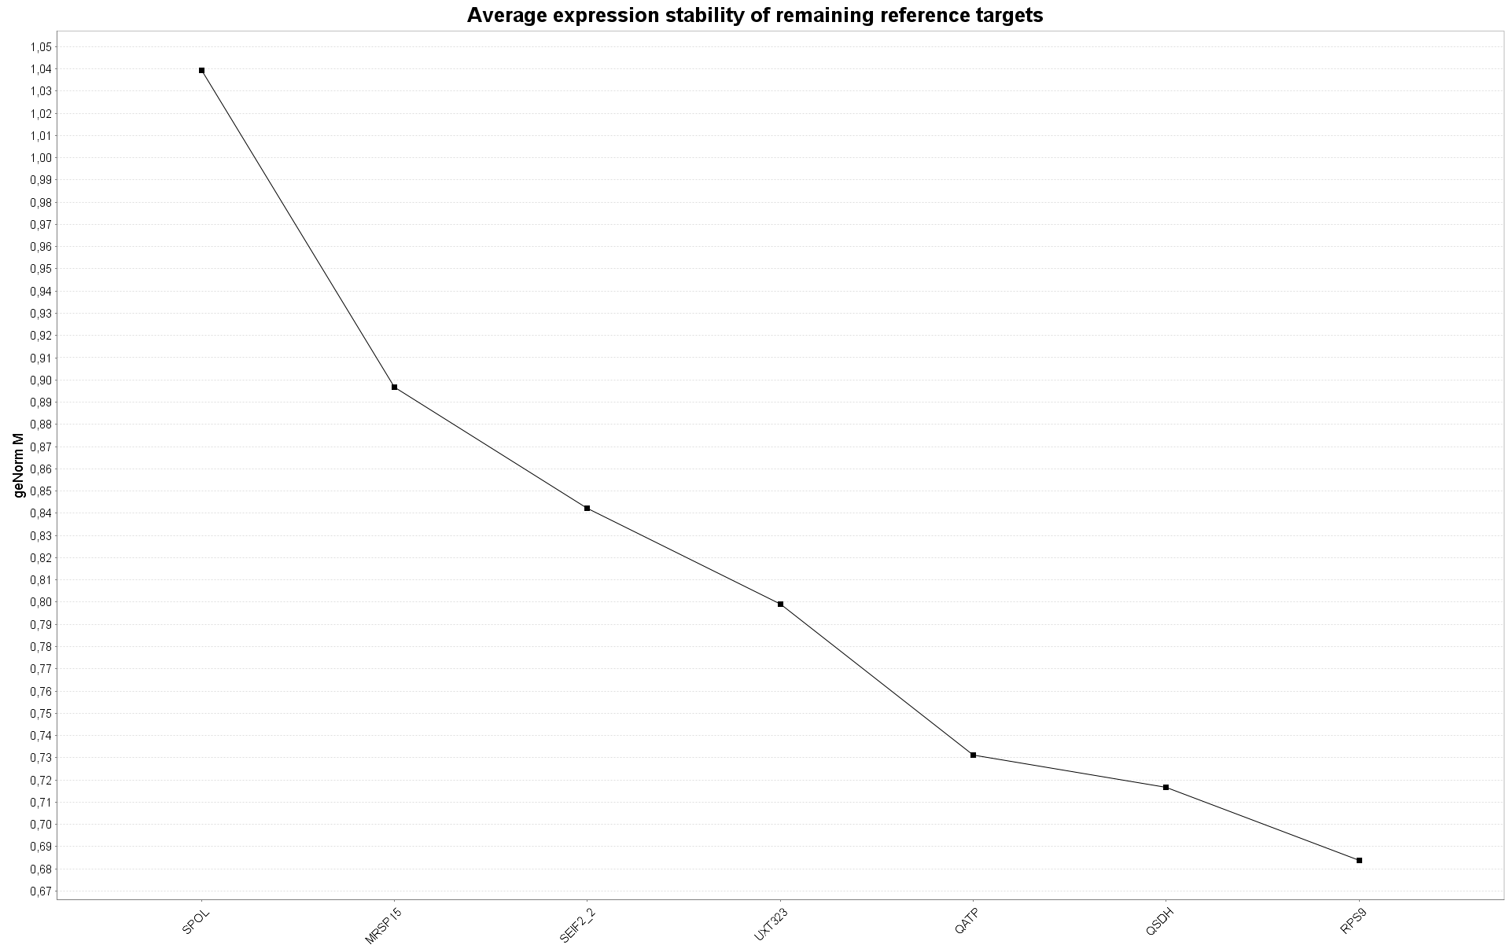
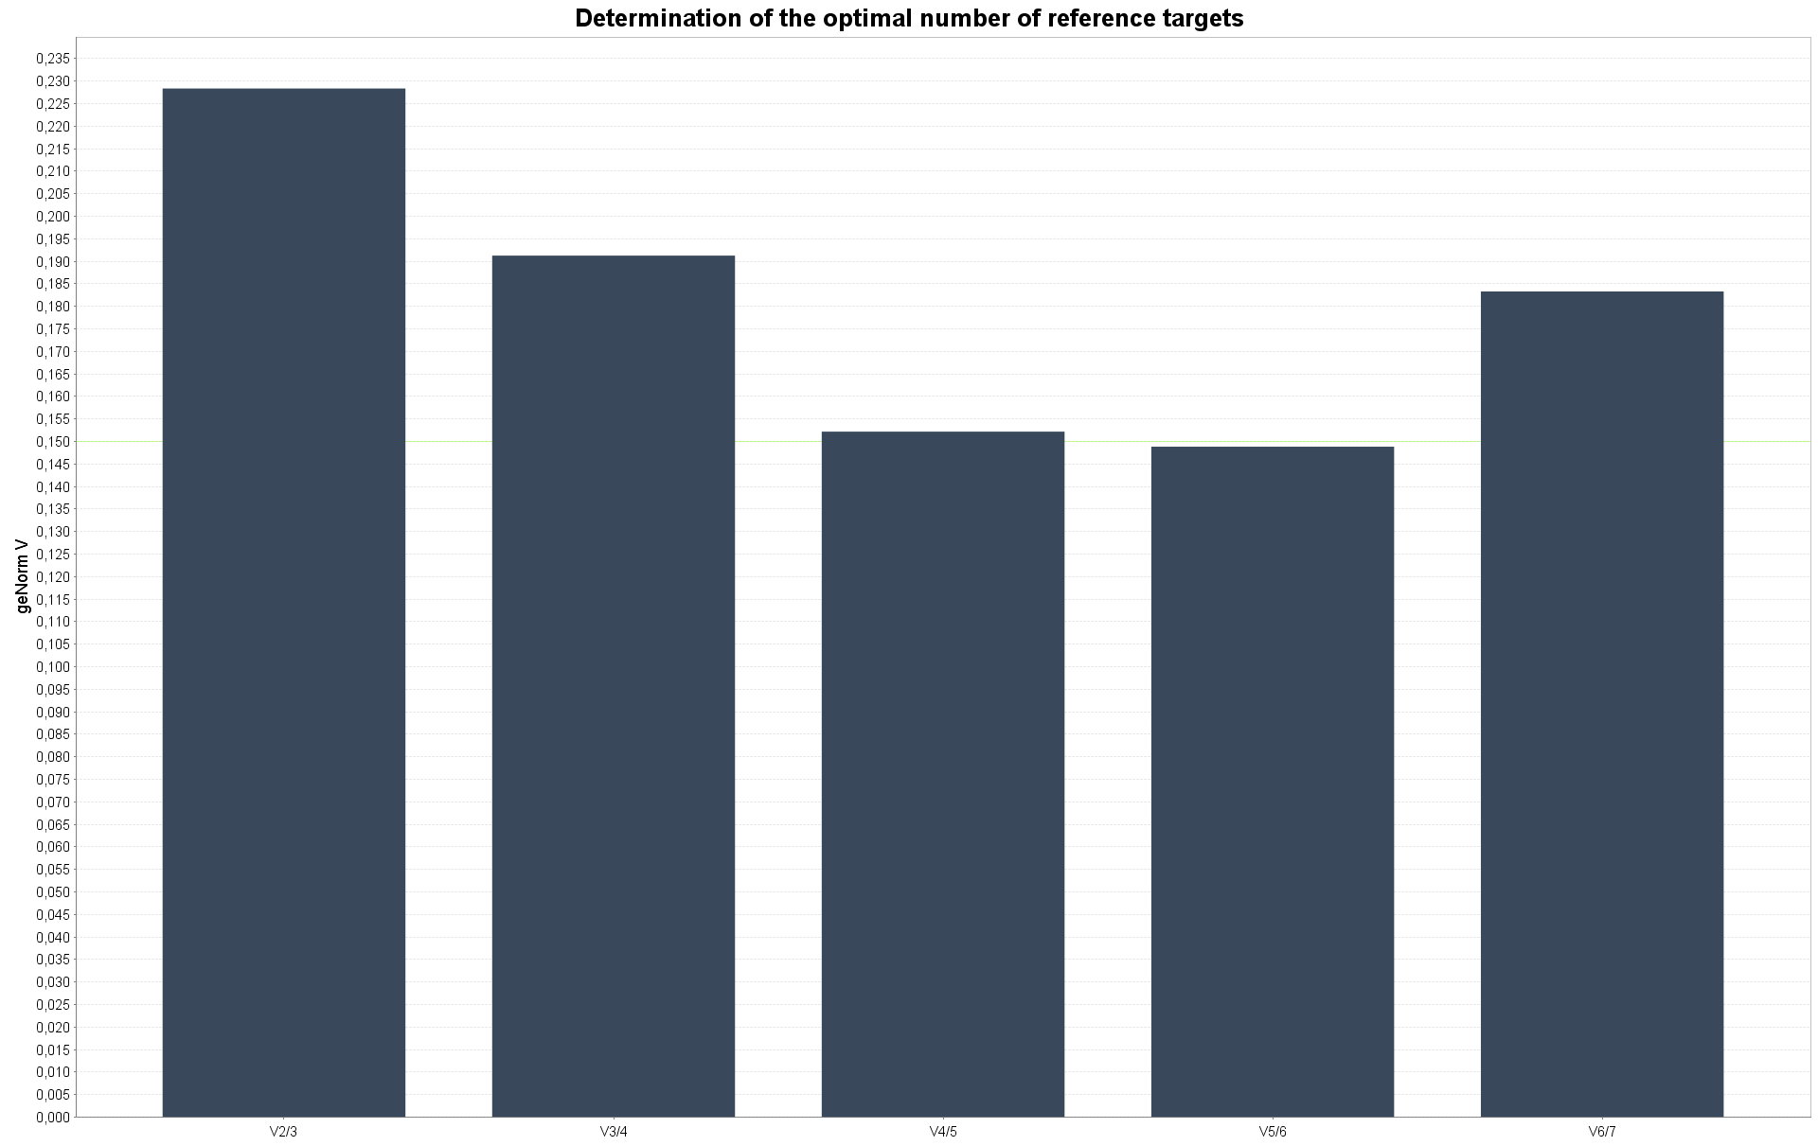
Determination of HK more stable
Determination of the optimal number of HK
1.05
0.235
0.150
0.90
0.00
V2/3
V3/4
V6/7
V4/5
V5/6
0.67
SPOL
MRSP15
SEIF2
UXT323
QATP
QSDH
RPS9

Slide 23
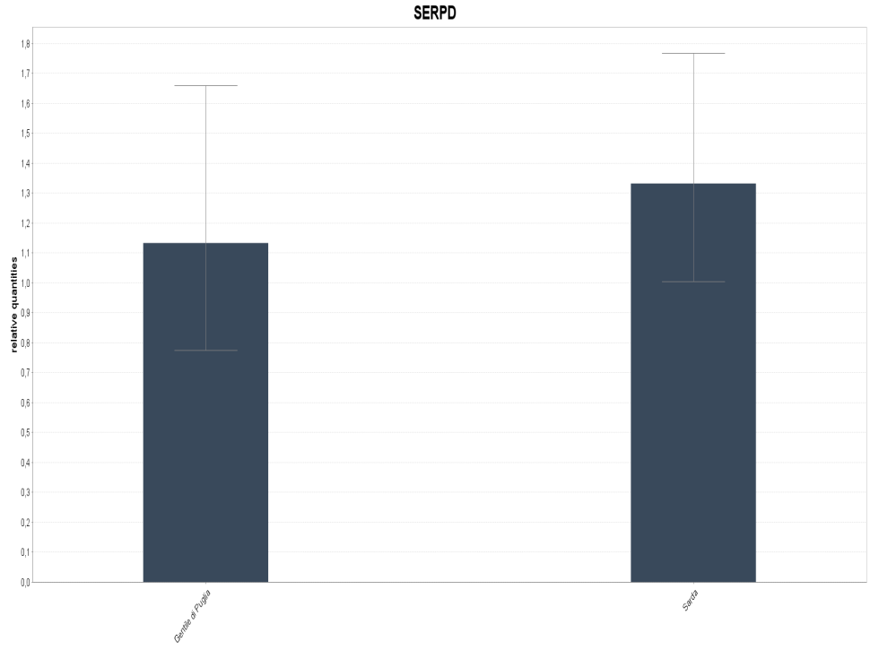
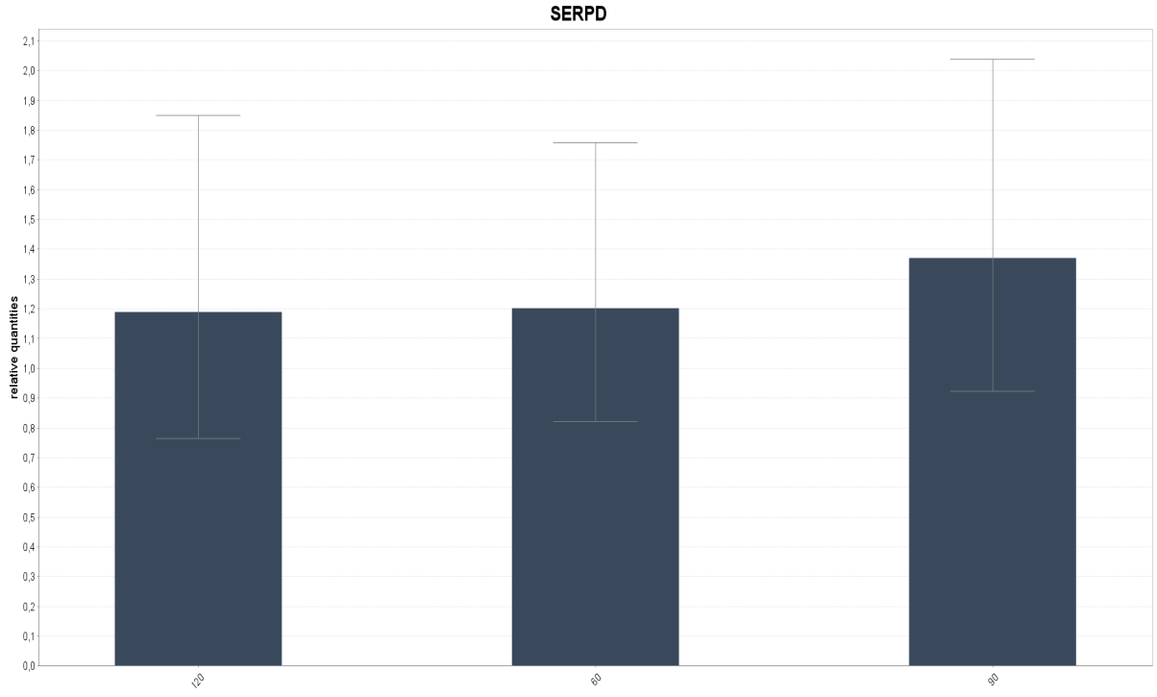
Results 1
We did not find any difference in expression levels
of SERPINA1 between two breed
Results 2
We did not find any difference in expression levels
Gentile
Sarda
120
60
90
Analysis of data by a repeated measure analysis
In GLM procedure of SAS software
Razza |  |  | Gentile | Sarda
 |  | N | 26 | 40
 |  | µ ± SE | 1.64 ± 0.04 | 1.69 ± 0.05
Giorni |  |  | 60 | 90 | 120
 |  | N | 26 | 23 | 17
 |  | µ ± SE | 1.65 ± 0.07 | 1.70 ± 0.04 | 1.64 ± 0.07
 | Razza |  | Gentile | Sarda | Gentile | Sarda | Gentile | Sarda
Giorni |  | N | 12 | 14 | 10 | 13 | 4 | 13
60 |  | µ ± SE | 1.67 ± 0.08 | 1.63 ± 0.07
90 |  | µ ± SE |  |  | 1.60 ± 0.07 | 1.80 ± 0.10
120 |  | µ ± SE |  |  |  |  | 1.66 ± 0.04 | 1.63 ± 0.06

Slide 24
Remarks 1
Our findings confirm the results obtained in pig, goat and cow
In other research in mammals a higher concentration of AAT was observed in the first lactation days or in mastitic mammary gland after calving
We hyphothesize that any SERPINA1 differential expression was observed because the first sampling was far away lambing (60 days)

Slide 25

Immune response
Could we consider SERPINA1 a biomarker for infiammation?
Which is expression of SERPINA1 during peripartum?
Does SERPINA1
Regulate expression of other immune genes as CD62L and IL8
Is there a differential expression of SERPINA1 in different blood cell

Slide 26
Acknowledgement
Funding
This study was supported by the research programme “Improvement of Italian livestock through the use of innovative biotechnologies: functional
genomics, transcriptomics and proteomics (GENZOOT)” funded by the Italian Ministry of Agriculture.
DESIGN and REALIZATION of experiments
Dr.ssa Alessandra Crisà
Dr. Francesco Napolitano
Dr.ssa Bianca Moiloli
Dr.ssa Elisa Mostarda
Sig. Francesco Grandoni
Care and management of animal
CRA-ZOE staff

