Slide 1

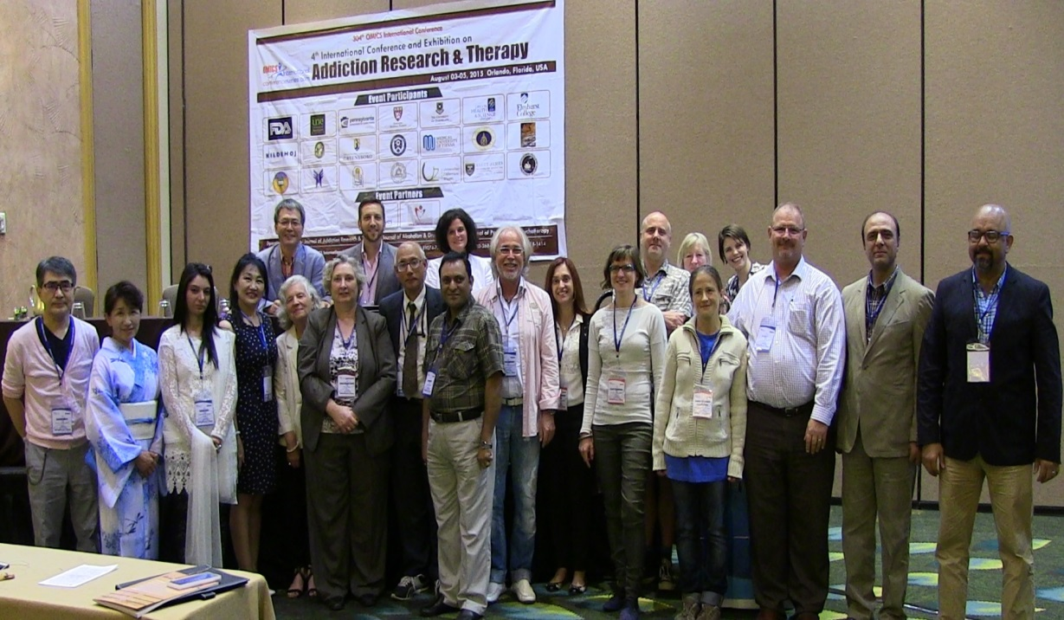
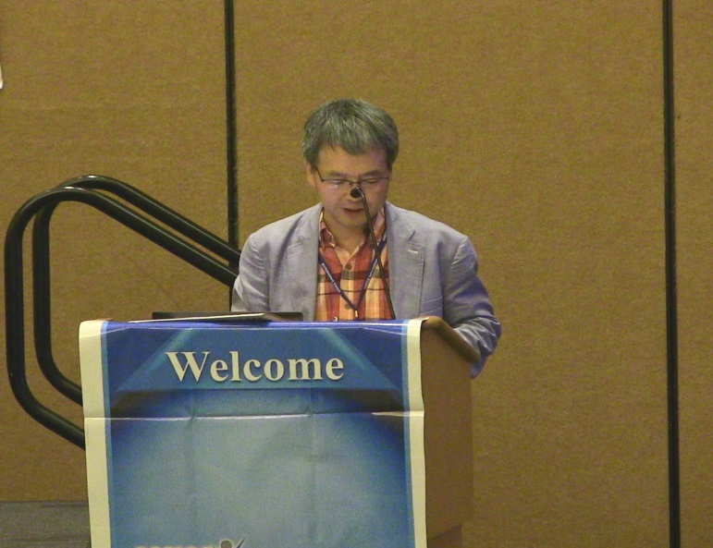
Addiction Therapy 2015
Florida, USA
August 03-08, 2015
Chun-Bae Kim

Slide 2
Does South Korea have hidden female smokers: Discrepancies in smoking rates between self-reports and urinary cotinine level
Chun-Bae Kim, MD, PhD
Department of Preventive Medicine, Yonsei University
Wonju College of Medicine

Slide 3
Background
In most countries, the smoking rate for women is lower than that for men. This gender difference indicates regional and cultural variations in Africa, the Asia-Pacific region, and Latin America.
Much greater gender differences were found in East and Southeast Asian in countries such as South Korea, Indonesia, and China, compared to Europe and the U.S.

Slide 4
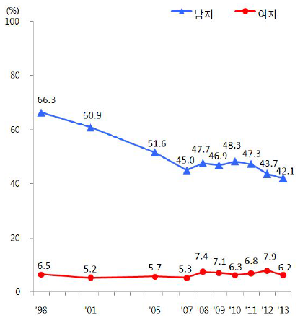
Current smoker trend in South Korea (1998-2013)
MALE
FEMALE
Source: The Korean National Health and Nutrition Examination Survey (KNHANEs)

Slide 5
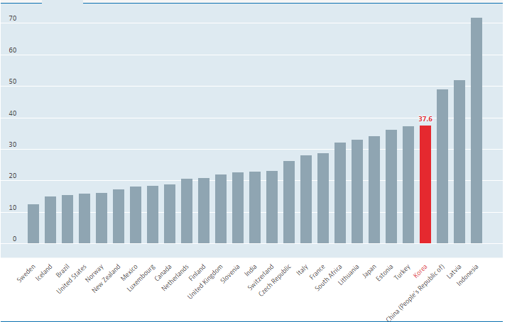
Daily smokers men among OECD members and partners
(% of men aged 15+, 2012)
Source: OECD STAT (https://data.oecd.org)

Slide 6
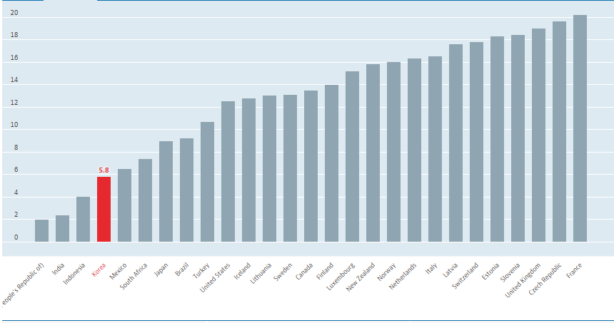
Daily smokers women among OECD members and partners
(% of women aged 15+, 2012)
Source: OECD STAT (https://data.oecd.org)

Slide 7
Study aims
First, to compare smoking rates based on self-reported survey results and urinary cotinine concentration (UCC) test results,
Second, to estimate actual smoking rates by year using a biological marker.

Slide 8
Measurement for smoking rates (1)
The most common method is a self-reporting survey targeting a certain population group. which is convenient and efficient and has relatively high accuracy.

Slide 9
Measurement for smoking rates (2)
Biological marker
Biological markers that measure smoking include cotinine, nicotine, carbon monoxide, thiocyanate, and carboxyhemoglobin.
Among these, cotinine is a metabolite of nicotine that has a relatively long half-life compared to other markers, making it a reliable indicator when used to identify smokers.

Slide 10
The Korean National Health and Nutrition Examination Survey (KNHANEs)
20 households were selected from 192 areas by probability sampling. The primary sampling unit was administrative unit (i.e., eup-myeon-dong), the secondary sampling was done by census, and the tertiary sampling was done at the household level. All members of the selected households were included as survey participants.
The KNHANEs has a stratified multistage sampling design that examines all household members above the age of one.

Slide 11
The Korean National Health and Nutrition Examination Survey (KNHANEs)
This survey comprises three areas: physical examinations, health-related surveys, and nutrition surveys.
During the study period, examiners visited different areas using a mobile examination vehicle and conducted check-ups that included blood and urine tests, X-rays, and oral examinations.

Slide 12
Data collection
Data were gathered from a study population of 26,593 adults over 19 years of age who responded to the question regarding smoking on the KNHANEs between 2008 and 2011.
From the above population, 14,086 respondents were selected for further analysis, because their urinary cotinine data were made available for use.

Slide 13
Measures (1)
Current smoker
Self reported:
The current smoking rate is based on the definition of a smoker as someone who has smoked at least 100 individual cigarettes in his or her lifetime and who, at the time of interview, reported smoking every day or some days.

Slide 14
Measures (2)
Current smoker
Urine-cotinine concentration (UCC)
Measurements of UCC are taken using gas chromatography–mass spectrometry, specifically with the detector model Clarus 600 T of Finland PerkinElmer. The indicators used in the measurement are cotinine and diphenylamine (Aldrich, USA).
UCC cut-off point 50 ng/ml (Society for Research on Nicotine and Tobacc0’s recommend)

Slide 15
The difference between smoking rates according to SRs and UCC (2008–2011) Unit: n*, %**
 | SRs (A) N1 = 11,353 | 95% CI | UCC (B) n1 = 6,618 | 95% CI | B-A | SRs (C) N2 = 15,240 | 95% CI | UCC (D) n2 = 7,468 | 95% CI | D-C
Overall | 4,909(47.8) | (45.6-48.9) | 3,442(55.1) | (53.6-55.6) | 7.3 | 920(7.1) | (6.5-7.6) | 1,283(18.2) | (16.8-19.6) | 11.1
Age (years)
20 - 29 | 710(50.2) | (47.3-53.1) | 586(56.5) | (53.2-59.9) | 6.3 | 216(11.4) | (9.5-13.2) | 264(24.9) | (21.7-28.1) | 13.5
30 - 39 | 1,262(59.8) | (57.5-62.1) | 871(64.7) | (61.9-67.5) | 4.9 | 213(8.4) | (7.3-9.6) | 305(21.8) | (19.3-24.3) | 13.4
40 - 49 | 1,094(49.9) | (47.4-52.4) | 774(56.6) | (53.5-59.6) | 6.7 | 150(5.8) | (4.8-6.8) | 247(17.5) | (15.0-19.9) | 11.7
50 - 59 | 847(43.7) | (41.1-46.4) | 574(49.7) | (46.5-52.9) | 6.0 | 107(4.7) | (3.6-5.8) | 182(13.2) | (11.0-15.4) | 8.5
60 - 69 | 601(33.0) | (30.3-35.7) | 408(41.5) | (37.7-45.3) | 8.5 | 99(4.0) | (3.1-5.0) | 150(10.7) | (8.5-12.8) | 6.7
70 over | 395(26.2) | (23.4-28.9) | 229(38.3) | (33.2-43.4) | 12.1 | 135(6.3) | (5.0-7.5) | 135(15.6) | (12.6-18.7) | 9.3
Number of household
1 | 273(56.1) | (51.1-61.0) | 186(58.5) | (52.6-64.4) | 2.4 | 137(11.9) | (9.5-14.2) | 121(21.2) | (17.4-25.0) | 9.3
2 over | 4,636(47.3) | (46.2-48.5) | 3,256(54.9) | (53.3-56.4) | 7.6 | 783(6.7) | (6.2-7.3) | 1,162(18.0) | (16.6-19.4) | 11.3
Income quartile
Low | 1,355(53.8) | (51.5-56.2) | 924(60.3) | (57.3-63.2) | 6.5 | 331(10.5) | (9.2-11.8) | 378(21.4) | (19.0-23.8) | 10.9
Middle low | 1,272(48.8) | (46.6-51.1) | 902(57.1) | (54.1-60.1) | 8.3 | 242(7.1) | (6.1-8.1) | 324(17.9) | (15.7-20.0) | 10.8
Middle high | 1,143(46.4) | (44.1-48.7) | 780(53.5) | (50.5-56.4) | 7.1 | 177(5.7) | (4.6-6.7) | 252(15.4) | (13.1-17.7) | 9.7
High | 1,063(41.8) | (39.6-44.1) | 770(49.2) | (46.3-52.1) | 7.4 | 152(4.9) | (3.9-5.8) | 300(17.8) | (15.3-20.4) | 12.9
Residential area
Metro | 2,152(47.0) | (45.3-48.7) | 1,487(52.9) | (50.6-55.2) | 5.9 | 418(6.8) | (6.1-7.6) | 563(17.4) | (15.5-19.4) | 10.6
Other urban city | 1,697(48.2) | (46.2-50.1) | 1,224(56.6) | (54.3-58.8) | 8.4 | 338(7.9) | (6.8-8.9) | 460(20.0) | (17.7-22.3) | 12.1
Rural area | 1,060(49.1) | (46.5-51.7) | 1,402(58.0) | (54.1-61.9) | 8.9 | 164(6.2) | (4.9-7.5) | 260(16.8) | (13.8-19.9) | 10.6
NCD***
Yes | 1,066(37.9) | (35.7-40.2) | 744(46.8) | (43.8-49.8) | 8.9 | 184(4.6) | (3.8-5.3) | 250(12.8) | (10.8-14.8) | 8.2
No | 3,843(50.6) | (49.2-51.9) | 2,698(57.2) | (55.5-58.9) | 6.6 | 736(7.8) | (7.1-8.5) | 1,033(19.7) | (18.1-21.2) | 11.9
Cancer
Yes | 54(20.5) | (14.2-26.7) | 46(38.0) | (28.4-47.5) | 17.5 | 896(3.6) | (1.7-5.5) | 29(11.1) | (6.5-15.8) | 7.5
No | 4,855(48.3) | (47.1-49.4) | 3,396(55.3) | (53.8-56.8) | 7.0 | 24(7.4) | (6.6-7.8) | 1,254(18.4) | 17.0-19.8) | 11.0
SRs, Self-reported surveys; UCC, Urinary cotinine concentration.
*Unweighted number of respondents. **Weighted percentage.
*** NCD: Non-Communicable Disease (physician diagnosis about hypertension, diabetes mellitus, dyslipidemia, etc.).
Notes:
The current smoking rate of adult males according to the SRs is 47.8%, while the current
smoking rate according to the UCC is 55.1%. The smoking rate among males was 55.1%
according to the UCC, which is 7.3% higher than the official smoking rates. In particular, the
female smoking rate according to the UCC (18.2%) was more than twice as high as the
official smoking rate indicated by the SRs (7.1%).
Smoking rates were highest among males in their 30s and females in their 20s, and in general,
the younger age groups (20s and 30s) exhibited higher overall smoking rates. By age group,
the highest smoking rates were observed in the 70+ groups for both males and females. The
widest gaps between the two indicators were found in the 70+ group for males, and in the 20–
29 group for females. By household, one-person households showed the highest smoking
rates for both males and females, but the gap was wider in households with two persons or
more. By individual income quartile, the “low” group showed the highest smoking rates for
both males and females. By region, “rural” regions showed the highest smoking rates among
males, along with the widest inter-indicator gap. For females, “other urban city” showed the
highest smoking rates and the widest inter-indicator gap. By cancer incidence experience, the
experience group showed the highest smoking rates for both males and females. For males,
the gap was wider among those who reported cancer incidence experience, while for females
it was wider among those without cancer (see Table 1).

Slide 16
Summarizing results of the accuracy for smoking rates according to UCC and SRs
 | Male (n*₁ = 6,614) |  |  |  |  | Female (n*₂ = 7,463)
 | SN* | SP* | PPV* | NPV** | DR* | SN | SP | PPV | NPV | DR
Overall | 0.8553 | 0.9768 | 0.9783 | 0.8465 | 1.143 | 0.3670 | 0.9956 | 0.9486 | 0.8761 | 2.600
Age (years)
20 – 29 | 0.8585 | 0.9819 | 0.9840 | 0.8422 | 1.146 | 0.4149 | 0.9867 | 0.9119 | 0.8358 | 2.204
30 – 39 | 0.8804 | 0.9366 | 0.9622 | 0.8104 | 1.093 | 0.3733 | 0.9969 | 0.9715 | 0.8510 | 2.595
40 – 49 | 0.8624 | 0.9812 | 0.9835 | 0.8455 | 1.141 | 0.3125 | 0.9993 | 0.9888 | 0.8727 | 3.182
50 – 59 | 0.8393 | 0.9879 | 0.9856 | 0.8618 | 1.175 | 0.2969 | 0.9964 | 0.9262 | 0.9027 | 3.143
60 – 69 | 0.8087 | 0.9915 | 0.9854 | 0.8798 | 1.221 | 0.3649 | 0.9968 | 0.9316 | 0.9302 | 2.610
70 over | 0.7482 | 0.9959 | 0.9913 | 0.8643 | 1.325 | 0.4484 | 1.0000 | 1.0000 | 0.9071 | 2.229
Number of household
1 | 0.9146 | 0.9830 | 0.9870 | .8908 | 1.079 | 0.5466 | 0.9960 | 1.0000 | 0.8908 | 1.782
2 over | 0.8545 | 0.9764 | 0.9777 | .8448 | 1.149 | 0.3530 | 0.9955 | 0.9455 | 0.8752 | 2.687
Unweighted number of respondents, Excludes cases for non-respondents of smoking status.
**SN = sensitivity, SP = specificity, PPV = positive predictive value, NPV = negative predictive value, DR = difference ratio (UCC/SRs).
***NCD = Non communicable disease (physician diagnosis about hypertension, diabetes mellitus, dyslipidemia, etc.).
Weights were applied to the SN, SP, PPV, NPV.
Notes:
Among the SR respondents, there were 14,086 individuals who participated in the urinary
cotinine measurements. After four males and five females who answered “I don’t know” to
the question of current smoking status were excluded, data from a total of 6,614 males and
7,463 females were analyzed to determine the response accuracy of the SRs. The sensitivity
of males was 0.8553, specificity 0.9768, PPV 0.9783, NPV 0.8465, and DR was 1.143. The
sensitivity for females was 0.3670, specificity 0.9956, PPV 0.9486, NPV 0.8761, and DR was
2.600. These results exhibit a very low response alignment rate compared to males. In the
case of females, the sensitivity was highest among female one-person households (0.5466).
Women in other age groups did not exhibit a sensitivity value that exceeded 0.5. With respect
to the number of household members, the sensitivity value of a minimum two-person
household was 0.3530, and DR was 2.687. These results exhibit a response alignment lower
than that of a one-person household. According to the sensitivity values with respect to
income quartiles, the “low” quartile had a value of 0.4581, “middle low” 0.4080, “middle
high” 0.2883, and “high” 0.2883. As income level increased, the response alignment
decreased (see Table 2).

Slide 17
Summarizing results of the accuracy for smoking rates according to UCC and SRs
 | Male (n*₁ = 6,614) |  |  |  |  | Female (n*₂ = 7,463)
 | SN* | SP* | PPV* | NPV** | DR* | SN | SP | PPV | NPV | DR
Income quartile
Low | 0.8893 | 0.9784 | 0.9842 | 0.8536 | 1.108 | 0.4581 | 0.9944 | 0.9568 | 0.8712 | 2.098
Middle low | 0.8364 | 0.9817 | 0.9838 | 0.8184 | 1.175 | 0.4080 | 0.9964 | 0.9611 | 0.8856 | 2.355
Middle high | 0.8651 | 0.9712 | 0.9719 | 0.8624 | 1.124 | 0.2883 | 0.9937 | 0.8923 | 0.8848 | 3.080
High | 0.8275 | 0.9750 | 0.9698 | 0.8537 | 1.171 | 0.2746 | 0.9974 | 0.9586 | 0.8636 | 3.490
Residential area
Metro (6,287) | 0.8576 | 0.9731 | 0.9728 | 0.8587 | 1.133 | 0.3727 | 0.9945 | 0.9348 | 0.8826 | 2.522
Other urban City (4,752) | 0.8550 | 0.9784 | 0.9810 | 0.8383 | 1.148 | 0.3704 | 0.9950 | 0.9485 | 0.8637 | 2.564
Rural area (3,038) | 0.8512 | 0.9851 | 0.9875 | 0.8273 | 1.160 | 0.3406 | 1.0000 | 1.0000 | 0.8821 | 2.947
NCD***
Yes (3,696) | 0.8166 | 0.9860 | 0.9808 | 0.8595 | 1.200 | 0.3135 | 0.9951 | 0.9037 | 0.9078 | 2.844
No (10,381) | 0.8639 | 0.9738 | 0.9778 | 0.8424 | 1.130 | 0.3766 | 0.9957 | 0.9556 | 0.8671 | 2.558
Cancer
Yes (383) | 0.5823 | 1.0000 | 1.0000 | 0.7964 | 1.719 | 0.3453 | 1.0000 | 0.9478 | 0.9241 | 2.921
No (13,694) | 0.8582 | 0.9763 | 0.9782 | 0.8476 | 1.140 | 0.3674 | 0.9954 | 1.0000 | 0.8746 | 2.592
Unweighted number of respondents, Excludes cases for non-respondents of smoking status.
**SN = sensitivity, SP = specificity, PPV = positive predictive value, NPV = negative predictive value, DR = difference ratio (UCC/SRs).
***NCD = Non communicable disease (physician diagnosis about hypertension, diabetes mellitus, dyslipidemia, etc.).
Weights were applied to the SN, SP, PPV, NPV.
Notes:
Among the SR respondents, there were 14,086 individuals who participated in the urinary
cotinine measurements. After four males and five females who answered “I don’t know” to
the question of current smoking status were excluded, data from a total of 6,614 males and
7,463 females were analyzed to determine the response accuracy of the SRs. The sensitivity
of males was 0.8553, specificity 0.9768, PPV 0.9783, NPV 0.8465, and DR was 1.143. The
sensitivity for females was 0.3670, specificity 0.9956, PPV 0.9486, NPV 0.8761, and DR was
2.600. These results exhibit a very low response alignment rate compared to males. In the
case of females, the sensitivity was highest among female one-person households (0.5466).
Women in other age groups did not exhibit a sensitivity value that exceeded 0.5. With respect
to the number of household members, the sensitivity value of a minimum two-person
household was 0.3530, and DR was 2.687. These results exhibit a response alignment lower
than that of a one-person household. According to the sensitivity values with respect to
income quartiles, the “low” quartile had a value of 0.4581, “middle low” 0.4080, “middle
high” 0.2883, and “high” 0.2883. As income level increased, the response alignment
decreased (see Table 2).

Slide 18
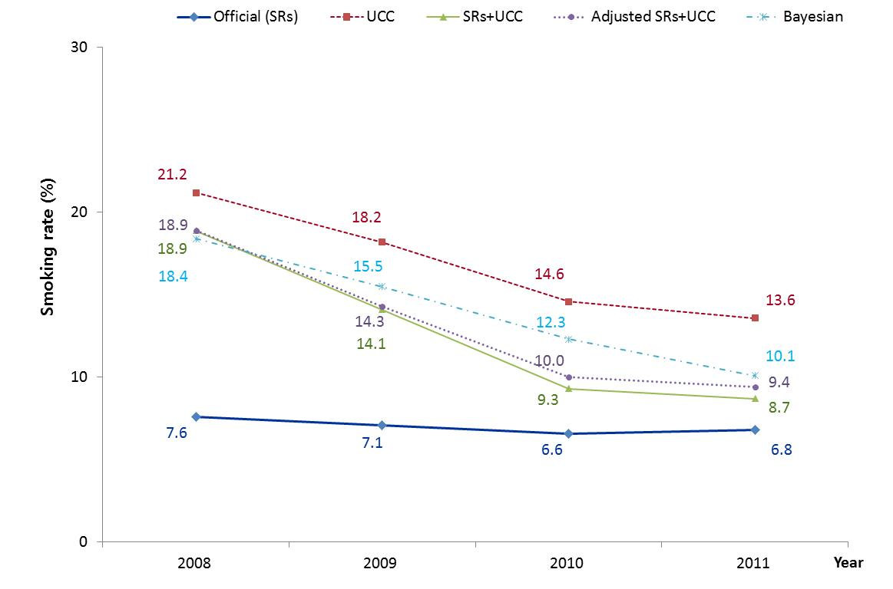
Female smoking rate by year.
SR: self-reported surveys. UCC: urinary cotinine concentration.
Bayesian: (R1*TP + R0*FN)/(R1*TP + R0*TN + R0*FN + R1*FP)
R0 (SRs non-smokers/UCC non-smokers), R1 (SRs smokers / UCC smokers),
true positives(TP), false negatives (FN), true negatives (TN), and false positives (FP).
Notes:
According to the female smoking rate by year, the official smoking rate based on the SRs was
7.6% in 2008, 7.1% in 2009, 6.6% in 2010, and 6.8% in 2011. Conversely, the smoking rate
according to the UCC was 21.2% in 2008, 18.2% in 2009, 14.6% in 2010, and 13.6% in
2011. While the difference between the two smoking rates does decrease over time, a
difference nevertheless remains. Moreover, if those who responded “no” as to whether they
were current smokers on the SRs, but who were considered current smokers according to the
UCC, were included in the total number of smokers (SRs + UCC), the female smoking rate
would have been 18.9% in 2008, 14.1% in 2009, 9.3% in 2010, and 8.7% in 2011. The UCC
study population decreased every year beginning in 2008, with 3,152 participants in 2008,
2,517 participants in 2009, 917 participants in 2010, and 882 participants in 2011. Thus,
when the UCC participant number by year was adjusted to analyze each year under the same
conditions, the smoking rate (adjusted SRs + UCC) was 14.3% in 2009, 10.0% in 2010, and
9.4% in 2011.The smoking rate according to the Bayesian Theory was 18.4% in 2008, 15.5%
in 2009, 12.3% in 2010, and 10.1% in 2011 (see Figure 1).

Slide 19
Discussion (1)
It is the first study to analyze the annual trends of actual smoking rates in South Korea by reflecting the results of biomarker tests.
Significant differences were noted in the smoking rates of both men and women between the SRs and the UCC, showing that many respondents provided false responses.

Slide 20
Discussion (2)
According to conventional studies, the self-reported smoking rates yielded by face-to-face interviews produce values that are lower than the actual smoking rates. Although there was a bigger gap between the different measurements of the female smoking rates than those of males, the difference in accuracy between genders was not large.
However, the accuracy difference between genders is larger than in South Korea; analysis indicates that the difference between the official smoking rate and the actual smoking rate is also very large.

Slide 21
Discussion (3)
Such a result can be attributed to the fact that the social desirability factor has a bigger impact on South Korean women than it does on women in Western countries, as South Korean society often ostracizes and vilifies female smoking. For females living in a minimum two-person household, with either their own family or other people, sensitivity values were low.
This may be because female participants did not want to reveal their smoking statuses to family members or neighbors.

Slide 22
Discussion (4)
Predictions assert that female smoking rates are underestimated to a greater extent in East Asian countries such as South Korea, Japan, and China as well as in Islamic countries as compared to American and European countries, since female smoking is perceived very negatively in the former countries.
Consequently, it is necessary to constantly monitor smoking rate trends through cumulative data.

Slide 23
Limitation
The limitation of the present study is that its calculation of female smoking rates in South Korea cannot be directly generalized to those of other Asian countries. Also, the study could not fully control for the participants the UCC identified as smokers owing to indirect smoking.
Furthermore, it is possible that infrequent or light smokers escaped UCC detection as their UCC levels are low.

Slide 24

T
h
a
n
k!

Slide 25

Meet the eminent gathering once again at
Addiction Therapy 2016
Miami, USA
October 06-08, 2016
Addiction Therapy 2016
Website: addictiontherapy.conferenceseries.com

