Slide 1
Micro-aerobic enhanced performance of denitrifying sulfide removal with high C/N ratios
Chuan Chen
Harbin Institute of Technology
Harbin, China
Email: echo110244@126.com
July 26, 2016 in Berlin, Germany

Slide 2

Outline
What is denitrifying sulfide removal process (DSR)
Performance of DSR
Micro-aerobic enhanced performance of DSR in high C/N ratios
Why is micro-aerobic enhanced performance ?
Summary and future challenges

Slide 3
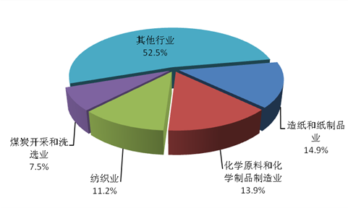
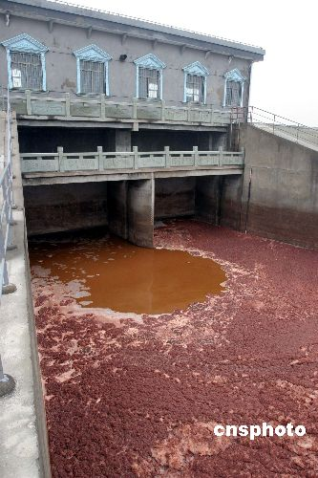
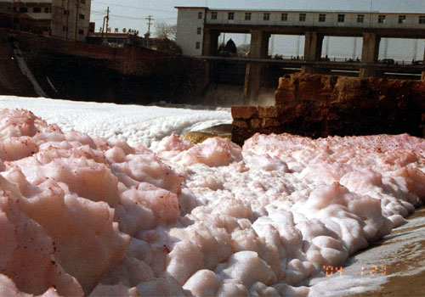
Background
Total industrial wastewater discharge over
twenty billions tons per year
Wastewaters discharged from paper, chemical engineering, textile and mining over nine billions tons (47.5% in total)
Contain sulfate, ammonia, nitrate and COD
More and more stringent discharge standards implemented
Based on Environmental statistic
annual report of China, 2013

Slide 4
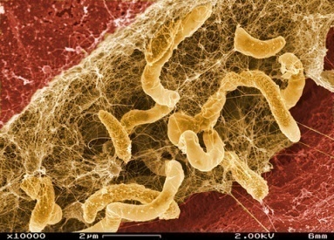
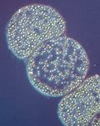
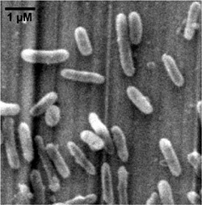
Sulfate reduction and sulfide-oxidation
Organic
SO₄²⁻
+e
Sulfate reduction
CO₂
S²⁻
http://www.davidsuzuki.org/blogs/science-matters/2010/02/caring-for-ourselves-goes-hand-in-hand-with-caring-for-the-planet/
Aerobic
Anaerobic
Sulfur accumulated intracellularly with low rate，Practical application restricted
Sulfur accumulated extracellularly with high rate，Suitable for Practical application
O₂
S²⁻
S²⁻
NO₃⁻
Sulfide oxidation
Autotrophic
denitrification
-e
-e
H₂O
S⁰
S⁰
N₂
http://www.mpi-bremen.de/en/Ecophysiology_Group.html
genome.jgi-psf.org/thide/thide.home.html

Slide 5
Denitrifying sulfide removal (DSR)
S²⁻ NO₃⁻
Sulfide oxidizing, nitrate reducing bacteria
(soNRB)
r₁
S⁰
NO₂⁻
Organic-C
Heterotrophic nitrate reducing bacteria
(hNRB)
r₃
r₂
N₂
SO₄²⁻
CO₂
Reaction rate argued by Reyes-Avila et al. (water res., 2004) and Chen et al. (Appl. Microbiol. Biotechnol. 2008,78(6): 1057-1063)

Slide 6
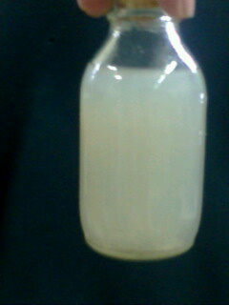
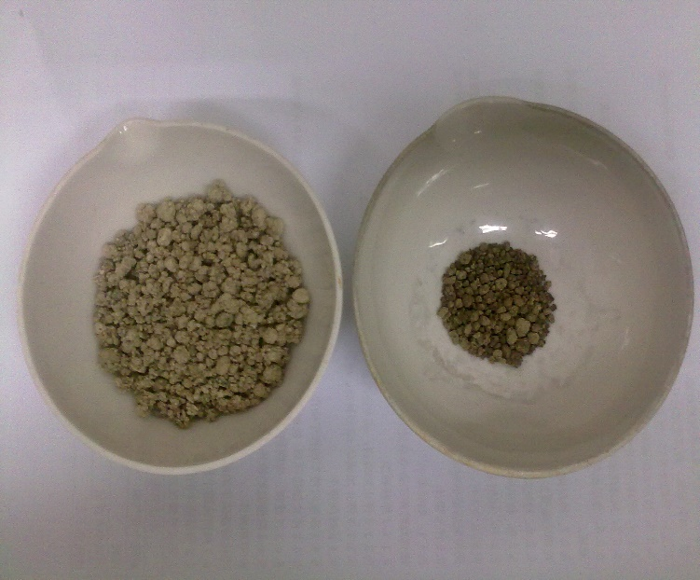
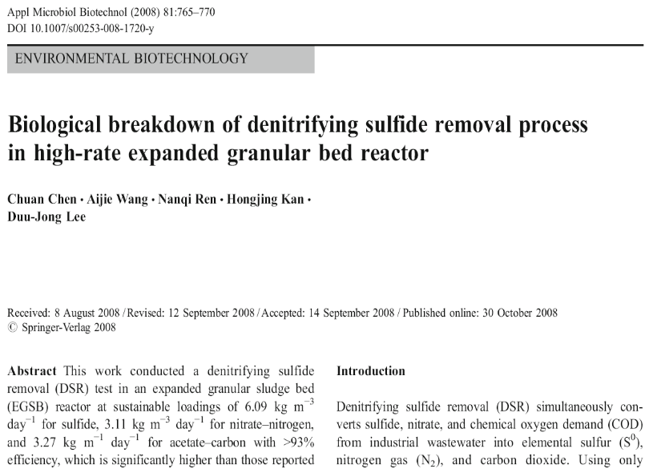
The optimum performance of DSR
The maximum capacity of EGSB-DSR process
Autotrophic bacteria：S²⁻ → S⁰
Heterotrophic bacteria：NO₃⁻ → N₂
Maximum sulfide loading
6.09kg/m³·d
Maximum sulfide loading: sulfide loading 0.294kg/m³·d
----- Reyes-Avila Jesus et al.，Wat Res., 2004, 38: 3313-3321

Slide 7
The problem of DSR in high C/N ratios
C/N 0.85 1.05 1.26 2
0.85 1.05 1.26 2
  Wth high C/N ratio, low S²⁻ removal and S⁰ recovery achieved
  Regulation strategy to solve the unbalance beteween soNRB and hNRB.

Slide 8
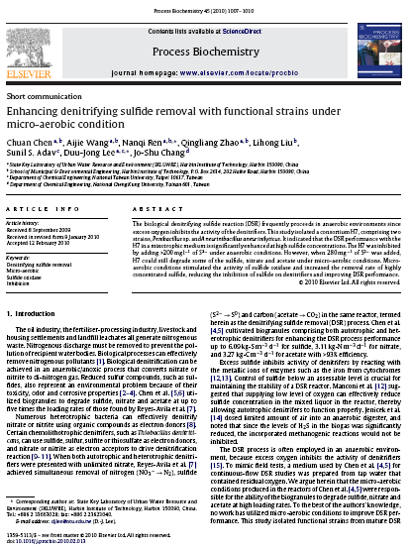
  Micro-aerobic condition increases S⁰ conversion
S²⁻
NO₃⁻
soNRB
S⁰
NO₂⁻
soNRB
NO₃⁻
S⁰
NO₃⁻
acetate
hNRB
NO₂⁻
SO₄²⁻
N₂
CO₂
  Under DO of 0.2-0.4mg/L, sulfide oxidation enhances significantly
2.0
Y8
70d
Axis2 (5.2%)
135d
C8
C5
115d
C6
Y1
125d
100d
15d
C1
-0.5
-0.5
Axis1 (35.1%)
2.5
Anaerobic
  micro-aerobic

Slide 9
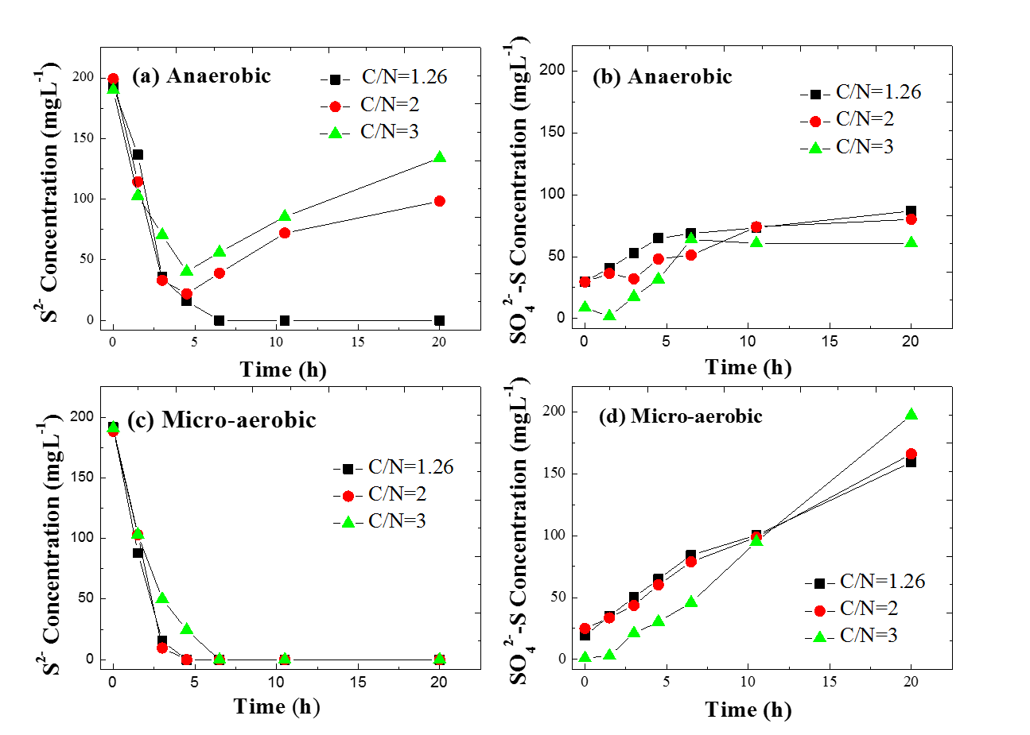
  Enhanced performance of DSR in high C/N ratios
  Batch tests
S/N=5/6
sulfide concentration “rebound” under C/N=2 and 3
C/N raio
“rebound”
concentration

Slide 10
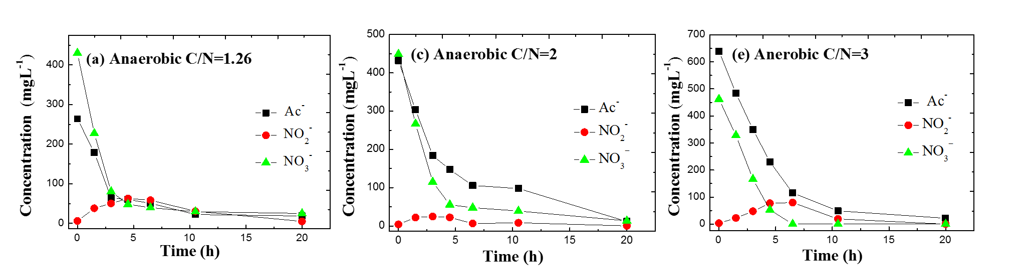
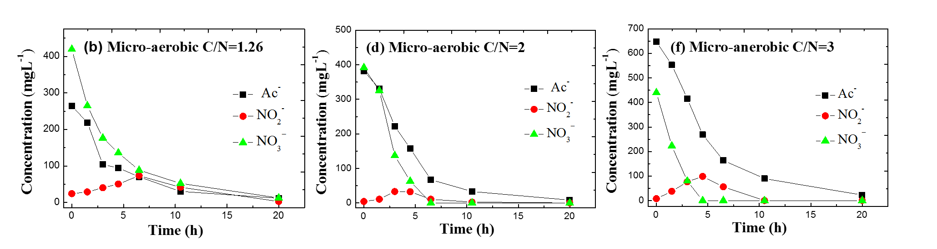
  Enhanced performance of DSR in high C/N ratios
  Batch tests
S/N=5/6
Complete degradation of Ac- and NO₃-
NO₂- accumulation

Slide 11
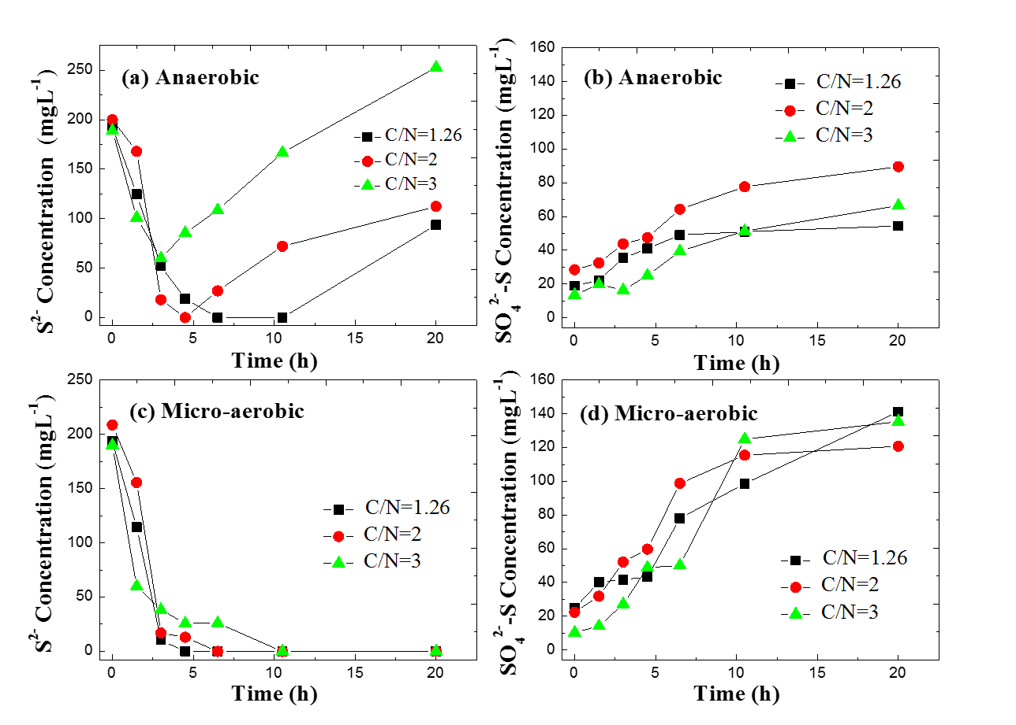
  Enhanced performance of DSR in high C/N ratios
  Batch tests
S/N=5/8
Anaerobic: rebound
Micro-aerobic: do not rebound
More than initial level

Slide 12
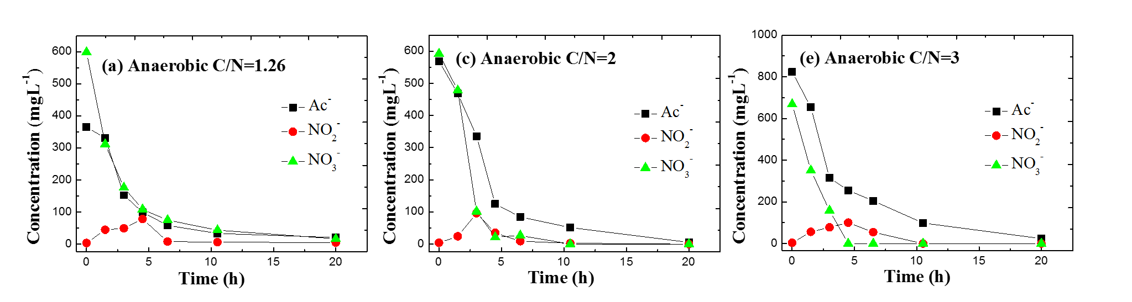
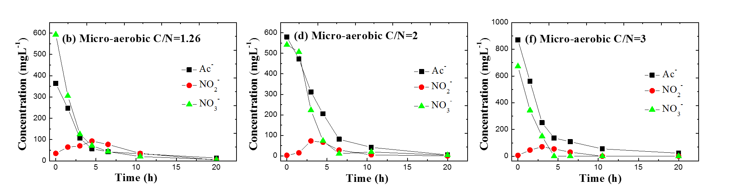
  Enhanced performance of DSR in high C/N ratios
  Batch tests
S/N=5/8
Same degredation rule as shown in S/N=5/6
Micro-aerobic: faster Ac- removal rate under C/N=3

Slide 13
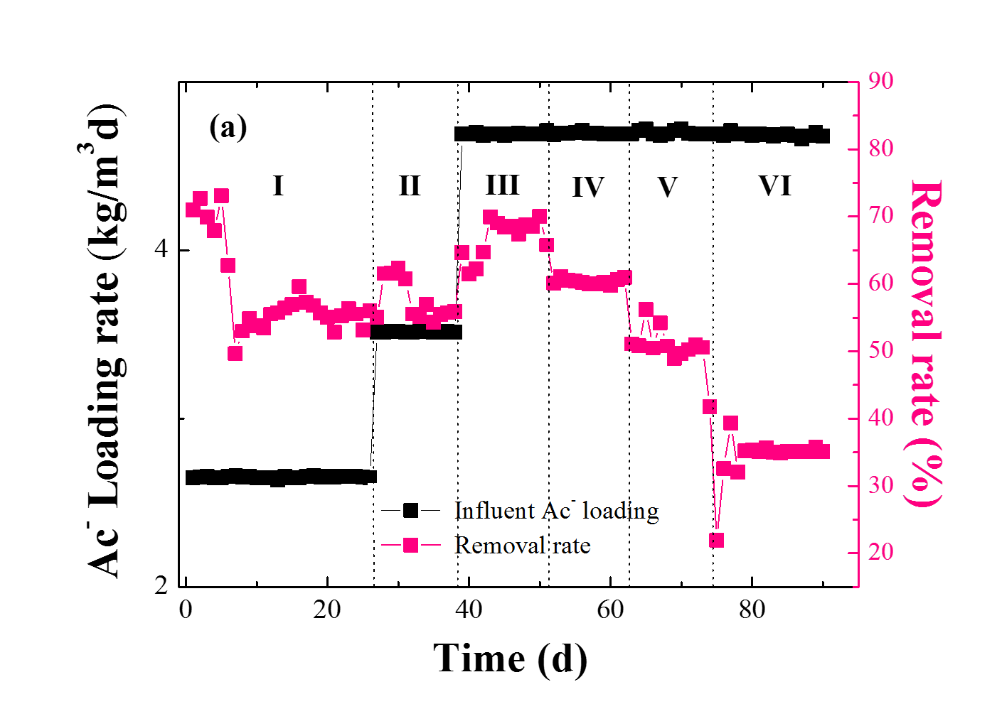
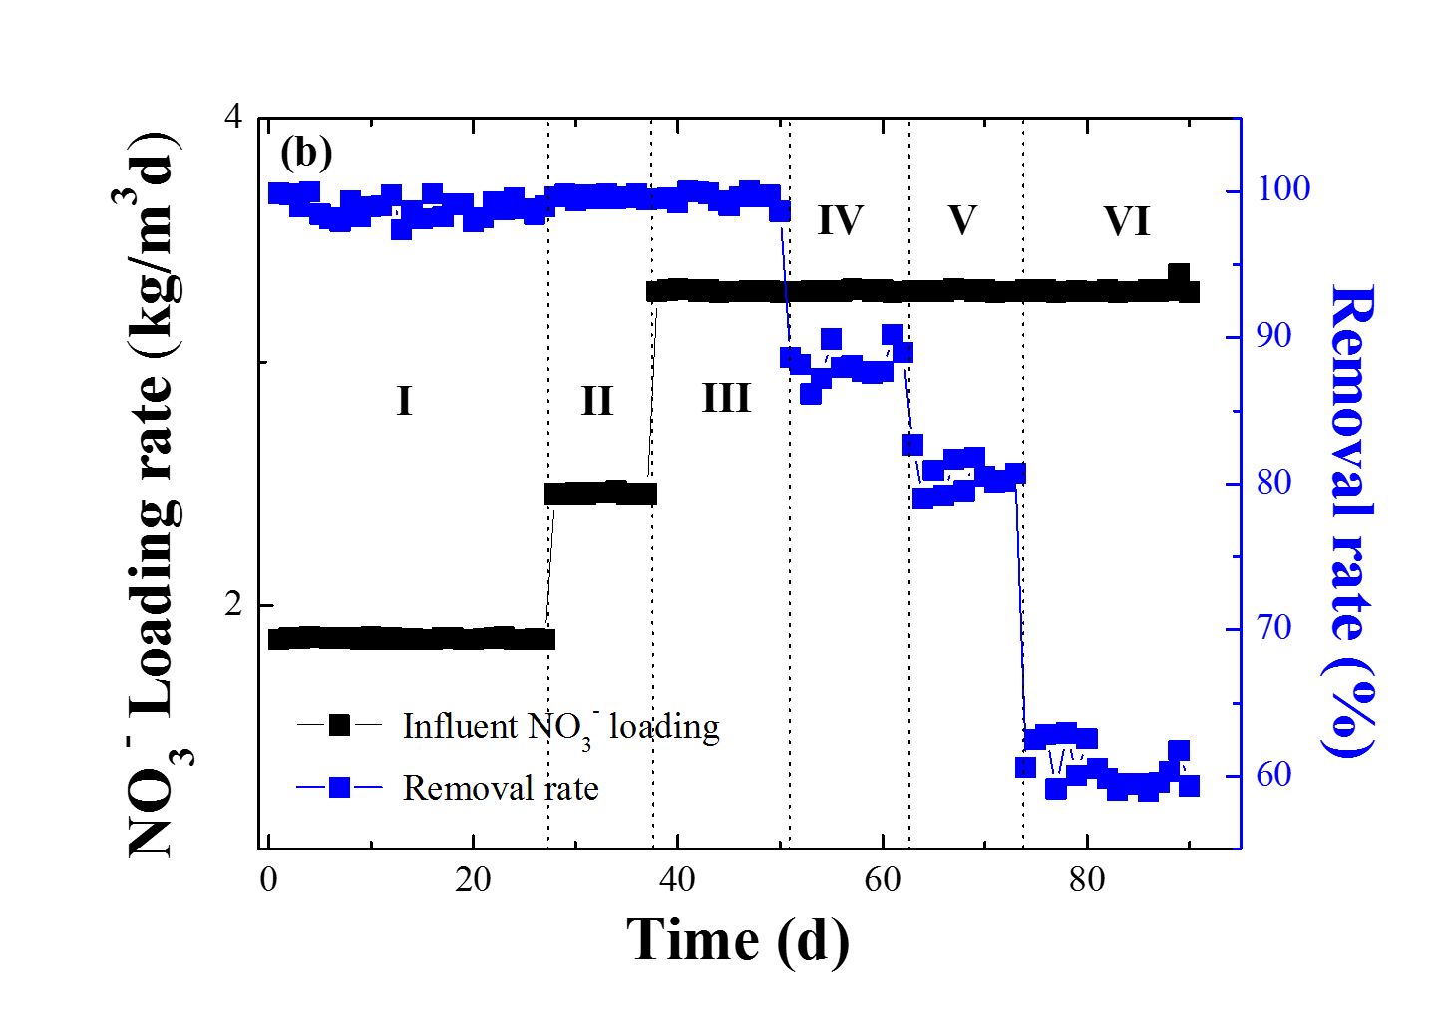
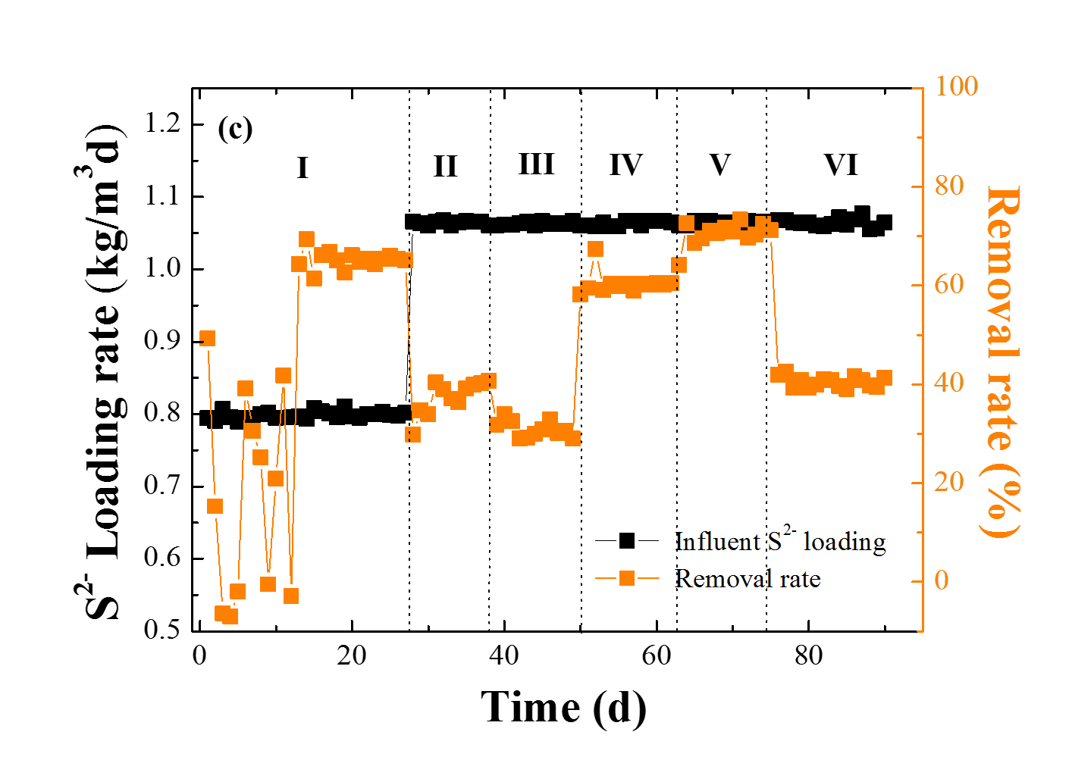
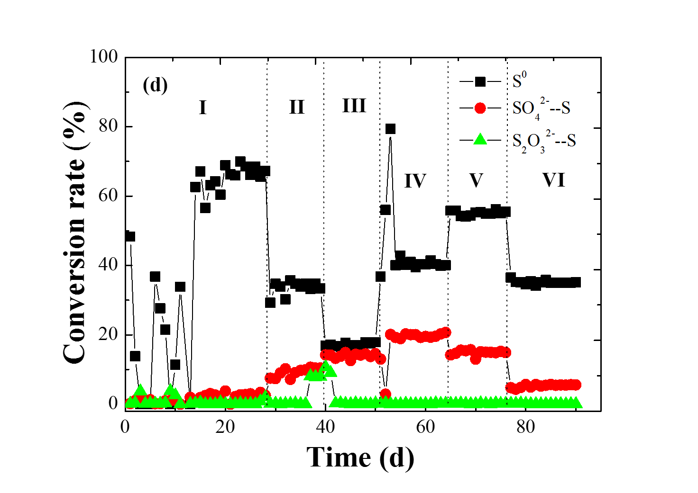
  Enhanced performance of DSR in high C/N ratios
  Continuous bioreactor
80% S²⁻ was removed and S0 recovery reached 55% at stage V (20 mL min⁻¹ L⁻¹, DO=0.2-0.3 mg/L )

Slide 14
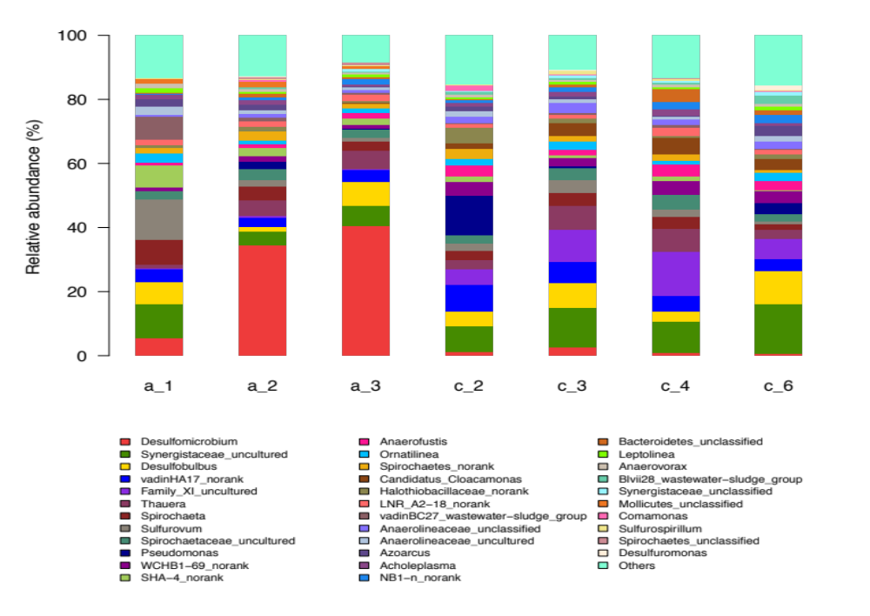
  Why is micro-aerobic enhanced performance obtained
  Microbial community analysis by Illumina
soNRB, including Sulfurovum, Pseudomonas,
Sulfurospirillum were much higher in proportion in micro-aerobic condition than in anaerobic condition

Slide 15
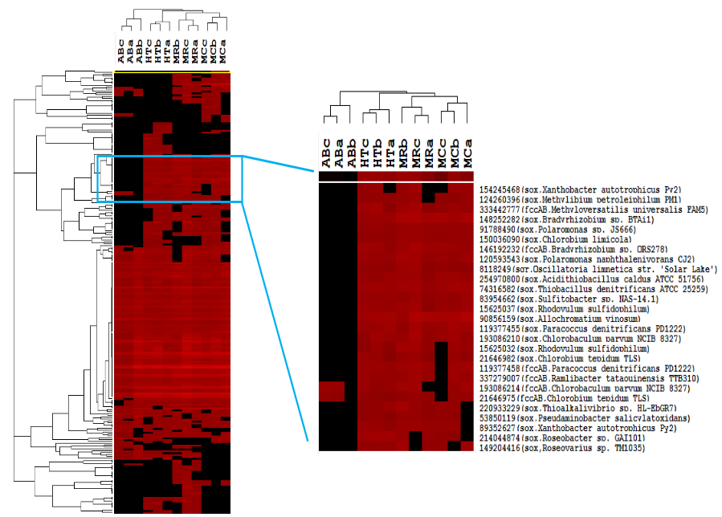
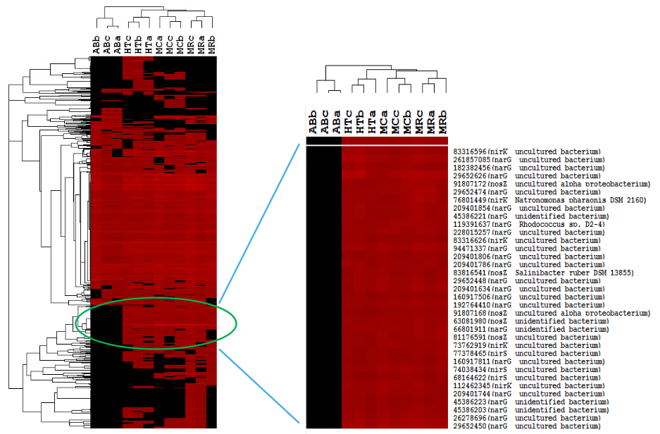
  Why is micro-aerobic enhanced performance
  Hierarchical cluster analysis of sulfur oxidizing genes
FccA/B genes
Sox gene
The abundance of SOB genes under micro-aerobic condition was significantly higher than that under anaerobic condition. These indicated that micro-aerobic had higher effect on sulfide oxidation and sulfur recovery
a,b,c: technical replicates

Slide 16
Proposed microbial relationships in micro-aerobic condition
SO₄²⁻
soNRB
Sulfurovum
SRB
Desulfomicrobium
Sulfurospirillum
COD
S₂O₃²⁻
soNRB
Sulfurovum
CO₂
NO₃⁻
soNRB
Sulfurovum
hNRB
Pseudomanas
Paracoccus
Sulfurospirillum
Alcaligenes
Micro-aerobic condition
NO₂⁻
S²⁻
hNRB
Pseudomanas
Paracoccus
Sulfurospirillum
N₂, NH₃
  Micro-aerobic condition can enhance activity of soNRB
  Micro-aerobic condition impact little on oxygen-sensitive SRB

Slide 17
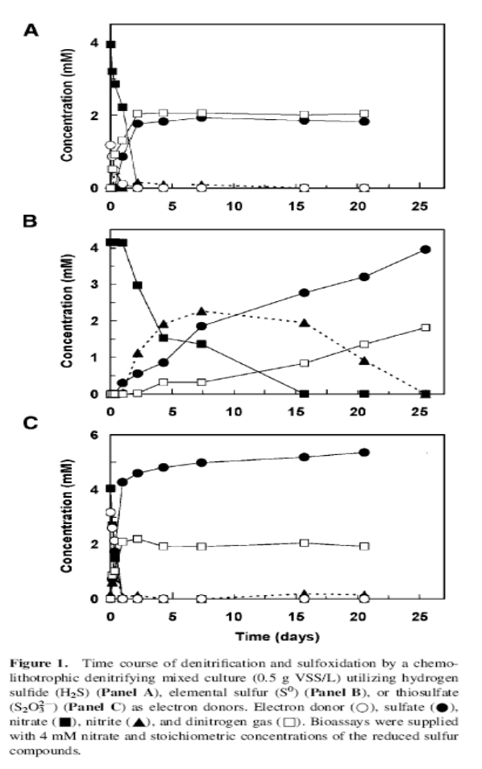
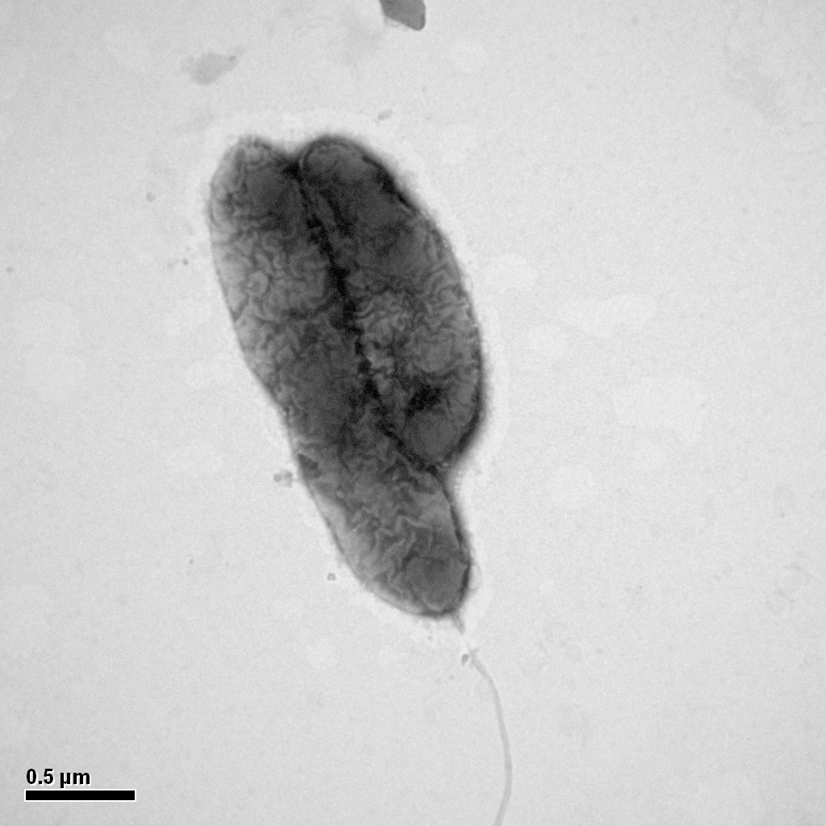
  Micro-aerobic enhanced performance by pure culture
  Breakthrough：Heterotrophic bacteria function in sulfide oxidation S²⁻ → S⁰
  Known theory: Heterotrophic bacteria function in denitrification NO₃⁻ → N₂
S²⁻
NO₃⁻
Autotrophic
S⁰
Autotrophic bacteria (T. denitrificans): 72 hours
NO₂⁻
Autotrophic
NO₂⁻
acetate
NO₃⁻
S⁰
Heterotrophic
N₂
CO₂
NO₂⁻
S₂O₃²⁻
Obtained
Pseudomonas sp. C27
Gene bank registration number ：GQ241351
S²⁻ 200mg/L
Heterotrophic bacteria (strain C27): 15 hours
S²⁻+2.4NO₃⁻+1.25CH₃COO⁻+0.95H₂O→
S⁰ +2.5CO₂+ 2N₂ +5.65OH⁻
Heterotrophic bacteria increase desulfurization and denitrification，sulfur transformation rate increase more than twice times.

Slide 18
  Micro-aerobic enhanced performance by pure culture
D0=0% Initial S²⁻=200mg/L S/N=5:6 C/N=3:1
S2-
NO3--N
Ac-C
NO2--N
D0=0-10%
S2-
S2O32-
NO3--N
Ac-C
NO2--N
The micro-aerobic condition (DO=0-10%) can enhance the performance of sulfide and nitrite removal

Slide 19
  Micro-aerobic enhanced performance by pure culture
D0=10-20%
S2-
Ac-C
NO3--N
NO2--N
D0=20-30%
Ac-C
S2-
NO3--N
NO2--N
The high DO (>10%) inhibited the denitrification of NO2- to NO_{X} and acetate removal.

Slide 20
  Micro-aerobic enhanced performance by pure culture
Protain concentations at different DO conditions
D0=0%
D0=0-10%
D0=10-20%
More than 500ppm sulfide, removal >80%
More than 500ppm sulfide, nitrate-N
removal >98%
Continuous flow using CSTR for C27
removal
removal
NO3--N
S2-
NO2--N

Slide 21
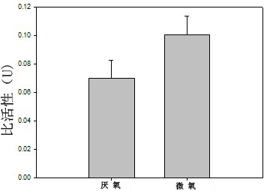
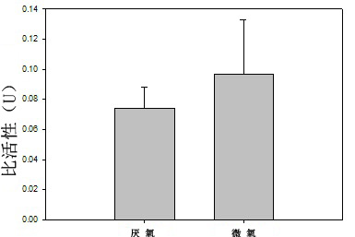
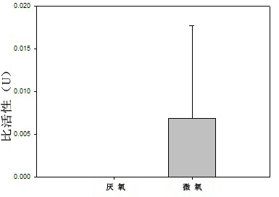
  Functional enzyme activity in Micro-aerobic condition
Sulfide oxidase Nitrate reductase
Specific activity (U)
Specific activity (U)
Anaerobic
Micro-aerobic
Anaerobic
Micro-aerobic
Nitrite reductase
Nitrite reductase activity inhibited by 200mg/L S²⁻
Enzyme activity were enhanced by micro-aerobic condition
Specific activity (U)
Anaerobic
Micro-aerobic

Slide 22
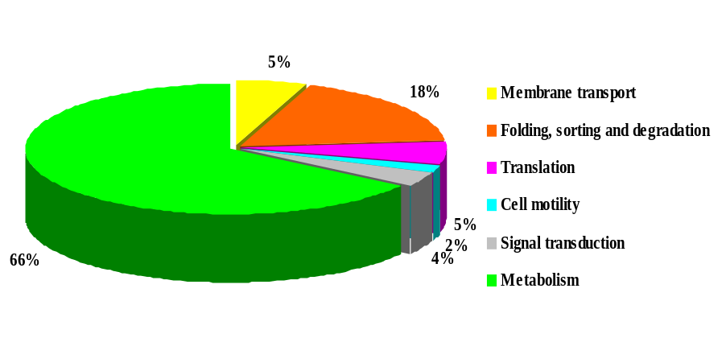
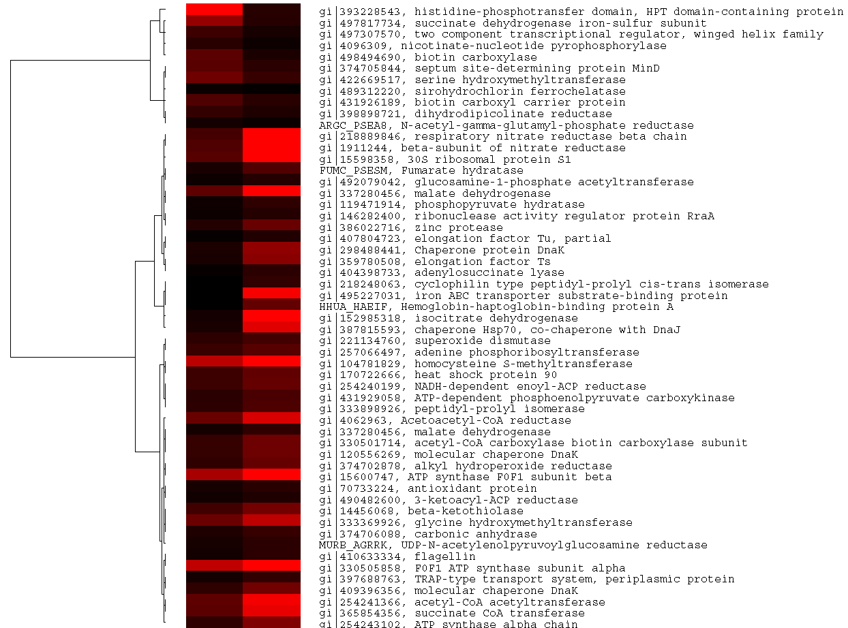
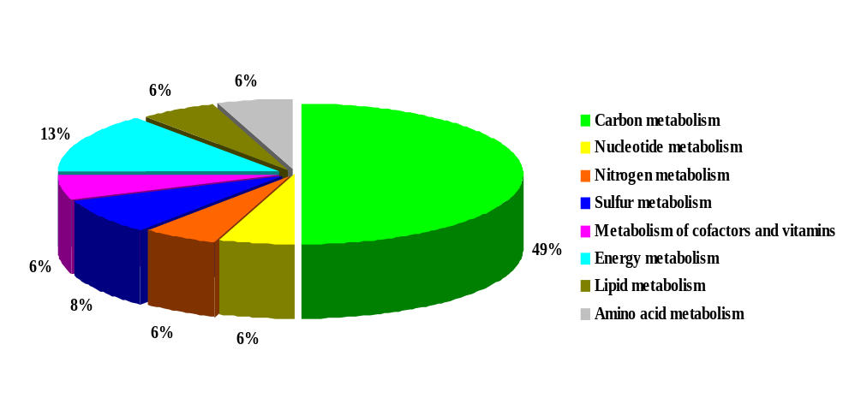
  Proteomic analysis of Pseudomonas sp.C27
micro-aerobic
anaerobic
Functional categorization of all identified proteins
Hierarchical cluster analysis
ClusterⅠ
Functional categorization of the proteins involved in metabolism
ClusterⅡ
totally 41 related proteins went up in micro-aerobic condition, compared with anaerobic condition

Slide 23
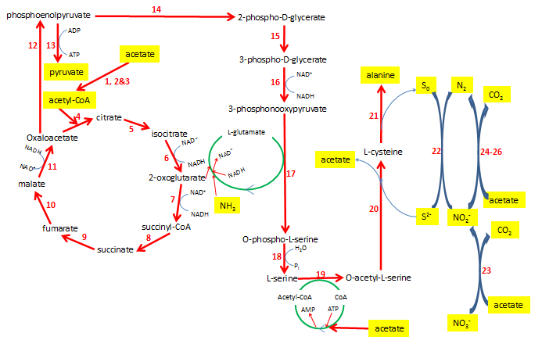
  Proteomic analysis of Pseudomonas sp.C27
1. gi|104782577
2. gi|472327168
3. gi|333901560
4. gi|146282233
5. gi|339486839
6. gi|146282649
7. gi|104782661
8. gi|397687799
9. gi|397687793
10. gi|28871476
11. gi|70733947
12. gi|431929058
13. gi|146308281
14. gi|472324702
15. gi|512688177
16. gi|146280793
17. gi|512619571
18. gi|346642691
19. gi|28868628
20. gi|28871054
21. gi|104780229
22. gi|431926008
23. gi|152987611
24. gi|397685765
25. gi|146283850
26. gi|116051410
The metabolic pathways of acetate degradation, sulﬁde oxidation and nitrate reduction for C27 in high C/N ratios. Nos. 27 and 28 are newly identiﬁed enzymes. Bioresource Technology, 2014, 171: 120-126.

Slide 24
  Summary and Future challenges
Feasible alternatives for DSR process under high C/N ratios in lab-scale mode.
Further parameters optimization and mechanisms exploration.
Verification with real wastewaters

Slide 25

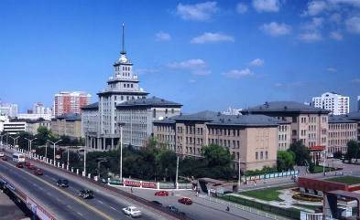

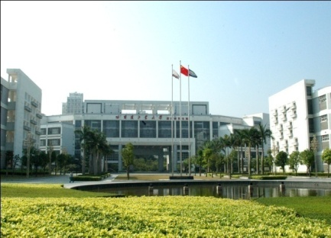
HIT— Where we are
HIT
Harbin Campus
Weihai Campus
Shenzhen Campus

Slide 26






HIT— Harbin city
St. Sophia Church
Ice-snow Festival

Slide 27
Thanks！
Any comments or questions?

