Slide 1


Multidimensional Mass Spectrometry Methods for Synthetic Polymer Analysis
Chrys Wesdemiotis
The University of Akron, Departments of Chemistry and Polymer Science, Akron, OH 44325
International Summit on
Current Trends in Mass Spectrometry
July 13-15, 2015 New Orleans, USA
Notes:
30 slides (including the title slide)

Slide 2
Mass spectrometry (MS): chemical analysis
based on mass (m/z) measurement
analyte
ionization
Key step
gas-phase
molecular
ions
MS
The m/z value of the molecular ions
reveals the composition of the analyte.

Slide 3
New ionization methods (MALDI, ESI, DESI, APCI) have enabled the MS analysis of a wide range of synthetic polymers and are now widely used to determine:
the compositional heterogeneity of new polymers
the identify of chain end groups
molecular weight distributions
functionality distributions
detection of minor products with exceptionally high sensitivity
Structural identification or confirmation - Insight on polymerization mechanisms - Assessment of commercial viability

Slide 4
Challenges in mass-based analysis
Polymerizations may create complex mixtures that are impossible to characterize by 1-D MS due to discrimination effects (in ionization or detection).
Isobaric components and isomeric architectures cannot usually be distinguished by m/z measurement alone.
With ESI, overlapping charge distributions complicate
mass determination and, hence, composition assignments.
Such problems can be addressed by 2-D MS (tandem mass spectrometry, MS²), and/or by interfacing MS with a separation method either before (LC-MS) or after ionization (ion mobility mass spectrometry, IM-MS).

Slide 5
Tandem (2-D) mass spectrometry
Characterization of individual end groups
Analysis of (co)polymer repeat units & sequences
Differentiation of polymer architectures (for example,
macrocycle vs. tadpole, or linear vs. branched)
C. Wesdemiotis, N. Solak, M.J. Polce, D.E. Dabney, K. Chaicharoen, B.C. Katzenmeyer,
Mass Spectrom. Rev. 30 (2010) 523-559

Slide 6
Tandem (2-D) mass spectrometry of polymers
MS-1 stage
Reaction
MS-2 stage
One oligomer ion,
among those formed
by MALDI or ESI,
is selected
The fragments are
mass-analyzed to
give the MS²
spectrum.
This ion is
induced to
fragment.
The structure (sequence) of the oligomer is determined
based on the types of fragments observed.

Slide 7
Tandem mass spectrometry of polymers
Characterization of individual end groups
Analysis of (co)polymer repeat units & sequences
Differentiation of polymer architectures (for example,
macrocycle vs. tadpole, or linear vs. branched)
C. Wesdemiotis, N. Solak, M.J. Polce, D.E. Dabney, K. Chaicharoen, B.C. Katzenmeyer,
Mass Spectrom. Rev. 30 (2010) 523-559

Slide 8
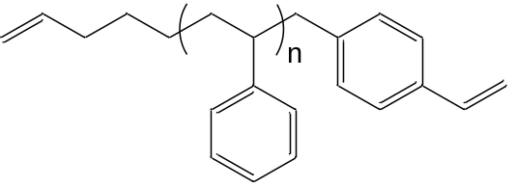
MALDI-MS
Polystyrene
α-C₅H₉ and ω-C₉H₉
end groups
2070.5 (19-mer)
Ag⁺
18
20
α
16
22
ω
14
24
12
26
28
n=10
30
32
34
36
1000
1500
2000
2500
3000
3500
4000
m/z

Slide 9
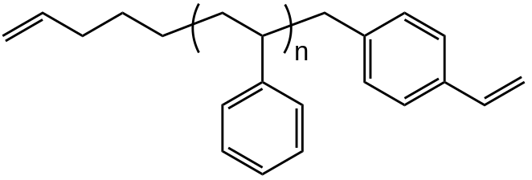
Ag⁺
MALDI-MS²
b₁•
m/z 2270.5 (19-mer)
280
z₁•
z₂•
*
a_{n} terminal fragments containing the α end group
314
K₃
y_{n} terminal fragments containing the ω end group
J₂•
^
419
b₂•
b₃•
(fragments revealing the individual α and ω chain ends)
2270.5
384
207
488
^
*
*
*
*
*
*
*
*
*
*
*
*
*
*
*
*
^
^
^
^
^
^
^
^
^
^
^
^
*
^
^
^
250
500
750
1000
1250
1500
1750
2000
m/z
Fragmentation pattern for linear PS chains: dominant low-mass fragments and less abundant medium- and high-mass fragments with individual end groups

Slide 10
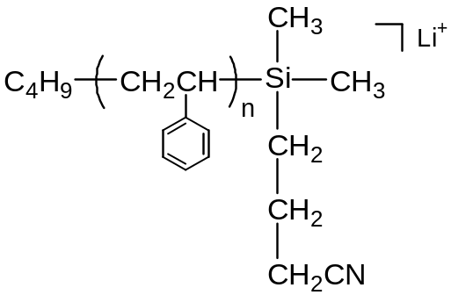
Polystyrene
[21-mer + Li]⁺
2375.5
Li⁺
MALDI-MS²
z₁●
223
y_{n}
^
terminal
fragments
K₃
319
linear structure
*
a_{n}
J₂●
b₁●
b₂●
202
596
2271
*
651
909
111
*
*
*
964
^
^
^
*
*
*
*
^
^
^
^
*
*
*
*
*
*
*
*
^
^
^
^
^
^
^
^
^
500
1000
1500
2000
m/z
Chain-end functionalization or cationization do not change the fragmentation pattern.

Slide 11
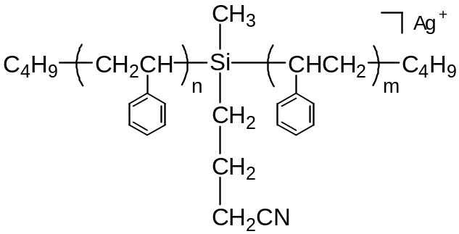
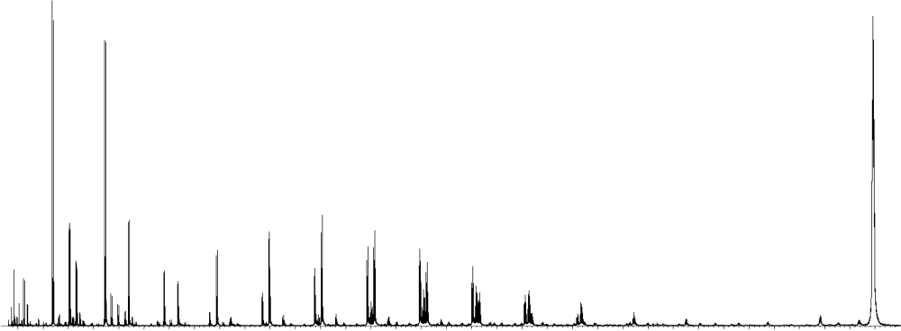
Polystyrene
MALDI-MS²
b₁•
[15-mer + Ag]⁺
1892.8
b₂•
in-chain substituted structure
An in-chain functional group leads to a unique fragmentation pattern and, thus, can be differentiated from a chain-end group.
J₂•
K₃
K_{3μ}
a₇
a₆
a₈
a₅
b₇
b₈
b₁⁺
K₂
a₄
b₆
a₉
b₉
b₅
b_{n} series with the
in-chain substituent
b₄
a_{6b}
a_{7b}
a_{8b}
a_{9b}
500
1000
1500
m/z

Slide 12
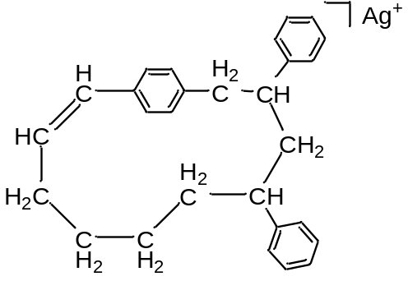
Polystyrene
MALDI-MS²
2555.7
n-1
Cyclic architectures also yield a distinct fragmentation pattern, based on which they can be conclusively identified.
2451.6
cyclic structure
-104
[23-mer + Ag]⁺
2347.4
302
2243.3
-104
2658.5
419
1291.1
1395.2
2139.1
1187.0
1499.3
1082.9
1603.4
1707.4
192.6
978.8
1811.6
1929.8
2033.8
-104
770.6
874.7
-104
500
1000
1500
2000
m/z
C. Wesdemiotis, N. Solak, M.J. Polce, D.E. Dabney, K. Chaicharoen, B.C. Katzenmeyer, Mass Spectrom. Rev. 30 (2011) 523
A.M. Yol, D.E. Dabney, S.-F. Wang, B.A. Laurent, M.D. Foster, R.P. Quirk, S.M. Grayson, C. Wesdemiotis, J. Am. Soc. Mass Spectrom. 24 (2013) 74

Slide 13
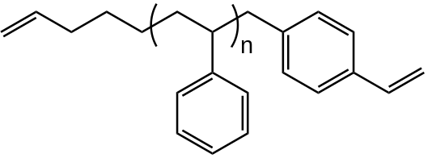
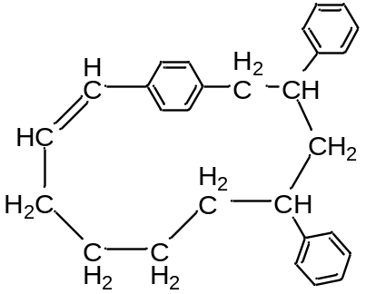
Differentiation of polymer architectures by MS²
Abundant low-mass fragments
chain-end substituted structure
2270.5
250
500
750
1000
1250
1500
1750
2000
m/z
Abundant high-mass fragments
macrocyclic structure
n-1
2658.5
500
1000
1500
2000
m/z
A.M. Yol, D.E. Dabney, S.-F. Wang, B.A. Laurent, M.D. Foster, R.P. Quirk, S.M. Grayson, C. Wesdemiotis, J. Am. Soc. Mass Spectrom. 24 (2013) 74

Slide 14
Differentiation of polymer architectures by MS²
Abundant low-mass fragments
2375.5
chain-end substituted structure
500
1000
1500
2000
m/z
macrocyclic structure
Abundant high-mass fragments
2658.5
500
1000
1500
2000
m/z
in-chain substituted structure
1892.8
Fragment distribution
in mid-mass range
500
1000
1500
m/z

Slide 15
Chromatographic separation
(Most efficient for amphiphilic polymers)

Slide 16

Online LC-MS of polymers
The most widely used HPLC method for synthetic polymers is gel permeation chromatography (GPC), which separates according to hydrodynamic volume (size).
Interactive LC (adsorption-mode LC), which separates based on chemical composition, functionality and mass, is less common in polymer analysis. Nevertheless, it is ideally suitable for the separation of oligomer mixtures with constituents of different polarities.
V. Scionti, B.C. Katzenmeyer, N. Solak Erdem, X. Li, C. Wesdemiotis, Eur. J. Mass Spectrom. 18 (2012) 113.
N. Solak Erdem, N. Alawani, C. Wesdemiotis, Anal. Chim. Acta 808 (2014) 83-93.

Slide 17
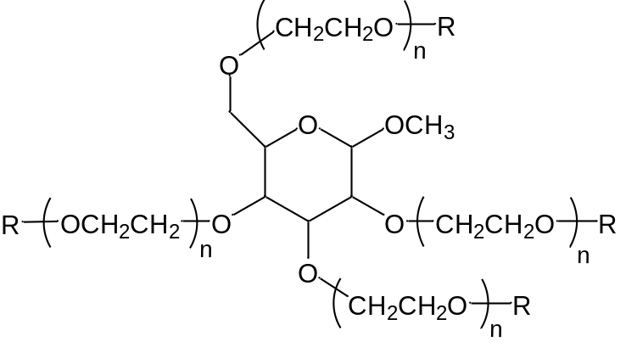


PEO-glucam sesquistearate (nonionic surfactant)
R = (stearate) or H
n_{avg} ≈ 5; ~1.5 mol stearate per mol surfactant
Generally a mixture of:
PEO-glucam mono and multiple stearates
PEO + stearates
V. Scionti, B.C. Katzenmeyer, N. Solak Erdem, X. Li, C. Wesdemiotis, Eur. J. Mass Spectrom. 18 (2012) 113.
N. Solak Erdem, N. Alawani, C. Wesdemiotis, Anal. Chim. Acta 808 (2014) 83-93.

Slide 18
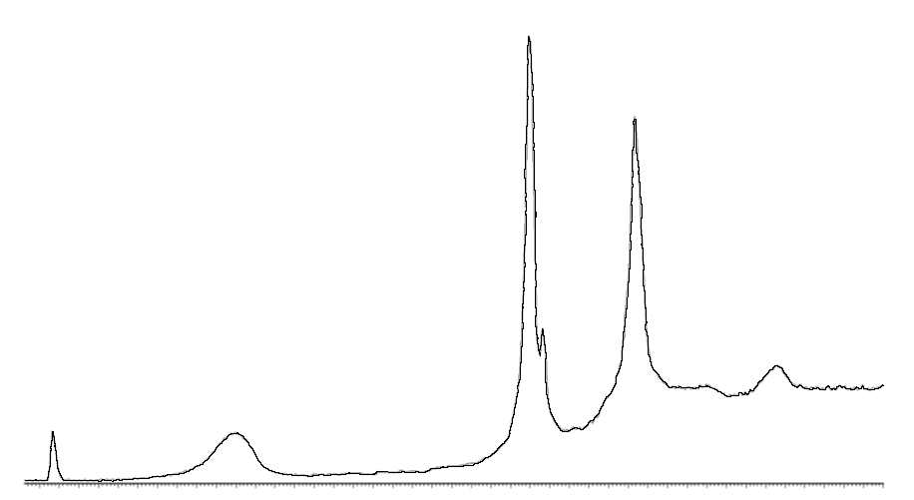
PEO-glucam sesquistearate (nonionic surfactant)
1
PEO-glucam monostearate
RP-UPLC
6.48
PEO-glucam distearate
7.83
PEO-glucam tristearate
PEO
monostearate
PEO
distearate
PEO
aggregates
PEO
6.66
9.66
0.41
2.74
0.00
2.75
5.50
8.25
Time [min]
11.00
hydrophobicity
Solvent A: 2.55 mM NH₄OAc in 97% H₂O / 3% MeOH – Solvent B: MeOH – Flow rate 0.4 mL/min
A / B : 100:0 → 60:40 (0-2 min); 60:40 → 40:60 (2-3 min); 40:60 → 0:100 (3-7 min); 100% MeOH (>7 min)
Notes:
2.74 min = longer chains that cannot interact with each other strongly enough to form association products
HPLC: particle size 5 u, pressure 6000 psi (~400 bar)
UPLC: particle size 1.7 u, pressure up to 15000 psi (1034 bar)

Slide 19
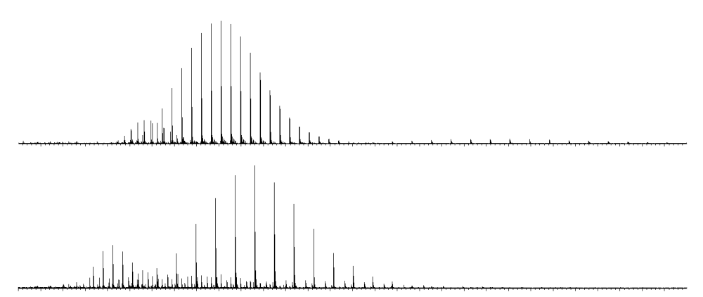
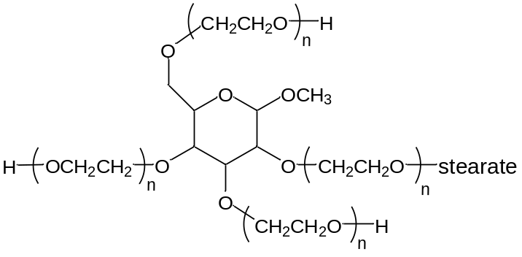
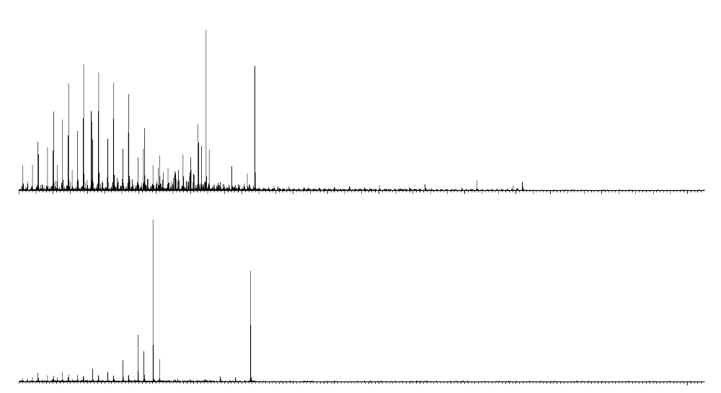
LC-MS & LC-MS² analysis of peak
1
1
754.498
2+
LC-MS
■
■
■
■
■
Accurate m/z: [M + 2NH₄]²⁺ of
(PEO)_{n}-glucam monostearate
with n = 26
■
■
6.48 min
■
■
3+
■
■
■
■
1+
◆
■
44 Da
◆
◆
◆
■
◆
■
◆
■
◆
■
◆
◆
■
■
■
✚
✚
✚
✚
✚
✚
✚
✚
✚
✚
✚
✚
✚
✚
✚
300
675
1050
1425
m/z
LC-MS²
645.39
PEO-glucam monostearate
333.2
787.544
[M + 2Li]²⁺
(n = 28)
245.2
44
Da
-284
1 stearic
acid loss
*311.3
1284.82
1568.09
100
600
1100
1600
m/z

Slide 20
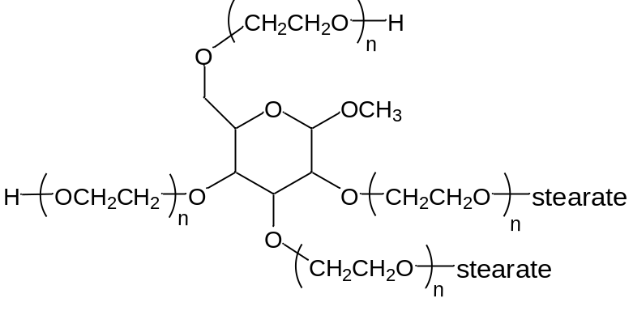
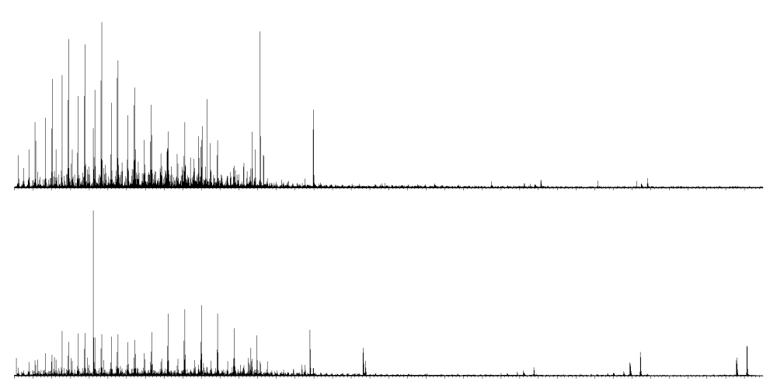
LC-MS & LC-MS² analysis of an oligomer in peak
2
2 x 284 Da
stearic acid
loss
LC-MS²
PEO-glucam distearate
333.2
756.420
245.2
-284
-284
*311.3
44
Da
614.291
898.549
[M + 2Li]²⁺
(n = 29)
1222.553
1506.867
1790.116
200
400
600
800
1000
1200
1400
1600
1800
m/z
Complete mixture separation & characterization based on polarity.

Slide 21
Faster separation with ion mobility mass spectrometry (IM-MS)

Slide 22
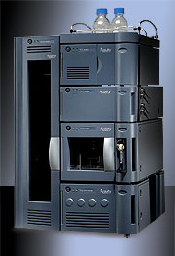
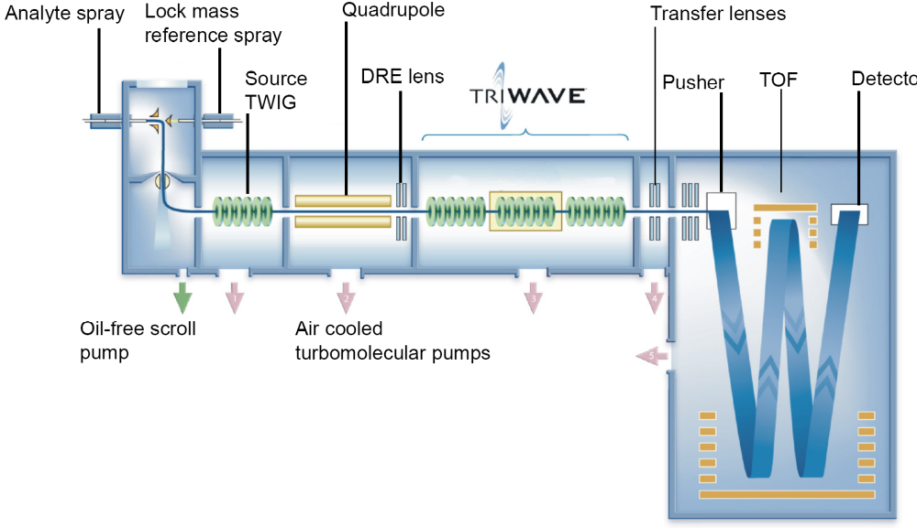
IM-MS using an
ESI-Q/ToF mass spectrometer
LC
system
trap
IM
transfer
ion mobility region
All ions coming from the ion source, or ions selected by Q can be gated to the IM cell, where they travel in an electric field against the flow of N₂ gas. This causes separation based on charge and collision cross-section, a function of size (mass) and shape.

Slide 23
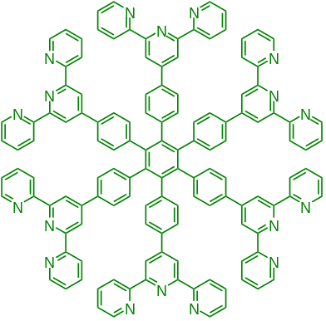
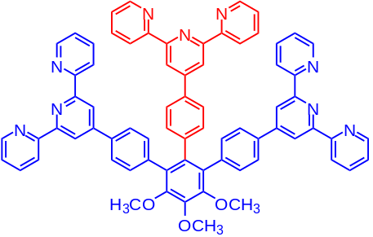


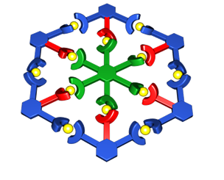
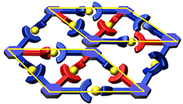
Differentiating 2D and 3D supramolecular
architectures by ESI-IM-MS & gMS²
rim ligand R3
core ligand R3
core ligand T6
Zn^{II}
Zn^{II}
2D
wheel
3D
wheel
(PF₆‾ counterions)
J.-L. Wang, et al., J. Am. Chem. Soc. 133 (2011) 11450;
X. Lu et. al., J. Am. Chem. Soc. 136 (2014) 18149
[T6₁–Zn₁₂–R3₆]
[R3₂–Zn₁₂–R3₆]

Slide 24
3D spoked wheel
[R3₂–Zn₁₂–R3₆]
ESI-MS
Confirms molecular composition and mass (12985.7 Da)
ESI-IM-MS
Confirms isomeric purity (single architecture)

Slide 25
Architecture and stability
insight on 2D vs. 3D wheel
2D
3D
[T6₁–Zn₁₂–T3₆]
12726.4 Da
[R3₂–Zn₁₂–R3₆]
12985.7 Da
CCS
1603 Å²
1550 Å²
E_{cm} (11+)
1.57 eV
1.35 eV
A lower CCS (collision cross-section) is found for the 3D wheel, despite its higher mass, corroborating its compact, more globular architecture). TEM cannot detect such relatively small differences.
Meanwhile, the lower disappearance E_{cm} for the 3D wheel indicates a lower thermal stability, consistent with the noncovalent binding in its core.

Slide 26
Top-down approaches for large, labile, or not directly ionizable materials via
ESI or ASAP coupled with IM-MS / MS²
ASAP = analysis of solids at atmospheric pressure
(mild thermal degradation in an atmospheric pressure chemical ionization source)

Slide 27
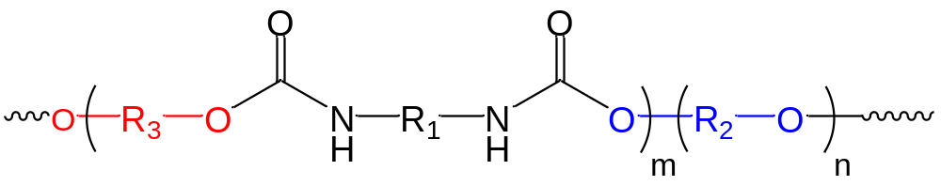
Thermoplastic polyurethanes
diol
chain
extender
+
diisocyanate
polyol
(small diol)
(aromatic or aliphatic;
linear or cyclic)
(polyether diol;
polyester diol;
PDMS diol)
hard segments (m)
soft segments (n)
Notes:
Elastollan (BASF)
Source T = 120 ºC
Desolvation T = 250 ºC (at 1200 l/h)
WH = 9.5 V
WV = 300 m/s

Slide 28
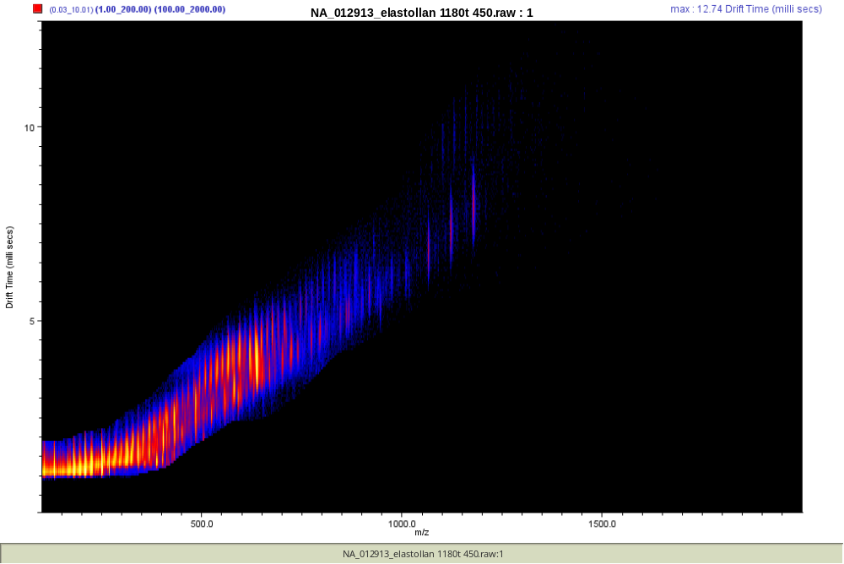
ASAP-IM-MS of a polyurethane PU-1; elastollan
Mild thermal degradation → APCI → IM separation (by CCS) → ToF mass analysis (m/z)
450 ºC
10
d
drift time (ms)
c
b
5
a
500
1000
1500
m/z

Slide 29
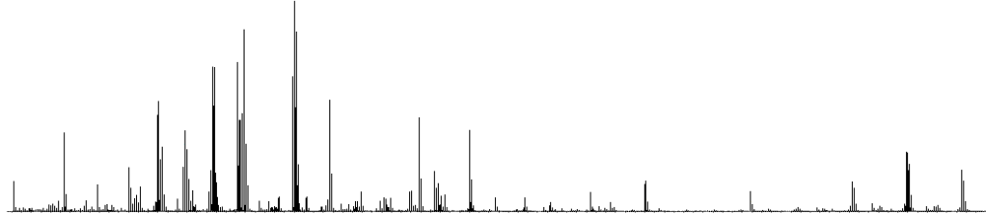
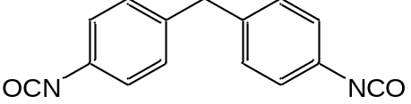
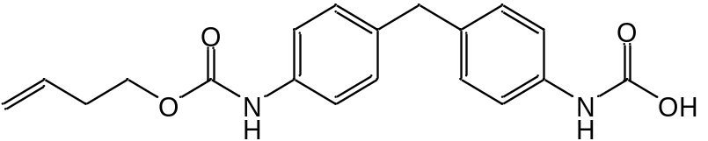
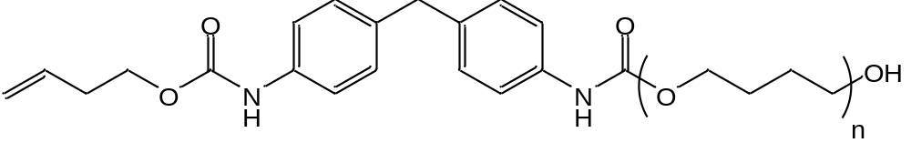
ASAP-IM-MS of PU-1; high T (450 ºC) products
IM region
a
250
224
MDI
1 hard + n soft segment units
208
180
268
314
132
194
340
72
Da
412
72
Da
72
Da
556
564
106
322
430
536
592
484
120
220
320
420
520
m/z
hard segment
MDI
BDO
MDI
(n = 1-3)
hard segment
soft segment
72-Da repeat unit and m/z values are consistent with poly(tetrahydrofuran), PTHF, as the soft segment and 1,4-butanediol, BDO, as the chain extender (structures confirmed by MS²).

Slide 30
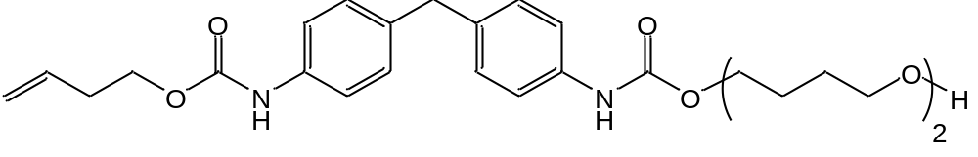
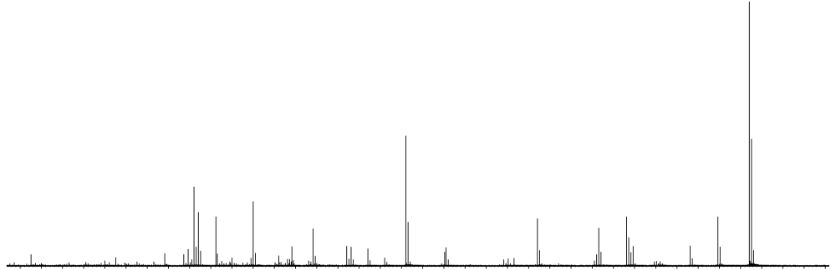
Verification of ASAP products from PU-1 by MS²
340.2
1 hard + 2 soft segment units
484.3
413.2
322.2
MDI
322.2
485.3
222.1
224.1
250.1
426.3
469.3
232.1
278.2
384.2
368.2
413.2
456.3
340.2
150
200
250
300
350
400
450
500
m/z

Slide 31
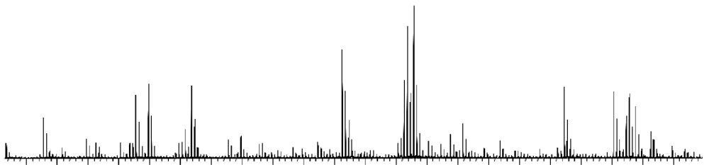
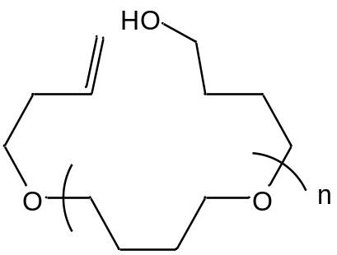
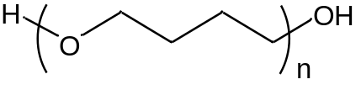
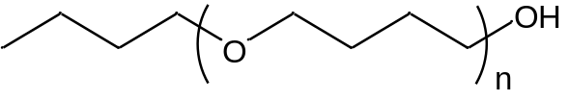
ASAP-IM-MS of PU-1; high T (450 ºC) products
795.7
IM region
b
%
793.7
772.5
#
865.8
*
867.8
709.6
723.6
844.6
860.6
%
*
#
675.5
811.7
%
#
739.6
$
872.6
$
*
$
879.7
680
720
760
800
840
m/z
1 hard + n (5-7) soft segment units
*
soft segment chains
#
$
soft segment chains
%
Series with a 72-Da repeat unit

Slide 32
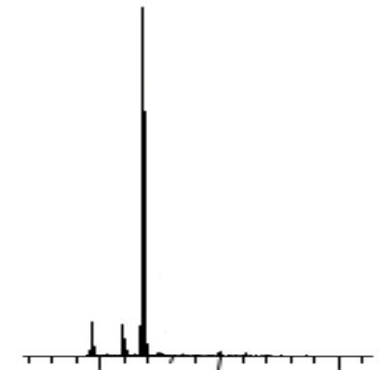
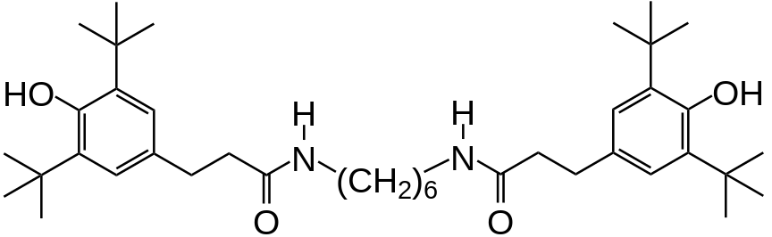
ASAP-IM-MS PU-1; high T (450 ºC) products
IM region
c
636.5
592.6
600
800
m/z
Irganox 1098

Slide 33
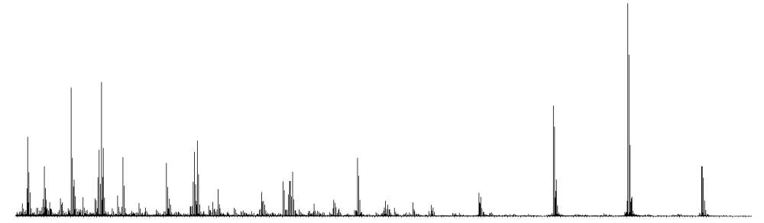
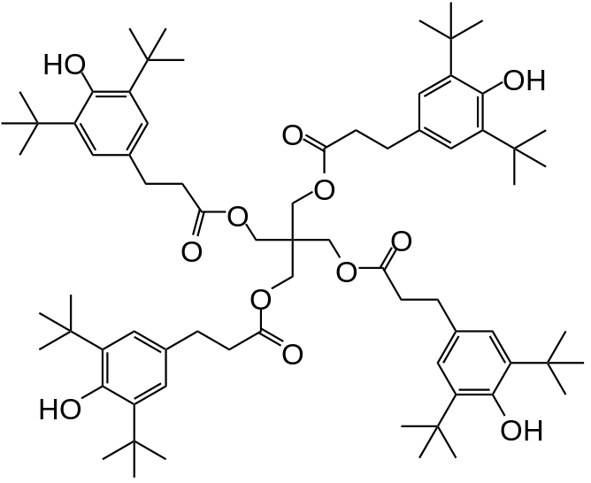
ASAP-IM-MS of PU-1; high T (450 ºC) products
IM region
d
1120.8
700.4
723.6
one ester bond hydrolyzed
1064.7
656.5
795.7
[M-tBu]⁺
739.6
793.6
680.3
772.5
867.7
916.6
1176.8
811.7
844.6
865.7
56
Da
1008.6
56
Da
56
Da
700
800
900
1000
1100
m/z
1200
Irganox 1010

Slide 34
Peptide (Protein) - Polymer Hybrid Materials
Hybrid materials usually consist of covalently linked peptides (or proteins) and synthetic polymers. Over the last decade, they have experienced increasing use in medicine and materials science, in a variety of consumer, industrial, and biomedical applications.
Challenges in their characterization:
Peptide-polymer conjugates are difficult to crystallize for X-ray analysis.
Such hybrids cannot often be chromatographically purified for definitive NMR analysis
Alternative solution: top-down MS, involving tandem MS (MS²) and ion mobility mass spectrometry (IM-MS).
A. Alalwiat, S.E. Grieshaber, B.A. Paik, X. Xia, C. Wesdemiotis, Analyst, submitted (July 2015)

Slide 35
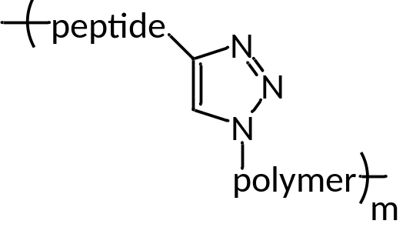


Elastin Mimetic Hybrid Copolymer
Hydrophilic domains (K and A rich) for crosslinking
Elastin: extracellular protein providing elasticity to soft tissues (lungs, skin, arteries, etc.)
+
Flexible hydrophobic domains (V, G, and P rich) for coacervation
+
click rxn.
VPGVG–VPGVG
poly(acrylic acid)
“VG2”
(in hydrophobic elastin domains)
PAA
(pH-responsive & functionalizable)
X. Jia et al., Soft Matter 9 (2013) 1589-99
Notes:
PAA: forms pH-responsive micelles, vesicles, hydrogels, and copolymer micelle-crosslinked hydrogels.

Slide 36
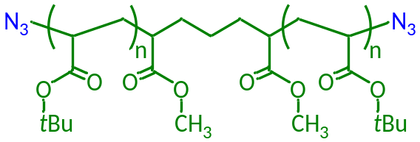
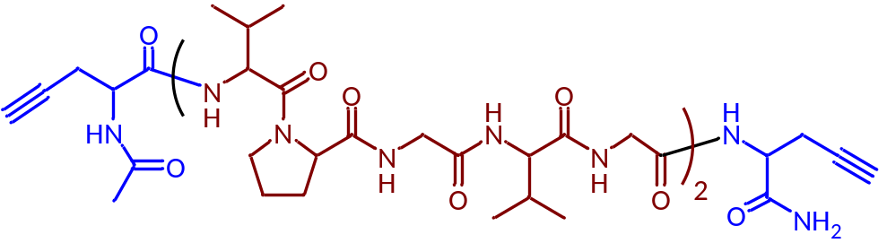
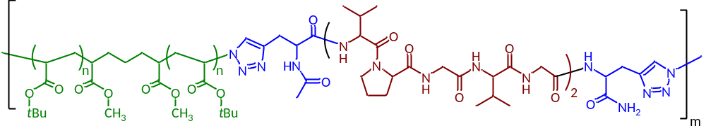
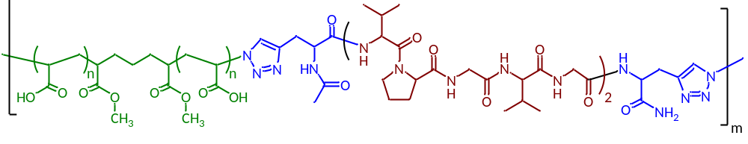
Hybrid material
[PAA‒VG2]_{m}
+
PtBA
VG2
Cu(I)
DMF
TFA
[PtBA‒VG2]_{m}
[PAA‒VG2]_{m}

Slide 37
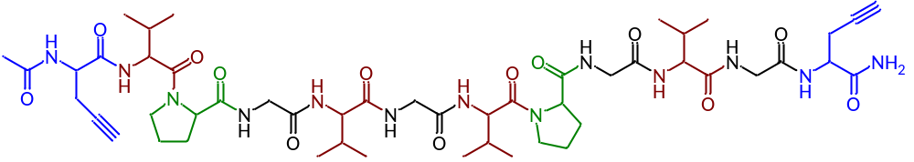
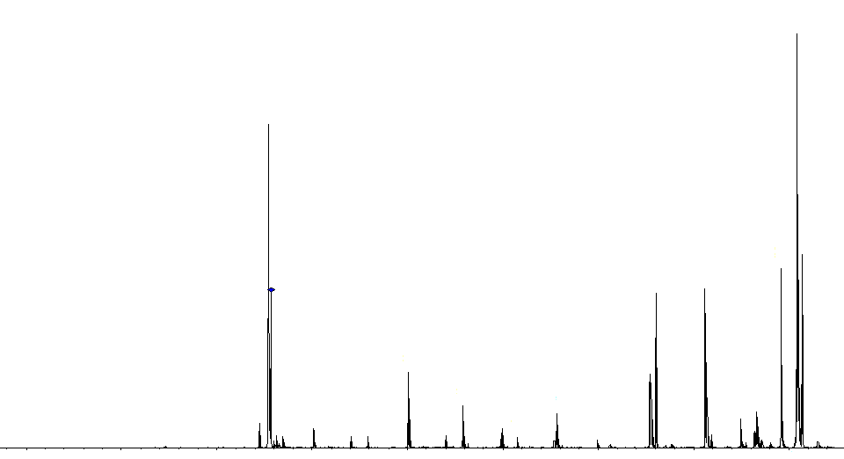
z₁₀
c₇
y₈
y₇
y₆
c₆
[VG2+Na+17]⁺
1107.5
a₇
c₈
c₉
c₁₀
a₂
c₅
c₄
a₆
VG2
553.6
[VG2+2Na]•⁺
ESI-MS² (ETD)
[VG₂+Na+17]•⁺²
[VG2+2Na]⁺²
c₁₀•+17
[VG2+ Na]⁺
VG2 sequence confirmed by MS²
z₁₀•*
1113.5
1011.5
1090.6
c₆•+17
959.4
c₅•+17
701.2
c₉•+17
602.1
y₇
c₄•+17
y₈
c₈•+17
700.2
c₇•+17
954.4
545.2
y₆
a₆
a₇
757.2
855.3
601.1
798.3
640.1
658.1
739.2
814.3
500
600
700
800
900
1000
m/z
Notes:
400 ms reaction time

Slide 38
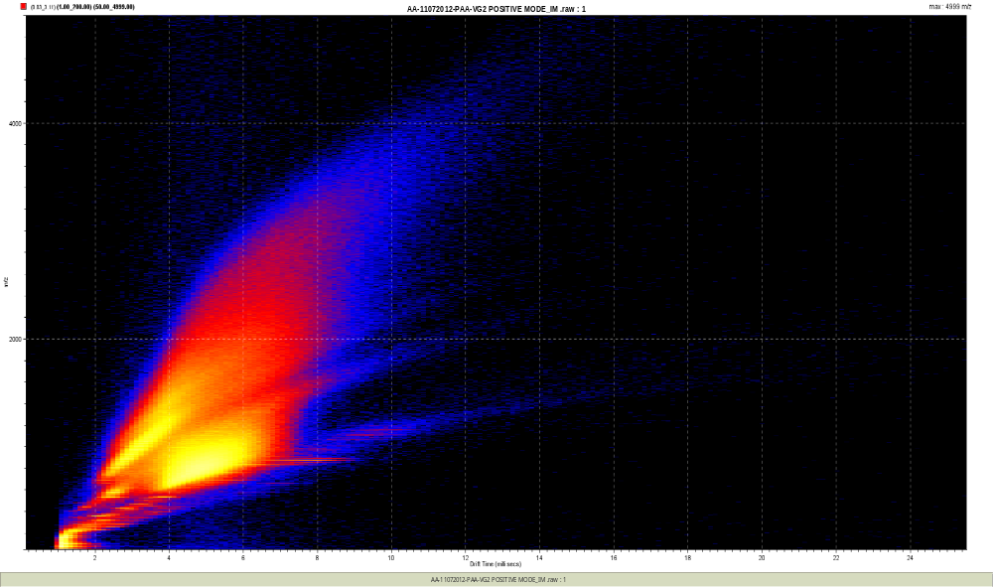
Hybrid material / [PAA‒VG2]_{m}
m/z
3000
PAA–VG2
ESI-IM-MS
2000
NH₄OAc (pH = 6.64)
+ 1% MeOH
3+
2+
1000
PAA (n+)
PAA–PtBA (n+)
PAA–PtBA–VG2 (n+)
2
4
6
8
drift time (ms)
IM-MS removes chemical noise and separates the desired amphiphilic hybrid both by charge state as well as from incompletely hydrolyzed hybrid and unreacted polymer to enable conclusive compositional characterization.

Slide 39
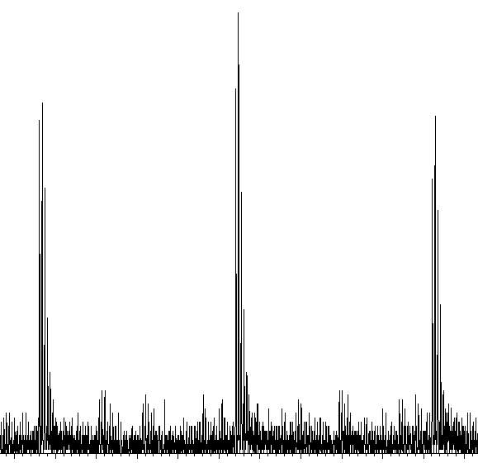
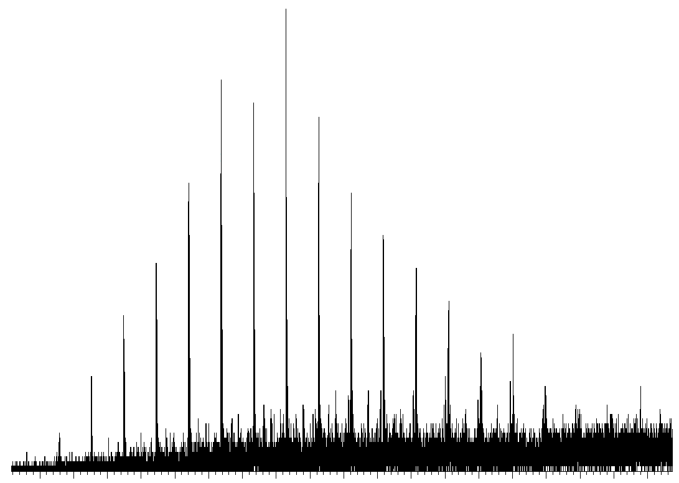
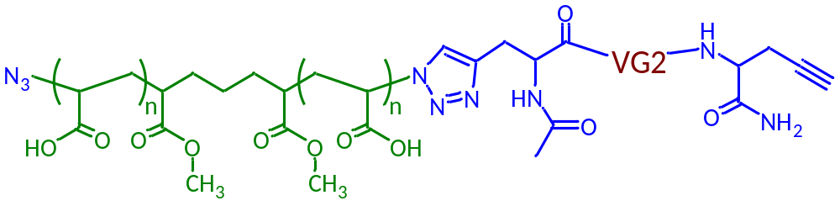
Hybrid material / [PAA‒VG2]_{m}
ESI-IM-MS
PAA₁₄
PAA₁₅
807.074
PAA₁₆
3+
783.043
831.076
780
790
800
810
820
830
m/z
807.07
759.04
783.07
831.08
735.03
855.04
[M+3H]³⁺
711.04
879.09
903.10
687.03
927.12
663.01
951.14
650
700
750
800
850
900
950
1000
m/z
ESI-IM-MS provides conclusive evidence for the formation of hybrid material with one constituent PAA–VG2 block, [PAA–VG2]₁:
Multiple blocks?

Slide 40
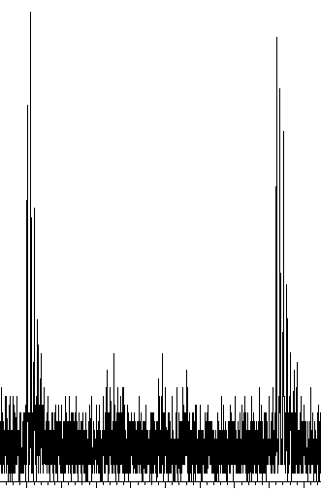
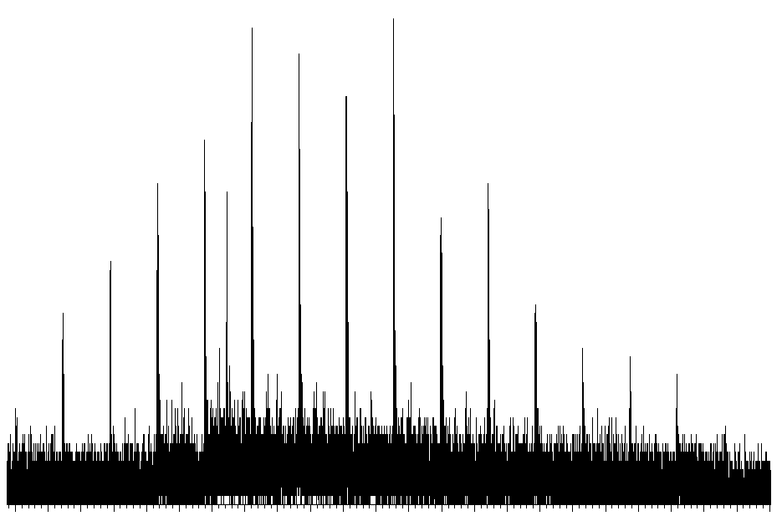
Hybrid material / [PAA‒VG2]_{m}
ESI-IM-MS
PAA₁₀
PAA₁₁
1030.06
1066.07
2+
1030
1040
1050
1060
1070
m/z
1030.06
1066.07
1138.10
1102.07
958.02
994.03
1210.14
1174.12
[M+2H]²⁺
895.97
922.00
1246.14
1282.14
1318.18
1354.21
900
1000
1100
1200
1300
m/z
ESI-IM-MS provides conclusive evidence for the formation of hybrid material with one constituent PAA–VG2 block, [PAA–VG2]₁:
Multiple blocks?

Slide 41
Hybrid material / [PAA‒VG2]_{m}
[PAA₁₀‒VG2]₁
[M+2H]²⁺
m/z 1030
ESI-IM-MS
5.42
[PAA₁₀‒VG2]₂
[M+4H]⁴⁺
6.95
[PAA₁₀+K]⁺
& [PAA₂₄+Na+K]²⁺
3.88
IM-MS on mass-selected ions confirms the formation of a multiblock hybrid copolymer.
0.00
2.50
5.00
7.50
10.00
drift time (ms)
[PAA₁₂‒VG2]₁
[M+2H]²⁺
m/z 1102
5.96
[PAA₁₂‒VG2]₂
[M+4H]⁴⁺
4.06
7.13
[PAA₁₁+K]⁺
& [PAA₂₆+Na+K]²⁺
0.00
2.50
5.00
7.50
10.00
drift time (ms)

Slide 42


Hybrid material / [PAA‒VG2]_{m}
Architecture?
linear ?
intramolecular azide click rxn.
cyclic ?

Slide 43
Hybrid material / [PtBA_{n}‒VG2]₁
Architecture
ESI-IM-MS
10
Collision
cross-section
(Å²)
8
7
calcd., linear
2+ ions
6
calcd., cyclic
n =
measured
4
m/z
With all chain lengths, the measured CCS matches the one calculated for the macrocyclic architecture, indicating that all possible 3+2 cycloadditions have taken place (only triazole and no azide / alkyne functionalities).
Notes:
TWV = 350 m/s; TWH = 8 V; calibration with polyalanine

Slide 44
Hybrid material / [PtBA_{n}‒VG2]₁
Architecture
ESI-IM-MS
Collision
cross-section
(Å²)
calcd., linear
9
calcd., cyclic
3+ ions
7
measured
6
5
n =
m/z
In the 3+ charge state, the composition is [PAA₃-PtBA_{n}-VG2 + 3H]³⁺. The agreement between measured CCS and calculated CCS for the macrocyclic architecture is again excellent (within 4%), confirming that only triazole functionalities are present.
Notes:
TWV = 350 m/s; TWH = 8 V; calibration with polyalanine

Slide 45
Hybrid material / [PAA_{n}‒VG2]₁
Architecture
ESI-IM-MS
14
16
16
15
15
n =
12
n =
14
calcd., linear
12
calcd., cyclic
10
8
10
Collision cross-section (Å²)
Collision cross-section (Å²)
measured
7
2+ ions
3+ ions
m/z
m/z
The measured CCSs are smaller then those of the macrocyclic architectures. This is attributed to extensive H-bonding between the COOH pendants and the VG2 amide groups, leading to compact conformations that were missed in the simulations.
Notes:
TWV = 350 m/s; TWH = 8 V; calibration with polyalanine

Slide 46
Multidimensional MS [interfaced separation & mass
analysis methodologies] in polymer and materials science
Information about polymer architecture and sequence from MS² studies.
Interactive LC is particularly useful for the separation of mixtures whose components differ significantly in polarity. On the other hand, IM separation is most effective for the separation of differently shaped polymers and ideally suitable for the analysis of labile/reactive/ weakly bound polymers (e.g., hybrid materials & supramolecular polymers).
Slow thermal degradation interfaced with IM-MS leads to composition and structure insight on complex polymers that cannot be desorbed/ionized and are difficult to analyze otherwise.
Top-down MS with IM-MS and MS² removes the need of high purity for structural characterization (as needed in XRD and NMR).
Collision cross-sections add a further dimension of structural differentiation & identification.
Significant improvement in the microstructure characterization of synthetic macromolecules.

Slide 47


Acknowledgements
Dr. Nilufer Erdem (Tubitak, Turkey)
Dr. Bryan Katzenmeyer (Valspar)
Dr. Aleer M. Yol (FDA)
Dr. Nadrah Alawani (Aramco)
Dr. Xiaopeng Li (Texas State U)
Ahlam Alalwiat
Lydia Cool
Selim Gerislioglu
NSF
OBR
The University of Akron
GoJo
Lubrizol
Goodyear
Omnova Solutions Foundation
Quirk - Cheng - Newkome - Pugh - Foster - Puskas - Jana - Weiss research groups
Dr. Xinqiao Jia (U Delaware)
Dr. Sarah Grieshaber (U Delaware)
Bradford Paik (U Delaware)

Slide 48


Dale Chilhuly’s “Rocks”
Morning - Daytime
Evening - Nighttime

Slide 49


Akron (Summit County)
Ohio

Slide 50





Rubber Companies
founded in Akron
Cuyahoga Valley
National Park

